Slide 1
THE OFFICE OF THE TAX OMBUD
Invitation to Brief the Select Committee of Finance on Tax Administration Challenges

Slide 2
MANDATE OF THE
TAX OMBUD
Section 16
Section 16(1)(b)
Review and address any complaint by a taxpayer regarding a service, procedural or administrative matter arising from the application of the provisions of a tax Act.
Review at the request of the Minister or at the initiative of the Tax Ombud with the Minister’s approval on any systemic/emerging issue relating to service matters or the applications of this Act or procedural/administrative provisions of a tax Act.

Slide 3
CHALLENGES FACING THE TAX OMBUD IN
DICHARGING HIS MANDATE
Independence of the Office of the Tax Ombud - The Tax Ombud’s appointment and powers and duties are derived from and assigned by the Tax Administration Act. These are specific and do not include accounting officer responsibilities nor the associated governance and fiduciary obligations.
For example: Administratively, OTO operates as a unit within SARS. The Commissioner of SARS retains accounting officer responsibilities for all budget and associated governance functions in terms of the PFMA.
Proposed Institutional Options
Assessment and Business Case Recommendations done with GTAC have been sent to the Minister of Finance.

Slide 4
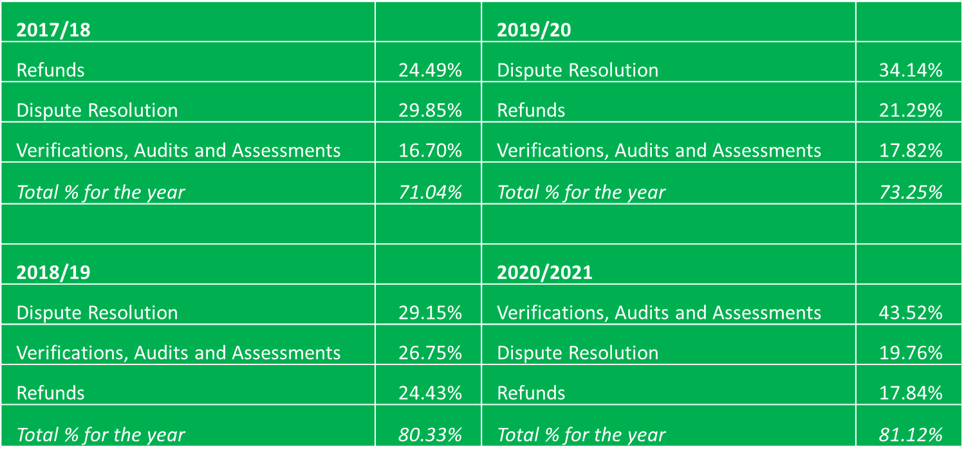
TAXPAYERS COMPLAINTS
What do taxpayers complain about?
Over the last four years, an average of 76% of complaints attended to by the OTO related to Tax Refunds, Dispute Resolution and Verification, Audits and Assessments:

Slide 5
2. Systemic Issues Identified and referred to SARS
Delay in Payment of Refunds – 102 months.
SARS’s non-adherence to the prescribed Dispute Resolution Procedure – 24 months.
Inability on the part of SARS to confirm correspondence was sent – 68 months.
Specific challenges relating to the Tax Compliance System – 52 months.
Raising assessments prematurely – 49 months.
Failure to respond to the request for a deferred payment arrangement within the undertaken turnaround times – 45 months.
Failure to respond to offers of compromise within the undertaken turnaround times – 45 months.
Failure to respond to requests for suspension of debt within the undertaken turnaround times – 45 months.
Delays in updating contact details of executors of deceased estates rendering them unable to complain - 3 months.
SARS repetitively conducting verifications on the same taxpayers, periods and risks – 1 month.

Slide 6
3. The OTO’s response to the specific issues as per the Committee’s request.
Issue 1: SARS’ perceived inequitable conduct about compliant taxpayers is creating a further risk of increased costs of collection and decreased taxpayer voluntary compliance.
To the extent that there is indeed inequitable conduct as alleged, the OTO invites Parliament or any other party to share information on this issue to enable the OTO to conduct an investigation to the extent that the matter falls within its mandate.
Issue 2: Taxpayer dissatisfaction with SARS’ services has increased, as evidenced by the number of operational queries received from members of the professional tax bodies.
The number of complaints received by the OTO has not increased, but the proportion of complaints received from taxpayer representatives did; in “taxpayer representatives” are included professional tax bodies.
Years | Taxpayers | Taxpayer Representative
2018/19 | 55% | 45%
2019/20 | 49% | 51%
2020/21 | 47% | 53%

Slide 7
Issue 3: SARS is not taking responsibility for its actions, such as the identity theft of taxpayer profiles.
We have heard this allegation from tax practitioners especially in relation to identity theft on eFiling a while back.
The issue was also raised in a SAICA communication to its members. The communication suggested constant engagements between SARS and SAICA on this subject.
SARS did however on 8 December 2021 issued a media statement to say that they were addressing the issue.
Based on the information available, the OTO did not consider it necessary to conduct further investigation into the allegations as a systemic issue, but if OTO can receive more information that it impacts taxpayers negatively, OTO could conduct a systemic investigation.

Slide 8
Issue 4: SARS’ conduct during VAT audits such as withholding VAT and diesel refunds violate taxpayers’ rights.
The OTO is unfortunately aware of this happening and has repeatedly raised this issue with SARS.
For example:
SARS conducts audits on VAT and would wrongfully withhold refunds on periods that do not fall under the audit.
When taxpayers complain about its actions, SARS would extend the scope of the audit to include the VAT periods that were not covered in the initial audit; this would be an attempt by SARS to remedy its non-compliance with the law.
In one of the cases received by the OTO, SARS took almost two years to finalise the audit while withholding refunds in excess of R70 million. SARS only revised assessments to the value of R1,6 million and paid more that R6 million in interest on the delayed refunds. SARS never responded to the OTO’s request for a legal basis on which it could withhold refunds for periods not under audit and simply extended the scope when the OTO raised the issue.
This modus operandi was criticised in the Judgement issued against SARS in Rappa Resources PTY Ltd v CSARS 20/18875 ZAGPPHC. The Court noted expressly this action by SARS cannot be condoned.

Slide 9
Issue 5: The inefficiency with which SARS handles disputes negatively affects the SMMEs, including those in business rescue.
SARS’s inefficiencies in attending to tax dispute resolution affect all taxpayers not just SMMEs, but based on the empirical data available it is clear that companies are affected more than other taxpayers.
This has already been raised repeatedly by the OTO and most notably in its report issued in 2020 after its systemic investigation.
Objections
The legally prescribed time for finalising objections is 60 business days after an objection is lodged, but for Company Income Tax, SARS takes more than 120 business days on average to finalise objections.
Between February and March 2022 there was an increase from less than 40 business days to more than 100 business days in the time it takes SARS to finalise VAT objections; this is a cause for concern.

Slide 10
Appeals
The period within which SARS finalises appeals is a major concern:
A typical appeal should not take SARS more than 120 business days to finalise (30 days to notify a taxpayer if an appeal is suitable for ADR and 90 days to finalise the ADR process).
Only a very small portion of appeals move beyond the ADR process and are referred to the Tax Board and the Tax Court.
It takes SARS in excess of a year to finalise appeals on average.
On appeals the time to finalise VAT disputes also suddenly spiked from just under 400 business days to nearly 600 business days.
VAT appeals take on average 476 business days to finalise.
CIT appeals take on average 500 business days to finalise.

Slide 13
THANK YOU.
Contact details:
Physical address:
Tel: 0800 662 837 / 012 431 9105
Fax: 012 452 5013
Email: complaints@taxombud.gov.za
Web: www.taxombud.gov.za
.
2nd floor, Menlyn Corner 87 Frikkie de Beer Street
Menlyn, Pretoria

