Slide 1
SPECTRUM AUCTION FINALISATION AND FUTURE REGULATIONS
CHAIRPERSON: DR KEABETSWE MODIMOENG
7 JUNE 2022

Slide 2
PRESENTATION OUTLINE
ICASA’s Organisational Mandate
Spectrum Management Institutional Framework
Overview
Various Stages of the licensing process
Auction Results
Issuance of the Radio Frequency Spectrum Licences
Future Regulations
2

Slide 3
ICASA’S ORGANISATIONAL MANDATE
ICASA is established pursuant to section 192 of the Constitution and in terms of the ICASA Act of 2000, as amended
ICASA is mandated to –
  Regulate electronic communications, broadcasting and postal sectors in the public interest
  Ensure affordable services of high quality for all South Africans
ICASA’s Legislative mandate is derived from:
The Constitution, 1996
ICASA Act, 2000
EC Act, 2005
Broadcasting Act, 1999
Postal Services Act, 1998
ECT Act, 2002
ICASA’s Policy mandate is derived from:
National Development Plan, 2012
South Africa Connect, 2013
Digital Migration Plan, 2012
Integrated ICT White Paper, 2016
National Radio Frequency Policy, 2010
3

Slide 4
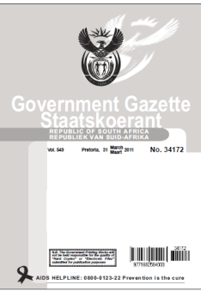
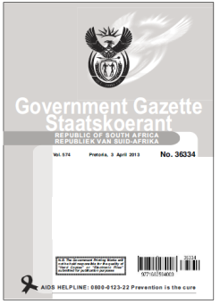

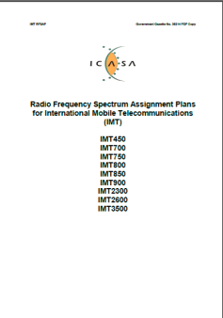
SPECTRUM LICENSING REGULATORY FRAMEWORK
Radio Frequency Planning Regulations
Radio Frequency
Spectrum Regulations 2015
Frequency Migration Plan 2019
IMT Roadmap
2019
Terrestrial Broadcasting Frequency Plan 2013
Update - Terrestrial Broadcasting Frequency Plan 2014
Radio Frequency Spectrum Assignment Plans, 2015
4

Slide 5
OVERVIEW
Spectrum is a finite resource requiring prudent management on behalf and for the public. A responsible ICT Regulator should ensure that all the spectrum is made available to the users and is used for the benefit of all.
The Authority initiated the licensing process through the publication of the Information Memorandum on 01 November 2019 for the radio frequency spectrum in the bands: IMT700, IMT800, IMT2600 and IMT3500 for the purposes of providing national broadband wireless open access services.
The licensing of the International Mobile Telecommunications (IMT) aimed, amongst others, to deal with growth in demand for spectrum as a result of significant growth in traffic for broadband services.
5

Slide 6
OVERVIEW (2)
Other objectives aimed to be achieved include:
  the promotion of Broad-based black economic empowerment,
  universal provision of electronic communications networks and connectivity for all,
  development of SMMMEs,
  encourage investment and innovation in the sector,
  promote competition within the sector; and
  ensure efficient use of the radio frequency spectrum.
Subsequent to the intensive consultative process, the Authority published the Invitation-to-apply on 10 December 2021. Six applications (i.e., Cell C, Liquid Telecoms, MTN, Telkom SA, Rain, and Vodacom) were received by the closing date of 31 January 2022.
6

Slide 7
VARIOUS STAGES OF THE LICENSING PROCESS
Qualification stage
Auction stage
31 January 2022
Applications received
11 February 2022
Qualification assessment completed
21 February 2022
Qualification letters
28/2 – 2/3 2022
Bidder training & mock auctions
8 March 2022
Opt-in Auction
10 March 2022
Main Auction Start
17 March 2022
Assignment Phase
Assignment phase
Held at ICASA’s offices (with representatives of all bidders present)
Qualification letters
Issued to the applicant qualifying them as bidders after meeting the requirements of the ITA
Bidder training & mock auctions
Conducted the bidder training and mock auctions to prepare for the auction process
Opt-in Auction
Sealed-bid auction
It was held at ICASA’s offices (with representatives of all bidders present)
Main Auction
Online multiple-round auction
Auction software: customized and tested

Slide 8
AUCTION RESULTS – OPT-IN ROUND
Cell C, Liquid Telecom, RAIN and Telkom SA were eligible to participate and took part in the Opt-in Auction.
Cell C, Liquid Telecom, Rain and Telkom all submitted valid bids and the winners were determined as per the Opt-In round rules provided in the ITA.
The total price and lots won by each bidder is outlined in the table below:
 | Lots won in 700 MHz | Lots won in 800 MHz | Lots won in 2600 MHz | Reserve Price (ZAR) | Premium (ZAR) | Total Price (ZAR)
Reserve price per Lot | 526 615 392,49 | 752 307 703,55 | 97 843 320,52
Rain | Lot 3, Lot 4 |  | Lot 23 | 1,151,074,105.50 | 200,000 | 1,151,274,105.50
Telkom |  | Lot 7, Lot 8 |  | 1,504,615,407.10 | 200,000 | 1,504,815,407.10
8

Slide 9
AUCTION RESULTS – MAIN AUCTION (1)
33 Lots across four bands were competed for in the main auction, and all six bidders participated in the main auction with the sub-1GHz and Overall Spectrum Caps imposed to ensure that equitable spectrum can be acquired by all.
The Authority opened the Main Auction Stage on 10 March 2022. The Main Auction Stage concluded on 17 March 2022, after 58 rounds of bidding held over 6 days. All but one of the Spectrum Lots was sold, and the Main Auction Stage raised a total of ZAR11.8 billion.
Figure 1: IMT spectrum acquired in the Main Auction
9

Slide 10
AUCTION RESULTS – MAIN AUCTION (2)
One Lot in the IMT800 band was not sold due to the coverage obligation attached to it, which required the successful winning bidder to achieve nationwide population coverage of 99.8%.
In aggregate, the Opt-In Auction and Main Stage raised a total of 14.48 billion rand. The table below summarises what each bidder won across the entire auction:
Bidder | 700 MHz | 800 MHz | 2600 MHz | 3500 MHz | Total Price (ZAR)
Telkom |  | 2x10 |  | 22 | 2,113,615,407
Liquid Telecom |  |  |  | 4 | 111,000,000
Cell C |  |  |  | 10 | 288,200,000
Rain | 2x10 |  | 20 |  | 1,431,374,106
MTN |  | 2x10 | 40 | 40 | 5,152,100,000
Vodacom | 2x10 |  | 80 | 10 | 5,381,600,000
Unsold |  | 2x10
10

Slide 11
ISSUANCE OF THE RADIO FREQUENCY SPECTRUM LICENCES
The Authority issued Radio Frequency Spectrum Licences to successful bidders by 10 May 2022 after receiving the proportional payment of the auction fees.
The social obligations relating to connecting various public institutions is in the process to be finalized. Consultation with the DCDT has commenced and it is envisaged that they will be concluded in this financial year.
One successful bidder has only serviced part of the auction fee. The Authority is taking advice on the matter.
11

Slide 12
FUTURE REGULATIONS
12

Slide 13
FUTURE REGULATIONS
Published draft on Long-term Spectrum Outlook (10 – 20 Years):
to promote efficient and effective use of spectrum;
to meet the growing need for capacity, which is exceeding the available spectrum; and
to provided certainly in the market
Dynamic and Opportunistic Spectrum Access (TVWS)
Regulatory Framework has been completed and the Authority is in the process of implementing the registration and Usage Process
Research is on-going to access other bands
Forward-looking Conformity Assessment Framework for Type-Approvals
Final Equipment Authorisation Regulations (Mar 2022)
ICASA undertakes type approval of equipment, devices etc.
Radio Frequency Spectrum Assignment Plans for IMT
The Authority is process of finalising the RFSAP through a consultative process which aims to release additional 200 MHz. The process in to be concluded by 31 March 2023
International Fora
WRC-23, WTDC-22, PP-22
ATU, SADC, CRASA, NPWG
The Regulations will be effective once the guidelines are in place
13

Slide 14
Thank You

