Slide 1
POLICE RECORDED CRIME STATISTICS
REPUBLIC OF SOUTH AFRICA
FOURTH QUARTER OF 2021/2022 FINANCIAL YEAR
( JANUARY TO MARCH 2022)

Slide 2
TABLE OF CONTENTS
Crime statistics analysis
  Highlights of the 17 community-reported serious crimes
  National crime overview
  Contact crime
    Murder
    Rape
          Trio crimes
    Crimes against women and children
    Domestic related crimes (selected contact crimes)
    Kidnapping
    Stock theft

Slide 3
REPUBLIC OF SOUTH AFRICA
CRIME SITUATION
CRIME CATEGORY | January to March 2017_18 | January to March 2018_19 | January to March 2019_20 | January to March 2020_21 | January to March 2021_22 | Count Diff | % Change
CONTACT CRIMES ( CRIMES AGAINST THE PERSON)
Murder | 4 668 | 4 896 | 4 589 | 4 976 | 6 083 | 1 107 | 22,2%
Sexual Offences | 12 275 | 13 801 | 12 627 | 12 133 | 13 799 | 1 666 | 13,7%
Attempted murder | 4 243 | 4 647 | 4 216 | 4 582 | 5 717 | 1 135 | 24,8%
Assault with the intent to inflict grievous bodily harm | 41 078 | 43 113 | 40 168 | 36 417 | 42 992 | 6 575 | 18,1%
Common assault | 39 314 | 42 262 | 42 866 | 38 889 | 45 746 | 6 857 | 17,6%
Common robbery | 12 225 | 12 667 | 12 262 | 9 549 | 10 787 | 1 238 | 13,0%
Robbery with aggravating circumstances | 31 864 | 33 130 | 33 404 | 30 768 | 32 783 | 2 015 | 6,5%
Total Contact Crimes ( Crimes Against The Person) | 145 667 | 154 516 | 150 132 | 137 314 | 157 907 | 20 593 | 15,0%
Total Sexual Offences
Rape | 9 695 | 10 792 | 9 905 | 9 518 | 10 818 | 1 300 | 13,7%
Sexual Assault | 1 793 | 2 072 | 1 913 | 1 910 | 2 165 | 255 | 13,4%
Attempted Sexual Offences | 500 | 610 | 497 | 433 | 547 | 114 | 26,3%
Contact Sexual Offences | 287 | 327 | 312 | 272 | 269 | -3 | -1,1%
Total Sexual Offences | 12 275 | 13 801 | 12 627 | 12 133 | 13 799 | 1 666 | 13,7%
SOME SUBCATEGORIES OF AGGRAVATED ROBBERY
Carjacking | 3 828 | 3 883 | 4 303 | 4 513 | 5 402 | 889 | 19,7%
Robbery at residential premises | 5 183 | 5 343 | 4 916 | 5 288 | 5 267 | -21 | -0,4%
Robbery at non-residential premises | 4 463 | 4 549 | 4 741 | 4 872 | 4 700 | -172 | -3,5%
Robbery of cash in transit | 50 | 40 | 47 | 42 | 53 | 11 | 26,2%
Bank robbery | 1 | 1 | 0 | 1 | 5 | 4 | 4 counts more
Truck hijacking | 254 | 245 | 284 | 354 | 465 | 111 | 31,4%

Slide 4
SELECTED CONTACT CRIMES
PER RATIO
CRIME CATEGORY | JANUARY TO MARCH
 | 2017_18 | 2018_19 | 2019_20 | 2020_21 | 2021_22
CONTACT CRIMES ( CRIMES AGAINST THE PERSON)
Murder | 8,1 | 8,4 | 7,7 | 8,3 | 10,0
Rape | 16,9 | 18,5 | 16,7 | 15,9 | 17,9
Attempted murder | 7,4 | 8,0 | 7,1 | 7,6 | 9,4
Assault with the intent to inflict grievous bodily harm | 71,4 | 73,8 | 67,8 | 60,8 | 71,0
Common assault | 68,3 | 72,4 | 72,4 | 64,9 | 75,5
Common robbery | 21,3 | 21,7 | 20,7 | 15,9 | 17,8
PER CAPITA (*RATIO PER 100 000 OF THE POPULATION). MID-YEAR POPULATION ESTIMATES, 2021 SERIES

Slide 5
REPUBLIC OF SOUTH AFRICA
CRIME SITUATION
CRIME CATEGORY | January to March 2017_18 | January to March 2018_19 | January to March 2019_20 | January to March 2020_21 | January to March 2021_22 | Count Diff | % Change
CONTACT-RELATED CRIMES
Arson | 840 | 946 | 853 | 732 | 910 | 178 | 24,3%
Malicious damage to property | 26 836 | 27 911 | 26 106 | 24 850 | 28 649 | 3 799 | 15,3%
Total Contact-Related Crimes | 27 676 | 28 857 | 26 959 | 25 582 | 29 559 | 3 977 | 15,5%
PROPERTY-RELATED CRIMES
Burglary at non-residential premises | 17 490 | 17 623 | 18 384 | 15 215 | 14 241 | -974 | -6,4%
Burglary at residential premises | 57 287 | 55 311 | 51 004 | 40 568 | 40 960 | 392 | 1,0%
Theft of motor vehicle and motorcycle | 12 284 | 11 813 | 11 163 | 9 240 | 9 377 | 137 | 1,5%
Theft out of or from motor vehicle | 31 238 | 30 785 | 27 810 | 20 111 | 20 457 | 346 | 1,7%
Stock-theft | 7 673 | 7 433 | 6 853 | 6 089 | 6 243 | 154 | 2,5%
Total Property-Related Crimes | 125 972 | 122 965 | 115 214 | 91 223 | 91 278 | 55 | 0,1%
OTHER SERIOUS CRIMES
All theft not mentioned elsewhere | 75 620 | 74 533 | 69 556 | 59 646 | 65 920 | 6 274 | 10,5%
Commercial crime | 19 218 | 21 225 | 20 193 | 22 558 | 25 431 | 2 873 | 12,7%
Shoplifting | 14 768 | 15 197 | 14 412 | 11 597 | 10 292 | -1 305 | -11,3%
Total Other Serious Crimes | 109 606 | 110 955 | 104 161 | 93 801 | 101 643 | 7 842 | 8,4%
Total 17 Community Reported Serious Crimes | 408 921 | 417 293 | 396 466 | 347 920 | 380 387 | 32 467 | 9,3%
CRIME DETECTED AS A RESULT OF POLICE ACTION
Illegal possession of firearms and ammunition | 4 071 | 3 854 | 3 607 | 3 184 | 3 542 | 358 | 11,2%
Drug-related crime | 82 456 | 41 810 | 43 344 | 35 932 | 42 309 | 6 377 | 17,7%
Driving under the influence of alcohol or drugs | 19 354 | 19 657 | 19 330 | 8 583 | 11 992 | 3 409 | 39,7%
Sexual Offences detected as a result of police action | 1 774 | 2 389 | 2 377 | 2 335 | 2 308 | -27 | -1,2%
Total Crime Detected As A Result Of Police Action | 107 655 | 67 710 | 68 658 | 50 034 | 60 151 | 10 117 | 20,2%

Slide 6
17 COMMUNITY-REPORTED SERIOUS CRIMES
TREND OVER THREE-MONTH PERIOD
Adjusted Level 1 (1 Oct21 to 4 Apr22)
Adjusted Level 1 (1Mar21 to 30 May 21)
Adjusted Level 3 (29 Dec20 to 28 Feb21)

Slide 7
17 COMMUNITY-REPORTED SERIOUS CRIMES
TOP 30 STATIONS

Slide 8
CONTACT CRIME
Contact crime refers to crimes in which the victims are the targets of violence or instances where the victims are in the vicinity of property that criminals target and are subjected to the use of or threats of violence by perpetrators.
Selected Contact Crimes :
  Causative factors
  Place of occurrence
Murder
Rape
Selected Contact Crimes against women and children
Selected Domestic Violence Related Crimes
Kidnapping
Robbery with aggravating circumstances
  Carjacking
  Robbery at non-residential premises
  Robbery at residential premises
  Robbery of cash in transit
Stock Theft
Trio

Slide 9
CONTACT CRIME
TREND OVER THREE-MONTH PERIOD

Slide 10
CONTACT CRIME
TOP 30 STATIONS

Slide 11
SELECTED CAUSATIVE FACTORS
MURDER, ATTEMPTED MURDER AND ASSAULT GBH
JAN TO MAR 2021/2022
Causative factors | Murder | Attempted murder | Assault GBH
Arguments/Misunderstanding (not domestic-related)/Road Rage/Provocation | 875 | 986 | 17 964
Retaliation/Revenge/Punishment | 341 | 292 | 1 248
Robbery | 262 | 643 | 271
Gang-related | 166 | 244 | 24
Vigilantism/Mob justice | 358 | 73 | 570
Law enforcement & security guards in line of duty (excl. police murder) | 22 | 290 | 185
Intervention in a fight | 23 | 35 | 629
Taxi-related | 9 | 27 | 13
Rape-related | 18 | 33 | 15
During commission of another offence - (not robbery or rape) | 38 | 57 | 1 435
Illicit mining | 8 | 7 | 0
Carjacking/attempted | 31 | 121 | 6
Sample size: murder = 5 226 counts, attempted murder = 4 276, assault GBH = 27 565

Slide 12
PLACE OF OCCURRENCE
SOME CATEGORIES OF CONTACT CRIME
JAN TO MAR 2021/2022
Place of occurrence | Murder | Attempted murder | Assault GBH
Residences of perpetrator/victim (including residence known by victims/ perpetrator e.g. family/friends/neighbours) | 1 350 | 1 197 | 13 035
Public place e.g. street/open field/recreational centre/park/beach/parking area/abandoned building | 2 268 | 1 807 | 8 576
Business premises (e.g. mall/restaurants/work place/office park/entertainment centre e.g. movie theatre, gambling facility) | 63 | 129 | 523
Liquor outlets e.g. shebeen /tavern/pub/night club/bottle store | 156 | 198 | 1 944
Agricultural land/farm/plot/small holding | 78 | 52 | 301
Mode of transport e.g. bus/car/taxi | 184 | 427 | 178
Prison/holding cells | 2 | 7 | 89
Sea/river/lake/pool/dam | 34 | 9 | 16
Educational institutions (schools, universities, college, day care facilities) | 7 | 22 | 195
Petrol station | 15 | 32 | 106
Public transport premises (Bus stop/taxi rank, Railway premises e.g. track/station) | 51 | 35 | 118
Mining area | 1 | 19 | 9
Leisure premises e.g. Hotel/guest house/BnB/motel/holiday resort | 5 | 7 | 34
Dumping site | 15 | 4 | 20
Tuckshop | 63 | 115 | 349
Sample Size: Murder = 5 226 Counts, Attempted Murder = 4 276, Assault GBH = 27 565

Slide 13
MURDER
TREND OVER THREE-MONTH PERIOD
Adjusted Level 1 (1 Oct21 to 4 Apr22)
Adjusted Level 1 (1Mar21 to 30 May 21
Adjusted Level 3 (29 Dec20 to 28 Feb21)

Slide 14
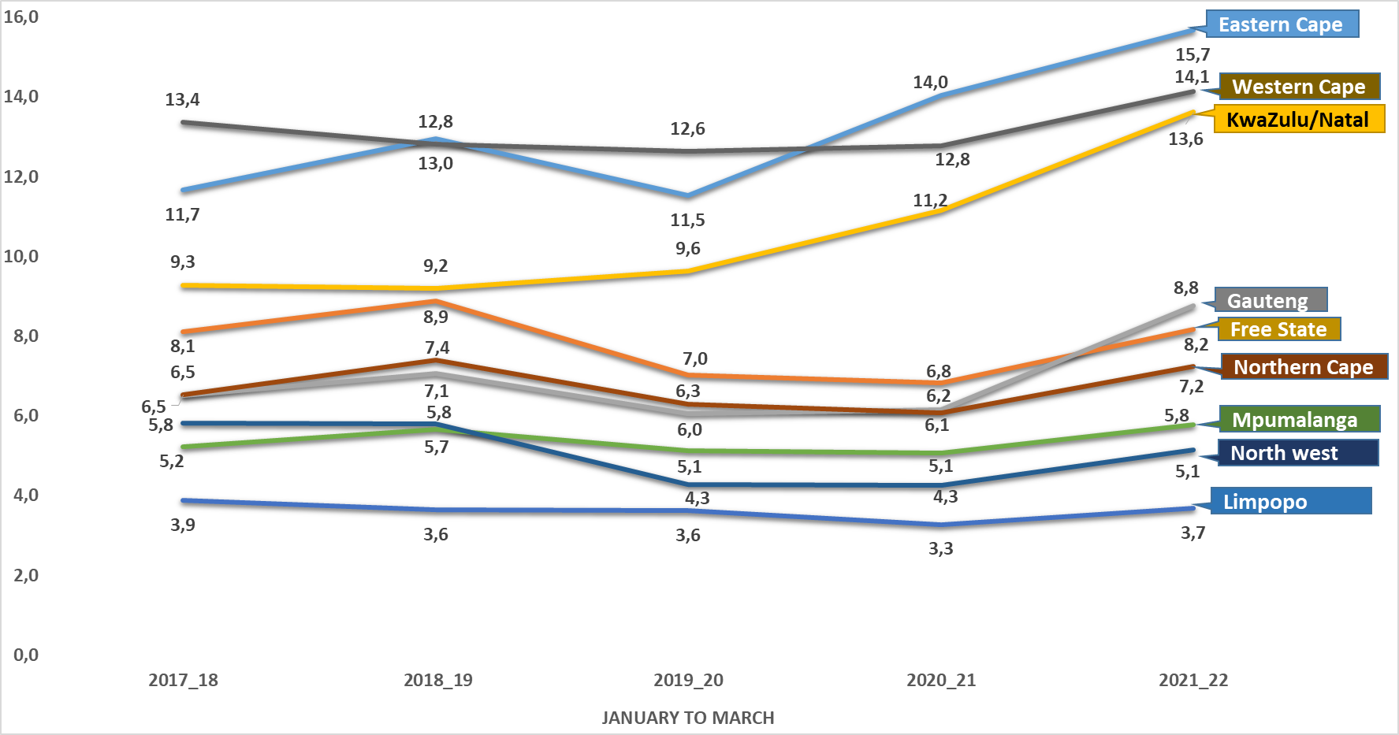
Murder
PER RATIO (PROVINCES)
PER CAPITA (*RATIO PER 100 000 OF THE POPULATION). MID-YEAR POPULATION ESTIMATES, 2021 SERIES

Slide 15
MURDER
TOP 30 STATIONS

Slide 16
MURDER: MOTIVE/CAUSATIVE FACTORS
JAN TO MAR 2021/2022
Murder causative factors | EC | FS | GP | KZN | LP | MP | NW | NC | WC | RSA
Arguments/ Misunderstanding (not domestic-related) / Road Rage / Provocation | 61 | 40 | 132 | 199 | 75 | 38 | 58 | 67 | 205 | 875
Robbery | 27 | 13 | 57 | 85 | 12 | 10 | 16 | 2 | 40 | 262
Vigilantism / Mob justice | 66 | 14 | 63 | 77 | 31 | 33 | 13 | 1 | 60 | 358
Gang-related | 4 | 1 | 0 | 0 | 0 | 0 | 0 | 0 | 161 | 166
Retaliation / Revenge | 28 | 3 | 12 | 107 | 3 | 7 | 5 | 2 | 174 | 341
Taxi-related | 0 | 0 | 9 | 8 | 2 | 0 | 0 | 0 | 9 | 28
Rape-related | 4 | 0 | 2 | 6 | 4 | 0 | 0 | 0 | 2 | 18
Law enforcement & security guards in line of duty (excluding police murder) | 3 | 2 | 1 | 3 | 5 | 3 | 3 | 2 | 0 | 22
Illicit mining | 0 | 0 | 4 | 0 | 2 | 0 | 2 | 0 | 0 | 8
Hijacking and attempts | 1 | 1 | 12 | 7 | 1 | 5 | 1 | 0 | 3 | 31
During commission of other crime (Not Robbery and Rape) | 3 | 5 | 2 | 11 | 4 | 0 | 3 | 2 | 8 | 38
Intervened in argument | 5 | 2 | 0 | 3 | 2 | 0 | 1 | 1 | 9 | 23
Sample size: murder = 5 226

Slide 17
CONTACT CRIME: LIQUOR AND DRUG-RELATED OFFENCES: 2021/2022
Confirmed incidents occurred at Liquor Outlets (Tavern/ shebeen/pub/bar/night clubs etc.)
Assault GBH = 1 944
Rape = 59
Murder = 156
Attempted murder = 198

Slide 18
MURDER OF MEMBERS OF THE POLICE
ON/OFF DUTY MEMBERS
TREND OVER THREE-MONTH PERIOD
Jan-March
2021/2022 | Eastern Cape | Free State | Gauteng | KwaZulu- Natal | Limpopo | Mpumalanga | Northen Cape | RSA
Off duty | 4 | 1 | 4 | 7 | 2 | 1 | 1 | 20
On duty | 0 | 1 | 1 | 4 | 0 | 1 | 0 | 7
 | Eastern Cape | Free State | Gauteng | Kwa-Zulu Natal | Limpopo | Mpumalanga | Northen Cape | Western Cape | RSA
2020/2021 | 7 | 0 | 2 | 8 | 1 | 1 | 1 | 4 | 24
2021/2022 | 4 | 2 | 5 | 11 | 2 | 2 | 1 | 0 | 27
Counts diff | -3 | 2 | 3 | 3 | 1 | 1 | 0 | -4 | 3

Slide 19
MURDERS OF FARMING COMMUNITY
TREND OVER THREE-MONTH PERIOD
1 Attempted Murder
6 Robbery at residential premises
2 Assault with the intent to grievous bodily harm.
1 Arson
 | EC | FS | GP | KZN | LP | MP | NC | NW | WC | RSA
Murder incidents at farms and small holdings (number of victims)
2019/2020 | 2 | 0 | 2 | 0 | 2 | 0 | 0 | 0 | 0 | 6
2020/2021 | 0 | 0 | 2 | 4 | 1 | 2 | 0 | 0 | 2 | 11
2021/2022 | 2 | 1 | 1 | 1 | 1 | 3 | 2 | 0 | 1 | 12
Counts diff | 2 | 1 | -1 | -3 | 0 | 1 | 2 | 0 | -1 | 1

Slide 20
RAPE
TREND OVER THREE-MONTH PERIOD

Slide 21
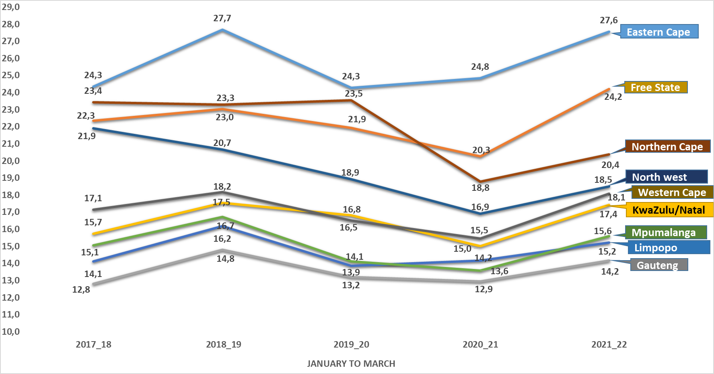
Rape
PER RATIO (PROVINCES)
PER CAPITA (*RATIO PER 100 000 OF THE POPULATION). MID-YEAR POPULATION ESTIMATES, 2021 SERIES

Slide 22
RAPE
TOP 30 STATIONS

Slide 23
RAPE
PLACE OF OCCURRENCE
Place of occurrence | EC | FS | GP | KZN | LP | MP | NW | NC | WC | Total
Residences of perpetrator/ victim (including residence known by victim/ perpetrator e.g. family/friends/ neighbours) | 875 | 266 | 608 | 1 009 | 337 | 299 | 365 | 223 | 671 | 4 653
Public place (street/open field/ recreational centre/ park/ beach / parking area / abandoned building) | 229 | 89 | 211 | 148 | 52 | 53 | 131 | 91 | 97 | 1 101
Mode of transport (bus / car / taxi) | 51 | 13 | 13 | 31 | 27 | 4 | 19 | 7 | 41 | 206
Educational institutions (school, university, college, day care facility) | 20 | 6 | 8 | 22 | 10 | 3 | 7 | 5 | 7 | 88
Hotel / guest house / BnB/ motel / holiday resort | 3 | 1 | 13 | 11 | 4 | 3 | 2 | 2 | 4 | 43
Liquor outlets (shebeen/ tavern / pub/ night club / bottle store) | 6 | 3 | 13 | 11 | 6 | 9 | 6 | 3 | 6 | 63
Agricultural land / farm / plot / small holding | 3 | 4 | 8 | 9 | 2 | 3 | 0 | 0 | 25 | 54
Sea/ river / lake / pool / dam | 13 |  | 1 | 16 | 5 | 7 | 1 | 2 | 3 | 47
Prison/ holding cells | 4 | 5 | 9 | 2 | 4 | 0 | 1 | 1 | 5 | 30
Public transport premises (bus stop/taxi rank, railway premises e.g. track/station) | 3 | 1 | 4 | 4 | 0 | 0 | 2 | 2 | 1 | 15
Business premises (mall/ restaurant /work place / office park / entertainment centre e.g. movie theatre, gambling facility) | 4 | 2 | 2 | 8 | 1 | 0 | 1 | 1 | 3 | 22
Tuckshop/spaza | 3 | 0 | 3 | 5 | 1 | 1 | 4 | 2 |  | 15
Dumping site | 0 | 2 |  | 1 | 0 | 1 | 0 | 0 | 2 | 6
Sample size: Rape = 7 031

Slide 24


SELECTED CONTACT CRIMES AGAINST WOMEN AND CHILDREN
MURDER, ATTEMPTED MURDER AND ASSAULT GBH
JAN TO MAR 2021/2022
 | WOMEN ( 18+ yrs.) |  |  |  | CHILDREN (0 to 17yrs) Boys and Girls
CRIME CATEGORY | Murder | Attempted murder | Assault GBH |  | Murder | Attempted murder | Assault GBH
January to March 2021 | 764 | 925 | 12 620 |  | 223 | 355 | 1 719
January to March 2022 | 898 | 1 222 | 15 034 |  | 306 | 331 | 1 937
Case Diff | 134 | 297 | 2 414 |  | 83 | -24 | 218
% Change | 17,5% | 32,1% | 19,1% |  | 37,2% | -6,8% | 12,7%

Slide 25
SELECTED DOMESTIC VIOLENCE-RELATED CRIMES
JAN TO MAR 2021/2022
BY PROVINCIAL BREAKDOWN AND SEX
Province | Murder | Attempted murder | Rape | Sexual Assault | Assault GBH | Common assault | Common robbery | Robbery aggravating | All theft not mentioned elsewhere | Arson | Malicious damage to property | Burglary at residential premises
Eastern Cape | 41 | 23 | 100 | 14 | 801 | 967 | 21 | 5 | 130 | 12 | 470 | 41
Free State | 17 | 18 | 64 | 11 | 474 | 1 351 | 9 | 7 | 164 | 12 | 471 | 22
Gauteng | 36 | 35 | 135 | 19 | 1 702 | 4 425 | 42 | 12 | 307 | 19 | 1 442 | 42
KwaZulu/Natal | 28 | 43 | 83 | 17 | 766 | 1 449 | 24 | 7 | 121 | 10 | 443 | 19
Limpopo | 12 | 12 | 32 | 3 | 342 | 564 | 13 | 5 | 25 | 13 | 230 | 8
Mpumalanga | 9 | 13 | 30 | 6 | 285 | 482 | 10 | 1 | 32 | 8 | 193 | 8
North West | 9 | 12 | 47 | 4 | 401 | 562 | 9 | 2 | 72 | 9 | 234 | 10
Northern Cape | 3 | 18 | 12 | 5 | 199 | 332 | 4 | 1 | 46 | 2 | 135 | 12
Western Cape | 42 | 33 | 162 | 39 | 1 255 | 3 822 | 31 | 10 | 594 | 42 | 1 296 | 201
Female | 134 | 169 | 638 | 113 | 5 037 | 12 314 | 139 | 39 | 1 145 | 100 | 3 853 | 279
Male | 63 | 38 | 27 | 5 | 1 188 | 1 640 | 24 | 11 | 346 | 27 | 1 061 | 84
RSA | 197 | 207 | 665 | 118 | 6 225 | 13 954 | 163 | 50 | 1 491 | 127 | 4 914 | 363

Slide 26
KIDNAPPING
TREND OVER THREE-MONTH PERIOD

Slide 27
KIDNAPPING
TOP 30 STATIONS

Slide 28
KIDNAPPING: CIRCUMSTANCES/CAUSATIVE FACTORS
 | EC | FS | GP | KZN | LP | MP | NW | NC | WC | Total
Sample size | 133 | 104 | 1 404 | 577 | 71 | 265 | 105 | 18 | 172 | 2 849
Hijacking-related | 12 | 22 | 784 | 175 | 4 | 98 | 23 | 0 | 29 | 1 147
Robbery-related | 16 | 15 | 221 | 107 | 12 | 42 | 12 | 3 | 37 | 465
Rape-related | 12 | 19 | 79 | 84 | 12 | 37 | 24 | 1 | 21 | 289
Retaliation/revenge | 28 | 13 | 90 | 76 | 9 | 20 | 14 | 6 | 18 | 274
Taxi-related | 3 | 0 | 9 | 2 | 0 | 0 | 0 | 0 | 3 | 17
Domestic-related | 13 | 10 | 17 | 35 | 3 | 17 | 8 | 0 | 10 | 113
Ransom | 4 | 9 | 32 | 8 | 10 | 2 | 4 | 3 | 6 | 78
Children Removed From Guardian/Parent Without Permission | 6 | 4 | 17 | 10 | 4 | 8 | 0 | 1 | 6 | 56
Intimidation | 2 | 4 | 22 | 8 | 1 | 5 | 2 | 0 | 6 | 50
Mob Justice | 3 | 0 | 9 | 2 | 0 | 0 | 0 | 0 | 3 | 17
Extortion | 1 | 0 | 20 | 4 | 2 | 3 | 1 | 0 | 2 | 33
Sexual Assault | 0 | 0 | 5 | 1 | 0 | 2 | 0 | 1 | 1 | 10
Human Trafficking | 0 | 1 | 7 | 2 | 0 | 2 | 0 | 0 | 0 | 12

Slide 29
SOME SUB-CATEGORIES OF ROBBERY WITH AGGRAVATING CIRCUMSTANCES CRIMES
  Carjacking
  Robbery at residential premises
  Robbery at non-residential premises
  Robbery of cash in transit
TRIO CRIMES

Slide 30
TRIO CRIMES
TREND OVER THREE-MONTH PERIOD

Slide 31
TRIO CRIMES
TOP 30 STATIONS

Slide 32
CARJACKING
TREND OVER THREE-MONTH PERIOD

Slide 33
CARJACKING
TOP 30 STATION

Slide 34
ROBBERY AT NON-RESIDENTIAL PREMISES
TREND OVER THREE-MONTH PERIOD

Slide 35
ROBBERY AT NON-RESIDENTIAL PREMISES
TOP 30 STATIONS

Slide 36
ROBBERY AT RESIDENTIAL PREMISES
TREND OVER THREE-MONTH PERIOD

Slide 37
ROBBERY AT RESIDENTIAL PREMISES
TOP 30 STATIONS

Slide 38
ROBBERY OF CASH IN TRANSIT
TREND OVER THREE-MONTH PERIOD

Slide 39
ROBBERY OF CASH IN TRANSIT
TOP 30 STATIONS

Slide 40
STOCK THEFT
TRENDS OVER THREE-MONTH PERIOD

Slide 41
STOCK THEFT
TOP 30 STATIONS

Slide 42
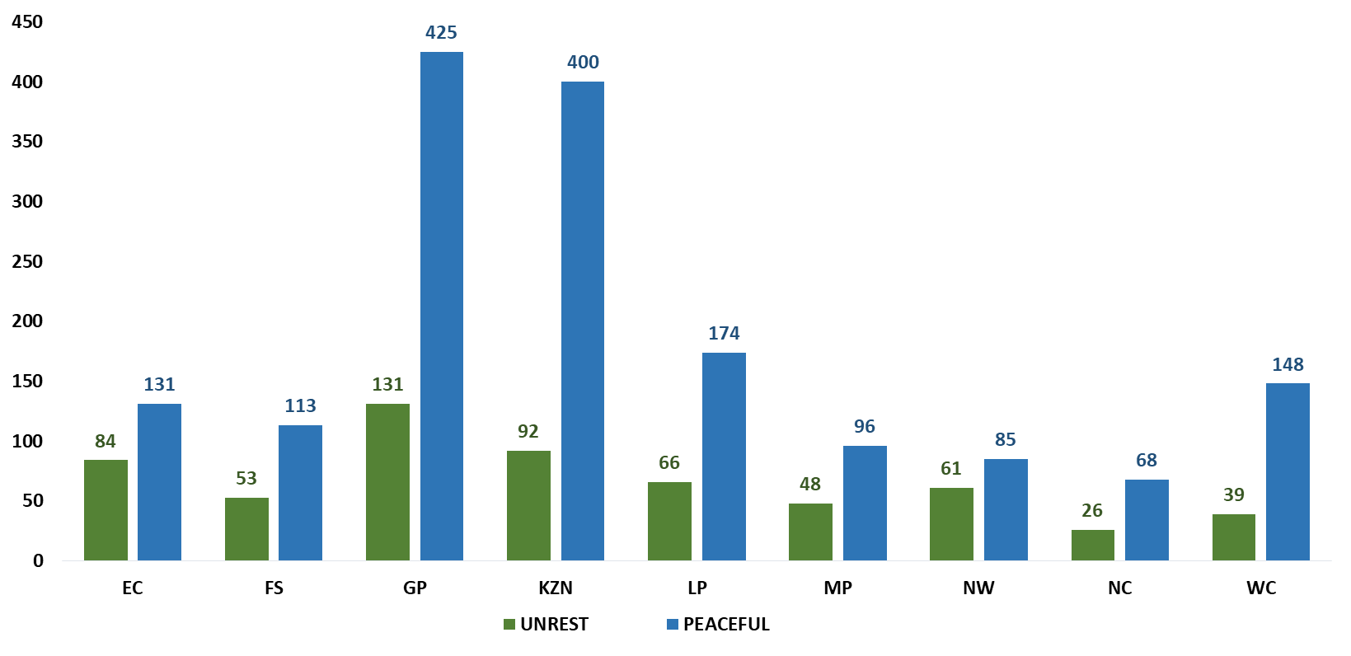
CORE DIVERSION
UNREST AND PEACEFUL CROWD MANAGEMENT
QUARTER FOUR (JANUARY TO MARCH 2022)

Slide 43
THE END
Thank you

