Slide 1
JICS DRAFT BILL (VERSION 20), Organisational form
& AMENDMENTS TO THE CORRECTIONAL SERVICES ACT, 111 OF 1998
Parliamentary Portfolio Committee on Justice and Correctional Services:
20 May 2022

Slide 2
INTRODUCTION BY THE INSPECTING JUDGE
The importance of independent prison oversight in South Africa.
JICS’s organisational form as a government component (business case process has been concluded; costing and staffing models; approval by the IAC and DPSA, which included officials from JICS, DCS and Treasury).
Why JICS will not further strain the fiscus.
Parallel processes for JICS Bill, CSA amendments and JICS as a national government component.
For powerful functional and operational reasons, absorbing JICS absorbed into the SA Human Rights Commission is strongly counter-indicated.

Slide 3
Purpose of the JICS Bill
To give effect to section 85(1) of Correctional Services Act, No 111 of 1998 (CSA), which establishes an independent Judicial Inspectorate for Correctional Services (JICS) under the control of the Inspecting Judge (IJ);
To give effect to the Constitutional Court’s judgment in Sonke Gender Justice vs The President;
To regulate powers and appointments of the IJ, Chief Executive Officer (CEO) and JICS in general;
To strengthen JICS’s mandate to ensure effective and efficient oversight;
To provide for mandatory reporting obligations and cooperation by officials of the Department of Correctional Services (the Department); and
To guarantee functional independence of JICS as a member of the National Preventive Mechanism (NPM).

Slide 4
Background
The Constitution requires, in section 35(2)(e) of the Bill of Rights, that conditions of incarceration and detention are “consistent with human dignity”.
Section 85 of the CSA provides for the establishment of JICS as an independent office under the control of the IJ.
In 2019, South Africa ratified the Optional Protocol to the Convention against Torture and other Cruel, Inhuman or Degrading Treatment or Punishment (OPCAT). It requires every State party to establish and maintain an NPM for the prevention of torture at the domestic level. Article 18 requires every State Party to “guarantee functional independence” and “independence of their personnel.”

Slide 5
Background continued
On 5 September 2019, the Western Cape High Court declared sections 91, 88A(1)(b) and 88A(4) of the CSA constitutionally invalid insofar as failing to guarantee JICS’s independence.
On 4 December 2020, the Constitutional Court confirmed the great substance of the High Court’s judgment. The Constitutional Court underscored the importance of a properly functioning oversight body such as JICS and that independence, structural, operational and perceived, is an “inherent characteristic” of an oversight body. The Court confirmed that sections 91 and 88A(1)(b) are constitutionally invalid and provided a constitutionally compliant interpretation of section 88A(4).
The declaration of invalidity is suspended for 24 months to afford Parliament an opportunity to remedy the defects.

Slide 6
Background continued
These developments make it imperative that JICS’s independence be affirmed through its own governing statute.
The JICS Draft Bill thus seeks to properly address the lack of independence of JICS and other related issues to sharpen its statutory oversight function.

Slide 7
Background continued
JICS has been vigorously working on the JICS Draft Bill which is now on version 20. At all stages, the updated versions were shared with DCS, which provided helpful input.
JICS also shared the JICS Draft Bill with stakeholders and incorporated amendments and comments where appropriate.
The stakeholders JICS consulted include:
The Chief State Law Advisor
Department of Correctional Services: Legal Services
African Policing Civilian Oversight Forum
Africa Criminal Justice Reform
Just Detention International
Accountability Now
South African Human Rights Commission.
The Department of Public Service & Administration
National Treasury
Department of Justice & Constitutional Development

Slide 8
UPDATES
Based on meetings with the Minister of Justice and Correctional Services, Deputy Minister of Correctional Services, Acting National Commissioner and DCS’s Legal Services, it has been agreed that the amendments to the CSA and the finalisation of JICS Draft Bill will run concurrently in parallel processes.
JICS’s organisational form is currently being finalised, with the Minister’s strong support for effective and complete autonomy. This issue should not delay the legislative process between JICS and DCS. It ought to be ventilated before and debated by Cabinet or taken up with the Presidency.
JICS Draft Bill (Version 20) has incorporated the comments from OCSLA.
DCS’s Legal Services are constructively engaging with the JICS Draft Bill (Version 20).

Slide 9
AMENDMENTS TO THE CSA
Incorporates definitions from the JICS Draft Bill (section 1).
To inform inmates of their rights to appeal in against segregations and mechanical restraints and for the head of the correctional centre or of remand detention facility to provide JICS with all relevant information relating to the matter (sections 30 and 31).
The CSA continues to establish JICS and outlines its core mandate (section 85).
Chapters 9 and 10 be repealed and replaced with an updated catch-all clause outlining DCS’s obligations to JICS (section 85A).
Expands mandatory reporting obligations (section 95D).
JICS’s finances “shall be defrayed from money appropriated by Parliament” (section 91 of previous drafts).

Slide 10
JICS DRAFT BILL V20
Chapter 1 (sections 1 - 4)
Definitions, Objects, Establishment and Independence
This chapter provides for the definitions and for JICS to be independent from the Department and under the control of the IJ.
In addition, it articulates the objects of the Bill once it is enacted which is to, among other things, ensure independent and efficient oversight over the treatment of inmates and conditions of correctional centres and remand detention facilities.

Slide 11
JICS DRAFT BILL V20 CONTINUED
Chapter 2 (sections 5 - 13)
National Office
This chapter provides for the functions of JICS’s national office.
It outlines the appointment process of the IJ as well as the terms of service and the powers, functions and duties of the IJ.
It further outlines the appointment process of the CEO as well as the terms of service and the functions and duties of the CEO.
It also details the appointment processes and functions of staff and special assistants.
Finally, it permits delegations and assignments.

Slide 12
JICS DRAFT BILL V20 CONTINUED
Chapter 3 (sections 14 - 16)
Regional Offices
This chapter establishes JICS’s regional offices and aligns them with the Department’s structures.
There is one designated regional office per region.
In addition, it outlines the appointment process as well as the functions and duties of regional managers to head each regional office.

Slide 13
JICS DRAFT BILL V20 CONTINUED
Chapter 4 (sections 17 - 22)
Functions, Duties and Powers of Inspectors and Investigators
This chapter outlines the appointments, powers, functions and duties of inspectors and investigators. In doing so, it places certain obligations on the Department to cooperate with JICS’s inspectors and investigators. It also provides for inspectors and investigators to take photographs or use visual or auditory material subject to conditions and safeguards.
It includes a National Inspection Plan and outlines the matters to be investigated by JICS.
It further includes clauses on limitation of liability and conflict of interest and disclosure of interest for JICS staff members and officials.

Slide 14
JICS DRAFT BILL V20 CONTINUED
Chapter 5 (sections 23 - 24)
Inmate Complaints
This chapter provides that the IJ may deal with various complaints from inmates.
It further outlines the powers, functions and duties of the IJ when dealing with complaints.
The IJ must, after an investigation has been conducted and upon receipt of all necessary documents and material, make a finding and recommendations to the Department, including the taking of disciplinary steps against officials or referring criminal matters.
The Department must furnish JICS with details of the steps taken to resolve the complaint – and where findings or recommendations are not accepted, must give reasons.

Slide 15
JICS DRAFT BILL V20 CONTINUED
Chapter 6 (sections 25 - 26)
Correctional Centre Monitors (CCMs) (formerly known as Independent Correctional Centre Visitors (ICCVs))
This chapter deals with the appointment of CCMs. It outlines their duties, terms of service and powers. CCMs must visit, interview inmates in public or private, record complaints from inmates, monitor and report on the progress of their complaints.
CCMs are appointed by the CEO in consultation with the IJ and the relevant regional manager.
Heads of centres must assist CCMs in the performance of their powers, functions and duties. If requests from CCMs are refused, the dispute is referred to the IJ, whose decision is final.

Slide 16
JICS DRAFT BILL V20 CONTINUED
Chapter 7 (sections 27 - 28)
Stakeholders’ Committee (formerly known as the Visitors’ Committee)
This chapter deals with the establishment of Stakeholders’ Committees, their powers, functions and duties.
The Stakeholders’ Committee consists of various stakeholders, including officials from the Department, members of the NPM, non-governmental organisations.
The Stakeholders’ Committee must meet and deal with unresolved complaints and other relevant issues.
The Stakeholders’ Committee must promote the public and community’s interest and involvement in correctional matters.
The Stakeholders’ Committee may submit complaints it cannot resolve to the IJ.

Slide 17
JICS DRAFT BILL V20 CONTINUED
Chapter 8 (sections 29 - 30)
Finances, Accountability and Reporting
The CEO is responsible to account financially on behalf of JICS.
This chapter outlines how JICS will be funded, and cross-references section 91 of the Correctional Services Act.
It also includes how JICS will report on its activities and account financially.
The IJ reports to the Minister and Portfolio Committee on all activities of JICS. The IJ submits quarterly reports and the annual report to the President and the Minister.

Slide 18
JICS DRAFT BILL V20 CONTINUED
Chapter 9 (section 31)
Offences and Penalties
This chapter regulates offences and penalties.
It is an offence for any person to interfere with, hinder or obstruct the IJ or any JICS officials in performing their duties and functions.
It is also an offence to impersonate an inspector or investigator.
It places duties on JICS staff and officials to make disclosures but also not to disclose certain information. It also includes secrecy or confidentiality clauses.

Slide 19
JICS DRAFT BILL V20 CONTINUED
Chapter 10 (sections 32)
Recommendations Regarding Disciplinary Steps taken against Officials of the Department and Disciplinary Measures
The IJ may recommend that disciplinary steps be taken against an official of the Department after an investigation for any failure to comply with this Act.
The IJ must report any failure by an official of the Department to comply with the mandatory reporting obligations in terms of section 95D of the Correctional Services Act to the National Commissioner, the Portfolio Committee and may recommend disciplinary steps to be taken against the official.
The National Commissioner may institute disciplinary proceedings.
If the National Commissioner declines to take disciplinary steps against the official, the National Commissioner must furnish the IJ with written reasons why disciplinary action was not taken.
The National Commissioner must submit a quarterly report to the IJ on progress made regarding disciplinary action recommended.

Slide 20
JICS DRAFT BILL V20 CONTINUED
Chapter 11 (sections 33 - 36)
Regulations, Transitional Arrangements, Repeal, Short Title and Commencement
This Chapter empowers the Minister of Justice and Constitutional Development in consultation with the IJ to make Regulations.
Transitional arrangements amendments to repeal laws are still outstanding.
It includes the short title and commencement.

Slide 21
Questions?

Slide 22
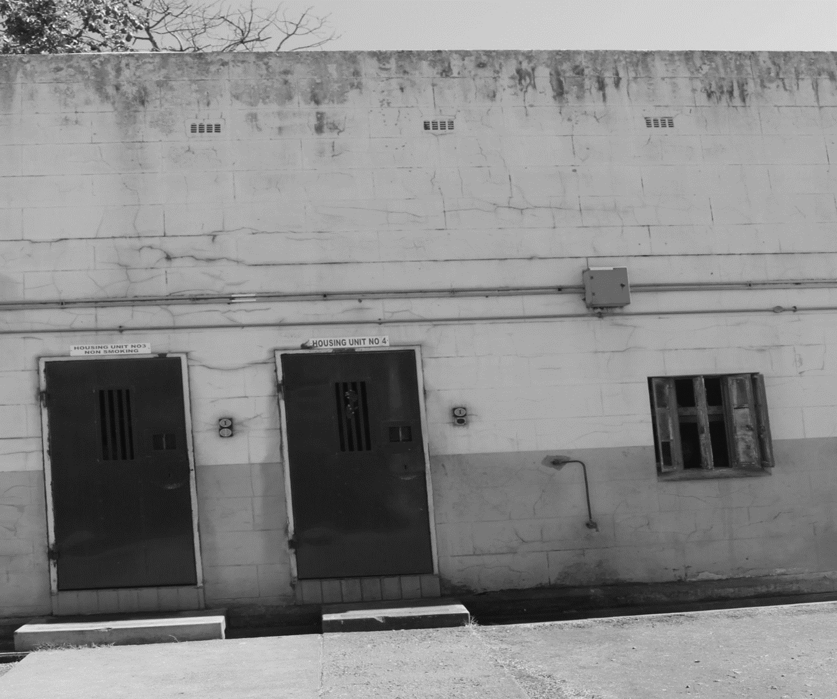
.
Thank you

