Slide 1
Department of the Premier
Report to Standing Committee on Premier
Broadband Update and Report on Information Security Operations
3 June 2022

Slide 2
BROADBAND UPDATE

Slide 3
Broadband Fundamentals
What is Broadband?
Broadband is a Wide Area Network (WAN) technology that provides network connectivity at WCG sites.
Broadband is high-speed connectivity, regarded as minimum speeds of 10Mbps (upload and download – symmetrical).
It enables the WCG to conduct its business digitally and use tools such as email, the Internet, MS Teams and other digital applications.
Broadband speeds are particularly important in the health and education environments for transmitting radiography/radiology images and facilitating e-learning.
WCG Broadband Strategic Framework
The WCG Broadband Strategic Framework, approved by Provincial Cabinet in 2011, set out to create an enabling environment for the creation of broadband infrastructure and skills to:
Improve provincial and local government service delivery (connected government)
Improve citizens’ access to communications infrastructure, information and opportunities – broadening their participation in society (connected citizens); and
Increase access to new opportunities and markets, while making the Western Cape business environment more competitive and open for new kinds of service-oriented businesses (connected economy).

Slide 4
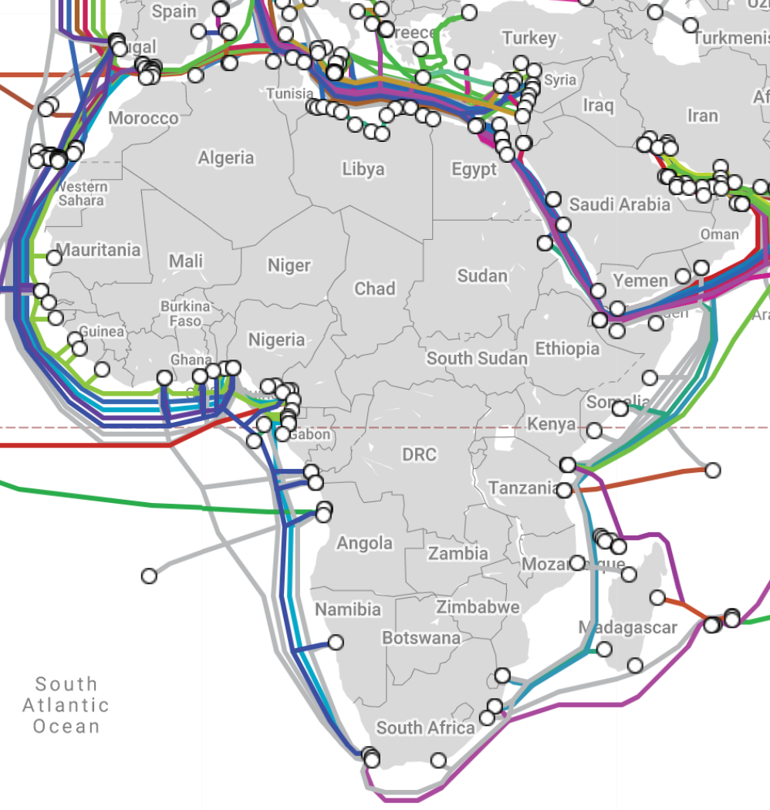
Broadband 1.0 Programme Goals
SITA, together with partner Liquid Intelligent Technologies (LIT), is rolling out a ten-year broadband programme on behalf of the WCG.
The scope of the programme includes WCG corporate sites, schools, healthcare institutions, libraries, Cape Access Centres as well as satellite administrative offices and depots of the WCG.
The telecommunications network is designed and built to carry data, voice and video communications and is capable of providing public Internet access through Wi-Fi hotspots on the same infrastructure.
The network infrastructure can provide access to government clients as well as businesses to better serve our citizens.

Slide 5
Broadband Business Value
Primary Value Delivered
Secondary Value Derived
High network speed that improved productivity - underpins Digital Transformation
Improved service to our citizens
Enabled the migration of 90% of WCG workloads to cloud, thereby:
Improving access to our applications from anywhere at anytime – Promotes remote working
Improved uptime of applications
Improved Service Continuity
Improved information security
Financial cost efficiencies through economies of scale (WCG connectivity and VOIP)
Enabled Public Wi-Fi Access to Western Cape residents
Ability to collaborate via Teams
WCG was one of the first entities nationally to seamlessly switch to MS Teams at outbreak of the COVID-19 pandemic
Reduced investment in ICT infrastructure equipment
Contributing to Green IT – Reduced IT Waste footprint
Reduced energy consumption
Enabling Innovation throughout the WCG.
Enabled other broadband network providers to improve connectivity to businesses and citizens by utilising LIT’s expanded infrastructure.
SITA able to add national and local government sites.

Slide 6
Status of Sites Connected to Broadband
 | 10mbps | 100mbps | 1Gbps | 10Gbps | Total
Corporate Sites | 15 | 73 | 57 | 3 | 148
Health Facilities | 81 | 126 | 75 | - | 282
Schools | 151 | 1017 | 73 | - | 1241
Libraries | 105 | 105 | 1 | - | 211
Cape Access Centres | 10 | 19 | - | - | 29
Total | 362 | 1340 | 206 | 3 | 1911
Summary:
Total of 1549 WCG sites upgraded to Phase 2 speeds of minimum 100Mbps (81%).
Phase 3 (minimum speeds of 1Gbps) commences on 1 October 2022.

Slide 7
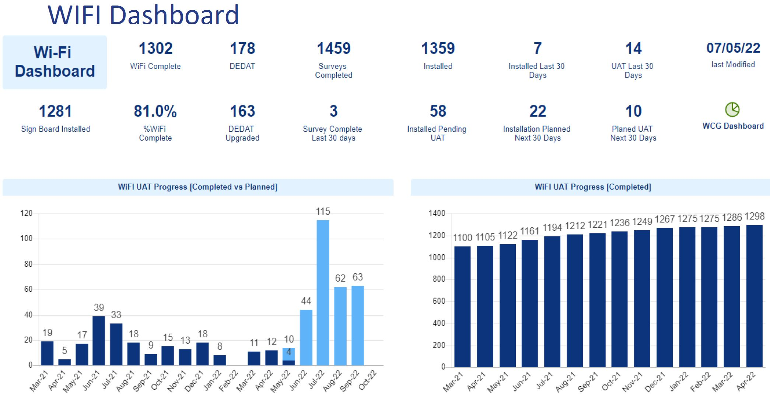
Public Wi-Fi Hotspots

Slide 8
WCG Public Wi-Fi Project Usage Overview
309 291 total users on the network during April 2022.
During April 2022, approximately 216TB of data was consumed.
Average of 683MB per user during April 2022.

Slide 9
WCG Public Wi-Fi Project Usage Overview
Top 10 Utilised WiFi Sites (GB)
Hourly Usage Trend (GB)

Slide 10
information security operations

Slide 11
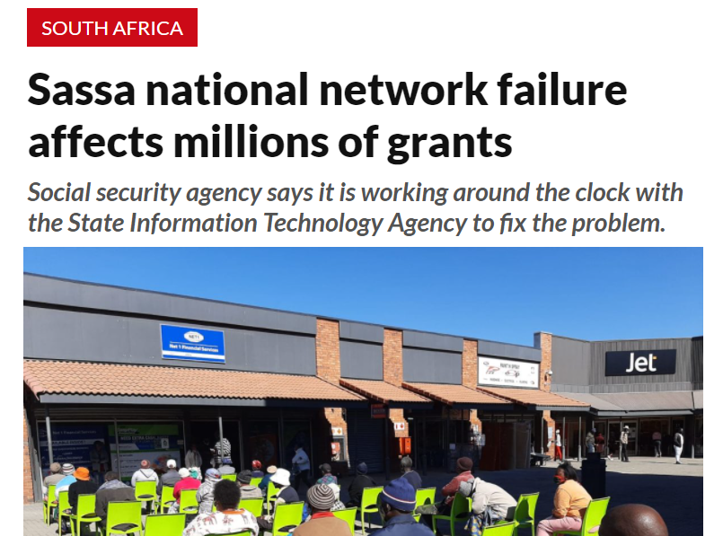
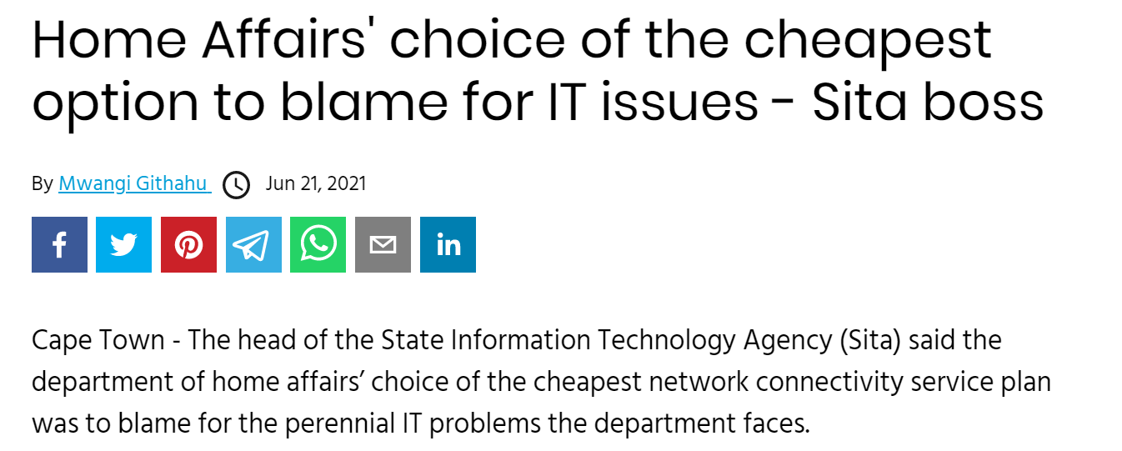
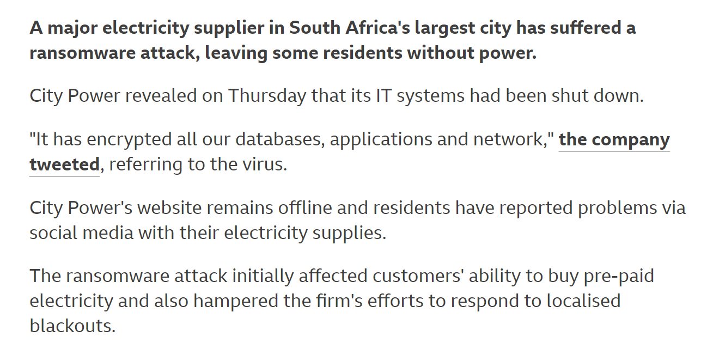
Major threats to Business Continuity and Service Delivery to our Citizens
Network Failure
Ageing infrastructure
Power Outages
Cyber Attacks

Slide 12
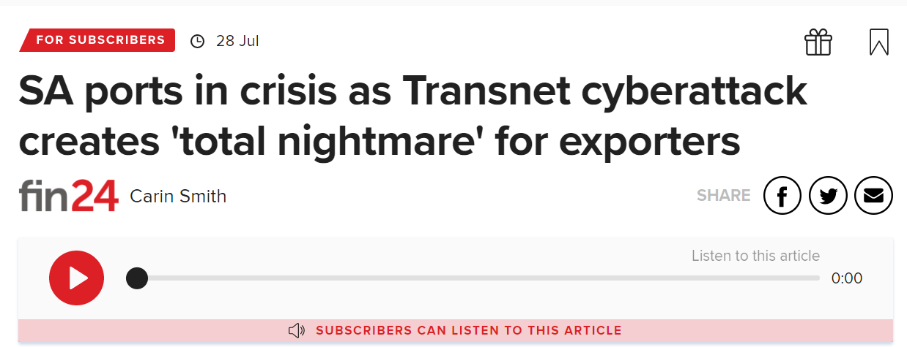
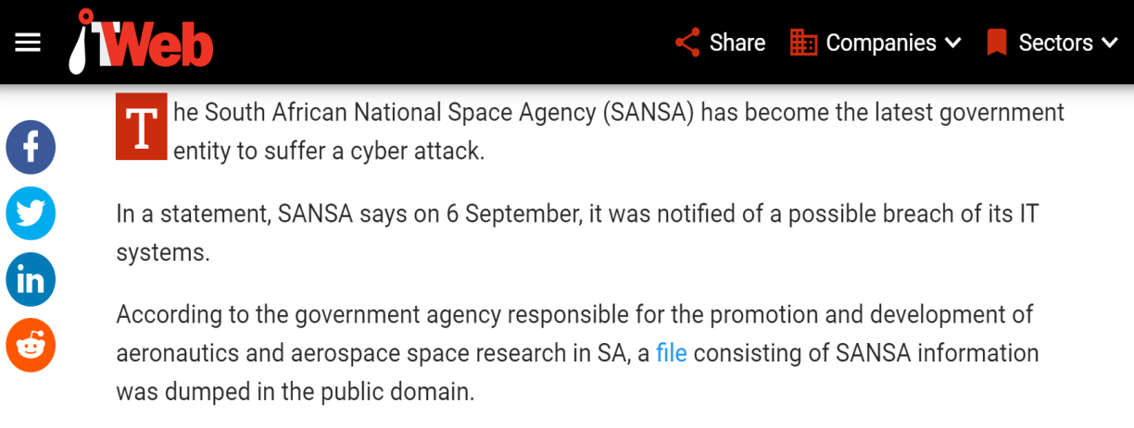
Recent South African Cyber Attacks

Slide 13
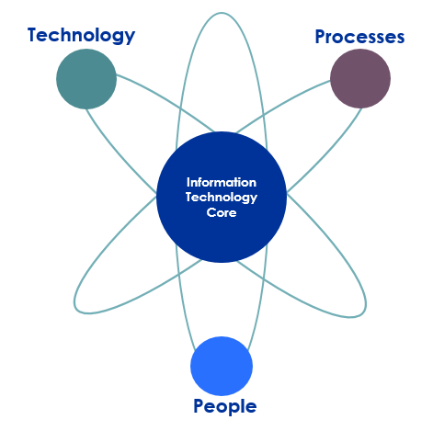
Information Threats and Risks Domain
TECHNOLOGY
Physical Devices (PD’s) e.g. Memory Sticks
Operating System (OS)
Application Software
Poor Systems design and Architecture
Database platforms
Programming Languages
Poor Data structures and protection
IT Tools
Internet Browsers
The Internet and Social Media
The Network
Access and Password protection
Facilities housing IT equipment
Data storage media
Mobile devices
Any digital device
Any point on the Network
Personal “Cloud” services
Cloud Services
Communication tools and systems
PROCESS
IT Security Framework, Policy, Standards, Controls & Procedures
IT Security Risk Management supporting the IT Risk Management and feeding into ERM
Incident and Breach Management
Change Control Management
IT Security Forum
IT Security Steercom
Systems administration
Effective ICT Security
PEOPLE
Capacity and skills
Awareness, responsibility, accountability and consequence
End-user behaviour, work culture and attitudes
Mistakes, Errors and Negligence
Deliberate leakage and sabotage
Criminal behaviour
Disgruntled employees and managers
Contractors and Contracting parties
Undepinnned by legislation, governance and controls

Slide 14
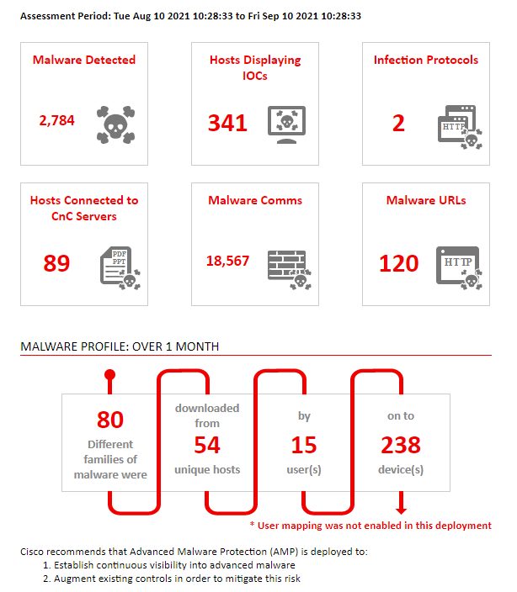
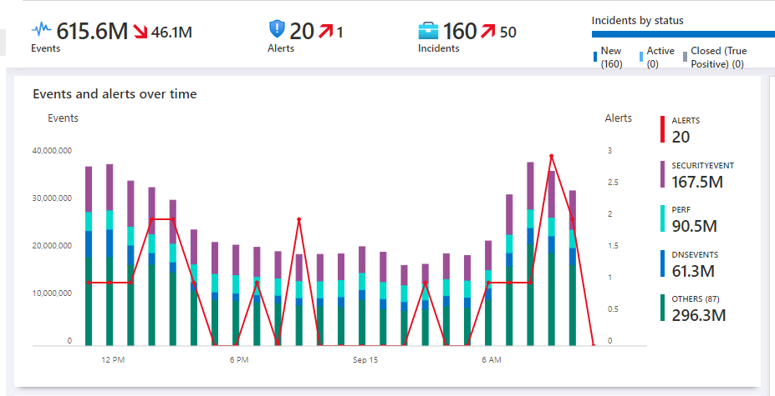
Attacks seen on the network
Attacks seen on the firewall
Security events seen on the network

Slide 15
Our Information Security Maturity

Slide 16
What is Your Overall Maturity?

Slide 17
How Mature Are Your Functional Activities?

Slide 18
High Priority Area: Develop Strategy

Slide 19
Risk Recon Assessment

Slide 20
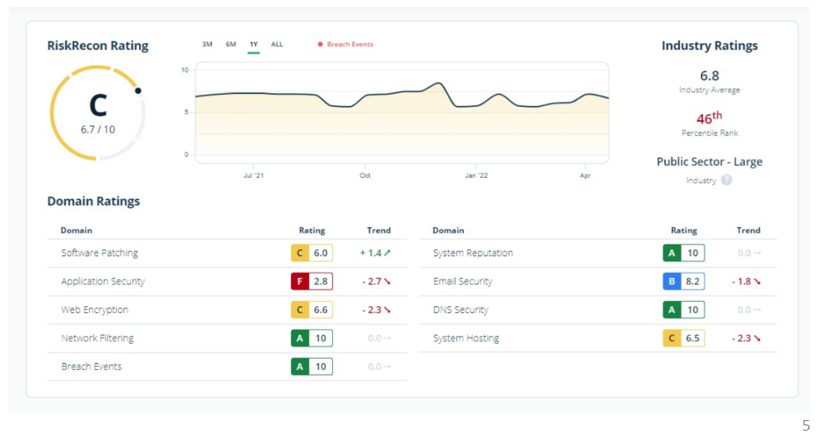
Network Scan (Risk Recon)

Slide 21
How are we mitigating our cyber security risks?

Slide 22
Phishing

Slide 23
“Catching the big fish: Analyzing a large-scale Phishing-as-a-Service operation”
“In researching phishing attacks, we came across a campaign that used a rather high volume of newly created and unique subdomains—over 300,000 in a single run. This investigation led us down a rabbit hole as we unearthed one of the operations that enabled the campaign: a large-scale phishing-as-a-service operation called BulletProofLink, which sells phishing kits, email templates, hosting, and automated services at a relatively low cost.
With over 100 available phishing templates that mimic known brands and services, the BulletProofLink operation is responsible for many of the phishing campaigns that impact enterprises today. BulletProofLink (also referred to as BulletProftLink or Anthrax by its operators in various websites, ads, and other promotional materials) is used by multiple attacker groups in either one-off or monthly subscription-based business models, creating a steady revenue stream for its operators.”
Types of Phishing
Whaling: A targeted type of phishing attack that goes after executives in an organisation as well as employees in crucial positions (e.g. Finance) - ​
​
Smishing: A phishing attack that uses text messaging or short messaging service (SMS) to execute the attack
Spear Phishing: A phishing attack that uses prior research to target specific individuals and groups to persuade users to share personal information –

Slide 24
Results of a recent security awareness poll
A poll was done in the monthly security forum.
29 answered the poll out of 38 participants.
The question posed to all attendees was as follows: ​
​
What is Spear Phishing? ​
​
Option 1: A targeted type of phishing attack that goes after executives in an organisation as well as employees in crucial positions (e.g., Finance)​
​
Option 2: A phishing attack that uses text messaging or short messaging service (SMS) to execute the attack​
​
Option 3: A phishing attack that uses prior research to target specific individuals and groups to persuade users to share personal information
Of the 29 participants, 72% answered the question correctly and 28% answered the question incorrectly.

Slide 25
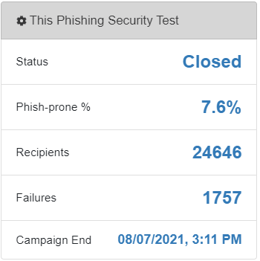
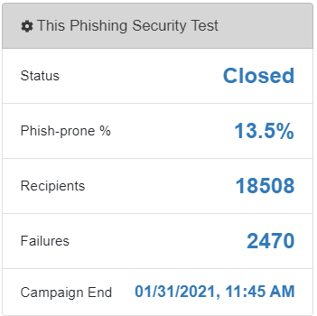
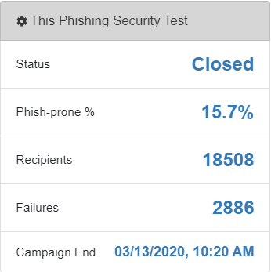
Overall Phish-prone for the last three tests
Phishing Test August 2021
Phishing Test January 2021
Baseline Phish test
The failures refer to the users that clicked on the simulated phishing email.

Slide 26
Working From Home/ Endpoint Risk areas

Slide 27
Key WFH/Endpoint risk areas and mitigation actions
Key risk areas | Controls/ Mitigating actions
Unmanaged endpoint devices | Monitor state of endpoints on security dashboards Log calls for troubleshooting of endpoint devices that are active on the network Corporate Communication requesting users to bring their devices to work as they return to the office
Managed devices not receiving updates | Monitor state of endpoints on security dashboards Implement MS Intune (Co-management) for Windows 10 computers that meet the requirements. Corporate Communication –encourage users to bring their devices to work as they return to the office
Risk of laptop/desktop theft | Implement MS Bitlocker to encrypt files Encourage the use of OneDrive for Business for information protection and encryption
Potential cases of accounts being compromised | Monitor alerts on Azure Security Centre Remediate risks and prevent incidents on the Cloud Application Security Portal Perform Azure AD Identity Protection Multifactor Authentication for 2nd layer of security Apply conditional access by enforcing conditions when accessing O365 resources Security Awareness campaign to influence user behavior
Non supported operating systems (Windows 7) | Running a project to upgrade endpoint devices to Win 10
Comprehensive Email Filtering Services | All emails internal and external are now been scanned by an advanced email filtering service

Slide 28
User Awareness Campaigns

Slide 29
NEW look ! Emailer and Theme for May 2022
ü

Slide 30
Spear Phishing – 30/05/2022 – 30/06/2022
The theme for May's Cyber Security Awareness is Spear Phishing. The campaign will be deployed to all WCG users on the 30th May and will close on 30 June 2022. Users will additionally be notified about the campaign via a Corporate Communications emailer that will be sent on before the launch of the campaign.
The WCG has experienced incidents in the past where users from various departments were specifically targeted and solicited for confidential information. Hence the need to create user awareness around this topic.
The aim of this campaign is to explain what spear phishing is, to help users identify potential threats, and how to protect yourself from becoming a spear phishing victim. This bite-sized video ends with a 5-question multiple choice quiz to test the users' knowledge. The video is produced in South Africa and stars local comedian Jason Goliath.

Slide 31
Upcoming themes
Quarter 2, 2022
May – Spear Phishing
June – Passwords
Quarter 3, 2022
July – How Scammers Work
August – Social Media Overshare
September – Protection of Personal Information
Quarter 4, 2022
October – Cloud Security (Cyber Security Awareness Month)
November – Device Security
December – Cyber Safe Holidays

Slide 32
Activities to address Risk Recon results <10

Slide 33
Recommended actions
Area | Our Actions
Software Patching | Address the patching of the servers by using the Qualys Vulnerability Management toolset for reporting and driving the compliance management through frequent vulnerability management meetings.
Application Security | The system owners to apply the 2FA. System owners to install all missing HTTP security headers.
Web Encryption | Prioritizing remediation of encryption issues for systems labeled. Replace all expired encryption certificates with certificates that are not expired. Implement processes to ensure that encryption certificates are replaced before expiration. Replace the X.509 encryption certificate with one that has a valid subject name for the system to which the certificate is deployed. Disable support for insecure protocols such as SSLv2, SSLv3, TLS 1.0, and TLS 1.1.
E-mail Security | The riskcon assessment reported on email domains that the WCG (Be-I) is not responsible for. The security team will attempt to engage the domain owners where possible. According to the report these email domains are linked to the Western Cape Government brand.
Systems Hosting | Continue to drive the policy condition of having unique IP addresses per server and not to used shared IP addresses or accounts.
User Awareness Campaign | Continue with security awareness strategy via the Knowb4 platform.

Slide 34
Conclusion
As we embrace digital transformation, the threat attack surface further expands, as new threats are introduced daily.
Ce-I will continue to strengthen its technical and governance capability through external contracts.
The most common threats on the WCG network are malware, phishing, password stealing, and vulnerabilities or weaknesses related to legacy applications.
To assist with cybersecurity response, automation will be used to investigate and remediate security events and alerts.
The WCG is not immune to security breaches and people remains the weakest link in the cybersecurity chain.

