Slide 1
Modernising the Presidential Hotline as an agile complaints management system
Portfolio Committee on Public Administration and Planning Monitoring and Evaluation.
01 June 2022

Slide 2
TABLE OF CONTENTS
Purpose
Vision
Current Status
Challenges encountered
Project Plan
Q4 Report

Slide 3
Purpose of Presentation
To provide a vision for a modernized Presidential Hotline to the Portfolio Committee on Public Administration and Planning Monitoring and Evaluation.

Slide 4
FOUNDING OBJECTIVES
To deepen the practice of participatory democracy in all spheres of public life to ensure that government remains in touch with the people and listen to their needs.
To entrench the Batho Pele principles and values within the Public Service in pursuit of service delivery excellence.
To remove complacency, cynicism and excuses in the delivery of services to the public;
To make real the fundamental right of all South Africans to freely express themselves on service delivery challenges.
To provide citizens with a sense that their government is LISTENING, CARING and WORKING hard to address their issues.

Slide 5
VISION
An apex , responsive, technologically-attuned, citizen-oriented, agile and a rapid response-like public complaints management system. This entails the following:
Multiple entry points to the Presidential Hotline using modern technology in the form of social media inclusive of Presidential Hotline Khawuleza App, twitter, face book, etc.
Management Information Intelligence System that uses advance analytics.
Integrated service delivery data from government call centers
Other data sources i.e. Stats SA, Municipal IQ
Analysis and reporting: comprehensive analysis i.e. predictive analysis
Effective and efficient case resolution system (25 working days turn around time)
Monitor responsiveness and performance of government departments and provinces in terms of resolution of cases

Slide 6
VISION (cont)
Early warning system to identify emerging issues
Proactive resolution of early warning trends
Extensive feedback to complainants and the Public at large

Slide 7
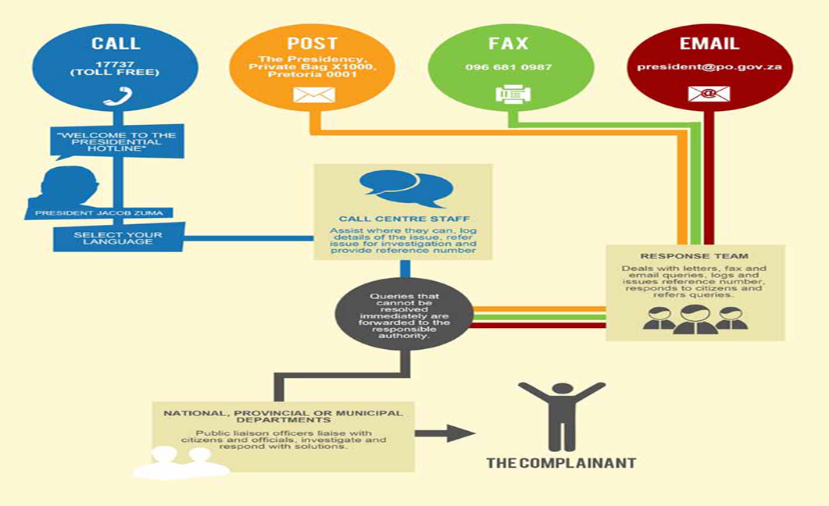
CURRENT PRESIDENTIAL HOTLINE BUSINESS PROCESS FLOW

Slide 8
OVERVIEW OF THE PRESIDENTIAL HOTLINE
PH complaints are received through a toll free call centre, emails, letters and walk-ins.
Complaints are captured on an electronic monitoring system and the resolution rates of government departments are tracked and monitored.

Slide 9
CURRENT STATUS: OPERATIONS
There are 30 Call Centre agents based at SITA who work on two shifts, 15 per shift and from (06h00-14h00) and (14h00- 22h00)
There are 18 staff members who are based at the Union Buildings who perform the back-office case management, knowledge & research management functions and walk-in centre services
There is a team dedicated to monitor and track case resolution in national departments and provinces.
The latter team coordinates PLO forums which are a platform where we interact with Public Liaison Officers (PLOs) and get feedback on how they are resolving queries.
The Khawuleza App is currently not integrated to the Presidential Hotline system.

Slide 10
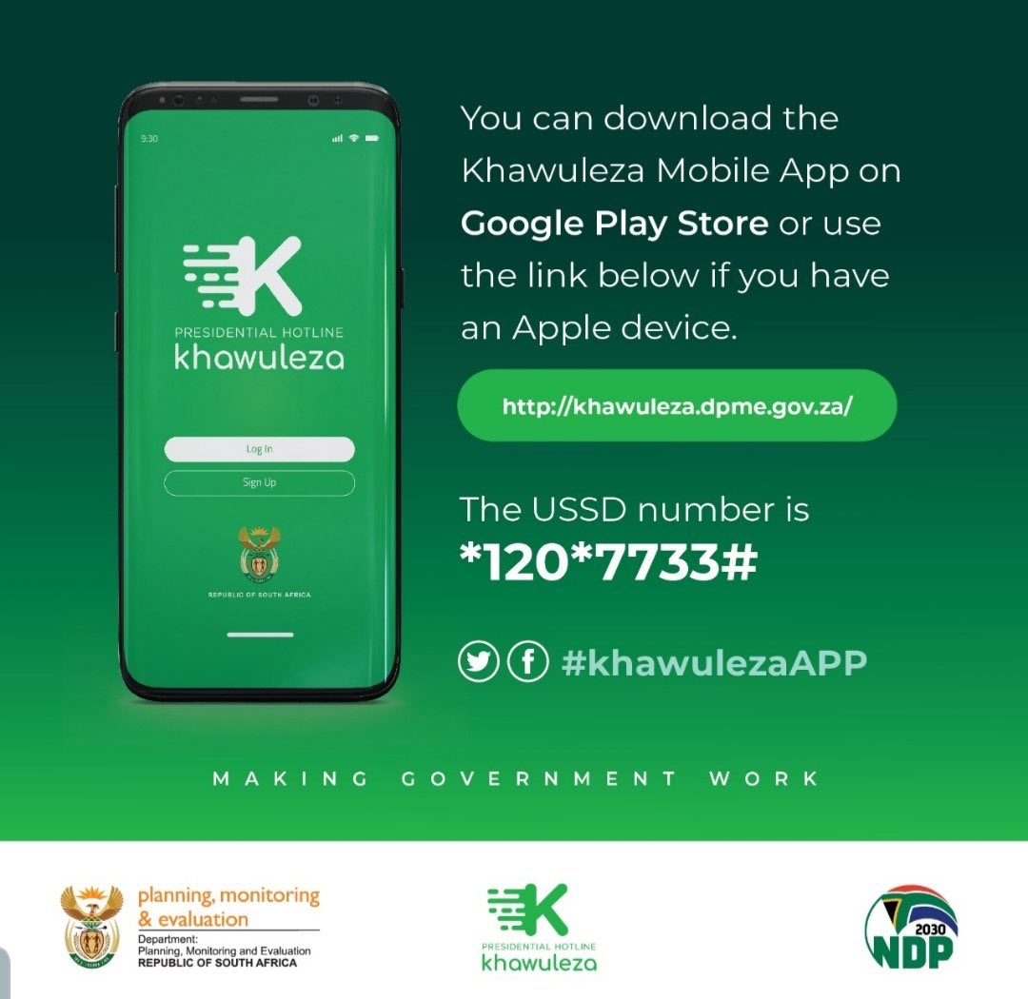
CURRENT STATUS: KHAWULEZA APP AND USSD ACCESS

Slide 11
CURRENT STATUS: THE KHAWULEZA APP AND USSD ACCESS
DPME has developed a Mobile App in-house and sourced a USSD Code from Vodacom to increase the channels for citizens to engage the government through the Presidential Hotline (PH)
The Mobile App and USSD Code will enable the citizens to lodge a service delivery complaint in a language of their choice on their phones.
The App will enable citizens to track their queries through a reference number and can be able to lodge their complaints anonymously.
The Khawuleza App was tested in Limpopo Province.
As a pilot, the services are only limited to complaint or compliments that relates to service delivery in Limpopo Province.
DPME will assess the rate of success of the Limpopo pilot and the state of readiness in other provinces and then announce the dates for provincial launches during the current financial year.
This will culminate in the national launch of a new-look and reengineered (PH)

Slide 12
CURRENT STATUS: Redesigning the PH through the USE OF TECHNOLOGY
During the 2018-2019 financial year, a partnership was sought with the Department of Science and Innovation (DSI) and CSIR to undertake a diagnostic assessment of how the PH can be redesigned to increase efficiency and cost effectiveness.
The report was finalized on the 31st March 2020 and the recommendations are being considered.
A prototype of a Data Analytics Platform which include a Social Media Ingestion Engine was developed by the CSIR but never deployed ICT concerns

Slide 13
Key recommendations: csir diagnostic report 2020
Potential for cost-saving in Business Process Outsourcing
Integration with GIS within DPME
Web portal for complainants to view status/ progress of their cases
Interface of PH with other departmental Call Centres to prevent forum shopping and duplication
PH to provide a 24/7 call-centre operations

Slide 14
CHALLENGES ENCOUNTERED: CAUSES AND MITIGATION
CHALLENGES | CAUSES | MITIGATION
Low resolution rate | Lack of responsiveness Lack of management accountability | Reporting to Governance structures to strengthen accountability Communication Strategy – publishing of resolution data Intelligent management systems
Under utilisation of the Presidential Hotline | Limited hours of service Limited avenues of access Low resolutions/response rates | Establish a fully fledged citizens complaints management system which will; Provide 24/7 service Provide multiple access points Proactive self service Communications/awareness campaign rolled out Roll out of Khawuleza App Improve responsiveness to cases
Limited use of information, intelligence and early warning | Limited management information systems capacity | Establishment of a fully fledged management and intelligence system which will; Integrate call centre and other data Provide analytical reports Development and tabling of quarterly reports to governance structures Internal data analysis performed
Proactive addressing of emerging trends | Limited early warning capability Limited management information systems capacity Internal capacity and capabilities | Establishment of an early warning system Develop intervention strategy. Coordinate the implementation of the intervention strategy

Slide 15
PROJECT PLAN: SHORT TERM
 | ACTIVITY | TIMELINES
1 | Reporting to Governance structures and publication of report | Quarter 1
2 | Roll out of Khawuleza App | Quarter 2
3 | Initiation of procurement process for new service provider | Quarter 4
4 | Building back office capacity – change management | Quarter 1
5 | Re – engineer and re-launch of the Presidential Hotline | Quarter 4
6 | Implementation of the PH Communication Strategy | Quarter 4

Slide 16
PROJECT PLAN: ROAD MAP TO AN IDEAL PRESIDENTIAL HOTLINE
Activity | Description | Current Status | Time horizon | Responsibility
Create seamless and automated customer service request system | A system which will integrate telephony, email, and other channels from other sources into one | Telephony: SITA Emails: DPME/Presidency Walk-ins: DPME Other Hotlines: | 31 March 2023 | DPME
A single view of service request resolution (which encompasses other spheres of govt) | PH to be a real apex complaint management mechanism. To have a “bird’s eye view” of complaints across all spheres of government | Currently, complaints management in government is fragmented and disparate. PH is often used as the first port of call | 2023/ 24 | Presidency, DPSA, DPME, COGTA
Social media tracking of WhatsApp, Facebook, Hello Peter, Twitter, etc | PH to take advantage of the latest technology (social media) to harvest public queries | Currently the PH is not linked to any media platform | 31 March 2023 | DPME/ Presidency
Citizens request system must be simple to use for adoption by Users | The means to lodge complaints must not be cumbersome but user-friendly. | Currently, users can lodge complaints through telephony, email, fax and walk-ins. Lately, there is the Khawuleza App which has been piloted in Limpopo | 31 March 2023 | DPME (ICT)

Slide 17
PROJECT PLAN: ROAD MAP TO AN IDEAL PRESIDENTIAL HOTLINE
Activity | Description | Current Status | Time horizon | Responsibility
PH to have correspondence Centre that deals with citizens service request and junk mails | A central point where all correspondence is received and sorted | Currently, the query correspondence comes from/ through multiple entry points | 2023/ 24 | DPME & Presidency
Case Management to monitor service request and analyse quality of responses | Case Management to be more analytical, agile and incisive in dealing with queries | Currently the Case Management monitors, tracks and assists PLOs in resolving queries. It draws out raw data from Call Centre to identify case resolution trends | 31 March 2023 | DPME
Business Intelligent system be used as the solution for the Presidential Hotline. | Information gleaned from the PH to be used to guide, predict and inform government policy formulation | Currently, quarterly and Annual reports are prepared which highlight where service delivery pressure points are | 31 March 2023 | DPME
Citizens request system to have intelligent internal process to connect the correct people | PH system should be configured in such a way that, for government information queries, it is automated in such a way to direct enquirers where they should go | Currently, this done manually through routing queries to a sector department | 31 March 2023 | DPME/ GCIS

Slide 18
PROJECT PLAN: ROAD MAP TO AN IDEAL PRESIDENTIAL HOTLINE
Activity | Description | Current Status | Time horizon | Responsibility
Weekly automated report of queries received and allocated to a particular department. | PH to generate weekly performance reports denoting which departments are acknowledging receipt, dealing with backlog and resolving current cases | Currently, Case Management generate these reports, but not to the detail of which department acknowledges queries sent to them. | On-going. This is already happening but may need to be tweaked/ modified. | DPME (CD)
Weekly report be generated for the attention of the political principals in the Presidency | Political principals to be provided with weekly reports of the performance of the departments and issues citizens are raising | Currently there are no weekly or monthly reports shared with principals. It is only in this financial year that PH was going to supply the Private Office of the President with quarterly reports |  | DPME (FMS)
Monthly report that deals with non-responses from another department | PH to produce a monthly report of departments & provinces who do not respond to queries | Currently, PH produces a monthly report of performance of all provinces and national departments which also highlights the top 10 issues being complained about | On-going . This is already happening but there may need to more emphasis on non-responsive entities. | DPME & Presidency

Slide 19
PROJECT PLAN: ROAD MAP TO AN IDEAL PRESIDENTIAL HOTLINE
Activity | Description | Current Status | Time horizon | Responsibility
Customer Satisfaction level report to be generated daily at the Call Centre | CSS report to be generated daily | Currently there is a monthly Customer Satisfaction Survey, but post call surveys are done daily | On-going . This is already happening but there may need to more emphasis on daily CSS reports | SITA/ DPME
Service level Agreements with Premiers and Mayors to commit in responding to service request | Secure the commitment of premiers and mayors through Service Level Agreement on how they are expected to respond to queries | Currently, no such political SLA exists. There is only an admin draft MoU document which still needs to be ratified/ signed off. | 31 July 2023 | Minister’s Office
Service level agreement with all national, provincial and local government departments | A protocol agreement that bind local, provincial & national departments to respond within a specified time period | There is currently no such agreement | 30 June 2022 | DPME

Slide 20
PROJECT PLAN: ROAD MAP TO AN IDEAL PRESIDENTIAL HOTLINE
Activity | Explanation | Current Status | Time horizon | Responsibility
All departments to have dedicated person to resolve issues | Departments to have personnel dedicated to solely deal with PH queries. | Currently, this function is performed by Public Liaison Officers as an ad-hoc or add-on function. For many officials, it is not even in their Performance Agreements | 30 September 2022 | Presidency/ DPME

Slide 21
QUARTER 4 REPORT (1 JANUARY 2022 – 31 MARCH 2022)
This report provides an overview of the number of complaints received, and trends in the types of complaints from Quarter 4 (1 January -31 March 2022)
The report gives a comprehensive account of the queries and complaints logged onto the Presidential Hotline system across the country.
The report highlights the top 5 issues nationally, for provinces and for national departments.
The report highlights the performance in the fourth quarter, showing trends over the three quarters

Slide 22
NATIONAL OVERVIEW OF TOP 5 CATEGORIES (1 JANUARY – 31 MARCH 2022)

Slide 23
PROVINCES TOP 5 CATEGORIES (1 JANUARY – 31 MARCH 2022)

Slide 24
A PLACE TO LIVE CATEGORY (1 JANUARY – 31 MARCH 2022)
A place to live
RDP houses
Applications for RDP houses
Quality of RDP houses
Access to RDP houses
Deeds office issues
Ownership of RDP houses
Land issues
Housing subsidies
This category has the highest number of cases among other categories with 179 cases received.

Slide 25
QUARTERLY PERFORMANCE TRENDS (1JANUARY – 31 MARCH 2022) PROVINCES
Resolved queries
Department/ Province
Logged queries
Open calls Q4
Performance (%)
PLO Eastern Cape
54
0
54
0
PLO Free State
47
34
13
72
PLO Gauteng
266
97
169
36
PLO KwaZulu Natal
59
5
54
8
PLO Limpopo
24
0
24
0
PLO Mpumalanga
37
2
35
5
PLO North West
35
10
25
29
PLO Northern Cape
9
9
0
100
PLO Western Cape
28
16
12
57
Grand Total
559
173
386
31

Slide 26
PROVINCES RECEIVING HIGH CALLS VOLUMES (1 JANUARY – 31 MARCH 2022)
Table 5: Top 5 provinces receiving high call volumes
Province | No. of calls logged | Resolved calls | Open calls | Resolved %
Gauteng | 266 | 97 | 169 | 36
KwaZulu Natal | 59 | 5 | 54 | 8
Eastern Cape | 54 | 0 | 54 | 0
Free State | 47 | 34 | 13 | 72
Mpumalanga | 37 | 2 | 35 | 5

Slide 27
BEST PERFORMING PROROVINCES (1JANUARY – 31 MARCH 2022) PROVINCES
Table 6: Best performing provinces
Provinces | No. of calls logged | Resolved calls | Open calls | Performance (%)
Northern Cape | 9 | 9 | 0 | 100
Free Cape | 47 | 34 | 13 | 72

Slide 28
NATIONAL OVERVIEW OF TOP 10 BEST PERFORMING DEPTS. (1 JANUARY – 31 MARCH 2022)
Table 8: Top 10 best performing departments
Department | No. of calls logged Q4 | Resolved Calls Q4 | Open Calls Q4 | YTD Performance (%) (Q4)
PLO Dept of Health | 12 | 12 | 0 | 100
PLO Dept of International Relations and Cooperation | 3 | 3 | 0 | 100
PLO Dept of Sport; Arts and Culture | 1 | 1 | 0 | 100
PLO South African Revenue Service (SARS) | 3 | 3 | 0 | 100
PLO Dept of Rural Development and Land Reform | 13 | 10 | 3 | 77
PLO Dept of Trade; Industry and Competition | 3 | 2 | 1 | 67
PLO Government Pensions Administration Agency (GPAA) | 32 | 21 | 11 | 66
PLO Dept of Home Affairs | 317 | 198 | 119 | 63

