Slide 1
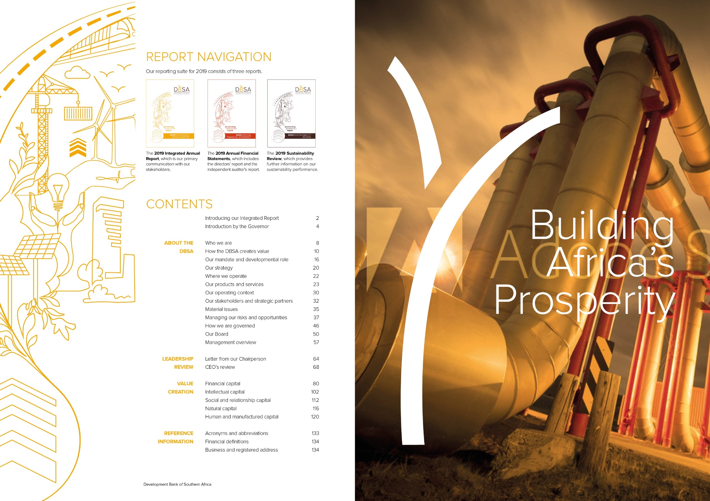
Update on performance and implementation of mandate
Presentation to Standing Committee on Finance
1 June 2022

Slide 2
CONTENTS
Background, mandate and strategy
Factors informing our operating environment
Integrated approach to infrastructure development
Performance report
DBSA public value
DBSA as implementor of government projects
Implementation of key programmes and other interventions
Challenges in implementing mandate
2

Slide 3
A.1 BACKGROUND
Founded
1983
DBSA
Act 1997
Owned
100%
by SA
Government
Total assets
R100bn
Equity
R41.3bn
Externally
rated
DBSA foreign
currency rating is
Ba3
(Moody’s)
Well
governed
Unqualified audits
A+ rating
from AADFI PSGRS
Globally
accredited
Global Environmental
Facility
Green Climate Fund
3
Note: DBSA Financials as at Sep 2022; AADFI PSGRS = Association of African Development Finance Institutions Prudential Standards, Guidelines and Rating System

Slide 4
A.2 MANDATE
Mandate
In terms of the DBSA Act, No 13 of 1997 (Amended Act No 41 of 2014) the Bank is mandated as a DFI with a primary purpose of promoting economic development and sustainable growth, human resource development and institutional capacity building by mobilising financial and other resources from the national and international private and public sectors for sustainable development projects and programmes in South Africa and the wider African continent.
The DBSA development position that flows from this mandate is reflected as follows:
“The DBSA contributes to a just transition toward a renewed and inclusive economy and society that embodies resilience, regeneration, and transcends current trajectories. As a sanctuary for development practitioners, the DBSA holds this to be the transformative change needed to realise a prosperous, integrated and resource efficient continent. This stance progressively advances the common goals for sustainable and equitable wellbeing. The DBSA will work in partnerships to co-produce impactful development solutions and the sustained platforms of an enabling environment for participation, a sense of purpose, empowerment and deep connections. The DBSA will bend the arc of history through our continued multi-faceted investments in sustainable infrastructure and human capacity development.”
4

Slide 5

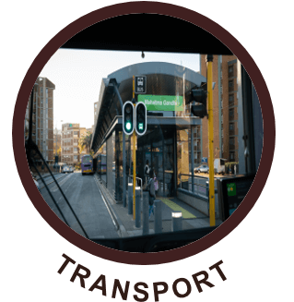
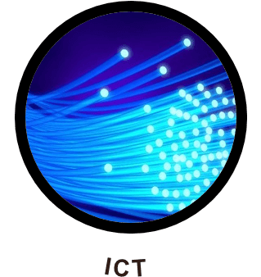
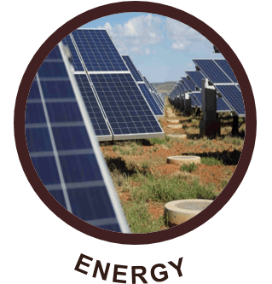
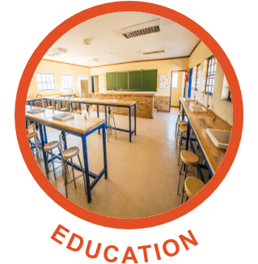


A.3 Integrated infrastructure development
1. Plan
2. Prepare
3. Finance
4. Build
5. Maintain
Municipal assessments
Bulk infrastructure plans
Infrastructure planning advice
Project identification
Feasibility assessments
Technical assistance
Programme development
Project preparation funds
Long-term senior and subordinated debt
Corporate and project finance
Mezzanine finance
Structured financing solutions
Managing design and construction of projects in education, health and housing sectors
Project management support
Supporting maintenance/ improvement of social infrastructure projects
CLIENTS:
SECTORS:
Public
Municipalities
SOEs
Sovereigns
Private
PPPs
Private sector
HUMAN SETTLEMENTS
5

Slide 6
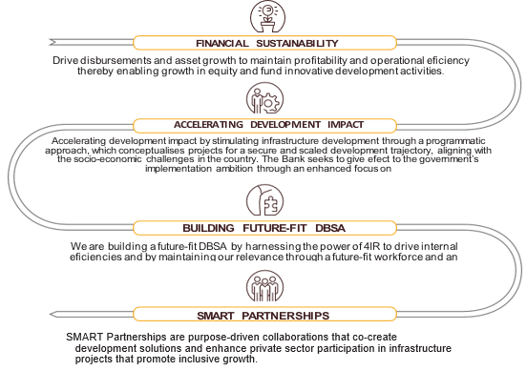
A.4 STRATEGY
Key Focus Areas
Strategy Objectives
Inclusive economic recovery in South Africa
Pursuing green growth for sustainability and resilience
Strengthening infrastructure to support economic expansion and an equitable society
Strategic rest of Africa lens
Pursuing sound Rest of Africa strategy
Doing things differently
Enhancing operational excellence
6

Slide 7

A.5 STRATEGY Action items 2022/23 (1/2)
Within the strategic pillars, 5 Big Issues were considered as strategic accelerators
Inclusive economic recovery in South Africa
Strategic rest of Africa lens
Doing things differently
Pursuing green growth for sustainability and resilience
Strengthening infrastructure to support economic expansion and an equitable society
Pursuing sound Rest of Africa strategy
Enhancing operational excellence
Big issue 1
Capital and Liquidity Management
Big issue 2
Just Transition
Big issue 3
Scale up and fast-tracking infrastructure development
Big issue 4
Intensify and accelerate B-BBEE funding
Fit-for-purpose
Big issue 5

Slide 8
A.6 STRATEGY Action items 2022/23 (2/2)
6 Supplementary Strategic Issues to advance overall strategy
Inclusive economic recovery in South Africa
Strategic rest of Africa lens
Doing things differently
Pursuing green growth for sustainability and resilience
Strengthening infrastructure to support economic expansion and an equitable society
Pursuing sound Rest of Africa strategy
Enhancing operational excellence
Other issue 1
Syndication and distribution
Other issue 2
Municipalities and DDM
Other issue 3
Book concentration
Other issue 4
SEZ/Industrial infrastructure
Other issue 5
Fragile economies and conflict zones
Other issue 6
ESG reporting

Slide 9
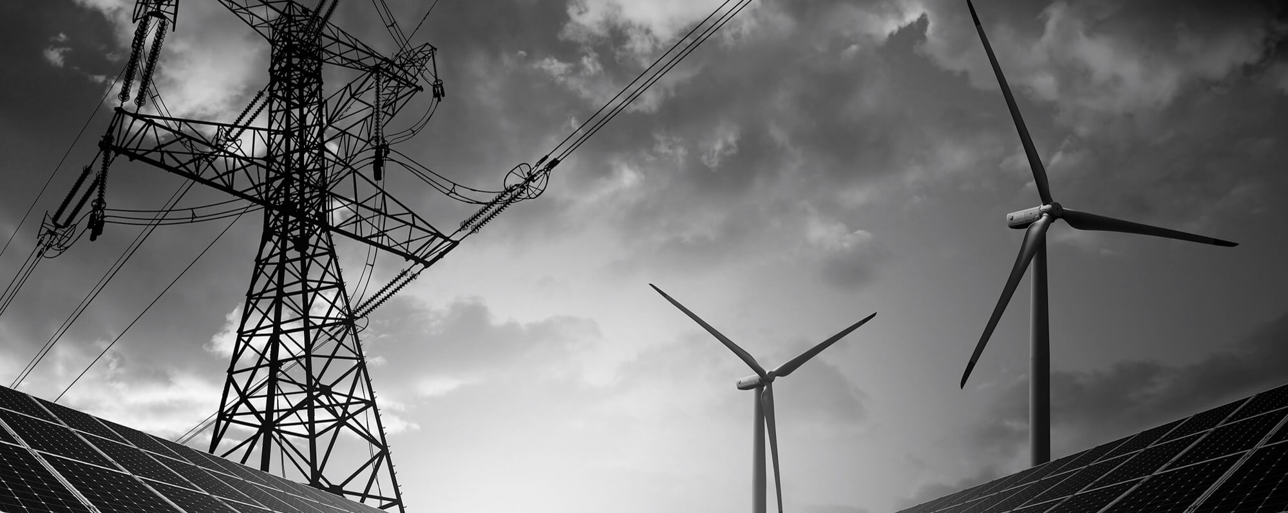
Dbsa OPERATING ENVIRONMENT

Slide 10
B.1 operating environment
Economic story line
Russia/Ukraine war, tighter global monetary policy, and continued COVID-19 disruptions will likely weigh on global and SSA growth recovery.
SA GDP growth likely to remain lacklustre due to weak confidence, continued loadshedding and expected higher interest rates.
Upside risk to the inflation outlook include higher oil prices and higher food price inflation due to supply constraints and the Russia/Ukraine war.
Trade balance will likely remain positive for now.
Risks to rand: global monetary policy tightening; strong dollar and weakening fundamentals in the rand
Dominated by COVID-19 infections and lockdowns (Levels 1 and 5) over the past 26 months
Notable Trends:
  Capital market meltdown
  Lacklustre economic performance
  Indebtedness (creditworthiness)
  Social inequality and tensions
  Climate change
  Working model
Economic growth % | 2021 | 2022 | 2023
Global | 6.1 | 3.6 | 3.6
Sub-Saharan Africa | 4.5 | 3.8 | 4.0
South Africa | 4.9 | 2,1 | 1,9
10

Slide 11
B.2 operating environment
Domestic Macroeconomic Forecast (April 2022)
Indicator | 2021 (actual) | 2022 | 2023 | 2024 | 2025
R/$ (rand) | 14.8 | 15.3 | 15.5 | 15.9 | 16.3
R/euro (rand) | 17.5 | 17.4 | 17.4 | 17.7 | 17.7
R/pound sterling (rand) | 20.3 | 20.8 | 21.1 | 21.3 | 21.5
NCD (3-Month) % | 3.7 | 5.0 | 6.1 | 6.8 | 7.7
JIBAR (6-Month) % | 4.2 | 5.6 | 6.5 | 7.3 | 8.1
Repo rate % | 3.5 | 4.7 | 5.8 | 6.5 | 7.4
10-year generic government bond rate % | 9.8 | 9.9 | 9.8 | 9.8 | 9.9
Brent crude oil (US$) | 70.8 | 93.6 | 82.7 | 80.4 | 81.0
CPI Headline % | 4.5 | 5.6 | 4.5 | 4.4 | 4.3
Real GDP % | 4.9 | 2.3 | 2.1 | 2.1 | 2.0
Gross fixed capital formation % | 2.0 | 3.3 | 4.1 | 4.2 | 4.3
Private sector % | 3.1 | 3.6 | 3.8 | 4.1 | 4.3
Public corporations % | 3.7 | 5.4 | 7.4 | 5.9 | 5.3
General government % | -2.9 | 0.6 | 2.9 | 3.4 | 3.8
Employed ('1000) | 14 691 | 15 585 | 16 175 | 16 604 | 16 987
% change | -2.5 | 6.1 | 3.8 | 2.7 | 2.3
Unemployed ('1000) | 7 658 | 8 075 | 7 570 | 7 630 | 7 676
% change | 21.9 | 5.4 | -6.3 | 0.8 | 0.6
Unemployment rate (%) | 34.3 | 34.1 | 31.9 | 31.5 | 31.1
11

Slide 12
Dbsa infrastructure value chain

Slide 13
C.1 Value chain: Planning
Infrastructure planning, project preparation, implementation and skills and capacity building services
Align with policy guidelines to ensure successful investment in economic infrastructure projects that drive effective urbanisation and economic growth
Differentiate municipal market into metros, secondary cities into ability to borrow in short, medium or long term
Emphasis on development planning to address lending challenges
Support in unlocking Municipal Infrastructure Grant as pledge for implementation of selected infrastructure projects

Slide 14
C.2 Value chain: Project Preparation
    Project Preparation seeks to address several key challenges hindering the African continent’s ability to exploit its infrastructure investment opportunities through:
  strategic partnerships;
  activities that ensure project success; and
  leveraging third party funding
Activities
  Identify projects for preparation
  Prepare projects from inception to bankability
  Supporting under-resourced municipalities to unlock key infrastructure programmes and projects
  Facilitating crowding in of private sector funders through syndication
  Aligning project preparation activities to key policy frameworks, e.g., NDP and B-BBEE
R billion | Value of projects approved and committed for funding by the DBSA | Value of projects prepared but funded by third parties | Value of projects for black-owned entities approved for project preparation funding
YTD Jan 2022 | 0.8 | 2.8 | Not reported
2021 | 0,9 | 1,6 | 2,2
2020 | 2,4 | 11.2 | 1,9
2019 | 6,8 | 4,8 | 3,2
2018 | 1,0 | 15,3 | Not reported
2017 | 0,6 | 0,6 | Not reported

Slide 15
C.3 Value chain: Financing
Instruments
Description
Bridging Finance
Bridging Finance (BF) to assist with expediting grant funded projects or bridging proceeds of long-term loans. To be repaid within the same financial year
Conditional grants front loading – bridging of conditional grants over the MTREF (2-3 years)
R billion | Approvals | Commitments | Disbursements
YTD Jan 2022 | 7.8 | 11.2 | 9.6
2021 | 14,4 | 10,9 | 13,5
2020 | 31,5 | 27,2 | 15,4
2019 | 39,7 | 17 | 9
2018 | 14,5 | 9,2 | 12,2
2017 | 13,4 | 9,7 | 12,4
Long-term Facilities
On-balance sheet debt – vanilla loans and bonds up to 30 years
Project (cash-flows backed) Finance
Sculpted and structured loans that match the expected project cash flows
Blended loans (tenor and interest rates) through:
  International DFI credit lines,
  Mobilising third party sector specific funds (e.g., GCF and GEF)
Credit Enhancement Securitisation Structure
Credit guarantees and first loss instruments
Subordinated (mezzanine) debt instruments
Catalysing of private sector (commercial banks and asset managers) funds by allowing private sector to take the shorter end with the DBSA taking the tail end of the deal

Slide 16
C.4 Value chain: Infrastructure Delivery
Infrastructure Delivery Division is an implementing agent of excellence that augments the capacity of clients to deliver infrastructure by:
  providing rapid procurement to enable fast project initiation and execution
  providing accurate project monitoring and reporting
  providing client-centric infrastructure delivery solutions through a multi-disciplinary team of professionals and technical specialists.
Key activities
Project management and implementation support in key sectors: education, health, housing and municipal infrastructure
An enabler of infrastructure projects, ensuring implementation within scope of requirements
Non-financing activities on full cost recovery basis
R billion | Number of new schools built | Number of schools refurbished | Value of spend allocated to SMMEs and subcontractors in R million
YTD Jan 2022 | 1 | 46 | 1 442
2021 | 11 | 51 | 611
2020 | 4 | 110 | 948
2019 | 8 | 107 | 536
2018 | 8 | 128 | 364
2017 | 12 | 77 | 449

Slide 17
C.5 Value chain: Infrastructure Delivery
Services
Description
Focus
Clients
Core
Implementing Agent Services
  Management of the design, construction, upgrades, refurbishment maintenance of social infrastructure projects using innovative, turnkey solutions to drive greater value for money, asset sustainability and full functionality
Refurbishment/upgrades
New builds construction
Operations and maintenance
National Government
Provincial Government
Municipalities
State-owned Institutions
Programme
Management Services
  Provision of programme management and specialist expertise to support the planning, design, budgeting, execution and maintenance of infrastructure projects and programmes
Programme Management Support
Revenue Enhancement initiatives
Coordination
Secondary
Learning Solutions
  Provision of innovative infrastructure delivery learning solutions that deliver measurable improvements in individual and business performance as well as developmental impact
Capacity building initiatives
Skills and artisan development
Enterprise development
Private sector
Donors

Slide 18
Dbsa PERFORMANCE REPORT

Slide 19
D.1 total infrastructure development support
Key highlights for the YTD performance (31Jan 2022)
Total disbursements of R9.6 billion (YTD target: R10.9 billion)
Infrastructure unlocked in under-resourced municipalities of R1.3 billion (YTD target: R1.0 billion)
Total funds catalysed from private sector of R11.4 billion (YTD target : R25.8 billion)
Infrastructure delivered by IDD primarily on behalf of the state: R2.4 billion (YTD target: R3.0 billion)
Planning support
Project preparation
Financing
Funds catalysed
Project delivery
Five year infrastructure support,
R billion
66,4
4,1
42,7
4,3
36,7
43,1
3,5
26,6
24,7
25,2
16,8
2,6
2,4
8,2
11,4
8,7
15,4
12,2
13,5
6,8
9,6
1,0
0,9
1,4
2,4
1,4
0,9
1,3
0,0
0,0
FY 2018
FY 2019
FY 2020
FY 2021
YTD Jan 2022

Slide 20
D.2 Performance report – disbursement
Metros
Small Metros and secondary cities
Economic infrastructure
Disbursements,
R million
4,500
4,476
7,301
3,000
3,000
5,473
3,581
4,019
2,000
2018
2019
2020
2021
YTD Sept 2021
2018
2019
2020
2021
YTD Sept 2021
2018
2019
2020
2021
YTD Sept 2021
Social infrastructure
Rest of Africa
Observations
Disbursements,
R million
Secondary cities – Limited balance sheet opportunity, increased competition and municipalities not coming to market to seek funding. This was exacerbated by cost of funding challenges precipitated by COVID-19, the ratings downgrade and contagion effect of the Land Bank.
Social infrastructure – A number of private sponsors who had delayed implementation in the previous year due to COVID-19, returned to market to implement their projects. Consequently, disbursements and commitments improved significantly from the prior year.
Rest of Africa (excl. South Africa) - Complexity and lengthy time periods required to reach financial close impact the ability to reach disbursement stage. COVID-19 and fiscal constraints from sovereign borrowers have negatively impacted deal bankability
5,406
4,535
3,233
1,703
2,083
2018
2019
2020
2021
YTD Sept 2021
2018
2019
2020
2021
YTD Sept 2021

Slide 21
D.3 FINANCIAL RESULTS
1
  Revenue
2
  Return on average equity (sustainable earnings)
R million
Percentage (%)
3 669
3 845
4 494
4 424
1 052
3
  Sustainable earnings
4
  Net profit
R million
R million
22
23
28
25
22
2.6
3.5
0.5
1.4
4.0
Total C/I ratio (%)
Return on assets (%)

Slide 22
D.4 Performance report – assets
Non-performing loans,
Percent (%)
Total assets
R billion
120
100
100
100
Debt/ equity ratio kept at prudential levels (140%)
Non-performing loans remain within acceptable limits but require careful monitoring
Return on rest of Africa assets book carries higher level of risk than South African book
100
89
89
80
60
40
20
0
2018
2019
2020
2021
YTD 30 Sep 2021
Total equity, R bn
34.3
37.2
37.6
39.2
41.3
Total liability, R bn
54.9
52.3
62.9
60.9
59
Debt / Equity ratio (%)¹
168
138
165
152.1
139.6
¹Excludes callable capital

Slide 23
D.5 GREEN FUNDING
Renewable energy exposure – YTD 31 Jan 2022
“Over the past 6 years the DBSA has raised $1,2 billion worth of green funding”
R million | Renewable Energy |  | Total
 | RSA | ROA
Hydro | 2 721 | 0 | 2 721
Solar | 6 304 | 0 | 6 304
Wind | 4 732 | 0 | 4 732
Total | 13 757 | 0 | 13 757
No. | Facility | Value
1 | Green bond – private placement with Agence Française de Développement | €200 million
2 | New Development Bank | $300 million
3 | European Investment Bank | €22 million
4 | European Investment Bank Kaxu CSP | $100 million
5 | Green Fund | R1,1 billion
6 | Green Climate Fund | $157,5 million
7 | Global Environmental Facility | $54 million
8 | PIMCO | $200 million

Slide 24
D.6 JUST TRANSITION
Towards an integrated sustainable development approach
Integrated Just Transition Investment Framework
Key actions in developing just transition pathway
DBSA Net Zero Statement
2030
Green Deep Dive (Portfolio) Evaluation
Current Policies
Stated Policy Scenario
Africa Case
Sustainable Development Scenario
DFI CEOs Forum on just transition
Country Resource Quality & Enabling Market Environment
Energy Technology Maturity & Deployment Levers
Independent Power Producers Programme
DBSA Integrated Just Transition Investment Framework
Reaccreditation by Green Climate Fund
Just Transition Enablement
Strategic Positioning & Portfolio Focus
Continued support of Eskom transition

Slide 25
D.7 SADC and rest of africa operations
SADC Exposure
Sector | R million
Energy | 42 659
Oil & Gas | 4 053
Roads & Drainage | 13 857
Communications and Transportation | 12 379
Social | 5 592
Water | 2 630
Sanitation | 804
Commercial | 979
Total | 82 953
Rest of Africa Exposure
Sector | R million
Energy | 1 980
Oil & Gas | 1 156
Roads and drainage | 2 912
Commercial | 2 718
Total | 8 766
25

Slide 26
DBSA PUBLIC VALUE

Slide 27
e.1 Financial support to municipalities
R million
Under-resourced municipalities
9 000
Metropolitan municipalities
8 055
8 000
7 000
6 000
5 471
5 556
5 000
4 750
7 452
4 000
3 671
4 476
3 280
3 355
2 469
2 000
1 634
4 488
879
1 156
3 000
3 000
2 000
1 000
19
835
1 800
860
818
799
1 080
0
338
603
280
355
469
262
2012
2013
2014
2015
2016
2017
2018
2019
2020
2021
The Bank has disbursed loans to municipalities to the value of R36.6 billion from 2012 to 2021, of which R6.8 billion was disbursed to secondary and under-resourced municipalities
R1.3 billion of the disbursed was the development bonds to metro municipalities
The funding was for electricity, water, sanitation, ICT and asset management sectors

Slide 28
e.2 Non-financial support to municipalities
Planning Support
R million
2018
2019
2020
2021
Value of infrastructure unlocked for under-resourced municipalities
Number of infrastructure plans completed
The DBSA’s infrastructure planning support from 2017/2018 to the end of the 2020/2021 financial year has resulted in the completion of 47 infrastructure plans in various infrastructure sectors comprising the water, sanitation, electricity, roads and storm water sectors
A total amount of R4.3 billion has been unlocked for infrastructure development from the completed infrastructure master plans in the various municipalities
The funds unlocked consists mainly of conditional grants from fiscal allocations

Slide 29
e.3 Non-financial support to municipalities
Implementation Support
2014
2015
2016
2017
2018
2019
2020
2021
Number of projects completed
The Bank has assisted the M2/M3 municipalities to implement and complete 248 projects from 2014 to 2021

Slide 30
e.4 Non-financial support to municipalities
Implementation Support
5 254
4 600
1 773
0
2014
2015
2016
2017
2018
2019
2020
2021
Number of jobs created
15 357 temporary job opportunities were created as a result of implementing support given to the municipalities since 2014

Slide 31
e.5 Non-financial support to municipalities
Implementation Support
457 022
154 028
109 000
76 553
2014
2015
2016
2017
2018
2019
2020
2021
Number of households benefited from completed projects
897 652 households benefited from projects implemented and completed over the past 8 years

Slide 32
DBSA as an implementor OF government projects

Slide 33
f.1 Infrastructure delivered
R’million
2014
2015
2016
2017
2018
2019
2020
2021
Value of infrastructure delivered
The Bank is among the implementing agents for the three spheres of government (National, Provincial and Local) in the delivery of infrastructure projects
The DBSA has delivered infrastructure to the value of R21.9 billion over the past 8 years

Slide 34
f.2 Development impact FROM infrastructure delivered
130
128
117
109
112
110
107
86
77
50
40
30
20
10
0
2012
2013
2014
2015
2016
2017
2018
2019
2020
2021
New ASIDI Schools completed
School Repairs,Refurbishments and Realignment
Municipal Projects delivered
Number of health facilities delivered
The Bank has completed 614 (139 new and 475 refurbished) schools between 2012 and 2021
A total of 111 municipal projects were completed between 2016 and 2021
A total of 402 health facilities were completed between 2012 and 2021

Slide 35
f.3 Support transformation and job creation
11 702
10 255
9 758
8 492
8 971
8 344
7 144
2014
2015
2016
2017
2018
2019
2020
2021
Number of Employment Opportunities Created (IDD and DBSA)
Number of SMMEs and Subcontractors benefitting
A total of 6 033 SMMEs and subcontractors have benefited from the infrastructure projects that were delivered by the DBSA from 2014 to 2021 to the value of R3.8 billion
A total of 70 434 job opportunities were created by the DBSA from 2014 to 2021 whilst delivering infrastructure as an implementing agent

Slide 36

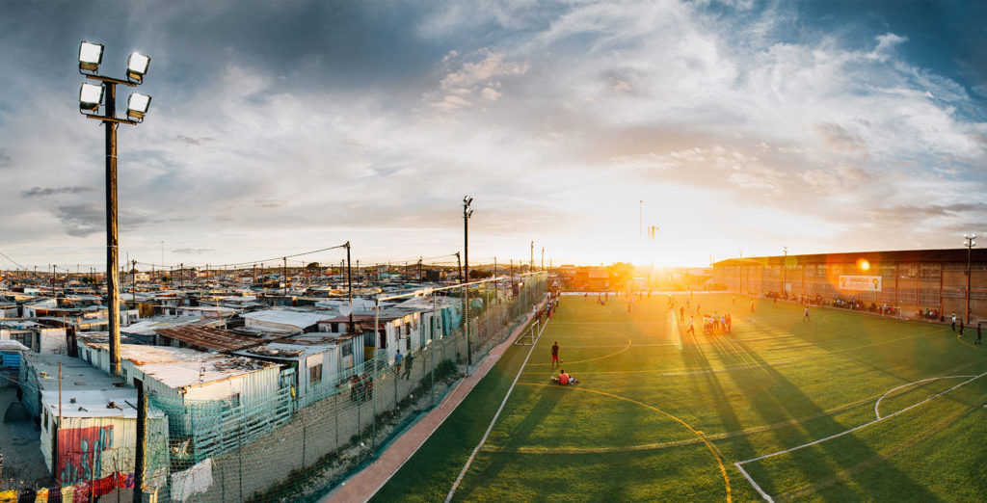

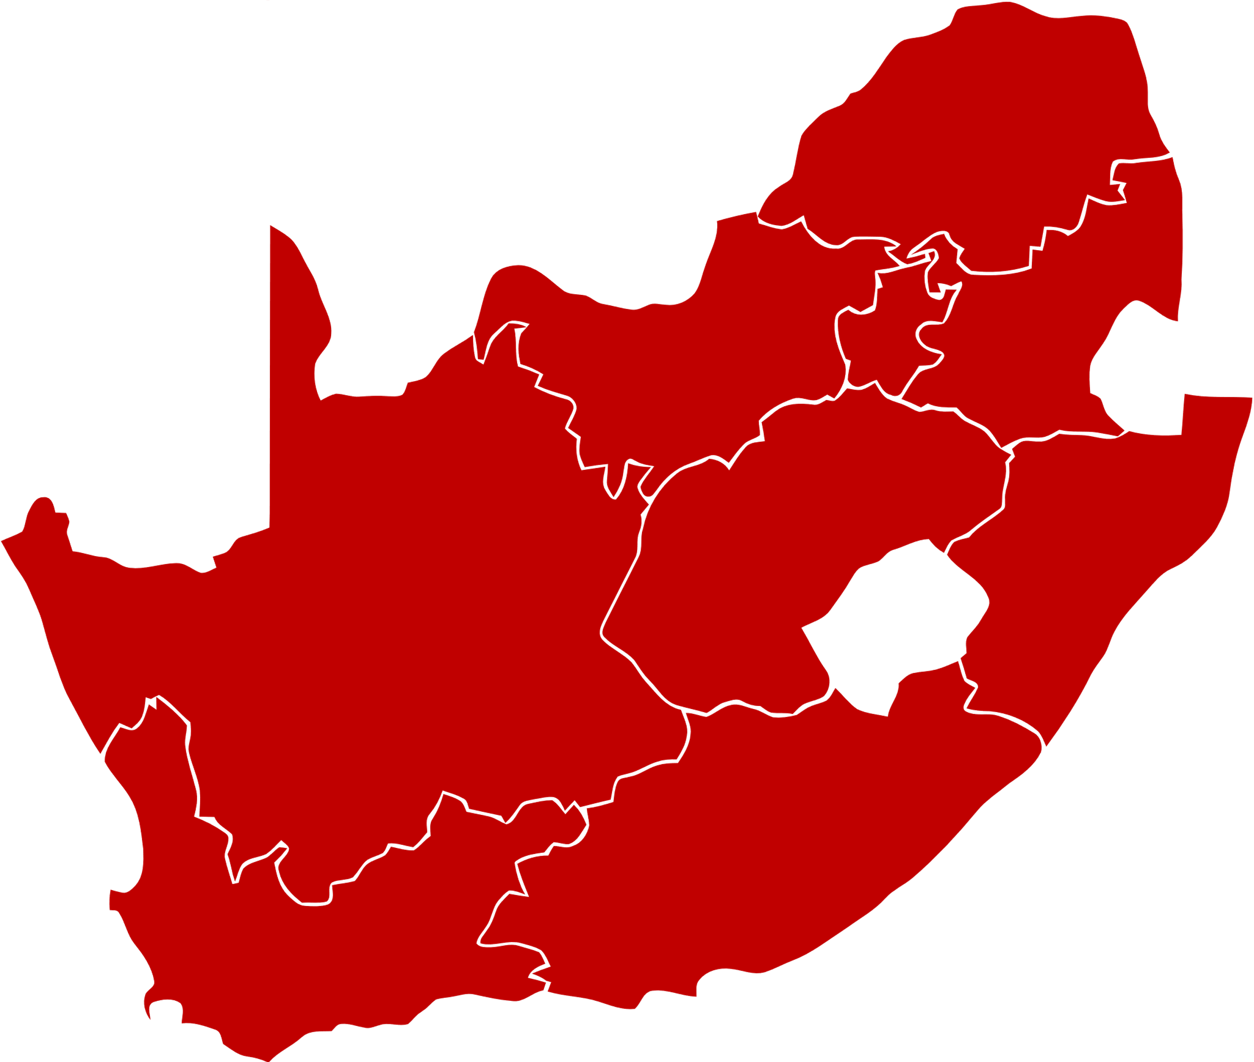





f.4 DBSA DEVELOPMENT LABORATORIES
DLAB PRECINCT SITES
LED ZONE ACTIVITIES
DBSA DISBURSEMENTS
R49.7m
182 SMMEs
5
2
SUPPORTED IN DLAB PRECINCTS
1
YTD DISBURSEMENTS
(FY 20/21 - FY 21/22)
1
Jabulani DLAB has received R25.2m to date, from a total 5-year budget of R48.9m.
Westridge DLAB has received R11.9m to date, from a total 3-year budget of R38.2m.
Alexandra DLAB has received R8.1m to date, from a total 5-year budget of R40.3m
Louwsburg DLAB has received R2.3m to date from a 5-year budget of R51.8m
Waterberg DLAB has received R2.2m to date from a 5-year budget of R51.8m
4
Number of start-up enterprises that received business-ready skills training.
3
5 DLABS
2 functional in year 2 , 3 new disbursing in year 1.
54 Jobs
PLACEMENT IN PERMANENT OPPORTUNITIES DIRECTLY WITHIN DLABS PRECINCT
Total 775 (Youth 309)
[1] Jabulani DLAB launched by the late mayor, Jolidee Matongo, 09 Sept and occupation date 26 October 2021.
[2] Alexandra DLAB launched 14 Sept and occupation date is pending OC certificate.
[3] Westridge DLAB building construction has commenced in Jan 2022. Programs running.
[4] Louwsburg DLAB is disbursing, programmes running.
[5] Waterberg DLAB is disbursing, programmes running
Female – 44%
Youth - 40%
Female – 52%
Youth – 80%
INDIVIDUALS SUCCESSFULLY COMPLETED FUTURE SKILLS PROGRAMMES
E.g., Precinct Coordinator, Community Health Care worker, Youth Café Coordinator, Playmaker, Grounds Keeper, Community Activator, Head of Facility, Lab Manager, etc.]
The majority of the future skills programmes took place predominately online and remote platforms, as part of the continuation plan in response to COVID-19.

Slide 37
IMPLEMENTATION OF KEY NATIONAL PROGRAMMES

Slide 38
G.1 Infrastructure fund and district development model
Infrastructure Fund
CIO and key management in place since October 2021
IFSAC established to provide oversight over the IF
Key establishment procedures completed including key stakeholder mapping
Budget Facility for Infrastructure (BFI) of R2.6bn i r o projects with capital value of R8.7 billion approved:
  Social Housing: BFI of R304,5m
  Student Housing: BFI of R900m
  Lepelle Northern Water: BFI of R985m
District Development Model (DDM)
Core project team in place in the three pilot districts (OR Tambo, eThekwini and Waterberg)
One Plans produced for all three districts
Catalytic projects with a combined capital value R210 billion have been identified
  OR Tambo: R14 billion
  eThekwini: R132 billion
  Waterberg: R64 billion
Information Management System (IMS) developed
DDM now entering execution phase

Slide 39
G.2 RESPONSE TO RECENT FLOODS DISASTER
KZN Worst Affected
EC Worst Affected
eThekwini
King Cetshwayo
Alfred Nzo DM
Chris Hani
iLembe District
Amajuba
Joe Gqabi
Amatole District
Ugu
uMgungundlovu
OR Tambo
Port St Johns
Main infrastructure types affected by floods
Social infrastructure
Economic infrastructure
Municipal infrastructure
Schools, Health facilities, Community facilities
National and Provincial Roads, Bridges, Ports and Electrical infrastructure
Roads, Bridges, Stormwater drainage, electricity etc.
R million | KZN | EC | Total
Water interventions | 43,5 | 21 | 64,5
Community mobility (Bridges) | 0 | 20 | 20
Replacement housing | 28 | 4,2 | 32,2
Sub-total | 71,5 | 45,2 | 116,7
Contingency | 7,2 | 4,5 | 11,7
Grand total | 78,7 | 49,7 | 128,4

Slide 40
CHALLENGES IN IMPLEMENTING MANDATE

Slide 41
h.1 Challenges and opportunities
Opportunity
Facilitate and drive infrastructure-led economic recovery
Leveraging multilateral, BRICS, bilateral and grant funding for infrastructure
Increase and diversify investor base
Diversifying sector investments
Seek self-generated and strategic infrastructure funding opportunities
Participate in and influence the just transition
Challenges
Macroeconomic cyclicality and post-lockdown effects on clients and projects
High cost of funding and foreign borrowing limits
Increased competition in the municipal finance environment
Credit quality deterioration, particularly NPLs in the African business
New DFI empowerment scorecard and SOE remuneration policy
Uncertainty on procurement legislation
Construction Mafia
41

Slide 42


THANK YOU

