Slide 1
LAND CLAIMS ISSUES AFFECTING SAFCOL AND ALEXKOR
Presentation to the PORTFOLIO COMMITTEE ON PUBLIC ENTERPRISES
01 JUNE 2022

Slide 2
Part 1

Slide 3
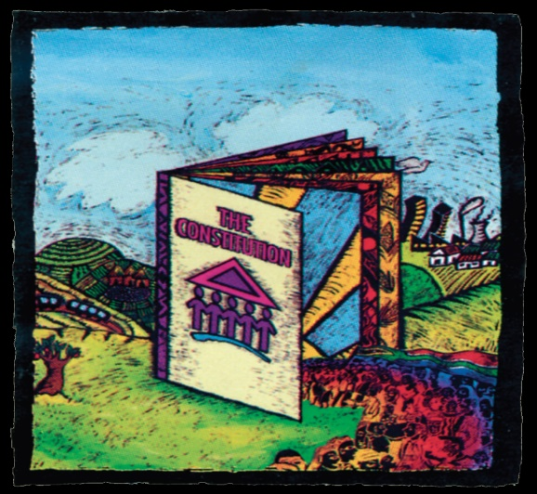
PREAMBLE: LAND REFORM MANDATE
The 1996 Constitution sets out the following framework for land reform:
That The state must take reasonable legislative and other measures, within its available resources,
to foster conditions, which enable citizens to gain access to land on equitable basis (Section 25(5)).
A person or community whose tenure of land is legally insecure as a result of past racially discriminatory laws or practices is entitled, to the extent provided by an Act of Parliament, either to tenure which is legally secure or to comparable redress (Section 25 (6)).
A person or community dispossessed of property after June 1913 as a result of past racially discriminatory laws or practices is entitled, to the extent provided by an Act of Parliament, either to restitution of that property or to equitable redress (Section 25 (7)).

Slide 4
LEGISLATIVE AND OTHER MANDATES
LEGISLATIVE MANDATE
The CRLR is an autonomous institution established by the Restitution of Land Rights Act, 1994 (Act No 22 of 1994) to solicit land claims, investigate them and attempt to resolve them through negotiation and mediation.
CONSTITUTIONAL MANDATES
Constitution of the Republic of South Africa, 1996 (Act No. 108 of 1996)
The mandate for restitution of land rights is derived from section 25 (7) of the Constitution of the Republic of South Africa, 1996 (“the Constitution”) which states that a “person or community dispossessed of property after 19 June 1913 as a result of past racially discriminatory laws or practices is entitled, to the extent provided by an Act of Parliament, either to restitution of that property or to equitable redress”.

Slide 5
Vision & MISSION
Vision
A Commission of excellence that ensures that effective, efficient and speedy redress is provided to victims of racially based land dispossessions.
Mission
We exist to provide redress to victims of racially motivated
land dispossession, in line with the provisions of the Restitution of
Land Rights Act, 1994 (Act No 22 of 1994), as amended.

Slide 6
PROGRAMME PURPOSE
Programme Purpose
The Restitution Programme exists to facilitate the settlement of claims and providing restitution or equitable redress to victims of racially motivated land dispossession, in line with the provisions of the Restitution of Land Rights Act, 1994 (Act No. 22 of 1994), as amended.
We contribute to the Department of Agriculture, Land Reform and Rural Development’s (DALRRD) strategic goal: “Equitable access to and sustainable use of land for development promoted”

Slide 7
RESTITUTION PROCESS
PHASE 1
LODGEMENT
SCREENING
NON-COMPLIANT
PHASE 2
GAZETTING
PHASE 3
INVESTIGATION
COURT REFERRAL /
EXPROPRIATION
NEGOTIATIONS
Verification
Valuation
Legal Entity
PHASE 4
SETTLEMENT
POST SETTLEMENT – DALRRD

Slide 8
Terminology

Slide 9
Terminology
Settled claim
Refers to a claim that has been approved as valid either through an agreement contemplated in section 42D of the Restitution Act or through an order of court in terms of section 42d(1)(a).
Finalised claim
Refers to a claim where the intended award approved through settlement by 42D or court order has been fully implemented. Land has been transferred or financial compensation has been paid in full in terms of section 42d(1)(b)-(f). This would have to include the full payment of grants that were allocated for the benefit of the claimants.

Slide 10
Terminology Cont…
Pure outstanding land claim
Refers to a claim that is wholly outstanding. In simple terms, this means that none of the properties subject to the claim have been settled. It is worth noting that claims that have been partially settled, which are commonly referred to as phased settlement, are not counted in this category.
State Land claims
Refers to a claim that affects a property registered in the name of the state.

Slide 11
Terminology cont…
Phased outstanding land claim
Refers to a claim where an agreement contemplated in section 42D of the Restitution Act has been entered into in respect of one or multiple portions/ properties under this one claim. This happens mostly in large claims, where the land under claim is owned by multiple owners – involving protracted negotiations – thus resulting in a staggered (phased) approach in the settlement of the entire claim.
.

Slide 12
Terminology cont…
Post settlement
Refers to a range of processes and activities that involve the provision of a variety of technical and financial resources to land restitution beneficiaries who receive land to enable them to secure land development plans (initially) as well as production capital (secondary).
Once a claim has been settled, what follows thereafter is the execution of the approval which happens through effecting transfer of the land or the payment of financial compensation or both. The commitment arising out of every approval is placed in a commitment register for monitoring and tracking to ensure that the award which could be land restoration or financial compensation and development grants is affected to the benefit of intended beneficiaries.
Once the entire award has been implemented, the value of the award that would have been entered into the commitment register is then removed.
.

Slide 13
STATISTICAL INFORMATION

Slide 14
CLAIMS LODGED AS AT 31 DECEMBER 1998
Claims lodged in 1998 were not only done at the Commission, however lodgement also took place at various departments, police stations, post offices and municipal offices. The above process have contributed to the challenge of arriving at a definitive figure for 1998 Lodgements.
Province | Total Lodged
Eastern Cape | 16 716
Free State | 2 682
Gauteng | 13 162
KwaZulu-Natal | 16 394
Limpopo | 3 489
Mpumalanga | 3 400
North West | 3 902
Northern Cape | 3 852
Western Cape | 16 099
TOTAL | 79 696

Slide 15
The land use breakdown indicates majority of the claims are mixed use which links back to the complexity of the outstanding claims
Breakdown of hectares by land use
Land use comments
The land use overview gives a complete message to the amount of hectares under claim per each of the various land uses
This information is critical when engaging directly with the sectors so that accurate plans and impact assessments can be produced
A notable observation is the amount of claims deemed “mixed” use indicating that for 1 claims multiple sector involvement is requires, hence increasing the complexity
Conservation
4%
Ecotourism
1%
Mining
0%
Agriculture
4%
Forestry
13%
Sugarcane
0%
Farming
5%
Residential
13%
Mixed
35%
TBD
25%

Slide 16
Part 2

Slide 17
OUTSTANDING CLAIMS ON SAFCOL / KLF PLANTATIONS
At least 61% of KLF plantations are directly affected by land claims.
Status of claims on SAFCOL / KLF Plantation is as follows:
SAFCOL is a minority shareholders in other entities leasing land from the State. Those claims are not included in this presentation.
PROVINCE | Phase One | Phase Two | Phase Three | Phase four | Phase five | Phase six | TOTAL
 | Lodgement | Screening and Categorisation | Research | Negotiations | Settlement | Implementation
KZN | - | - | 3 | 4 | 4 | 3 | 14
LIMPOPO | - | - | 3 | 14 | 5 | - | 22
MPUMALANGA | - | - | 6 | 5 | 4 | - | 15
TOTAL |  |  |  |  |  |  | 51

Slide 18
COMMERCIAL FORESTRY SECTOR MASTER PLAN 2020-2025: QUARTERLY REPORT
DELIVERABLE | MILESTONES | QUARTERLY TARGET | ACTUAL ACHIEVED | IF NOT, REASON FOR NON-ATTAINMENT | CATCH UP PLAN/INTERVENTION
Deliverable 1: Land claims expedited (particularly those close to finalisation) | Convene quarterly national level forum to deal with land claims issues ii. Obtain details of outstanding land claims related to state owned plantations iii. Identify plantations well-positioned for early development | Q1: Identify relevant role players | Role players identified Commission of Restitution of Land Rights submitted a total of 152 outstanding forestry claims, 152(EC13, KZN49, LP17 and MP73) of which 33 are state owned and 16 being a combination of state owned and private.

Slide 19
COMMERCIAL FORESTRY SECTOR MASTER PLAN 2020-2025 : QUARTERLY REPORT
DELIVERABLE | MILESTONES | QUARTERLY TARGET | ACTUAL ACHIEVED | IF NOT, REASON FOR NON-ATTAINMENT | CATCH UP PLAN/INTERVENTION
Deliverable 3: Provision of Post-settlement support |  | Q1: Develop a draft MoU / Review of Settlement models | Draft MoU has been developed and submitted to DFFE. To date the review of settlement models which includes Forestry has been done. The settlement models pilots have been conducted. Kaapschehoop Community Claim in Mpumalanga has been identified as the forestry settlement model pilot.

Slide 20
COMMERCIAL FORESTRY SECTOR MASTER PLAN 2020-2025 : QUARTERLY REPORT
DELIVERABLE | MILESTONES | QUARTERLY TARGET | ACTUAL ACHIEVED | IF NOT, REASON FOR NON-ATTAINMENT | CATCH UP PLAN/INTERVENTION
Deliverable 3: Provision of Post-settlement support |  | Q2: Finalise MoU between DFFE and DALRRD | MoU was circulated and is in the process of being finalized. Internal meeting was held between B & C Branch and Forestry Branch to discuss the merging of MoU between DFFE and DALRRD. Forestry supported the recommendation that processes to develop Memoranda of Understanding between DALRRD (including CRLR) and DFFE should be merged for the purpose of having a broader MoU between DFFE and DALRRD. The Land Claims indicated that they do not have a directive to participate on the broader MoU.

Slide 21
Part 3

Slide 22
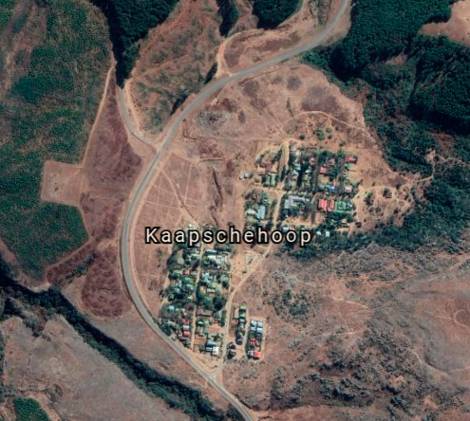
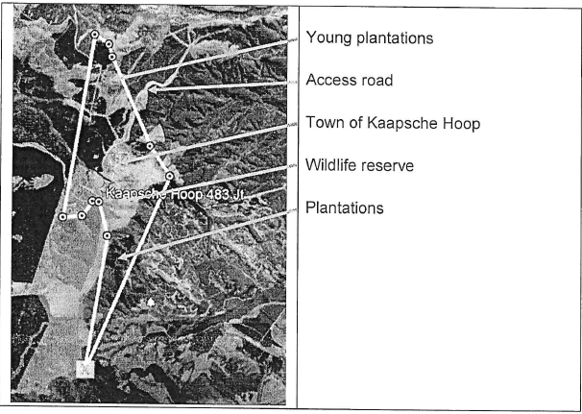
The Kaapsehoop Community Land claim in Mpumalanga was selected as the pilot for the Forestry Sector
Kaapsehoop Forestry Pilot
Claim Overview
Claim Details
PHASE 1: Financial Compensation
Portion 2 (21.63 ha)
PHASE 2: Land Restoration
Remainder of Farm (1199.41 ha)
The claim was lodged by Mtwalo Elphus Fakude on behalf of the Kaapsehoop community.
The community was dispossessed of their rights in land around the year 1968.
There are 81 verified households as part of the claim
The land is owned by the Government (DPW)
SAFCOL is the management authority and currently manages the forestry plantation.
The claim is being settled in two phases
The Kaapsehoop Town is not restorable, therefore claimants will be receiving financial compensation for that portion of land.
Financial compensation to the value of R21m is currently being paid out to the claimants
The remaining extent of the farm under title deed No T29832/1993 is used for forestry timber operations and managed by SAFCOL.
The land comprises Pine tree plantations, natural vegetation that has been declared as an eco-sensitive.

Slide 23
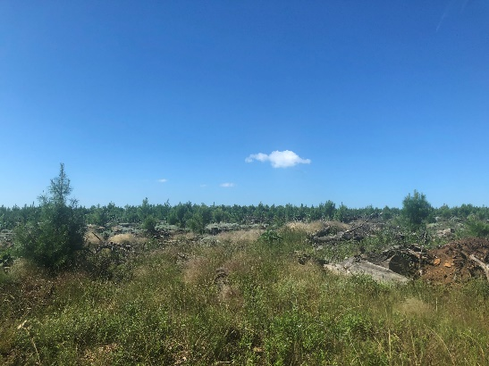
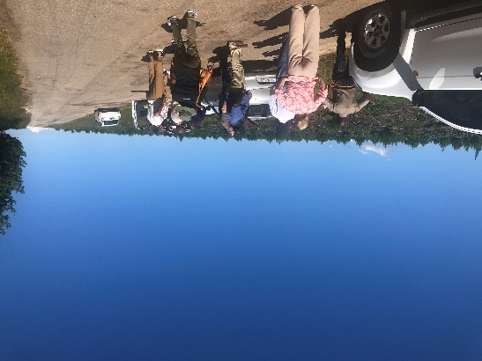
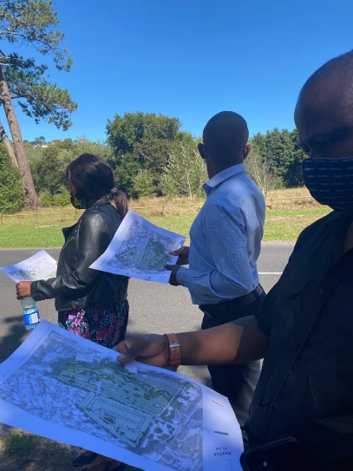
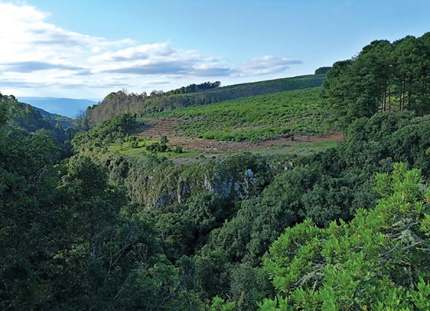
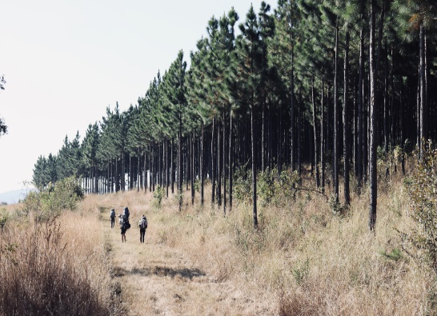
Several site visits and engagements have been undertaken with the CPA, SAFCOL and other key stakeholders during the Forestry pilot
Kaapsehoop Forestry Pilot
Pilot Site Visits
View of forestry plantation on claimed land
Stakeholders viewing stand of young trees on claimed land
Visual of the plantation
Trees on the Berlin Plantation
Illustrative picture of pilot site visit activities
Natural area adjacent to claimed land (Source: Forestry SA)
Hiking Trails on land in the vicinity of the claimed land (Source: AFRI trails)
Source: Afri Trails

Slide 24
The potential model to be used for Kaapsehoop is an inclusive business model/ SAFCOL’s Proactive Community Engagement model
Kaapschehoop Community Claim
Potential Settlement Model
Inclusive Business Model/SAFCOL Proactive Community Engagement Model
SAFCOL engages the community in 4 key areas:
Upstream, i.e. before entering SAFCOL’s value chain
In SAFCOL’s value chain
In SAFCOL’s related activities, conservation/tourism/unplanted areas
Downstream, i.e. utilising SAFCOL’s final products
For example: commercial opportunities in SAFCOL’s operations, access to land for livestock grazing, food and related product production, enterprise and supplier development, learning and skills development
Former Landowner
Department of Public Works
Donates land to CPA
Management Authority
SAFCOL SOC Ltd
Potential rental income – t.b.c
Communal Property Association (CPA)
SAFCOL to continue to manage the plantation through 100% owned Komatiland Forests
Rental Income – use to develop commercial enterprises
Trees
Land
Kaapschehoop Community
A workshop between the Pilot Task Team and SAFCOL is being planned to enter further discussions of the model
Note: Above model based on SAFCOL’s Proactive Community Engagement Model

Slide 25
RICHTERSVELD

Slide 26
BACKGROUND OF THE THREE CLAIMS
3 land claims were lodged in the Richtersveld Local Municipality, Namakwa District in the Northern Cape Province by Mr Henk Smith (Legal Resources Centre) on behalf of the Richtersveld community before the closing date of 31 December 1998 for:
Land mined and operated by the SOE, Alexkor Diamond Mine in Alexander bay and state-owned land – settled
Mining Lease 2/91 Transhex Farm 11, Richtersveld) – in progress
The Remainder of Portion 10 of the Farm Grootderm No.10 – in progress

Slide 27
ALEXKOR
The claim was referred to the Land Claims Court (LCC) and a settlement proposal was presented to Cabinet for approval.
October 2003, the Constitutional Court (Case Nr. CCT 19/03) concluded that the real character of the title that the Richtersveld Community was dispossessed of in the Richtersveld was a right of communal ownership under indigenous law.
The Minister of Public Enterprises entered into negotiations and this culminated into the signing of a Deed of Settlement (DoS) and a memorandum of understanding with Alexkor in 2007.
The then Minister of Agriculture and Land Affairs co-signed the DoS and in principle, the undertakings and responsibilities of the Department of Land Affairs.
The DoS was then made an order of court for implementation by various stakeholders.

Slide 28
ALEXKOR
The DoS directed that at least 2 Trusts and a number of companies be established to manage and operate the various business operations of the CPA. The Richtersveld Investment Trust (RIT) is the sole shareholder in the Richtersveld Investment Holding Company (RIHC).
The community, assisted by the Legal Resources Centre, formed their own legal entity known as the Richtersveld Sida! Hub Communal Property Association (CPA).
The CPA verified and compiled their own list of beneficiaries and submitted it to the Commission and the DRDLR.
Approximately 2,630 beneficiaries were verified in towns of Sanddrift, Kuboes, Lekkersing, Eksteensfontein and Alexander bay.

Slide 29
ALEXKOR
The financial compensation made available by the Commission was transferred to the Richtersveld Investment Holding Company (RIHC) as follows:
R50m for development of the agricultural and mari-culture properties or for other developments which would benefit the CPA members;
R190m to be grown and invested in terms of an investment policy and to provide an income for the Richtersveld Investment Trust; and
R45m to the CPA for property development by the Richtersveld Property Holding Company (RPHC) but which is to be managed by the RIHC).

Slide 30
ALEXKOR
The property compensation consisted of:
A number of farms,
The land on which the local airport is situated,
The township of Alexander Bay, and
Substantial mining areas.
The total property portfolio of the CPA is considerable and amounts to approximately 195 000ha which is spread over a vast and diverse area.

Slide 31
ALEXKOR
The Department of Agriculture; Land Reform and Rural Development has pursuant to an order granted by the Northern Cape High Court on the 28th February 2020 on case 961/2019, appointed Honey Attorneys, represented hereto by Mr. Don Majiedt, as the Judicial Administrator of Richtersveld Communal Property Association for a period of three (3) years.
The main duties of the Administrator were to ensure that the CPA was regularized; and
The membership list of the CPA is updated.

Slide 32
ALEXKOR
A new Executive Committee for the Richtersveld CPA has been elected, and additional Directors for the various companies in the CPA have been appointed to ensure compliance with the DoS and full functionality.
Subsequently, the PSSC: NC together with the office of the RLCC: NC held a CPA induction workshop for the newly elected Richtersveld CPA and its entities on 22 – 23 April 2022. During this workshop the legal roles and responsibilities of the Executive committee were outlined.

Slide 33
Thank YOU

