Slide 1
STATUS OF THE RICHTERSVELD LAND CLAIM PRESENTATION TO THE PORTFOLIO COMMITTEE ON PUBLIC ENTERPRISES
Date: 01 JUNE 2022

Slide 2
OUTLINE
Purpose
Background
Richtersveld Sida !Hub Communal Property Association: Status of Entities Established as a Result of the Land Claim
Conclusion

Slide 3
1. PURPOSE
The purpose of the presentation is to brief the Portfolio Committee on Public Enterprises regarding the status of Richtersveld Land Claim.

Slide 4
2. BACKGROUND/CONTEXT
The Community of Richtersveld, with the assistance of Mr Henk Smith filed a land claim in 1998 in terms of the Restitution of Land Rights Acts 22 of 1994;
Following the protracted court proceedings, the Constitutional Court awarded the land and mineral rights to the community of the Richtersveld;
The Department of Public Enterprises (DPE) and the then Department of Land Affairs (now Department of Agriculture, Land Reform and Rural Development (DALRRD) represented the Government in the settlement negotiations;

Slide 5
... BACKGROUND / CONTEXT
The Deed of Settlement (DoS) was signed on 22 April 2007, between the Richtersveld Community, the Government and Alexkor on 9 October 2007. This made an order of court;
Although the Richtersveld Land Claim is finalised, there are some challenges which need attention;
Richtersveld Sida !Hub Communal Property Association (RCPA) was placed under Judicial Administration on 28 February 2020 through a court order granted by the Northern Cape High Court on the 28th February 2020 (Case 961/2019);
Judicial Administration is in terms of Section 13(1) of the Communal Property Association, Act 28 of 1996 (CPA Act);

Slide 6
… BACKGROUND / CONTEXT
Honey Attorneys were appointed as Judicial Administrator, represented by Attorney (Mr Don Majiedt) for a period of three (3) years, in line with Section 13(2) of the CPA Act;
In terms of the court order of 28 February 2020, the Judicial Administrator is required to exercise powers of the Executive Committee of RCPA and perform all functions assigned to him in terms of the said court order;
The Administrator has met with representatives from all the areas of Richtersveld, and developed workplan which has been been approved (as part of the court order)
6

Slide 7
3.RICHTERSVELD SIDA !HUB COMMUNAL PROPERTY ASSOCIATION: STATUS OF ENTITIES ESTABLISHED AS A RESULT OF THE LAND CLAIM
In order to protect the interests of the community, the DoS sought to create a very comprehensive yet complex structure of Trusts and Companies to house the interests of the Community;
The DoS signed by the parties in 2007, directed that at least 2 Trusts and 6 companies must be established to manage and operate the various business dealings and RCPA; and
Consequently 8 (eight) entities were established under the Richtersveld Community Claim.

Slide 8
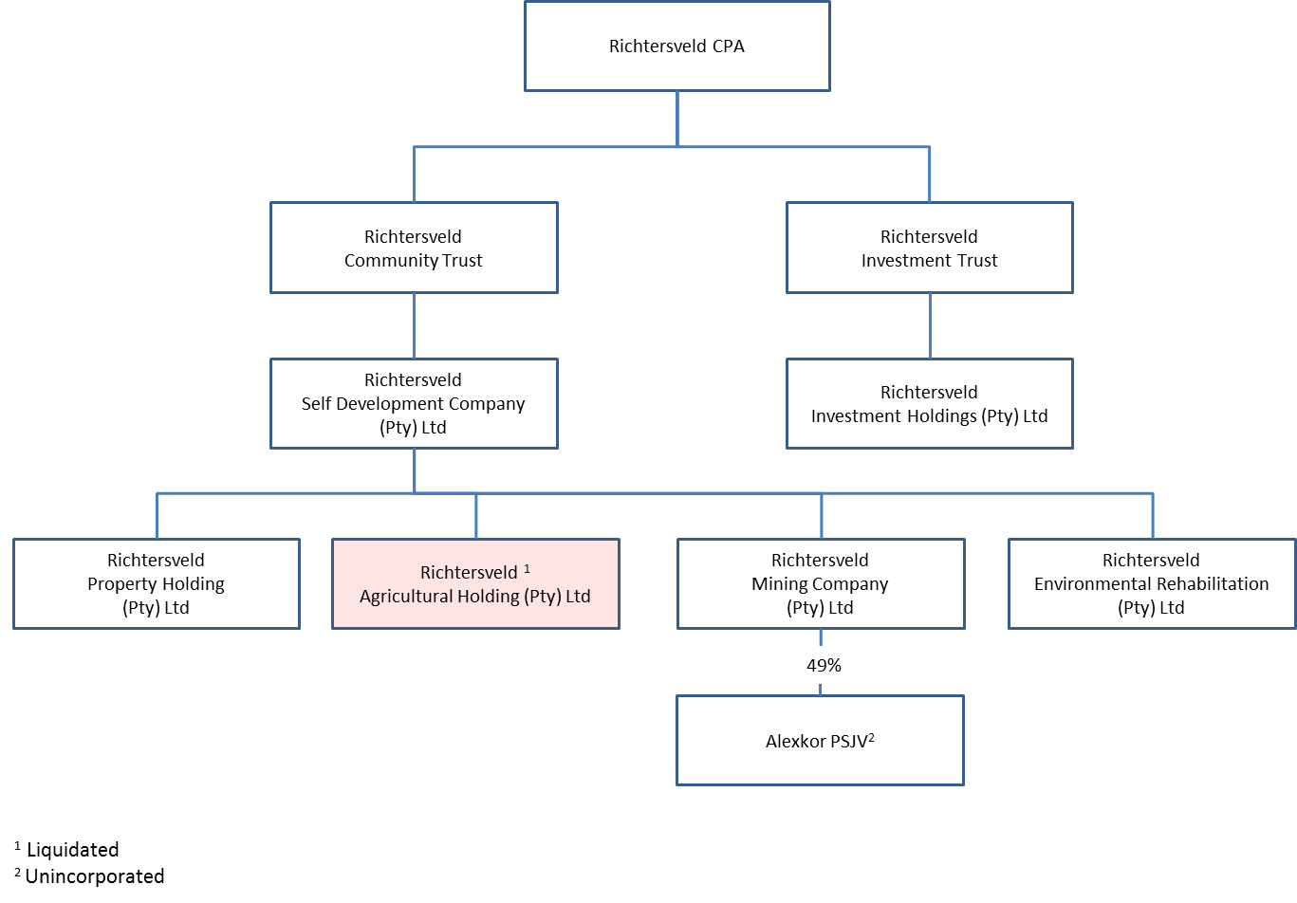
… STATUS OF ENTITIES ESTABLISHED AS A RESULT OF THE LAND CLAIM SETTLEMENT

Slide 9
… STATUS OF ENTITIES ESTABLISHED AS A RESULT OF THE LAND CLAIM SETTLEMENT
An elections agency (EIFSA) was appointed by DALRRD to assist with elections of the Executive Committee of RCPA which took place in November 2021, and by- elections in January 2022.
The current status of the entities are as per the following slides:

Slide 10
… STATUS OF ENTITIES ESTABLISHED AS A RESULT OF THE LAND CLAIM SETTLEMENT
Entity | Status | Outstanding | Challenges
(1) Richtersveld Communal Property Association (RCPA) Composition 15 members | Still under judicial administration of DALRRD until February 2023 8 elected through the community to work with the administrator. 2 Representatives from Local municipality 2 at discretion RCPA 1 from DALRRD | 2 at the discretion of the RCPA Executive Committee to address issues of gender and persons with disability | Dispute of electing Chairperson and Deputy Chairperson has emerged Discomfort of other members that municipality decided to nominate politicians (Councillors) on the structure.

Slide 11
… STATUS OF ENTITIES ESTABLISHED AS A RESULT OF THE LAND CLAIM SETTLEMENT
Entity | Status | Outstanding | Challenges
(2) Richtersveld Community Trust Composition 7 Trustees | 4 Community members elected 3 independent directors nominated by the CPA 3 | Awaiting the registration of Trustees by the Office of the Master of the High Court. | The Trust does not have personnel nor budget to effect its registrations.

Slide 12
… STATUS OF ENTITIES ESTABLISHED AS A RESULT OF THE LAND CLAIM SETTLEMENT
Entity | Status | Outstanding | Impact / Risk/ challenges
(3) Richtersveld Mining Company (RMC) Composition 6 Directors | 4 Community members appointed | Nomination of 2 independent directors by SELFDEVCO | RMC cannot nominate PSJV board members as it is not fully constituted. Formal request for community to attend all Board meetings as observers has been approved and they’ve attended meetings. However there is unhappiness regarding this temporary arrangements. In the interim court appointed directors are currently used so that operations of the PSJV are not disrupted; until the RMC structure has elected its representatives. However there is unhappiness regarding this temporary arrangements Court Case to be held on the 03rd June 2022.

Slide 13
… STATUS OF ENTITIES ESTABLISHED AS A RESULT OF THE LAND CLAIM SETTLEMENT
Entity | Status | Outstanding | Impact / Risk/ challenges
(4) Richtersveld Environmental Rehabilitation Company Composition 6 Directors | 4 Community members appointed Nomination of 2 independent directors by SELFDEVCO | Determination for the need of this company will be done. All rehabilitation obligations has been completed according to DoS requirements. | N/A

Slide 14
… STATUS OF ENTITIES ESTABLISHED AS A RESULT OF THE LAND CLAIM SETTLEMENT
Entity | Status | Outstanding | Impact / Risk/ challenges
(5) Richtersveld Agricultural Holding Company Composition 6 Directors (Liquidated) | Initial company liquidated. | New company established called Richtersveld Growers. 4 Community members elected for the new company. No need to have 6 Directors as per RCPA resolution | There is a new group calling themselves Take Charge Nama United Richtersveld company which submitted a petition through Provincial legislature to be the managers of the farm. This poses a threat to the stability regarding the Agricultural company of the RCPA

Slide 15
STATUS OF ENTITIES ESTABLISHED AS A RESULT OF THE LAND CLAIM SETTLEMENT
Entity | Status | Outstanding | Impact / Risk/ challenges
(6) Richtersveld Property Holding Company Composition 6 Directors | 4 Community members appointed | 2 independent directors to be appointed by SELFDEVCO | Directors are still to negotiate with Alexkor regarding the feasibility of transfer for both R45Million and the residential/ business properties to this company as required by DOS.
(7) Richtersveld Self Development Company Composition 11 Directors | 4 Community members appointed | 3 independent directors to be appointed by community trust 4 persons to be nominated by each of the subsidiary companies | The company will be fully constituted subject to the Community Trust and subsidiary companies been fully constituted.

Slide 16
… STATUS OF ENTITIES ESTABLISHED AS A RESULT OF THE LAND CLAIM SETTLEMENT
Entity | Status | Outstanding | Impact / Risk/ challenges
(8) Richtersveld Investment Trust Composition 9 Trustees | 4 Community members appointed 3 Independent Directors nominated . | 1 by Minister Finance 1 by Minister DALRRD The seven Trustees are awaiting the registration by the office of the Master of the High Court | Finance Minister exercised his right not to participate further. Pending approval of DALRRD Minister.

Slide 17
…STATUS OF ENTITIES ESTABLISHED AS A RESULT OF THE LAND CLAIM SETTLEMENT
Richtersveld Entity | Status | Outstanding | Impact / Risk/ challenges
(9) Richtersveld Investment Holding Company Composition 8 Directors | 4 Community members appointed | independent directors appointed by the Investment Trust 1 by the Minister Finance 1 by Minister of DALRRD 1 to be nominated SELDEVCO | Payment of dividends to members is dependent on this structure. Disputes regarding membership list have not yet been resolved. Compromise/negotiations regarding this matter poses challenges for administration process. This exercise requires legal process separate from the Administration process.

Slide 18
4. CONCLUSION
The dynamics of the Richtersveld entities (No staff to support directors, Limited financial benefits, a bloated and complex structure, poor communication and limited accountability), which were created to protect the assets and the RCPA members, is regarded as one of the factors impacting negatively (is recognised as the primary reason for the levels of conflict in the Richtersveld Community) on the operation, survival and effectiveness of the Richtersveld Communal Property Association;
Richtersveld project requires sufficient Human Resources in order to address the different needs provided for in the DoS;
Different structures mentioned above requires dedicated specialist officials to support the structures until such time that the structures are reviewed. Appointment of independent directors is cumbersome without any administration support staff and budget for any of the entities.

Slide 19
…CONCLUSION
The last CPA general meeting was held on the 1st December 2021 to deal with the elections disputes and preparations for by-elections;
Elected members have appointed their own Attorney to intervene in most of the matters, without them having to be directly involved as elected representatives working together;
In April 2022, members of the 9 entities held an induction workshop regarding the different roles provided in the DOS and training on CPA compliance and Governance;

Slide 20
…CONCLUSION
The Judicial Administrator is on course in implementing the Court Order;
The CPA General Members meeting is planned to be (were) held on the 30th and 31st May 2022 to discuss:
> Membership list
> Preparations for RCPA Constitution workshop for
members
> Status of the RCPA structures
The Portfolio Committee to note report progress.

Slide 21
THANK YOU

