Slide 1
Department of Community Safety
Standing Committee Briefing:
Law Enforcement Advancement Plan (LEAP)
May 2022

Slide 2
Criteria to determine funding allocation to the LEAP

Slide 3












THE ORIGINS OF THE SAFETY PRIORITY
LEAP
PSP
2019-2024
PSP
2014-2019
Recovery
Plan 2021
EOTR
COVID-19
WCSP
VIPs
Priorities
PSGs
Policing capacity and effectiveness
Safe & cohesive communities
Support to youth and families at risk
COVID RECOVERY
What?
1
1
Social cohesion and public spaces
JOBS
Improved policing and law enforcement
2
2
Growth & Jobs
Increase wellness, safety and tackle social ills
Data
Evidence
SAFETY
Safety social cluster
3
3
Empowering People
Area-specific
Urban design
4
4
Mobility & Spatial Transformation
How?
WELLBEING
5
5
Innovation & Culture

Slide 4




The Cardiff Model as it applies to the Western Cape
The Cardiff model requires the strategic use of cross-departmental information
How?
How?
When?
When?
Where?
Where?
Anonymous
information about violence is combined from all sources
to create a complete map and picture of where in the province violence
is occurring
HOSPITAL-BASED SCREENINGS
LAW ENFORCEMENT REPORTS
How did the injury happen?
When did it happen?
Where did it happen?
How did the injury happen?
When did it happen?
Where did it happen?
Sharing information through partnerships with communities can help create provincial and local solutions for preventing injuries from violence in public spaces.

Slide 5





HEALTH DATA
Road Traffic Incidents (RTI)
Forensic Pathology Services (FPS) Data
Safety Dashboard
Data on RTI fatalities shared with DTPW, CoCT, Disaster Management
Data shared for many years with DoCS, SANDF and DotPP. Also includes an FPS dashboard
Data shared with DoCS, CoCT, DSD
Emergency Medical Services (EMS) Reports
Area Specific Reports
Flat PDF reports shared with DoCS, and CoCT
Geocoded data shared with DotP for mapping.

Slide 6


APPROACH TO APPLICATION OF FPS/HEALTH DATA TO SUPPORT LEAP
Forensic Pathology Services (FPS)
Cardiff Model:
How?
When?
Where?
LEAP deployment
Trend analysis/M&E
Impact of intervention
6

Slide 7
CRITERIA FOR FUNDING
The Law Enforcement Advancement Programme (LEAP) was implemented as a direct result of the Western Cape Provincial Safety Plan (WCSP)
The Western Cape Safety Plan through LEAP prioritises the reduction of murder and therefore the areas with the highest homicide rates in province has been prioritised
Based on the homicide reports from the DoH co-angulated with the SAPS Crime Statistics the stations with the highest murder rates are located within the City of Cape Town (CoCT).
Therefore homicide rates has been the main criteria for the allocation of Law Enforcement funding during the MTEF period
The LEAP funding has been prioritised to these priority areas

Slide 8
Legislative framework guiding the oversight and monitoring role the Department has over the use of the funding

Slide 9

LEAP IGR LEGISLATIVE FRAMEWORK FOR OVERSIGHT AND MONITORING
  DoCS legislative framework is derived from the Law Enforcement Advancement Programme (LEAP) Gazette that is tabled annually.
  The Gazette sets out monitoring requirements for the beneficiary institution and has an effective oversight and monitoring requirement for the funding Department (DoCS)
  The Gazette is supported by the TPA in accordance with the PFMA & MFMA
  Furthermore, the DoCS initiated a Section 35 IGR Governance & Protocol Agreement to further strengthen the effective financial and resource management and governance of LEAP.
  The way in which the monitoring and oversight mechanism is implemented is detailed on the following page.

Slide 10
LEAP MONITORING & GOVERNANCE OVERSIGHT
  DoCS appointed a single manager as nodal point to ensure more streamlined, effective and efficient management of and reporting on the LEAP and improved communication between roleplayers
  The CoCT appointed a new LEAP Project Manager during 2021 to streamline internal and external compliances and reporting thereon.
  A revised IGR Governance Framework was developed and implemented that includes multiple technical teams, progress reviews and regular engagements between parties.
  The LEAP Manager is supported by Operational and Technical Teams and meetings monthly are held to ensure effective governance:
    Quarterly Executive and Top Management Engagements
    Bi-weekly/Monthly operational meetings
    Quarterly financial expenditure reports with financial review meetings between CoCT Finance Department and DoCS progress reports review meeting including financial dashboards
    Quarterly Dashboard and Data reporting engagement
    Training and recruitment reporting Enagements

Slide 11
REVISED IGR GOVERNANCE FRAMEWORK

Slide 12
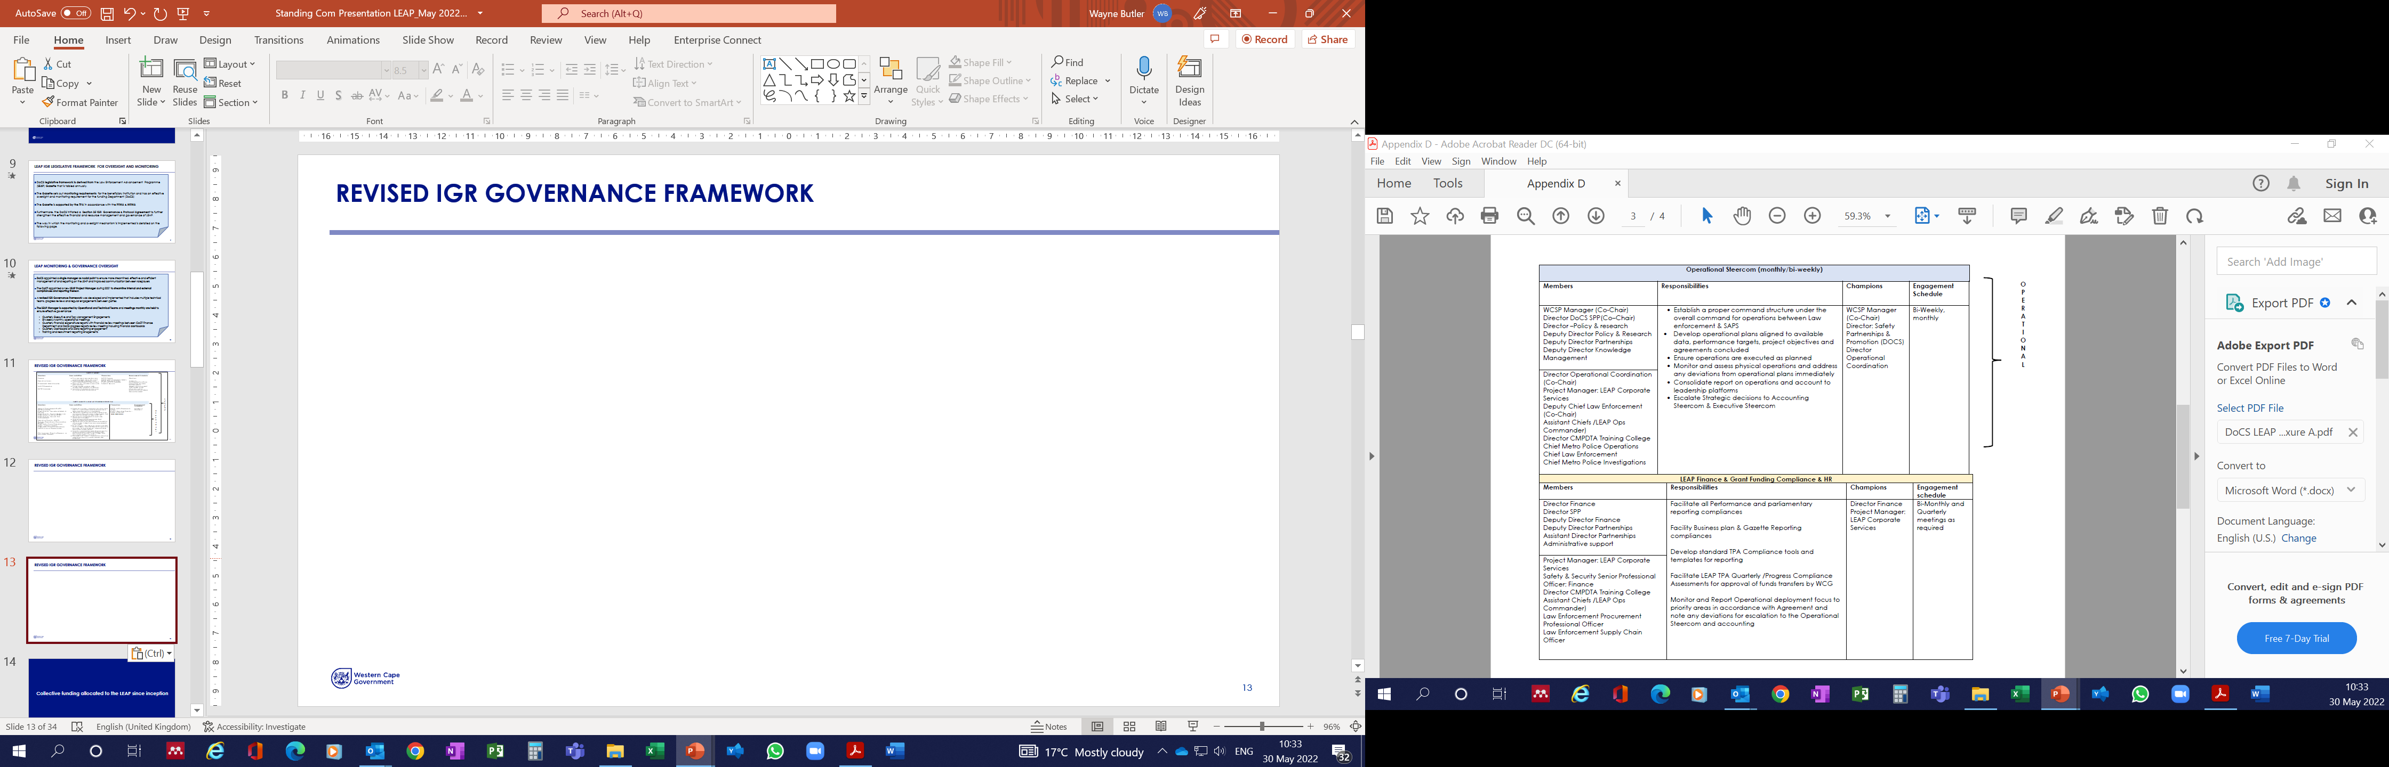
REVISED IGR GOVERNANCE FRAMEWORK (continued)

Slide 13
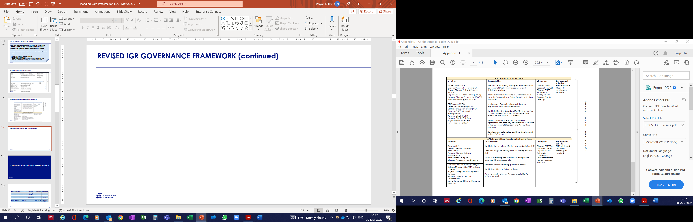
REVISED IGR GOVERNANCE FRAMEWORK (continued)

Slide 14
Collective funding allocated to the LEAP since inception

Slide 15
FINANCIAL ANALYSIS – TRANSFERS
PERIOD | GAZETTED AMOUNT | AMOUNT TRANSFERRED (AS PER TPA) | PERIOD OF TPA | DATE TPA SIGNED | DATE OF PAYMENT
2019-20 | R130 million | R130 million | 1 February 2020 – 30 June 2020 | 27 February 2020 | March 2020
2020-21 | R417 million | R417 million | 1 July 2020 – 31 December 2021 | 18 February 2021 | March 2021
2021-22 | R165,25 million | R165,25 million | 1 July 2021 – 30 June 2021 | 15 December 2021 | R140.25m paid in December 2021 R25m paid in March 2022

Slide 16
FINANCIAL ANALYSIS: CO-FUNDING MODEL
PERIOD | TOTAL PROJECTED COST | WCG (DOCS) CONTRIBUTION | % OF TOTAL PROJECT COST | COCT CONTRIBUTION | % OF PROJECT COST
2019-20 | R169,8 million | R130 million | 77% | R39,8 million | 23%
2020-21 | R557,7 million | R417 million | 75% | R140,7 million | 25%
2021-22 | R458,7 million | *R350 million | 76% | R108.2 million | 24%
*Budget reduced by R184.75m, final TPA amount R165,25m due to roll-over process

Slide 17
Projected number of financial years in which
the funding will continue

Slide 18
FINANCIAL ANALYSIS – TRANSFERS
PERIOD | GAZETTED AMOUNT
2022-23 | R400 million
2023/24 | R350 million
2024/25 | R350 million

Slide 19
Extending funding to similar programmes in rural municipalities that are enabled with its own municipal policing and/or law enforcement capability

Slide 20
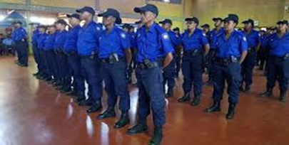
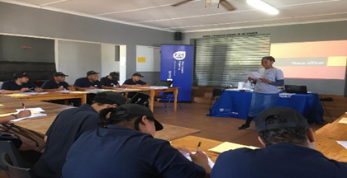
STRENGTHENING LE RURAL DISTRICTS & LOCAL MUNICIPALITY PARTNERSHIPS
Establishing K9 units in Districts in high crime rural areas
Establishing Reaction Teams to provide District wide support
Provided 352 training opportunities for rural Law Enforcement (LE) / Peace Officer in partnership with Metro Training College to increase LE standards and learnings from LEAP

Slide 21
PROGRAMME 2&3
The scope of the Department’s role in determining the deployment of LEAP officers

Slide 22
SCOPE OF DEPARTMENTS ROLE IN LEAP DEPLOYMENTS
Authorized in business plan between CoCT & DOCS
Deployments are data led
Deployments managed on bi-weekly operational meetings
Weekly reports from CoCT obtained as M&E
Deviation from deployments agreed to in business plan
22

Slide 23
KEY REQUIREMENTS FOR DATA TO INFORM DEPLOYMENTS AND OPERATIONS (MPA)
What (murder, crime)
Where (street, place)
When (Day of week & time of day)
Why (motive, gang)
How? (gunshot, stabbing)
Who (age & gender)
Five whiskeys and hotel

Slide 24




OTHER DATA SOURCES
SAPS
Communities
Released crime statistics and data
Information through CPF’s, NHW, whistle blowers and other community structures
Integrated and joint planning operations
WCLA
Area-Specific
Integration happens here through
LETATS as data is shared and
enhanced with other partners in CJS
Assist enforcement section of WCLA with operations on request
24

Slide 25
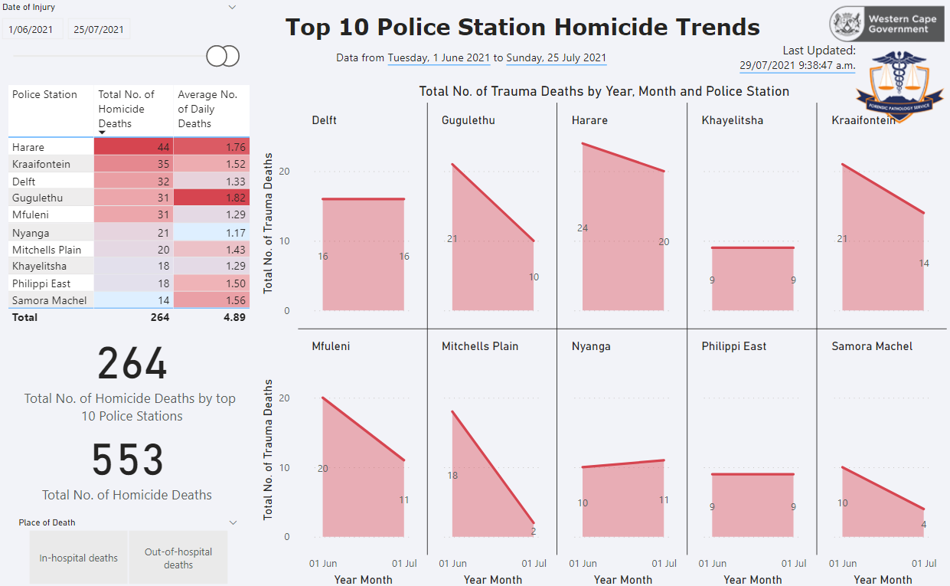
MONTH-ON-MONTH CHANGE IN HOMICIDES BY PRECINCT
The Forensic Pathology Service (FPS) Report allows to relatively compare the month on month change in homicides in the highest affected precincts. For example, when comparing July to June, once sees 6 precincts absolute murders decrease, 3 remain unchanged and 1 with an increase.
Notes:
Update slide with recent data

Slide 26
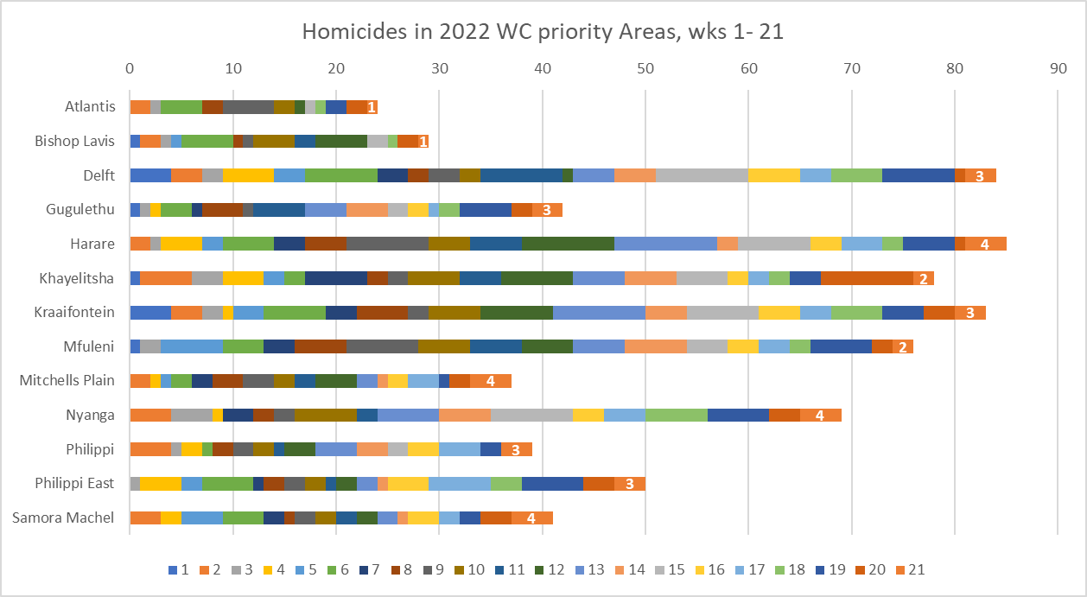
HOMICIDE STATISTICS IN THE 13 PRIORITY AREAS (WHERE?)
Homicide in the 13 priority areas, wks. 1-16 of 2022
The highest recorded homicides (wk 1-21) were in Harare (85), Delft (84), Kraaifontein (83), Khayelitsha (78), Mfuleni (76), and Nyanga (69).

Slide 27
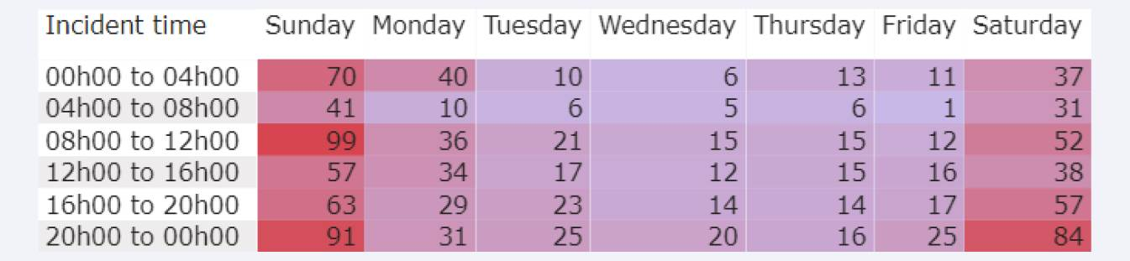
HOMICIDE STATISTICS ON DAYS AND TIMES IN THE PROVINCE (WHEN?)

Slide 28
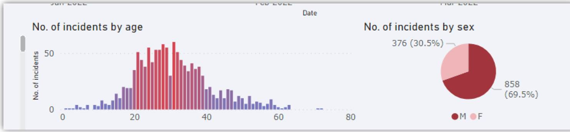
HOMICIDE STATISTICS ON AGE AND GENDER IN THE PROVINCE (WHO?)

Slide 29
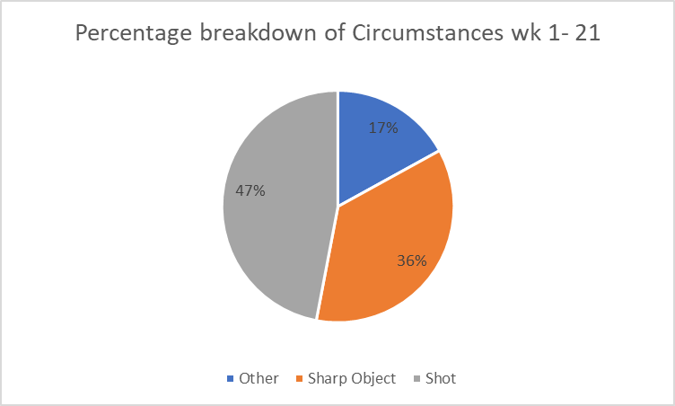
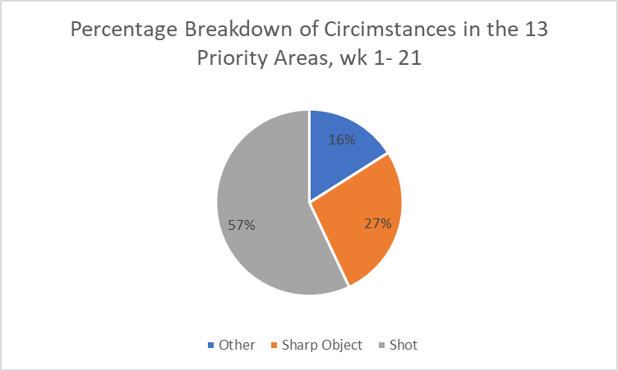
CIRCUMSTANCES OF HOMICIDES IN THE PROVINCE (HOW?)
Percentage breakdown of circumstances of homicide in the Western Cape, week 1-21 of 2022
Circumstances in 13 priority areas

Slide 30
PROGRESS AND DETERMINATION OF DEPLOYMENT (LEAP)
Analysis of data (DoH)
Has influenced the LEAP deployment
Where?
Prior to 01 July 2021: Equal deployment in the priority areas
Since 01 July 2021:
  More LEAP officers deployed to precincts with higher murder rates
  Second set of deployment were prioritised to Kraaifontein, Mfuleni, Harare & Gugulethu based on latest health data
  Reaction unit established to deal with flare ups in murders
  Improved coordination between Law Enforcement agencies
Since 1 Feb 2022: Third cohort of deployments to be extended to Atlantis, Philippi East & Samora Machel based on latest health data & SAPS’ crime statistics
Assist with identification of priority areas, hotspots and circumstances of murders
Prior to 01 July 2021: Deployment predominantly during weekdays, 2 shifts between 06:30 and 22:00, overtime on weekends
Since 01 July 2021:
  24 hours / 7-day (24/7) shift system, deployment numbers aligned to murder data
  Overtime expenditure utilised for operational needs
Assist with identification of day of the week & time of the day (incident pattern analysis)
When?
1,116 law enforcement officers (LEOs) are currently employed in terms of the programme, with a further 154 officers that are currently being trained. They are permanently deployed in fifteen (15) high-crime policing precincts, of which ten (10) forms part of the top murder stations in the Western Cape, i.e., Delft, Gugulethu, Harare, Khayelitsha, Kraaifontein, Mfuleni, Mitchells Plain, Nyanga, Philippi East, and Samora Machel. The other high-crime areas where they are deployed to, are Atlantis, Bishop Lavis and Philippi (Hanover Park).
Reaction unit deployed in Grassy Park (Ottery) and Steenberg to stabilise the area

Slide 31
LEAP OFFICERS EMPLOYED, CURRENTLY IN TRAINING AND ACTUAL DEPLOYMENTS
87 members started their training on the 14th of March to be completed by the 10th of June 2022
These members (87) will be used to fill consequential vacancies and the additional is for any top up that may occur should members take up permanent positions as in the past
In total, 979 Learner Law Enforcement Officers (LLEOs) and 137 Commanders
Therefore, a total of 1,116 members are currently deployed in 13 areas, of which 10 areas form part of the top 10 murder areas in the Western Cape
194 LEAP members are deployed in the malls and 89 members at the schools in the 13 areas as the motor vehicle supplier indicated that the additional required vehicles to deploy these members will only be delivered by the end of June 2022

Slide 32
LEAP ACTIONS & SUCCESSES SINCE INCEPTION
Total arrests executed:
6599
Alcohol: 8526 liters seized
5780 drug arrests
Mandrax: 8133 tablets seized
1183 dangerous weapons seized
527462
persons searched
203 firearms confiscated
Tik: 5373 grams seized
32

Slide 33

FIREARMS CONFISCATED BY LEAP
Impact of change in deployment strategy & operational focus
Pre-intervention – 1st year
(Jan 2020 - Dec 2020)
Post-intervention – 2nd year
(Jan 2021 - Dec 2021)
Average No. of Firearms recovered per month
2,1
Average No. of Firearms recovered per month
9,3
+348%
Firearm Recovery Rate
Total = 25
Total = 112
Total firearms recovered since inception = 203
33

Slide 34
Department of Community Safety

