Slide 1
SA POST OFFICE
Annual Results at 31 March 2021
31 May 2022

Slide 2
Scope of Presentation
Highlights
Covid-19
Strategy and Performance on Targets
Financial Performance
Focus Areas 2022/23FY

Slide 3
Highlights
Operational
Mail delivery performance recovered from 0% during April Level 5 lockdown to 52.95% by year end.
Technology
Network availability uptime achieved at 99.37%.
Reduction of mail carryover items from 9.94 million items to 5.07 million.
Co-loading implemented.
Unprecedented increase in armed robberies at branches, CIT, vehicle hijacking and business burglaries from 583 incidents (2020) to 887 (2021).
Completion of Customs Declaration System
Upgraded International Postal System
Continued contribution to the Nal’ibali programme to deliver reading material to schools and reading clubs.
Network upgrade project achieved 96% with 1263 sites fully commissioned and upgraded connectivity.
SITA collaboration initiative for the development of the Enterprise Application – and eCommerce platform.

Slide 4
Highlights
Human Resources
Reduction of 912 employees headcount to 15 826.
Government
SA Post Office an essential services provider.
Employee Satisfaction level established at 43%.
Staff continuously redeployed to address shortages.
Recruitment for vacant positions placed on hold, except for key strategic positions.
Continued payment of Social Grants during Level 5 Lockdown.
7.9 million SASSA beneficiaries paid monthly.
8.9 million beneficiaries received Social Relief of Distress grants from June 2020 to March 2021.
Total of 1 161 591 qualifying needy households registered for the DTT subsidised STBs and 598 409 STBs distributed

Slide 5
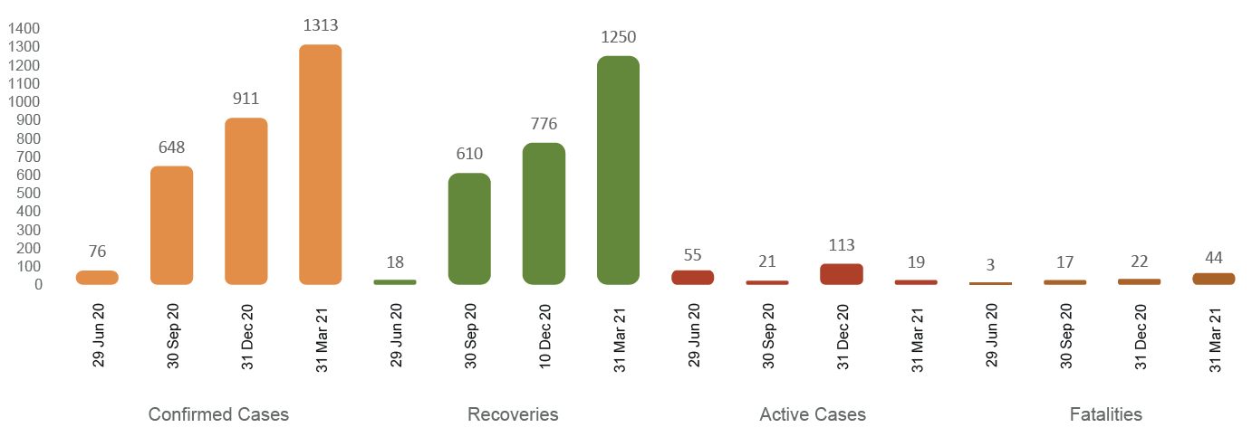
Covid-19
Covid-19 Steerco constituted on 23 March 2020
Chief Risk Officer as Chairperson with executives from various Business Units.
Structure replicated at regional level
Regular Covid-19 Steerco meetings held
Monthly meetings with Regional General Managers and Organised Labour
Communication section consistently conveyed the need for vigilance, compliance to protocols and regulations
Covid-19 statistics shared regularly with employees

Slide 6
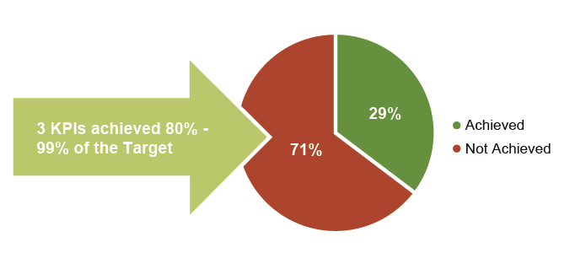
Performance on Targets

Slide 7
Performance on Objectives
Financial Sustainability
Improving the financial position of the SA Post Office by becoming financially sustainable and achieve a positive net financial and cash position.
Baseline revenue target, return on assets and cost to income ratio achieved the annual target.
Optimised Assets and Infrastructure
Optimising the value of the SA Post Office’s assets and owned infrastructure by way of the installation of security upgrades at SA Post Office branches and Mail Centres and the restoration and refurbishment of properties.
The target for installations of security devices was not achieved due to the SA Post Office not fulfilling payment conditions. The project will continue in the 2021/22 FY as a Corporate KPI.
The target for the restoration and refurbishment of 14 critical sites in line with the EXCO reprioritisation, was not attained.
Funding availability is a critical enabler for achieving the annual target for both KPIs

Slide 8
Performance on Objectives
Customer and Communities First
At its core, the SA Post Office is a Government entity to serve the citizens of South Africa.
100% resolution of customer complaints recorded at the call centre within 14 days was not attained at 59.7%, for the period 1 April 2020 to 30 November 2020, due to the effects of Covid-19. The Remedy system was unavailable from December 2020.
Customer satisfaction survey was undertaken which indicated a customer satisfaction level of 33% against a target of 60%.
The CSI target achieved with the Nal’ibali programme, a non-profit organisation that has partnered with the SA Post Office to deliver reading material to schools and reading clubs all over South Africa.
Efficient Systems & Processes
Improving service delivery to all customers by way of achieving the regulated mail standard and ensuring network availability uptime at online SA Post Office branches for customers to transact.
Regulated mail delivery standard of 92% was not achieved due to the effects of the Covid-19 pandemic at a 53% mail delivery standard.
Target network availability uptime at online SA Post Office branches of 98% was achieved at 99.37% network availability uptime.

Slide 9
Performance on Objectives
Digital Transformation
Improving the market relevance of the SA Post Office through digital transformation and increased customer access to digital services offered.
Enterprise Application Platform did not proceed and it was subsequently decided to opt for a cost-effective solution through the SITA/SA Post Office collaboration initiative.
Implementation of the eCommerce Platform achieved 95% of the annual target.
Culture of Excellence
Improve organisational performance and have engaged and high performing employees.
Employee Satisfaction Survey target of 55% was not achieved at 43% due to a number of outstanding and unresolved labour matters and the ongoing low staff morale, impacting the overall organisational climate.
Corporate Governance
Strengthened organisational governance with entrenched and consistently applied governance principles in managing the organisation.
Not been achieved with a Disclaimer of Audit Opinion issued by the Auditor General. Work is continuing with the aim of addressing the outstanding audit matters and improving the audit outcome for the 2021/22 FY.

Slide 10
Financial Overview – Statement of Profit and Loss
Income statement
Revenue of R2.9 billion for the year ending 31 March 2021 (2020: R4.1 billion) Revenue has declined by R1.2 billion (29%) Postal services revenue of R1.6 billion (2020: R2.8 billion) declined by R1.2 billion (45%) Financial services revenue of R1.4 billion (2020: R1.2 billion) increased by R135 million (11%)
Operating costs of R6.2 billion (2020: R6.5 billion) reduced by R370 million (6%)
Staff cost reduced by R180 million (5%) to R3.7 billion Staff costs contributes 61% of operating costs
Loss for the year (continued operations) increased by R469 million to R2.3 billion

Slide 11
Financial Overview – Statement of Profit and Loss

Slide 12
Financial Overview – Statement of Financial Position
Net Asset Value (NAV) – negative amount of R2.5 billion (2020: negative amount R40 million)
Current liabilities of R8,7 billion exceeds currents assets by R4.9 billion
(2020:Current liabilities of R5,5 billion exceeds currents assets by R2.1 billion)
Liquidity position worsened due to the loss of R2.3 billion for the year.

Slide 13
Financial Overview – Statement of Cash Flows
Expenses has continued to exceed revenue resulting in insufficient funds to settle liabilities.
R493 million subsidy to fund Universal Service Obligations (2020: R475 million)
R42 million utilised for capex (2020: R68 million)

Slide 14
Focus Areas - 2022/23FY
Implementation of the Post Office of Tomorrow to address the sustainability and relevance of the SA Post Office.
Improve operational performance to achieve local and international compliance to standards.
SITA collaboration to stabilise the SA Post Office IT and move towards modernisation and digitalisation.
Improved organisational governance to eliminate instances of Irregular - and Fruitless and Wasteful Expenditure.
Implementation of Consequence Management for instances of financial misconduct
Change management to drive culture change towards high preforming organisation

Slide 15
THANK YOU

