Slide 1
NATTIONAL LAND TRANSPORT AMENDMENT BILL
E-LIST

Slide 2
Clause 7
Clause 7 amends section 11 of the Act to provide that municipalities may enter into new contracts for public transport services only where they meet criteria that will be prescribed by the Minister in consultation with the Minister responsible for local government matters.
Provisions have also been inserted to empower provinces to intervene, and if necessary enter into the contracts themselves, where municipalities do not comply with the prescribed requirements or criteria.

Slide 3
President’s reservations
Clause 7(a) - appears to confer on national government the power to conclude a wide range of contracts concerned -irrespective of whether they are national in scope, provincial in scope or merely local in scope.
If this is so, then clause 7(a) appears to be in conflict with the principle that national and provincial governments are not generally permitted, via legislation, to assume the local government functions for themselves.

Slide 4
Cont…
Clause 7(b) - appears to allow provinces themselves to conclude the relevant public transport contracts with operators, which appears to be in conflict with the principle that national and provincial governments are not generally permitted, via legislation, to assume the local government functions for themselves.

Slide 5
Cont…
Clause 7(h) and (m) - the power in (h) is made subject to the new section 11(6).
The President is raising reservations about the constitutionality of the new section 11(6).
Section 11(6) deletes the provision that would allow for the function to be assigned by the Minister and instead vests the contracting authority automatically in the province.

Slide 6
Cont…
The President has reservations that this is inconsistent with the Constitution and the principle that national and provincial governments are not permitted, via legislation, to assume the local government functions for themselves.
Clause 7(i) –is part of the package of amendments that the Bill makes to the division of responsibilities between national, provincial and local government.

Slide 7
Cont…
Clause 7(j), (k) and (l) - It is not clear whether the intent and effect of clauses 7(j) to (I) of the Bill is to preclude the assignment powers contemplated in section 156(4) of the Constitution if that were to be their effect, that would appear to be unconstitutional.

Slide 8
E-List
On page 5, from line 35, to omit paragraphs (a) and (b).
“The national sphere of government is responsible for─
(xi) concluding subsidised service contracts, negotiated contracts, and stopgap contracts contemplated in section 41A, with operators;
‘‘The provincial sphere of government is responsible for─
(viiA) concluding negotiated contracts, subsidised service contracts, commercial service contracts, and stopgap contracts contemplated in section 41A, with operators for services provided in the province where the relevant municipality or municipalities do not meet the requirements or criteria prescribed by the Minister under subsection 10(d), after following the prescribed procedures, which may include issuing directives in terms of subsection 10(b); (viiB) concluding contracts for dedicated services for transporting scholars contemplated in section 72, unless the Minister directs otherwise under subsection (10)(b); and’’
The effect is of the E-List is that those will be deleted - (reservation wrt 7(a) and (b).

Slide 9
Cont…
On page 6, from line 1, to renumber paragraphs (c) to (h) to be (a) to (f), respectively.
On page 6, from line 33, to omit subparagraph (xxvi) and to substitute the following paragraph:
“(xxvi) concluding subsidised service contracts, commercial service contracts, [and] negotiated contracts [contemplated in section 41(1)] and stopgap contracts contemplated in section 41A, with operators for services within their areas of jurisdiction, subject to subsection (9)”.

Slide 10
Cont…
In the Bill – there was an added proviso which provided that the municipal sphere of government is responsible for entering into the said contracts:
“Provided that the municipality meets the requirements and criteria prescribed by the Minister under subsection (10)(d) and the Minister has certified in writing that it has complied”;

Slide 11
Cont…
On page 6, from line 41, to omit paragraphs (i) and (j).

Slide 12
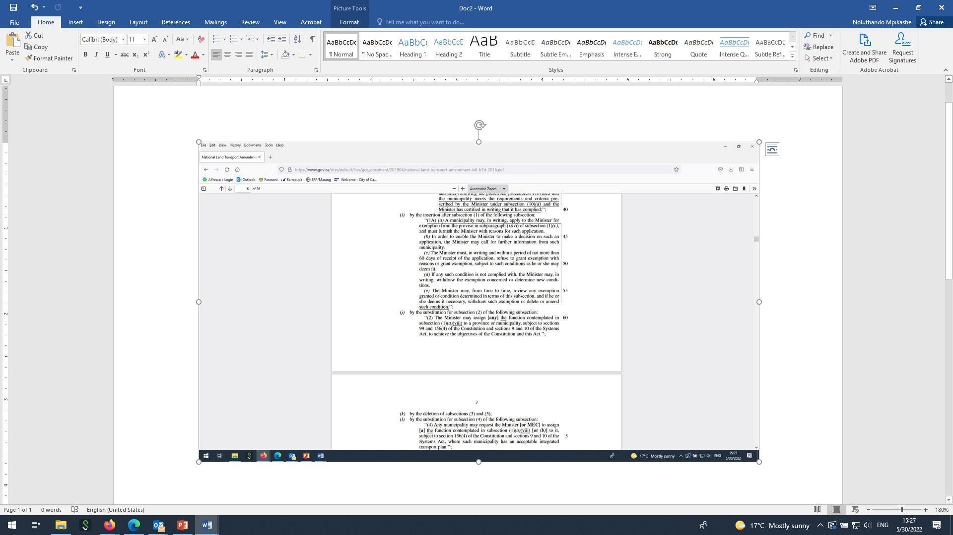

Slide 13
Cont…
On page 7 from line 1, to omit paragraphs (k) to (m).
Paragraph k- proposed deletion of section 11(3) and (5).
(3) Empowers the MEC to assign any function contemplated in subsection (1)(b) (a provincial function) to a municipality, subject to the Constitution and the Municipal Systems Act.
(5) Where a municipality is performing a function contemplated in subsection (1)(a) on the date of the commencement of this Act, such function is deemed to have been assigned to that municipality under subsection (2).
These two provisions will remain in the Act.

Slide 14
Cont…
Para (m) - (6) [Subject to section 21, where] Where a province is performing [a function contemplated in subsection (1)(a)] the function of acting as contracting authority for contracts concluded under the Transition Act on the date of commencement of this Act, it must continue performing that function, [unless that function is assigned to a municipality by the Minister] until those contracts have lapsed or expired or been cancelled, or replaced by other contracts or arrangements in terms of this Act.’’
This was a consequential amendment to the new proposed provisions in relation to municipalities meeting the set criteria, so the provision will remain as it is in the Act.

Slide 15
Cont…
On page 7, in line 16, to renumber paragraph (n) to be (g).
On page 7, from line 17, to omit “(a)”- this is because paragraph (b) will be deleted as stated in number 9 of the E-List.
On page 7, from line 28, to omit “: Provided that the municipality complies with the criteria and requirements prescribed by the Minister under subsection 10(d)”.
The proviso will be deleted consequential to the removal of the provisions relating to municipalities meeting the criteria set by the Minister (point 1 above).

Slide 16
Cont…
On page 7, from line 30, to omit paragraph (b) – the paragraph provides that the deleted proviso does not apply to municipalities that have been exempted – another amendment consequential to the removal of the provisions relating to municipalities meeting the criteria set by the Minister.
On page 7, from line 52, to omit “; and” and to substitute a full stop – editorial amendment since the next paragraph will be deleted.

Slide 17
Cont…
On page 7, from line 53, to omit paragraph (d) – paragraph (d) empowers the Minister to prescribe the requirements and criteria which municipalities must comply with in order to conclude the contracts stipulated in section 11(1)(c)(xxvi).
The provision in relation to the contracts and the municipalities is being removed from the Bill, thus the paragraph will be deleted.

Slide 18
THE END

