Slide 1
SOUTH WEST GAUTENG TVET COLLEGE
PRESENTATION ON STATE OF THE COLLEGE
TO
PORTFOLIO COMMITTEE ON HIGHER EDUCATION, SCIENCE & INNOVATION
PRESENTATION BY MJ MONYAMANE
25 MAY 2022

Slide 2
COLLEGE PROFILE
South West Gauteng College is a public Technical and Vocational Education and Training (formerly FET) College operating under the auspices of the Department of Higher Education and Training in terms of the Continuing Education and Training Act of 2006, as amended.
The college is one of the biggest TVET colleges in the country, based on enrolment numbers, with a head office and three of its six campuses, Molapo Campus, George Tabor Campus and Dobsonville situated in Soweto, whilst the three other campuses, Roodepoort and Roodepoort West and Technisa are situated in Roodepoort and Randburg.
On offer at the college are education and training programmes in Engineering, Business Studies and Utility Studies, covering most sectors of the economy.

Slide 3
COLLEGE VISION
TO BE THE BENCHMARK TVET COLLEGE IN THE DELIVERY OF QUALITY VOCATIONAL EDUCATION AND TRAINING

Slide 4
COLLEGE MISSION
TO INNOVATIVELY MOBILIZE ALL COLLEGE RESOURCES TO ENSURE EXCELLENCE IN OUR DELIVERY, EMPLOYABILITY AND EMBRACING OF ENTREPRENEURSHIP AMONG STUDENTS AND ISO CONSISTENCY IN OUR SERVICE.

Slide 5
VISION AND MISSION SIMPLIFIED
“College which inspires students, espouses Integrity, offers fulfilment to personnel, propels them to perform and achieve … and repels non- performers and character lapses”

Slide 6
VALUES
The College Council, Management and Personnel of South West Gauteng College COMMIT to the following values:
• The principles of Batho Pele with emphasis on client and uBuntu
• The principle of a better life for all
• The principle of upholding a culture of learning, teaching and service delivery • Professional conduct
• Good governance
• Mutual respect
• Environmental sustainability
• Non-racialism and non-sexism
• Redress • Honesty and Integrity
• Environmental Sustainability
• Inspiration and Development of Students (Wholly

Slide 7
South West Gauteng TVET College Governance Report 2022
Status of College Governance
Chapter 3 section 9(I) of Continuing Education and Training Act, No. 16 of 2006 provide that, every public college must establish a council, an academic board and a student representative council (SRC).
Section 10(1) of CET ACT 16 of 2006, make provisions for the council of a public college to perform all the functions, including the development of a college statute, which are necessary to govern the public college, subject to this Act and any applicable national or provincial law.
Section 12(1) to (4) of CET ACT 16 of 2006, further provides that the council may establish a committee to assist it in the performance of its functions and appoint a person who is not a member of the council as member of the committee.
:

Slide 8
South West Gauteng TVET College Council Composition
Surname & Initials | Portfolio
Mr. ZL. Dlamini | Chairperson: External
Ms. N. Lamula | Vice Chairperson
Ms. M. Liau | External Member
Ms. F. Mazibuko | External Member
Pro T. Moloi (Resigned in December 2020), and replace by Mr LA Vatsha | External Member
Adv. Khorommbi (Resigned in January 2022), to be replaced in June 2022. | External Member
Mr. A.G. Netshimbupfe | External Member
Mr. M.M. Magoele | External Member
Mr. L. Nengovhela | External Member
Mr. S. Manthata | External Member: Donor
MR.MJ.Monyamane | Internal Member:Acting Principal
Mr. M. Maisela (Resigned in May 2020) and replaced Mr M Moja | Secretary :Internal (Staff Rep)
Mr.R. Mosiane | Internal Member: Academic board
Mr. L. Tshoko | Internal Member: (Lecture Rep)
Mr S Mokoena | Internal Member:SRC President
Mr V Khumalo | Internal Member:SRC Secretary General

Slide 9
South West Gauteng TVET College Council Functions
The council performs functions In accordance with Sections 10(1) to 10(3) of the CET ACT 16 of 2006.
Subject to applicable policy determined by the Minister, council determines the student admission policy of the College.
The Council may, subject to applicable policy, and with the approval of the Director General and after consultation with the Academic Board refuse the readmission of a student who fails to satisfy the minimum requirements for readmission.
The Council must take the necessary steps within its available resources to ensure that the College is accessible to disabled students.
The Council approves tuition fees, accommodation fees and any other fees payable by students.
The Council approves the annual budget of the College.
Council is responsible for the appointment of college Lecturers and support staff in terms section 20(1) to (8) of the CET ACT 16 of 2006.

Slide 10
South West Gauteng TVET College Council Committees
In line with Section 12(1)(a)(b) of CET ACT 16 of 2006, the college has established the following committees;
Executive Committee of Council (Exco)
Audit and Risk Committee
Finance Committee
Planning and Resources Committee
ICT Governance committee
Employability committee
Human Resources and Remuneration Committee

Slide 11
Executive Committee of Council (Exco)
The Executive Committee of Council is assigned, but not limited to the following functions;
To oversee implementation of strategies and decisions taken by the Council.
To recommend planned (budgeted ) expenditure greater than R1 million, or within the limits as set by the DAF to Council, and further recommend the strategic, financial, risk management and internal control policies, procedures and systems for the approval of Council, as motivated by the Council subcommittees.
To oversee the preparation of the Annual report for approval by the Council
To review business plans and expenditure, and planned capital projects, and make recommendations to Council.
To receive reports from management on legal matters and litigation of material concern.
To recommend to Council any sale or disposal of moveable assets proposed by management, above the delegated authority of the Accounting Officer.
To recommend to Council the write-off of all bad debts or settlement or abandoning of legal actions to recover amounts due to the College.
To recommend to Council the write-off resulting from impairment of assets per the College’s financial policies.
Executive Committee of Council (Exco) South West Gauteng TVET College
Initials & Surname | Portfolio
Mr ZL Dlamini | Chairperson: External
Ms N Lamula | Vice Chairperson External
Mr MJ Monyamane | Acting Principal: Internal
Mr S Masiza | Interim Secretary: Internal
Mr A Schlemmer | PDC: Invitee
Mr J Makola | DPA: Invitee
Ms Z Qwesha | DPF: Invitee

Slide 12
Audit and Risk Committee
The Committee`s primary mandate is to provide oversight and to assist the College Council in matters relating to the effectiveness of internal controls.
The Audit and Risk Management Committee must, amongst other matters, review the following:
The effectiveness of the internal control systems.
The effectiveness of the internal audit function.
The effectiveness of the external audit function
The risk areas of the College’s operations, as identified by the risk management function, to be covered in the scope of internal and external audits.
The adequacy, reliability and accuracy of the financial information provided to management and other users of such information.
Any accounting and auditing concerns identified as a result of internal and external audits; and compliance with legal and regulatory provisions.
Review the Risk Committee policy.
Audit and Risk Committee of South West Gauteng TVET College
Initials & Surname | Portfolio
Ms M Liau | Chairperson: External
Mr M Magoele | External member
Ms LT Khorommbi (Resigned 31 January 2022) | External member
Mr MJ Monyamane | Acting Principal: Internal
Ms Z Qwesha | CFO: Internal member
Mr W Magagula | ASD: QMS: Internal member
Ms N Nkambule | Internal Auditor:

Slide 13
Finance Committee
Finance committee is assigned but not limited to the following functions;
To monitor the implementation of the DAF that has been prescribed by the DHET.
To take overall responsibility for the review of the appropriateness and applicability of financial policies and recommend suitable changes to Council.
To oversee and approve College budget submissions, deviations and quarterly revisions and ensure that the outputs to be delivered are specific and consistent with the desired outcomes.
To recommend to Council, and ensure that the necessary steps are taken to instigate any investigations into financial misconduct or maladministration.
To ensure that an appropriate management information system is established to provide timely and accurate financial information.
To review and recommend to Council any capital projects, prior to commitment, and to monitor and report on the progress thereon.
To consider disposal and impairment of assets as well as write-off of bad debts:
To review and recommend the annual financial statements to the Council.
Audit and Risk Committee of South West Gauteng TVET College
Initials & Surname | Portfolio
Ms M Liau | Chairperson: External
Mr M Magoele | External member
Ms LT Khorommbi (Resigned 31 January 2022) | External member
Mr MJ Monyamane | Acting Principal: Internal
Ms Z Qwesha | CFO: Internal member
Mr W Magagula | ASD: QMS: Internal member
Ms N Nkambule | Internal Auditor:

Slide 14
Planning and Resources Committee
Planning and Resources committee is assigned but not limited to the following functions;
To oversee and review the planning, organizing, monitoring and review of the College’s strategic plan.
Monitor the College’s organizational structuring within the objectives of the College’s strategic plan.
Monitor management’s allocation of the College’s resources in line with the objectives of its strategic plan.
Review the required resources per the Annual Performance Plans.
Recommend to Council the approval of the College’s strategic plan
Planning & Resources Committee of South West Gauteng TVET College
Initials & Surname | Portfolio
Ms N Lamula | Chairperson: External
Ms F Mazibuko | External member
Mr MJ Monyamane | Acting Principal: Internal member
Mr A Schlemmer | DPC: Internal member
Mr G Mathatho | Invitee
Mr L Taleni | Invitee

Slide 15
ICT Governance committee
The ICT Steering Committee is assigned the following functions;
Recommend for approval ICT strategies and plans that ensure the cost effective application and management of ICT systems and resources throughout the College usually codified as the ICT Strategic Plan.
Review current and future technologies to identify opportunities to increase the efficiency of ICT resources.
Inform and make recommendations to the College Principal and Council on significant ICT issues.
Consider new projects that emerge outside the ICT Strategies Planning Cycle and investigate the impact of their implementation on other projects, priorities, budgets etc.
Review and approve the detailed ICT project implementation plans and project management documents such as ICT risk management and information security.
Monitor compliance with the law and industry practices/ standards and report any departures from the compliance arrangements to the Principal.
Ensuring that systems are in place to support teaching and learning, data integrity, data protection and backup.
Planning & Resources Committee of South West Gauteng TVET College
Initials & Surname | Portfolio
Mr L Nengovhela | Chairperson: External
Mr S Manthata | External member
Mr A Schlemmer | DPC: Internal member
Mr B Sepato | ASD IT: Internal member
Mr MJ Monyamane | Invitee: Acting Principal
Mr L Sithebe | Invitee: IT Technician

Slide 16
Employability committee
The Employability Committee is assigned the following functions:
To take overall responsibility for the review of the appropriateness and applicability of Employability policies and recommend suitable changes to Council.
To promote and support initiatives aimed at connecting the students of the college to the economy.
To assist in the establishment of an appropriate management information system related to partnership programs for the prompt provision of accurate information.
To consider all funding matters relating to the College’s relationship with Government Departments, SETAS and any other public/private organization and make appropriate recommendations to Council, if necessary.
Employability Committee of South West Gauteng TVET College
Initials & Surname | Portfolio
Mr AG Netshimbupfe | Chairperson: External
Ms F Mazibuko | External member
Mr MJ Monyamane | Acting Principal: Internal member
Mr A Sebe | ASD NBDU: Internal member
Mr J Makola | Invitee: DPA
Ms P Makhaphela | Invitee: Marketing Manager

Slide 17
Human Resources and Remuneration Committee
Human Resources and Remuneration Committee assist Council to:
Oversee the processes operated by management to ensure that the College remunerates employees fairly, responsibly and in accordance with the Department’s directives, norms and the College’s policies.
Ensure that the disclosure of Council members’ remuneration is accurate, complete and transparent.
Oversee that human capital, transformation and related matters are attended to by management, in accordance with legislation, norms, standards and policies of the College.
Human Resources & Remunerations Committee of South West Gauteng TVET College
Initials & Surname | Portfolio
Ms F Mazibuko | Chairperson: External
Mr AG Netshimbupfe | External member
Mr L Nengovhela | External member
Mr A Schlemmer | DPC: Internal member
Mr L Tshoko | Internal member
Mr T Khuse | Internal member

Slide 18
Academic board of South West Gauteng TVET College
The Academic board of the college is established in terms of chapter 3 section 11(3) to (5) of CET ACT 16 of 2006 and perform its functions In accordance with Sections 11(1) to (2) of the Act.
The academic board of the college is consist of 51 members of which the majority of the board membership are lecturers. The board membership comprise of 16 African females, 32 African males, 2 male Coloureds and 1 is white male.
The academic board is accountable to the college council, for the academic functions of the college and the promotion of the participation of women and the disabled in the learning programmes.
It is responsible for establishment of internal academic monitoring and quality promotion mechanism.
Responsible for ensuring that the requirements of accreditation to provide learning against standards and qualifications registered on the National Qualifications Framework are met.
Subject to the approval of the council and to any applicable policy, the academic board must determine the learning programmes Contemplated in section 43 that will be offered at the public college

Slide 19
Student Representative Council of South West Gauteng TVET College
The Student Representative Council (SRC)of the College is fully constituted in terms of section 9(1) and 14 of the CET ACT 16 of 2006.
The Student Representative Council of the College consist of 11 members elected by Students of the college in line with the constitution of the SRC, of which seven(7) are African females and four(4) are African males as per the table below.
NAME | SURNAME | PORTFOLIO |  | GENDER | CAMPUS
SAMKELO | MOKOENA | PRESIDENT |  | MALE | GEORGE TABOR
NONHLANHLA | NKOSI | DEPUTY PRESIDENT |  | FEMALE | ROODEPOORT
VIVIAN | KHUMALO | SECRETARY |  | MALE | DOBSONVILLE
FAITH | MATABANE | DEPUTY SECRETARY GENERAL |  | MALE | TECHNISA
VHULENDA | MASINDI | TREASURER GENERAL |  | FEMALE | ROODEPOORT WEST
THABILE | SITOLE | SPORTS,ARTS & CULTURE |  | FEMALE | DOBSONVILLE
NHLANAHLA | BUTHELEZI | ACADEMICS |  | MALE | MOLAPO
LUCIA | MHAKA | GENDER & DISABILITY |  | FEMALE | ROODEPOORT
THANDEKA | MTHEMBU | HEALTH & SAFETY |  | FEMALE | TECHNISA
NOMVULA | MOLEANE | EMPLOYABILTY |  | FEMALE | MOLAPO
AVIWE | BEKWA | EVENTS & COMMUNCATIONS |  | FEMALE | ROODEPOORT WEST

Slide 20
Gender demographics in management, governance structures and student populace
Structure | Female | Male | Total
College Council | 4 | 9 | 13
Academic Board | 16 | 35 | 51
Students Representative Council | 7 | 4 | 11
Senior Management | 1 | 3 | 4
Middle Management | 6 | 15 | 21
Campus Managers | 4 | 2 | 6
Student Populace | 9 572 | 5 447 | 15 019

Slide 21
COLLEGE FINANCIAL STATUS
Bank Balances
Description | Bank Statement Balance at 30 April 2022 | Bank Statement Balance at 31 December 2021 | Bank Statement Balance at 31 December 2020
ABSA- Current Accounts | 398 528 364,06 | 254 609 695,10 | 203 167 122,51
ABSA - Investments | 405 907 572,33 | 401 986 157,35 | 290 544 368,32
Investec Investments | 59 788 019,52 | 58 977 320,37 | 56 831 137,89
Total | 864 223 955,91 | 715 573 172,82 | 550 542 628,72

Slide 22
Progress report on disbursement of the National Student Financial Aid Scheme (NSFAS) funding and allowances to students
Progress report on NSFAS 2022 as at 20 May 2022 for South West nGauteg College
No of students funded for 2022 | 6668
Registration Data Uploaded for Students 2022 | 5229
Number of students under Progress 2022 | 1439
 | Tuition | Accommodation | LivingAllowance | Transport | Grand Total
Registration Data Uploaded for 2022
Number of Students - Reg loaded 2022 | 5229 | 401 | 5229 | 4828 | 5229
Amounts - Reg loaded 2022 | R 43 348 900 | R 9 382 200 | R 11 695 810 | R 26 468 738 | R 90 895 648
Disbursement to | College | Paid via sBux
Number of students | 1610 | 279 | 4714 | 4435 | 11038
Amounts disbursed | R 5 176 607 | R 2 630 640 | R 3 616 880 | R 8 537 761 | R 19 961 888
Payments received by College for 2022
Upfront | R 26 958 085
Allowances (Resident Students) | R 1 491 600

Slide 23
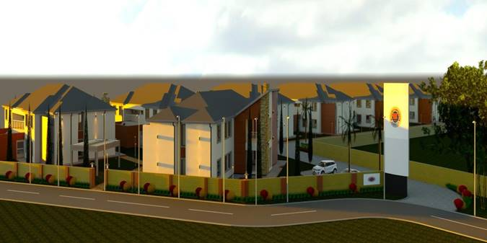
Overview of student housing and infrastructure projects
The college is currently accommodating ???? Primary Agricultural students at its training satellite campus in Hectpoort in Magaliesburg area.
We currently set aside funding to build modern students accommodation that will accommodate 600 students.
The accommodation will be all inclusive, which amongst other facilities it will include, canteen, laundry, study centre etc.

Slide 24
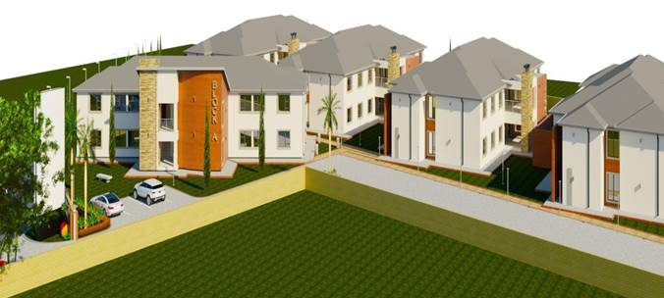
Overview of student housing and infrastructure projects
Continue;

Slide 25
Overview of the college’s partnerships with industries for work integrated learning (WIL) and related matters.
Student Placements
100 Students funded by MICTSETA
50 Students funded by EWSETA
26 Students funded by MQA
80 Students funded by Lethatsi Education
20 Students funded by Global Optima
7 Students funded by Clover – Only Hospitality
100 Students funded by WAL Training
25 Students funded by Harmanote Business Solution
25 Students funded by HWSETA through Strategy Life Ithala
234 Students funded by Food and Beverage SETA
30 Music Students funded by Cathsseta
160 Students funded by SASSETA, TETA and FP&M SETA

Slide 26
Overview of the college’s partnerships with industries for work integrated learning (WIL) and related matters.
Lecturer Industry Placement
Energy and Water SETA – 10 Lecturers from Roodepoort Campus are attended the placement at Resolution Circle for PLC.
35 Lecturers are funded by Transport Education and Training Authority to attended the Placement for various Intervention
2 Human Resources Management attended the placement at Clover funded by Foodbev SETA
10 Lecturers from Roodepoort West Campus attended the Mechatronics and they even went to Germany in March 2021 for experiencing the industrial robotics.

Slide 27
Overview of the college’s partnerships with industries for work integrated learning (WIL) and related matters.
SIGNED MOU/MOA PRIVATE SECTOR:
The college signed MOU/MOA with the following entities:
NooderpoortCollege = Exchange Programme (Netherlands)
BBW = Mechatronics Programme & Lecturer Development (Germany)
AMAZOM = Internet of things: United Kingdom
The Dr Richard Maponya Institute for Skills and Entrepreneurship Development = Placement of students and lecturers
Huawei Accredited the George Tabor Campus as the ICT Academy
Huawei, MICTSETA and Nepad to Fund the College to become the 5G Campus with the equipment to the value of R25 000 000.00
100 Students from Katlegong, Daveyton, Eldorado Park and Soweto are attending the online on CISCO IT Essential programme funded by ETDP SETA
EPWP and Agriseta for apprenticeship
University of Free State – Leadership Programme
University of Johannesburg
City of Johannesburg
Mogale City

Slide 28
Overview of the college’s partnerships with industries for work integrated learning (WIL) and related matters.
SIGNED MOU/MOA PRIVATE SECTOR: Continue;
Transport SETA – R1 500 000.00 for Lecturer Placement
NPC – for the placement of Students, Lecturers and Entrepreneurship
Lethatsi Education – For Both Students and Lecturers on the Placement and Learnerships
Procoding Consultants – IT Lecturer and Students Placements
Gauteng E-Gov and University of Johannesburg for SMME’s and ICT
SEIFSA – Apprenticeship Students
RTMC for Students Licencing
City of Johannesburg for lecturer and students placement
Thuthukisa for Agriculture students
Bodibeng Academy TETA Collaboration
JFa2 Technical Training Institution

Slide 29
Overview of the college’s partnerships with industries for work integrated learning (WIL) and related matters.
ACCREDITATION BY SETAs:
-South West Gauteng Tvet College is accredited by 18 SETA and some of the following SETA’s role is as below:
MICTSETA – Accredited George Tabor Campus as the IT Centre of Specialisation and also TVET Office Establishment.
Mining Qualification Authority – Funding the College staff members with a bursary of R4 800 000.00 and also the Lecturer Placement for R700 000.00
Food and Beverage SETA – The College is received R33 000 000.00 for apprenticeship
Energy and Water SETA – The Memorandum of Understanding to Collaborate with the Special Projects.

Slide 30
Overview of the college’s partnerships with industries for work integrated learning (WIL) and related matters.
National Skills Fund
For 2020 – 2024 the College is allocated an amount of R27 975 362,25 for 370 Beneficiaries as below:
15 Electricians Trade
Welding Workshop Refurbishment to Qualify for Trade Test
10 WIL For Lecturer
05 Lecturers to attend PLC Training
295 Students on Various Learnerships
15 WIL for Business Studies Students
30 WIL for Engineering Studies Students

Slide 31
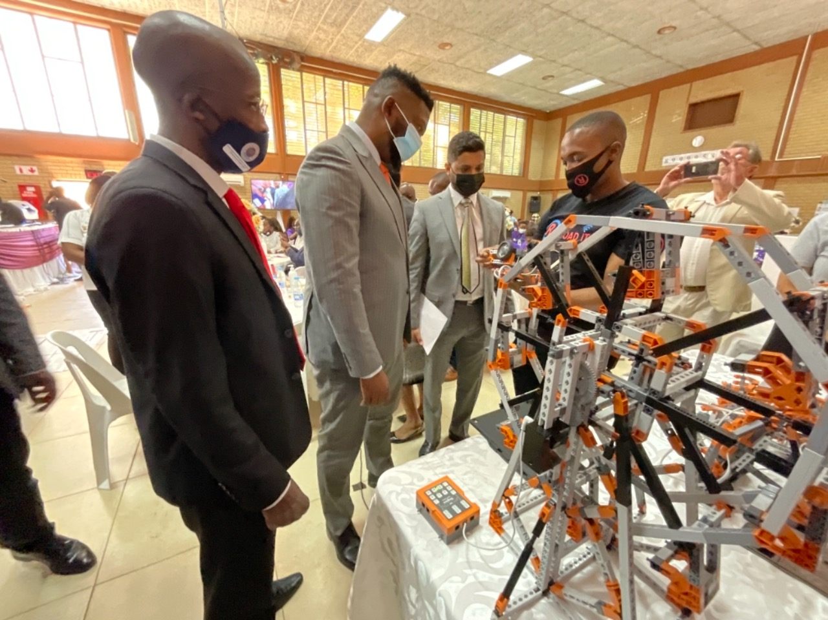
Overview of the college’s partnerships with industries for work integrated learning (WIL) and related matters.
SWGC-CHIETA PARTENERSHIP: ROBOTICS
IN ATTENDED BY Hon. Deputy Minister Buti Manamela

Slide 32
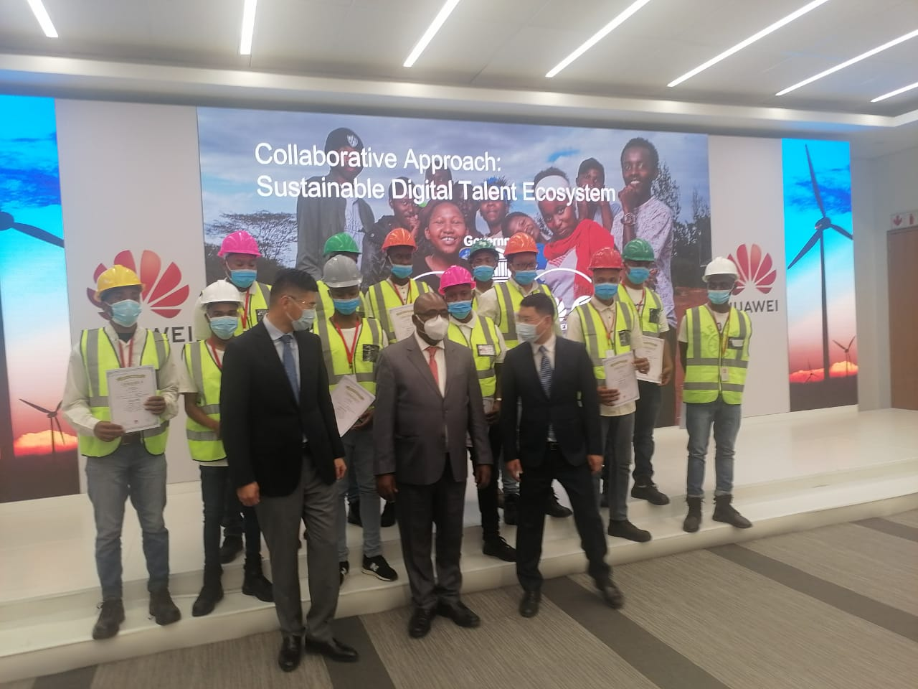
Overview of the college’s partnerships with industries for work integrated learning (WIL) and related matters.
SWGC-HUAWEI PARTENERSHIP
Attended by Hon. Minister of Employment and Labour Thulas Nxesi

Slide 33
Student success, drop-out and throughput rates, causes and measures put in place to address them.
The college academic performance for the academic year under review 2021:
1. Pass rate for Report 191 Business and Utility Studies = 76.59%
2. Certification rate Report 191 Business and Utility Studies = 40,84
3. Retention rate for Report 191 Business and Utility Studies = 86,86%
4. Pass rate for Report 190 Engineering Studies = 53.65%
5. Certification rate Report 190 Engineering Studies = 32,93%
6. Retention rate for Report 190 Engineering Studies = 90.14%
7. Pass rate for National Certificate Vocational Studies = 72.36%
8. Certification rate for National Certificate Vocational Studies = 40.05%
9. Retention rate for National Certificate Vocational Studies = 79.19%
10. Throughput rate for NATED programmes = 13%
11. Throughput for National Certificate Vocational = 11%

Slide 34
Student success, drop-out and throughput rates, causes and measures put in place to address them.
Cuases for student`s drop-out.
The following are some of the reasons but not limited for the students drop-out:
Employment
Arrest
Pregnancy
Substance abuse
Late payment of students allowance by NSFAS
Students not meeting sub-minimum
Wrong career choice
Psycho-socio economic issues
Impact of COVID-19
Mortality

Slide 35
Student success, drop-out and throughput rates, causes and measures put in place to address them.
Remedial action/interventions through students support services
The college has employed 2 counsellors to deal with students psycho-socio economic matters.
Every campus has a Students Support Officer that monitor students attendance.
All campuses has remedial lecturers
Students who failed to meet sub-minimum to qualify for exam are given a second chance to write assessment test that will make them to qualify.
Career advise is offered to all prospective students before the register for their proffered qualifications.
Remedial support is given to those students who are in need for such intervention.
All campuses are equipped with 24 hour Free WI-FI with 200mbps speed.
The college procured a software system called Academic Support Technology to assist students with skills in numeracy and literacy.
The campuses `s library are uploaded with laptops and e-books which allows the students to access e-books anywhere at anytime.
All lecturers of the college are provided with laptops and data for the provision of blended learning.

Slide 36
Progress in the implementation of the Commission for Gender Equality (CGE) recommendations of the Report on Gender Transformation Investigations in TVET colleges.
The college management continued with its gender equality and people with disability transformation:
In campus management of the college 6 sites/campuses 4 are female and 2 males.
In College Students Representative Council structure 7 are female and 4 are males.
The college enrolled 24 blind students at its 2 campuses, 9 female and 15 males.
All these students are provided with laptops loaded with relevant software such as JAWS, voice recorder and magnifier for partially blind students
The college provide Scriber for blind students and other students with various disability who require the assistance of scribers during assessment.
Both the campuses has functional disability unit to that provide service to students living with disability.
The college received R4.2million for SNE infrastructure upgrade from DHET

Slide 37
Progress in the implementation of the Commission for Gender Equality (CGE) recommendations of the Report on Gender Transformation Investigations in TVET colleges.
To date the college have enrolled 9 572 female students and 1002 of them registered for Engineering studies and 5 447 male students amount to 15 019 students with 1 semester and 1 Trimester left to complete the enrolment for the 2022 academic year.
In terms of Sexual Harassment: Two male staff members where charged with sexual harassment misconduct. One case has been concluded and the outcome is dismissal, however, the staff member concern lodged appeal. The second case is at final phase.
Gender Base Violence campaign: The college through SRC held march in support to victims of GBV and pledging to work with SAPS and the community in all matters relating to GBV. A Memorandum was handed over to Moroka police station in Soweto

Slide 38
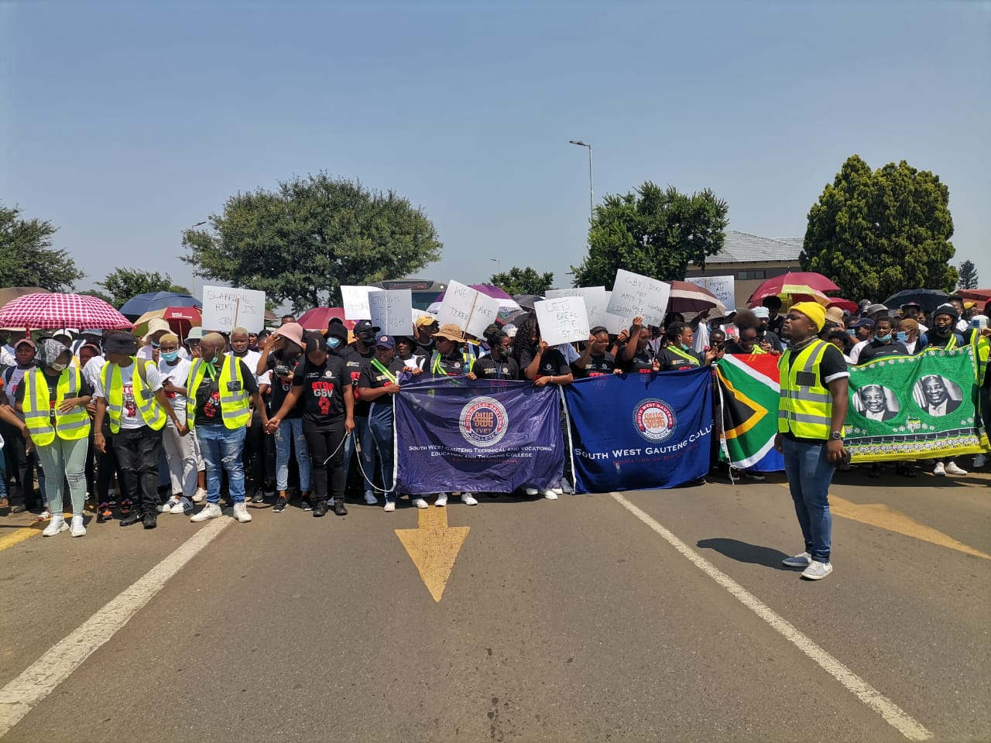
Progress in the implementation of the Commission for Gender Equality (CGE) recommendations of the Report on Gender Transformation Investigations in TVET colleges.
SRC/STUDENTS GBV MARCH TO MOROKA POLICE STATION

Slide 39
Progress in the implementation of the Commission for Gender Equality (CGE) recommendations of the Report on Gender Transformation Investigations in TVET colleges.
Administration Staff

Slide 40
Progress in the implementation of the Commission for Gender Equality (CGE) recommendations of the Report on Gender Transformation Investigations in TVET colleges.
Lecturing Staff

Slide 41
Curriculum Delivery
Report 191 General Studies N4-N6: Combined Semester 1, & 2 Campus Performance): on 24 January 2022)
Campus | No. of Heads Enrolled | No. of Heads Written | No. of Heads Passed | % Pass on Enrolled | % Pass on Written | Average % Passed | Retention Per Head | No. of Heads Certified | % Certified Enrolled | % Certified written | % Certified Ave | No. Heads Passed 5/4 Subjects | No. of Heads Passed 3 Sub | Distinctions
Dobsonville | 1642 | 1397 | 1010 | 61.51 | 72.30 | 66.91 | 85.08 | 673 | 40.99 | 48.17 | 44.58 | 673 | 337 | 281
George Tabor | 279 | 234 | 224 | 80.29 | 95.73 | 88.01 | 83.87 | 158 | 56.63 | 67.52 | 62.08 | 158 | 66 | 53
Roodepoort | 2633 | 2176 | 1571 | 59.67 | 72.20 | 65.94 | 82.64 | 1015 | 38.55 | 46.65 | 42.60 | 1015 | 556 | 385
Total | 4554 | 3807 | 2805 | 61.59 | 73.68 | 67.64 | 83.60 | 1846 | 40.54 | 48.49 | 44.52 | 1846 | 959 | 719

Slide 42
NC (V) Nov 2021 (Overall Campus Performance: L2, L3 and L4: on 25 January 2022
Campus | No. of Heads Enrolled | No. of Heads Written | No. of Heads Passed | % Pass on Enrolled | % Pass on Written | % Passed Average | Retention Per Head | No. of Heads Certified | % Certified Enrolled | % Certified written | %Certified Average | No. Pass 7 Sub | No. Pass 6 Sub | No. Pass 5 Sub | Distinctions
Dobsonville | 900 | 658 | 450 | 59.89 | 80.94 | 70.42 | 61.78 | 216 | 23.78 | 38.85 | 31.35 | 216 | 145 | 89 | 282
George Tabor | 1993 | 1535 | 1105 | 55.44 | 71.99 | 63.72 | 77.02 | 611 | 30.66 | 39.81 | 35.24 | 611 | 300 | 194 | 559
Molapo | 569 | 446 | 262 | 46.05 | 58.74 | 52.40 | 78.38 | 85 | 14.94 | 19.06 | 17.00 | 85 | 81 | 96 | 160
Roodepoort | 930 | 792 | 620 | 66.67 | 78.28 | 72.48 | 85.16 | 384 | 41.29 | 48.49 | 44.89 | 384 | 137 | 99 | 414
Roodepoort West | 203 | 163 | 97 | 47.78 | 59.88 | 53.83 | 79.80 | 49 | 24.14 | 30.25 | 27.20 | 49 | 28 | 20 | 56
Technisa | 494 | 436 | 382 | 77.33 | 87.62 | 82.48 | 88.26 | 269 | 54.45 | 61.69 | 58.07 | 269 | 70 | 43 | 382
Total | 5089 | 4030 | 2916 | 57.30 | 72.36 | 64.83 | 79.19 | 1614 | 31.72 | 40.05 | 35.88 | 1614 | 761 | 541 | 1853

Slide 43
Report 191 Natural Science Studies N1-N6: Combined Trimester 1; & 2 Level Performance): on 25 January 2022
Level | No. of Heads Enrolled | No. of Heads Written | No. of Heads Passed | % Passed on Enrolled | % Passed on Written | Average % Passed | Retention Per Head | No. of Heads Certified | % Certified on Enrolled | % Certified on Written | % Average Certified | No. of Heads Passed 4 Subjects | No. of Heads Passed 3 Subjects | Distinctions
N1 | 511 | 472 | 387 | 75.73 | 81.99 | 78.86 | 92.37 | 275 | 53.81 | 58.26 | 56.04 | 275 | 112 | 294
N2 | 410 | 368 | 184 | 44.88 | 50.00 | 47.44 | 89.76 | 93 | 22.68 | 25.27 | 23.98 | 93 | 91 | 67
N3 | 430 | 400 | 190 | 44.19 | 47.50 | 45.85 | 93.02 | 119 | 27.67 | 29.75 | 28.71 | 119 | 71 | 74
N4 | 353 | 303 | 125 | 35.41 | 41.25 | 38.33 | 85.84 | 68 | 19.26 | 22.44 | 20.85 | 68 | 57 | 21
N5 | 242 | 210 | 80 | 33.06 | 38.10 | 35.58 | 86.78 | 45 | 18.60 | 21.43 | 20.02 | 45 | 35 | 23
N6 | 153 | 139 | 49 | 32.03 | 35.25 | 33.64 | 90.84 | 23 | 15.03 | 16.55 | 15.79 | 23 | 26 | 11
Total | 2099 | 1892 | 1015 | 48.36 | 53.65 | 51.01 | 90.14 | 623 | 29.68 | 32.93 | 31.31 | 623 | 392 | 490

Slide 44
HOD Programme Performance Ranking
Rank | Surname & Initial of Lecturers | Campus | Programme | Number of Heads Enrolled | Number of Heads Written | % on Retention on Heads | Number of Heads certified | % Certified on Enrolled | % Certified on Written | Average Performance Passed | Distinction (s)
1 | Gonyela BP | Technisa | NC(V) | 494 | 436 | 88.26 | 269 | 54.45 | 61.69 | 58.07 | 382
2 | Snyman NGS | Roodepoort | NC(V) | 930 | 792 | 85.16 | 384 | 41.29 | 48.49 | 44.89 | 414
3 | Mabunda A | Dobsonville | Report 191 | 1642 | 1397 | 85.08 | 673 | 40.99 | 48.17 | 44.58 | 281
4 | Ncanyana J | George Tabor | Report 191 & NC(V) | 1427 | 1146 | 80.31 | 562 | 39.38 | 49.04 | 44.21 | 357
5 | Nevondwe NT | Roodepoort | Report 191 | 2633 | 2176 | 82.64 | 1015 | 38.55 | 46.65 | 42.60 | 385
6 | Selemi W | Molapo | Report 191 | 1016 | 898 | 88.39 | 331 | 32.58 | 36.86 | 34.72 | 270
7 | Bambo MM | Dobsonville | NC(V) | 900 | 658 | 61.78 | 216 | 23.78 | 38.85 | 31.35 | 282
8 | Mokoena TL | George Tabor | NC(V) | 845 | 623 | 73.73 | 207 | 24.50 | 33.23 | 28.87 | 237
9 | Zondi S | Roodepoort West | Report 191 | 1083 | 994 | 91.78 | 292 | 26.96 | 29.38 | 28.17 | 220
10 | Jara N | Roodepoort West | NC(V) | 203 | 163 | 79.80 | 49 | 24.14 | 30.25 | 27.20 | 56
11 | Motloung J | Molapo | NC(V) | 569 | 446 | 78.38 | 85 | 14.94 | 19.06 | 17.00 | 160

Slide 45
END OF PRESENTATION
THANK YOU!!!

