Slide 1
PRESENTATION TO PORTFOLIO COMMITTEE ON SMALL BUSINESS DEVELOPMENT 25 MAY 2022

Slide 2
OCPO STRATEGIC OBJECTIVES
O-CPO Strategic Objectives
Improve the performance and efficiency, of the state procurement system
Develop and implement a procurement regulatory environment that is responsive to the policy goals and objectives of government
Improve compliance with the procurement legislative environment
Leverage government spending to contribute to sustainable economic, social, and environmental development
Modernise state procurement by leveraging information technology
Leverage the benefits of strategic sourcing
Achieve savings on government spending
Improve supplier and stakeholder relations
Improve the performance of state procurement in respect of achieving ‘value for money’ and service delivery
Improve governance and increase the accountability and transparency of the state to stakeholders, particularly civil society
Improve the capability and performance of procurement officials

Slide 3
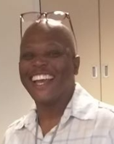
OCPO STRUCTURE
The OCPO is set up as a distinctive Division within the National Treasury headed by the Chief Procurement Officer (CPO). The functional structure is organised into six units, each headed by a Chief Director.
Chief Procurement Officer
(Molefe Isaac Fani Acting)
Divisional Support
SCM Stakeholder & Client Management
(Rakgadi Motseto)
SCM Policy, Norms & Standards
(Mpho Nxumalo -Acting)
SCM Governance, Monitoring & Compliance
(Basani Duiker)
SCM Information & Comms Technology (ICT)
(Tumelo Ntlaba)
Strategic Procurement
(Estelle Setan)
Transversal Contracting
(Mothushi Moifo
Acting)
To ensure and create appropriate platforms to disseminate the work of the OCPO to different types of stakeholders. ort
To manage the development and implementation of state SCM norms and standards for National, Provincial and Local government so as to influence the state SCM transformation agenda
To manage the design, development and implementation of the SCM governance framework, monitoring evaluation and compliance thereto and the management of non-compliance in all three spheres of Government.
To modernise the state supply chain management system.
To manage the development and provision of strategic procurement services to improve performance and efficiency of the state procurement system in all three spheres of government.
To ensure value for money and quantification of economic and other benefits by managing the contracting of state transversal commodities.

Slide 4
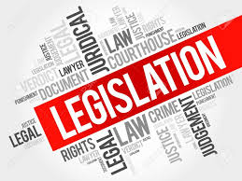
SCM LEGISLATIVE FRAMEWORK
The constitution of the Republic of SA, 1996.
Section 217. (1) When an organ of state in the national, provincial or local sphere of government, or any other institution identified in national legislation, contracts for goods or services, it must do so in accordance with a system which is fair, equitable, transparent, competitive and cost-effective.
Public Finance Management Act (PFMA and it’s regulations)
Municipal Finance Management Act (MFMA and it’s regulations)
Municipal Systems Act
Preferential Procurement Policy Framework Act (PPPFA and it’s regulations)
Broad - Based Black Economic Empowerment Act 53 of 2003 (B-BBEE)
Construction Industry Development Board Act No. 38 of 2000 (CIDB)
Promotion of access to information Act (PAIA) 2 of 2000
Promotion of Administrative Justice Act (PAJA) 3 0f 2000
The Prevention and Combating of Corrupt Activities Act No. 12 of 2004.
National Treasury Practice and Instruction notes and Circulars.
SCM: A guide to Accounting Officers (Not an Act – Not a regulation)
Departmental /Institutional SCM Policy

Slide 5
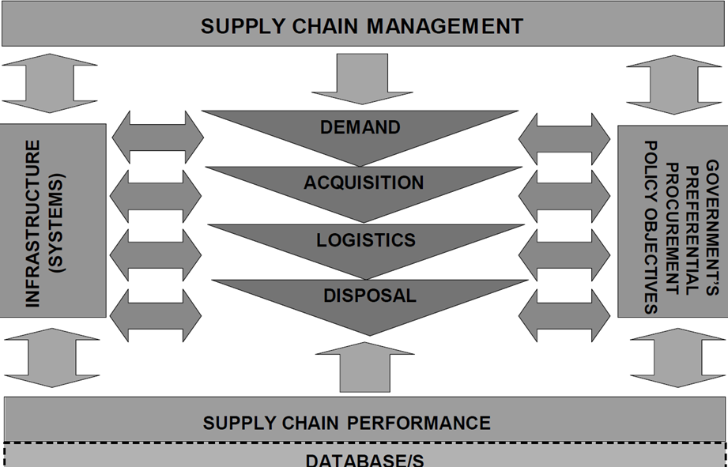
OVERVIEW OF SUPPLY CHAIN MANAGEMENT Source: SCM: A guide to Accounting Officers February 2014

Slide 6
Demand Management (BSC) Challenges
Officials who are involved in BSC should be trained in order to be able to specify requirements that meet the Constitution’s requirements of fairness and transparency.
Specifications that do not meet legislative requirements and other guidelines set by N/T could lead to Non-compliance and costly litigation.
Leading to
cancellation of bids
Contract modifications
Deviations
Irregular Expenditure
The biggest drivers of increase in contract modifications as well as deviations.

Slide 7
Acquisition (BEC) Challenges
Bid Committees not properly constituted and not understanding their roles.
Inexperienced committee members or not familiar with SCM regulatory framework.
Conflict of interest.
Changing the evaluation criteria advertised during the evaluation.
Separating physical inspection and presentation from functionality evaluation.
Incorrect calculations.
Leading to
cancellation of bids
Contract modifications
Deviations
Irregular Expenditure
The biggest drivers of increase in contract modifications as well as deviations.

Slide 8
Acquisition (BAC) Challenges
Bid Adjudication
BAC not properly constituted.
BEC members also BAC members creating conflict
BAC Not understanding their roles.
Conflict of interest.
Endorsing unfair disqualifications.
Endorsing incorrect calculations.
Changing the BEC scoring.
Allocating scores to the bidders
Leading to
cancellation of bids
Contract modifications
Deviations
Irregular Expenditure
The biggest drivers of increase in contract modifications as well as deviations.

Slide 9
Common Reasons for Deviations and Expansions
Sole Supplier and/or Single Source – e.g. OEM
Closed bid process (Limited market)
Business continuity
Business Strategy/operations (Recently found with SOCs with their turn-around strategies)
Service Delivery Urgency
Extensions on current contracts due to new tender processes not concluded in time
Failed tender processes; Restart tender processes
Value-for-money
Extension of Accommodation Leases
Continue using existing software
Exceeding the 15%/R15m or 20%/R20m threshold for expansions (especially SOCs with large projects)
Government-to-Government Procurement (GTAC, CSIR, etc)
Expansion of scope (time & material)

Slide 10
Trends and observations
Increased departure from the competitive bidding process.
Continuous modification of contracts that keep same service providers
Increasing audit disputes
Increasing compliance reviews related to Personal Protective Equipment (PPE) from the Fusion Centre
Poor procurement planning
Poor implementation of projects leading to either contract expansion or single source deviations
Poor governance structures
Non implementation of consequence management on officials who cause irregular expenditure
Poor service delivery
Less participation by small businesses (and other designated groups such as women, people with disabilities etc.)

Slide 11
OCPO KEY ISSUES
Public Procurement Bill
Anticipated to be tabled at Cabinet in November 2021 and Parliament in December 2021.
Strengthening capacity of OCPO
Enable the OCPO to be capacitated to deal with the new requirements of the Public Procurement Bill
Procurement Transparency
To proactively have procurement governance oversight
Effective analysis of procurement data and achievement of policy objectives
Curb corruption
SCM Automation and Modernisation
Government wide procurement automation (IFMS)
ITC enablement (4IR in public procurement)
General mis-understanding and abuse of public procurement processes
Fuels fraud and corruption
Increased discontent from public

Slide 12
Operational Challenges and remedies
Challenges | Remedies
Manual process of requests/applications, resulting in inadequate monitoring | Project to automate submission, processing, monitoring and reporting of procurement processes.
Insufficient capacity that results in delays in processing requests and responding to organs of state | Engagements with specific institutions Conducting site visits on that necessitates physical observations
Inadequate, incorrect, intentional or negligent supply of information in the applications to the OCPO | Developing a Deviations framework to set the standards for deviations and contract modifications Workshops are conducted to educate organs of state on procurement processes
Inability to design and implement proactive measures to minimise abuse of SCM system and non-compliance | Automated system and additional capacity to the Division that can design and implement a Governance framework to proactively improve adequacy, efficiency and effectiveness of SCM units in government.
Increasing investigations due to inappropriate use and implementation of emergency procurement procedures | Compliance reviews are being conducted on emergency deviations and affidavits provided to law enforcement agencies (HAWKS, SIU, PP etc.) for procurement investigations

Slide 13
Thank You

