Slide 1
FOCUS ON GENDER-BASED VIOLENCE
Briefing to the Portfolio Committee on Police
25 May 2022

Slide 2
PURPOSE OF THE PRESENTATION
The purpose of this presentation is to brief the Portfolio Committee on Police on the implementation of Domestic Violence for the period, 01 March 2021 to 30 September 2021

Slide 3
Presentation overview
SAPS Mandate in terms of the Section 18(5) of the Domestic Violence Act, 1998
Domestic Violence Bi-Annual Report for the period: 01 April 2021 to 30 September 2021.
Stations Monitoring
Implementation of GBV Desks
GBV Budget, 2022/23

Slide 4
1. SAPS Mandate i.t.o. Domestic Violence Act

Slide 5
SAPS Mandate
In terms of Section 18(5) of the Domestic Violence Act, the National Commissioner of the SAPS must, every six months, submit a report to Parliament regarding:
Number and particulars of complaints received against its members, in respect of any failure contemplated in Subsection (4)(a);
Disciplinary proceedings instituted as a result thereof and the decisions emanating from such proceedings; and
Steps taken as a result of recommendations made by the Civilian Secretariat for Police Service (CSPS).
In addition to the legislated reporting requirements, the PCOP requested additional reporting on:
Members as victims and perpetrators, firearms seized in the process and the number of police stations where members are deployed.
Broader management of the Domestic Violence Programme.

Slide 6
2. Bi-Annual Report in terms of Section 18(5)(d) of Domestic Violence Act, 1998(Act No. 116 of 1998) For the period: 01 April 2021 to 30 September 2021

Slide 7
FINALISATION OF COMPLAINTS FROM PREVIOUS PERIOD: 1 OCTOBER 2020 - 31 MARCH 2021
Provinces | Brief description of alleged non- compliance | Outcomes | Total
Gauteng | Failed to complete SAPS 508(a) and SAPS 508(b) | 1 verbal warning | 1
KwaZulu-Natal | Failed to complete SAPS 508(a) and SAPS 508(b) | 1 corrective counselling | 3
 | Failed to assist a complainant to open a case | 2 matter still in progress
Western Cape | Failed to complete SAPS 508(a) and SAPS 508(b) | 4 matter still in progress | 4
Total |  |  | 8

Slide 8
NUMBER AND NATURE OF COMPLAINTS
Nature of Complaints | Number of complaints
Failure to complete SAPS 508(a) and 508(b) | 35
Failure to record DV incidents in the Occurrence Book/Pocket Book | 3
Failure to file Protection Order | 2
Failure to arrest the perpetrator | 0
Failure to open a case | 15
Failure to serve a Protection Order | 0
Failure to submit pocket book entry and endorse case number | 1
Failure to confiscate a firearm of a perpetrator | 0
Failure to do 1st level of inspection | 1
Failure to render a satisfactory service to the victim | 2
TOTAL | 59

Slide 9
NUMBER OF COMPLAINTS PER PROVINCE
Number of complaints per province for the period 1 April 2021 – 30 September 2021
Provinces | Apr’21 | May’21 | June’21 | July’21 | Aug’21 | Sept’21 | Total
Eastern Cape | 0 | 0 | 0 | 0 | 0 | 0 | 0
Free State | 2 | 0 | 6 | 2 | 2 | 1 | 13
Gauteng | 0 | 0 | 0 | 0 | 0 | 3 | 3
KwaZulu-Natal | 0 | 0 | 0 | 0 | 0 | 0 | 0
Limpopo | 0 | 0 | 0 | 0 | 0 | 0 | 0
Mpumalanga | 0 | 0 | 0 | 0 | 0 | 0 | 0
Northern Cape | 0 | 0 | 0 | 0 | 0 | 0 | 0
North West | 0 | 0 | 0 | 0 | 0 | 0 | 0
Western Cape | 1 | 17 | 0 | 0 | 4 | 21 | 43
Total | 3 | 17 | 6 | 2 | 6 | 25 | 59

Slide 10
DEPARTMENTAL ACTIONS AGAINST MEMBERS PER PROVINCE
CATEGORIES | EC | FS | GP | KZN | LP | MP | NC | NW | WC | TOTAL
DS1: Remedial Steps (after initial interview – Not serious) | 0 | 1 | 0 | 0 | 0 | 0 | 0 | 0 | 28 | 29
DS2: Verbal Warning (after initial interview)- Not serious | 0 | 7 | 0 | 0 | 0 | 0 | 0 | 0 | 7 | 14
DS3: Written Warning (Not serious) | 0 | 2 | 1 | 0 | 0 | 0 | 0 | 0 | 2 | 5
DS3A: Final Written Warning | 0 | 0 | 0 | 0 | 0 | 0 | 0 | 0 | 0 | 0
DS4A: Departmental Investigation (Serious) Under Investigation | 0 | 3 | 2 | 0 | 0 | 0 | 0 | 0 | 6 | 11
DS4B: Departmental Investigation Serious) Under investigation: Guilty (state sentence) | 0 | 0 | 0 | 0 | 0 | 0 | 0 | 0 | 0 | 0
DS4C: Departmental investigation (serious): not guilty | 0 | 0 | 0 | 0 | 0 | 0 | 0 | 0 | 0 | 0
Application for exemption granted: Failure to complete SAPS 508(a) and 508(b) | 0 | 0 | 0 | 0 | 0 | 0 | 0 | 0 | 0 | 0
Total number of disciplinary proceedings | 0 | 13 | 3 | 0 | 0 | 0 | 0 | 0 | 43 | 59

Slide 11
SAPS MEMBERS AS ALLEGED DV PERPETRATORS
Province | Number of members who are identified as alleged DV perpetrators (SAPS 508c) | Number of police stations at which members are identified as alleged DV perpetrators (SAPS 508c)
Eastern Cape | 1 | 1
Free State | 26 | 19
Gauteng | 26 | 17
KwaZulu-Natal | 6 | 6
Limpopo | 2 | 2
Mpumalanga | 4 | 3
Northern Cape | 3 | 3
North West | 3 | 3
Western Cape | 76 | 41
Total | 147 | 95

Slide 12
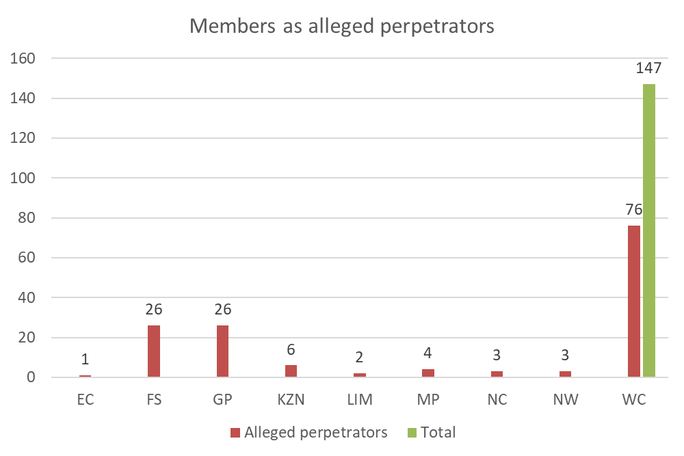
TOTAL NUMBER OF MEMBERS IDENTIFIED AS ALLEGED PERPETRATORS OF DOMESTIC VIOLENCE, PER PROVINCE: SAPS 508(C)

Slide 13
SAPS MEMBERS AS VICTIMS
Province | Number of SAPS members identified as victims of DV (SAPS 508d) | Number of police stations at which SAPS members are identified as victims of DV (SAPS 508d)
Eastern Cape | 1 | 1
Free State | 19 | 15
Gauteng | 9 | 7
KwaZulu-Natal | 5 | 5
Limpopo | 0 | 0
Mpumalanga | 2 | 2
Northern Cape | 1 | 1
North West | 2 | 1
Western Cape | 34 | 18
Total | 73 | 50

Slide 14
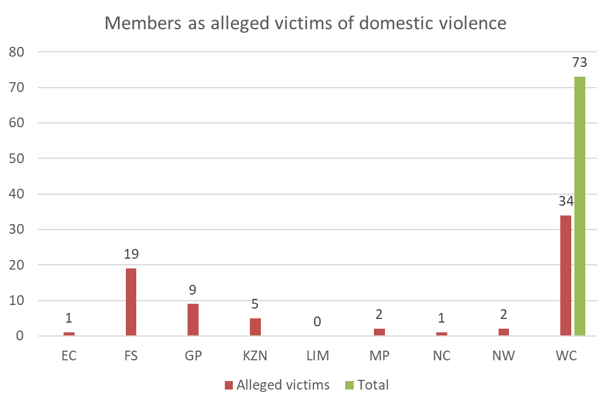
TOTAL NUMBER OF MEMBERS IDENTIFIED AS ALLEGED VICTIMS OF DOMESTIC VIOLENCE, PER PROVINCE: SAPS 508(D)

Slide 15
SEIZURE OF FIREARMS
Provinces | Number of firearms seized from SAPS members | Number of firearms not seized from SAPS Members | Number of members not issued with official firearms | Number of private firearms seized from SAPS members | Total
Eastern Cape | 1 | 0 | 0 | 0 | 1
Free State | 16 | 0 | 10 | 0 | 26
Gauteng | 17 | 0 | 9 | 2 | 28
KwaZulu-Natal | 6 | 0 | 0 | 0 | 6
Limpopo | 2 | 0 | 0 | 0 | 2
Mpumalanga | 4 | 0 | 0 | 0 | 4
Northern Cape | 2 | 0 | 1 | 0 | 3
North West | 1 | 0 | 2 | 0 | 3
Western Cape | 26 | 0 | 50 | 0 | 76
Total | 75 | 0 | 72 | 2 | 149

Slide 16
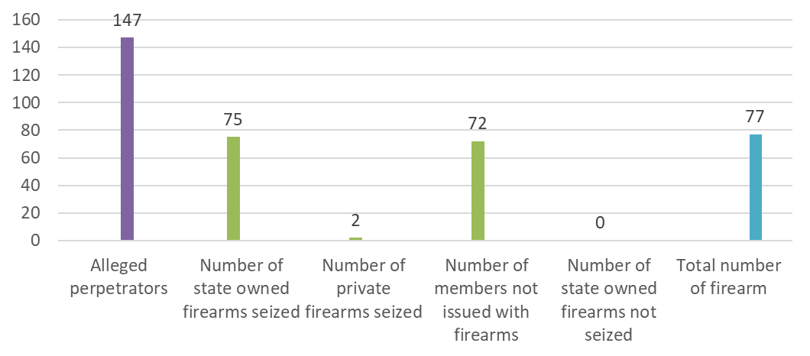
TOTAL NUMBER OF MEMBERS IDENTIFIED AS ALLEGED PERPETRATORS AND STATE OWNED FIREARMS WITHDRAWN FROM MEMBERS

Slide 17
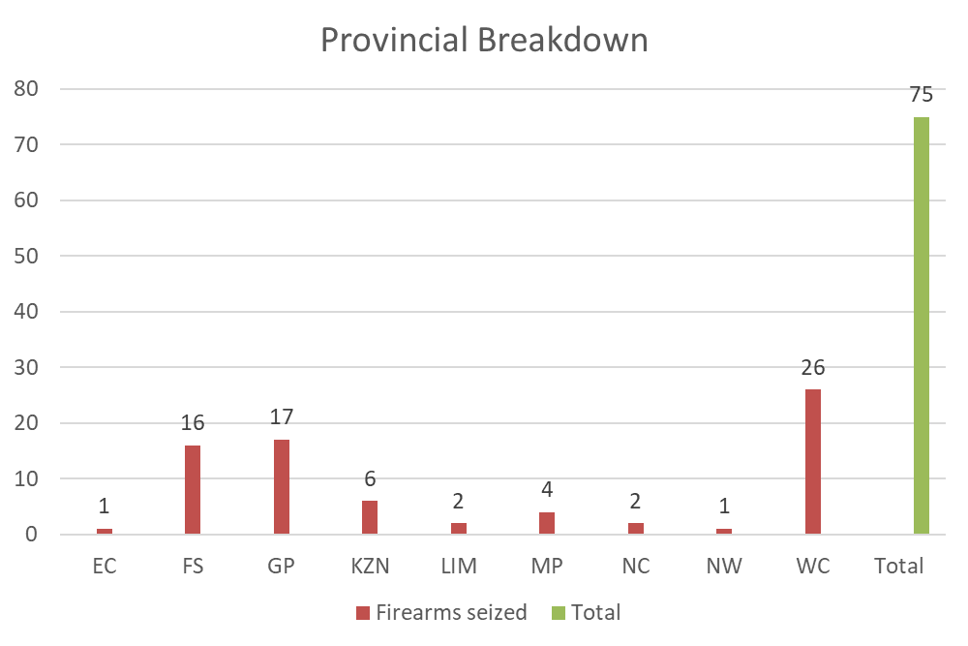
TOTAL NUMBER OF STATE FIREARMS SEIZED FROM THE MEMBERS

Slide 18
MONITORING AND EVALUATION
Capacity building sessions are held with members across the country on regular basis in order to ensure compliance with Domestic Violence National Instruction, 7 of 1999.
Station compliance visits are conducted on continuous basis to ensure compliance with prescripts.
Non-compliance behaviours are rectified immediately at the station level
Members are encouraged during station lectures and on/off duty parades to ensure compliance.
Participation in the Joint Compliance Forum with Provincial and National Civilian Secretariat for Police Service (CSPS)

Slide 19
TRAINING AND CAPACITY BUILDING
Basic training contains a module on domestic violence and all new intakes are beneficiaries of skills development.
The following learning programmes are conducted through in-service training:
Domestic Violence Learning Programme
Domestic Violence Train the Trainer Course
National Victim Empowerment Training
The following courses are also presented as an integrated part of the Basic Police Development Learning Programme:
Victim Empowerment;
First Responder to Sexual Offences;
Domestic Violence; and
Vulnerable Children

Slide 20
PUBLIC EDUCATION AND AWARENESS
Provinces are continuously conducting public education and awareness programmes to address GBV, in partnership with civil society and other Government departments.
SAPS members conduct awareness raising campaigns to address GBV and victim empowerment in support of the national and global events, such as:
Youth Month
Women’s Month
Crime Victim Rights Week (September).
Trafficking in Persons Awareness Month (October).
16 Days of Activism Campaign

Slide 21
CONTINUOUS IMPROVEMENT ON MONITORING THE IMPLEMENTATION OF THE DOMESTIC VIOLENCE ACT
Strengthening of Joint Compliance Fora (SAPS and Civilian Secretariat of Police Service).
National GBV and Femicide Steering Committee meetings are held quarterly to assess progress and challenges
SAPS Inter-Divisional Forum was established as an implementation monitoring structure over the national action plan
Monthly monitoring of Top 30 GBV areas

Slide 22
MEASURES PUT IN PLACE TO ENABLE ALL VICTIMS ACCESS TO SERVICES AT POLICE STATIONS
SAPS has put measures in place to enable all victims access to services at police stations.
SAPS has a total of 1 155 police stations.
A total of 1 014 police stations have Victim Friendly rooms
A total of 141 police stations are utilising alternative rooms.
A total of 1 102 police stations, including units, have Victim Friendly rooms
Total no of stations | Police stations with Victim Friendly Facilities | Units & satellites stations with Victim Friendly Facilities | Police stations using alternative rooms (i.e. without VFR’s)
1155 | 1014 | 88 | 141

Slide 23
CHALLENGES
Police stations with limited space for the erection of victim friendly rooms
Buildings that cannot be renovated due to being non-devolved (e.g. declaration as national heritage, privately owned buildings, etc.)
Cost of construction may limit the number of buildings or renovations that can be made, per year
Training of SAPS members was derailed for the period “1 April 2021 to 30 September 2021” due to COVID-19 restrictions and protocols.

Slide 24
RECOMMENDATIONS TO IMPROVE IMPLEMENTATION OF DVA
Continuous compliance inspections and capacity building of members
Prioritise the training of SAPS members as first responders
Continue to ensure consequence management for non-compliance.
Intensify public education and awareness campaigns
Strengthen the functionality of Provincial Fora with all relevant stakeholders including civilian societies

Slide 25
3. Stations monitoring

Slide 26
Station inspected (1)
The SAPS continues to monitor the implementation of the relevant legal framework and directives.
A total of 22 police stations were monitored during the reporting period
The following police stations were visited through compliance visits, between 1 April 2021 and 30 September 2021:
PROVINCE | POLICE STATIONS | DATE VISITED
Gauteng | Diepsloot | 2021/09/23
 | Themba | 2021/08/23
 | Moroka | 2021/05/07
Mpumalanga | Kaapmedaan | 2021/05/15
 | Schoemansdaal | 2021/05/18
 | Matsulu | 2021/05/14

Slide 27
Station inspected (2)
PROVINCE | POLICE STATIONS | DATE VISITED
North West | Ikageng | 2021/08/15
 | Reveilo | 2021/09/17
 | Colingly | 2021/09/15
KwaZulu-Natal | Umlazi | 2021/09/21
 | Inanda | 2021/09/15
 | Ntuzuma | 2021/09/16
 | KwaMashu | 2021/09/17
 | Osizweni | 2021/09/22

Slide 28
Station inspected (3)
PROVINCE | POLICE STATIONS | DATE
Western Cape | Bellville | 2021/06/02
 | Delft | 2021/05/14
 | Gugulethu | 2021/05/27
 | Khayelitsha | 2021/05/25
 | Mitchells Plain | 2021/05/27
 | Nyanda | 2021/05/14
 | Mfuleni | 2021/05/27
 | Kraaifontein | 2021/05/11

Slide 29
4. Implementation of gbv desks

Slide 30
IMPLEMENTATION OF THE GBV DESKS
GBV desks were implemented as a pilot, in phases, as follows:
1st Phase – Top 30 National Hotspots & Western Cape stations (30 September 2021)
2nd Phase – Top 30 GBV Hotspots identified by each province (31 December 2021)
3rd Phase – Remainder of police stations (31 March 2022)
Current status:
GBV Desks were established in all police stations by the 31st March 2022
Review process to assess the functioning and structure of desks is underway by provinces
A guideline and the Implementation Plan on the functionality of the GBV desk will be developed and rolled out to all provinces
Capacity building and compliance inspections will be conducted.

Slide 31
5. Gbv budget allocation , 2022-23

Slide 32
GBV Budget, 2022-23
Province | Allocation
Western Cape | R15 836 000
Northern Cape | R5 921 000
Free State | R8 437 000
Eastern Cape | R13 090 000
KwaZulu Natal | R15 336 000
Mpumalanga | R7 446 000
Limpopo | R7 446 000
Gauteng | R18 051 000
North West | R8 437 000
Capacitation of FCS units (physical resources)
Victim Friendly Facilities (excluding establishment)
Training of frontline officers and FCS members
Community awareness and crime dialogues including communication material
Inspections and compliance assessments
Support for national campaigns (16 days campaigns and child protection week)
Total GBV budget = R100m
Focus Areas

Slide 33
Thank you
South African Police Service

