Slide 1
Select Committee 24 May 2022
DFFE solutions in the establishment of a small-scale commercial fishery sector

Slide 2
PRESENTATION OUTLINE
Acronyms
Introduction & Background
ANALYSIS OF SSF SECTOR AND IDENTIFIED SUPPORT
Objectives of the sector
Principles of the sector
Overall challenges of the sector
Summary of problems
Summary of objectives/priorities
Need for a strategy
Current interventions
Implementation impediments

Slide 3
ACRONYMS
KZN = Kwa-Zulu Natal
IDP = Integrated Development Plan
MLRA = Marine Living Resources Act, 1998 (Act No. 18 of 1998)
MTSF = Medium Term Strategic Framework
NDP = National Development Plan
SSF = small-scale fishers
SSFP = small-scale fisheries policy
SMME = Small, Medium and Micro Enterprise

Slide 4
INTRODUCTION & BACKGROUND
The Small-Scale Fisheries Policy (SSFP) was developed as a response to an Equality Court order in 2007.
The court order compelled government to redress the inequalities suffered by traditional fishers who conducted fishing and fishing related activities for many years as part of their livelihood, but were generally marginalized.
The SSFP went through an extensive process of consultation with all relevant stakeholders under the oversight of National Economic Development and Labour Council (NEDLAC).
The primary aim of the SSFP is to provide redress and recognition of the rights of traditional fishers.

Slide 5
INTRODUCTION & BACKGROUND..CONT
In 2013 the SSFP Implementation Plan (IP) was finalised. The IP estimated a five (5) year process and a total budget of R424 million.
Accordingly, the MLRA had to be amended to accommodate the small-scale fishing sector.
The MLRA Amendment Bill was extensively consulted on and was signed into law by the President in May 2014.
Extensive consultation was done on the draft SSF Regulations, which was based on the SSFP. Feedback was also provided to NEDLAC on the SSF Regulations.
The SSF Regulations were approved by Minister and President promulgated the Amended MLRA in March 2016, which allowed the Department to proceed with the SSFP implementation process.

Slide 6
INTRODUCTION & BACKGROUND..CONT
Since the Marine Living Resource Act (MLRA) was amended to accommodate the small-scale fishing sector, much progress has been made in rolling out the small-scale fishing sector.
The following is a breakdown of declared small-scale fishers (SSF) and registered co-operatives with 15-year fishing rights granted to date:

Slide 7
Definition of a small-scale fisher:
“…persons that fish to meet food and basic livelihood needs, or are directly involved in harvesting/ processing or marketing of fish, traditionally operate on or near shore fishing grounds, predominantly employ traditional low technology or passive fishing gear, usually undertake single day fishing trips, and are engaged in the sale or barter or are involved in commercial activity” (Small-Scale Fisheries
Policy, 2012).

Slide 8
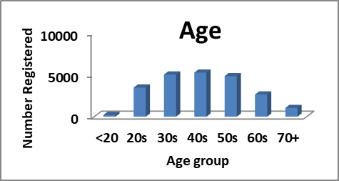
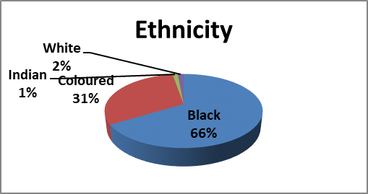
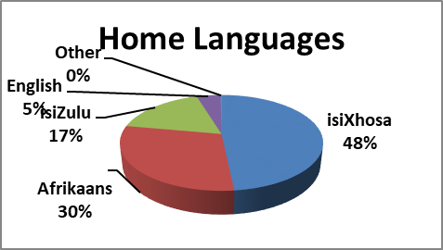
BRIEF ANALYSIS OF SSF SECTOR
The majority of applicants were male.
The average age was 44.
Majority classified as previously disadvantaged ethnic groups.

Slide 9
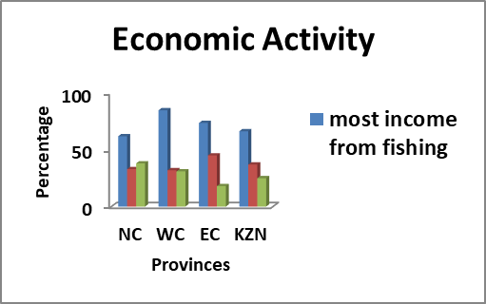
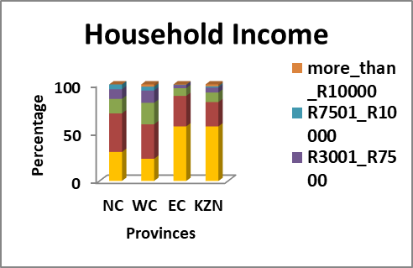
BRIEF ANALYSIS OF SSF SECTOR...cont.
The majority of respondents in each province are mainly dependent on fishing for more than 50% of their income.
Large dependency on government grants (32-45%) & limited involvement in other forms of economic activity.
~80% of respondents living under or close to the poverty line of R1558 pm.

Slide 10
BRIEF ANALYSIS OF SSF SECTOR...cont.
Low literacy levels and yet they have to operate co-operatives, which demands certain skills

Slide 11
OBJECTIVES OF THE SECTOR
Objectives:
Promote equitable access and involvement in all aspects of the fishing industry;
Rectify past injustices against woman, the youth and persons living with disabilities;
Recognize approaches to fisheries management, which contributes to food security, socio-economic development and the alleviation of poverty.

Slide 12
PRINCIPLES OF THE SECTOR
Principles
Maintain the health of marine ecosystems;
Uplift fishing communities by providing appropriate support mechanisms;
education and training, infrastructure and participatory management practices;
Communities and Government co-manages near-shore marine living resources;
Takes fundamental human rights, MLRA principles and international obligations into account;
Give due regard to promoting interests of women, disabled and child-headed households.

Slide 13
OVERALL CHALLENGES OF THE SECTOR
The SSFP recognises the general shortcomings of SSF communities;
The SSFP emphasizes the need for government to prioritize and facilitate support programmes;
A socio-economic baseline surveys were conducted and emphasised the need for a coordinated support strategy;
Need for SSF to meaningfully contribute to the goals of the NDP, MTSF, MLRA.

Slide 14
SUMMARY OF PROBLEMS
Core Problem:
Small-Scale fishers are under capacitated to run sustainable business entities.
Direct Causes:
No skills to run business entities
Do not participate in the value chain
Limited infrastructure support

Slide 15
SUMMARY OF OBJECTIVE/PRIORITY
OVERALL GOAL
Is to ensure that Small-scale fishers are capacitated to run sustainable business entities such as co-operatives
Intended Outputs
SSF co-operatives participate in the value chain.
SSF co-operatives have access to markets.
SSF co-operatives are in control of the price of their fish and related produce.

Slide 16
NEED FOR INTERGRATED DEVELOPMENT SUPPORT STRATEGY
Department developed a strategy for supporting the sector and it is currently being implemented;
A detailed implementation plan is being finalised with costing,
Various partnerships have been formed and formalised as guided by the strategy;
Establishing a working relationship with the Department of Small Business Development to assist in capacitating the cooperatives;
Various projects have been initiated as guided by the strategy;
Some of the partners support includes registration of secondary cooperatives; various types of training; provision of equipment; and opening of bank accounts.

Slide 17
STAKEHOLDER Stakeholder List and categorisation (Red – Government, Green – Private, Yellow – Gov. entities)
Department of Small Business Development

Slide 18
NATIONAL PROGRAMME DATA MATRIX
Narrative Summary | Indicators | Means of Verification | Important Assumption
Overall Goal Small-Scale Fishing Primary Co-operatives are fully capacitated to effectively run business entities | Economically sustainable SSF Coops | Diagnostic report of co-operatives and the sector | The co-operative members are committed to achieving the goal
Programme Purpose To ensure that Small-Scale Fishing Primary Co-operatives participate meaningfully in the value chain | Consistent participation in the value chain and beneficiation | “bankable” business model and status of co-operatives | The co-operatives will be able to carry out all the activities from pre-harvesting, harvesting and post harvesting.
Outputs Small-Scale Fishing Primary Co-operatives have improved skills to run successful business entities. Small-Scale Fishing Primary Co-operatives are in control of the price of their fish Small-Scale Fishing Primary Co-operatives have access to markets. Small-Scale Fishing Primary Co-operatives have access to infrastructure and equipment. | Co-operative have business capacity and resilience The co-operatives are determining or able to negotiate price based on coops business model. Product flow through determined markets established Improved infrastructure and access to fishing-related equipment | Skills and capacity audit Product flow report and profit margins. Product flow report and profit margins. Status of infrastructure reports | Rights allocated are relatively economically viable; There is cohesion in the co-operative; There is willingness to learn; Other government stakeholders are willing to participate

Slide 19
CURRENT INTERVENTIONS
Based on the approved strategy, the Department has initiated interventions in partnership with relevant stakeholders;
These are guided by the approved strategy and focus on “Programme Purpose”
The details of all the interventions with various organisations and government departments per municipality are listed below.

Slide 20
Details of all the interventions with various organisations and government departments are listed in table below:
ORGANISATIONS |  | INTERVENTION
Department of Forestry, Fisheries, and the Environment |  | The Department facilitated and registered a secondary co-operative in Coffee Bay, Tshani-Mankosi. The Department further developed a business plan for Tshani-Mankosi co-operative. This involves two co-operatives established in this area. One co-operative was granted 15year fishing rights and the other co-operative has a Fish Processing Factory.
OR TAMBO DISTRICT MUNICIPALITY: Ingquza Hill (Cuthwini) |  | Business Entrepreneurship training was provided at Ingquza Hill Local Municipality: Sikhatsha Fishing Primary Co-operative
OR Tambo District Municipality |  | The Municipality has committed to provide fish processing equipment such as refrigeration to small-scale fishing co-operatives under the municipality;
 |  | The Department is STILL waiting on the OR tambo District Municipality to confirm delivery date to communities

Slide 21
INTERVENTIONS CONTINUED
ORGANISATIONS |  | INTERVENTION
National Skills Fund |  | A training centre and holding tanks were built in the Coffee Bay area. A total of twelve (12) Fishing Primary Co-operatives were handed containers designed to be used as holding tanks for live marine species. Seven Additional containers and generators were handed over to seven additional co-operatives.
 |  | Some of the Co-operatives that have benefited are: King Sabata Dalindyebo Local Municipality: Sikhaleni Fishing Primary Cooperative, Siyaloba Fishing Primary Co-operative, Jonga Fishing Primary Co-operative, Lutatweni Kob Fishing Primary Co-operative. Nyandeni: Hluleka Fishing Primary Co-operative, Tshani Fishing Primary Co-operative, Presley Bay Fishing Primary Co-operative

Slide 22
INTERVENTIONS CONTINUED
ORGANISATIONS |  | INTERVENTION
South African Fisheries Development Fund |  | The Fund continues to support the Northern Cape co-operatives with various training interventions, provision of Personal Protective Equipment (PPE) during National lock down in partnership with the Department. The Fund has engaged with the Department on providing support to EC and KZN cooperatives. The Department has to identify co-operatives that are rural (that have received little training) as a pilot for the 2022/2023 financial year. The fund is currently investigating other value chain and marketing options for other species with the assistance of the Department.
 |  | For the first time in three fishing seasons, the Port Nolloth cooperatives operated at a profit of over R100 000 for the 2020/21 financial year.
Oceana Group |  | Provided training intervention for small-scale fishing communities in Kouga and Koukamma municipalities.
 |  | Training was further rolled out in all co-operatives in Eastern Cape and Kwa-Zulu Natal to date. This was a total of 107 small-scale fishing co-operatives.
 |  | The training focussed on business and Financial management, and co-operative governance training.

Slide 23
INTERVENTIONS CONTINUED
ORGANISATIONS |  | INTERVENTION
First National Bank |  | First National Bank has been assisting with the opening of Bank Accounts for co-operatives. The bank has opened a number of accounts for the co-operatives and for individual members as well;
 |  | The Bank also facilitated financial awareness in all training sessions.
National Skills Fund |  | National Skills Fund has approved the training of all co-operatives under the OR Tambo District Municipality, Alfred Ndzo District Municipality and Amathole District Municipality. This training will focus on Business acumen, safety at sea, the value chain, etc…
 |  | Logistics and procuring of training service providers are underway and will take place soon.
Department of Rural Development and Agrarian Reform |  | Department of Rural Development and Agrarian Reform procured fishing equipment for Small-Scale Fishing co-operatives in Port St Johns. The equipment was delivered to a number of co-operatives. Due to demand from other co-operatives, the Department is engaging with the provincial department to procure additional equipment.

Slide 24
INTERVENTIONS CONTINUED
ORGANISATIONS |  | INTERVENTION
World Wide Fund for Nature (WWF) |  | Partnership with WWF on Fisheries Improvement Project in the Kogelberg area, Hamburg and Port St Johns;
 |  | The Kogelberg project site has been delayed due to the court process for Western Cape regarding the small-scale fisheries process,
 |  | Hamburg project site is operational and capacitated by WWF
Economic Development, Tourism and Environmental Affairs |  | The KZN provincial department of Economic Development, Tourism and Environmental Affairs is assisting with the procurement and installation of Fish Processing Plans for small-scale fishing co-operatives under Ugu District Municipality. The budget for the nine (9) cooperatives was approved during the 2020/2021 financial year. The provincial department faced challenges in completing the bid and appointing a service provider. DFFE has since assisted with providing advice on the technical information for the provincial department to incorporate as part of their supply chain process in securing the necessary infrastructure.

Slide 25
INTERVENTIONS CONTINUED
ORGANISATIONS |  | INTERVENTION
NATIONAL SEA RESCUE INSTITUTE |  | The National Sea Rescue Institute provide sea-safety training for all co-operatives in Eastern Cape and KwaZulu-Natal (107 co-operatives)
DEPARTMENT OF RURAL DEVELOPMENT AND AGRARIAN REFORM (DRDAR) |  | Fishing equipment was delivered to the following cooperatives Waterfall Bluff under Ingquza Hill Local Municipality Chascavu under Port St Johns Local Municipality Presley Bay under Nyandeni Local Municipality Ngoko under KSD Local Municipality

Slide 26
INTERVENTIONS CONTINUED
ORGANISATIONS |  | INTERVENTION
KZN Department of Economic Development, Tourism and Environmental Affairs & Moses Kotane Institute |  | The intervention focussed on Co-operative capacitation through Business Management skills. The following co-operatives were trained: Ntabende Fishing Primary Co-Operative Ltd, Nyakaza Mazambane Fishing Primary Co-Operative Ltd, Nhlabane Fishing Primary Co-Operative Ltd, Senzakwenzeke Fisheries Primary Co-Operative Ltd, Ingule Fishing Primary Co-Operative Ltd, Siyadida Tuna Fishing Primary Cooperative Ltd, Mduduzi Fishing Cooperative, Isiphethosohwebede Fishing Primary Co-Operative Ltd, Wangu Fishing Primary Co-Operative Ltd, Amatikulu Mouth Fisheries Primary Co-Operative Ltd, Nkunzebomvu Fishing Primary Co-Operative
Ilembe District Municipality | The Municipality procured fishing equipment to co-operatives that fall under the Municipality
Municipality: Mandeni Local Municipality |  | The budget for the three (3) co-operatives was approved during 2020/2021 financial year and was utilised before the end of June 2021,
 |  | The following co-operatives benefited: Isiphethosohwebede Fishing Primary Cooperative Ltd, Wangu Fishing Primary Co-Operative Ltd, Amatikulu Mouth Fisheries Primary Co-Operative Ltd.

Slide 27
INTERVENTIONS CONTINUED
ORGANISATIONS | INTERVENTION
SAMSA | Training offered on Safety at sea to 6 coops at Winnie Madikezela Mandela,4 cops at Ingquza Hill, 16 Port St Johns , 5 coops at Nyandeni and 7 at KSD Local Municipalities The training was building capacity of coop members on water safety and safety at sea

Slide 28
INTERVENTIONS CONTINUED
ORGANISATIONS | INTERVENTION
DEDEAT | Training was conducted with cooperatives at Nqushwa , Ndlambe , Buffalo City , Great Kei Port St Johns Local Municipalities and Buffalo City Metropolitan Municipality The training focused mainly in building capacity on skills to cooperative members. The initial training focused on cooperative leadership. In addition training included cooperative governance, financial management and value chain marketing.

Slide 29
INTERVENTIONS CONTINUED
ORGANISATIONS | INTERVENTION
SEDA | SEDA EC provided cooperative training to the following cooperatives: Siyaphambili Fishing Primary Coop, Umlibo Fishing Primary Coop. Benton Fishing Primary Coop, Kiwane Fishing Primary Coop, Kei Mor Fishing Primary Coop. SEDA NC has committed to provide training assessments in two cooperatives in the NC, namely Aukotowa primary cooperative and Long-time Hondeklipbaai primary cooperative. The assessment is scheduled for the 18th March 2022. SEDA KZN in collaboration with EDTEA provided training on Awareness in food safety, contamination issues to the following cooperatives, Ingule, Funinhlanzi, Siyadida and Mutshini Fishing Cooperatives. Ongoing engagement with SEDA on support and training for all four coastal provinces is planned for the 202/2023/24 financial years

Slide 30
CHALLENGES AFFECTING IMPLEMENTATION
Funding
Limited funding from other government institutions due to reprioritisation of funds to covid-19 related programs.
Solution: Continue Strengthening partnership with District Municipalities and influence SSF support through IDPs and District Models
Continuous engagement with government departments mandated to support SMMEs
Limited basket of species
Much of the nearshore marine resources that are required for the small-scale fisheries sector have been allocated in the commercial sector.
Status of certain nearshore marine resources does not allow for additional allocation/ apportionment to be issued.
Solution: Apportionment split between small-scale fishing and local commercial sector are being considered after a public consultation process was concluded.

Slide 31
CHALLENGES AFFECTING IMPLEMENTATION..CONT
Delays in the Western Cape
The Minister is taking the process and decisions on verification and recognition of small-scale fishers in the Western Cape to court for review and setting aside.
This is after the Minister responded to complaints from various communities regarding the verification process. The process and its decisions were audited and a legal opinion obtained advised for the Minister to take the process and its decision on review.
Solution: Court papers have been lodged. The Department is preparing for the new process. Access to fishing will be provided while court process and new recognition process is taking place.

Slide 32
CHALLENGES AFFECTING IMPLEMENTATION..CONT
Demand for reconsideration of ”Subsistence” in KZN
A group in Durban is demanding the Department to recognise them as subsistence fishers outside of the definition of “small-scale fisheries”.
Solution: A series of meetings have been held with the group and the legal framework has been outlined to the group. Various options of ensuring their participation in the sector have been presented to them. The issue of definitions will be reviewed as part of the amendment process of the Marine Living Resources Act that will commence in 2022.

Slide 33
THANK YOU!
FISHERIES MANAGMNENT BRANCH

