Slide 1
PROGRESS UPDATE ON THE IMPLEMENTATION OF BROADCASTING DIGITAL MIGRATION TO PORTFOLIO COMMITTEE ON COMMUNICATIONS
May 2022

Slide 2
UPDATE SINCE LAST COMMITTEE MEETING
Since the last Portfolio Committee meeting, there are 3 key developments that shaped our focus and influenced the timelines for the BDM project as follows;
The Minister gazetted the 31st March 2022 as the Analogue Switch-Off (ASO) date.
ICASA pronounced a transitional period for the remaining analogue switch-offs
The Gauteng High Court ruled that the Analogue Switch-off should be concluded by the 30th of June 2022.

Slide 3
Progress Since Last Committee Meeting (February 2022)
INSTALLATIONS
On the 28th March 2022 The Gauteng High Court ruled the following judgement:
507,251 households to be migrated by 30 June 2022 and
260,868 households by 30 Sept 2022
Installations are currently underway in all 9 provinces in order to reach the target. The department is making progress on installations to meet the March court ruling that support the Minister to migrate those who registered by 31 October 2021 and ASO to be concluded by 30 June 2022
Gauteng has reached target for Installations, Northern Cape also completed.
The remaining installations to reach target will be completed in the month of May and June

Slide 4
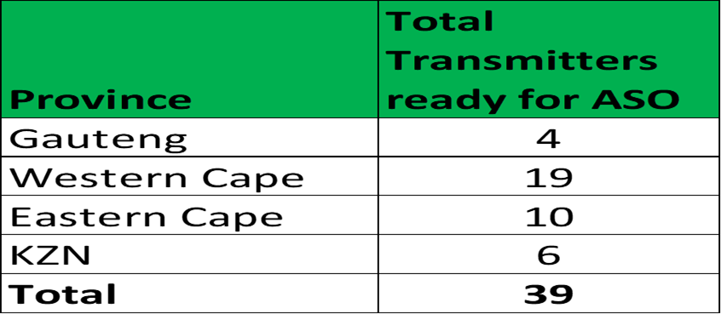
Progress Since Last Committee Meeting (February 2022)
ANALOGUE SWITCH OFF
SABC sites were switched-off during the period, bringing the total of 163 SABC Analogue Transmitters sites that have been Switched off to date
ETV has switched off 5 more transmitters bringing a total of 9 Analogue Transmitters that have been switched off
39 SABC Transmitters are ready to be switched as installations have reached threshold

Slide 5
Progress Since Last Committee Meeting (February 2022)
AWARENESS CAMPAIGN
National characters scroller on all analogue receiving televisions
Live reads on community radio stations across the country.
PSA on S1,2,3
On the ground/door to door campaign
Social media activation across all stakeholder platforms (digital ads, weekly messages)
Telcos SMS campaign (Telkom, MTN, Cell C etc.)
Interviews of key personnel on radio and TV

Slide 6
Progress Since Last Committee Meeting (February 2022)
SPECTRUM RESTACKING
The Spectrum Restacking process commences as soon as we conclude analogue switch-off in a province. In provinces where analogue has been switched-off, we have concluded re-arranging spectrum (Restacking) in these 5 provinces thereby giving a way for the spectrum to be assigned for future technology usages.
The last two provinces of Mpumalanga and Limpopo were concluded during the months of February and March 2022.

