Slide 1



CONSOLIDATED PROGRESS REPORT ON THE RECENT FLOODS IN KWAZULU NATAL
18 MAY 2022

Slide 2
PURPOSE
To provide updates on the severe impact of heavy rains and flooding disaster incidents that occurred in the Province of KwaZulu-Natal;
To highlight the disaster response and recovery interventions provided and needed to support the affected sectors; and
Briefly highlight the challenges and improvement measures required to efficiently manage the current disaster situation in the Province.

Slide 3
BACKGROUND
GROWING KWAZULU-NATAL TOGETHER
On 08 April 2022, the South Africa Weather Service (SAWS) issued an early warning (and subsequent updates) whereby disruptive rainfall were to be expected in various parts of the Province due to cut-off low pressure system.
Early warnings were sent to all Disaster Management Centres and key stakeholders to ensure state of readiness and to raise awareness to the general public.
As forecast by SAWS, the cut-off low pressure system generated prolonged heavy rains that impacted all district municipalities and the Metro within the Province.
3

Slide 4
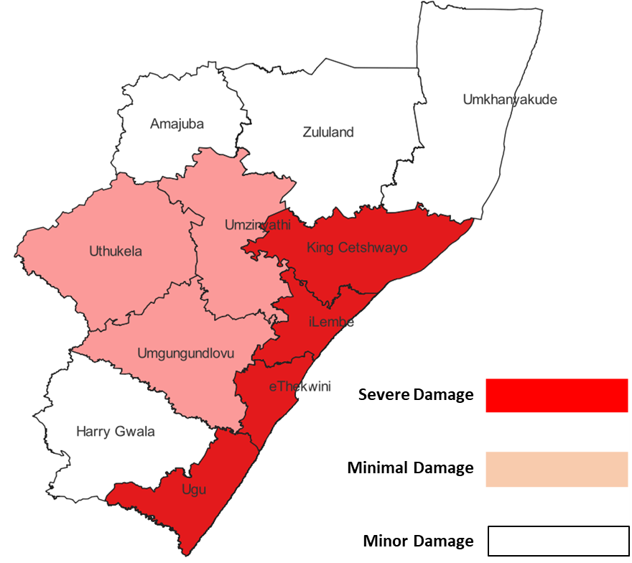
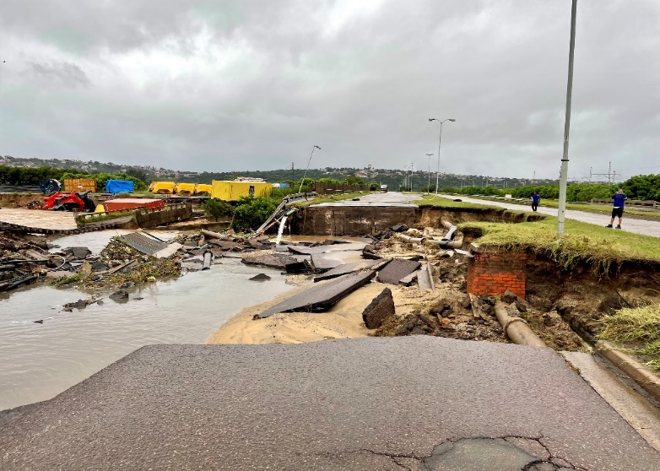
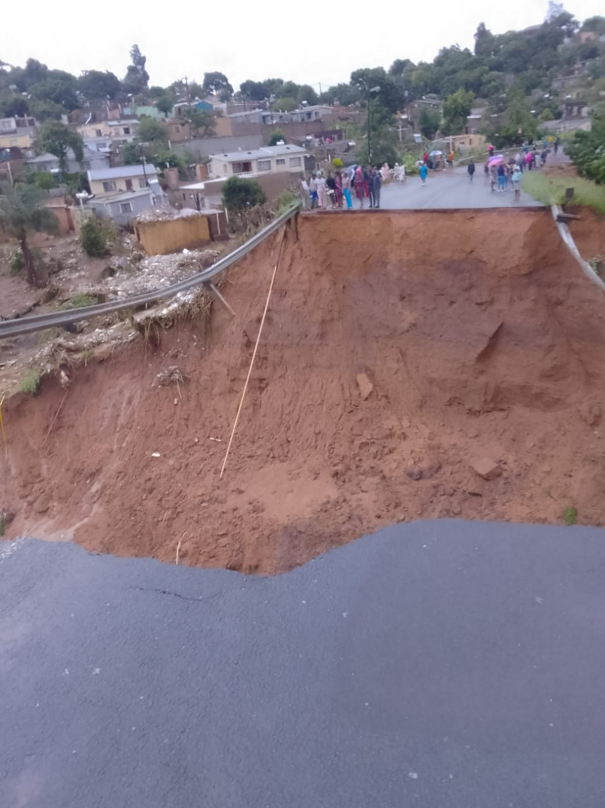
SEVERITY OF DISASTER IMPACT
According to reported damage thus far, the municipalities most impacted are EThekwini, UGu, King Cetshwayo, ILembe, and UMgungundlovu. However, the damage assessment is ongoing.
4

Slide 5
CURRENT STATUS
GROWING KWAZULU-NATAL TOGETHER
  A total of 85280 people has been affected.
  A total of 448 fatalities has been reported .
  A total of 88 missing people has been reported.
  A total of 6895 are homeless.
  A total 0f 50 were reported injured
  Department of Agriculture, Department of Education schools); Department of Transport; Social Development; ESKOM and Department of Human Settlements
Total number of people affected
Affected organs of state
  All 10 Districts (including Metro) were been affected.
uMkhanyakude
uThukela
uMzinyathi
UMgungundlovu
Zululand
EThekwini
ILembe
Harry Gwala
King Cetshwayo
UGu
Amajuba
Total number of households affected
Affected Districts
  A total of (27069) households affected
  A total of (8584) houses were totally destroyed
  A total of (13536) houses were partially destroyed
5
5

Slide 6
SUMMARY INCIDENT PER DISTRICT
Municipalities | Number of Incidents | Households Affected | Houses Destroyed |  | Homeless | People Affected | Fatalities | Injuries | Missing Person
 |  |  | Totally Destroyed | Partially Damaged
uMkhanyakude | 03 | 86 | 78 | 08 | 10 | 273 | 00 | 01 | 00
uThukela | 05 | 2180 | 1692 | 1731 | 221 | 12902 | 02 | 13 | 00
uMzinyathi | 04 | 206 | 153 | 124 | 21 | 1208 | 02 | 01 | 02
UMgungundlovu | 07 | 687 | 242 | 796 | 97 | 3705 | 02 | 04 | 02
Zululand | 05 | 360 | 171 | 264 | 00 | 2348 | 00 | 00 | 00
EThekwini | 505 | 17158 | 3000 | 7200 | 5423 | 40000 | 386 | 01 | 39
ILembe | 20 | 3000 | 1442 | 1406 | 399 | 9328 | 31 | 21 | 00
Harry Gwala | 17 | 650 | 297 | 252 | 250 | 1856 | 03 | 02 | 00
King Cetshwayo | 155 | 755 | 349 | 688 | 172 | 5201 | 04 | 03 | 01
UGu | 35 | 1769 | 1049 | 910 | 288 | 7437 | 07 | 04 | 04
Amajuba | 29 | 218 | 111 | 157 | 14 | 1022 | 00 | 00 | 00
TOTAL | 785 | 27069 | 8584 | 13536 | 6895 | 85280 | 448 | 50 | 88

Slide 7

GROWING KWAZULU-NATAL TOGETHER
INSTITUTIONAL ARRANGEMENTS TO ENHANCE COORDINATION
STRUCTURE | CHAIR AND ATTENDEES | FREQUENCY AND TIME
IMC ON DISASTERS at National level | Minister of COGTA and all relevant Ministers | Once a week or as required
IMC ON DISASTERS AT PROVINCIAL LEVEL | MEC for COGTA and relevant ministers | Daily at 7.30am or 7pm
Technical and Political Clusters as per PEC | Relevant Mecs and HODs as appointed by the Premier | As required/ Daily/Weekly
Nat JOINTS | SAPS | Weekly or As required
National Joint Floods Coordinating Committee NJFCC | DG at DCOG and attended by DGs and workstream leaders | As required and at 5pm
NJFCC Workstreams | Relevant Workstream leaders at National Level | Weekly or As required
ProvJOCOM | HOD COGTA and Provincial Commissioner with attendance of entity CEOs, HODs and DGs at both local and national level and affected municpallitirs | Daily at 1600 hrs
ProvJOC | Head of the PDMC and attended by all government departments, municipalities and civic organisations at operational level | Daily at 11.00
Municipal JOC | Head of the DDMC or LDMC and attended by all government departments at district level, local municipalities and civic organisations at operational level | As required/ Daily/Weekly
OSS/DDM structures | MEC / HOD Champion District Mayor/MM | Weekly in worst affected districts or As required
War rooms | LTT Chairs and OSS/DDM members | As required/ Daily/Weekly
7

Slide 8
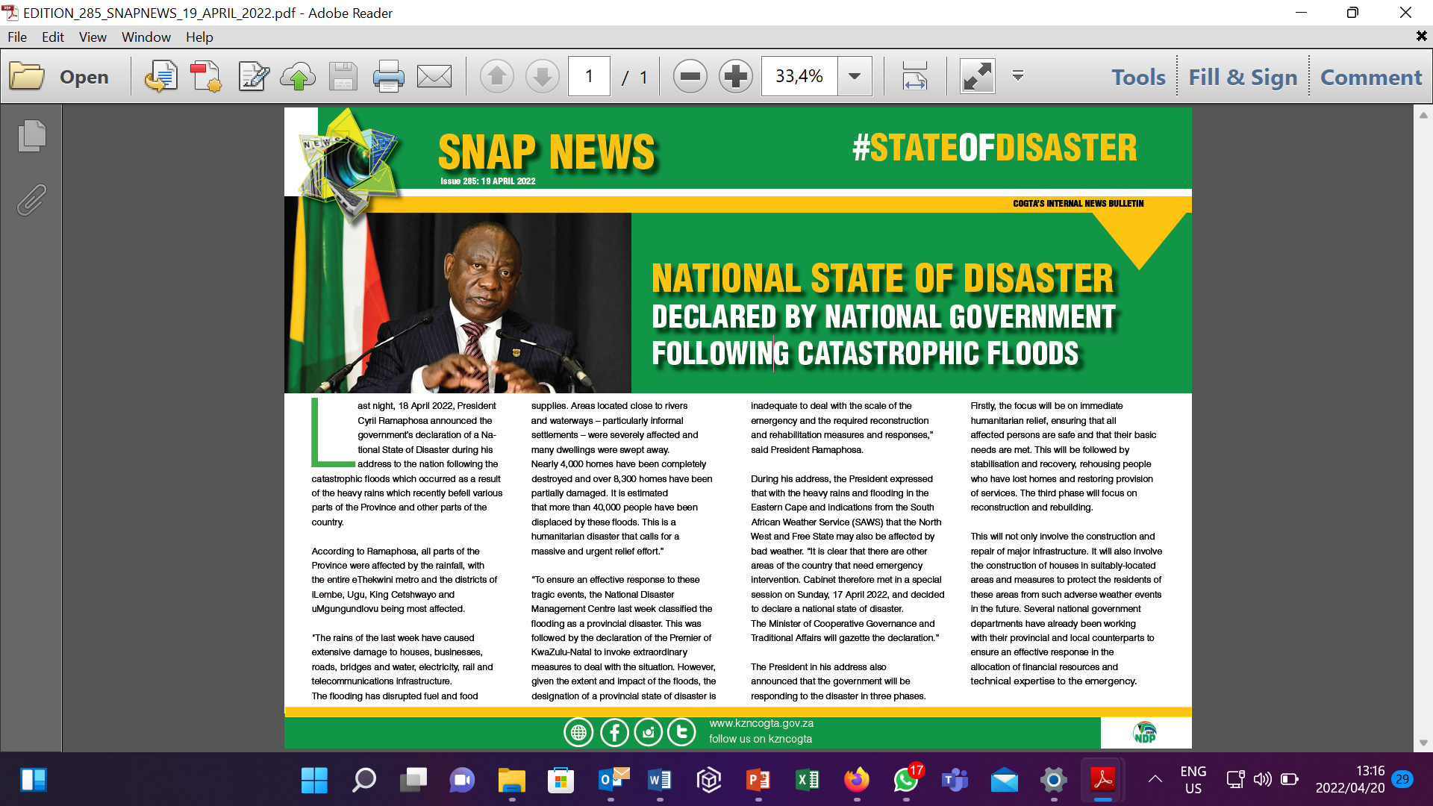
DISASTER CLASSIFICATION AND DECLARATION
Upon the request by KZN Government, on 13 April 2022, the National Disaster Management Centre, classified the flooding as a provincial disaster. This was done to ensure an effective response to these tragic events.
This was followed by the declaration of the Premier of KwaZulu-Natal to invoke extraordinary measures to deal with the situation.
However, given the extent and impact of the floods, the designation of a provincial state of disaster is inadequate to deal with the scale of the emergency and the required reconstruction and rehabilitation measures and responses.
The significance of the Port of Durban and related infrastructure for the effective operation of the country’s economy means that this disaster has implications far beyond the province of KwaZulu- Natal.
With the heavy rains and flooding also in other provinces, Cabinet therefore met on 17 April 2022 and decided to declare a national state of disaster.
8

Slide 9
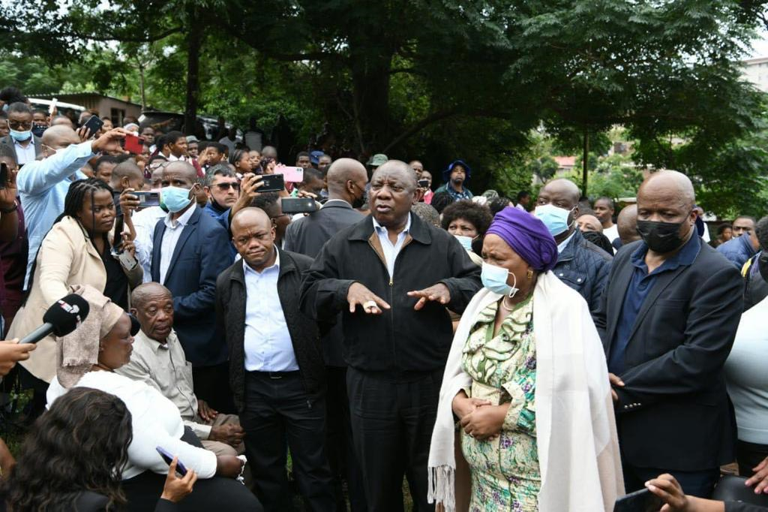
RESPONSE TO ETHEKWINI
DEPARTMENT OF HUMAN SETTLEMENTS
On the 13th April 2022, President Cyril Ramaphosa Premier and their entourage visited the flood damaged areas of Clermont, Lindelani, Ntuzuma to assess the damage as well as interact with affected families and communities and pass his condolences.
9
Notes:
9

Slide 10
GROWING KWAZULU-NATAL TOGETHER
GOVERNMENT DISASTER RESPONSE APPROACH
Government is responding to this disaster in three phases:
1.
2.
3.
Focus on immediate humanitarian relief, ensuring that all affected persons are safe and that their basic needs are met.
Focus on stabilization and recovery, rehousing people who have lost homes and restoring provision of services.
Focus on rehabilitation and reconstruction (Building Back Better).
This will not only involve the construction and repair of major infrastructure. It will also involve the construction of houses in suitably-located areas and measures to protect the residents of these areas from such adverse weather events in the future.
10

Slide 11
SEARCH AND RESCUE TEAMS FROM OTHER PROVINCES
NAME OF TEAM | ARRIVAL DATE | DEMOBILIZATION DATE
Western Cape 10 Rescuers 3 DM Coordinator 1 Engineer Search and Rescue ZA Rescuers 22 Vehicles 18 | 15 April 2022 | 22 April 2022
Free State 01 Disaster Managers 03 Rescuers 03 Structural Engineers | 17 April 2022 | 21 April 2022
Gauteng 30 Rescuers | 21 April 2022 | 27 April 2022
Northwest - Rustenburg | 21 April 2022 | 29 April 2022
Welkom | 29 April 2022 | 02 April 2022
TOTAL CALL OUTS : 760
TOTAL RESCUED :165
TOTAL BODIES RECOVERD : 448
HUMANITARIAN ASSISSTANCE : 15

Slide 12
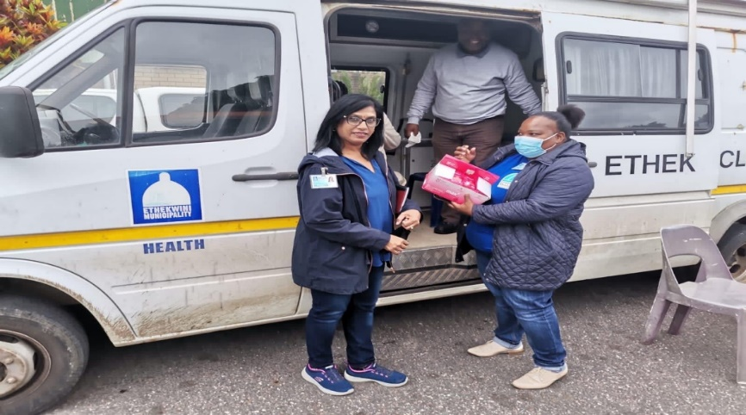
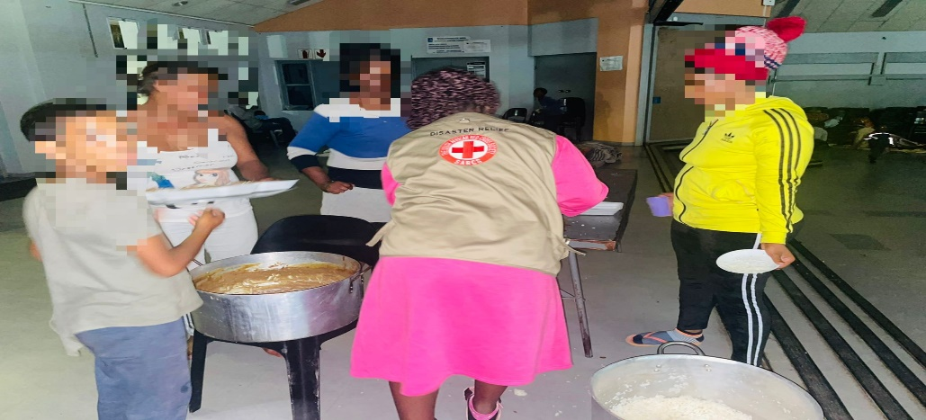
  SUMMARY ON SHELTERS AND SUPPORT PROVIDED
District | Local Municipality | No. of Shelters | No of People | Support provided | Organization Providing support
UMgungundlovu | Msunduzi | 01 | 35 | Blankets, sponges, vanity packs and hot meals | SASSA, DSD & NGOs
Ilembe | KwaDukuza | 09 | 245 | Blankets, sponges, vanity packs and hot meals | SASSA,DSD & NGOs
 | Ndwedwe | Shelter closed. People have managed to get back to their homes
UGu | Umzumbe | 01 | 12 | Blankets, sponges, vanity packs and hot meals | SASSA, DSD & NGOs
 | Umdoni | 04 | 91 | Blankets, sponges, vanity packs and hot meals | SASSA, DSD & NGOs
 | Ray Nkonyeni | 03 | 56 | Blankets, sponges, vanity packs and hot meals | SASSA, DSD & NGOs
King Cetshwayo | uMhlathuze | Shelter closed . People have managed to get back to their homes
eThekwini | eThekwini | 55 | 7245 | Blankets, sponges, vanity packs and hot meals | SASSA,DSD & other NGOs

Slide 13
CLOSED SHELTERS
No | Districts | Local_municipality | Ward_number | Name_of_the_facility | Number_of_people_in_the_facilit | Status
1 | eThekwini Metropolitan | eThekwini | 21 | Clermont hall (Now extension of Ndunduma Community Hall | 21+74 | Closed
2 | eThekwini Metropolitan | eThekwini | 13 | Abudant life ministry church | 36 | Closed
3 | Harry Gwala | Ubuhlebezwe | 14 | Ndwebu Community Hall | 8 | Closed
4 | Ugu | Ray Nkonyeni | 16 | Sea park | 4 | Closed
5 | Ugu | Ray Nkonyeni | 28 | Sigedleni hall | 18 | Closed
6 | eThekwini Metropolitan | eThekwini | 32 | Dalton Hostel Beer Hall | 139 | Closed
7 | eThekwini Metropolitan | eThekwini | 54 | Inhlungwane Community Hall | 74 | Closed
8 | eThekwini Metropolitan | eThekwini | 74 | Bantuvukani primary school | 46 | Closed
9 | eThekwini Metropolitan | eThekwini | 75 | eWema | 69 | Closed
10 | eThekwini Metropolitan | eThekwini | 76 | Glebelands | 23 | Closed
11 | eThekwini Metropolitan | eThekwini | 23 | Permary Ridge Primary School | 98 | Changed Name to Truro
13

Slide 14
FUNERALS SUPPORT PROGRESS TO DATE
Two organisations pledged to support with funeral assistance being AVBOB at R3m and Motsepe Foundation at about R8m
Value of support limited to R20 000 per family as a service to bury the deceased
Some families had however buried their beloved using own resources and policy covers and will be refunded through Motsepe Foundation
The Funeral task team is assisting families to be reimbursed and have engaged legal services to ensure the refunds are processed as agreed and with full cooperation of the funeral parlours.

Slide 15

DONATIONS CURRENT STATUS
The donations are divided into two categories as:
Donations Directly to the State and
Donations given to the State through NGOs or other entities.
Direct Disbursements
Approximately 15% of the donors disburse or report to have disbursed directly to affected communities e.g. most individuals and most NGOs.
Disbursement through 3rd parties
It must be noted that, at least 80% of the donors prefer to disburse their donations through 3rd parties whilst on the other hand they announce the intention to donate to Provincial Government; e.g. RBM committed R 5 million to Provincial Government and disbursed it through the Gift of the Givers and Red Cross Society.
Microsoft has redesigned a template that will indicate the two categories as well as, to provide progress on each donation, place where it was disbursed, recipient list and impact on the donation. A list herein attached as Annexure.

Slide 16
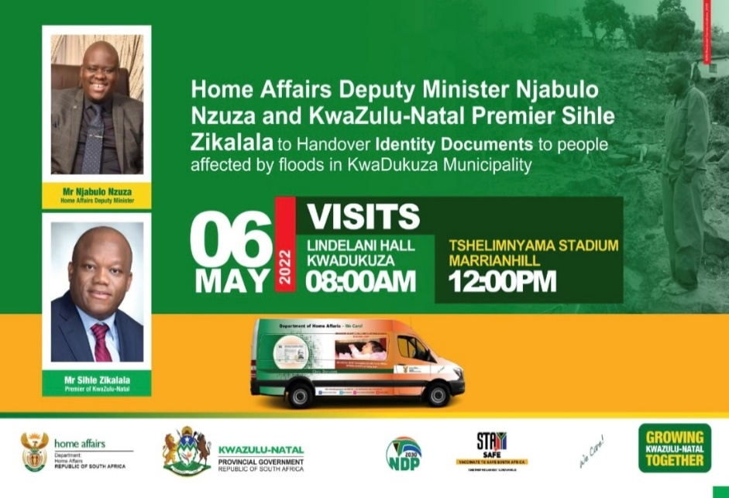
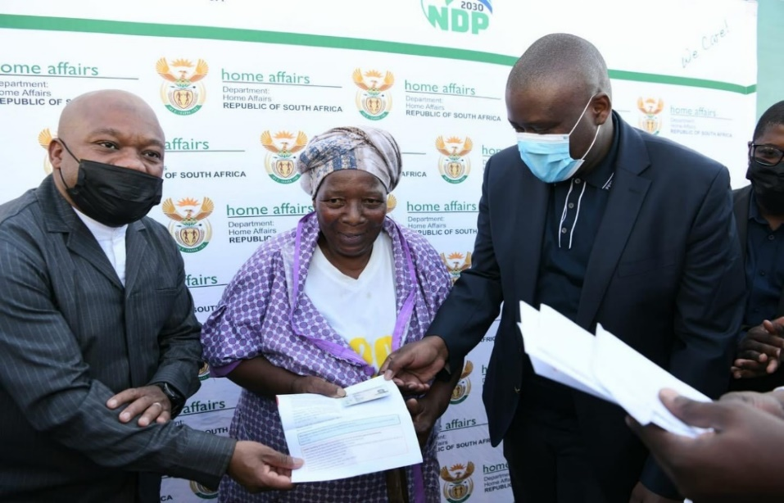
DEPARTMENTS OF HOME AFFAIRS MILESTONES ACHIEVED
Date | Venue Visited | Number of People Sheltered | Number of people needing DHA services | Number of Mobile Deployed | Statistic | Statistic Reprint of Birth | SIDC REC | Handed Out | SIDC - Still to be Handed out
 |  |  |  |  | Smart Card Applications
21-Apr-22 | Te Huise – Ward 74 | 500 | 86 | 2 | 59 | 27 | 20 |  | 20
22-Apr | Te Huise – Ward 74 |  | 78 | 2 | 75 | 3 | 20 |  | 20
25-Apr-22 | Te Huise – Ward 74 |  | 119 | 4 | 119 | 0 | 67 |  | 67
26-Apr-22 | Te Huise – Ward 74 |  | 47 | 4 | 47 | 0 | 4 |  | 4
21-Apr-22 | Tshelimnyama Sport Field – Ward 15 | 805 | 141 | 2 | 112 | 29 | 96 | 22 | 74
22-Apr-22 | Tshelimnyama Sport Field – Ward 15 |  | 64 | 2 | 28 | 36 | 16 | 0 | 16
22-Apr-22 | Ntunzuma Hall | 110 | 88 | 2 | 74 | 14 | 74 | 62 | 12
28-Apr-22 | Shakaville - Ilembe |  | 17 | 2 | 15 | 2 |  |  | 0
28-Apr-22 | Lindelani Hall - Ilembe |  | 44 | 2 | 39 | 5 | 39 | 35 | 4
29-Apr-22 | Malendele - Ilembe |  | 74 | 4 | 74 | 0 |  |  | 0
03-May-22 | Boyi Boyi |  | 4 | 1 | 4 | 0 |  |  | 0
03-May-22 | Malangeni |  | 8 | 1 | 4 | 4 |  |  | 0
03-May-22 | Nqolobane |  | 4 | 1 | 3 | 1 |  |  | 0
03-May-22 | Kwadinabakubo Hall |  | 88 | 3 | 88 | 0 |  |  | 0
03-May-22 | Cliffdale |  | 55 | 2 | 53 | 2 |  |  | 0
04-May-22 | V Section Umlazi |  | 57 | 2 | 57 | 0 |  |  | 0
09-May-22 | Isipingo Hall |  | 41 | 2 | 41 | 0 |  |  | 0
09-May-22 | Wema Hostel |  | 47 | 2 | 40 | 7 |  |  | 0
09-May-22 | Umgagababa Thusong |  | 34 | 2 | 29 | 5 |  |  | 0
10-May-22 | Shembe Hall |  | 50 | 2 | 50 | 0 |  |  | 0
10-May-22 | SUB 5 Hall |  | 41 | 2 | 33 | 8 |  |  | 0
10-May-22 | Chesterville Hall |  | 38 | 2 | 32 | 6 |  |  | 0
10-May-22 | Burlington Hall |  | 22 | 1 | 22 | 0
11-May-22 | Ngengenzi Hall |  | 50 | 2 | 36 | 14
11-May-22 | KwaCultshwayo Hall |  | 26 | 2 | 26 | 0
11-May-22 | Nazareth Hall |  | 56 | 3 | 56 | 0
12-May-22 | Ntunzuma Hall F | Distribution | 2 |  |  |  |  | 2
12-May-22 | Tshelimnyama Sport Field – Ward 15 | Distribution | 10 |  |  |  |  | 10
13-May-22 | Bhambayi Hall |  | 33 | 2 | 24 | 9
13-May-22 | Nhlungwane Hall |  | 101 | 2 | 73 | 28
13-May-22 | Ntuzuma H Hall |  | 18 | 2 | 14 | 4
Total |  | 1415 | 1931 |  | 1710 | 209 | 336 | 131 | 217

Slide 17
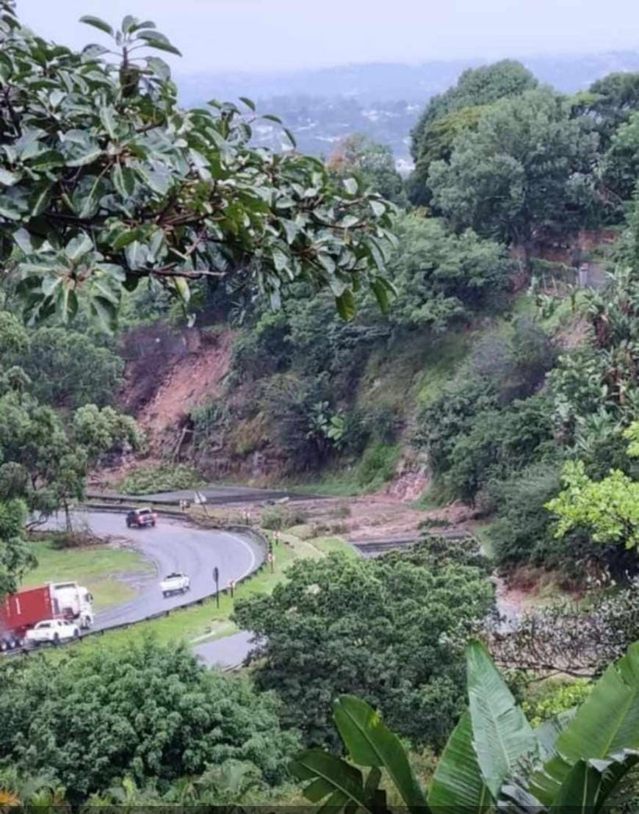
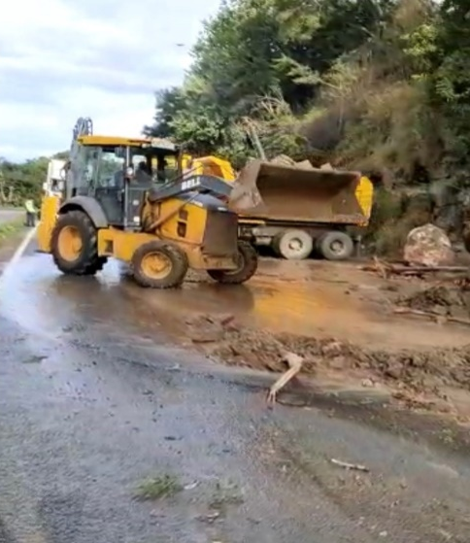
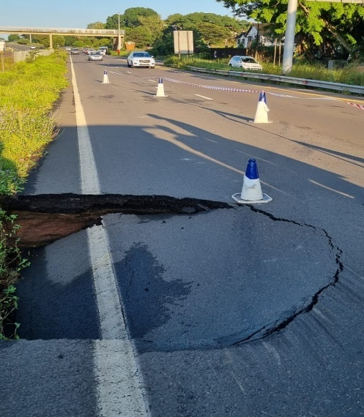
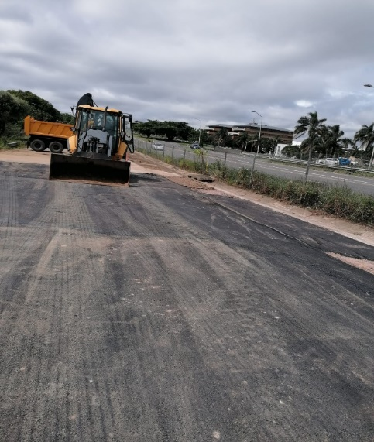
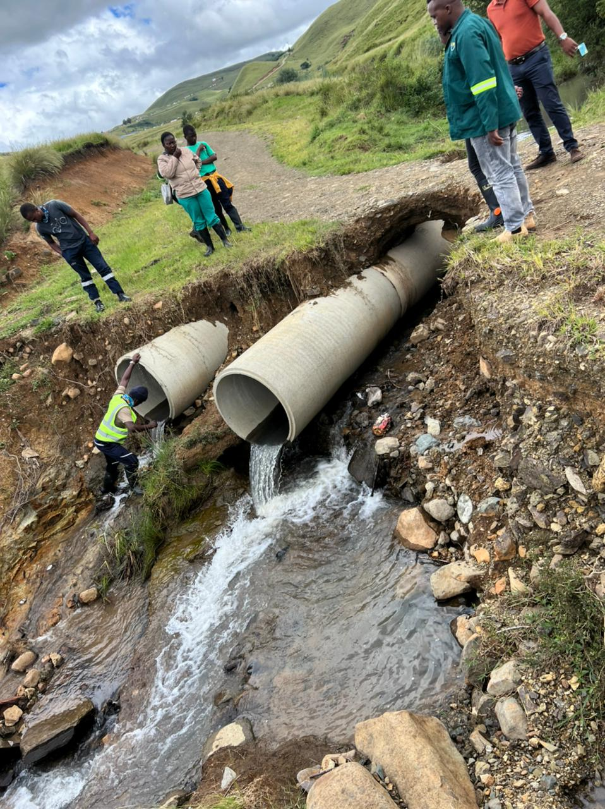
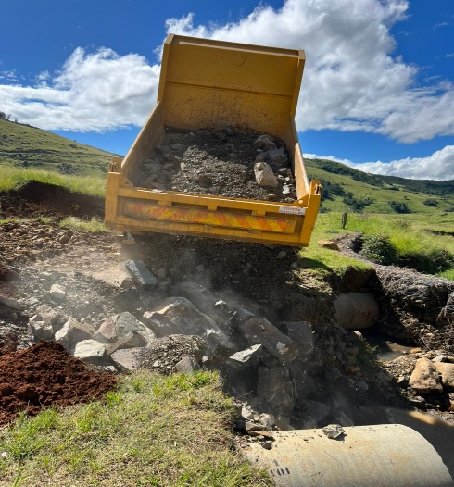
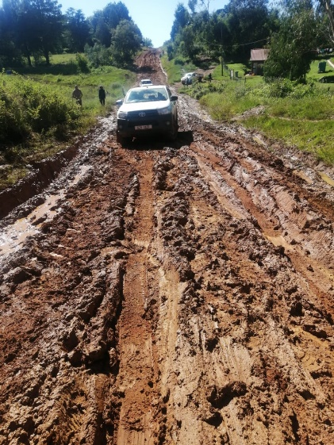
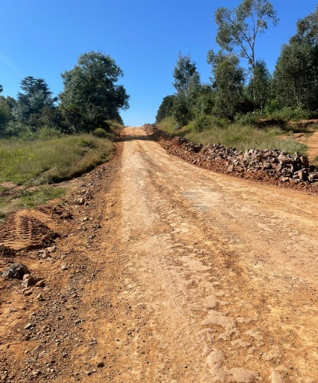
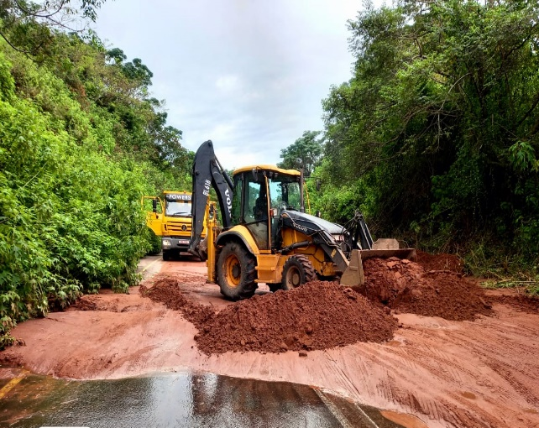
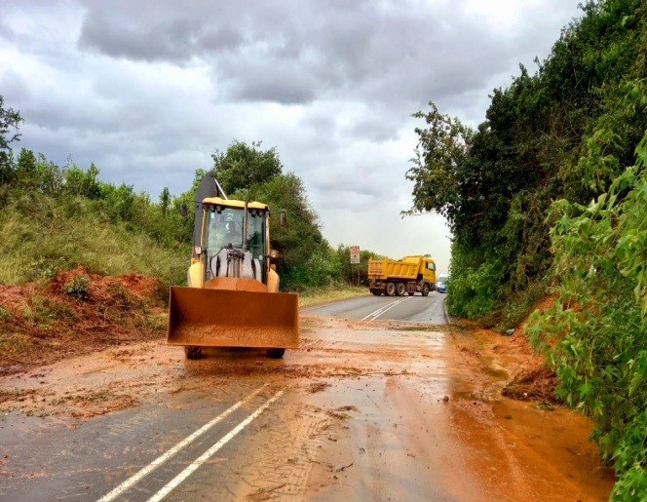
DOT: SHORT TERM INTERVENTIONS BY TECHNICAL TEAMS
Slip failure on M13 resulting in road closure
Internal teams clearing M13 - 2 lanes open
Sinkhole on M13 at Blair Atholl Interchange
M13 at Blair Atholl Interchange repairs
L917 In Underberg - scour
Mudslides on P85
Cleared of mudslides by
internal teams on P85
L917 Repairs
D7 – slippery Gravel loss
D7 – Regravelling Complete

Slide 18

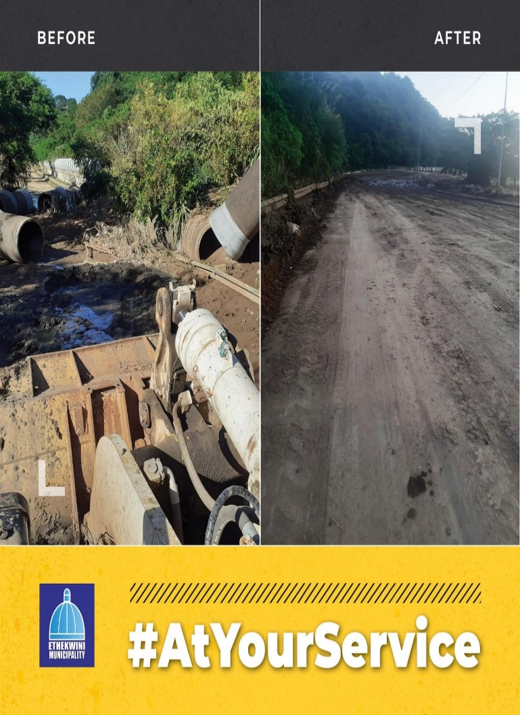
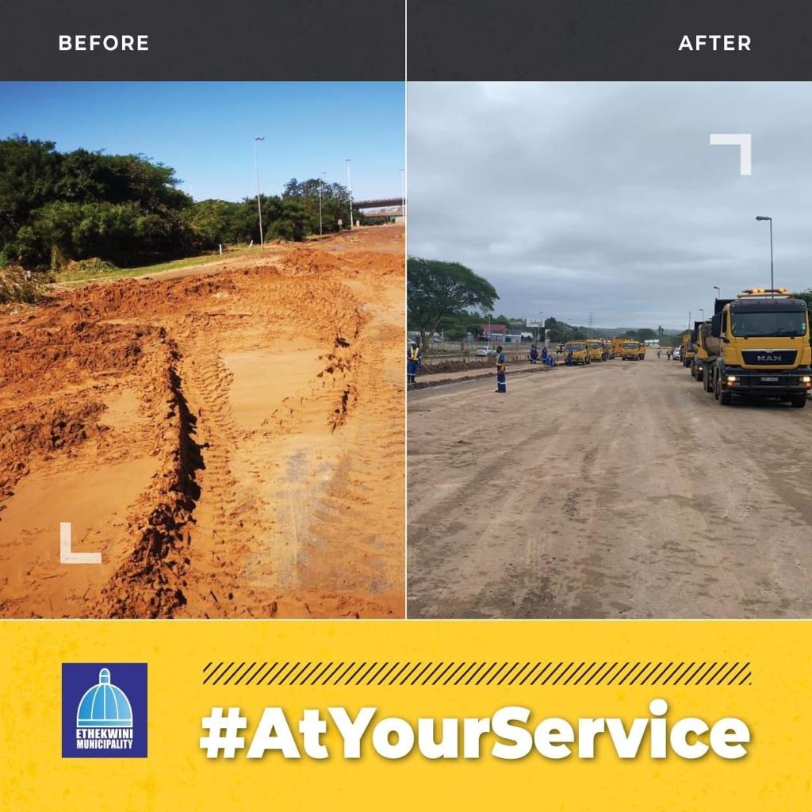

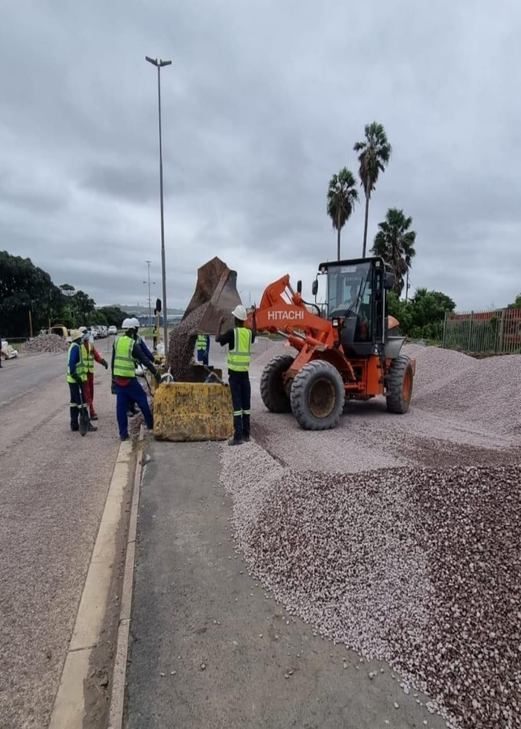
ETHEKWINI STRATEGIC ROAD REPAIRS
Solomon Mahlangu(Edwin Swales) Drive now open for traffic however the fast lane is closed in both direction in the area around south way mall is closed due to collapsed fence

Slide 19
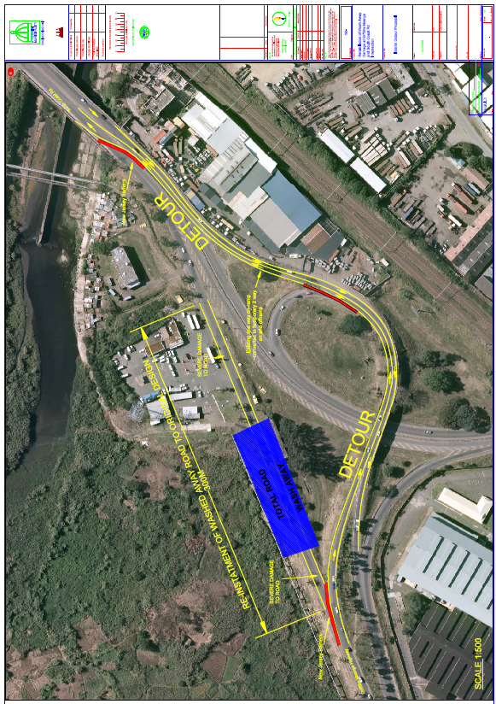
ETHEKWINI STRATEGIC ROAD REPAIRS
Umlazi, Isipingo, Prospecton - N2/R102 - Progress Report to Date
As per the site confirmation assessment confirmed, on 15 April 2022 the alternative Route option to enable Plan for temporary access into and out of Umlazi through R102 near Mega City is as follows.
City Engineers Team are working on repairing the flyover and deviate all traffic from Mega City.
Traffic Signals are being positioned over the interim route
It routes back onto the R102, Himalaya’s and M41
The Sinkhole over the bridge is being filled R102 over bridge - Work In Progress

Slide 20
DOH SUMMARY OF AREAS AFFECTED
Adjustment of the Annual Implementation completed awaiting for signing by HOD.
The adjustments are being populated into the IRM template provided by Treasury in order to ensure the realignment of the IRM with the adjusted AIP for reporting purpose.
A total of 24 projects and 2 Major programme had to be halted which includes a 72 hr Standby Generator Programme and Institutional Minor Maintenance Programme all to the value of R 259 206 284,84. Most projects halted were at Planning and design phases.
Approval have been given to DOPW on 09 May 2022 for 68 floods recovery projects to the estimated value of R118,399,032.35.
The balance of the projects to the value of R 140 807 252 will be implemented by DOH , Head office and Institutions.
DISTRICT | COUNT OF DAMAGES SUSTAINED | CURRENT COST ESTIMATE AFTER ASSESSMENT
Ethekwini | 48 | R178 335 761,84
Ilembe | 10 | R8 423 174,00
King Cetshwayo | 11 | R24 140 214,00
Ugu | 5 | R21 477 830,00
Umgungundlovu | 8 | R20 783 000,00
Umkhanyakude | 4 | R6 046 305,00
Grand Total | 86 | R259 206 284,84
20

Slide 21
DEPARTENT OF HEALTH PROGRAMME PLANNING
MILESTONE | ESTIMATED START DATE | ESTIMATED COMPLETION DATE
Conditional assessments reports and costing information finalised | 19 April 2022 | 28 April 2022
Bills of Quantities were finalised | 29 April 2022 | 03 May 2022
Bid Documents presented at Infrastructure Technical Specification Committee (DOH) | 10 May 2022 | 10 May 2022
Advertisement of the tenders by DOH SCM using a shortened tender period of 10 days | 16 May 2022 | 30 May 2022
DOPW instruction to implement | 10 May 2022 | 10 May 2022
DOPW - Bid documents be presented to BSC for Minor Works | 13 May 2022 | 13 May 2022
Advertisement of the tenders by DOPW SCM using a shortened tender period of 05 days for (minor works) | 16 May 2022 | 20 May 2022
Adjudication Process for minor works | 23 May 2022 | 27 May 2022
Site Handover for minor works | 02 June 2022 | 30 August 2022
DOPW instruction to implement | 10 May 2022 | 10 May 2022
Bid documents be presented to BSC for Major Works | 25 May 2022 | 25 May 2022
Advertisement of the tenders by DOPW SCM using a shortened tender period of 10 days for (major works) | 03 June 2022 | 17 June 2022
21

Slide 22
HEALTH FACILITIES WATER DISRUPTION ISSUES
GROWING KWAZULU-NATAL TOGETHER
Institution | Challenge | Scope | Update
Osindiswini Hospital | No Water due to Damage Municipal Supply | Install four 5000 litre JoJo Tanks with two pumps connected to pump in elevated tank | Work completed and water tanks are filling up the tanks. The water is still a challenge as from the report of 11 May 2022
Mahatma Ghandi Memorial Hospital | No Water due to Damage Municipal Supply | Installed six 5000 l jojo tanks with two pumps that pump water into elevated Tanks | Work completed and water tanks are filling up the tanks. The flush masters are not working due to pressure and the Institution has issued an order for a booster pump. The water is still a challenge as from the report of 11 May 2022
Kwadabeka CHC | No Water due to Damage Municipal Supply | Installed four 5000 litre jojo tanks with two pumps. Those pumps feeds water into elevated Tanks | Jojo tanks and piping complete. Pumps installed 12 May 2022. The water is still a challenge as from the report of 11 May 2022
22

Slide 23
IMPLEMENTATION OF IMMEDIATE RESPONSE BY HUMAN SETTLEMENTS
DEPARTMENT OF HUMAN SETTLEMENTS
Phase 1 procurement finalized for the construction of TRUs in all affected Districts.
Construction of 1810 units has commenced in all affected districts.
Beneficiary profiling and assessments have commenced in all districts.
Meeting held with NHFC and NHBRC to refine and operationalize the voucher system to repair partially damaged units.
Assessment tool for uniformity is available, NHBRC has submitted. Vouchers to be categorized according to severity of damage and work order will be issued to contractors on database. Payment will be done by NHFC for completed work.
Activity/ Milestone | DISTRICT MUNICIPALITY | ALLOCATED UNITS
TEMPORARY RESIDENTIAL UNITS (TRUs) | ILembe | 200
 |  | 200
 | UGu | 200
 | EThekwini | 600
 | King Cetshwayo | 40
 | uMkhanyakude | 40
 | Zululand | 40
 | Harry Gwala | 150
 | Amajuba | 20
 | uThukela | 70
 | uMzinyathi | 50
 | UMgungundlovu | 200
TOTAL |  | 1810

Slide 24
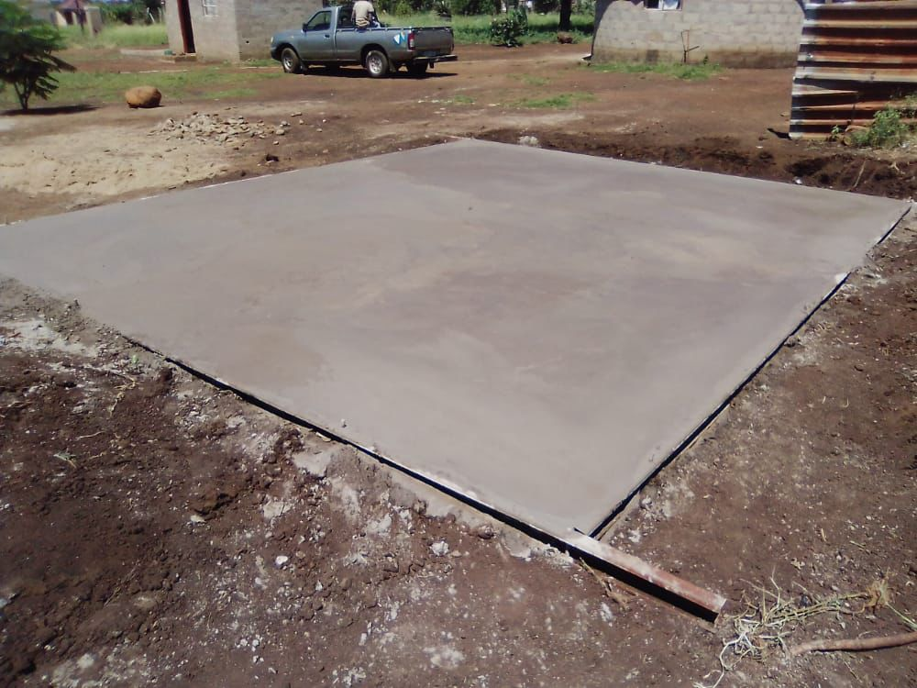
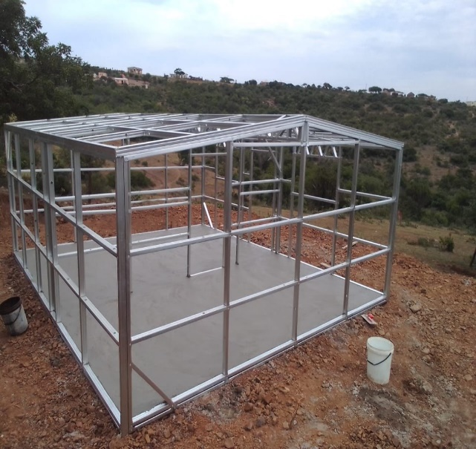
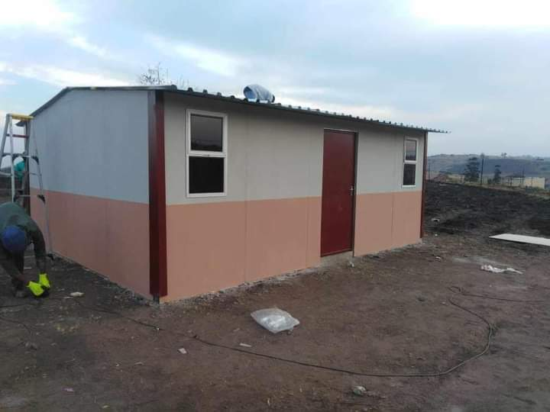
TEMPORAL RESIDENTIAL UNITS (TRUs)

Slide 25
LAND IDENTIFICATION PROCESS
Identify areas affected by floods such as informal settlements and halls and schools where people were relocated to
Identify vacant land through satellite imagery
Identify vacant land within 5 km from affected areas
Verify whether the land is vacant or not by using building structures
Assess land i.t.o geophysical constraints such as:
  proximity to rivers
  100 year flood line
  Slope
  Geohazards
  Soil stability
  Durban Metropolitan Open Space System (D’MOSS)
  Biodiversity
Confirm land ownership
Complete desktop study and submit results for physical site verification

Slide 26
SUMMARY OF AFFECTED HOUSEHOLDS
LAND IDENTIFICATION PROCESS
Process | Progress | Deadline | Comment
Identify areas affected by floods such as informal settlements and halls and schools where people were relocated to. | In process | 31 May | Most areas were located on spatial databases. Not all areas exist on databases
Identify vacant land through satellite imagery | Complete |  | 77 766 properties were identified in eThekwini Metro - This equates to 17 780 hectares
Receive asset registers from government departments | In process | 15 May | 616 properties received from NDPWI across the province 614 were located, of which bulk (258) were in eThekwini 193 properties received from PDPWI
Verify whether the land is vacant or not by using building layers | In process | 26 April | Data set received from eThekwini in 2020. - Eliminate land parcels with buildings
Assess land i.t.o geophysical constraints such as: Slope 1 in 100-year flood plain Intersected by river/streams and/or wetlands In Critical Biodiversity Area (CBA) In Ecological Support Area (ESA) In Protected Area Affected by Geohazards (active land slide, flood risk, high water table, highly erodible, steep, unstable, etc.) Identify vacant land within 5 km from affected areas and people housed in community facilities | In process | 31 May | Of the 616 NDPWI land parcels across the province 258 land parcels (41.88%) do not have geophysical constraints 15 (5.8%) out of the 258 land parcels in eThekwini do not have geophysical constraints 193 PDPWI properties need to be assessed 44 properties (22.79%) do not have geophysical constraints Of the 77 766 vacant land parcels identified in eThekwini 17 931 properties (23.05%) do not have geophysical constraints A total of 18 233 properties could be recommended for physical site visits
Confirm land ownership | Not started | 31 May | Verify ownership against existing databases and confirm with user departments
26

Slide 27
GROWING KWAZULU-NATAL TOGETHER
PROPOSAL FOR
PEMARY RIDGE SCHOOL EVACUATION DEAL
DHS to Initiate development of Temporary Residential Units (TRUs) at Pemilton site ( site owned by DPW)
3 storey walkup flats
Reservation of existing worship site
40 sqm units
Sectional title
Common area to include playlot, washing lines and waste disposal
parking

Slide 28
PROGRESS ON SUPPLY OF MOBILE CLASSROOMS
No. | DISTRICT | NO OF SCHOOLS | UPDATED REQUIREMENT | MOBILES DELIVERED | MOBILES NOT YET DELIVERED | PROGRESS UPDATE
1 | Pinetown | 17 | 38 | 38 | 0 | 16 mobiles installation are at 100 % complete (8 schools.) 1 SNP kitchen at 100% delivered 3 mobile installations at 50% complete ( 2 schools). 4 mobile installation at 30% complete ( 1 school) 5 mobiles installations at 10% complete ( 1 school). 10 mobiles installation at 0% complete(3 schools)
2 | UGu | 02 | 6 | 6 | 0 | 06 mobiles installation is 100%.
3 | Umlazi | 07 | 30(4) | 21 | 9 | 17 mobiles installation are at 100% complete ( 6 schools). 4 mobiles installation are at 60% complete– Brattonwood H School has a limited space on site to place the mobiles ( the 9 mobiles supply is currently on hold).
TOTAL |  | 26 | 74 | 65 | 9

Slide 29
SCHOOLS TO BE DONE BY DONORS- KZN GAMBLING BOARD
GROWING KWAZULU-NATAL TOGETHER
BUILDING REPAIRS | NO. | NAMES OF SCHOOLS | DISTRICT
 | 1 | AMANDLAKHE PRIMARY SCHOOL | UMGUNGUNDLOVU
 | 2 | ONGANE COMBINED SCHOOL | ZULULAND
 | 3 | LUKHASA SECONDARY SCHOOL | ILEMBE
 | 4 | ST. NIVARDS PRIMARY SCHOOL | UGU
BUILDING MATERIALS & REPLACEMENT OF LOST & DESTROYED | NO. | NAMES OF SCHOOLS | DISTRICT
 | 1 | BELVERTON SECONDARY SCHOOL | PINETOWN
 | 2 | GWADU-ZENEX PRIMARY SCHOOL | PINETOWN
 | 3 | INHLAKANIPHO HIGH SCHOOL | PINETOWN
 | 4 | MNYAMENI ZENEX SECONDARY SCHOOL | PINETOWN
 | 5 | SIYAJABULA HIGH SCHOOL | PINETOWN
 | 6 | ISIKHWELO SENIOR PRIMARY SCHOOL | UMLAZI
 | 7 | SANDAKAHLE COMBINED PRIMARY | UMLAZI
 | 8 | VUKUZAKHE HIGH SCHOOL | UMLAZI
 | 9 | ZANDILE PRIMARY SCHOOL | UMLAZI
 | 10 | UMKHUMBI HIGH SCHOOL | UMLAZI
 | 11 | DR MACKEN MISTRY PRIMARY SCHOOL | UMLAZI
:

Slide 30
SCHOOLS TO BE DONE BY DONORS
GROWING KWAZULU-NATAL TOGETHER
NO. | NAMES OF SCHOOLS | DISTRICT
1 | BELVERTON SECONDARY SCHOOL | PINETOWN
2 | GWADU-ZENEX PRIMARY SCHOOL | PINETOWN
3 | INHLAKANIPHO HIGH SCHOOL | PINETOWN
4 | MNYAMENI ZENEX SECONDARY SCHOOL | PINETOWN
5 | SIYAJABULA HIGH SCHOOL | PINETOWN
6 | ISIKHWELO SENIOR PRIMARY SCHOOL | UMLAZI
7 | SANDAKAHLE COMBINED PRIMARY | UMLAZI
8 | VUKUZAKHE HIGH SCHOOL | UMLAZI
9 | ZANDILE PRIMARY SCHOOL | UMLAZI
10 | UMKHUMBI HIGH SCHOOL | UMLAZI
11 | DR MACKEN MISTRY PRIMARY SCHOOL | UMLAZI
NO. | NAMES OF SCHOOLS | DISTRICT
1 | BRETTONWOOD HIGH | UMLAZI
2 | BRIGHT FUTURE (OLD SITE) | UMLAZI
3 | DR MACKEN MISTRY PRIMARY | UMLAZI
4 | NAGARI PRACHARIN PRIMARY | UMLAZI
5 | BRIADALE PRIMARY | UMLAZI
6 | SHERWOOD PRIMARY | UMLAZI
7 | CASTLEHILL PRIMARY | UMLAZI
8 | SPEARMAN ROAD PRIMARY | UMLAZI
9 | ISIPINGO HILLS PRIMARY | UMLAZI
10 | MARIANHILL PRIMARY | UMLAZI
11 | MEADOWLANDS TECHNICAL HIGH | UMLAZI
12 | JOSEPHINE MAKHANYA PRIMARY | UMLAZI
13 | WESTMEAD SECONDAY | PINETOWN
14 | ISIZINDA SECONDARY | PINETOWN
15 | GREEN HEIGHTS PRIMARY | PINETOWN
16 | INTAKEMAZOLO COMBINED | PINETOWN
:

Slide 31
COMPLETION TIMELINES
The revised allocation per categories as well as timeframes for the repair to be undertaken in the three categories are tabled below
Category | Number of Schools | Timeframe
A | 37 | End of June 2022
B | 100 | End of September 2022
C | 171 | End of December 2022
TOTAL | 308
:

Slide 32
FOOD SECURITY:
AGRICULTURE PROPOSED AGRIC RECOVERY ACTION PLAN
Immediate/ Short-Term Interventions:
Intervention | Details of Intervention | No. of Farmers/ People/ hectares/ livestock Affected | Quantification of Intervention | Resources Required | Responsible
Humanitarian relief to farm workers and dwellers | Food Parcels, Shelter, Food Security Packs | 745 Households | 745 Food Parcels | R1 490 000 | DALRRD Provincial Shared Service Centre, DSD and DARD
 |  | 267 Households | 267 Temporal Shelter | R53 400 000
 |  | 204 Households | 204 Food Security Pack | R2 040 000
Soil fertility support (liming and fertiliser support scheme to farmers) | DARD to provide free soil testing services to affected farmers. | 654 Farmers | 1 544 Soil samples | R1 238 000 | DARD and DALRRD
Soil Liming | Provision of lime | 2 895ha | 13 510 tons | R6 484 000 | DARD
Crop Maintenance | Provision of fertilizers | 5 789ha | 17 367 X 50kg bags | R20 840 400 | DARD
Supply household garden packages (household food security intervention) | Garden Tools, production inputs, fencing and water tanks | 500 Households | 500 Food Security Pack | R5 000 000 | DARD , DALRRD, Municipalities and Donors
Rehabilitation of infield roads | Re-gravelling, repairing of damaged roads and construction of culverts | 14 farms/ farmers affected | 29Km to be gravelled | R23 083 100 | DARD and DALRRD

Slide 33
PROPOSED AGRIC RECOVERY ACTION PLAN
Immediate/ Short-Term Interventions:
Intervention | Details of Intervention | No. of Farmers/ People/ hectares/ livestock Affected | Quantification of Intervention | Resources Required | Responsible
Support re-enforcement of Bio security measures of farms | Training and awareness | 175 Livestock projects | 350 (175 x 2) livestock farmers to be trained | To be done in-house by existing personnel including Agricultural FET Colleges (Cedara & OSCA) | DARD, Farmers, Private Sector
 | Infrastructure | 27 Projects | 110 Agricultural Infrastructure | R4 000 000 | DARD and DALRRD Provincial Service Centre
 | chemicals | 157 Projects | 157 sets of chemicals | R6 000 000
Resuscitating Livestock operations on affected farms | Procurement of feed for Cattle | 3 500 Cattle | Purchasing licks and bales | R6 000 000 | DARD , DALRRD, Municipalities and Donors
 | Procurement of feed for Pigs | 5 000 Pigs | Purchase of Grower, feed, and Finisher Feed (8 493 X 50Kg bags) | R3 100 000
 | Procurement of feed for Poultry and Stock replacement | 25 633 Poultry | Purchase of poultry feed and stock replacement | R10 381 365
Sugar cane support initiative | Fertilizer, Ratoon management and replanting | 140 farmers | 2 237ha | R71 590 400 | DARD, DALRRD and Industry
TOTAL BUDGET REQUIRED |  |  |  | R214 647 265
#PHEZ’KOMKHONO

Slide 34
SHORT TERM BUDGET REPRIORITIZATION
Intervention | Budget required | Reprioritised budget | Shortfall
Rehabilitation of infield roads | R23 083 100 | R13 762 000 | R9 321 100 | R12 million Reprioritised from Voted for Yellow plant College infrastructure (R1 762 000)
Farm workers, dwellers & Vulnerable/ substance households | R56 930 000 | R37 040 000 | R24 890 000 | Reprioritising from Food Security Voted Funds (R7 040 000) REID (R30 000 000)
Soil fertility soil PH balance support (soil testing, liming and fertiliser support scheme to farmers) | R1 238 000 | R1 238 000 | R0,00 | Reprioritised from College infrastructure
Supply household garden packages (household food security intervention) | R5 000 000 | R0,00 | R500 000
Soil Liming | R6 484 000 | R6 484 000 | R0,00 | KYD (R450 000), Land Care voted (3 000 000) Letsima (1,500 000) CASP Vet clinic (700 000) Engineering voted funds (R 1 300 000) Food Security Voted (R34 000)
Crop Maintenance | R20 840 400 | R0,00 | R19 452 000
Support re-enforcement of Bio security measures of farms | R10 000 000 | R0,00 | R10 000 000
Resuscitating Livestock operations on affected farms | R19 481 365 | R2 000 000 | R17 141 165 | Mentorship (R1 000 000), Letsima Goat project (R1000 000)
Sugar cane support initiative | R71 590 400 | R0,00 | R71 590 400
 | R214 647 265 | R60 524 000 | R154 123 265

Slide 35
PROPOSED RECOVERY ACTION PLAN CONT.
MEDIUM TO LONG-TERM INTERVENTIONS:
Intervention | Details of Intervention | No. of Farmers/ People Affected | Quantification of Intervention | Resources Required | Responsible
Replanting programme (production input support for crop enterprises) | Assistance with production inputs (Seeds, chemicals & basal fertilizer) and Mechanization | 772 farmers to be supported | 5 789ha | R75 257 000 | DARD and DALRRD
Expansion of household food security programme (household garden packages) | Garden Tools, production inputs, fencing and water tanks | 1 500 households | 1 500 set of Food Security Packs | R15 000 000 | DARD and DALRRD
Farm infrastructure rebuild (fencing, irrigation, tunnels, livestock production housing, diptanks etc.) | Rehabilitation of the Tunnels | 8 Projects | 35 Tunnels to be erected | R7 000 000 | DARD and DALRRD
 | Rehabilitation of the Fencing | 26 Projects to be fenced | 33,5 Km | R3 224 000
 | Rehabilitation of the Irrigation | 16 Projects | Rehabilitation of 57ha | R5 670 000
 | Animal Housing | 14 Projects | 14 animal houses rehabilitation | R3 038000
 | Dip Tank | 17 Projects | 17 Dip tanks rehabilitation | R2 707 300
Rehabilitation programmes / land restorations | Establishment of contours | To be assessed | To be assessed | To be assessed | DARD
TOTAL BUDGET REQUIRED |  |  |  | R111 896 300

Slide 36
VERIFIED FARMERS
DISTRICT | CROP FARMERS VERIFIED |  |  | LIVESTOCK FARMERS VERIFIED |  |  | INFIELD ROADS VERIFIED
 | NO OF FARMS/ PROJECTS | NO OF HA | COST | NO OF FARMS/ PROJECTS | NO OF LIVESTOCK | COST | NO OF FARMS | NO KM | COST
Zululand | 58 | 366.55 | R3 143 053 | 20 | 20 | R1 050 080 | 1 | N/A | R150 000
Uthukela | 32 | 480.45 | R8 131 320 | 3 | 0 | R119 000 | 0 | 0 | R0
Umzinyathi | 13 | 237.88 | R1 925 000 | 11 | 0 | R13 233 140 | 8 | N/A | R550 000
Umkhanyakude | 112 | 230.6 | R8 368 957 | 8 | 88 | R143 700 | 25 | N/A | R617 500
Umgungundlovu | 70 | 609.06 | R19 736 122 | 25 | 11 588 | R9 118 545 | 3 | 2 | R2 250 000
Ugu | 58 | 261.72 | R5 288 220 | 33 | 0 | R3 597 560 | 8 | 25 | R3 540 000
King Cetshwayo | 108 | 237.08 | R12 880 163 | 23 | 109 | R709 960 | 6 | 2 | R459 000
Ilembe | 102 | 39.34 | R27 990 056 | 22 | 325 | R331 805 | 13 | 24,9 | R6 969 280
Harry Gwala | 83 | 665.36 | R9 432 095 | 15 | Not Quantified | R2 789 000 | 7 | 0,45 | R3 670 000
eThekwini Metro | 109 | 746.51 | R4 415 000 | 8 | 500 | R281 900 | 7 | 0,104 | R2 250 000
Amajuba | 81 | 671.6 | R6 550 367 | 10 | 140 | R1 797 270 | 11 | 13 | R1 428 200
Total | 826 | 4546.15 | R107 860 353 | 178 | 12 770 | R33 171 960 | 89 | 67,454 | R21 883 980
#PHEZ’KOMKHONO

Slide 37

ETHEKWINI METRO
WATER SUPPLY STATUS
INNER WEST REGION
Supply to this region has improved from 30% to 80%
SOUTH REGION
Supply to this region has improved from 15% to 75%
NORTH REGION
Supply to this region has improved from 40% to 45%
CENTRAL REGION
Supply to this region has improved from 45% to 72%
OUTER WEST REGION
Supply to this region has improved from 45% to 70%

Slide 38
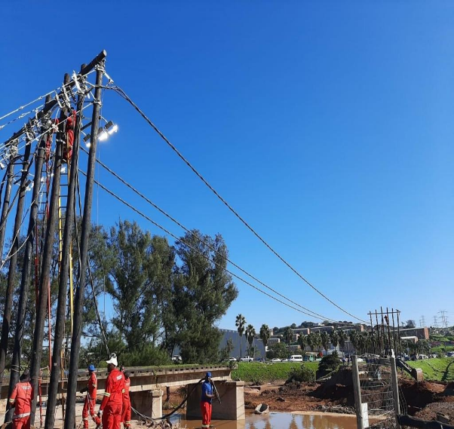
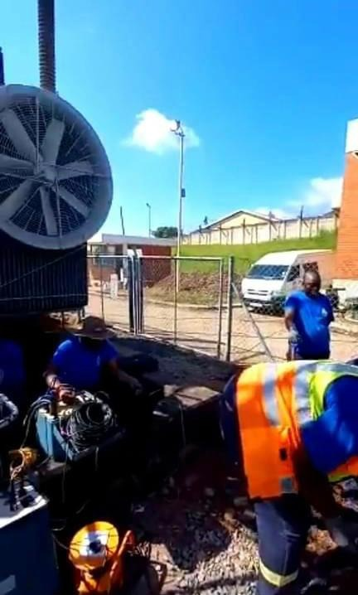
ETHEKWINI ELECTRICITY INTERVENTIONS
Electricity staff is hard at work ensuring that power is restored around uMlazi Mega City and surrounding areas where a bridge collapsed and electrical equipment was washed away.
EThekwini technicians are working round the clock to repair the Marianridge High Voltage Substation which serves several communities around Marianridge. The sub station was damaged in a fire recently.

Slide 39

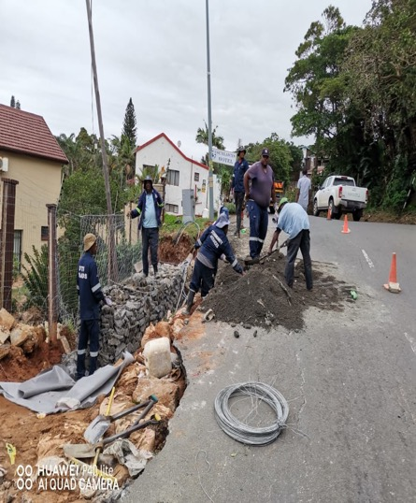
UGU INTERVENTIONS
WATER SYSTEMS DAILY PRODUCTION
Water Supply System | Design Capacity | Average daily Production (Ml/day) (Pre Floods) | Deficit/Shortfall (Ml/d) (Post floods) | Baseline Demand | Remarks/Status Quo
Mhlabatshane Water Treatment Works | 6Ml/Day | 4Ml/Day | 2Ml/Day | 12Ml/Day | There are a number of pipe breaks that were found in this system thus affecting the supply. All pipes that were damaged as results of flood damages were attended and resolved. Systems is running as normal.
KwaLembe Water Treatment Works | 0.75Ml/Day | 0.75Ml/Day | 0Ml/Day | 1.5Ml/Day | Filter pump has been installed. The plant is back online, and KwaLembe Abstraction Chamber has been cleaned, silt removed. Team will start the plant up and follow through the system for pipe leaks and restore supply.
Ndelu Water Treatment Works | 1.4Ml/Day | 1.4Ml/Day | 0Ml/Day | 2.5Ml/Day | There are a number of pipe breaks that were found in this system thus affecting the supply.
Vulamehlo Water Treatment Works | 4.5Ml/Day | 2Ml/Day | 2.5Ml/Day | 7Ml/Day
Pipe Replacement and Road construction- Main Bermuda Way

Slide 40
UMGUNGUNDLOVU DISTRICT MUNICIPALITIY
OTHER INTERVENTION REQUIRED
Due to heavy rains and floods that have affected the road conditions in rural areas, the community that are relying on water tankers for water supply are affected. When the access roads are slippery, the water tankers are unable to deliver water to those affected areas. The areas that are mostly affected include the following local municipalities: Richmond, Umngeni, Impendle and Mpofana.
There is a need for these areas to have boreholes that will supply community with water and this will also result to a number of water tankers that are going to these areas to be reduced. The community will have access to borehole water which will be tested to ensure that it meets the acceptable drinking water quality standards. The project will benefit about 3082 households
Installation of boreholes will be implemented once funding is available

Slide 41

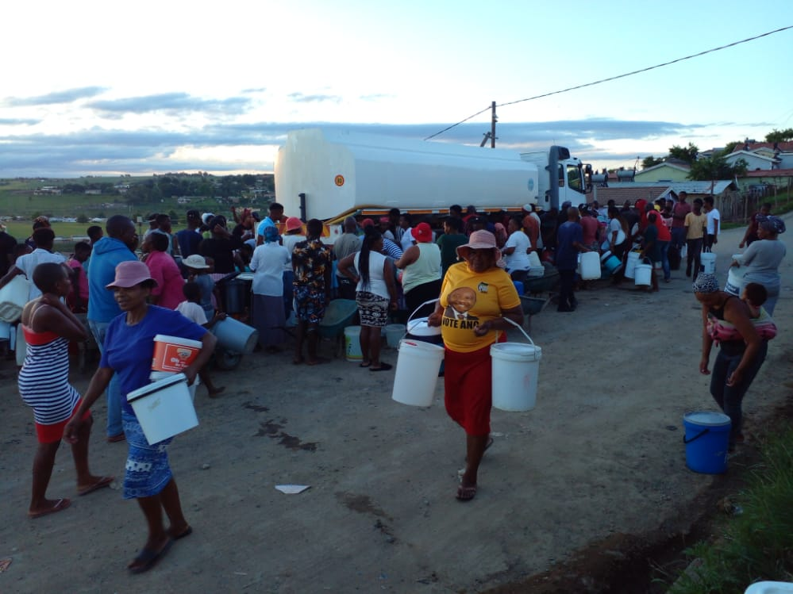
UMGUNGUNDLOVU WATER INTERVENTIONS
Mpofana LM
The water tankers collected water from 12 April 2022 Springroove water point in Rosetta for distribution in Bruntville because the raw water abstraction pump was submerged in the water.
Richmond LM
The meter box at Embuthisweni, Richmond was affected, hence three water tankers delivered water to affected areas.

Slide 42
ILEMBE RIVER POLLUTION MONITORING
ILembe District Municipality - Wastewater Treatment Works Effluent Compliance Affected by April 2022 Floods
STW Name | River discharged into | Effluent Compliance before 11/04/2022 | Effluent Compliance After 11/04/2022 | Comments
Sundumbili WWTW | Mandeni river which feeds Uthukela River | 5 April 2022- Ammonia (13 mg/L), Electrical Conductivity (130 mS/m), Chemical Oxygen Demand (172 mg/L), E.Coli Bacteria (>2420 MPN/100mL), Suspended Solids (63mg/L) and Residual Chlorine (0.45 mg/L) | No results yet -Weekly Sample | STW was flooded. Plans currently underway to ensure that second re-prioritization commences to ensure interim repairs while awaiting long term interventions..
Mandeni | Uthukela River | 5 April 2022- Chemical Oxygen Demand (204 mg/L) | No result yet - Monthly Sample | STW not affected by floods
Tugela | Uthukela River | 5 April 2022- E.Coli Bacteria (>2420 MNP/ 100mL) and Ammonia (13.4 mg/L) | No result yet - Monthly Sample | STW not affected by floods
Montebello | Umdlotshana Stream which feeds Umdloti River | 5 April 2022- Ammonia (24mg/L), Chemical Oxygen Demand (162 mg/L), E.Coli Bacteria (2420 MPN/100 mL) and Suspended Solids (73 mg/L) | No result yet - Monthly Sample | STW was flooded but back in operation
Mphumulo |  | 04 April 2022 - Ammonia (12.6mg/L); COD (113 mg/L); E.coli (2420 MPN/100ml); Suspended Solids (38 mg/L). | No result yet - Monthly Sample | STW not affected by floods
Ntunjambili |  | 05 April 2022 - Ammonia (2.05mg/L); COD (46 mg/L); E.coli (2420 MPN/100ml); Suspended Solids (10 mg/L). | No result yet - Monthly Sample | STW not affected by floods
Vukile |  | 04 April 2022 - Ammonia (4.39mg/L); COD (46 mg/L); E.coli (313 MPN/100ml); Suspended Solids (51 mg/L). | No result yet - Monthly Sample | STW not affected by floods

Slide 43
DISTRICTS WATER TANKER SERVICES
 | Ugu |  | eThekwin | iLembe | KCDM | Mgungundlovu
Internal | 19 |  | 77 | 41 | 39 | 3
Hired | 12 |  | 42 | 4 | 36 | 36
Motsepe Foundation | - |  | 20 | - | - | -
SANDFG | - |  | 8 | - | - | -
DWS | 13 |  | 32 | 12 | - | -
COGTA | 8 |  | 7 | 8 | - | 2 (Msunduzi)
TOTAL | 52 | 186 |  | 65 | 75 | 41

Slide 44
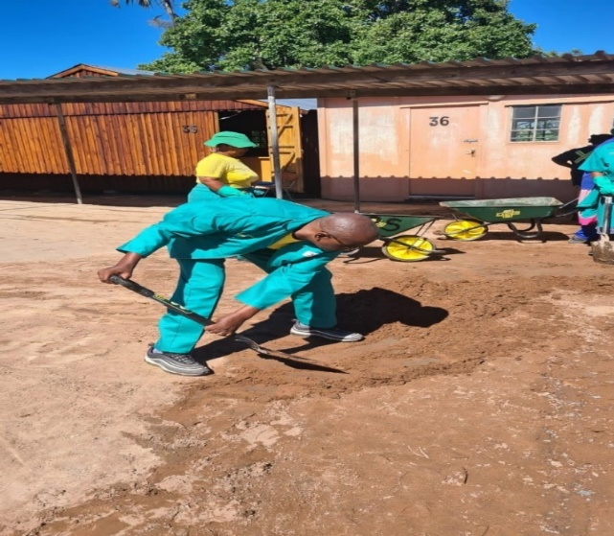
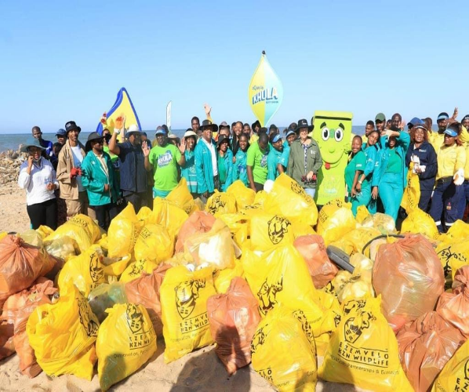
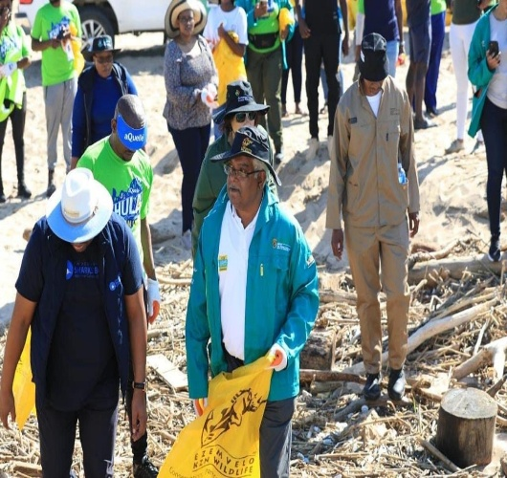
CLEAN UP CAMPAIGN
To support the efforts of normalising the situation and the environmental impact post floods, COGTA is implementing a clean-up campaign in the affected Districts.
The campaign is implemented through the utilisation of Community Works Programme participants and the other component involves the use of yellow plant as a supplementary resources.
The campaign commenced on the from the 19th April 2022 in Ugu, eThekwini, iLembe, King Cetshwayo, Amajuba and Umgungundlovu.
Work is proceeding however the teams can benefit from additional equipment and PPE to ensure safety as well as improve efficiency and area coverage.
On the 29th April 2022, the Minister for Forestry, Fisheries and Environment, Barbara Creecy together with MEC for Economic Development, Tourism and Environmental Affairs, Ravi Pillay led a beach clean up at the Coastline of Durban Beach.

Slide 45
ECONOMIC RECOVERY AND RECONSTRUCTION
KZN ECONOMIC IMPACT
KZN has suffered three major setbacks within a short space of time: Covid 19, Social Unrest and April 2022 Floods
The most impacted were cities in the coastline with Greater eThekwini being the most impacted by floods
The floods affected both economic and social infrastructure
DTIC Survey data shows that at least 826 companies were affected and the cost of the damages to the companies is estimated at R6.4 billion
Recently President Ramaphosa, accompanied by key Ministers visited the province to engage with business on government’s response to the disaster. The greatest threat identified by business were:
  Lack of maintenance of municipal infrastructure (aged and ageing) particularly, storm water drainage, sewer, energy, water
  the possibility of being rendered “uninsurable” due to the lack of maintenance on municipal infrastructure
  Safety and security, particularly linked to the radical business forums and the security of the cargo when moving on the N3
The emerging threat is on the economic hub of the South Durban Basin (ranked as the second most profitable hub Nationally) and the second hot-bed being Ladysmith
With the recent floods and the damage to Toyota resulting in their temporary closure in the Durban South basin, an estimate of over 30,000 employees across the manufacturing industry is out of work currently. This means that employees could be without pay for approx. 3 months given the severity of damage at TSAM. Proposal to consider utilising TERS approach
Through involvement of key role-players, prepare an integrated solution to developing a climate resilient infrastructure

Slide 46
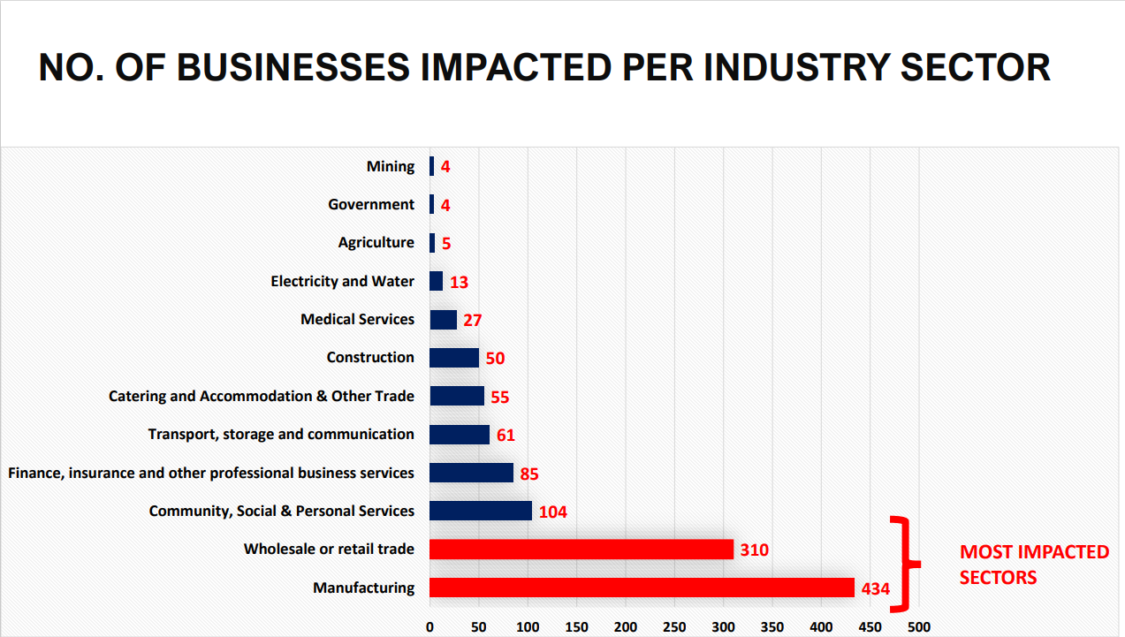

Slide 47
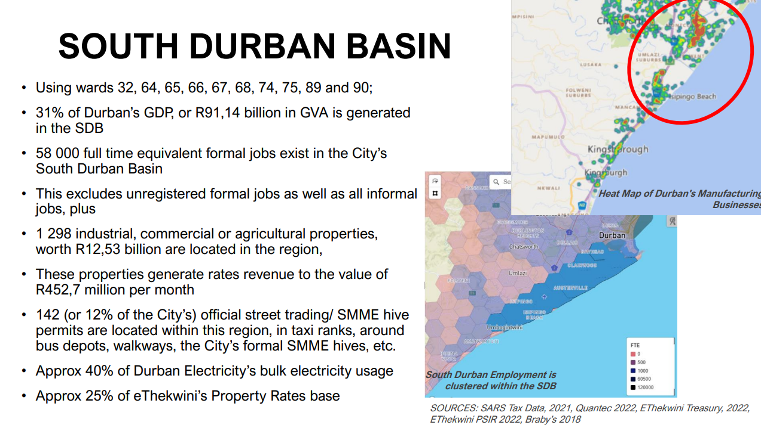

Slide 48
ECONOMIC RECOVERY INTERVENTIONS
Work with the private sector to identify affected businesses and Quantifying the flood damage;
Re-prioritisation of budgets;
Measures to assist Spaza shops in Townships;
DTP assisting with Warehousing for food parcels;
Beach clean-up campaigns by Sharks board;
Tourism sector interventions;
SMME relief for infrastructure – A committee led by EDTEA to devise interventions;
Working with Toyota and other big businesses to bring production back; and
Informal sector interventions .

Slide 49
INTERVENTIONS BY EDTEA
Repurposing of R67.5 million towards SMME and COOPs Relief Fund has been approved by Provincial Treasury.
The Fund will prioritise Township, Rural Businesses and Informal Traders,
The relief fund will prioritize SMMEs that have been affected by floods in the following districts:
  EThekwini Metro
  Ilembe District
  King Cetshwayo District; and
  uGu District
EDTEA and Trade and Investment KwaZulu-Natal are in discussion on the implementation protocols, inline with the existing model by TIKZN as reported previously
A criteria to access the fund will be made public once it has been approved.
A service level agreement will be signed by EDTEA and TIKZN

Slide 50
PROPOSED AREAS OF UN SUPPORTOMMUNI
Social Development (Immediate Humanitarian Aid)
Health
Education
Agriculture
Disaster Risk Management and Coordination
Support to Economic Recovery
Department of Social Development
Department of Health
Department of Education
Department of Agriculture
Department of Cooperative Governance and Traditional Affairs
Department of Employment and Labour and Department of Small Business Development
IOM
UNHCR
UNFPA
OHCHR
WFP
OCHA
UNODC
UNICEF
UN Women
OCHA
UNDP
UNAIDS
WHO
UNFPA
UNICEF
UNESCO
UNDP
FAO
WFP
UNICEF
OCHA
UNDP
UN Habitat
ILO
UNDP
ILO
UNESCO
UNICEF

Slide 51
RESOURCES AVAILED BY UNCT
Stream/Cluster | UN Support
 | UN Funds Allocated | UN Technical Support | Assistance Already Delivered/Ongoing Implementation
Social Development (immediate humanitarian aid) | ZAR 6 845 000 | IOM, UNHCR, UNFPA, OHCHR, WFP, UNODC, UN Women, OCHA, UNICEF, ILO, UNDP | UNFPA has delivered 2500 dignity kits valued at R300 000 to the DSD. UNICEF
Health | ZAR 3 660 000 | UNAIDS, WHO, UNFPA, UNICEF, UNESCO, UNDP
Education | ZAR 1 725 000 | UNICEF, UNESCO
Agriculture | ZAR 150 000 | FAO, WFP, UNICEF (nutrition) | FAO completed a geospatial analysis of the flood impacts on crops in KwaZulu-Natal and Eastern Cape provinces of South Africa
Disaster Risk Management and Coordination | ZAR 3 950 000 | UNDP, UN Habitat, ILO
Support to Economic Recovery | ZAR 1 425 000 | UNDP, ILO
Repurposed Funds | ZAR 17 755 000
Pipeline Donor Funding | ZAR 3 900 000
Total Funding | ZAR 21 655 000

Slide 52
SECTOR DEPARTMENTS FUNDING REQUESTS
SECTOR DEPARTMENTS
No | Name of Applicant | Required Amount | Own Funding/ Contribution | Shortfall | DESCRIPTION OF DAMAGES
1 | DEPT OF EDUCATION | R202 240 077,30 | R20 350 000,00 | R181 890 077.30 | 167 damaged school infrastructure and provisions of mobile classes.
2 | DEPT OF AGR & RURAL DEVEL | R 331 264 365,00 | R58 524 000,00 | R 272 740 365.00 | Livestock, Infrastructure for Farm Dwellers (houses), Agriculture infrastructure such as Access roads, Fencing, water pumps and irrigation systems and crops
3 | HEALTH | R259 206 284,84 | R21 336 173,00 + R125 000 000,00 to be reprioritized through HFRG | R112 870 111,84 | 88 health facilities that include, Clinics, Community Health Centre, EMS base, Hospitals, Laundry, Nursing campus, Office accommodation and Pharmaceutical depot.
4 | SOCIAL DEVELOPMENT | R 239 423 132,00 | R0,00 | R 239 423 132 | Top up of Immediate social relief to continuously manage shelters for homeless, including the provision of security.
5 | HUMAN SETTLEMENTS | R2 127 542 632,24 | R515 975 906,24 | R1 611 566 726 | 788 Temporary Services, 4983 Temporary Accommodation Units 4983 Replacement of Houses 8199 Repairs to partially destroyed houses. 2500 Repairs to services 2000 Retaining of Walls 8310 Supply of building material 200 repairs to flats and hostel Technical assessments and appointment of professionals.
6 | DEPT OF SPORT, ARTS & CULTURE | R16 758 000 | R0,00 | R16 758 000 | Repairs to 39 facilities TO CONSIDER REPRIORITISATION FROM COE.
7 | COGTA | R23 636 070.00 | R0,00 | R23 636 070.00 | Repairs to 15 Community Service Centres (CSCs) and Traditional Administrative Centres (TACs)
8 | DEPT OF TRANSPORT | R 5 608 731 584 | R2 910 890 588 | R2 697 840 996 | Repairs and constructions of bridge and road network infrastructure.

Slide 53
STATE OWNED ENTERPRISES FUNDING REQUESTS
NO. | Organ of State | Summary of Projects | Own Funding | Requested Amount
01 | PRASA | Perway | R0.00 | R1 707 000 000,00
 |  | Signals | R0.00 | R126 000 000,00
 |  | Electrical | R0.00 | R813 000 000,00
 |  | Telecoms | R0.00 | R24 500 000,00
 |  | Stations | R0.00 | R221 200 000,00
 |  | Sub-total | R0.00 | R2 891 700 000,00
02 | Umgeni Water | R0.00 | R0.00 | R857 500 000,00
 |  | Sub-Total | R0.00 | R857 500 000,00
03 | Dept of Economic Development, Tourism and Environmental Affairs Entities | Ezemvelo KZN Wildlife | R0.00 | R93 720 000,00
 |  | Ithala | R0.00 | R45 000 000,00
 |  | KZN Sharks Board | R0.00 | R3 585 000,00
 |  | Sub-Total | R0.00 | R142 305 000,00

Slide 54
MUNICIPAL SUBMISSIONS
NO | NAME OF APPLICANT | REQUEST LETTER | TEMPLATE | BUSINESS PLAN | Required Amount | Own Funding | Shortfall
UMGUNGUNDLOVU DISTRICT
1 | UMgungundlovu | Submitted | Submitted | Submitted | R119 574 132.00 | R0.00 | R119 574 132.00
2 | Mpofana | Submitted | Submitted | Submitted | R 86 000 000.00 | R0.00 | R 86 000 000.00
3 | Msunduzi | Submitted | Submitted | Submitted | R 343 794 712.00 | R0.00 | R343 794 712.00
4 | Mkhambathini | Submitted | Submitted | Submitted | R 67 980 000.00 | R0.00 | R 67 980 000.00
5 | Impendle | Submitted | Submitted | Submitted | R 15 600 000.00 | R0.00 | R 15 600 000.00
6 | uMngeni | Submitted | Submitted | Submitted | R 48 107 000.00 | R0.00 | R 48 107 000.00
7 | Mshwathi | Submitted | Submitted | Submitted | R 9 450 000.00 | R0.00 | R 9 450 000.00
8 | Richmond | Submitted | Submitted | Submitted | R29 850 000.00 | R0.00 | R29 850 000.00
AMAJUBA DISTRICT
9 | Newcastle | Submitted | Submitted | Submitted | R 107 500 000.00 | R0.0 | R 107 500 000.00
10 | Emadlangeni | Submitted | Submitted | Submitted | R 141 694 000.00 | R25 855 000.00 | R 115 839 000.00
HARRY GWALA DISTRICT
11 | Harry Gwala | Submitted | Submitted | Submitted | R 7 600 000.00 | R0.00 | R 7 600 000.00 Application is not relevant
12 | UBuhlebezwe | Submitted | Submitted | Submitted | R115 000 000.00 | R0.00 | R115 000 000.00
13 | Dr NDZ | Submitted | Submitted | Submitted | R46 060 000.00 | R0.00 | R46 060 000.00
14 | Greater Kokstad | Submitted | Submitted | Submitted | R 46 060 000.00 | R0.00 | R 46 060 000.00
15 | uMzimkhulu | Submitted | Submitted | Submitted | R 44 000 000.00 | R0.00 | R 44 000 000.00
UGU DISTRICT
16 | UGu | Submitted | Submitted | Submitted | R85 156 200.00 | R0.00 | R85 156 200.00
17 | UMdoni | Submitted | Submitted | Submitted | R 429 650 000.00 | R0.00 | R429 650 000.00
18 | Ray Nkonyeni | Submitted | Submitted | Submitted | R861 217 600.00 | R0.00 | R861 217 600.00
19 | Umuziwabantu | Submitted | Submitted | Submitted | R34 788 850 000 | R0.00 | R34 788 850 000
20 | Umzumbe | Submitted | Submitted | Submitted | R182 485 000.00 | R0.00 | R182 485 000.00
ILEMBE DISTRICT
21 | ILembe | Submitted | Submitted | Submitted | R99 550 000,00 | R0.00 | R99 550 000,00
22 | Mandeni | Submitted | Submitted | Submitted | R382 900 000,00 | R0.00 | R382 900 000,00
23 | KwaDukuza | Submitted | Submitted | Submitted | R 1 054 473 516 | R0.00 | R 1 054 473 516
24 | Maphumulo | Submitted | Submitted | Submitted | R 756 202 000.00 | R0.00 | R 756 202 000.00
25 | Ndwedwe | Submitted | Submitted | Submitted | R 534 347 000.00 | R0.00 | R534 347 000.00
UTHUKELA DISTRICT
26 | uThukela | Submitted | Submitted | Submitted | R69 734 898.00 | R0.00 | R69 734 898.00
27 | Inkosi Langalibalele | Submitted | Submitted | Submitted | R43 000 000.00 | R0.00 | R43 000 000.00
28 | Alfred Duma | Submitted | Submitted | Submitted | R149 975 867.44 | R460 000.00 | R 149 515 867.44
29 | Okhahlamba | Submitted | Submitted | Submitted | R34 547 360.18 | R0.00 | R34 547 360.18
KING CETSHWAYO
30 | King Cetshwayo | Submitted | Submitted | Submitted | R 43 380 000.00 | R0.00 | R 43 380 000.00
31 | uMfolozi | Submitted | Submitted | Submitted | R 128 300 000.00 | R0.00 | R 128 300 000.00
32 | Mthonjaneni | Submitted | Submitted | Submitted | R 36 600 000.00 | R0.00 | R 36 600 000.00
33 | uMhlathuze | Submitted | Submitted | Submitted | R 182 116 000.00 | R0.00 | R 182 116 000.00
34 | uMlalazi | Submitted | Submitted | Submitted | R105 425 100.00 | R0.00 | R 105 425 100.00
UMZINYATHI DISTRICT
35 | Nquthu LM | Submitted | Submitted | Submitted | R163 500 000.00 | R.00 | R163 500 000.00
UMKHANYAKUDE DISTRICT
36 | UMhlabuyalingana | Submitted | Submitted | Submitted | R103 452 000.00 | R0.00 | R103 452 000.00
37 | Mtubatuba | Submitted | Submitted | Submitted | R 11 730 000.00 | R0.00 | R 11 730 000.00 Application is not relevant
ZULULAND DISTRICT
38 | Zululand | Submitted | Submitted | Submitted | R 49 925 000.00 | R0.00 | R 49 925 000.00
39 | uPhongolo LM | Submitted | Submitted | Submitted | R 21 840 000.00 | R0.00 | R 21 840 000.00
40 | eDumbe | Submitted | Submitted | Submitted | R28 000 000.00 | R0.00 | R28 000 000.00
41 | ULundi | Submitted | Submitted | Submitted | R5 000 000.00 | R0.00 | R5 000 000.00
ETHEKWINI METRO
42 | EThekwini Metro | Submitted | Submitted | Submitted | R 5 678 381 607 | R0.00 | R 5 678 381 607

Slide 55
ZULULAND DISTRICT
38 | Zululand | Submitted | Submitted | Submitted | R 49 925 000.00 | R0.00 | R 49 925 000.00
39 | uPhongolo LM | Submitted | Submitted | Submitted | R 21 840 000.00 | R0.00 | R 21 840 000.00
40 | eDumbe | Submitted | Submitted | Submitted | R28 000 000.00 | R0.00 | R28 000 000.00
41 | ULundi | Submitted | Submitted | Submitted | R5 000 000.00 | R0.00 | R5 000 000.00
ETHEKWINI METRO
42 | EThekwini Metro | Submitted | Submitted | Submitted | R 5 678 381 607 | R0.00 |  | R 5 678 381 607

Slide 56
RECOMMENDATIONS
IT IS RECOMMENDED THAT THE MEMBERS NOTE:
  THE CONTENTS OF THE REPORT;
  THE CURRENT DAMAGE COST ESTIMATES AT R25 BILLION
  RESPONSE AND RECOVERY INTERVENTIONS COORDINATED AND PROVIDED BY ORGANS OF STATE;
  MUNICIPALITIES AND SECTOR DEPARTMENTS HAVE SUBMITTED BUSINESS PLANS TO PROCESS THE FUNDING APPLICATIONS TO NDMC THROUGH THE PDMC.
  THAT SECTORS AND MUNICIPALITIES HAVE REPRIORITISED THEIR BASELINE BUDGETS TO RESPOND TO IMMEDIATE NEEDS AND RECOVER SOME MUNICIPAL SERVICES SUCH AS WATER , SANITATION ,ROADS AND ELECTRICITY

Slide 57


THANK YOU
GROWING KWAZULU-NATAL TOGETHER
57

