Slide 1

Briefing to Parliament
Monitoring Report on the National Development Plan Indicators
NPC Secretariat

Slide 2

Contents
1
Introduction, Locating Current Conjuncture, Planning Perspective
2
Challenges identified in the NDP
3
Internal and External Factors Shaping SA’s development
4
NDP Goals and Approach
5
Main review findings: The economy, the people and the state
6
Pathways for implementation of NDP 2021-2030
7
Implementation, Monitoring, Measurement
8
Conclusion

Slide 3

Introduction
Since NDP was adopted, progress has been slow towards achieving its main goals
SA underperforming on various targets, esp. poverty, unemployment & inequality, now aggravated by COVID-19
Social Protection & social wage has been key, and now more critical
Progress achieved on some health, education, & access to services indicators
A re-invigorated implementation strategy with credible delivery mechanisms and priorities is required
A focused and committed leadership across society, as well as a stronger role by the private sector and other social partners remains critical.
It is important to improve the quality and efficiency of government spending through better planning, streamlining the institutions of government, being decisive in professionalising the public service and stabilising management and leadership within the state

Slide 4



Locating the current conjuncture
NDP since 2012
Inform priorities for
Reviewed the MTSF 2019-2024
DPME
MTSF 2019-24
7 Priorities of the 6th Administration
2024
Remainder of mid-term 2024
Priorities for remainder of medium-term to 2024, and pathway to 2030 should reflect:
Review of performance on NDP
Review of MTSF
Plans responding to COVID-19 Sectoral plans (ERRP, Infrastructure Plan, etc) remaining towards 2030.
2030
Pathways to 2030
Economic Recovery and Reconstruction Plan (ERRP) – short term responses to current COVID-19 challenges and the recent civil unrest and what is being proposed about them
In line with its mandate as long term planning and advisory think tank, the NPC undertook a review of implementation and progress with NDP top goals since adoption in 2012.
NDP Implementation towards 2030
MTSF 2024-29

Slide 5
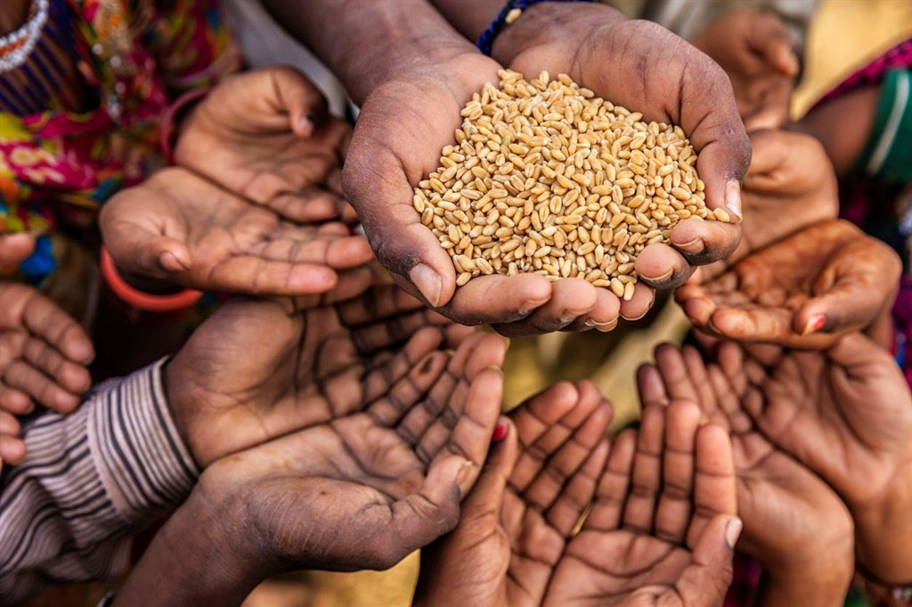





Long Term Planning Perspective
OUTLINED IN REVISED GREEN PAPER – NATIONAL DEVELOPMENT PLANNING OF 2010
THE NDP REVIEW ASKED…
“We need a long term perspective …
to reduce poverty and extreme inequalities…
Growth and development, strengthening institutions, nation-building and a developmental state are long term projects. A single term of government is too short a time…
“Lack of a coherent long term plan has weakened ability to provide clear and consistent policies…
to mobilise all of society…
to prioritise resource allocations…
to drive implementation
In addition, weaknesses in coordination of government have led to policy inconsistencies and poor service delivery outcomes.”
How has the NDP been implemented?
What course correction is needed?
What needs to change?
What has been the impact?

Slide 6

Long Term Planning Perspective
WE ARE HERE
NDP Adopted
MTSF 2014-2019
MTSF 2019-2024
2012
2014
2019
POVERTY
MTSF 7 PRIORITIES
NDP
2030
ERRP
UNEMPLOYMENT
Infrastructure, Sectoral, Skills, Plans
INEQUALITY
MID-TERM REVIEW OF IMPLEMENTATION
Where are we?
What to prioritise?
  to 2024
  to 2030

Slide 7








NDP Responds to SA’s Core Challenges
NPC revisited its Diagnostic of 2010 and affirmed it is still valid
Too few jobs
Build a Capable State
Spatial Divides
Divided
Communities
High Disease Burden
Resource Intensive Economy
Corruption
Poor Education
Crumbling
Infrastructure

Slide 8


Internal and External Factors Shaping SA’s development
Internal & external factors influence SA’s development trajectory
Some are in NDP and other plans
Globalisation is prone to cycles of crises – and countries have unequal capacity to respond
This evident in current COVID-19 global health crisis (vaccine nationalism; implications for tourism); what lessons for future?
A multipolar world with China as emerging power, but US-China fallout had global repercussions, also for world trade system
Anti-globalist/inward-looking shifts – e.g Brexit, with implications for SA.
Climate
change
Migration.
Rising African economy, continental integration, but instability remains (e.g. Swaziland, Mozambique, etc).
Population growth (currently outpacing GDP growth) & Youth bulge/Demographic dividend.
Technological advances (4IR opportunities; digital divide).

Slide 9





“Vision without action is merely a dream. Action without vision just passes the time. Vision with action can change the world” – Joel Barker
AGENDA 2030
AGENDA 2063
ACTION
DOMESTICATION
NATIONAL DEVELOPMENT PLANS AND STRATEGIES

Slide 10
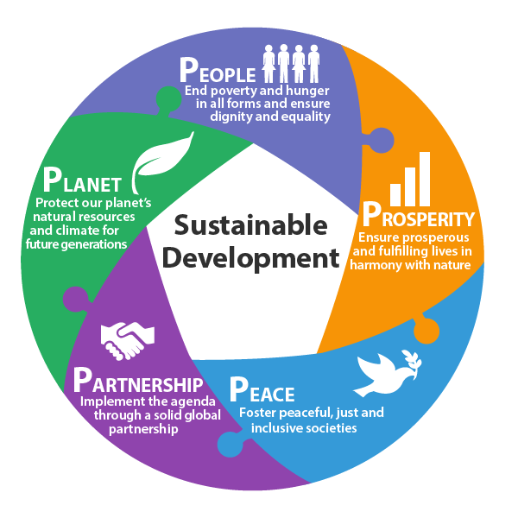
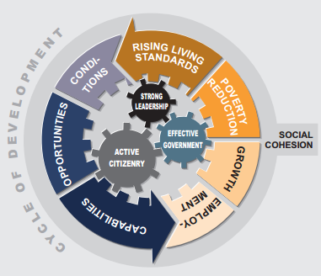
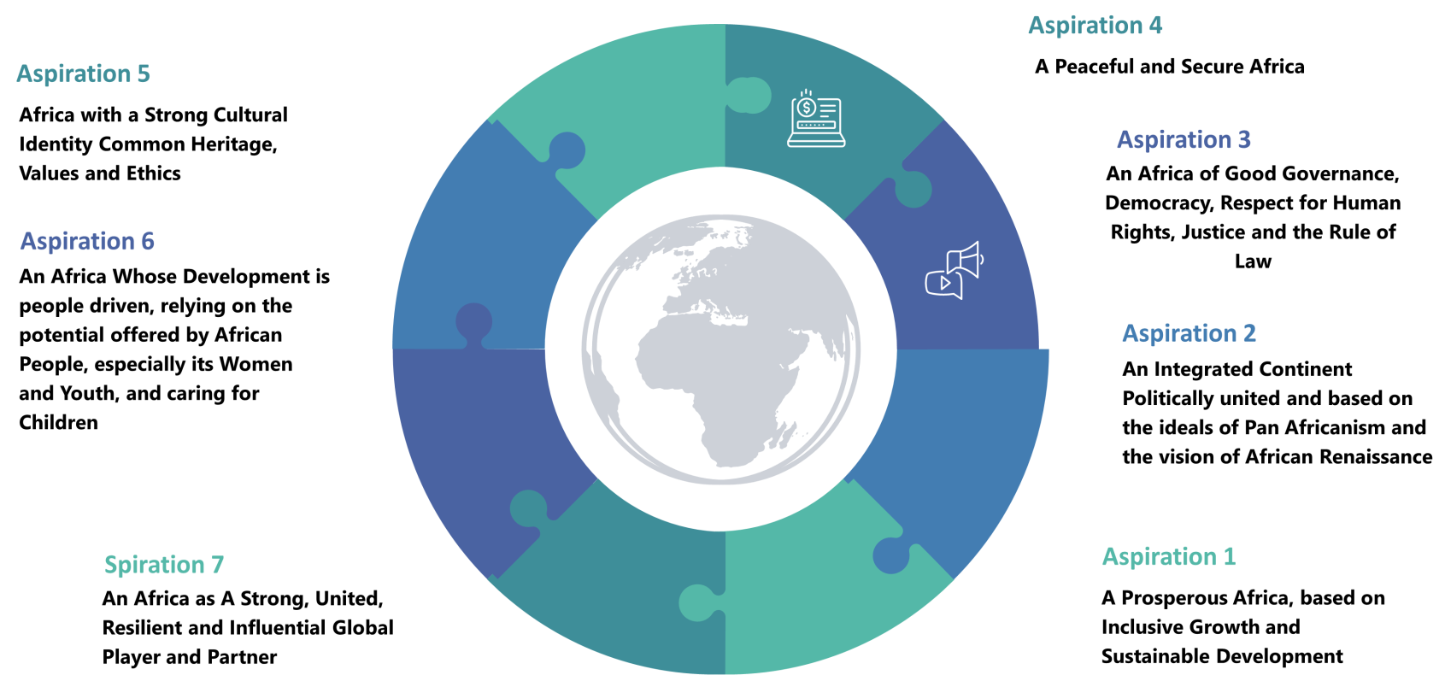
NDP and the SDGs/Agenda 2063

Slide 11
SDG and Agenda 2063 targets addressed by NDP

Slide 12
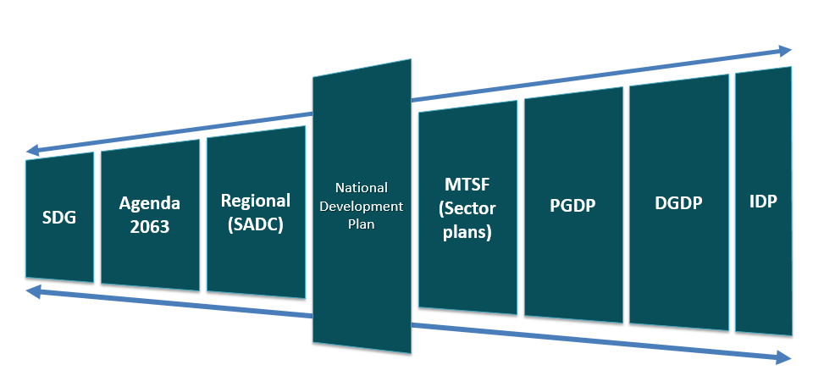
Alignment of development agendas and plans

Slide 13
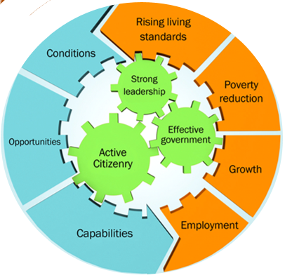
NDP Approach to Change
Virtuous cycle of development:
Raising living standards through increasing inclusive growth, employment, social wage and good quality public services. Interlinked with improved education, rising incomes and broadening opportunities for all.
Key is to build Capabilities of People, the State and the Economy.

Slide 14


NDP Goals
ERADICATE POVERTY
39% (2012)
people living below the poverty line of R419 (2009 prices).
REDUCE INEQUALITY
through a range of policy interventions, so that by 2030
SA would be a more prosperous and equal society.
To achieve this, SA had to:
Grow economy by 5.4% per annum over twenty years.
Create about 11 million new jobs.
NEXT SLIDES SHOW PERFORMANCE TOWARDS ACHIEVING NDP GOALS

Slide 15
Poverty
Poverty rates improved significantly to 2011, but progress stalled thereafter
Global evidence shows that it is possible to make dramatic inroads into reducing poverty
Income poverty: Those living below the lower bound poverty line decreased from 51% of population in 2006 to 36.4% in 2011, increasing again to 40% in 2016.
Social wage: Played an important role and Covid-19 has emphasized the need, especially the social grants. However, the key is raising employment, stronger service delivery and reduced cost of living.
Asset poverty is deep. Central concerns are related to land redistribution, low-income housing; the deeds registry system; too few people have a pension; and high indebtedness.

Slide 16
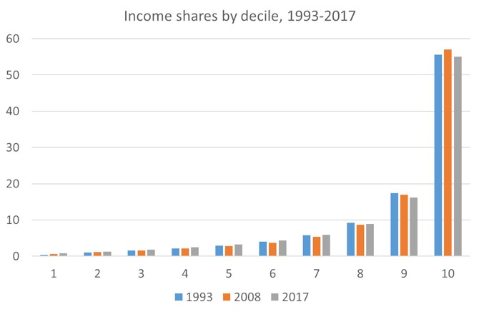
Reducing Inequality is too Slow
Income Inequality
GINI is 0.68, hence South Africa remains the most unequal society.
90%-95% of wealth concentrated in top decile, compared to global average of 55-60%.
5% of wealth in bottom 40% of population.
Most significant difference in SA is that middle class (decile 5-9) have such a small asset base.
This will have significant impact on pathways for inter-generational class mobility.
Income Shares by Decile (1993 – 2017)
GINI Trends (1993-2017)
1993
2008
2017
0.67
0.67
0.65
Wealth Inequality
Note: Measure of wellbeing is per capita household income after direct taxes and transfers. Deciles contain equal numbers of people. Census weights have been applied.

Slide 17
Employment growth is not sufficient
Employment grew but trend does not meet NDP target
Employment target for 2030 unlikely to be met
  2.5 million jobs created between 2010-19.
  Four concerning trends
    By 2019, employment shortfall was 1.5m, or about 60% of the target. Challenge is bigger from 2020.
    Falling employment in manufacturing (2010-2019) - 313,000 jobs lost.
    Share of small firms in total employment fell from 64% to 55% between 2008 and 2015. Absolute numbers hardly grew.
    Youth employment stagnated.
  Trends of unemployment since 2012 has been upward.
  The original target of full employment by 2030 can no longer be achieved.
  Vulnerable and informal workers need social protection.
  COVID-19 is making it even harder, given that unemployment rate is 34.4%.
  It is still imperative to commit to full employment as a top priority.
NPC recommends expansion of PEPs (incl. EPWP; new social employment and community care) to achieve target of at least 2m participants p.a by 2023.

Slide 18
The Economy (1/2)
Growth is too slow; and capacity of economy has fallen
SA has a long-term path of low per capita growth, that is not sustainable given our challenges
NDP target by 2020 was to lift growth to average 4.6%
  employment expands by about 0.6% to 0.7% for every 1% GDP growth.
With NDP implementation growth would have been above average, with rebound from global economic crisis.
Instead, average growth was 2.2% and has fallen to -7.0% in 2020, due to COVID-19
This significant loss of economic capacity means a rebound is challenging.
Population growth is 1.6%pa, which means the we are getting poorer.
Countries on par or at lower level in 1960s, lifted up with generations of commitment to structural change & investment in people
Even after 1994, upper middle-income countries (excl China) passed SA.
In 2002, SA was 5% below average per capita income of UMICs; by 2013 SA was 18% below.

Slide 19

The Economy (2/2)
SA pattern of economic growth does not generate jobs and livelihood opportunities at required scale to overcome unemployment and poverty
SA struggles with legacy of deep structural challenges:
  high levels of concentration across many sectors
  barriers to entry for SMMEs
  declining manufacturing and dominance of services (skills intensive)
  misalignment of skills production/supply vs. skills demand
  highly polarised incomes; concentrated ownership and wealth, impeding black economic participation; and economy remains untransformed
Immediate binding constraints include:
  Public finances, limiting ability of government to expand investment in economic and social development
  Electricity supply has become a physical constraint on growth
SA remains one of the most unequal countries in the world

Slide 20


Building Human Capabilities and Improving Quality of Life (1/3)
(NDP population growth prediction)
58.8 million by 2030
Now 60.2 million (2021 population estimate)
Implications for service delivery and development targets
  Further youth development and unemployment challenges (demographic dividend)
LIFE EXPECTANCY
HEALTH
NDP 2030 average life expectancy target of 70 years for all South Africans is under threat
Average life expectancy at birth dropped by 3,5 years (2021)
Deaths increased by about 34% mainly due to COVID-19 (Stats SA, 2021) – a threat to NDP 2030 life expectancy target
Building human capabilities in the health sector, and managing and fighting COVID-19 remains immediate priority
The number of persons living with HIV increased from an estimated 4.25 million (2002) to 8.23 million (2021)
Prevalence of Non-Communicable Diseases (NCDs) on the increase, thus posing a risk to become leading cause of death
Stunting rate is 27% (DHS 2016). Approx. 1.5million children ( <5 yrs) whose health and development is compromised
The planned National Health Insurance (NHI) system seeks to transform and integrate public and private healthcare financing
SOCIAL PROTECTION
Marginalised households typically rely on free public services for health and education
Poor households heavily over-represented in the former apartheid Bantustan regions - 28% of all households
Female headed households have a 48% probability of being poor

Slide 21
Building Human Capabilities and Improving Quality of Life (2/3)
EDUCATION
Overall, there has been system improvements in education sector, but education quality still far too low
Generational transitions: 70% of secondary school grads aged 20-34 and 67% of 24 year old black post-secondary students exceeded parents’ education level
Significant progress in learner achievement to 2011 but slowing improvements since then (TIMSS, PIRLS, SACMEQ)
Significant rise in bachelor’s passes in quintile 1-3 schools from 35% in 2008 to 57% in 2016
’Deficits’ are concentrated in poorest 80% of schools at least two grade levels behind in curriculum. Also, performance in STEM subjects has not improved.
Number of black university students tripled, with growing numbers in contact universities and in SET subjects. TVET enrolments doubled over 2010-15 to 737,880.
TRANSFORMING HUMAN SETTLEMENTS & SPACE ECONOMY
Programmes such as the National Housing Subsidy incentivise the use of the most affordable land.
The demand for housing has been influenced by urbanisation, which has increased the number of informal dwellings and demand for infrastructure.
The housing function to larger municipalities has not yet been changed. Some cities have developed Bus Rapid Transit systems, but they have been found to be expensive and not always well focused.

Slide 22
Building Human Capabilities and Improving Quality of Life (3/3)
MAJOR ACHIEVEMENT
Rollout of social protection for poor and vulnerable citizens and communities, supported by fiscal policy, through for example social grants, delivery of basic services, health and education.
however
Many of poorest households are not benefitting from full range of available funded provisions.
There’s urgent need to reinforce the role of social protection in reducing poverty and social inequalities, as well as promoting economic development through equitable and inclusive strategies.
Close attention needs to be given to consolidating all elements of social wage as part of social protection floor and effective delivery of the social wage to poorest households.
The outbreak of COVID-19 has reinforced the case for a social protection floor and the need for pathways towards a universal Basic Income Grant for unemployed adults between the ages of 18 and 59 years.

Slide 23


Building a Capable, Ethical and Developmental State (1/2)
The NDP envisaged a state capable of a transformative and developmental role to grow the economy and deliver services through well-coordinated and functional public institutions, and capable, ethical and professional public servants.
Currently, challenges confronting the state include:
  Unstable political-administrative interface including high turnover of HODs - from 2.7 years (2014) to 3.08 years (2017) (DPME 2019), ‘right skill-right job’ and limited performance management.
  Lack of coordination between the three spheres, entrenched culture of silos and fragmented planning.
  High levels of corruption. In 1994/95, the murder rate stood at 69 per 100 000 and by 2011/12 had decreased to a low of 29 per 100 000. Since then, the murder rate has increased to 36 per 100 000. Contact crimes registered a 60.6% increase in 2021/22 Q1.
  JPCS challenges include:
  Inadequate visible policing, courts backlogs and lack of capacity
  Inadequate training and skills of SAPS
  Insufficient coordination and community based approach to crime prevention and safety

Slide 24
Building a Capable, Ethical and Developmental State (2/2)
Spatial, Social and Economic Injustice
  Deeply entrenched inefficiencies and inequities in settlements patterns, lack of integration between housing plans and land use, transportation and bulk municipal infrastructure investment.
  Including against the vulnerable, violent service delivery protests, breakdown between the government and the citizens.
  Prevalence of division along race, class, gender and ethnicity lines pose social cohesion challenges.
  Citizen lack of trust in government and absence of active citizenry in NDP implementation. In 2019, the levels of trust in all three spheres of government remain below 50% - National at 42%, Provincial 36%, and Local 34% (DPME 2021).
High Crime Levels
Segregation
Lack of Trust
PROGRESS
Administrative Head of the Public Service , National Implementation Framework for Professionalisation of the Public Service, DDM; stabilising SOE governance, fighting corruption

Slide 25

NDP Implementation towards 2030
Based on the NDP review and other research, NPC consolidated proposals for implementation in next 8 years to 2030
The Commission framed these proposals as NDP Implementation Pathways
Pathways: a high-level action-oriented approach towards 2030, based on NDP’s strategic direction and Plan’s focus on building capabilities of the State, the People, and the Economy
INFORMED BY ISSUES RAISED BY CABINET ON THE REVIEW….
SO WHAT?
ENGAGING WITH PRIORITISATION…

Slide 26






Growing an Inclusive Economy
 | In the long term, strengthen the foundations of economic development by addressing the following:
 | Change ownership patterns through stronger implementation of transformation policies
 | Land question and expansion of agriculture - tenure security, extension services, financing, access to inputs and capital equipment, transport infrastructure especially for small-scale and emerging farmers
 | Economic concentration reduction through promoting greater competition, reducing entry barriers and regulatory burden for SMMEs and providing access to finance
 | Industrialisation and economic diversification including through supportive macroeconomic policies and innovation and digitalisation
 | Skills shortage/mismatch by strengthening education and training system and greater involvement of employers into the development of skills policies, program and curriculum
 | Infrastructure backlogs in particular in water, energy and transport and strengthen state and SOE capacity
 | Climate change by ensuring a just transition to a low carbon economy
 | ERRP as a basis to develop a broad social compact to ensure a more inclusive economy

Slide 27






Growing an Inclusive Economy
 | In the short term, use ERRP to revitalise economic recovery through the following;
 | Restore confidence in budget process and commitment to fiscal framework, modernise revenue collection capability and strengthen municipal and SOE governance
 | Deal with electricity constraint and spectrum allocation
 | Implement township and rural support programme and local economic development initiatives, reduce regulatory burden and increase financial support for small business development
 | Effective support and implementation of public employment programmes (mass employment initiatives)
 | Provide support to revitalise tourism industry
 | Enhance focus on trade and investment within region and continent

Slide 28
Building Human Capabilities and Improving Quality of Life
SOCIAL PROTECTION
EDUCATION
HEALTH
Strengthen social protection floor by consolidating social wage: (social grants;
access to reliable free basic services; free education;
free primary health;
public transport;
minimum wages; etc.) to enable opportunities for development
Specifically, implement basic income grant (BIG) for unemployed adults between ages of 18-59 years, who constitute 33 million people, of which 7.3 million are not economically active and live in extreme poverty
Improve accountability to ensure better education outcomes, expand digital infrastructure, improve quality of education and make basic education an essential service
Build effective leadership and management at schools and district level
Accelerate implementation of National Integrated ECD Policy through development of first 1000 days comprehensive programme
Strengthen transition of students from low- and middle-income communities from school through PSET into work, and improve the contribution of TVET system to the skills base of economy
Advance implementation of NHI and work towards Universal Health Coverage; and address public health challenges exacerbated by COVID-19, and manage the pandemic
Reduce burden of disease through improved quality of primary health care (Ideal Clinics)

Slide 29
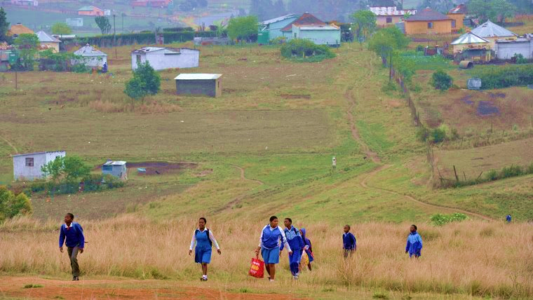

Building a Capable, Developmental and Ethical State
STATE CAPACITY
HUMAN SETTLEMENTS
ACTIVE CITIZENRY
Intensify progress being made to rebuild state capacity and strengthen critical institutions
Decisively address the political-administrative interface to ensure stability of management and leadership
Implementation of Cabinet approved National Anti-Corruption Strategy and establish an anti-corruption advisory council
Finalise and implement Integrated Crime and Violence Prevention Strategy
Improve capacity to deal with crime scene investigations, forensic analyses and prosecutions
Demilitarise police service and instill best possible discipline & professional ethos in police service
Implement DDM and cohesive national spatial framework (NSDF) for integrated & sustainable human settlements, & improve access to basic services
Address spatial inequality by ensuring more people live closer to places of work, with better quality public transport and more jobs in or close to dense, urban townships
Unite and rally the nation behind the NDP
Reinvigorate social cohesion initiatives to build and unite the nation
Rebuild trust between the state and citizenry

Slide 30
Towards focused and detailed implementation
WE ARE HERE
MTSF 2019-2024
2021
POVERTY
Implementing NPC proposals is through existing plans
MTSF 7 PRIORITIES
2030
ERRP
UNEMPLOYMENT
Infrastructure, Sectoral, Skills, Plans
INEQUALITY

Slide 31

NDP Implementation - Key Principles & Pre-requisites
  Successful implementation is dependent on availability of resources, recognising the prevailing constrained fiscal space,
  Also: trade-offs, priorities and optimal fiscal stance
Partnership, Co-ownership and Collaboration
(whole of Government & Society)
Prioritization, Focus & Resources
(optimal fiscal stance and efficiencies)
Monitoring and Measurement
Leadership and Accountability

Slide 32
Implementation, Monitoring, Measurement (1/3)
NPC’s Review of NDP makes following observations regarding implementation:
  NDP did not spell out an implementation plan that is rigorous and detailed, beyond broad proposals
    Focused leadership
    NDP as a Plan for all, not just government
    Institutional capability
    Resource mobilisation
    Agreement on trade-offs
    Social Compact on how to tackle poverty, unemployment & inequality
    Requires robust monitoring & measurement tools; uniform and consistent indicators.
    Implementation also challenged by:
      institutional instability
      political-administrative interface challenges
      coordination weaknesses
      corruption
  Pre-requisites for successful implementation of NDP did not fully materialise
How to translate policy & high-level aspirations into actual implementation is critical
How to
improve implementation needs focused attention

Slide 33
Implementation, Monitoring, Measurement (2/3)
Measurement and Monitoring require focused attention, to strengthen and sharpen tools used
Use of agreed and consistent Indicators has been moving target
NPC, working with DPME – drafted indicators to measure NDP implementation, framed by:
  3 NDP Apex Priorities – growing & transforming economy; developing human capabilities; building a capable state
  54 NDP Objectives/targets drawn from 15 Chapters of the Plan
  159 Indicators to annually assess progress over period 2021-2030
At FOSAD agreed to do further work on this area, also focusing on data gathering systems, evaluations, etc, to measure impact over time
Also to underpin Future Planning, drawing on lessons learnt (2022 marks 10 years of NDP)
NPC, DPME AND STATSSA

Slide 34
Implementation, Monitoring, Measurement (3/3)
Joint-up government approach
All social partners to collectively measure NDP implementation & impact
NPC
DPME, STATS SA, NATIONAL TREASURY, DPSA, PARLIAMENT
INPUT indicators
OUTPUT indicators
OUTCOME indicators

Slide 35
Recap and Way Forward
The things outlined in this presentation require detailed planning with which colleagues doing MTSF are seized with and there is interface between this advisory note and MTSF.
The NPC relies on short and medium term plans achieve the proposed critical actions.
The finalisation of the integrated planning system and bill remains critical as it assist to guide institutionalisation of planning and formally clarify the roles and functions of different plans and planning bodies
The identification of specific policy mechanisms and levers, which can help to build alignment around key developmental priorities informed by the NDP remains important.
Strengthening implementation approaches and strategies, building on systems that have worked well, and strengthening partnerships with non-state stakeholders, anchored on the NDP.
Translation of the NDP’s long-term goals into medium-term priorities; moving from prioritisation to focusing on actions that would catalyse and sustain momentum within the society, and how they would be measured and monitored.
Making hard choices and trade-offs about what would be most impactful to prioritise, because it is not possible to focus on everything remains critical

Slide 36
Conclusion
Overall priority is to accelerate Economic Recovery & Reconstruction
To this end, focused attention on role and capacity of the state remains critical
Deepening specific policy interventions and levers around key developmental priorities informed by NDP remains important.
NPC’s role to assist NDP implementation during 2022-2030
Detailed planning based on NPC proposals in current MTSF (as revised post-Covid), ERRP and other sector plans.
2022, Ten year Review of the implementation of NDP since 2012
Lessons and priorities for next MTSF 2024-29
Better implementation towards 2030….Eight years remaining

Slide 37
Conclusion
The third NPC’s mandate appointed in December 2021 by President Ramaphosa entails amongst others;
to lead the development of a strategy for a post COVID-19 economy and society to deal with the country’s triple challenge of poverty, unemployment and inequality by 2030,
mobilise society to promote the acceleration in implementing the National Development Plan towards 2030.

Slide 38

Thank You

