Slide 1
PROGRESS REPORT ON RESPONSE OF HUMAN SETTLEMENTS TO THE APRIL DISASTER
HUMAN SETTLEMENTS

Slide 2
KEY AREAS OF FOCUS
Overview of the situation
Financial implications
Key interventions
Implementation of emergency housing assistance

Slide 3
PURPOSE
To provide an update on the impact floods experienced in the KZN Eastern Cape and North West Province Provinces and subsequent interventions
3

Slide 4
OVERVIEW OF THE SITUATION
Extensive rains in April severely affected households in both KwaZulu-Natal, Eastern Cape and North West Provinces
Informal settlements were among the most affected especially those located in poor terrain
Mud houses were also badly affected
Assessment of damages is ongoing, as some areas continue to be inaccessible due to damages to roads and bridges
Reconstruction and redevelopment work has begun in all three provinces
4

Slide 5
KEY INTERVENTIONS
TRUs
  Manufacturers of Temporal Residential Units (TRUs) have been requested to increase capacity in KZN
  HDA has been appointed by EC to manage the construction of TRUs in affected districts
Building material
  The material suppliers has been requested to increase capacity
Land
  Land needed to relocate the people has bee identified but more is still required
Technical capacity
  Support is provided to provinces in conducting technical assessments to determine the extent of structural damage to homes
Replacement of mud houses
  Replacement of mud houses through Rural Housing Programme
  Directives on expediting responses for repair of housing units damaged during natural disasters

Slide 6
KEY INTERVENTIONS (2)
Funding Reprioritisation
  Reprioritisation of Human Settlements Grants based on Section 6 (a) of DORA, 2022
    Allocations (Province)
      HSDG = R2.9 billion
      ISUPG = R756 million
    Metro Allocations ( 01 July 2022)
      USDG = R1.3 billion
      ISUPG = R727 million
    Emergency Housing Grants
      PEHG = R326 million
      MEHG = R175 million
  R992m provided to KZN and R115 provided to EC Provinces
  The Provinces were requested to reprioritised the disaster in their business plan
  The payment schedule were revised to accommodate emergency housing requirements
  Funds have been transferred to both KwaZulu-Natal and Eastern Cape
  Both provinces are being assisted to complete emergency housing grant applications
  Mobilisation of National DHS entities to use retained surpluses and CSI allocations for some relief interventions

Slide 7
IMPACT OF APPROACH TO HUMAN SETTLEMENTS PROGRAMME
Revision downwards of MTSF and APP targets
Revision (downward) of project performance targets ISRDP Sites, ISRDP Units & Rural Housing Subsidy Units, UISP, etc., to make provision for more TRUs and Material Supply vouchers
The exact revised performance figures have not yet been finalised

Slide 8
EMERGENCY ASSISTANCE PROGRAMME
Key Area | Item | Amount
Indirect Cost for Temporal Assistance | Beneficiary administration | R382
 | Safety inspector | R110
 | Environmental Control Officer | R88
 | Preplanning Studies | R590
 | Project management If the Municipality cannot manage the project | R118
 | Geotechnical investigations | R33
 | Contour survey Only if the site is to be used for temporary settlement with a permanent housing solution or for scoping study | R22
 | Land surveying and site pegging Only if the site is to be used for temporary settlement with a permanent housing solution, or where the topography necessitates for services planning purposes. | R110

Slide 9
EMERGENCY ASSISTANCE PROGRAMME
Key Area | Item | Amount
Indirect Cost for Temporal Assistance | Land survey (Surveyor-General examination fee Site pegging only for the site to be used for temporary settlement with a permanent solution or permanent temporary area | R34
 | Town Planning Layout Township Establishment | R61 R88
 | Environmental Impact Assessment | R39
 | Civil Engineer: Services design & site supervision | R181
 | Social facilitation | R79
 | Lega; fees When applicable | R8
 | Mediation When applicable | R63
Subtotal – Indirect cost per stand | Subtotal – Indirect cost per stand | R2 006

Slide 10
EMERGENCY ASSISTANCE PROGRAMME
Direct Cost | Item | Cost
Basic Municipal Engineering Services in respect of temporary assistance on a shared basis (Inc. VAT) | Water reticulation on a shared basis | R1 584
 | Sanitation on a shared basis | R1 481
 | Roads (Main access) | R1 171
 | Storm Water | R413
 | Sub-Total: Direct Cost | R 4 649
 | TOTAL STAND COST a (portion of an ordinary stand shared between 5 units) (rounded off) | R6 655

Slide 11
EMERGENCY ASSISTANCE PROGRAMME: TEMPORAL ASSISTANCE
DIRECT COST | ITEM | COST
Construction Cost of Temporary shelter (Inc. VAT). | Covering | R8 341
 | Side Cladding / Wall Cladding | R13 737
 | Columns and anchor bolts | R8 145
 | Column footings: Concrete bases for structure posts | R1 960
 | Rafters | R3 778
 | Purlins | R4 904
 | Door & Window posts and frames | R3 285
2. Construction Cost of Temporary shelter (Inc. VAT). | Side rails to support side cladding | R4 022
 | Flashings | R1 178
 | Door | R3 031
 | Window | R2 931
 | Flooring: Concrete | R9 815
 | Thermal improvement under roof | R3 533
Sub-Total: | Sub-Total: | R68 660
Rounded Off | Rounded Off | R68 660
GRAND TOTAL PER GRANT | GRAND TOTAL PER GRANT | R 75 315

Slide 12
EMERGENCY ASSISTANCE PROGRAMME
Item | Total cost
Repair of services to National Norms and Standards: B Grade Level: Up to a guideline amount of | R43 835
Repair of services to National Norms and Standards: A Grade Level: Up to a guideline amount of | R 55 594
Repair/Replacement of damaged house with a new structure: (40sqm) 2014 SANS 10400 XA spec up to a maximum amount including Repairs to a 30m² house includes enlargement to 40m² | R 140 085

Slide 13
KWAZULU-NATAL DISASTER
Overview of disaster & Interventions

Slide 14
SUMMARY OF AFFECTED HOUSEHOLDS
DISTRICT | NUMBER OF HOUSEHOLDS AFFECTED | NUMBER OF HOMELESS HOUSEHOLDS | NUMBER OF PARTIALLY DESTROYED
UMzinyathi | 46 | 36 | 10
Amajuba | 19 | 0 | 19
uMgungundlovu | 88 | 28 | 60
uThukela | 194 | 132 | 69
UGu | 601 | 511 | 90
Zululand | 394 | 108 | 281
uMkhanyakude | 21 | 17 | 4
King Cetshwayo | 150 | 49 | 103
iLembe | 1 005 | 454 | 252
Ethekwini Metro | 11 492 | 3 000 | 7 200
Harry Gwala | 398 | 143 | 222
TOTAL | 14 449 | 4 478 | 8 310

Slide 15
FINANCIAL IMPLICATIONS
Activity/ Milestone | Number | Unit Cost | Budget
TEMPORARY SERVICES | 788 | R12 656,23 | R 9 973 109,24
TEMPORARY ACCOMODATION (TRUs) | 4 478 | R68 659,00 | R307 455 002,00
REPLACEMENT HOUSES | 4 478 | R139 722,00 | R625 675 116,00
HOUSE REPAIRS (PARTIALLY DAMAGED) | 8 199 | R89 000,00 | R 729 711 000,00
REPAIRS TO SERVICES | 2 500 | R55 596,00 | R138 990 000,00
RETAINING WALLS | 2000 | R55 000,00 | R 110 000 000,00
MATERIAL SUPPLY | 8 310 | R9 100,00 | R75 621 000,00
REPAIRS TO FLATS & HOSTELS | 200 | R22 000,00 | R4 400 000,00
TOTAL |  |  | R2 001 825 227,24

Slide 16

DETAILS OF AFFECTED HOUSEHOLDS
DISTRICT | LOCAL MUNICIPALITY | WARD | ISIGODI/AREA | NUMBER OF HOUSEHOLDS AFFECTED | NUMBER OF HOMELESS HOUSEHOLDS | NUMBER OF PARTIALLY DESTROYED
UMZINYATHI | Nquthu | 2 | KwaQwabe | 1 | 1 | 0
 |  | 3 | Ethula | 5 | 5 | 0
 |  |  | EMhosheni | 2 | 2 | 0
 |  |  | EMangweni | 6 | 6 | 0
 |  |  | Embokodo | 2 | 2 | 0
 |  |  | Ndwalane | 1 | 1 | 0
 |  |  | KwaMngxangala | 6 | 6 | 0
 |  | 11 | KwaNyezi | 1 | 1 | 0
 |  | 5 | Battleside | 2 | 2 | 0
 | Endumeni | 1 | Wasbank | 4 | 1 | 3
 | uMvoti | 13 | Ematimatolo | 2 | 2 | 0
 | Msinga | 3,16,19,20 | Ngcengeni, Gxobanyawo Bahulazi, Mahlaba | 14 | 7 | 7
TOTAL |  |  |  | 46 | 36 | 10
AMAJUBA | Newcastle | Ward 6; 25;31&15 | Masondeza, Fairleigh, Lennoxton, Maskraal & Blaaubosch | 60 people (1 person reported missing) | 0 | 19 (18 destroyed by the rains and 1 by fire)
TOTAL |  |  |  | 60 | 0 | 19
16

Slide 17
DETAILS OF AFFECTED HOUSEHOLDS
DISTRICT | LOCAL MUNICIPALITY | WARD | ISIGODI/AREA | NUMBER OF HOUSEHOLDS AFFECTED | NUMBER OF TOTALLY DISTROYED | NUMBER OF PARTIALLY DESTROYED
UMGUNGUNDLOVU | Msunduzi | 35 & 39 | Sobantu& Vulindlela | 11 | 1 | 10
 | Impendle | 5 | Khamndeni | 3 | 1 | 2
 | Mkhambathini | 1,3, 5 &7 | John Crookes farm, Mandalay, Mavulandlela Informal settlements, Maqogqo,Nkanyezini& Njobokazi | 35 | 18 | 17
 | Richmond | 1,2,3 & 4 W1 | Ndlaveni, Endongeni, esgcakini,townland & Khenana | 7 | 1 | 6
 | Mpofana | 1, 2 &4 |  | 32 | 07 | 25
TOTAL |  |  |  | 88 | 28 | 60
17

Slide 18
DETAILS OF AFFECTED HOUSEHOLDS
DISTRICT | LOCAL MUNICIPALITY | WARD | ISIGODI/AREA | NUMBER OF HOUSEHOLDS AFFECTED | NUMBER OF TOTALLY DISTROYED | NUMBER OF PARTIALLY DESTROYED
UTHUKELA | Alfred Duma | 7 | Emachibini | 1 | 0 | 1
 |  | 9 | Umbulwane | 4 | 0 | 4
 |  | 10/21 | Steadville | 1 | 1 | 0
 |  | 13 | Roosboom | 4 | 3 | 1
 |  | 14 | Burford | 8 | 8 | 0
 |  | 15 | Peacetown | 6 | 0 | 5
 |  | 17 | Mathondwane | 15 | 8 | 9
 |  | 18 | Watersmeet | 6 | 1 | 4
18

Slide 19
DETAILS OF AFFECTED HOUSEHOLDS
DISTRICT | LOCAL MUNICIPALITY | WARD | ISIGODI/AREA | NUMBER OF HOUSEHOLDS AFFECTED | NUMBER OF HOMELESS HOUSEHOLDS | NUMBER OF PARTIALLY DESTROYED
UTHUKELA | Alfred Duma | 23 | Matiwane | 3 | 1 | 2
 |  | 24 | Nkunzi/Baldaskraal | 6 | 5 | 7
 |  | 26 | Blue bank | 6 | 1 | 6
 |  | 20 | Acaciavale | 8 | 7 | 1
 |  | 29 | Egoqweni | 11 | 8 | 3
 |  | 36 | KwaHlathi | 25 | 20 | 5
 |  | 7/27 | St Chads | 5 | 4 | 1
 | Okhahlamba | 1,2,4,9,11&12 | Woodford, Emaus, Winterton, Kwamaye, Zwelisha, Hambrook | 63 | 50 | 13
 | Inkosi Langa Libalele | 1,4,20,21& 24 | Emakekeni, Enkomakazini, Mngwamama, Nhliwe, ePhangweni, eMkholombe | 22 | 15 | 7
TOTAL |  |  |  | 194 | 132 | 69
19

Slide 20
DETAILS OF AFFECTED HOUSEHOLDS
DISTRICT | LOCAL MUNICIPALITY | WARD | ISIGODI/AREA | NUMBER OF HOUSEHOLDS AFFECTED | NUMBER OF TOTALLY DISTROYED | NUMBER OF PARTIALLY DESTROYED
UGU | Ray Nkonyeni | 8,13,16,23,25,26,28,35 | Fairview,Echibini, Godloza,Hlakazela, Skhonkwana, Dunjaneni, Goso, Sgedleni, Bethani | 126 | 36 | 90
 | uMzumbe | 1,3,5,6,8 | Esibanini, Ngoza, Gumatana, Zibulale, Phongolo, Thafeni, Ediphini | 50 | 50 | 0
 | uMuziwabantu | 3,4,5,6,7,8,9, | Harding, KwaMbotho, KwaMachi,KwaJali, | 11 | 11 | 0
 | uMdoni | 2,4,7,9,11,13,14,18 | Malangeni, Umzinto, kenterton | 414 | 414 | 0
TOTAL |  |  |  | 601 | 511 | 90
20

Slide 21
DETAILS OF AFFECTED HOUSEHOLDS
DISTRICT | LOCAL MUNICIPALITY | WARD | ISIGODI/AREA | NUMBER OF HOUSEHOLDS AFFECTED | NUMBER OF HOMELESS HOUSEHOLDS | NUMBER OF PARTIALLY DESTROYED
Harry Gwala | UBuhlebezwe | 2, 3, 4, 5, 7, 9, 10 and 11 | Ofafa Fairview rank Shayamoya Springvalley Umhlabashane Nokweja Jolivet Hluthankungu | 341 | 143 | 222
21

Slide 22
DETAILS OF AFFECTED HOUSEHOLDS
DISTRICT | LOCAL MUNICIPALITY | WARD | ISIGODI/AREA | NUMBER OF HOUSEHOLDS AFFECTED | NUMBER OF TOTALLY DISTROYED | NUMBER OF PARTIALLY DESTROYED
ZULULAND | eDumbe LM | 1 | Khombela, Breche, Bazangoma | 20 | 3 | 17
 |  | 6 | Bhadeni, Lujojwna & KwaNyosi | 11 | 5 | 6
 |  | 7 | Mahloni, Mbambasi, Mahlalothini, Khambule | 10 | 2 | 8
 |  | 3 | Lindelani Madelakufa Phoqukhalo | 10 | 5 | 5
 |  | 10 | Emaxhambozini, Nhlakanipho | 10 | 2 | 8
22

Slide 23
DETAILS OF AFFECTED HOUSEHOLDS
DISTRICT | LOCAL MUNICIPALITY | WARD | ISIGODI/AREA | NUMBER OF HOUSEHOLDS AFFECTED | NUMBER OF TOTALLY DISTROYED | NUMBER OF PARTIALLY DESTROYED
ZULULAND | eDumbe LM | 9 | Nkonkotho, Sbewuzane, Madanyini | 15 | 3 | 12
 |  | 8 | Mahangini, Paddafontein, Ophuzane | 5 | 0 | 5
 |  | 5 | NdondokaZulu, Makhalibethe | 12 | 1 | 11
 |  | 4 | Mbizeni | 7 | 2 | 5
 |  | 5 | NdondokaZulu, Makhalibethe | 12 | 1 | 11
 |  | 4 | Mbizeni | 7 | 2 | 5
TOTAL |  |  |  | 119 | 26 | 93
23

Slide 24
DETAILS OF AFFECTED HOUSEHOLDS
DISTRICT | LOCAL MUNICIPALITY | WARD | ISIGODI/AREA | NUMBER OF HOUSEHOLDS AFFECTED | NUMBER OF TOTALLY DISTROYED | NUMBER OF PARTIALLY DESTROYED
UMKHANYAKUDE | Mtubatuba LM | 1; 2; 3; 5; 8; 9; 10; 17; 19; 21; 23. | Dukuduku D1; Ndonyana; Khayelisha; Indlovu village; Nkombose; KwaMshaya; Nkolokotho; Shikishela; Nsabalele; Mfekayi; Nkundusi | 21 | 17 | 4
24

Slide 25
DETAILS OF AFFECTED HOUSEHOLDS
DISTRICT | LOCAL MUNICIPALITY | WARD | ISIGODI/AREA | NUMBER OF HOUSEHOLDS AFFECTED | NUMBER OF TOTALLY DISTROYED | NUMBER OF PARTIALLY DESTROYED
KING CETSHWAYO | Mthonjaneni | 9,11 | Wambaza,KwaMbhensa,Gobihlahla &Eqhude | 13 | 6 | 9
 | Mlalazi | 1,4,5,6,7,8,10,11,13,14,15,16,17,18,19 & 28 | Mvuzane,Gobhotane,Ezingwenya,Gedlesi,Ndanyani, EmaNkwanyaneni,Ngonje,KwaNogqeke,KwaSanusi,Emankenganeni, Mphendle,Mathibelana,Mawusheni, Ntumeni,Nsukazi,KwaMfana,Mabhokweni,Ematibovana,Thafeni,Gingindlovu Township,Ward 19 Bhade River & KwaKhoza | 137 | 43 | 94
TOTAL |  |  |  | 150 | 49 | 103
25

Slide 26
DETAILS OF AFFECTED HOUSEHOLDS
DISTRICT | LOCAL MUNICIPALITY | WARD | ISIGODI/AREA | NUMBER OF HOUSEHOLDS AFFECTED | NUMBER OF TOTALLY DISTROYED | NUMBER OF PARTIALLY DESTROYED
iLembe | KwaDukuza | 29 | Charlotedale (KwaMyeza /Mbonambi) Dube Village (Nonhlevu) Dube Village (C/Hall) Mthethwa Area 10 Arca | 300 | 180 | 20
iLembe | KwaDukuza | 09 | Mnyundwini Hangoes Malende New Groute KwaG Upper Malende KwaMaNtuli Area Mgigimbe | 101 | 21 | 80
26

Slide 27
DETAILS OF AFFECTED HOUSEHOLDS
DISTRICT | LOCAL MUNICIPALITY | WARD | ISIGODI/AREA | NUMBER OF HOUSEHOLDS AFFECTED | NUMBER OF TOTALLY DISTROYED | NUMBER OF PARTIALLY DESTROYED
iLembe | KwaDukuza | 23 | Shayamoya | 20 | 16 | 04
iLembe | KwaDukuza | 13 | Steve Biko Glen Hills | 22 | 15 | 7
iLembe | KwaDukuza | 11 | Charlottedale Charlottedale (Oqalweni) Khulukuthu Manqomfini Njekane Etsheni | 50 | 25 | 25
iLembe | KwaDukuza | 18 | Shakaville | 2 | 2 | 0
ILembe | KwaDukuza | 20 | Etete - Beruit | 2 | 1 | 1
ILembe | KwaDukuza | 27 | Nodunga,Oqaqeni,Jabula,Zola,Nyongo, Gungu Kotshi | 64 | 28 | 36
27

Slide 28
DETAILS OF AFFECTED HOUSEHOLDS
DISTRICT | LOCAL MUNICIPALITY | WARD | ISIGODI/AREA | NUMBER OF HOUSEHOLDS AFFECTED | NUMBER OF TOTALLY DISTROYED | NUMBER OF PARTIALLY DESTROYED
iLembe | KwaDukuza LM | 01 | KwaKhumalo Ndalazini Sakhamkhanya Sokesimbone Nkwezane Zinkwazi Sadloko Ogunqu Nonoti | 412 | 83 | 120
 | Mandeni LM | 1 | Ngulule | 5 | 2 | 4
 |  | 3 | High View Park | 1 | 1 | 1
 |  | 4 | Hlomendlini | 3 | 4 | 4
28

Slide 29
DETAILS OF AFFECTED HOUSEHOLDS
DISTRICT | LOCAL MUNICIPALITY | WARD | ISIGODI/AREA | NUMBER OF HOUSEHOLDS AFFECTED | NUMBER OF TOTALLY DISTROYED | NUMBER OF PARTIALLY DESTROYED
iLembe | Mandeni | 5 | Matsheketsheni, Dendethu, Okhovithi, Othini and Lugede | 7 | 7 | 5
 |  | 6 | Ndulinde | 1 | 1 | 0
 |  | 8 | Nsunduzana | 1 | 1 | 1
 |  | 9 | Ngeqeni and Bambinkunzi | 3 | 2 | 1
 |  | 17 | Ezavutha, Ejikeni and Othini | 3 | 3 | 3
 |  | 18 | Isithebe Makhempini | 8 | 3 | 0
TOTAL |  |  |  | 921 | 412 | 210
29

Slide 30
DETAILS OF AFFECTED HOUSEHOLDS
ETHEKWINI METRO | ETHEKWINI REGION | WARDS | IZIGODI/AREAS | NUMBER OF HOUSEHOLDS AFFECTED | NUMBER OF TOTALLY DISTROYED | NUMBER OF PARTIALLY DESTROYED
ETHEKWINI | NORTHEN REGION | Various | Nanda, Ntuzuma, Kamashu, Verulam and Tongaat areas | 3400 | 984 | 1940
 | WESTERN REGION | Various | Inchanga, Molweni, Kwadabeka, Ngcolosi, KwaXimba, Marrianhill, Clermont, Ndengezi, Cato ridge, Hammersdale | 2897 | 1019 | 1460
 | SOUTHERN REGION | Various | Umlazi, Philani , Malukuazi, Folweni, Isipingo, Adams, Umbumbulu, Umgababa, Mfume, Mnini, Lovu | 5195 | 997 | 3800
TOTAL |  |  |  | 11492 | 3000 | 7200
30

Slide 31
IMPLEMENTATION OF THE EMERGENCY HOUSING RESPONSES
ACTION PLAN FOR IMMEDIATE INTERVENTION ( 18-30 April)
ACTION | COMMENTARY
Emergency housing grant application | Application have been packaged to be submitted at NDHS by end of 6th May 2022
Reprioritisation of funds | Reprioritisation has been done within existing financial resources in compliance with grant frameworks and the National Housing Code. The adjustments made are as follows: Revision of cashflows by increasing a first quarter drawdown from R552 million of R922 million
Site assessment in preparation for construction | 21 April 2022
Issuing of Material Vouchers | Procurement of service providers for Material supply to be finalised by 04 May 2022
Commence with construction of TRA’s | Construction commenced on the 22 April 2022
31

Slide 32
IMPLEMENTATION OF THE EMERGENCY HOUSING RESPONSES
Established a Joint Coordinating Committee (JOC) to manage the interventions
The Housing Development Agency is acting as secretariate
Work completed through work streams focusing on…
  Housing & Land
  Infrastructure & Services
  Governance

Slide 33
IMPLEMENTATION OF THE EMERGENCY HOUSING RESPONSES
Phase 1 procurement has been finalised for the construction of TRUs in all affected Districts
Construction of 1000 units has started in eThekwini, uGu and iLembe districts. Other districts to commence on the 3rd May 2022
Beneficiary profiling and assessments has commenced in all districts
NHFC and NHBRC refining and operationalising the voucher system to repair partially damaged units
NHBRC has completed the development of an assessment tool for damaged houses in order to ensure uniformity in assessment
Vouchers will be categorised according to severity of damage and work order will be issued to contractors on the database
NHFC will manage the payments for completed work

Slide 34
IMPLEMENTATION OF THE EMERGENCY HOUSING RESPONSES
Activity/ Milestone | DISTRICT MUNICIPALITY | ALLOCATED UNITS | Progress to date
TEMPORARY ACCOMODATION (TRUs) | ILembe | 200 | Construction commenced on the 22 April 2022, due to rains experienced construction was delayed. To date 10 TRA’s have been completed. The contractor is progressing well,
 |  | 200 | Procurement of the additional contractor finalized on the 28th April 2022. Construction to commence on the 3rd of May 2022
 | UGu | 200 | Construction commenced on the 22 April 2022, due to rains experienced construction was delayed. To date 3 TRA’s have been completed. The contractor is progressing well,
 | EThekwini | 600 | Three contractors appointed and allocated to each Region to construct 200 TRA’s, construction commenced at various stages. To date 4 TRA’s have been completed
 | King Cetshwayo | 40 | Procurement finalized on the 28th April 2022. Construction to commence on the 3rd of May 2022
 | uMkhanyakude | 40 | Procurement finalized on the 28th April 2022. Construction to commence on the 3rd of May 2022
 | Zululand | 40 | Procurement finalized on the 28th April 2022. Construction to commence on the 3rd of May 2022
 | Harry Gwala | 150 | Procurement finalized on the 28th April 2022. Construction to commence on the 3rd of May 2022
 | Amajuba | 20 | Procurement finalized on the 28th April 2022. Construction to commence on the 3rd of May 2022
 | uThukela | 70 | Procurement finalized on the 28th April 2022. Construction to commence on the 3rd of May 2022
 | uMzinyathi | 50 | Procurement finalized on the 28th April 2022. Construction to commence on the 3rd of May 2022
 | UMgungundlovu | 200 | Procurement finalized on the 28th April 2022. Construction to commence on the 3rd of May 2022
TOTAL |  | 1810
GROWING KWAZULU-NATAL TOGETHER

Slide 35
IMPLEMENTATION OF THE EMERGENCY HOUSING RESPONSES
Temporary Residential Units/ TRU’s
  All allocations are within the subsidy quantum
  Procurement finalized on 5 May 2022.
2. Material Vouchers
  Two options will be used
    standard pack
    catalogue system
  Procurement finalized on 5 May 2022.

Slide 36
Work Stream : Land assembly
Process | Progress | Deadline | Comment
Identify areas affected by floods such as informal settlements and halls and schools where people were relocated to. | In process | 29 April | Most areas were located on spatial databases. Not all areas exist on databases
Identify vacant land through satellite imagery | Complete |  | 77 766 properties were identified in eThekwini Metro - This equates to 17 780 hectares
Receive asset registers from government departments | In process | 15 May | 616 properties received from NDPWI across the province 614 were located, of which bulk (258) were in eThekwini 193 properties received from PDPWI
Identify vacant land within 5 km from affected areas and people housed in community facilities | In process | 29 May | Example selected in Tongaat area
Verify whether the land is vacant or not by using building layers | In process | 26 April | Data set received from eThekwini in 2020. - Eliminate land parcels with buildings
Assess land i.t.o geophysical constraints such as: Slope 1 in 100-year flood plain Intersected by river/streams and/or wetlands In Critical Biodiversity Area (CBA) In Ecological Support Area (ESA) In Protected Area Affected by Geohazards (active land slide, flood risk, high water table, highly erodible, steep, unstable, etc.) | In process | 31 May | Of the 616 NDPWI land parcels across the province 258 land parcels (41.88%) do not have geophysical constraints 15 (5.8%) out of the 258 land parcels in eThekwini do not have geophysical constraints 193 PDPWI properties need to be assessed 44 properties (22.79%) do not have geophysical constraints Of the 77 766 vacant land parcels identified in eThekwini 17 931 properties (23.05%) do not have geophysical constraints
Confirm land ownership | Not started | 31 May | Verify ownership against existing databases and confirm with user departments

Slide 37
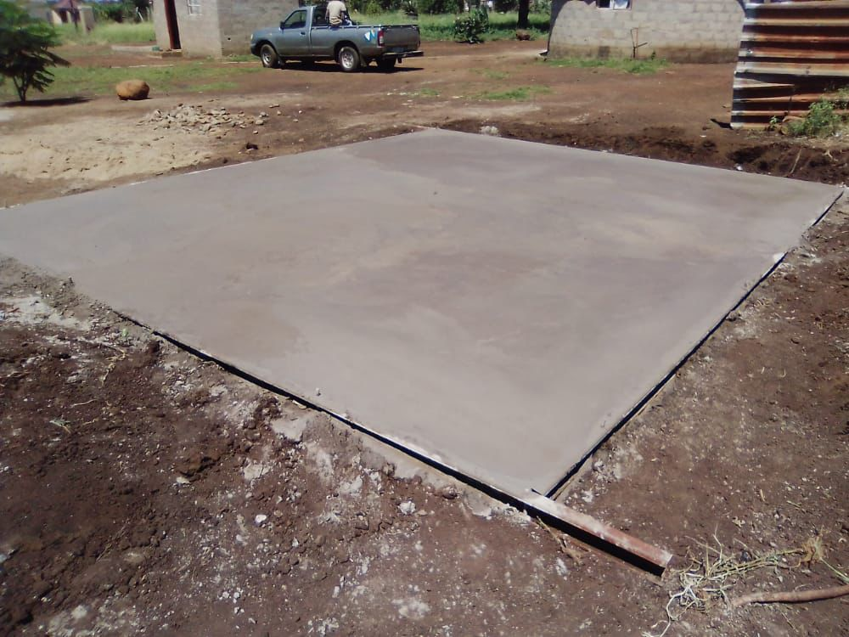
slab FOR TEMPORARY SHELTERS

Slide 38
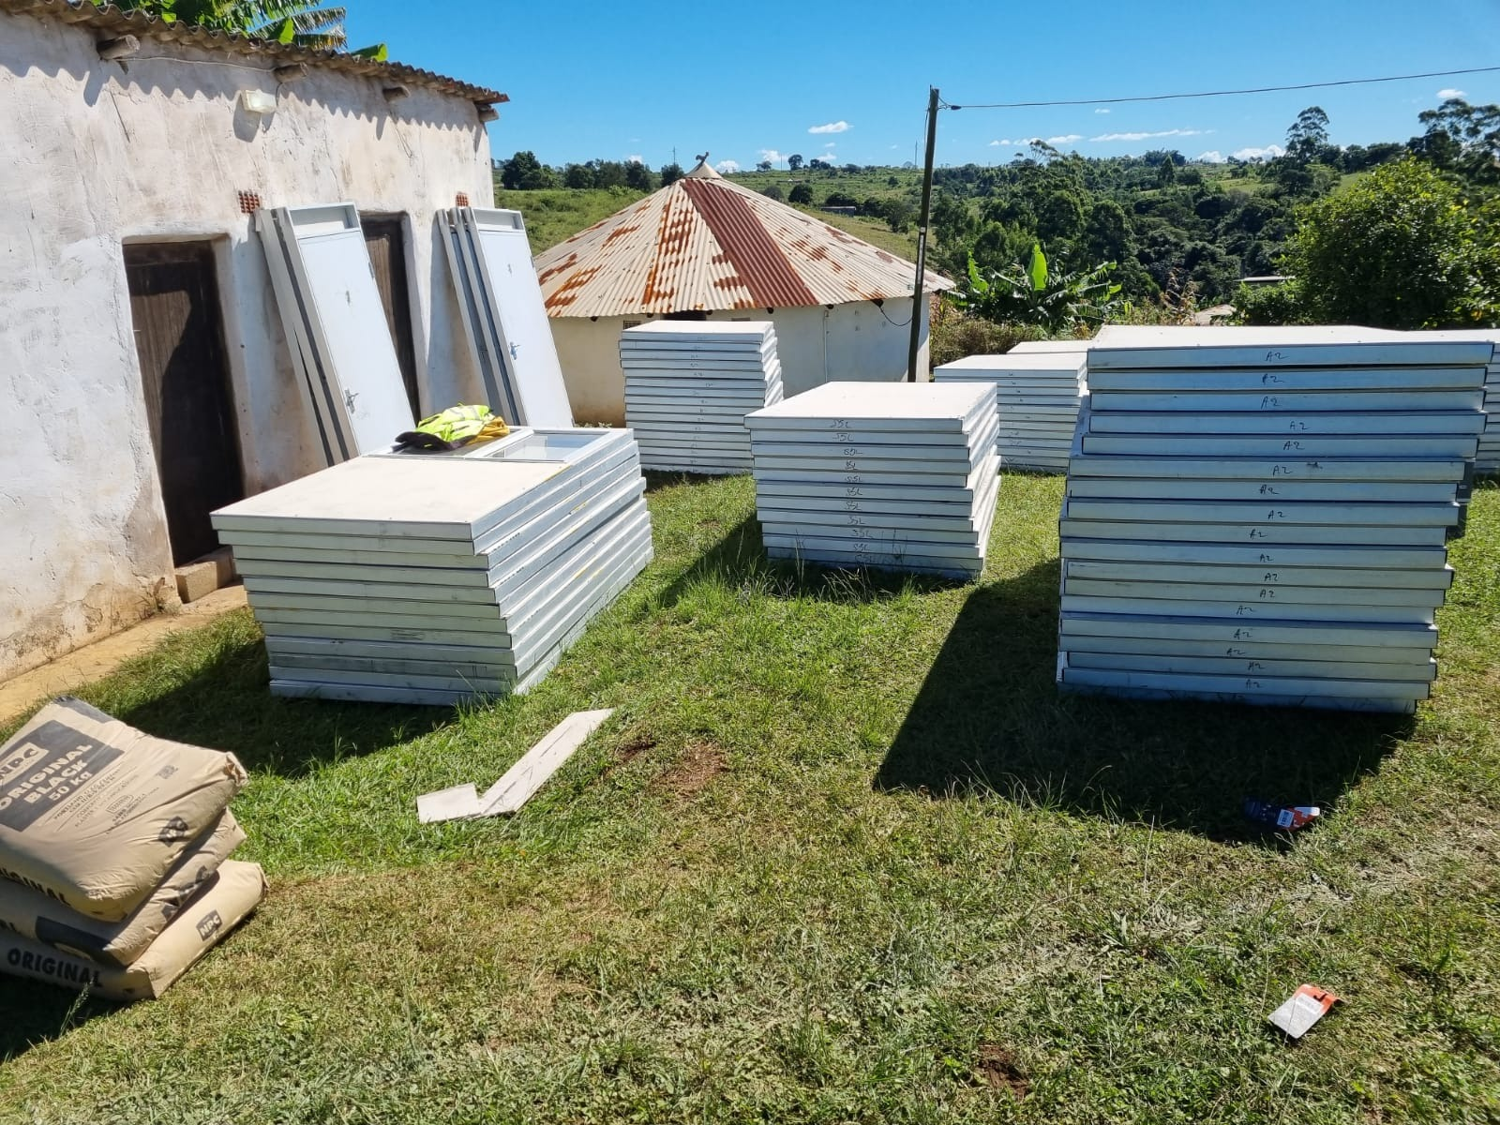
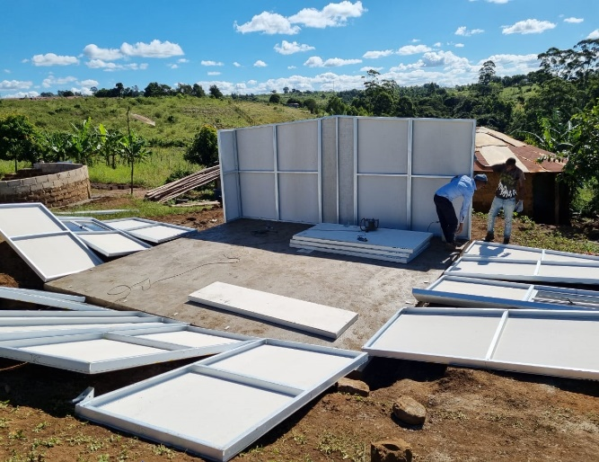
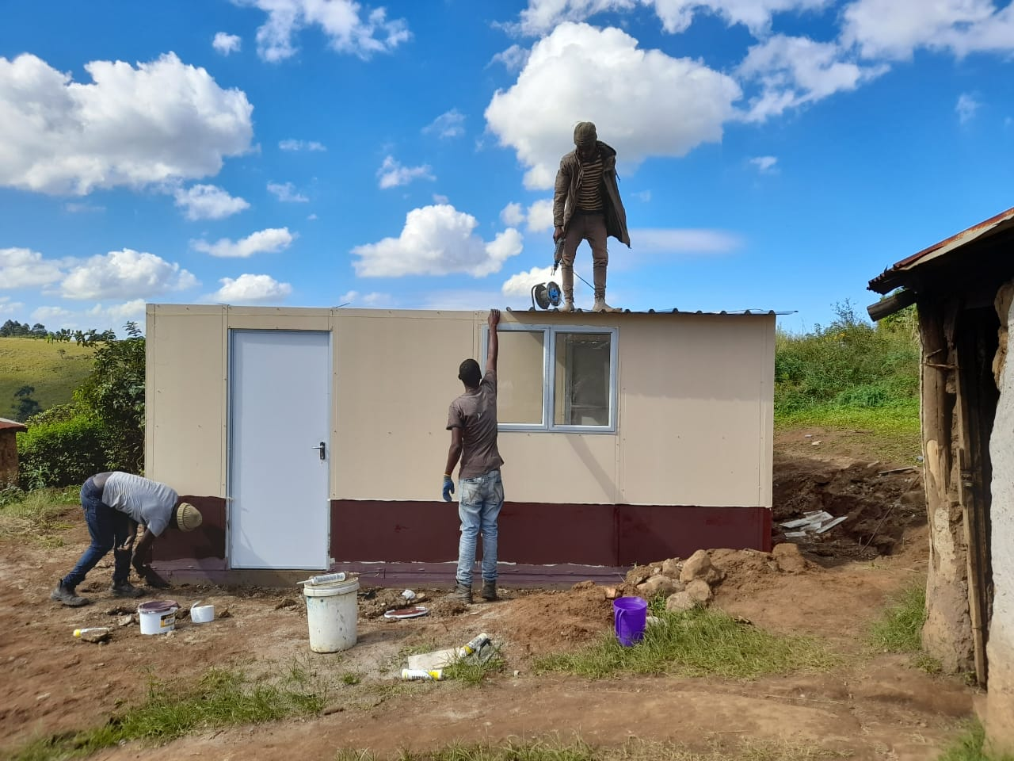
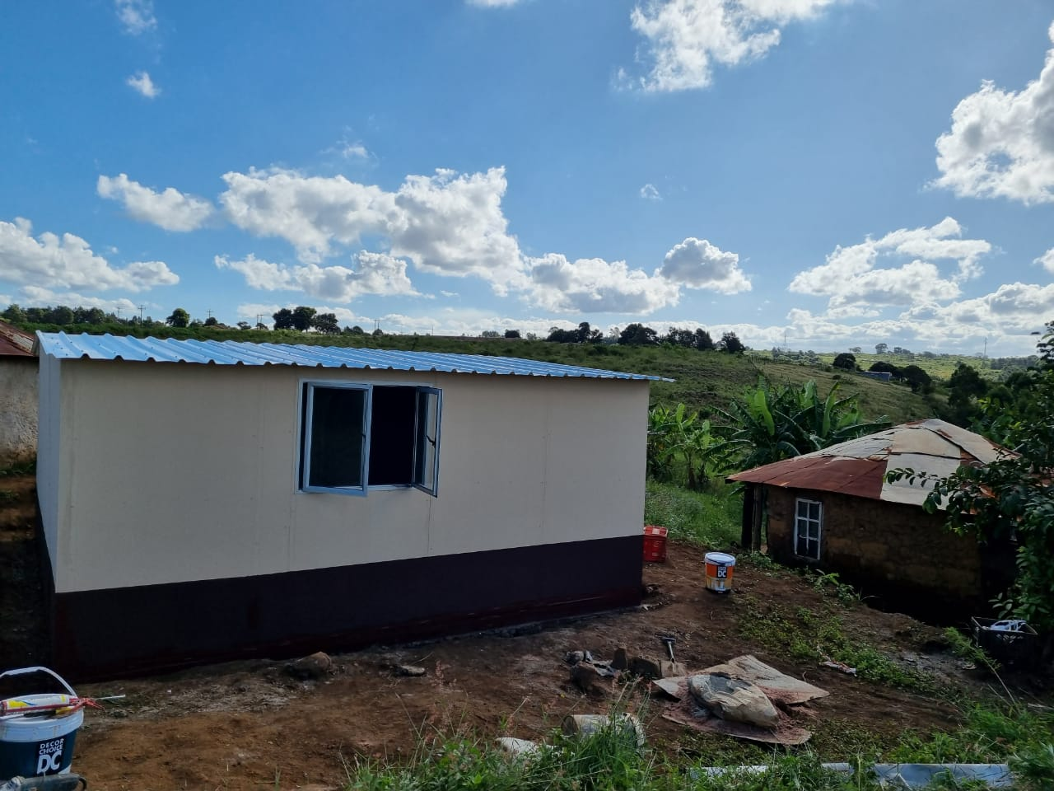
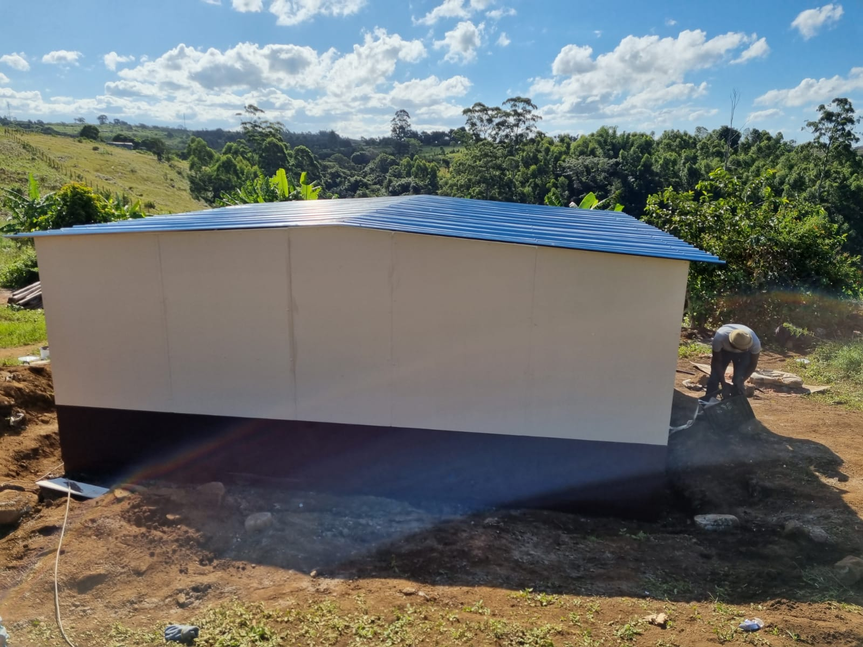
38

Slide 39
EASTERN CAPE DISASTER
Overview of disaster & Interventions

Slide 40
SUMMARY OF AFFECTED HOUSEHOLDS
DISTRICT | NUMBER OF HOUSEHOLDS AFFECTED | NUMBER OF HOMELESS HOUSEHOLDS | NUMBER OF PARTIALLY DESTROYED HOUSES
Alfred Nzo | 620 | 435 | 185
OR Tambo | 2842 | 1256 | 1586
Joe Gqabi | 26 | 26 | 0
Amatole | 282 | 282 | 0
Chris Hani | 76 | 76 | 0
TOTAL | 3846 | 2075 | 1771
40

Slide 41
FINANCIAL IMPLICATIONS
ACTIVITY/ MILESTONE | NUMBER | UNIT COST | BUDGET
Temporary Services | 3846 | 43 835 | 168 589 410
Temporary Accommodation (TRUs) | 2075 | 68 680 | 142 511 000
Replacement Houses | 2075 | 140 085 | 290 676 375
House Repairs (Partially Damaged) | 1771 | 75 315 | 133 382 865
Repairs to Services | 3846 | 43 835 | 168 589 410
Material Supply | 1771 | - | -
TOTAL ESTIMATED BUDGET |  |  | 903 749 060
41

Slide 42
DETAILS OF AFFECTED HOUSEHOLDS
DISTRICT | LOCAL MUNICIPALITY | WARD | AREA | NUMBER OF HOUSEHOLDS AFFECTED | NUMBER OF HOMELESS HOUSEHOLDS | NUMBER OF PARTIALLY DESTROYED
ALFRED NZO | Matatiele | 02, 03,,04,15,18,23,25,25,27 | Mdeni,Masakala, Kwa Qili,Mnyameni,Kwakhesa,Sidakeni,Bhubesi,Mangoloanemg,Bhethesda,Ramafole, Moriting,Magogoweni,Jalubane,Madimong,Hebron,Tiping,Tsitsong,Zikhalini,Rockville,Maluti,Maritseng,Kwamasakala & Paballong | 102 | 52 | 50
 | Winnie Madikizela Mandela | 01.03,04,05,06,07,14,15,20,22,30,32 | Downtown,Dumsi,Nkantswini,Ndayingana,KwaJali,Majazi,Polar Park,Meje,Nontlanga,Reformed,Labane,Lower Madadana,Mamcakweni,Lower Ethridge,Lindokuhle,Stanford,Upper Etridge,Quza,Marhazula,Lugwijini,Dutch,Mxinga and Dindini | 258 | 214 | 44
42

Slide 43
DETAILS OF AFFECTED HOUSEHOLDS
DISTRICT | LOCAL MUNICIPALITY | WARD | AREA | NUMBER OF HOUSEHOLDS AFFECTED | NUMBER OF HOMELESS HOUSEHOLDS | NUMBER OF PARTIALLY DESTROYED
ALFRED NZO | Ntabankulu | 02,08,15,11.18 | Dumsi,Zinyosini,Chibini,Kungqina,Manaleni,Ludeke,Lalashe,Nkonkoni,Bomvini,Ntlambashe,Dambeni,KuBhonga,Ndlantaka,Mzalwaneni,Lucingweni,Zanokhanyo,Jakuja,Gcwaleni,Zola,Dedelo,& Mkhomanzi | 127 | 73 | 54
 | Umzimvubu | 03,10,12 &26 | Ntlangwini,Gugwini,Msukeni,Manzana,Siqhingeni,Mtsila,Nomkholokothi,umgugundlovu,Mmangweni,Mrholweni,Bhobhodla,Nyuswa,Nyantungo & Trustin | 133 | 96 | 37
TOTAL |  |  |  | 620 | 435 | 185
43

Slide 44
DETAILS OF AFFECTED HOUSEHOLDS
DISTRICT | LOCAL MUNICIPALITY | WARD | AREA | NUMBER OF HOUSEHOLDS AFFECTED | NUMBER OF HOMELESS HOUSEHOLDS | NUMBER OF PARTIALLY DESTROYED
OR TAMBO | King Sabatha Dalindyebo | 01,02,03,04,06,08,10,11,13,14,15,16,17,18,20,21,22,23,24,25,26,27,28,29,30,31,32,34,35,36,37 | Bongweni, Bhongweni, Khambi, Khambkhambii, Link, Sheshegu, Luxeni, Makhumsheni | 385 | 169 | 216
 | Ingquza Hill | 03,04,06,08,12,13,14,15,16,17,1921,22,23,24,26,30,31 | Ntsimbi, Gabajana, Mpoza, Dubana, Siwali, (KwaNene)Sirhetshe, Tshandatsha | 296 | 73 | 223
 | Mhlontlo | 03,04,05,07,08,09,10,11,13,14,15,20,22,23,24,25,26 | Bele, Gqeyane, Ngcolosi, Malongwe, Manka, Mahlubini, Mngceleni, Matyeba, Mdibanisweni, Ntibane, Mayaluleni, Ntshiqo, Ntshiqo, Mayaluleni, Ntshiqo, Holtin, Mhlabathi, Gomeni | 133 | 80 | 53
44

Slide 45
DETAILS OF AFFECTED HOUSEHOLDS
DISTRICT | LOCAL MUNICIPALITY | WARD | AREA | NUMBER OF HOUSEHOLDS AFFECTED | NUMBER OF HOMELESS HOUSEHOLDS | NUMBER OF PARTIALLY DESTROYED
OR TAMBO | Nyandeni | 01,02,05,06,07,08,09,10,12,13,14,15,1 6,17,18,19,20,2123,24,25,26,28,29,30,31,32 | Mdumazulu, Hamsini, Thekwini, Lutoli, Ntilini, Mahoyana, Zandukwana, Thembeni, Gqwarhu, Ngcoya, Zibungu, Marubeni, Makhotyana | 739 | 284 | 455
 | Port St Johns | 01,03,04,05,06,07,08,09,10,11,13,14,15,16,17,18,19,20 | Mdumazulu, Hamsini, Thekwini, Lutoli, Ntilini, Ntilini, Marubeni, Ngojini, KwaGreen, eMajola | 918 | 279 | 639
TOTAL |  |  |  | 2471 | 885 | 1586
45

Slide 46
DETAILS OF AFFECTED HOUSEHOLDS
DISTRICT | LOCAL MUNICIPALITY | WARD | AREA | NUMBER OF HOUSEHOLDS AFFECTED | NUMBER OF HOMELESS HOUSEHOLDS | NUMBER OF PARTIALLY DESTROYED
JOE GQABI | Senqu | 1, 2, 6, 8, 9, 10, 11, 12, 13 | Naledi, Fela, Kwagquba, Mkhunyazo, | 26 | 26 | 0
TOTAL |  |  |  | 26 | 26 | 0
46

Slide 47
DETAILS OF AFFECTED HOUSEHOLDS
DISTRICT | LOCAL MUNICIPALITY | WARD | AREA | NUMBER OF HOUSEHOLDS AFFECTED | NUMBER OF HOMELESS HOUSEHOLDS | NUMBER OF PARTIALLY DESTROYED
CHRIS HANI | Sakhisizwe | 5,6,7,8,9 | Cala Pass,Mchewula,Sifononondile,Manzana,Manzimdaka,Upper Mnxe & Mgwalana | 24 | 24 | 0
 | Engcobo | 01,02,03,04 | Quluqu-Ncityana,Tora,Cwecweni,Nqaneni,Jinginja,Mqonci-Siqikwi,Xhonya | 31 | 31 | 0
 | Intsikayethu | 04,05,06,07,12,15,18,21 | Great Place,Chamama,Kwa –Tshatshu,Thaleni,Magwala,Mcungco,Mgwala,Mbulu,Tsomo & Kwa Ntsume | 21 | 21 | 0
TOTAL |  |  |  | 76 | 76 | 0
47

Slide 48
DETAILS OF AFFECTED HOUSEHOLDS
DISTRICT | LOCAL MUNICIPALITY | WARD | AREA | NUMBER OF HOUSEHOLDS AFFECTED | NUMBER OF HOMELESS HOUSEHOLDS | NUMBER OF PARTIALLY DESTROYED
Amathole | Mbashe |  |  | 107 | 107 | 0
 | Mnquma |  |  | 75 | 75 | 0
TOTAL |  |  |  | 282 | 282 | 0
48

Slide 49
IMPLEMENTATION OF THE EMERGENCY HOUSING RESPONSES
National Department has transferred R115 million to the Province to assist with response to the disaster.
A contractor has been appointed to erect temporary shelters in Alfred Nzo and OR Tambo
  Alfred Nzo - 435 TRUs
  O.R. Tambo district municipalities - 565 TRUs
On 03 May the Eastern Cape DHS appointed the HDA to erect 1141 TRUs in OR Tambo, Chris Hani, Joe Gqabi and Amathole District Municipalities
HDA is on site conducting the assessment of Partially Damaged Houses to determine the need for permanent solution and remedial works
The province is exploring the voucher system for the repair or rebuilding of houses
Beneficiary administration has engaged the Department of Home Affairs to assist with those families that have lost their Identity documents.

Slide 50
NORTH WEST

Slide 51
NATURE OF DISASTER
Heavy rains in April affected the communities residing in Deelpan and several adjacent villages such as Witpan 1 and 2 which are within Tswaing Local Municipality
There are 250 households that are homeless

Slide 52
MAIN INTERVENTIONS
Reprioritisation of HSDG funding for the disaster
Provision of TRUs for destitute communities
Securing of land for relocation

Slide 53
IMPLEMENTATION OF INTERVENTIONS
The Province requested the utilisation of HSDG towards the Emergency Housing Programme to assist affected households
DHS approved an amount of R54 928 000.00 to address emergency housing needs of the community of Deelpan Village

Slide 54
IMPLEMENTATION OF INTERVENTIONS
The Tribal Authority has identified as parcel of land where people can be relocated
The NW Department and NHBRC has finalized specifications of the Temporary Structure in line with prescribed norms and standard of Emergency Housing Programme
Procurement Process to appoint Service Providers has already started to provide about 250 temporary structures

Slide 55
Project Delivery timeline
ACTIVITY | TIMELINE
Tswaing Local Municipality to submit list of beneficiaries to the Department | 06 May 2022
Briefing of the Service Providers by the Department, finalization of the contractual agreement between the Department and Service Providers and handing-over of site to Service Provider | Monday,09 May – Wednesday, 12 May 2022
Completion of project | 30 May 2022

Slide 56
RECOMMENDATION
Please note the progress report

Slide 57
Thank you
www.dhs.gov.za

