Slide 1
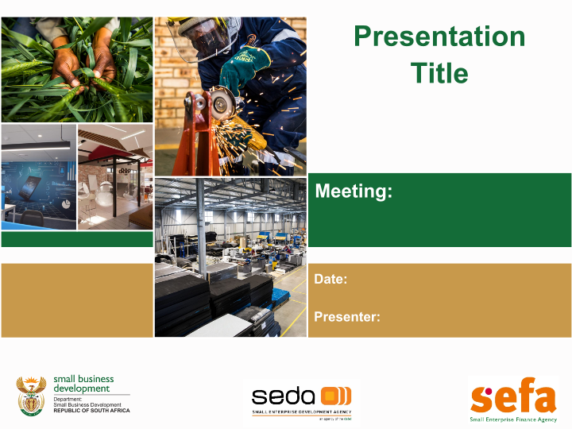
Seda Quarter 4 Report
Portfolio Committee
11 May 2022
N Mbatha: CEO (Acting)

Slide 2
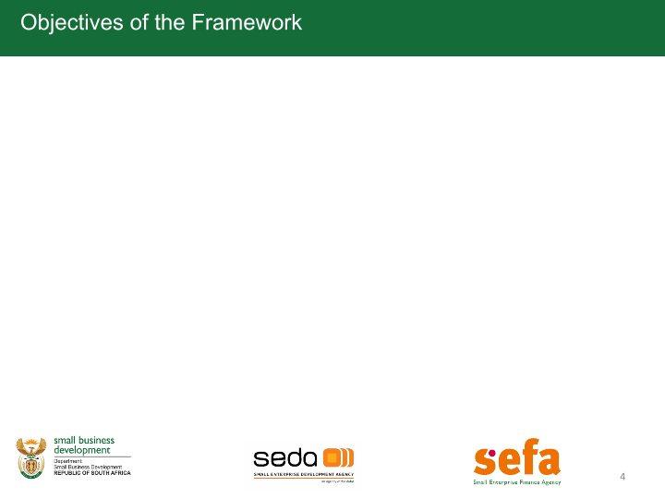
SEDA PRESENTATION OUTLINE
1 | Introduction
2 | Performance Information
3 | Performance Comparison
4 | Human Resources Report
5 | Draft Financial Report
6 | Governance & Compliance
7 | Key Projects

Slide 3
1. INTRODUCTION

Slide 4
Introduction
This report highlights the organisation's performance during the fourth quarter of the 2021/22 Financial Year.
A total number of 29 indicators were monitored in the quarter 4. The organisation achieved 100% or more on 24 indicators, reflecting an organisation's achievement of 83%.
Five indicators were underachieved, three (3) indicators were achieved between 80% to 99% and two (2) indicators were achieved between 50% to 79% category.
Seda continued with the hosting of Pop-Up Markets in partnership with external stakeholders, The intention of these pop-up markets is to expose SMMEs to customers who might not be aware of their products and potential buyers that might source from them. A number of Pop-Up Markets were hosted in various Provinces in the 4th quarter, which included Western Cape, Free State, Gauteng, Mpumalanga, Northern Cape and North West.
Seda facilitated the participation of SMMEs in international events in Zanzibar Pan African Women’s Summit, Ghana Food & beverage event 2022 and Kenyan Food event 2022. A group of 11 SMMEs participated in the Global Entrepreneurship Congress that was held in Saudi Arabia. Fifteen clients with 150 products were assisted to list their products on the Take-a-lot platform, 13 of them secured markets.
In 2021-22 financial year, the organisation was measuring its performance on 30 indicators, at the end of the FY, the Organisation had achieved 24 indicators which indicated 80% achievement

Slide 5
2. PERFORMANCE INFORMATION

Slide 6
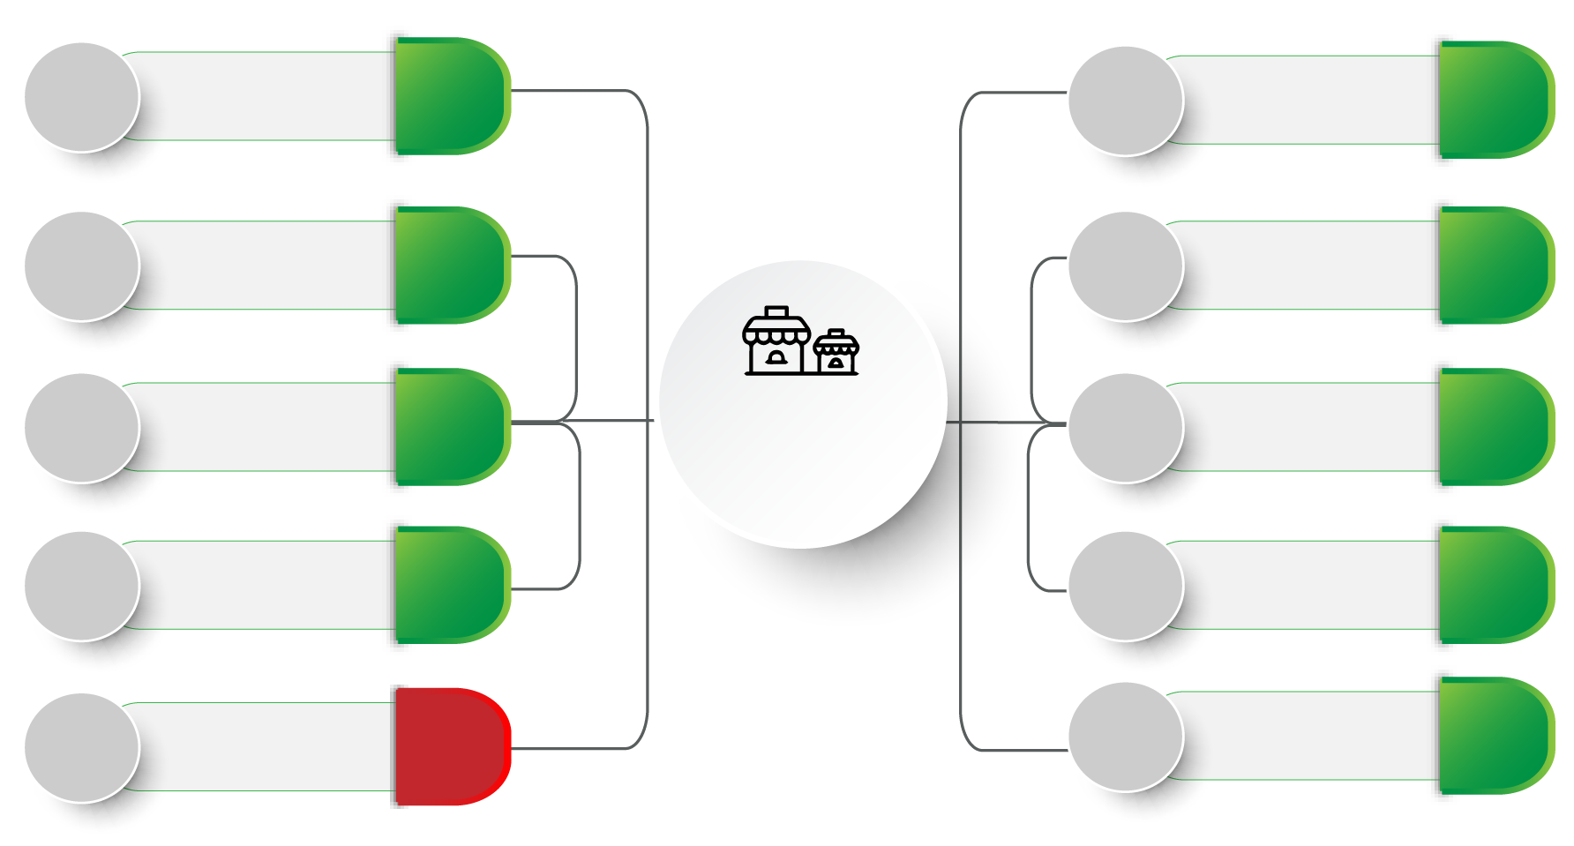
Performance dashboard
9 276
Entrepreneurship
Awareness
19 966
696
Productivity
Improvement
862
8 546
Township & Rural
based clients
8 632
696
Quality
Improvement
2 780
1 249
Localisation
Support
2 033
Total SMMEs &
Cooperatives
Supported
58 463
25 000
Ecosystem
Support
14 707
Access to
International
Markets
Manufacturing
Support
400
1 660
696
3 398
812
Incubation support
588
1 392
Sector Specific
Training & Coaching
3 837

Slide 7
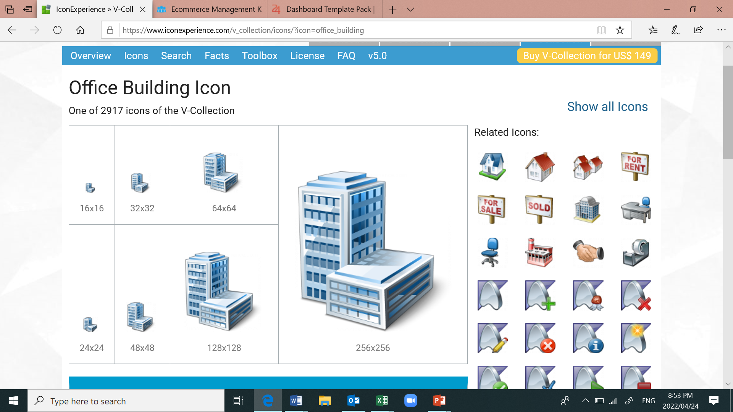
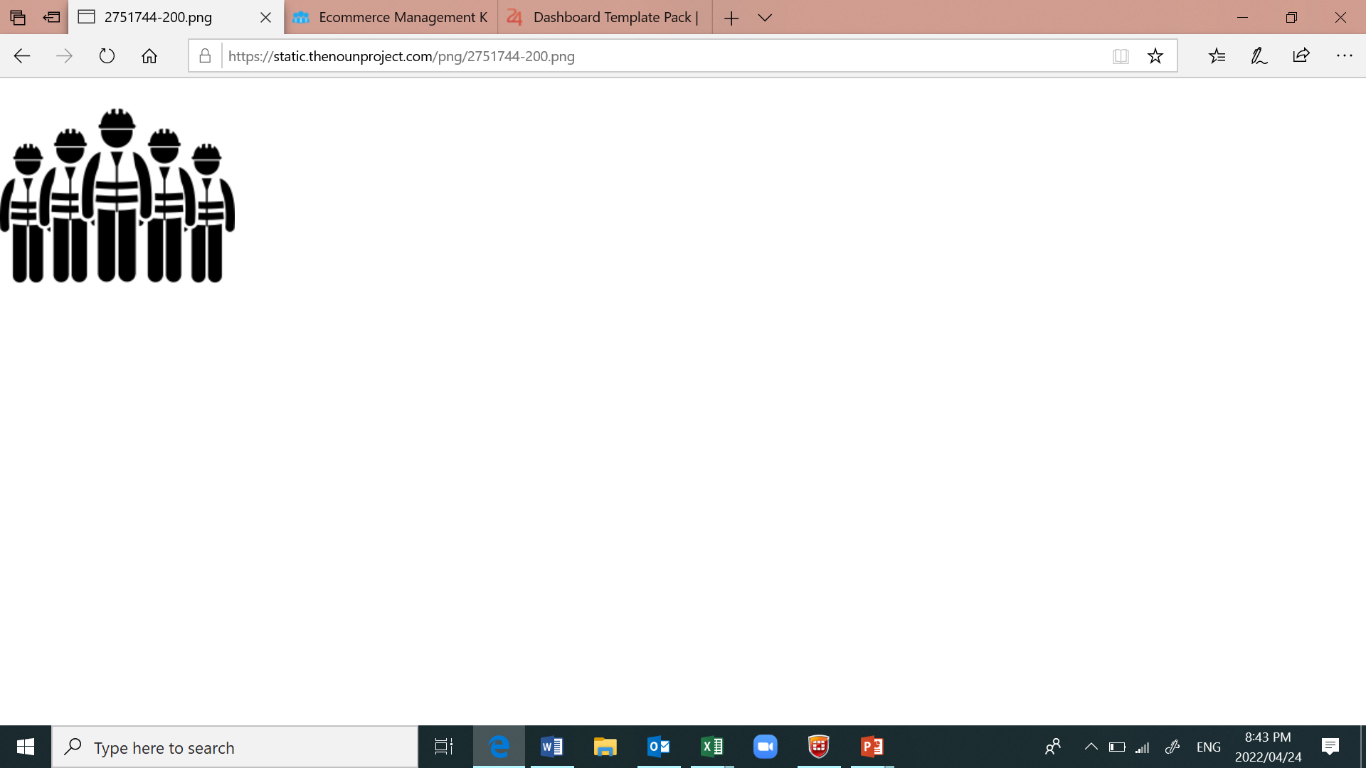
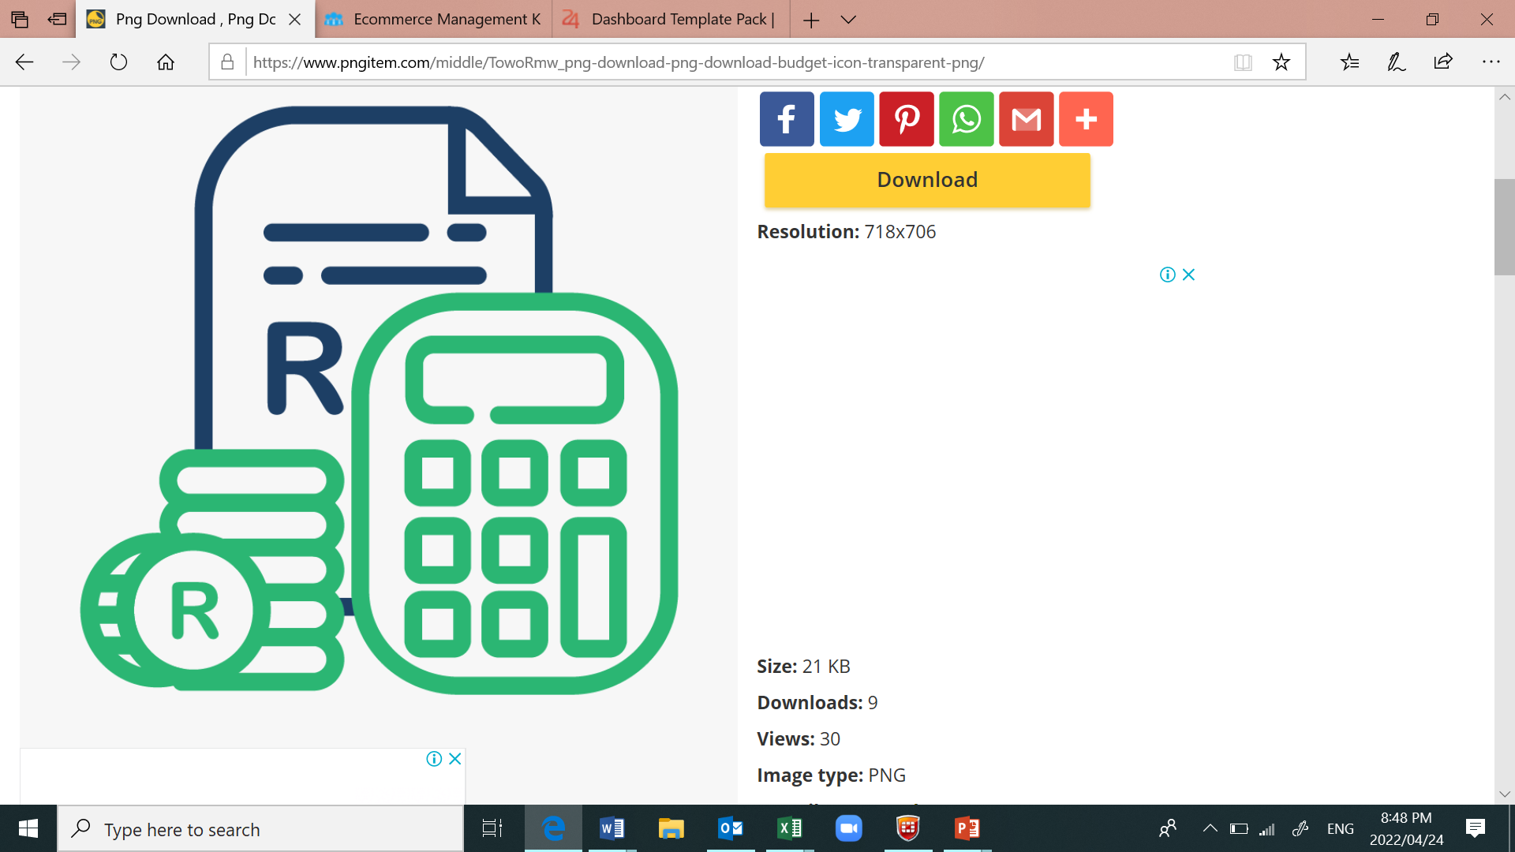
Performance dashboard
Jobs Created
Service Access Points
Budget Spend – 91%
Seda Branches - 54
3505
R388,32 Million
Incubation centers - 110

Slide 8
3. PERFORMANCE COMPARISON

Slide 9
Performance Comparison

Slide 10
Performance Comparison
Indicators | Quarter 1 |  | Quarter 2 |  | Quarter 3 |  | Quarter 4 |  | Annual Performance
 | 20/21 | 21/22 | 20/21 | 21/22 | 20/21 | 21/22 | 20/21 | 21/22 | 20/21 | 21/22
Indicators Monitored | 24 | 25 | 23 | 25 | 23 | 26 | 23 | 29 | 23 | 30
Indicators Achieved | 12 | 16 | 13 | 21 | 11 | 18 | 10 | 24 | 12 | 24
Indicators Underachieved | 12 | 9 | 10 | 4 | 12 | 8 | 13 | 5 | 11 | 6
Percentage Achievement | 50% | 64% | 57% | 84% | 48% | 69% | 43% | 83% | 52% | 80%

Slide 12
Performance Comparison

Slide 13
PROGRAMME 1: Township, Rural and Informal Business
NO. | Output Indicator | Annual Targets | Q 4 Target | Q4 Achievement | Q4 Variance | % Achievement | Reason for Variance | Corrective Measures | YTD Target | YTD Achieve ment
1.1 | Number of SMMEs & Cooperatives reached through entrepreneurship awareness sessions | 37 104 | 9 276 | 19 966 | 10 690 | 215% | Target exceeded due to focus on outreach campaigns and information sharing. Performance enablers such as virtual platforms were also used. | None | 37 104 | 67 029
1.2 | Number of Spaza shops and general dealer supported | 9 276 | 2 319 | 2 034 | -285 | 88% | Seda branches were experiencing several challenges with the conversion of informal Spaza shops to formal, as these are mostly owned by foreigners. In addition, the turnaround time for applications for accessing funding from DSBD is hampering the uptake of this support. | The organisation will continue to support SMMEs who are in this sector in the new financial year, working with various associations to improve the uptake. | 9 276 | 6 694
1.3 | Number of Personal Care businesses supported | 2 000 | 500 | 981 | 481 | 196% | Marketing initiatives improved the uptake of the programme. | None | 2 000 | 2 738

Slide 14
PROGRAMME 1: Township, Rural and Informal Business
No. | Output indicator | Annual Targets | Q 4 Target | Q4 Achievement | Q4 Variance | % Achievement | Reason for Variance | Corrective Measures | YTD Target | YTD Achieve- ment
1.4 | Number of Informal and Micro Restaurants and Tshisanyama supported | 1 500 | 750 | 1 186 | 436 | 158% | Target exceeded due to referrals and collaboration with existing stakeholders. | None | 1 500 | 3 425
1.5 | Number of Fruit and vegetable vendors supported | 4 638 | 1 159 | 1 083 | -76 | 93% | The recruitment of fruit and vegetable vendors was reduced because the financial support offered by DSBD and sefa was reallocated to support informal businesses that were affected by riots in KZN. | The organisation will continue to support SMMEs who are in this sector in the new financial year, working with various associations to improve the uptake. | 4 638 | 4 333
1.6 | Number of Panel beaters, motor mechanics, auto spares and auto-fitment businesses supported | 4 638 | 1 159 | 993 | -166 | 85% | Underperformance is largely due to low uptake of the programme. The scheme was restructured to address the needs of the small businesses that are in this sector. | Sefa has increased the upper limit of the scheme to R1 million, which should improve the uptake. The partnership with ABSA has also been finalised. | 4 638 | 2 305

Slide 15
PROGRAMME 1: Township, Rural and Informal Business
No. | Output indicator | Annual Targets | Q 4 Target | Q4 Achievement | Q4 Variance | % Achievement | Reason for Variance | Corrective Measures | YTD Target | YTD Achieve- ment
1.7 | Number of Small scale bakeries and confectionaries supported | 2 000 | 500 | 828 | 328 | 166% | Relationships with key stakeholders and the appointment of Service Providers to augment internal capacity assisted with improving performance | None | 2 000 | 2 546
1.8 | Number of Clothing, leather and textile businesses supported | 2 000 | 500 | 866 | 386 | 173% | There is a large number of Seamstresses who needs equipment, working capital and further business development support | None | 2 000 | 3 631
1.9 | Number of Butcheries supported | 2 000 | 500 | 661 | 161 | 132% | Businesses in this sector cannot compete with supermarkets on price and most have closed down. Most butcheries in the township operate as Tshisanyamas. | None | 2 000 | 2 216
1.10 | Number of jobs created | 4 638 | 1 159 | 3 503 | 2 267 | 302% | Businesses that were evaluated in this quarter showed an improvement in the number of jobs created. | None | 4 683 | 4 865

Slide 16
  PROGRAMME 2: Business Competitiveness and Viability
No. | Output indicator | Annual Targets | Q 4 Target | Q4 Achievement | Q4 Variance | % Achievement | Reason for Variance | Corrective Measures | YTD Target | YTD Achieve- ment
2.1 | Number of SMMEs & Cooperatives supported to be competitive in local markets | 2 500 | 1 249 | 2 033 | 784 | 163% | Access to Local market interventions like mall activation, pop-up markets & capacity building contributed to this achievement. | None | 2 500 | 5 546
2.2 | Number of SMMEs and Cooperatives listed to supply wholesalers and retailers | 1 000 | 200 | 220 | 20 | 110% | Most of the targeted clients are being supported to meet the required retail listing standards. | None. | 1 000 | 651
2.3 | Number of SMMEs & Cooperatives exposed to international markets | 1 000 | 200 | 1 037 | 837 | 519% | Since the lifting of the Covid 19 restrictions, Seda was able to support a significant number of clients to participate in many tradeshows that were previously postponed. | None. | 1 000 | 1 989

Slide 17
  PROGRAMME 2: Business Competitiveness and Viability
No. | Output indicator | Annual Targets | Q 4 Target | Q4 Achievement | Q4 Variance | % Achievement | Reason for Variance | Corrective Measures | YTD Target | YTD Achieve- ment
2.4 | Number of SMMEs & Cooperatives registered on export platforms | 2 000 | 200 | 281 | 81 | 141% | Seda was able to register more clients through conducting Webinars and localised workshops. | None | 1 000 | 1 170
2.5 | Number of SMMEs and Cooperatives assisted with incubation programme | 3 247 | 812 | 588 | -244 | 72% | Some of the incubated SMMEs graduated in the third quarter. | The new intake of incubates will be enrolled in the new financial year. | 3 247 | 3 269
2.6 | Number of SMMEs and Cooperatives assisted with productivity improvement | 2 783 | 696 | 862 | 166 | 124% | The increase in performance was due to the increased demand of Technology assistance services. | None. | 2 783 | 3 430

Slide 18
  PROGRAMME 2: Business Competitiveness and Viability
No. | Output indicator | Annual Targets | Q 4 Target | Q4 Achievement | Q4 Variance | % Achievement | Reason for Variance | Corrective Measures | YTD Target | YTD Achieve- ment
2.7 | Number of SMMEs and Cooperatives assisted with quality improvement | 2 783 | 696 | 2 780 | 2 084 | 399% | Seda conducted webinars and assisted SMMEs and Cooperatives with interventions and training to improve the quality of their products and to meet the standards for supplier development. | None | 2 783 | 5 254
2.8 | Number of SMMEs & Cooperatives assisted through the ecosystem | 70 000 | 25 000 | 14 707 | -10 293 | 59% | The number of clients supported by ecosystem partners were below the anticipated performance. | The relationship between Seda and ecosystem partners will be reviewed to improve client support. | 70 000 | 62 240
2.9 | Percentage of Identified Stakeholders Participating in the Ecosystem | 75% | 75% | 100% | 25% | 133% | All targeted stakeholders participated in the ecosystem support | None | 75% | 100%

Slide 19
  PROGRAMME 2: Business Competitiveness and Viability
No. | Output indicator | Annual Targets | Q 4 Target | Q4 Achievement | Q4 Variance | % Achievement | Reason for Variance | Corrective Measures | YTD Target | YTD Achieve- ment
2.10 | Number of SMMEs and Co-operatives whose turnover has increased | 2 783 | 696 | 1 531 | 818 | 220% | Businesses that were evaluated in this quarter showed improvement in turnover reported. | None. | 2 783 | 3 320
2.11 | Number of SMMEs and Co-operatives supported in the manufacturing sector | 2 783 | 696 | 3 398 | 2702 | 488% | There was a great demand expressed by SMMEs in the manufacturing sector and the organisation structured more interventions targeting SMMEs in this sector. | None | 2 783 | 9 397
2.12 | Number of SMMEs and Co-operatives supported through Sector specific training | 2 783 | 696 | 1 894 | 1 198 | 272% | Seda structured its offerings to provide support to clients who were grouped according to specific sectors. | None | 2 783 | 4 476
2.13 | Number of SMMEs and Co-operatives supported enterprise Coaching | 2 783 | 696 | 1 943 | 1 247 | 279% | There was a good uptake for this programme in various Provinces. | None | 2 783 | 2 910

Slide 20
  PROGRAMME 3: Administration
No. | Output indicator | Annual Targets | Q 4 Target | Q4 Achievement | Q4 Variance | % Achievement | Reason for Variance | Corrective Measures | YTD Target | YTD Achieve- ment
3.1 | Percentage of innovative ideas implemented | 25% | 25% | 33% | 8% | 132% | One third of the approved innovative ideas were implemented in this financial year | None | 25% | 33%
3.2 | Percentage of staff recognized for excellence | 25% | 25% | 67% | 42% | 268% | 67% of the evaluated employees were rated above 311 and the balance was rated below. | None | 25% | 67%
3.3 | Percentage of staff satisfaction | 75% | - | - | - | - | The employee participation rate in 2021 was 43% compared to 38% in 2019. Majority of employees are dissatisfied with; Leadership & Management, Remuneration and, Resources. Overall employees are satisfied with; Strategy alignment, Training and Development, Empowerment/Autonomy, Communication, Employee Engagement and Recognition. | Management will review the developed action plan to respond to the areas of weaknesses identified in the employee satisfaction survey. | 75% | 43%

Slide 21
  PROGRAMME 3: Administration
 | Output indicator | Annual Targets | Q 4 Target | Q4 Achievement | Q4 Variance | % Variance | Reason for Variance | Corrective Measures | YTD Target | YTD Achieve- ment
3.4 | Percentage of customer satisfaction | 80% | 80% | 95% | 15% | 119% | The target was exceeded due to the quality of service rendered. | None. | 80% | 95%
3.5 | Percentage of stakeholder satisfaction | 80% | 80% | 86% | 6% | 108% | Stakeholders are satisfied with Seda’s partnership | None | None | 86%
3.6 | Percentage of vacancy rate | 10% | 10% | 7% | 3% | 143% | Continuous engagements and follow-ups made to accelerate the filling of approved critical vacant positions | None | 10% | 7%
3.7 | Percentage of funds allocated to core delivery | 75% | 75% | 88.5% | 13.5% | 118% | Most of the organisations budget is allocated to support clients. | None | 75% | 88.5%

Slide 22
5. HUMAN RESOURCE REPORT

Slide 23
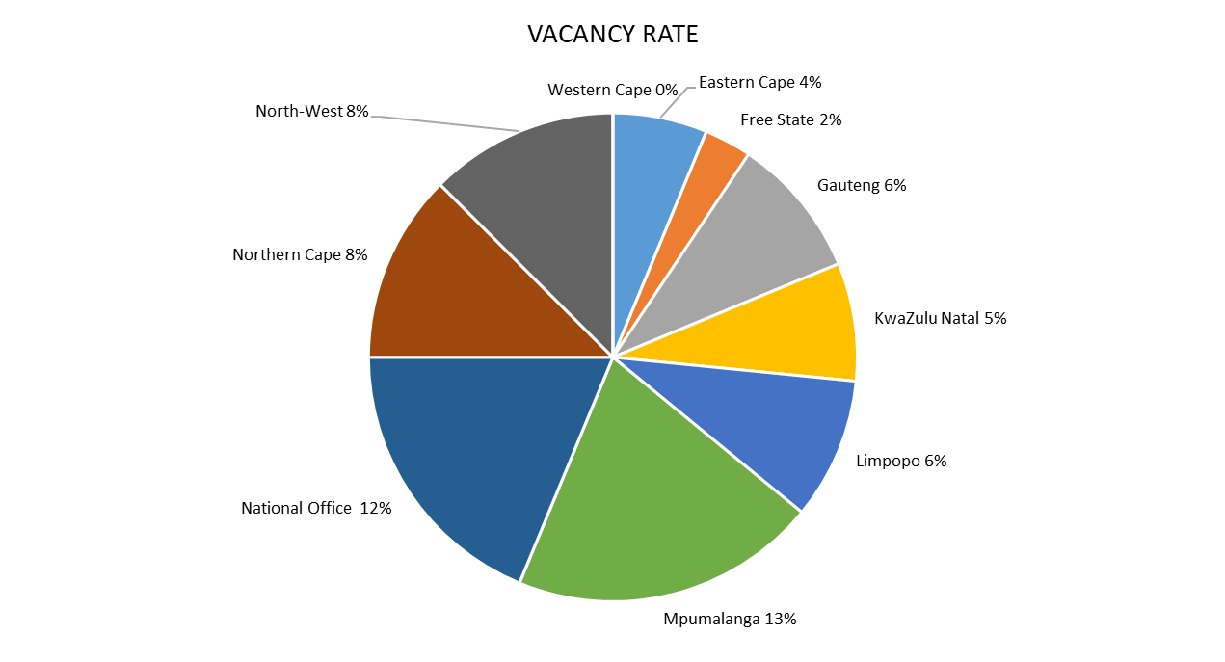
HUMAN RESOURCE VACANCIES
Total number employees as per approved structure -713
Number of staff as at end March 2022 was 664
The vacancy rate as end March 2022 : 7%

Slide 24
5. DRAFT FINANCIAL REPORT

Slide 25
ANNUAL APPROVED FUNDING vs FUND RECEIVED 2021/22
Details | Annual Approved Rm | Funding received Rm | Variance Rm | % (under)/ Over
Seda – baseline | 606,5 | 606,5 | - | 0%
STP – baseline | 156,5 | 156,5 | - | 0%
STP - Capacity Building programme – CFEs | 15,9 | 15,9 | - | 0%
STP Enterprise Incubation | 59,6 | 59,6 | - | 0%
Seda - Dsbd Specific Project – Gazelles | 29,3 | - | - 29,3 | -100%
External earning | 6,9 | 41,1 | 34,2 | 495%
Other income | 11,5 | 18,2 | 6,7 | 58%
Total | 886,2 | 897,7 | 11,6 | 1%
Note
Seda received the budget cut during the year, amount of R29,3 million for the Gazelles project was not received.
External earning exceeded target by R34,2 million due to funding received from Provincial government, Local government and other Specific projects.
Other Income exceeded target by R6,7 million due higher Interest received from bank and Sundry Income.

Slide 26
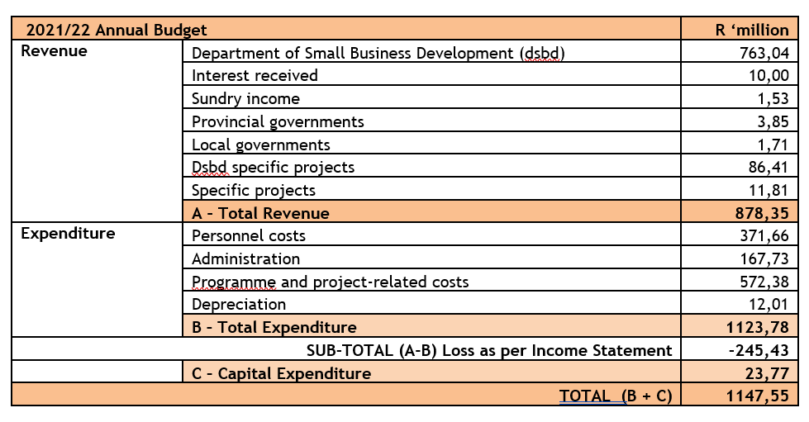
REVISED BUDGET 2021/2022
Revised Budget for 2021/22 due to Surplus approved
Seda received approval for their 2020/21 surplus retention from National Treasury in quarter three. This surplus funding was added to the expenditure side of the budget. Seda needed to budget for a deficit for the remainder of the financial year 2021/22 in order to utilize the surplus budget. The expenditure budget is now R1 147,55 million against the income of R878,35 million, therefore budgeted deficit is R269,2 million.

Slide 27
SPLIT PER PROVINCES & NATIONAL OFFICE 2021/2022
The surplus of R101,98 million is a preliminary as at April 2022, the commitments and accruals are estimated to be R250 million.
The expenditure is above the original budget of R886,2 million, the underspending is on the surplus received in quarter 3.

Slide 28
BREAKDOWN OF NATIONAL OFFICE BUDGET 2021/22
Details | Revenue | Expenditure | Net Surplus | % Over/ (Under) spend
 | R | R | R
National Office | 688 280 579 | 601 184 654 | 87 095 925 | -13%
TOTAL | 688 280 579 | 601 184 654 | 87 095 925 | -13%
Personnel cost – R141m;
Administrative - R34m;
Capital expenditure - R8m;
General expenses - R20m
Centralised costs for all Provinces:
Incubators – R288m;
Projects (TTA, QS, PAD, LA) - R130m;
Point of sales devices - R35m;
Computer licenses; Internet & Professional services - R33m.

Slide 29
EXPENDITURE SPLIT OF CORE VS SUPPORT FUNCTIONS
 | Core | Support
Draft Actual expenditure | R954,64 million | R90,93 million
Target | 75% | 25%
Achieved | 91% | 9%
From the approved Surplus of R294 million, an amount of R236 million (80%) was allocated to the Core, i.e.
Pop-up Markets, Incubators & TTA committed, New incubators & TTA, Point of sale devices, EDF, other projects and Capital expenditure for Provinces.
Due to the additional funding allocated to the Core, the target of 75% was over exceeded.

Slide 30
PRELIMINARY SPENDING END OF QUARTER 4
The expenditure for the forth quarter (Jan – Mar 2022), amounted to R388,32 million against the budget of R430,75 million, resulting in underspending of R42,43 million.
The actual expenditure for the YTD period April to March 2022 amounted to R1 045, 57 million resulting in the underspending of R101,99 million, against the budget of R1 147,55 million.
Overall Total spending as at March 2022 is 91% of the annual budget. Accrual are in progress and the % underspending may be lower.
99,8% of the invoices were paid within 30 days.

Slide 31
FINANCIAL REPORT end of Quarter 4
Details | Annual Budget | Actual | Variance | % under/ (Over)
Personnel cost | 371 662 586 | 374 151 582 | - 2 488 996 | -1%
- Core | 280 737 264 | 282 981 688 | - 2 244 424 | -1%
- Support | 90 925 322 | 91 169 894 | - 244 572 | 0%
Goods and services | 740 105 345 | 639 641 303 | 100 464 042 | 14%
Depreciation | 12 010 628 | 13 657 315 | - 1 646 688 | -14%
Capital Expenditure | 23 773 512 | 18 115 708 | 5 657 804 | 24%
Total | 1 147 552 071 | 1 045 565 908 | 101 986 162 | 9%

Slide 32
FINANCIAL REPORT end of Quarter 4
Explanation of underspending:
Personnel costs – 1%. Minor deviation.
Goods & services – Underspending of 14% at the end of the 4th quarter is mainly on programmes and projects. Currently underspending is mainly on Enterprise Development Fund at Provinces by 3,24% and National Office is mainly on Seda Technology Programme and Enterprise Development Division by 12,36%. The report is preliminary and accruals are in progress, the final underspending to be confirmed on 31 May 2022 when the draft Annual Financial Statements are available for audit purposes.
Capital expenditure – Underspending on assets purchases was mainly caused by non-availability of computers in the country. Purchase orders have been issued and delivery is expected in the new year.
Overall Total expenditure as at March 2022 is R1 045, 57 and is 91% of annual budget.

Slide 33
6. GOVERNANCE & COMPLIANCE

Slide 34
Board and Committee Meetings
Committee | No of Scheduled Meetings | Dates
Board Meetings | 6 | 8 February 2022 (Special) and In Committee 24 February 2022 and In-Committee 24 March 2022 and In-Committee
Social Ethics Committee(sec) | 2 | 4 February 2022 (Special) 22 March 2022
Strategy and Organisational Performance Committee (SOPC) | 3 | 26 January 2022 4 February 2022 (Special) 21 February 2022 (Special)
Audit And Risk Committee (ARC) | 2 | 27 January 2022 and In-Committee
Human Resources & Remuneration Committee | 3 | 10 March 2022 and In-Committee 22 March 2022 (Special)

Slide 35
Board Priorities (January – March 2022)
The Board attended to the following priorities during this quarter:
Quarterly Performance Reporting
Financial Report Quarter 3

Slide 36
7. KEY PROJECTS

Slide 37
High Impact Projects
Project/targeted support | Project Focus/ Outcomes
Technology Transfer | Seda assisted a total of 177 clients in this reporting period. The improvements in the assessment of SMMEs through return on investment (ROI) approach assisted the organisation to achieve better results compared to previous years. The total commitment generated is R 110 Million and purchase orders worth R 34 million were generated by the end of the quarter.
Eastern Cape Automotive Industry Initiative | Seda and the AIDC EC have partnered to facilitate a process of a sustainable transformation of the automotive sector in the EC and towards alignment to the SA Automotive Masterplan 2035. The objective of the partnership is to work together in developing the automotive industry in the EC by providing access to financial and non-financial support to participating SMMEs in the broader supply and value chain of the automotive sector.
Point of Sale | A service level agreement was signed with the service provider to deliver 5000 Point of Sale devices, of this number, 2491 were delivered to clients in North-West, Western Cape and Northern Cape. Seda is currently finalising the training roll-out plan to benefit the targeted SMMEs.

Slide 38


Slide 39
