Slide 1
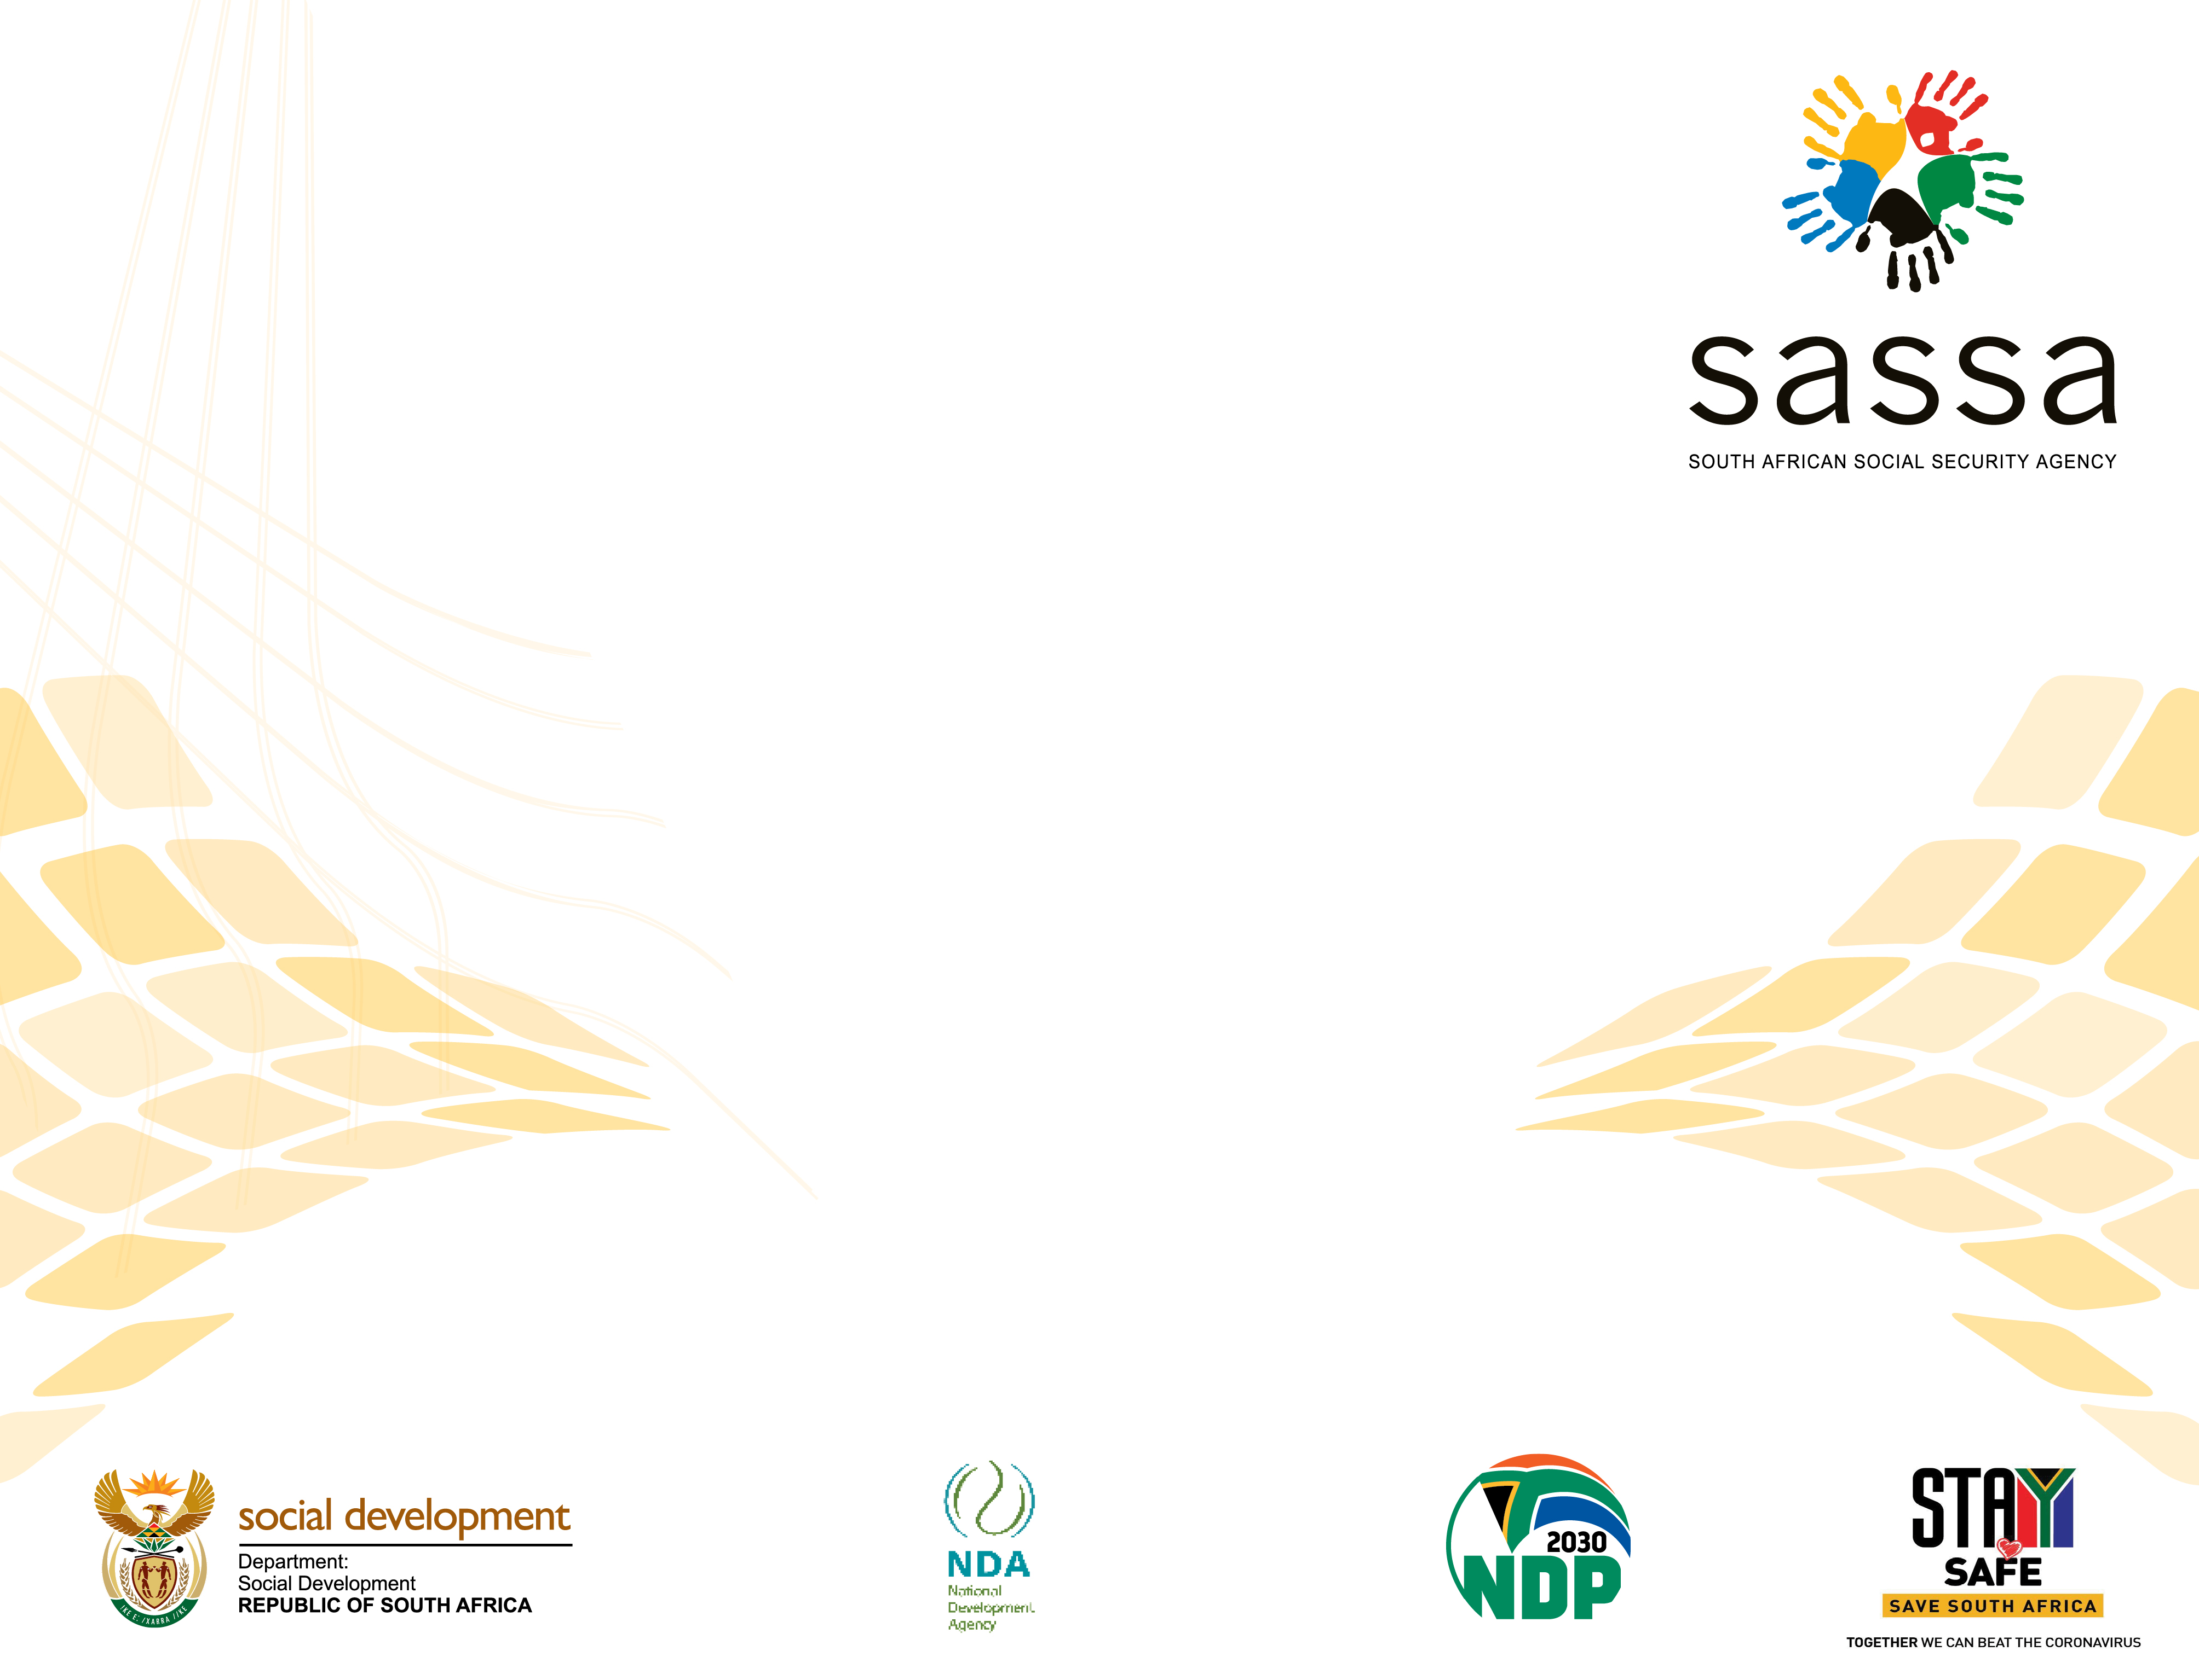
PRESENTATION TO THE STANDING COMMITTEE ON SOCIAL DEVELOPMENT ON THE SRD AND CSG TOP-UP GRANT
10 MAY 2022

Slide 2
PURPOSE OF THE PRESENTATION
To provide the Standing Committee on Social Development the latest information on the application processes for the new SRD Grant (R350 Grant) and the CSG Top-up Grant

Slide 3
SOCIAL RELIEF OF DISTRESS (SRD) GRANT

Slide 4
BACKROUND
The Covid-19 R350 Grant was initially introduced in May 2020 under the Covid-19 national state of disaster regulations
With the lifting of the disaster regulations the grant will now be provided under a new legislative framework within the Social Assistance Act.
Beneficiaries of the former Covid-19 grant are now obliged to re-apply for the new SRD (R350) Grant.
Regulations in this regard was published in the Government Gazette during April 2022.

Slide 5
LEGISLATION AND QUALIFYING REQUIREMENTS
A person in need of temporary assistance, may qualify for the social relief of distress called the Covid-19 Social Relief of Distress if he or she is a person with insufficient means. The person with insufficient means must in addition be:
(a) a person who is-
(i) a South African citizen; or
(ii) a permanent resident; or
(iii) a refugee; or
(iv) a holder of a special permit under the Special Angolan Dispensation, the Lesotho Exemption Permit Dispensation or the Zimbabwe Exemption Permit Dispensation; or
(v) an asylum seeker, whose section 22 permit or visa is valid.

Slide 6
LEGISLATION AND QUALIFYING REQUIREMENTS
registered on the Department of Home Affairs database or registered on the Agency’s social grant database with a unique system generated identifying number for people without identity documents; and
between the ages of 18 and 60; and
(d) currently residing within the borders of South Africa;
(e) not a resident in a government funded or subsidised institution; and
(f) not unreasonably refuse to accept employment or educational opportunities.

Slide 7
LEGISLATION AND QUALIFYING REQUIREMENTS
For the purpose of validating insufficient means, the Agency may
use-
(a) a declaration from the applicant attesting to such; and
(b) a screening questionnaire; and
(c) a proxy means test consisting of—
(i) checks against databases that may indicate income or alternative financial assistance; and
(ii) verification of insufficient means with banks.

Slide 8
LEGISLATION AND QUALIFYING REQUIREMENTS
If the results from the means testing with the banks contradicts the results from the data checks with external databases , the results from the means testing with the banks will be used to make the final legibility determination.
The income threshold for insufficient means, contemplated in this regulation, is R350 per person per month.
If a person has more than one bank account, the criteria for insufficient means is deemed to have been met if all the bank accounts, assessed individually, are below the income threshold.
A person is not entitled to a social grant for himself or herself and Covid-19 Social Relief of Distress simultaneously.

Slide 9
APPLICATION PROCESS
1. APPLICATION CHANNELS
There are 2 application channels:
WhatsApp: Send message to 0820466553 (not yet active)
SRD Website: https://srd.sassa.gov.za
2. WHATSAPP APPLICATIONS
Applicant will provide personal details as prompted by the chat
Applicant will receive a reference number, an OTP and website link to click on
Once the applicant click on the link, insert the OTP number and click verify
Applicant will then need to provide surname and ID number
The applicant will then be required to confirm the details as provided on the chat and agree to the terms and conditions

Slide 10
APPLICATION PROCESS
3. APPLICATION via WEBSITE
Once the applicant is on the SRD website (https://srd.sassa.gov.za) the following must be done:
The applicant capture his/her ID number and mobile number and send
A six (6) digit OTP number will be send to the applicant which need to captured to continue
The applicant must then capture the required information respond to all questions and agree to the terms and conditions
4. FURTHER STEPS FOR APPLICANT
The applicant will be required to provide:
Personal details (ID, name, surname, address, gender, etc.)
Choose a payment option:
Existing clients: confirm details and agree to terms and conditions. Cashsend clients have the option to add their bank details if available
New clients with bank accounts will be required to submit their bank details or choose the Cashsend option

Slide 11
APPLICATION PROCESS
5. RECEIVE A SMS ON MOBILE NUMBER
It is important that the applicant provides SASSA with a mobile number where SASSA will be able to reach the applicant with a SMS regarding the outcome of the application

Slide 12
APPLICATION PROCESS
SASSA VERIFICATION AND VALIDATION
ID number, name and surname as well as life status of the applicant will be verified with Home Affairs
ID number of applicant will be matched against approved databases such as UIF, SARS, NFSAS, GEPF, Persal, Persol, Correctional Services, etc.
Application will be assessed according to the responses to the application questions as submitted by applicant i.e responses to income and employment questions
Application will be validated with Banks for R350 income threshold for insufficient means testing
Fraud Risk scoring is done with Fraud prevention partners.
The application is then approved or declined with reasons.

Slide 13
GENERAL REMARKS
The application status can be viewed on 3 channels:
SRD Website – https:/srd.sassa.gov.za
WhatsApp – 082 046 8553
Toll free call centre – 0800 60 10 11
A client can lodge an appeal with the Independent Appeals Tribunal within 90 days if the application is declined. An appeal must be raised for every month that an application is declined and the client wants to appeal. Appeals can be lodged on the website of Social Development.
SRD grants can be cancelled on own request via the website and also re-instated via the same channel.

Slide 14
GENERAL REMARKS
During March 2022, the last month of Covid 19 SRD grant there were 1,289,767 recipients in the Western Cape Province. This represented 8% of the recipients in the country
All the recipients have to re-apply for the new SRD grant.
The applications only commenced on 23 April 2022 and more than 9.7 million clients already applied.
SASSA received more applications in the first week of this grant than in the first week of reapplications in August 2021

Slide 15
CHILD SUPPORT
GRANT TOP-UP

Slide 16
EXTENDED PAYMENT CSG
In 2011, the North Gauteng High Court required the Minister of DSD to design and implement a comprehensive legal solution to the crisis in the foster care system.
The foster care system at the time was servicing 550 000 children, the majority who were orphans living with relatives.
In 2015, Cabinet approved the proposal by the Department of Social Development to implement the CSG TOP-UP GRANT. The aim is to increase the CSG amount for orphans in the care of relatives and orphans in child headed households. In order to provide a legislative framework for the CSG Top –Up, the Social Assistance Act No 16 of 2020 was published in 2020.
CSG Top Up is (R480 + 240)
The CSG Top-Up is not a new grant but builds on the CSG, hence the rules and the procedures for the CSG will continue to be followed.

Slide 17
EXTENDED PAYMENT CSG
For the CSG Top-Up, relatives will need to provide proof that they are a relative of the child by attesting to their relation to the child
Proof that the child is an orphan in the form of death certificates of the child’s parents or one parent’s death certificate and an affidavit attesting to their lack of knowledge as to whether the other parent is dead or alive.
All orphans already in court ordered foster care will remain in the foster care system until they naturally age out when they turn 18 (or 21 if they are still in education). This is because it is constitutionally regressive to take the FCG away from children who are already receiving it.

Slide 18
ELIGIBILITY CRITERIA FOR CSG TOP-UP APPLICATION
Orphans in the care of relatives.
A child heading a household who is aged between 16 and 18 can apply for and receive the child support grant for him/herself as well as receive the CSG Top-Up for the children under his/her care;
The children may also be placed in the care a caregiver, or relatives (relatives are defined as grandparents, brothers, sisters, uncle, aunts and or cousins of the child/ren or anyone who cares for the orphan child/ren) who can apply for the CSG Top-Up;
The applicant for the CSG Top-Up is subjected to the means test, where the applicant income and /or his/her spouse is considered irrespective whether they are married in or out of community of property and regardless of their relationship to the child;
Applicants can go directly to SASSA without first needing a social worker investigation, report and a court order.

Slide 19
ELIGIBILITY CRITERIA FOR CSG TOP-UP APPLICATION
CSG Top Up is (R480 + 240)
Applicants can go directly to SASSA without first needing a social worker investigation, report and a court order.

Slide 20
RECOMMENDATION
The Standing Committee on Social Development should take note of the application processes for the new SRD (R350) Grant and the new Child Support Grant Top-up

Slide 21
  THANK YOU

