Slide 1
THE SCHOOL ADMISSIONS CRISIS
IN THE WESTERN CAPE

Slide 2
SCOPE AND OUTLINE OF THE PRESENTATION
1. Who is the Equal Education Law Centre?
2. Statistics
3. Systemic admission issues in the Western Cape:
3.1 Application processes
3.2 Lack of cohesion between the schools and the districts
3.3 Admission appeal processes
3.4 Overcrowding
4. Recommendations

Slide 3
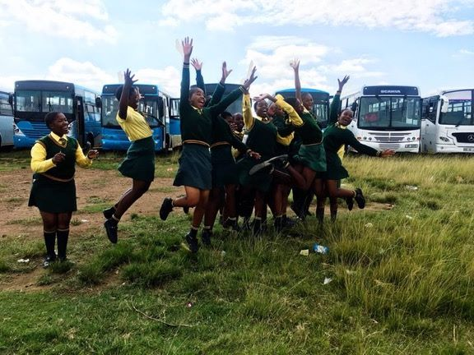
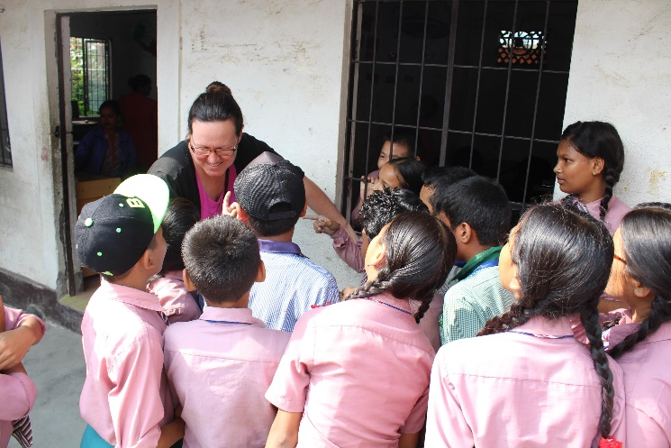
Movement Lawyering | Community Lawyering | Research and Advocacy
The EELC provides support to activists engaged in grassroots campaigns for social justice | The EELC runs a walk-in clinic, providing free legal assistance to all community members, including learners or family members | The EELC uses legal research to enhance legal literacy and develop accessible tools for schools
Notes:
Introduce ourselves.
Who is the EELC?
How did the report come about? (objectives)
Note what report covers and what it does not (e.g. curriculum development etc)
How the issues we have covered in the report arise in other areas.

Slide 4
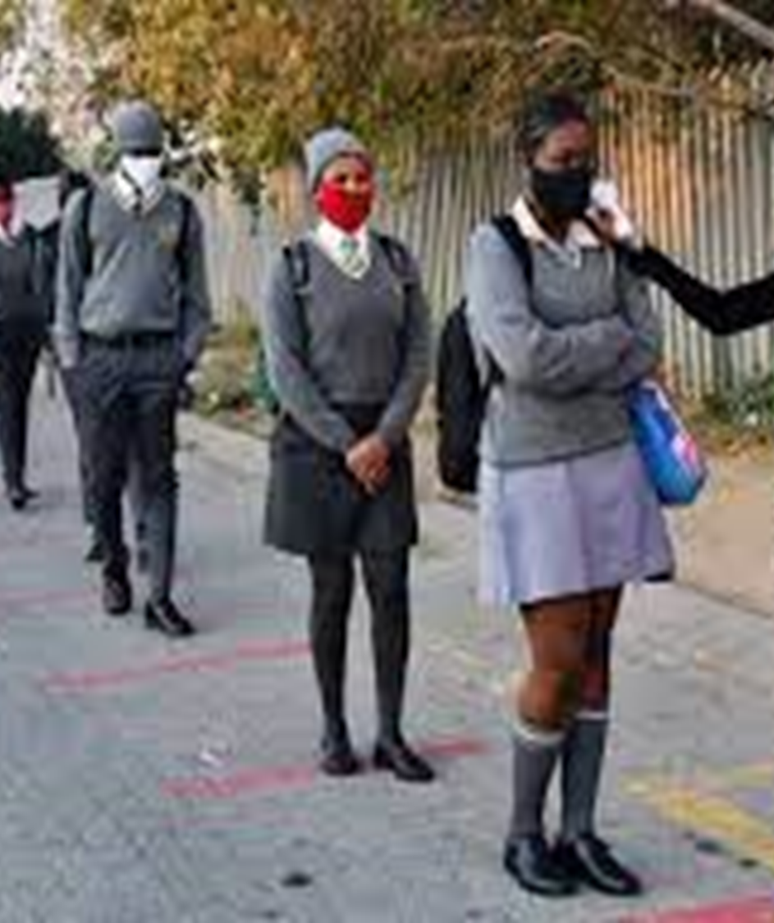
STATISTICS
January 2021: 5537 unplaced grade 1 learners, 10 450 unplaced grade 8 learners;
April 2021: 2 550 unplaced learners;
53 058 late applications received between April 2021 and March 2022;

Slide 5
STATISTICS
January 2022: 3 589 unplaced grade 1 and 8 learners. (excluding late applications);
January 2022: 32 000 late applications received by the WCED;
March 2022: 341 unplaced grade 1 and grade 8 learners

Slide 6
Systemic Admission Issues
Application Processes
Co-ordination between Schools and Districts
Admission Appeal Processes
Overcrowding

Slide 7
Admission processes
Inaccessible processes
Online Applications
Ineffective late application procedures
Lack of support and resources

Slide 8
Effective administrative systems
Proper systems to ensure consistency and uniformity
Adequate system and process support and resources throughout application process
Improved coordination and communication
Proper reporting
Accountability
RECOMMENDATIONS

Slide 9
CO-Ordination between schools and districts
Lack of cohesion between schools and districts
No uniformity between districts
Districts not following proper procedures
Lack of communication

Slide 10
Effective administrative systems
Proper systems to ensure consistency and uniformity
Improved coordination and communication
RECOMMENDATIONS

Slide 11
Admission APPEAL processes
No application outcomes from schools in writing
No legislative guidance for parents who are required to appeal to schools
Lack of guidance and support on appeal processes to the MEC’s office
Lack of publicly available information
No timelines for consideration of appeals

Slide 12
Proper reporting
Accountability
Legislated admission appeal processes and timelines
Effective administrative systems
Proper systems to ensure consistency and uniformity
Improved coordination and communication
RECOMMENDATIONS

Slide 13
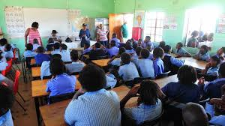
Overcrowding
Oversubscription of schools
Schools not being built in areas of need
Lack of publicly available information and plans
Lack of funding
Inadequate forecasting / planning

Slide 14
Proper reporting
Accountability
Publicly available long-term plans
Increased funding
Improved coordination and communication between government departments
RECOMMENDATIONS

Slide 15
Proper reporting
Accountability
Publicly available information
Long-term plans
Increased funding
Legislated admission appeal processes and timelines
Effective administrative systems
Proper systems to ensure consistency and uniformity
Adequate system and process support and resources throughout application process
Improved coordination and communication
CONSOLIDATED RECOMMENDATIONS

Slide 16
CONTACT US
For more information, visit
www.eelawcentre.org.za
info@eelawcentre.org.za
@Eelawcentre
facebook.com/EqualEducationLawCentre
3rd Floor, Isivivana Centre
8 Mzala Street
Khayelitsha
Western Cape

