Slide 1
SANSA
2020-2025 Revised Strategic Plan
2022/2023 Annual Performance Plan
Presentation to the Portfolio Committee on Higher Education, Science and Innovation
By SANSA Board and Executives
06 May 2022

Slide 2
Contents
Strategic Context
Revised SANSA 2020/2025 Strategic Plan
Vision / Mission / Impact
Measuring Our Outcomes
Outcome Indicators and Key Interventions
Key Strategic Priorities
SANSA Alignment: Economic Reconstruction and Recovery Plan (ERRP)
2022-2023 APP Output Indicators and Medium-Term Targets
Operational Information
Organisational Focus / Key 2022 - 2023 Priorities
Employment by Programme
Key Challenges
SANSA Institutional Review
Financial Overview
2

Slide 3
Strategic Context
The Revised 2020—2025 strategy has marked a new trajectory for SANSA towards the following objectives as provided by the SANSA Act (No. 36 of 2008):
3

Slide 4
REVISED SANSA 2020/2025 STRATEGIC PLAN
4

Slide 5
“An integrated National Space Capability that responds to socio-economic challenges in Africa by 2030”.
“To provide leadership in unlocking the potential of Space for the advancement and benefit of humanity”.
“A sustainable South African space sector that contributes meaningfully to socio-economic development across the African continent”.
5

Slide 6
Measuring Our Outcomes
Outcome 1 | Increased - space relevant knowledge that supports the developmental agenda
Outcome 2 | Stimulated and growing, inclusive space sector
Outcome 3 | Increased human capacity for the implementation of key space initiatives
Outcome 4 | SANSA positioned as a key enabler for the implementation of government's space-related policies
Outcome 5 | Enabling infrastructure developed and upgraded to support the space sector value chain
Outcome 6 | Increased participation of the national space programme in the regional and global space market
6

Slide 7
Outcome Indicators & Key Interventions
Outcome 1 | Five-year outcome indicator target: achieve an average research publication rate of 3 for South African researchers in direct space-related areas. Key intervention: support fundamental and applied research outputs for use in the development of new knowledge, new technology platforms and for new products and services. B-BBEE Focus: Funding and supervision support provided to researchers from designated groups.
Outcome 2 | Five-year outcome indicator target: achieve an average 30% operational expenditure spend on SMEs. Key interventions: Contract the sector, with a focus on SMEs, for upstream and downstream activities; Promote growth of the sector through investment; and Collaborations to ensure industry promotion: advocacy to support industry sustainability and transformation. B-BBEE Focus: promote preferential procurement to SMEs in line with MTSF 2019 -2024 targets for WYPWDs.
7

Slide 8
Outcome Indicators & Key Interventions
Outcome 3 | Five-year outcome indicator targets: - Up to 20% of all registered postgraduate students graduate with space-related degrees. - Up to 50% of all students and interns mentored by SANSA employed by the formal labour market. Key interventions: a robust human capital development programme to build the requisite pipeline & contribute to development of a Sector Skills Development Strategy by DHET/DSI B-BBEE Focus: Ensure support to youth from designated groups.
Outcome 4 | Five-year outcome indicator target: progress from 42% to 80% of government departments and public entities using space products and services Key interventions include: (i) adopting a user-needs approach for all activities and programmes; (ii) Successful rollout of infrastructure developments / upgrades. B-BBEE Focus: SANSA employment equity profile to align with proposed DOL sector targets .
8

Slide 9
Outcome Indicators & Key Interventions
Outcome 5 | Five-year outcome indicator target: percentage growth in Rand value of the national infrastructure asset base by between 25% and 50%. Key interventions include: (i) infrastructure developed to support the growth of sector (support developmental agenda); and (ii) implementation of the SIH. B-BBEE Focus: (i) 30% allocation of infrastructure development and maintenance budget directed at SMEs & (ii) apprenticeships/learnerships in TVET trade-related fields
Outcome 6 | Five-year outcome indicator targets: (i) growth in revenue generated from space products and applications by between 5% and 8%; & (ii) growth in products and services provided to the market (20% to 40%). Key interventions: (i) Lead / facilitate creation of new products and applications to increase market share & (ii) additional external revenue generated: to supporting the sustainability of SANSA B-BBEE Focus: Support new entrants into the industry.
9

Slide 10
Key Strategic Priorities
10

Slide 11
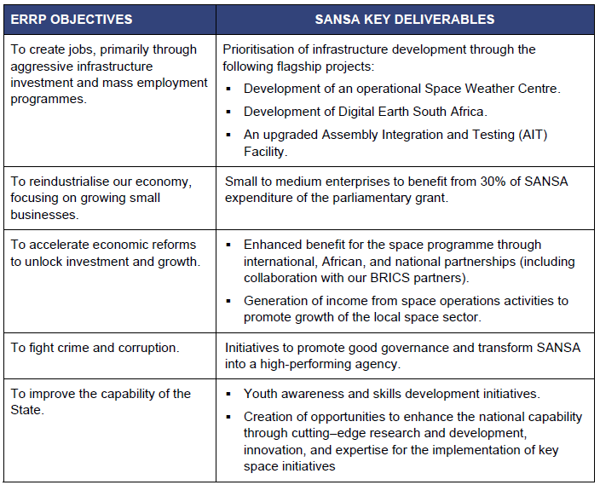
Alignment of SANSA’s deliverables with South Africa’s Economic Reconstruction and Recovery Plan (ERRP)
11

Slide 12
2022 / 2023 APP OUTPUT INDICATORS AND
MEDIUM-TERM TARGETS
12

Slide 13
Outcomes and Outputs
Outcome | Output | Output Indicator | Medium-Term Targets
 |  |  | 2021/22 | 2022/23 | 2023/24 | 2024/25
Outcome 1 Increased space relevant knowledge that supports the developmental agenda | 1.1. National research and development output in space-related sciences | 1.1.1. National research productivity score for supported R&D | 1 300 | 1 445 | 1 715 | 1 800
Outcome 2 Stimulated and growing, inclusive space sector | 2.2. SANSA space-related industry expenditure | 2.2.1. The total contract expenditure to the broad space-related industry for core space projects | R10 million | R61 million | R67 million | R70 million
Outcome 3 Increased human capacity for the implementation of key space initiatives | 3.1. Youth awareness of space-related sciences | 3.1.1. Number of youth directly engaged on space-related sciences | 21 125 | 37 250 | 42 500 | 48 000
 | 3.2. Students and interns supported | 3.2.1. Number of students and interns supported for formalised training | 50 | 72 | 92 | 105
13

Slide 14
Outcomes and Outputs
Outcome | Output | Output Indicator | Medium-Term Targets
 |  |  | 2021/22 | 2022/23 | 2023/24 | 2024/25
Outcome 4: SANSA positioned as a key enabler for the implementation of government's space-related policies | 4.3. Joint space programme initiatives undertaken through partnerships | 4.3.1. Number of joint initiatives undertaken through formal international partnerships | 11 | 9 | 9 | 12
 |  | 4.3.2. Number of joint initiatives undertaken through formal African partnerships | 9 | 10 | 11 | 14
 |  | 4.3.3. Number of joint initiatives undertaken through formal National partnerships | 12 | 13 | 14 | 18
 | 4.4. Awareness and training to key users of space-related products and services | 4.4.1. Number of awareness and training interventions to key users of space-related products and services | 5 | 8 | 8 | 12
 | 4.5. Government departments and public entities using space products and services | 4.5.1. Number of additional government departments and public entities that are using space products and services | Indicator reframed | 10 | 10 | 10
14

Slide 15
Outcomes and Outputs
Outcome | Output | Output indicator | Medium-Term Targets
 |  |  | 2021/22 | 2022/23 | 2023/24 | 2024/25
Outcome 5 Enabling infrastructure developed and upgraded to support the space sector value chain | 5.1. Infrastructure developed or upgraded | 5.1.1. Development of Digital Earth South Africa | Ingestion of Landsat archive | An operational Digital Earth South Africa | An operational Digital Earth South Africa | An operational Digital Earth South Africa
 |  | 5.1.2. Development of the Space Infrastructure Hub (SIH) | Conclusion of a feasibility study for a bankable project | Initiate acquisition of the Phase-1 mission system | Conclude acquisition of the Phase-1 mission system | Launch and in-orbit testing of Phase-1 satellites (including development of downstream applications)
 |  | 5.1.3. Percentage progress towards a new operational space weather centre, as per an approved Business Case | 70% | 100% | Operational Space Weather Centre maintained at 75% | Maintain Operational Space Weather Centre maintained at 90%
 |  | 5.1.4. Percentage progress towards the development of deep space capabilities | Environmental Impact Assessment (EIA) and Business case concluded for the development of deep space capabilities | Cost benefit and proposal to government and funders Site establishment 20% | Site establishment 30% | Site establishment 60%
 | 5.1. Infrastructure developed or upgraded | 5.1.5. Percentage progress towards an upgraded AIT Facility | Revised project schedule and implementation plan | 50% | 100% | -
15

Slide 16
Outcomes and Outputs
Outcome | Output indicator | Medium-Term Targets
 |  | 2021/22 | 2022/23 | 2023/24 | 2024/25
Outcome 6 Increased participation of the national space programme in the regional and global space market | 6.1.1. Number of products and applications | 6 | 7 | 7 | 7
 | 6.2.1. Rand value of total revenue generated from space operations activities | R69 million | R70 million | R72 million | R75 million
 | 6.3.1. Successful satellite pass monitoring rate for Earth Observation | 98% | 98% | 98% | 98%
16

Slide 17
2022 – 2023 OUTPUT INDICATORS AND TARGETS
17

Slide 18
2022-2023 Output Indicators and Targets
Output Indicator | Target
National research productivity score for supported R&D | : 1 445
The total contract expenditure to the broad space-related industry for core space projects | : R61 million
Number of youth directly engaged on space-related sciences | : 37 250
Number of students and interns supported for formalised training | : 72
Number of joint initiatives undertaken through formal international partnerships | : 9
Number of joint initiatives undertaken through formal African partnerships | : 10
Number of joint initiatives undertaken through formal National partnerships | : 13
Number of awareness and training interventions to key users of space-related products and services | : 8
Number of additional government departments and public entities that are using space products and service | : 10
18

Slide 19
2022-2023 Output Indicators and Targets
Output Indicator | Target
Development of Digital Earth South Africa | : An operational Digital Earth South Africa
Development of the Space Infrastructure Hub (SIH) | : Initiate acquisition of the Phase-1 mission system
Percentage progress towards a new operational Space Weather Centre, as per an approved Business Case | : 100%
Percentage progress towards the development of deep space capabilities | : Cost benefit and proposal to government and funders Site establishment 20%
Percentage progress towards an upgraded AIT Facility | : 50%
Number of products and applications | : 7
Rand value of total revenue generated from space operations activities | : R70 million
Successful satellite pass monitoring rate for Earth Observation | : 98%
19

Slide 20
OPERATIONAL INFORMATION
20

Slide 21
Organisational Focus
Key priorities for 2022-2023 include:
Implementation of the new business model, change management and organisational culture change initiatives;
The building of adequate space capacity;
Improvement of geospatial information;
Development of key infrastructure in support of the sector;
The provision of technical skills interventions, research capacity (Research and development (R&D) programmes and knowledge management tools;
Continued support to students and interns through formalised training to build a pipeline that can be absorbed by the formal labour market;
Facilitating the creation of products and applications to address society’s needs and challenges;
Leveraging on national, African, and international partnerships to ensure benefit for the South African Space Programme; and
Increasing the percentage of government departments and public entities that use geospatial information through space products and services.
21

Slide 22
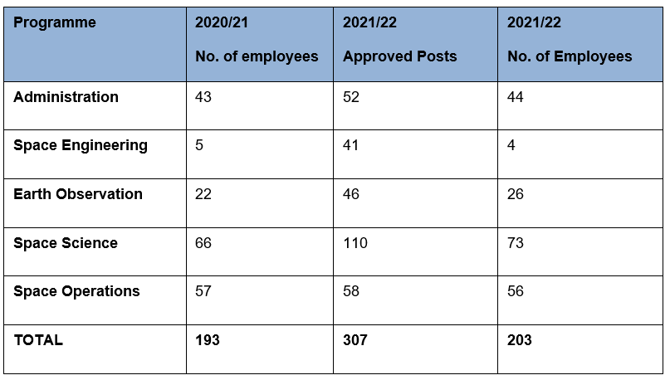
Employment by Programme
The overall number of employees grew from 193 at the beginning of the financial year to 203 by the end of March 2022.
Recruitment processes relating to the vacant Executive positions are in progress and will remain a priority in the new financial year.
key resource requirements for SANSA’s strategic projects i.e., Space Infrastructure Hub, Space Weather Centre and the AIT facility upgrades.
22

Slide 23
Key Challenges
Support to the broader space industry is constrained by limited resource pool (generation of revenue remains a priority);
A key challenge encountered during the planning phase is that resources currently remain stretched, as the Parliamentary Grant is not adequate for project planning and implementation;
Mandate scope remains limited when it comes to telecommunications, navigation and positioning applications and technologies;
Supporting SANSA’s new Business Model more so during the transition;
Support in terms of SANSA’s ability to borrow in the context of the Space Infrastructure Hub (SIH);
Ensuring continuation of the EO-Sat1 satellite programme; and
The prolonged delay relating to transfer of the Houwteq facility from Denel to SANSA negatively impacted the establishment of an Assembly, Integration, and Testing (AIT) facility by the entity to ensure the provision of relevant support to industry.
23

Slide 24
SANSA Institutional Review
SANSA was pleased to see the kick-off of this important evaluation in the 3rd quarter of 2021/22 focusing on a retrospective review seeking to determine the relevance, efficiency, and effectiveness of SANSA .
The review further sought to ascertain the strategic positioning of SANSA’s programmes, in the context of an evolving global space landscape.
The prospective view aimed to assess our strategic outlook (including the 2020/25 strategy and new business model), for the independent panel to be better positioned to provide recommendations that would enhance the performance and future orientation of SANSA.
By the end of Quarter 4, an International Review Panel, with expertise in Earth Observation, Space Science, Space Operations and Satellite Engineering had undertaken the evaluation informed by an in-depth analysis of documentation related to SANSA’s strategy and policy context, and engagements with key internal and external stakeholders.
The Institutional Review Draft Report Presentation to the management of both SANSA and the National Research Foundation (NRF) was delivered by the Panel on 29 March 2022 – paving the way for preparation of management responses by SANSA, submission of the final report to the SANSA Board and DSI and project closure in the first quarter of the 2022/23 financial period.
24

Slide 25
FINANCIAL OVERVIEW
25

Slide 26
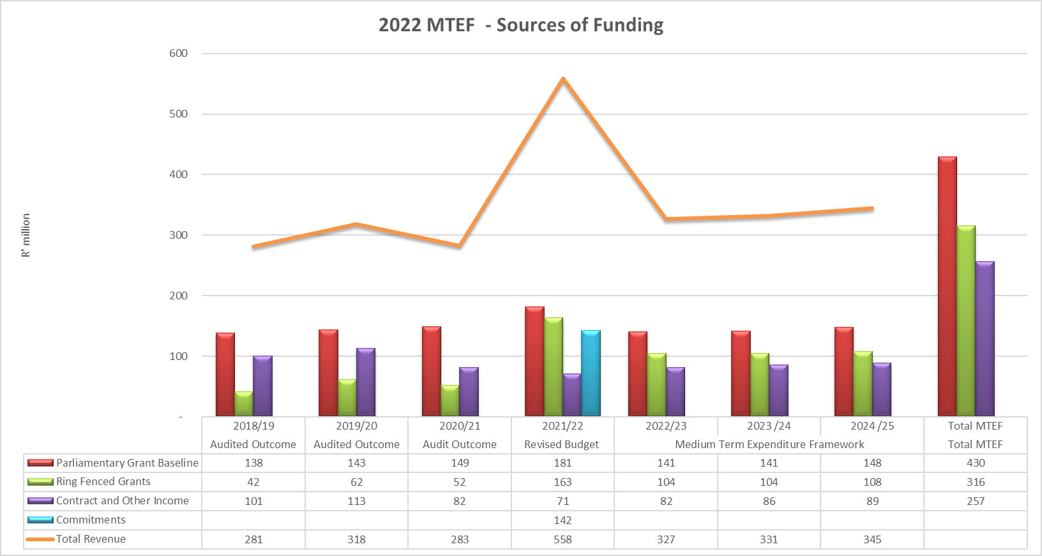
MTEF Sources of Funding
26

Slide 27
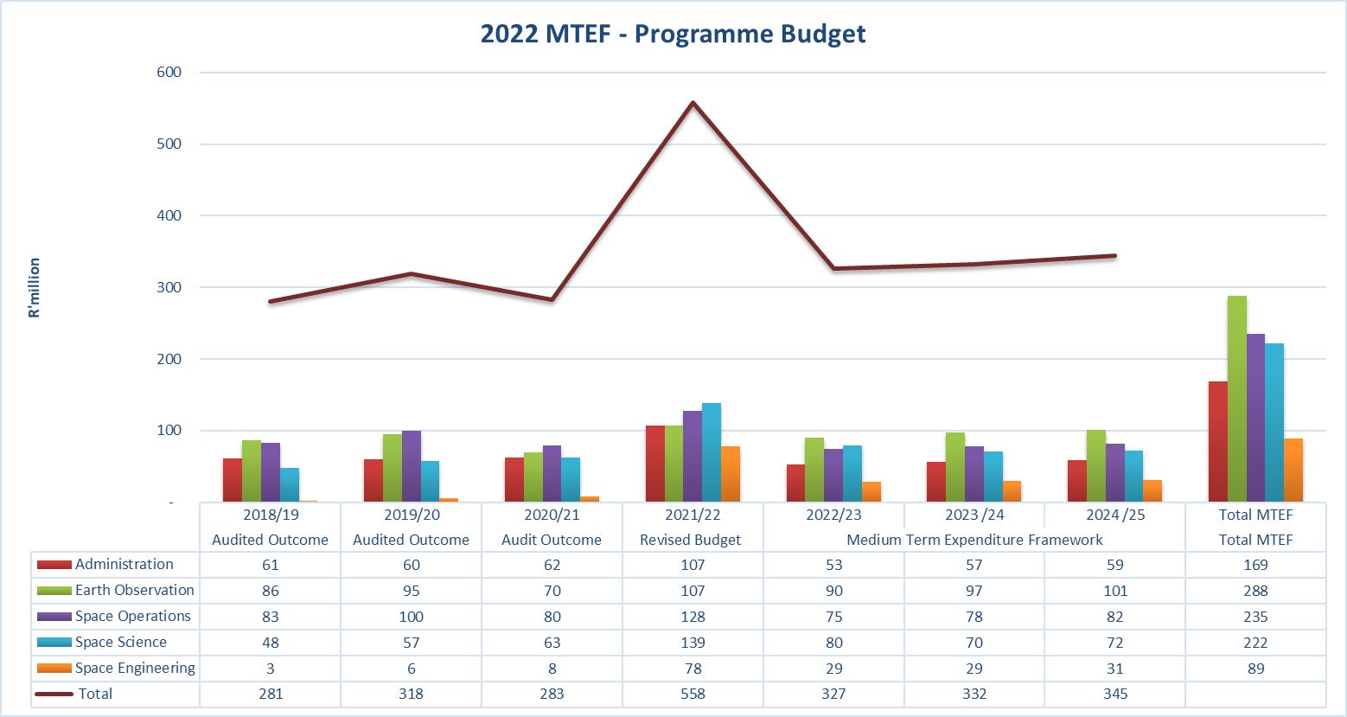
MTEF Programme Budget
27

Slide 28
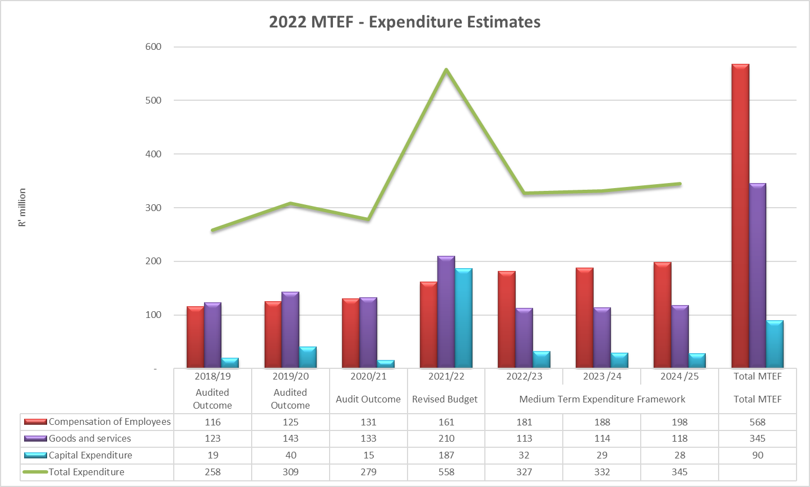
Economic Classification: Expenditure Estimates
28

Slide 29
Financial Narrative
MTEF Budget Trends: The 2022/23 Parliamentary Grant is anticipated to decrease by 22% (R40.5 million) in comparison to the 2021/22 financial year, to complement additional operational costs emanating from projects that are currently in place.
Revenue Sources: External revenue will increase by 13% (R8.8 million) largely due to 20% growth in foreign exchange income.
  The Agency is expecting a slight decrease in public sector income growth amounting to 0.8%.
  Private sector income is anticipated to increase by 10%.
Expenditure: Operational expenditure is only expected to decrease by 21% (R76,8 million) and capital expenditure a decrease by 83% (R154 million), mainly due to major projects nearing completion and the reduced Parliamentary Grant.
SANSA anticipates grant funding to decrease by 36% (R59.1 million) as most of the grants approach their completion phase.
29

Slide 30
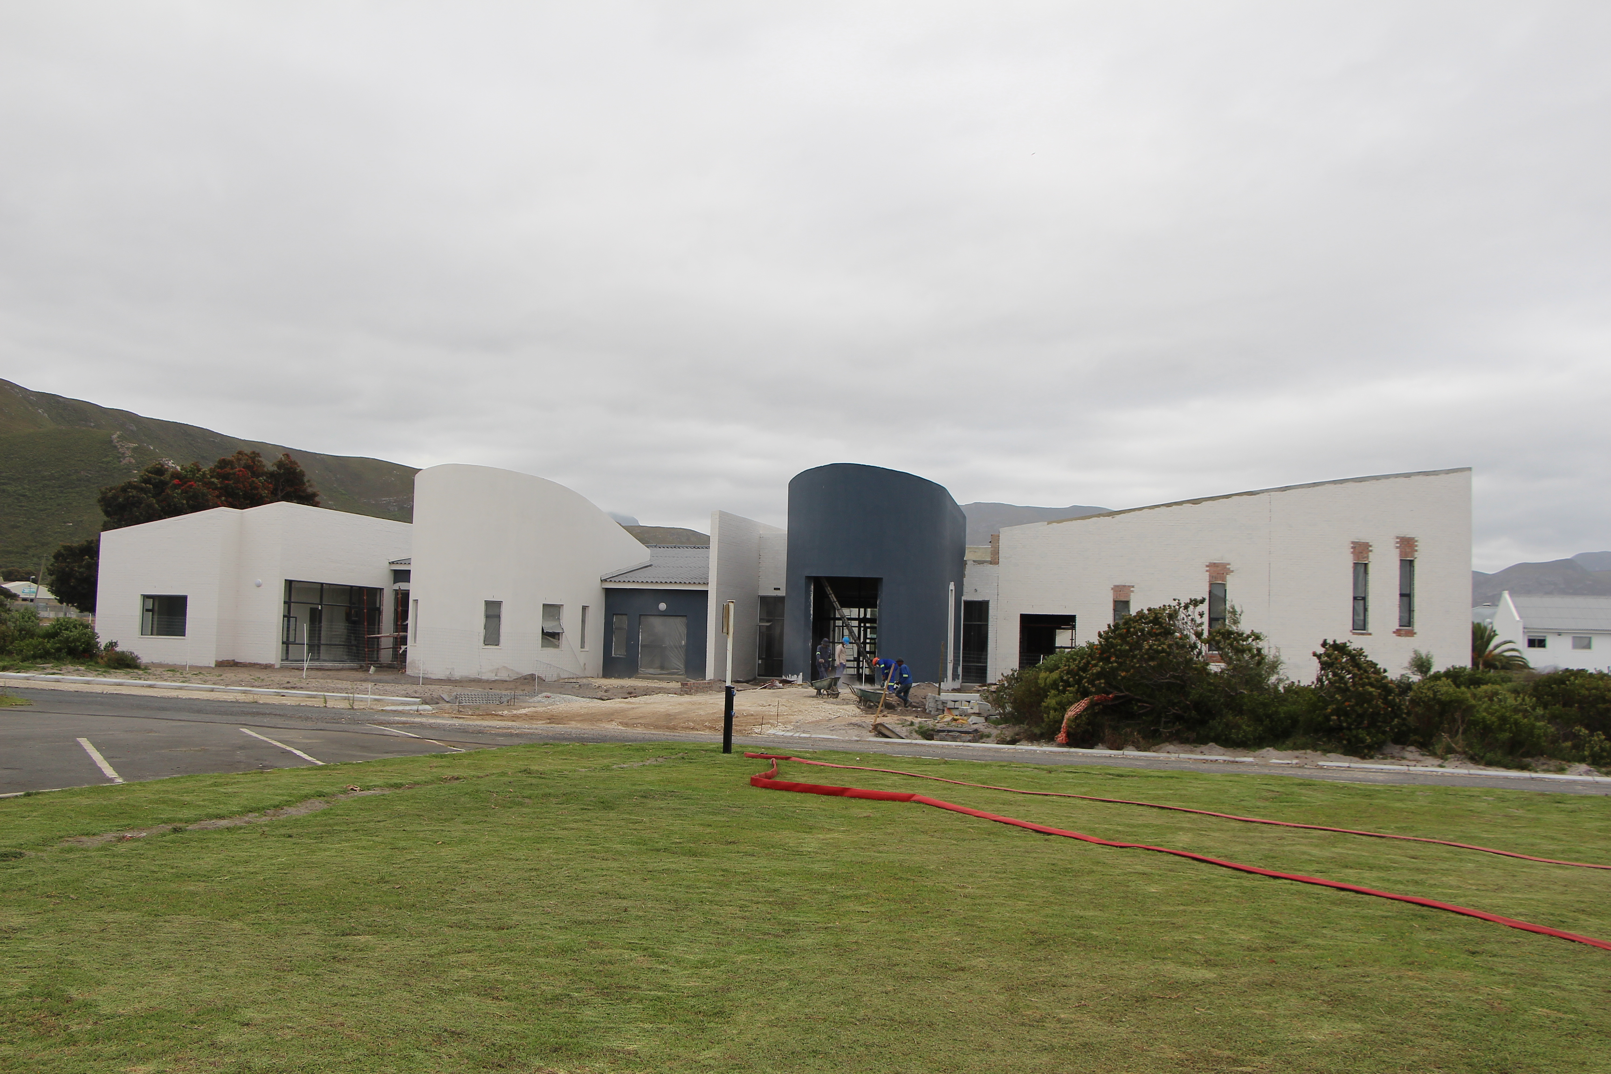
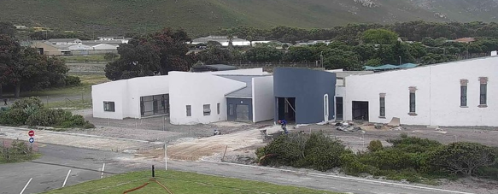
NEW SPACE WEATHER CENTRE
With funding support provided by the DSI, the 24/7 Operational Space Weather Services Project is on track towards completing the business case objectives by October 2022. By financial year end, 70% of the project has been completed.
30

Slide 31


Thank You!!!

