Slide 1
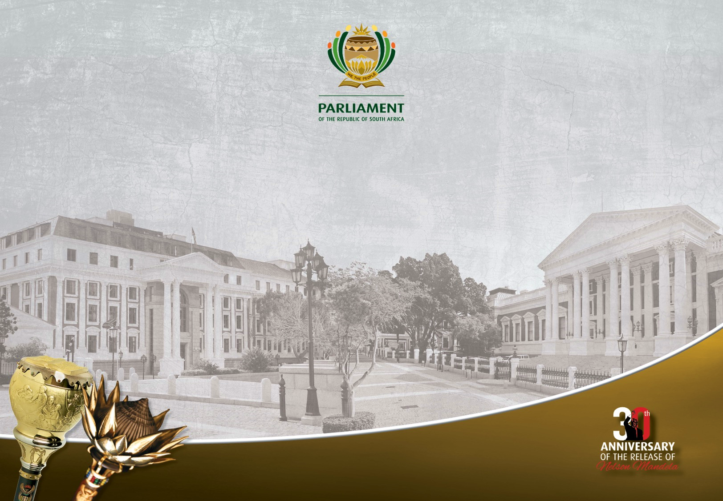
Presentation to the Portfolio Committee on Home Affairs
RE: ELECTORAL AMENDMENT BILL, B1-2022
LEGAL AND CONSTITUTIONAL ISSUES RAISED IN THE SUBMISSIONS

Slide 2
INTRODUCTION
The CLSO has considered:
  The Electoral Amendment Bill B1-2022;
  The Consolidated Public Participation Report on the Electoral Amendment Bill;
  The written submissions submitted to the Portfolio Committee on Home Affairs;
  The oral submissions presented to the Portfolio Committee on Home Affairs on 1 and 2 March 2022.
The CLSO considered the legal and constitutional issues raised in these submissions and the purpose of this presentation is to address only the legal and constitutional issues.
Policy issues have been left to the Executive to address.

Slide 3
BACKGROUND
The Constitutional Court (“CC”) in the New Nation Movement Judgment came to the technical/legal conclusion that the freedom of association enshrined in section 18 includes the negative right not to associate.
This was the basis of its decision that the political rights in section 19 may therefore be exercised through either political parties (for those who choose to associate) or Independent Candidates (“ICs”) (for those who choose not to associate).
This was fundamentally the case that the applicants made in their court papers and in arguments that they have chosen not to associate and therefore should not be compelled by the Electoral Act to do so.
The CC essentially agreed that the right enshrined in section 19(3)(b) may not be lawfully proscribed by the Electoral Act as it vests in “Every adult citizen”.

Slide 4
BACKGROUND continued…
There are practical differences in how ICs and parties may be accommodated in an electoral system;
These differences seem to be the major points of contention in most submissions received;
Issues raised straddle both policy and law and consequently it is not always possible to separate;
We have deliberately focused on legal/constitutional issues as the DHA has dealt with most policy issues;

Slide 5
VOLUNTARY ASSOCIATIONS & INDEPENDENT CANDIDATES
SUBMISSION:
  ICs formed Voluntary Associations in the local government elections through section 15A of the Electoral Commission Act and obtained PR seats. (One South Africa Movement)
  The Bill infringes on the Rights of ICs as it prevents them from forming Voluntary Associations. (One South Africa Movement, National Elders Council of SA, New Nation Movement and Citizens Parliament)
  Definition of IC should be extended to include movements and organisations (Independent Candidate Association)
LEGAL QUESTION:
  Does the Bill prevent ICs from forming Voluntary Associations, and does this prevention constitute an infringement on ICs s18 Constitutional Right to Freedom of Association?

Slide 6
RESPONSE
S15A of the Electoral Commission Act has been repealed by the Electoral Laws Amendment Act 4 of 2021
Previously the Electoral Commission Act provided for two different types of registrations:
  Parties to register Provincially and Nationally
  Parties to register for Municipal Elections (s15A) – which at local government level had been interpreted by civic organizations as permitting the registration of voluntary associations.
There is no provisions within the current reading of the Electoral Commission Act (post amendment) that reflects the provisions of the previous section 15A. ONLY ONE FORM OF REGISTRATION – S 15 (which includes the registration of parties for the Republic, province or municipality)
The definition of “party” in the Electoral Commission Act is wide & includes organisations or movements of a political nature (Voluntary Associations).
These Voluntary Associations are not precluded from the requirements imposed on political parties, as section 15A is now repealed.
Regardless of the s15A being repealed, s18 of the Constitution provides for Freedom of Association.
Therefore an IC can choose to stand as an IC or choose to form an association, and even though the Bill does not expressly provide for a voluntary association, it does not prevent a person from forming a voluntary association and registering as a “party”.
The Bill therefore DOES NOT undermine the right to freedom of association.
We propose that the DHA confirm this understanding.

Slide 7
EXTRA REQUIREMENTS FOR INDEPENDENT CANDIDATES
SUBMISSION:
  The Bill creates unfair advantages towards Political Parties as:
    IC require support of a prescribed amount of voters within region, must not have been part of a party 3 months prior to elections & pay a deposit – IC lack financial and organisation support enjoyed by Political Parties (UNISA, FW de Klerk Foundation, One SA Movement, Mandela Bay Community Movement, Dear SA, Zolani Zonyane, Abatsha Force of Change
  Bill unjustly limits the ICs right to contest elections as:
    ICs can only contest within their region of residence, ICs cannot contest the 200 compensatory seats, Bill reflects that PR is only for Political Parties (Helen Suzman Foundation, Raising Righteous Rulers: Devoted Citizens)
  Bill reflects that PR is only for Political Parties:
    Does not reflect the requirement of general proportionality as ICs do not contest 200 compensatory seats (SA Institute of Race Relations, Abatsha Force of Change)
LEGAL QUESTION:
  Does the Bill create more stringent requirements on ICs and therefore unfairly discriminates ICs & infringes upon their section 19 (3)(b) right to stand public office?

Slide 8
  RESPONSE:
  It is argued that the Bill does not unfairly discriminate ICs:
    The right to equality is not being infringed, as ICs and Political Parties will always have unequal footing due to the political nature of these institutions (ICs = one seat, political parties = more than one)
    Harksen v Lane - does the provision differentiate between people or categories of people? If so does the differentiation bear a rational connection to a legitimate government purpose?
    What is the legitimate government purpose for the requirements?
      Deposit Requirement - EFF v Electoral Commission confirmed the legitimacy of financial deposits as a requirement to participate in elections
      Not belong to a Party for 3 months prior requirement - “cooling off” period prevents Parties from fielding candidates as ICs
      Prescribed amount of voter supporter requirement – to determine seriousness of candidate

Slide 9
  It is further argued that Bill does not infringe upon the ICs right to stand to public office:
    The requirements may discourage ICs from contesting, but does not limit their right:.
    Is it the purpose of the Bill to encourage ICs or is the purpose of the Bill to create an electoral system that is generally based on proportional representation, which accommodates ICs?
  The Bill does reflect Proportional Representation, the constitutional requirement is general proportional representation. Although proportional representation is a requirement that is not exclusively for political parties, it is practically difficult to provide for proportional representation with independents as they can only hold 1 seat, even though they may receive more votes than a political party.
      HOWEVER, the requirement of being an ordinary resident in a region or province has been criticized as being unjustifiable – the DHA needs to respond to this as there seems to be no similar requirement for Ward Councilors in the Local Government Elections.

Slide 10
WASTED VOTES
SUBMISSION:
  The Bill does not fulfill the principles of “one person – one vote”. (One SA Movement, Mandela Bay Community, Dear SA,
  The Bill infringes upon the rights of independent candidates, as the Bill allows for surplus votes of independent candidates to be discarded, and therefore not reflecting the true will of the voter. (SA Institute of Race Relations, Freedom Advocacy Network )
LEGAL QUESTION:
  Does the Bill undermine the equal value of every vote, making votes for independent candidates less equal as they are discarded?

Slide 11
RESPONSE
An IC may only occupy one seat at a time;
Once the minimum number of votes required to secure a seat is determined all additional votes may not practically be utilised;
On the face of it this appears to be “wasted votes” but in effect it gives an expression to the will of those voters who voted for the IC;
This is inherent in the choice that a person has taken to run as an IC as opposed to party or association;
August v Electoral Commission – “the vote of each and every citizen is a badge of dignity and personhood. Quite literally, it says that everybody counts”
It is argued, that the dignity and personhood of those voters who vote for an IC are not infringed, as the will of their vote manifests in the occupation of a seat by their chosen IC, regardless of whether their vote counted towards the appointed of the IC or whether their vote forms part of the excess votes that went towards the appointment of that IC, but were discarded due to the IC gaining a seat.
Furthermore in terms of other jurisdictions, where the plurality system is used such India, UK and Canada, discarded votes are inevitable.

Slide 12
VACANCIES
SUBMISSION:
Vacancies should be filled by a by-election per region or use the same counting system as general elections (Independent Candidate Association)
The Bill does not conform in its entirety to the minority option. Minority Option at clause 5.1.7 – vacancies refilled by recalculating the result of the election, with disregard to the votes of the independent candidate – Yet the Bill at clause 11 (section 34) states that vacancies of independent candidates will not be filled until the next election. (African School of Governance NPC)
Absurd to keep vacancies of ICs open, the same principle as local government elections should be applied. (Abatsha Force of Change)
PR vacancies should be filled with the next most senior candidate
LEGAL QUESTION?
Is it reasonable and justifiable to leave an IC’s vacant seat open?
Notes:
Are vacancies kept open for Political Parties?

Slide 13
VACANCIES
RESPONSE:
Votes are an expression of the “will of the people”;
Parties have a party list to fill vacancies;
Although it may appear practical to not fill a vacancy (due to by-elections being costly), it seems constitutionally unjustifiable that a seat must remain vacant for the remaining term in the case of ICs;
It puts voters of ICs at a disadvantage in comparison to party voters;
Most importantly it undermines the very purpose of having ICs.

Slide 14
RECALL OF MEMBERS/ REPRESENTATIVES
SUBMISSION:
  constituencies should have the power to recall their representatives if they are not happy with the commitment shown by the said representative (New Nation Movement).
LEGAL QUESTION:
  Can the Bill allow for representatives/members to be recalled?

Slide 15
RESPONSE:
s47(3) and s106(3) of the Constitution specifically set out the circumstances as to when a person loses membership of the NA and PL respectively.
  These circumstances are:
    The person ceases to be eligible as per section 47(1) and 106(1);
    He or she is absent from the NA or PL without permission in the circumstances for which the rules and orders of the NA/PL prescribe loss of membership; or
    he or she ceases to be a member of the party that nominated that person as a member of the NA/PL.
These constitutional provisions provide a closed list circumstances under which a member can lose membership of the respective legislature.
These provisions also do NOT provide that national legislation may provide for other circumstances as to how members may lose membership of either of the legislatures.
In order to provide for constituencies to “recall” its representatives from either the NA or PLs, it is submitted that a constitutional amendment would be required.
It is submitted that the Bill CANNOT lawfully provide for such “recall”.

Slide 16
SCHEDULE 3 OF THE ACT: EQUITABLE REPRESENTATION IN ALLOCATION OF SEATS TO THE PROVINCIAL LEGISLATURE
SUBMISSION:
  Schedule 3 be amended to allow for a review of the determination of seats allocated to each provincial legislature based on the most recent official statistics in order to ensure equitable representation for provinces; and that the said review take place once every 10 years as opposed to having a cut-off date (current cut-off date in the Act was 31 March 1999). (Gauteng Provincial Legislature)
LEGAL QUESTION:
  Should the Bill amend Schedule 3 accordingly?

Slide 17
RESPONSE:
It would appear that clause 16 of the Electoral Laws Amendment Act, 2021 (Act No. 4 of 2021) addresses this issue by:
Removing the cut-off date of 31 March 1999; and
Providing that the determination of seats contemplated in items 1 and 2 must be completed by the Commission before every election and the Commission must publish such a determination in the prescribed manner.

Slide 18
ACCOMODATING INDEPENDENT CANDIDATES IN THE NCOP
SUBMISSION:
  the Bill should make explicit provision for Independent Candidates in the NCOP. (IFNASA)
LEGAL QUESTION:
  Should the Bill provide for the election/appointment of Independent Candidates in the NCOP?

Slide 19
RESPONSE
The CC judgment was limited to allow ICs to contest elections for the National Assembly and provincial legislatures. It did not address the NCOP.
The Bill (Electoral Act) cannot make such provision – the Constitution itself will need to be amended (sections 60 and 61).
Sections 60 of the Constitution deals with the composition of the NCOP and provides that the NCOP is made up of a single delegation from each province consisting of 10 delegates (4 special delegates and 6 permanent delegates);
Section 61 (1)) – deals with the allocation of delegates in accordance with a formula in Part B of Schedule 3. This formula determines a party’s participation in the provincial delegation.
Section 61(2) - provides that a provincial legislature must determine, in accordance with national legislation, how many of each party’s delegates are to be permanent delegates and how many are to be special delegates, and appoint the permanent delegates in accordance with the nomination of the parties.
Section 61(3) – provides that the national legislation envisaged must ensure the participation of minority parties in both the permanent and special delegates’ components of the delegation in a manner consistent with democracy.
These provisions make it clear that NCOP seats may only be allocated to “parties” and not independent candidates.
Therefore should a decision be taken to include Independent Candidates within the provincial delegations for the NCOP: Section 60 and 61 would need to be amended as well as the Determination of Delegates (National Council of Provinces) Act, 1998 (Act No. 69 of 1998) - This Act provides for the determination of permanent and special delegates to the National Council of Provinces as contemplated in section 61(2) of the Constitution. If section 61(2) is amended to accommodate Independent Candidates, then this Act would need to be amended accordingly.
Notes:
Q: can these provisions be read as to include ICs in the NCOP given the CC judgment – think of it in terms of section 236 and also what the CC said about the other sections which only focused on parties.
Q: Do I list the other national legislation here too that might require amendments?

Slide 20
ASSESSING POTENTIAL CANDIDATES FOR PREVIOUS SEXUAL CONVICTIONS
SUBMISSION:
  That risk assessments of candidates be conducted to determine whether the candidates have a history of sexual offences and convictions to avoid having convicted sexual offenders into public office. (Commission for Gender Equality)
LEGAL QUESTION:
  Should the Bill make provision for such assessments and disqualification?

Slide 21
RESPONSE:
Sections 47(1) and 106(1) of the Constitution specifically provides that every citizen who is qualified to vote for the NA is eligible to be a member of the NA or PL except under certain listed disqualifications.
The listed grounds of disqualification is a CLOSED list.
One of the grounds of disqualification is that anyone who is convicted of an offence and sentenced to more than 12 months imprisonment without the option of a fine. A disqualification under this paragraph ends five years after the sentence has been completed” (section 47(1)(e) and 106(1)(e)).
To extend the listed grounds of disqualifications, a constitutional amendment would be required.
Furthermore, while other provisions in the Constitution, such as those relating to the requirements for members of a Commission, do provide that other requirements for their eligibility and suitability can be prescribed by national legislation (i.e. Section 193 of the Constitution), no such provision is contained in section 47 and 106 of the Constitution, therefore a constitutional amendment will be necessary.
Also, the Sexual Offenders register held by the Department of Justice can also be checked.

Slide 22
OTHER SECTIONS IN ELECTORAL ACT WHICH MIGHT RQUIRE AMENDMENT TO FULLY ACCOMMODATE INDEPENDENT CANDIDATES
In order to fully accommodate Independent Candidates within the Electoral Act, the following additional amendments might be required:
  Reference to and consultation with “party liaison committees” – seems to only apply to parties and not Independent candidates (sections 1, 20, 62, 64, 100);
  Party agents – only registered parties may appoint agents to observe proceedings at voting stations, counting stations, etc. and no provision for independent candidates to do so (sections 39(1)(b), 58, 59, 66).
  Section 96(2)(c) needs to be amended in the Bill to allow for the Electoral Court to impose a sanction of forfeiture of the deposit paid by an independent candidate in terms of section 31B(3)(b) - to link with the amendment to section 106 in clause 8 of the Bill
Should these amendments be considered necessary, then procedural advice would need to be sought on whether:
  The House needs to be approached for permission to make these amendments (as per NA Rule 286(4)(c); and
  Such amendments, if made, will need to be re-advertised for comment.
Furthermore, the views of the department is sought on the issues in respect of agents for independent candidates and consultation with only party liaison committees.

Slide 23
OTHER LEGISLATION REQUIRING AMENDMENTS BEFORE THE NEXT ELECTION
The Electoral Commission Act, 1996 (Act No. 51 of 1996)
This Act, inter alia, contains sections providing for certain functions which the Commission needs to carry out in relation to parties and party candidates (ie. maintaining liaison and cooperation with parties, to name one example).
The Act would need to be scrutinized to make it applicable to Independent Candidates as well, where required.
The Electronic Communications Act, 2005 (Act No. 36 of 2005)
This Act contains sections which, inter alia, deal with prohibitions on granting broadcasting service licences to party-political entities; broadcasting of party election broadcasts on public broadcasting services; and political advertising on broadcasting services intended to advance the interest of political parties.
The Act should be amended to allow for Independent Candidates to be allowed to make such broadcasts.

Slide 24
OTHER LEGISLATION REQUIRING AMENDMENTS continued…
The Political Party Funding Act, 2018 (Act No.6 of 2018)
This Act was drafted to give effect to section 236 of the Constitution, which provides that: “To enhance multi-party democracy, national legislation must provide for the funding of political parties participating in national and provincial legislatures on an equitable and proportional basis.”
In order to ensure that provision is also made for independent candidates to receive funding, this Act should be amended accordingly.
The Financial Management of Parliament and Provincial Legislatures Act, 2009 (Act No. 10 of 2009)
This Act contains provisions requiring the Speaker to consult with political parties represented in the National Assembly; provisions that each party represented in the National Assembly must be provided with financial and administrative assistance; and so forth.
The Act should be amended to allow for Independent candidates to also be consulted and be provided with financial and administrative assistance.

Slide 25
WAY FORWARD
The Constitution gives the power to determine an electoral system to Parliament;
Parliament has a constitutional obligation to engage in meaningful public participation;
Doctors for Life judgment sets minimum standards that must be fulfilled in public participation;
Parliament must therefore be able to demonstrate that it considered all submissions in order to justify that its choices are rational, and therefore it is submitted that we require further input from the DHA on the following matters in order to give effect thereto:
  Whether DHA is in alignment with our argument regarding Voluntary Associations and ICs contesting compensatory seats;
  A justification or explanation as to the rationality behind the requirement that an IC must be a resident of the constituency he is contesting;
  DHA to provide alternatives to the vacancy predicament and consider ways to address the vacancy issue; and
  DHA to provide a reason as to why the provisions relating to party liaison committees and agents were not amended to be made applicable to ICs.

Slide 26
THE END

