Slide 1
NECSA GROUP CORPORATE PLAN
2022/23 - 2024/25
PORTFOLIO COMMITTEE ON MINERAL RESOURCES AND ENERGY
David Nicholls
Necsa Chairman
May 2022

Slide 2
INTRODUCTORY REMARKS
We have approved the corporate strategy, which sets the tone for rationalisation of Necsa. Its KPAs and KPIs are based on this strategy
As the Board, we are enabling the implementation of the strategy through a new integrated organisational structure.
The Board is monitoring the evolving policy framework and macro-economic environment and will ensure the agility of the organisation in taking advantage of emerging opportunities (noting the newly-gazette NIP 2050) and mitigating risks
As a Board we believe that this corporate plan gives Necsa an opportunity to transform the organisation in various aspects, e.g. workforce make-up in terms of gender, age and race, supporting SMMEs and ensuring appropriate skills development
Necsa has turned the corner. The groundwork that has been done gives us confidence that the organisation will succeed in achieving the targets set in this corporate plan sustainably and as part of our oversight we will continuously monitor executive management’s performance and account accordingly

Slide 3
NECSA GROUP CORPORATE PLAN
2022/23 - 2024/25
PORTFOLIO COMMITTEE ON MINERAL RESOURCES AND ENERGY
Loyiso Tyabashe
Group Chief Executive Officer
29 April 2022

Slide 4
NECSA MANDATE
United Nations Sustainable Development Goals
IRP 2019
DMRE Strategic Plan
ERRP
NIP 2050
Nuclear Energy Policy of 2008
Nuclear Energy Act of 1999

Slide 5
SITUATIONAL ANALYSIS
P
E
S
T
E
L
Political
Economical
Social
Technological
Environmental
Legal
DOH’s drive to improve accessibility of healthcare to more people through creation and implementation of the National Health Insurance (NHI) is likely to boost product development in nuclear medicine.
Acute need for nuclear medicine in rest of Africa. Government’s policy position as far as nuclear power goes has been made clear in the 2019 IRP
Rising joblessness and other social issues play out as citizens show their dissatisfaction through marches that tend to be disruptive. Political pressure increases on government in terms of the burden of SOCs
SOCs are under intense Government scrutiny. The current SA economy fiscal position makes it difficult to expect financial help from government.
Due to the impact of COVID-19 and recent cut of SA’s sovereign credit rating to sub-investment grade, higher cost of capital will potentially slowdown capital projects. Funding instruments for technology development are relatively limited.
Beneficiation of resources is seen as one of the ways to turn SA’s fortunes around creating jobs and bringing foreign income
Reputational issues around “nuclear” carry negative reputational baggage in the world with South Africa not being exempt of this.
SA has high incidence of diseases that has large negative effect on quality of life and productivity of the work force, such as breast, cervical and oesophagus cancers, drug resistant TB and malaria - many of which can benefit from nuclear medicine.
Indigenous medicine is widely used and the culture can be maintained and enriched through value addition via radiation techniques
Growth of expertise base of radioisotopes with good medical applications other than Technetium with wider applications in terms of modalities and production methods
Changes in production technologies such as petroleum refineries moving towards newer alkylation technology likely to have a negative impact on HF sales
Existing technology on the beneficiation of Uranium, Zircon and Fluorspar is well established at Necsa including patents, licensing and intellectual property
The effects of climate change will need to be mitigated; and presents a global opportunity for nuclear power generation growth
Tolerances for environmental releases is likely to become stricter going forward
Resource management (raw materials) and efficiency will remain important business drivers
Legislative environment will continue to change and the organisation will be required to ensure compliance (PFMA; LRA; BCEA; BBBEE; PPPFA; cGMP etc.)
The product regulatory environment; particularly as far as radiopharmaceuticals is concerned, is well understood
South Africa will continue to subscribe to relevant international nuclear conventions and treaties

Slide 6
SITUATIONAL ANALYSIS
STRENGHTS
Track record of commercialization (Mo-99, I-131 etc.)
Good Manufacturing Practice (GMP) certified clean room for radiopharmaceuticals research
Plasma technology platform with wide application areas
Hazardous chemical substance handling experience
Sole producer of fluorochemicals in the Southern Hemisphere
Integrated Management System (SHEQ) enables compliance to NNR license requirements
Nuclear Installation License Compliance & oversight
SAFARI-1’s established track record
Well established nuclear waste management processes
ISO 9001, ASME VIII ‘U’ Stamp & ASME III ‘N’ Stamp certifications for
design and manufacturing
R&TD capability to develop technologies with high market potential into products and services
Differentiated infrastructure for product development and sales
(SAFARI, NTP isotope supply)
WEAKNESS
Sub-economic Fluorochemical plants (Small production plants with no economies of scale)
Geographical distance to export markets
No processes for the treatment of special waste streams
Ageing equipment and infrastructure
Insufficient succession planning
Limited capacity building
Performance management system not functioning optimally
Limited market intelligence in some areas
Core capability for industrial applications sub-critical and dispersed
Poor business culture, processes and expertise
Lack of an Integrated Business management system (ERP system) to have a “live pulse” of the state of the business from planning through to execution through to financial performance
Limited investment / fundraising capability
OPPORTUNITIES
THREATS
Declining grant (in real terms)
Loss of early mover advantage due to inadequate technology development funding
Withdrawal of radioactive licenses by the Regulator due to non-compliance
Withdrawal of South African Health Products Regulatory Authority (SAHPRA) authority to produce radiopharmaceuticals due to non-compliance to most recent Good Manufacturing Practice (GMP) requirements
Limited suppliers of critical input materials in SA (e.g. current fluorspar mine is foreign owned and a competitor to Necsa, Yb)
Long lead time for growth project approvals by executive authority
Serious safety, environmental and security incidents (and associated potential reputational damage)
High cost of regulatory compliance in SA
Opposition towards nuclear power
Growing demand for nuclear medicine products locally and internationally
Exports of fluorochemicals to AFRICA, ASIA and LATIN AMERICA
Diversification into broader fluorochemicals portfolio (Pharma, Cooling, Polymers etc.).
Large fluorspar reserves
DSI funds for product and infrastructure development
Increased D&D Stage 1 programme
Technology Innovation Agency funds early stage product commercialization
Empowering African States with safeguards implementation capabilities
Government-wide MPR project for the replacement of SAFARI-1
R&TD pipeline of technologies with high market potential
Exploit immovable assets to grow commercial revenue

Slide 7
RATIONALISATION PROCESS
30 Jul – Board HRSE Subcommittee approval of structure
18 Mar – Collective Agreement
15 Jan – Group Bargaining Forum
17 Mar – Collective Bargaining process
26 Jul – Meeting: Management, Staff & NEHAWU
31 Mar – Development of next level structures, grading, advertisement & appointments
16 Mar – HR Change management Roadmap
21 Jul – Meeting with NEHAWU
30 Sept – Development of grading of Level 1 structure positions
13 Jan – Meeting: Nehawu, PWU & the GCEO
16 Mar – HR Change management Roadmap
19 Jul – EXCO support the structure
Dec ‘20
Jan ‘21
Feb ‘21
Mar ‘21
Apr ‘21
May ’21
Jun ’21
Jul ’21
Aug ’21
Sep ’21
Oct ’21
Mar ’22
4 Dec – Meeting: Labour, management & Letsema
1 Feb – Task team launched
23 Apr – Leaders in the Organisation & Union Strategy Workshop
10 Jun – CEO meeting with NEHAWU
31 Aug – Board approval of Strategy & Structure
31 Oct - Dec 2021 Advertisements, interviews & appointments
8 Dec – Meeting: Labour, management & Letsema
18 Feb – Burning Platform & Visioning Workshop
Board Approved Strategy Framework
A consultative process was followed with key stakeholders
Necsa EXCO was involved in the review and design input along all stages of the process
The development of the new Group Strategy was done to ensure that there is a strategy that addresses the key challenges faced throughout the Necsa Group
Consultation will continue throughout the implementation phase of the new Group Structure as well as the Change Management Programme

Slide 8
STRATEGIC PILLARS
Financially sustainable organisation with efficient operations and good governance
Talent Excellence and High Performance Culture
Financial recovery & sustainability
Research & Innovation
Profitable Commercial Enterprises
Business Continuity and Efficiency
Values: Excellence, Accountability, Safety First, Integrity and Innovation (EASII)
Mission: To develop and safely utilize nuclear, radiation and related technologies to make socio-economic impact in diverse global markets through commercial and non-commercial technologies, in an environmentally responsible manner
Vision: To be a global nuclear and related technology leader, positively touching people’s lives socio-economically.
Mandate: To develop, utilise and manage nuclear technology for national and regional socio-economic development through: Applied R&D; Commercial application of nuclear and associated technology; Contributing to the development of skills in science and technology.
8

Slide 9
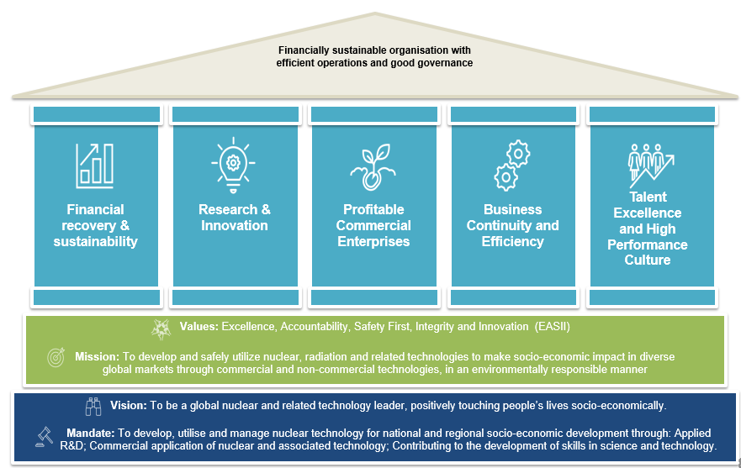
STRUCTURE
Minister
Necsa Board
Cosec
Group CEO
Integrated Assurance (Audit & Risk)
Office of the GCEO
Financial Capital
Human Capital
Strategy & Business Enablement
Nuclear Operations & Advanced manufacturing
Research & Innovation
Nuclear Radioisotopes
Chemicals
Power & Industry
9

Slide 10
STRATEGIC FOCUS AREAS
AND KPA’S
The strategic pillars have well defined key performance areas and indicators
KPA’s
KPA’s
KPA’s
KPA’s
KPA’s
Financial Growth
Audit outcome
Increased Revenue
Research Publications
Innovation Disclosures
NTP NPAT
Pelchem NPAT
Operational Safety
Operational Compliance
SAFARI Availability
MPR
D&D Programme Execution
Performance management.
Talent management.
Transformation.
1. Financial recovery & sustainability
2. Research &
Innovation
3. Profitable Commercial Enterprises
4. Business Continuity and Efficiency
5. Talent Excellence and High Performance Culture

Slide 11
PERFORMANCE AREAS AND RELATED ANNUAL TARGETS (1 of 3)
 | Strategic Focus Areas | KPA | KPI | 2023FY Target | 2024FY Target | 2025FY Target
 | Financial Recovery And Sustainability | Financial Performance | Necsa Group Net Profit After Tax (R’m) | (23.1) | 86.8 | 106.9
 |  | Audit Outcome | Audit Opinion | Unqualified audit opinion for 2022/23 audit | Unqualified audit opinion | Unqualified audit opinion
 | Research And Innovation | Increased Revenue | Contract R&D income generation (R’m) | 40 | 42 | 45
 |  | Research Publications | Number of peer-reviewed publications | 23 | 20 | 20
 |  | Innovation Disclosures | Number of innovation disclosures | 6 | 6 | 6
 | Profitable Commercial Enterprises | NTP Group Net Profit After Tax (R’m) | To improve financial performance | 19.7 | 23.7 | 35.2
 |  | Pelchem Net Profit After Tax (R’m) | To improve financial performance | 19.7 | 61.0 | 65.2

Slide 12
PERFORMANCE AREAS AND RELATED ANNUAL TARGETS (2 OF 3)
 | Strategic Focus Areas | KPA | KPI | 2023FY Target | 2024FY Target | 2025FY Target
 | Business Continuity And Efficiency | Operational Safety | Disabling Injury Incidence Rate (DIIR) | <1.8 | <1.8 | <1.8
 |  | Operational Compliance | Public dose impact limit (mSv per annum) | <0.25 | <0.25 | <0.25
 |  | SAFARI-1 Operational Availability | Number of days available per year | 287 | 287 | 287
 |  | Multi-Purpose Research Reactor Development | Replacement of SAFARI-1 Reactor | FIDPM Feasibility study completed | R40m available from MTEF | Financial close reached (financing and main contracts)
 |  |  |  | EIA application submitted | EIA positive record of decision
 |  |  |  | Overarching Licensing strategy approved by NNR | Construction application submitted to NNR | Basic design approved by NNR
 |  | D&D Programme Execution (Stage 1) | Execution of Annual Plan of Action as approved by Necsa board and submitted to DMRE | 90% | 90% | 90%
12

Slide 13
PERFORMANCE AREAS AND RELATED ANNUAL TARGETS (3 OF 3)
 | Strategic Focus Areas | KPA | KPI | 2023FY Target | 2024FY Target | 2025FY Target
 | Talent Excellence And High Performance Culture | Performance Management | Staff productivity percentage (Group HR Basic Salary cost as percentage of Group Revenue) | 48% | 46% | 44%
 |  | Talent Management and Culture | Improvement of performance culture and maintaining core skills | 100 % EXCO enrolled and completed Necsa Leadership development programme | 95 % Senior Managers enrolled and completed Necsa Leadership development programme | 95 % Supervisory Level enrolled and completed Necsa Leadership development programme
 |  | Transformation | Percentage of Black Professionals in Middle Management and Higher | 67% | 70% | 75%
13

Slide 14
FINANCIAL OBJECTIVES
Key financial objectives are indicated with growth in profitability from FY 2022/3 to FY 2025/6
YTD performance shows an improvement, as the losses are less than projections indicated in the Corporate plan 2021/22 – 2023/24

Slide 15
STRATEGIC COMMERCIAL AND IMPACT PROJECTS
In addition to the Corporate Plan targets, we shall also be developing and monitoring the second tier of targets, which are aimed at supporting Necsa’s sustainability:
Nuclear Radioisotopes product diversification and consolidation including Ketlaphela
Multi-Purpose Reactor (MPR) as replacement to SAFARI-1
Thabana Pipestore Extension for reactor used fuel storage
Flourochemicals (Plant refurbishment/New markets/Product diversification)
Nuclear Manufacturing (Koeberg Life Extension/MPR/New Build)
Waste Reduction projects (incl. waste-to-energy)
Decontamination and Decommissioning (D&D)
Uranium Recovery project

Slide 16
STRATEGIC COMMERCIAL AND IMPACT PROJECTS
Healthcare Business Integration Strategy: to establish an integrated Pharmaceutical business within the Necsa group with improved profitability
Ketlaphela
C1
The other part of the Integration will be to incorporate Ketlaphela, a conventional generics Pharmaceutical company into the healthcare business. The aim of this is to leverage each of the individual businesses strenghts and combine them to ensure the most profitable outcome.
Pharmaceutical API manufacturer
Pharmaceutical Manufacturing
C2
Target Date: Aug 2022
Warehouse
Integrated NTP Healthcare Business
The goal is to establish an integrated pharmaceutical business within the Necsa group with improved profitability.
D1
Radiopharmaceutical Manufacturing
Pharmaceutical Manufacturing
D2
Warehouse & Distribution
Research & Industry Pharmacy services
GOAL
D3
A1
B1
Radiopharmaceutical Manufacturing
Marketing & Sales
A2
B2
The Integration of NTP and AEC’s Radiopharmacuetical businesses is necessary to regain the local market share and expand the export market opportunities, as this will created a united front to the market to improve market dynamics as well as allow the full utilization and capatilisation of resources and strenghts.
Radiopharmacuetical retail pharmacy
Warehouse & Distribution
NTP Radiopharmaceuticals
AEC- Amersham
Target Date: June 2022
Radiopharmaceutical Products
Nuclear Products
Equipment
Life Sciences

Slide 17
STAKEHOLDERS
Shareholder Government Department &Parliament
Customers
Employees
Investors/ Funders
Business and industry
Necsa will continue to maintain good and mutually-beneficial relationships with its various stakeholders while managing a myriad of issues that are of importance to these stakeholders
Local communities
NGOs
NECSA STAKEHOLDER LANDSCAPE
International community
Regulators
Media
Scientific/ Academic/ research community
Suppliers
Labour organisations

Slide 18
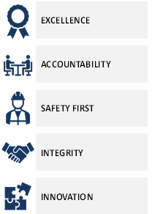
CONCLUSION
This Corporate Plan is aligned to the approved strategy derived from the rationalization process
Values
Key activities in the plan seek to improve and grow Necsa as it delivers on its mandate and shareholder compact through strong governance
Strategic commercial and high impact projects will ensure long-term sustainability
Five strategic pillars with measurable targets, anchored on strong company values (EASII) will drive performance across the Necsa Group
Financial Recovery and Sustainability
Research and Innovation
Profitable Commercial Enterprises
Business Continuity and Efficiency
Talent Excellence and High Performance Culture
Financial outlook is positive showing stabilization and a steady move towards profitability and a stronger balance sheet

Slide 19
Questions

Slide 20
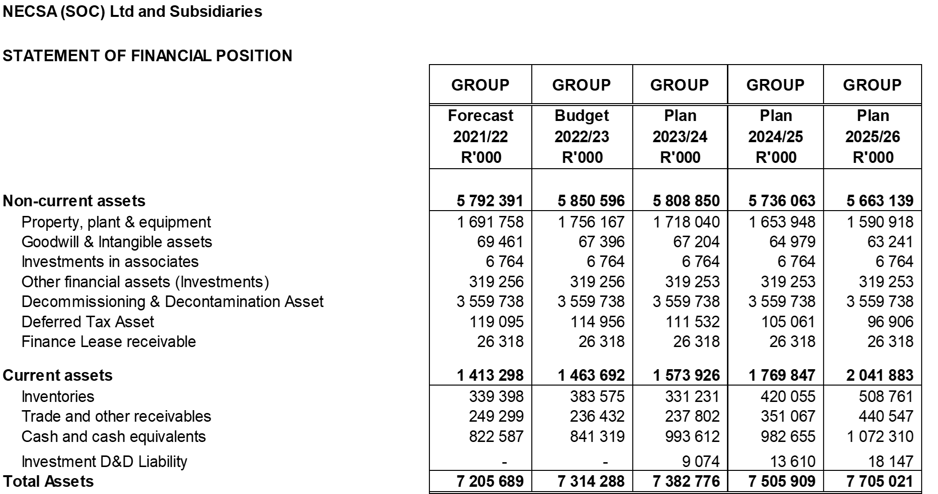
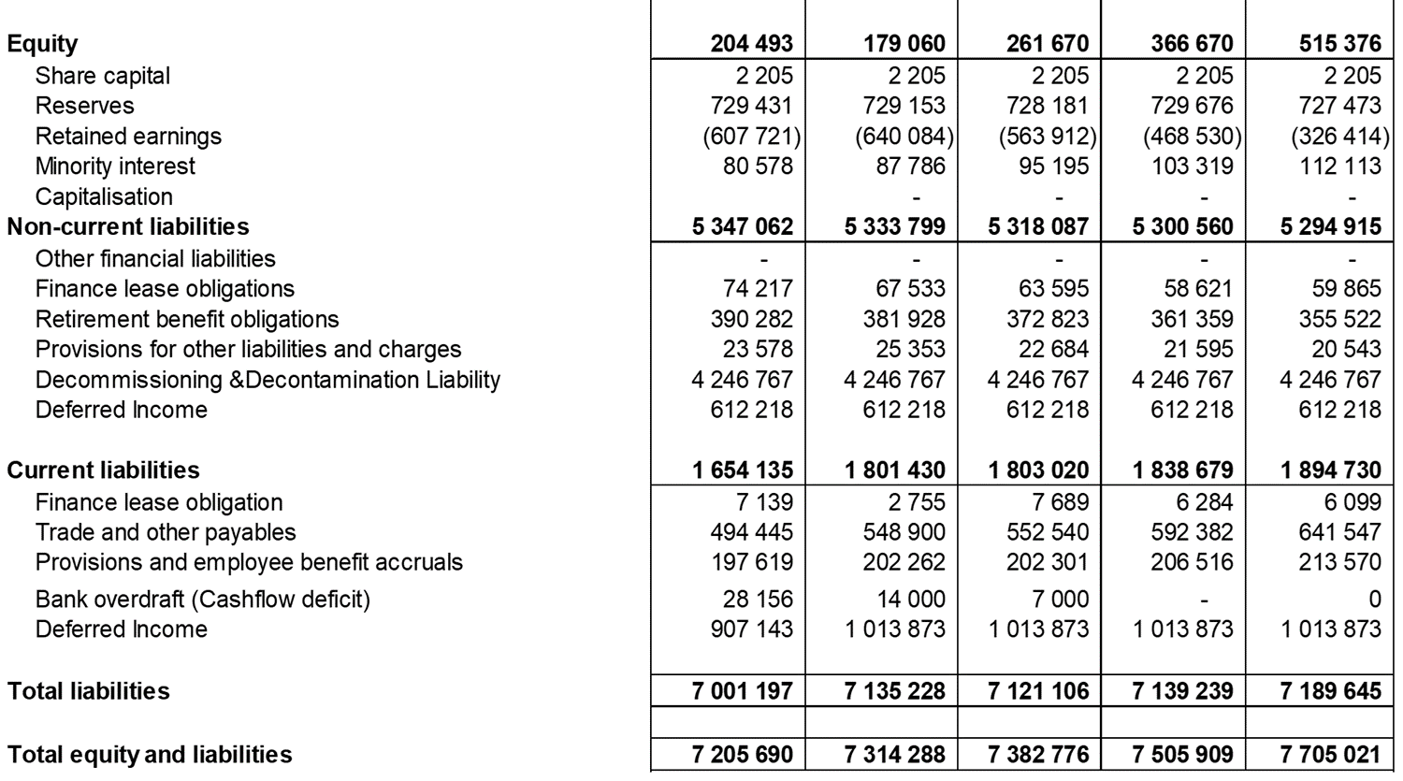
STATEMENT OF FINANCIAL POSITION

Slide 21
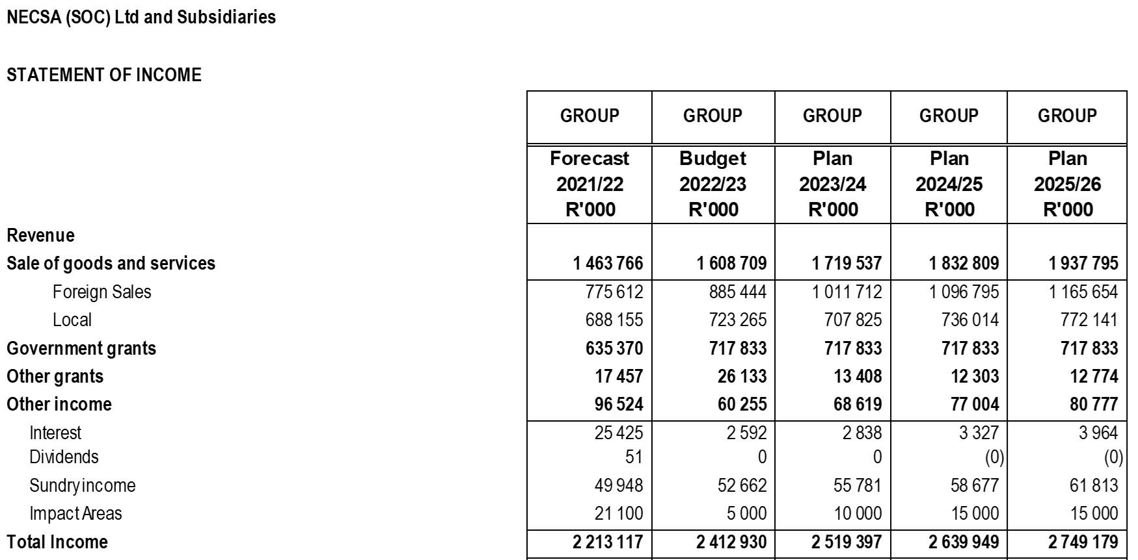
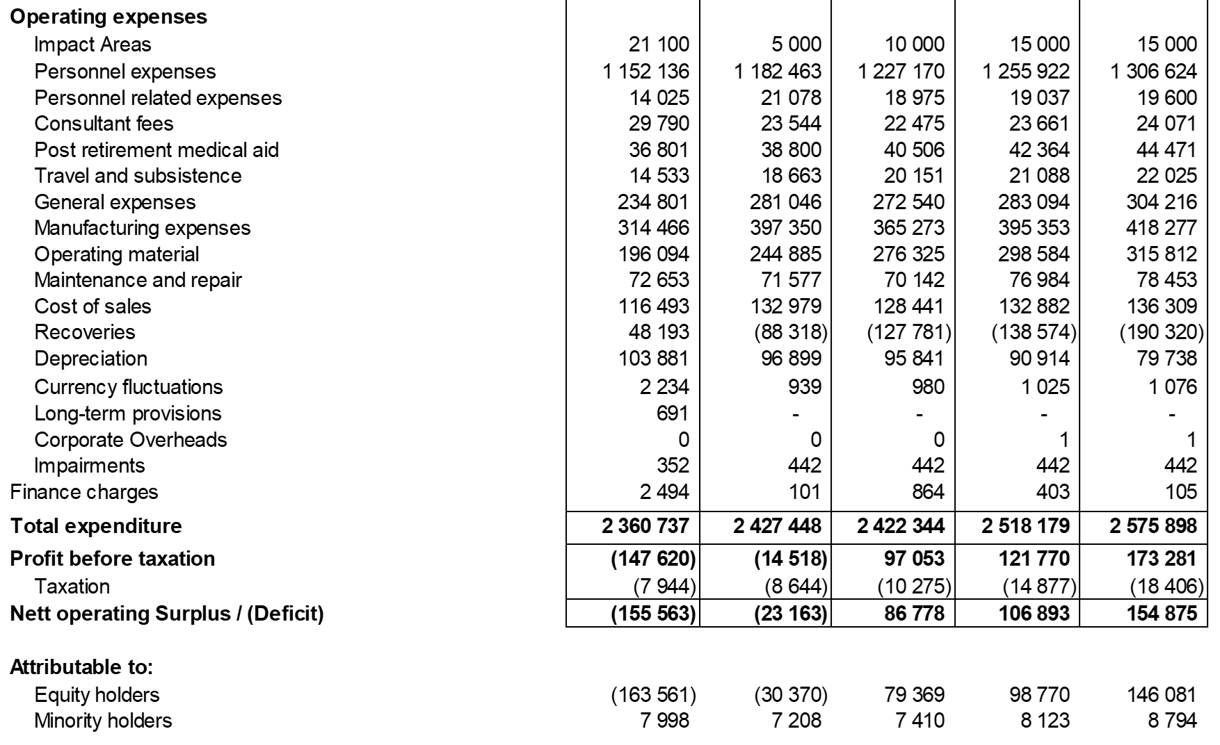
STATEMENT OF INCOME

