Slide 1

Presentation to Portfolio Committee on Justice and Correctional Services
Annual Performance Plan (APP) and Budget 2022-2023
06 May 2022

Slide 2

Presentation Outline
INTRODUCTION
ANNUAL PERFORMANCE PLAN 2022-2023
BUDGET 2022-2023
CONCLUDING COMMENTS
UPDATE ON LAND RIGHTS MANAGEMENT UNIT
1
Presentation to PC on Justice & Correctional Services: May 2022

Slide 3

Legal Aid SA Vision, Mission and Values
Presentation to PC on Justice & Correctional Services: May 2022
3

Slide 4
1. Introduction
The 2022/2023 financial year is the third year of the implementation of Legal Aid SA Strategic Plan 2020-2025.
The Legal Aid SA Annual Performance Plan (APP) 2022-2023 outlines the programmes, outputs, output indicators and targets that the organisation aims to achieve.
The APP has factored in the new responsibility that arises as a result of government’s policy direction related to justice in land matters.
Legal Aid SA took over the legal representation function formerly undertaken by the Land Rights Management Facility of the Department of Agriculture, Land Reform and Rural Development on 01 January 2022.
The Budget for the 2022-2023 financial year was prepared in accordance with a baseline reduction of R230 million composed of R125m for compensation of employees and R105m for goods and services expenditure.
The reduced budget will result in a reduction in the coverage of courts and delivery of legal aid services to indigent and vulnerable persons, affecting the ability of Legal Aid SA to fulfil its mandate.
1
Presentation to PC on Justice & Correctional Services: May 2022

Slide 5

2. Legal Aid SA Annual Performance Plan 2022-2023
Summary of the APP Programmes
Annual Performance Plan 2022-2023
Presentation to PC on Justice & Correctional Services: May 2022

Slide 6
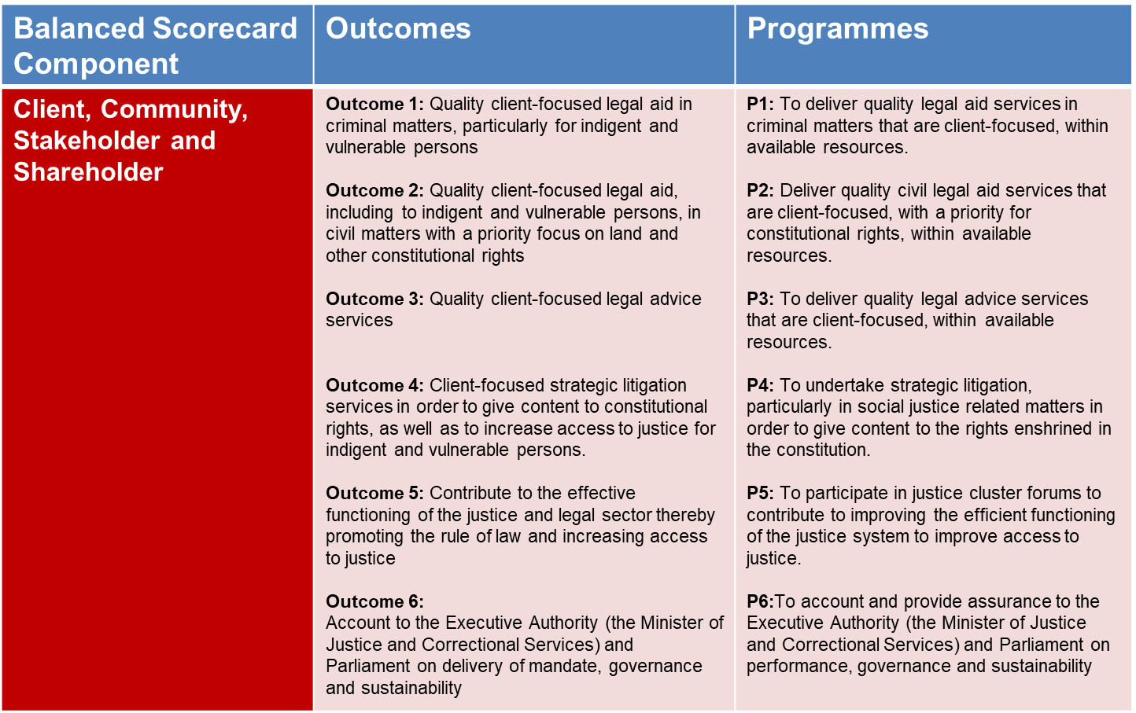
Summary of Legal Aid SA APP 2022-2023
1
Presentation to PC on Justice & Correctional Services: May 2022

Slide 7
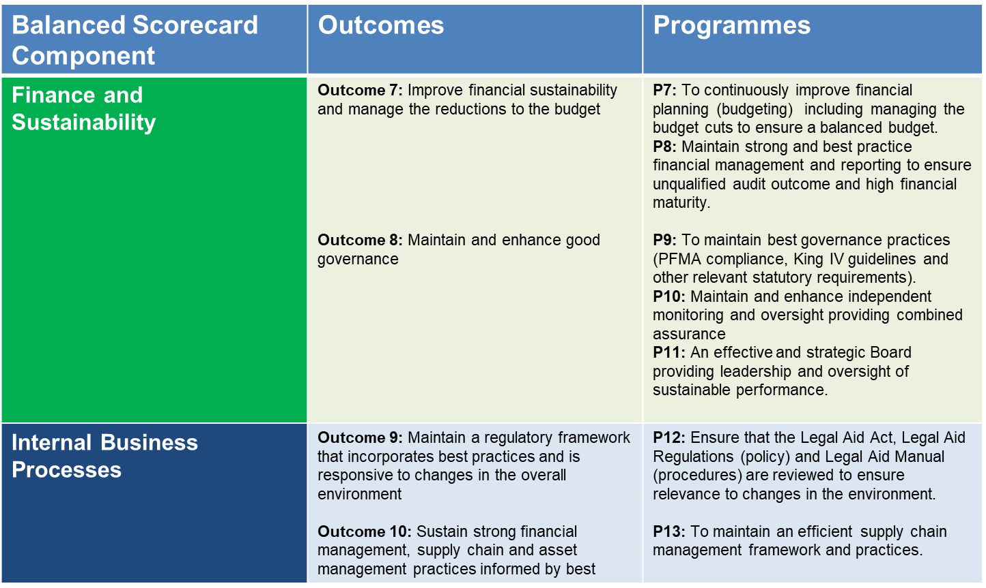
Summary of Legal Aid SA APP 2022-2023
1
Presentation to PC on Justice & Correctional Services: May 2022

Slide 8
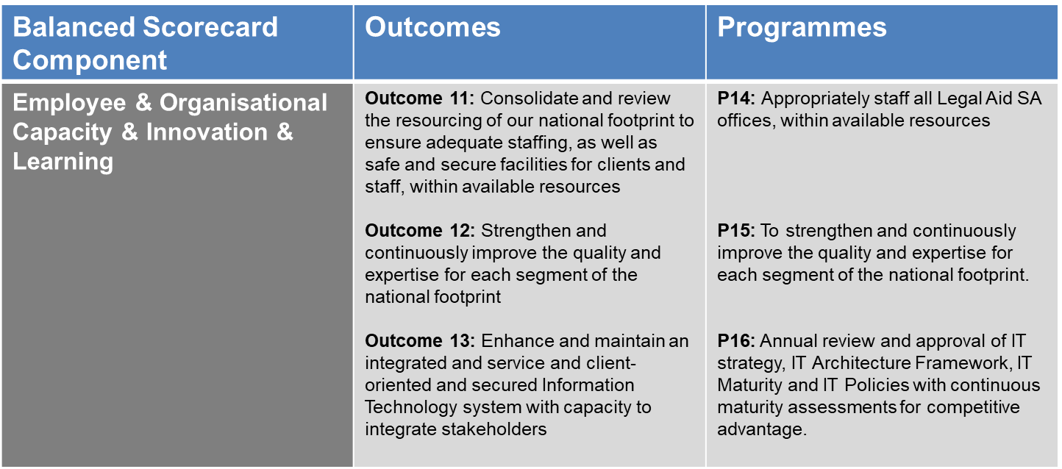
Summary of Legal Aid SA APP 2022-2023
1
Presentation to PC on Justice & Correctional Services: May 2022

Slide 9
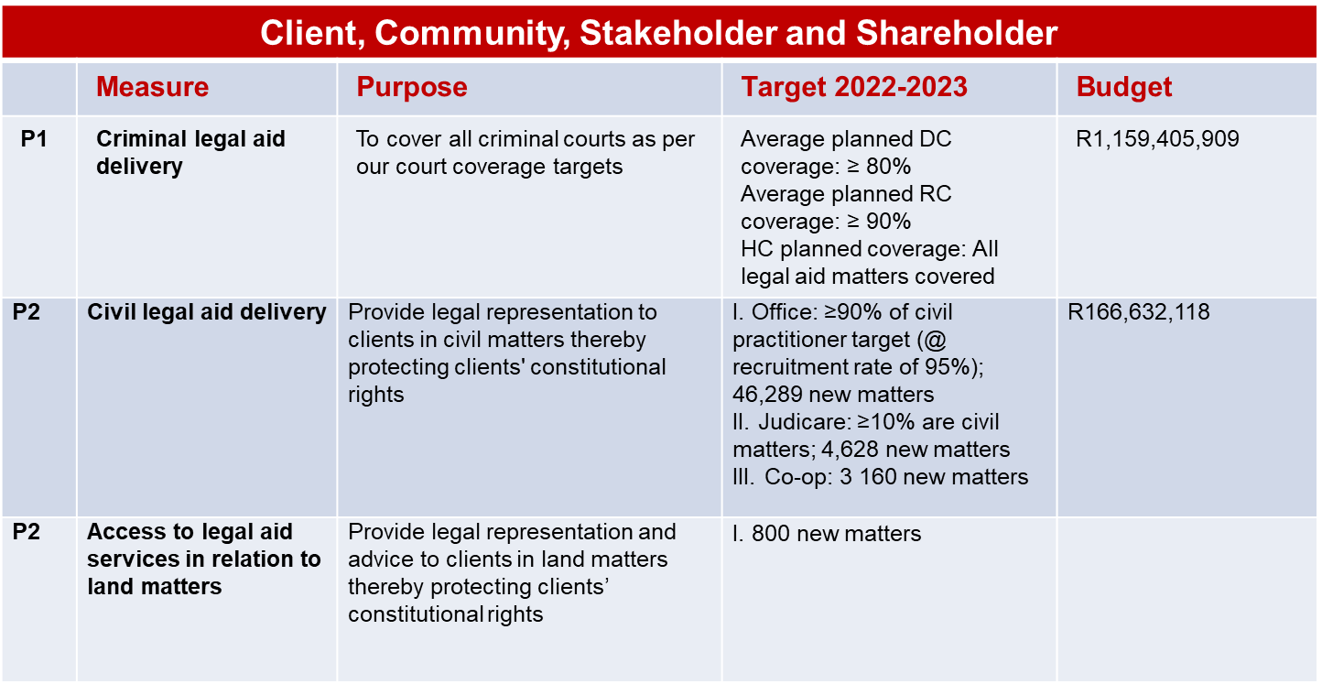
Legal Aid SA APP 2022-2023
Presentation to PC on Justice & Correctional Services: May 2022

Slide 10
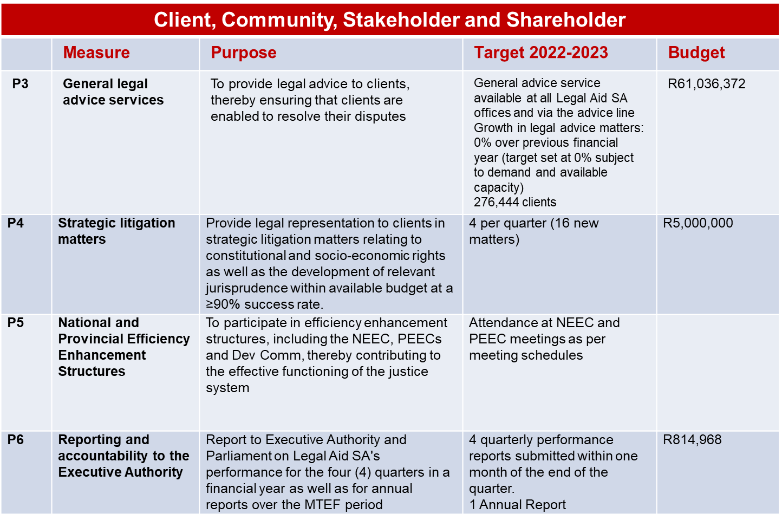
Legal Aid SA APP 2022-2023
Presentation to PC on Justice & Correctional Services: May 2022

Slide 11
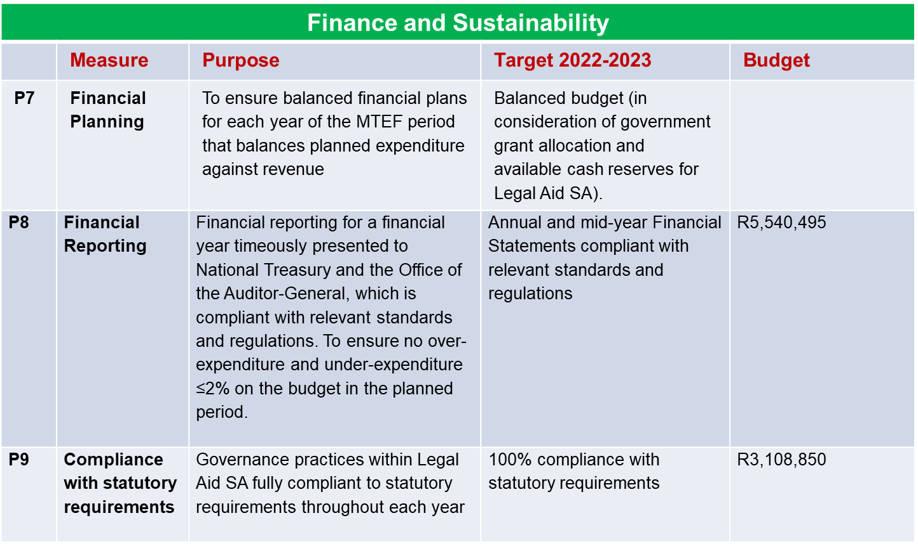
Legal Aid SA APP 2022-2023
Presentation to PC on Justice & Correctional Services: May 2022

Slide 12
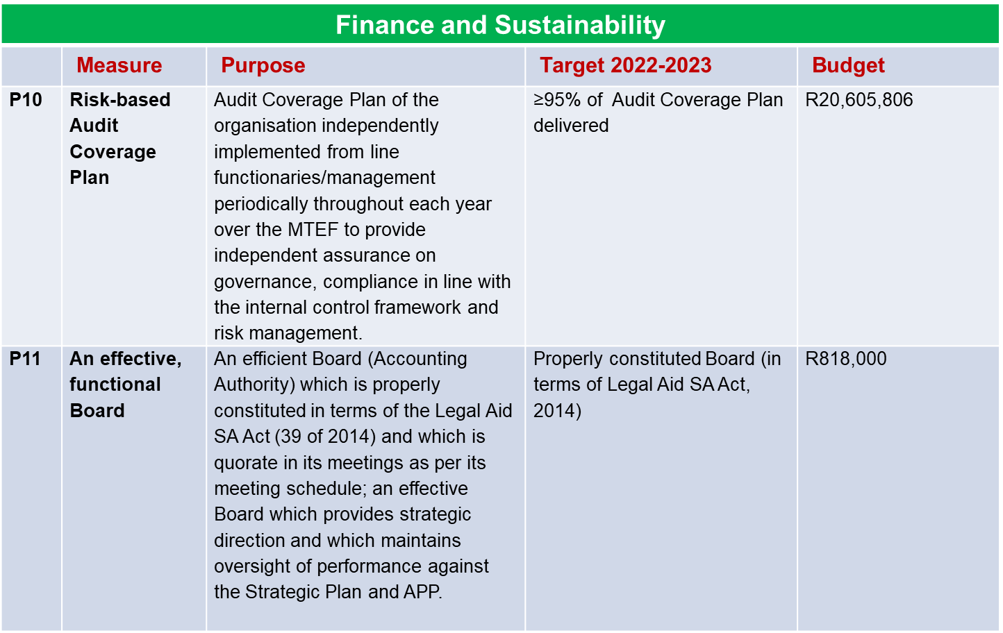
Legal Aid SA APP 2022-2023
Presentation to PC on Justice & Correctional Services: May 2022

Slide 13
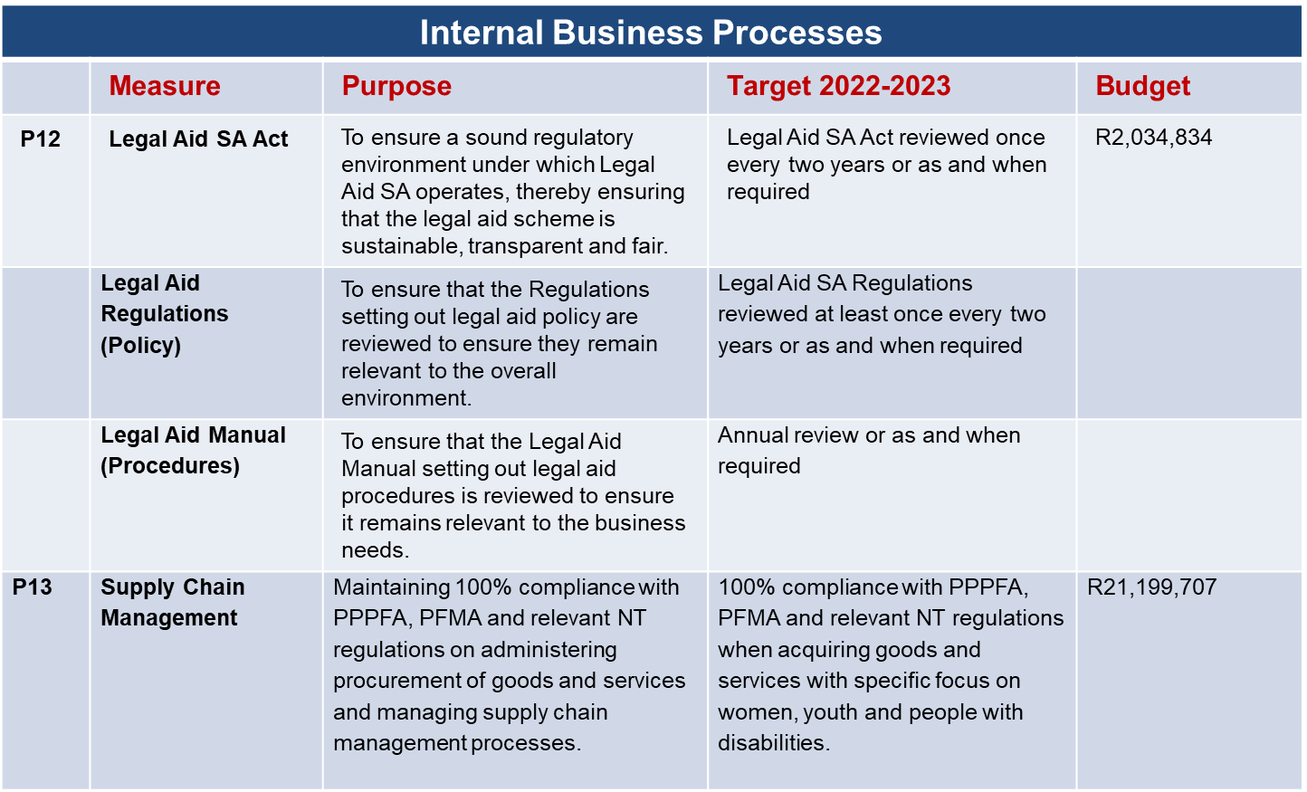
Legal Aid SA APP 2022-2023
Presentation to PC on Justice & Correctional Services: May 2022

Slide 14
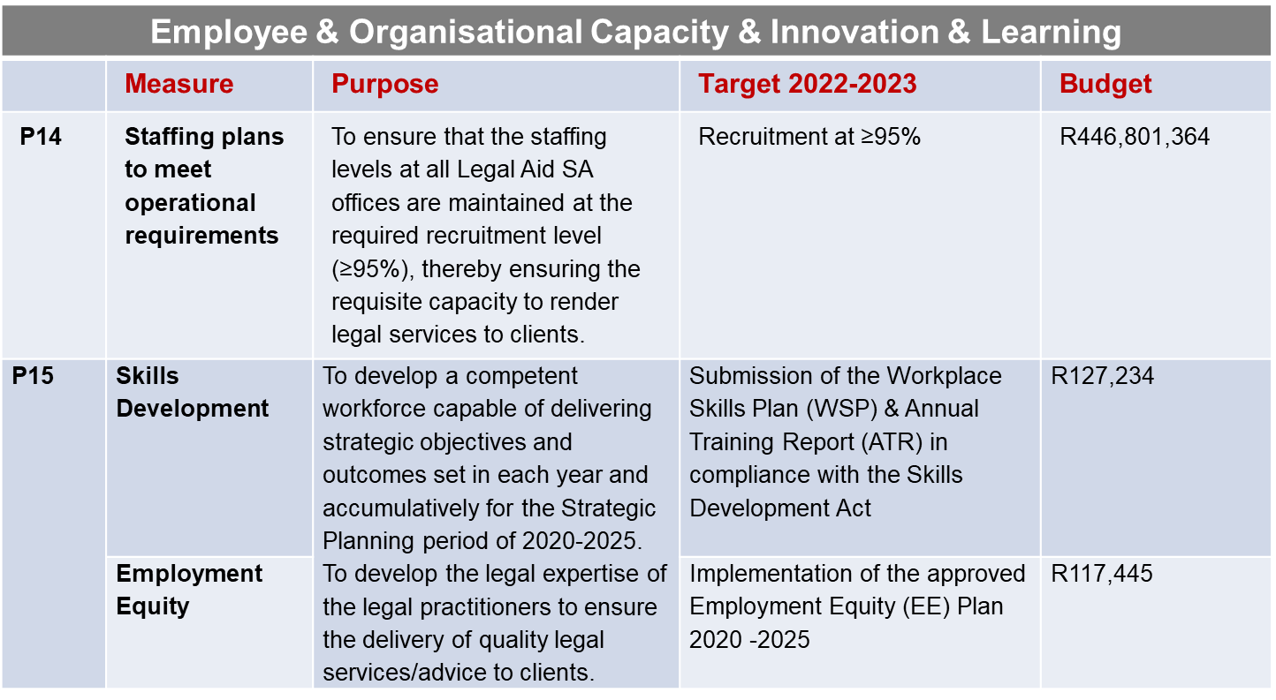
Legal Aid SA APP 2022-2023
Presentation to PC on Justice & Correctional Services: May 2022

Slide 15
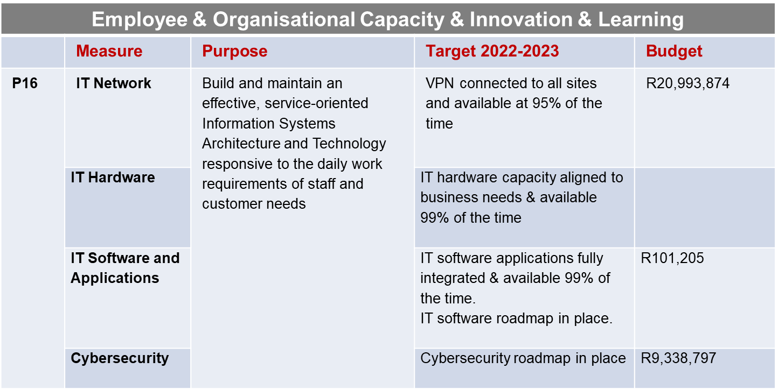
Legal Aid SA APP 2022-2023
Presentation to PC on Justice & Correctional Services: May 2022

Slide 16
3. BUDGET 2022-2023
Overview
Budget Allocation 2022/23
MTEF Baseline Reductions
  Impact on Goods and Services directly linked to service
  delivery
  Impact on Staff Composition
  Impact on Matters
  Impact on Court Coverage
  Impact on Civil Matters
Presentation to PC on Justice & Correctional Services: May 2022

Slide 17
Budget 2022/23 Overview
Legal Aid SA, like all state funded institutions has experienced a reduction in budget allocation over the MTEF periods. The decline in funding is continuing in the current MTEF period.
The 2022/23 budget allocation was cut by 10% and it is expected that further cuts by 5% in the 2023/24 financial years respectively, as per the 2022/23-24/25 MTEF allocations.
The total reduction in the current MTEF cycle is R352 million (15%).
This has had a negative impact on service delivery as 80% of the budget is spent on employee costs and legal practitioners make up 79% of the total staff component. Vacant permanent positions have not been filled due to lack of certainty on future funding requirements.
1
Presentation to PC on Justice & Correctional Services: May 2022

Slide 18
Budget 2022-2023
MTEF and Budget Allocations for the 2020/21 to 2024/25 Period
1
Presentation to PC on Justice & Correctional Services: May 2022

Slide 19
Budget allocation 2022/23 – 2024/25 MTEF
1
Presentation to PC on Justice & Correctional Services: May 2022

Slide 20
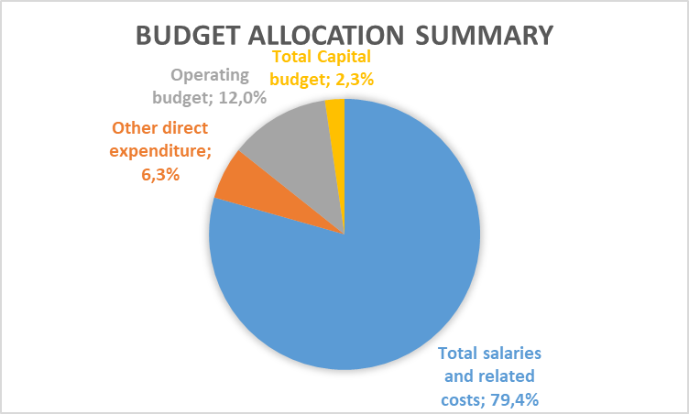
Budget allocation 2022/23 – 2024/25 MTEF
Salaries and related costs continue to be the largest driver of spending, these account for 79% of the allocation.
Operating budget is the second highest driver accounting for 12% of the allocation. 73% of the operating budget is contractual obligations, these include office rental, cleaning services, wide area network etc.
Other direct expenditure relates to expenditure that is directly linked to the provision of Legal services.
The remaining 2% is for the replacement of capital assets according to the CARP.
1
Presentation to PC on Justice & Correctional Services: May 2022

Slide 21
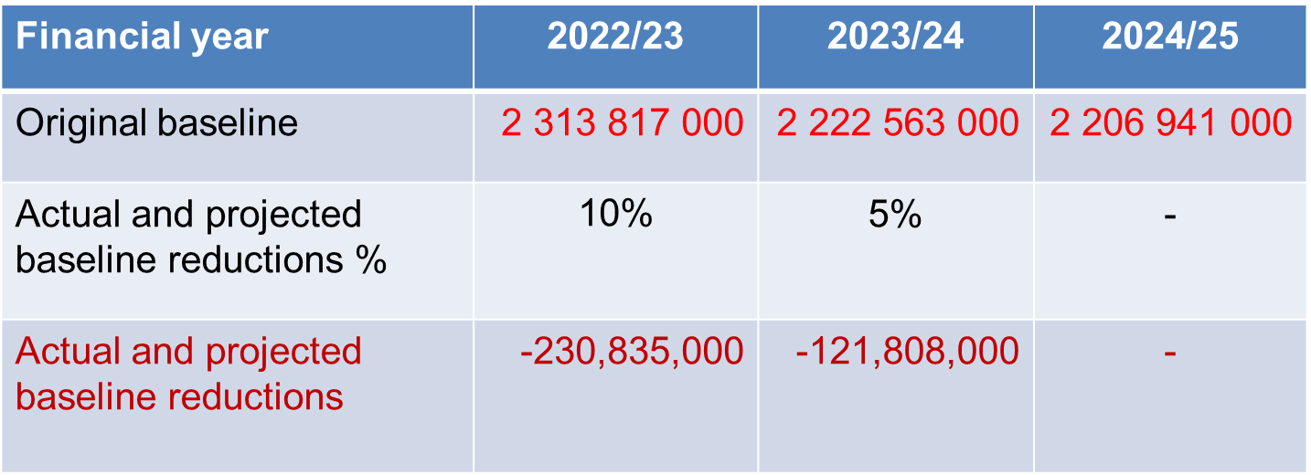
MTEF Baseline Budget Reductions 2022/23 – 2024/25 MTEF
1
Presentation to PC on Justice & Correctional Services: May 2022

Slide 22
Impact on Goods and Services Directly Linked to Service Delivery
2022/23
Judicare and direct expenses
(R8.8m)
2023/24
Judicare and direct expenses
(R7.6m)
The R7,6m cut reduces the number of matters allocated to Judicare which negatively impacts service delivery.
1
Presentation to PC on Justice & Correctional Services: May 2022

Slide 23

Impact on Staffing
Description
44
15
2022/23
65
22
38
9
10
18
8
25
6
7
11
5
2021/22
Support
Criminal Production DC
Criminal Production RC
Criminal Production HC
Criminal Management
Civil Production
Paralegals
Total = 284
113
171

Slide 24
Impact on Matters
Description
12 100
2 295
2022/23
18 150
3 350
4 500
26 400
300
2 750
16 500
2021/22
District Courts
Regional Courts
High Courts
Civil
General Advice
450
Total = 86 795
33 945
52 850

Slide 25
Impact on Court Coverage
DC-76.5%
RC-85.4%
2022/23
DC-76.5%
RC-85.4%
2023/24
DC-76.5%
RC-85.4%
2024/25
DC- 82.1%
RC- 90.8%
2021/22
No additional staff available to provide relief capacity should a practitioner become unavailable.

Slide 26
Impact on Civil Matters
2021/22
Advice 236,355 (-11%)
Advice 209,955 (-10%)
2022/23
Civil 40,034 (-11%)
Civil 36,034 (-8%)
Presentation to PC on Justice & Correctional Services: May 2022

Slide 27
4. Concluding Comments
The Legal Aid SA Annual Performance Plan 2022-2023 is focused on the fulfillment of the constitutional and legislative mandate, thereby assisting indigent and vulnerable South Africans to access justice.
The outlook for the future in terms of finances remains uncertain and Legal Aid SA is committed to managing the budget carefully, given the baseline reductions over the MTEF period 2022/23 – 2024/25.
Great effort is and will be placed on:
  Fulfilling the Strategic Plan and APP deliverables;
  Supporting efforts towards land justice
  Ensuring good governance and management of the business
  Repositioning the Employment Value Proposition to maintain a values-based high performance agile workplace
  Addressing the challenges and risks; and
  Assessing the impact of the current economic challenges as well as COVID-19 on the strategic objectives.
1
Presentation to PC on Justice & Correctional Services: May 2022

Slide 28
5. Update on the Land Rights Management Unit (LRMU) January - April 2022
Background
Service Delivery Model
Organisation structure
LRMU Funding
LRMU Priorities 2022-2023
Presentation to PC on Justice & Correctional Services: May 2022

Slide 29
BACKGROUND
In December 2019, the Inter- Ministerial Committee on Land Reform recommended the transfer of the Land Rights Management Facility (LRMF) from the Department of Agriculture, Land Reform and Rural Development (DALRRD) to Legal Aid SA.
The Legal Aid SA Strategic Plan 2020 -2025 stated that legal representation function (and related budget) undertaken by the LMRF of the DARD&LR will be transferred to Legal Aid SA placing Legal Aid SA at the centre of the efforts towards land justice.
In February 2020, a Task Team comprising DoJ& CD ,DALRRD and Legal Aid SA was established to facilitate the interim transfer of the legal representation function from the LMRF to Legal Aid SA.
From July - December 2021 Legal Aid SA started working alongside DALRRD in preparation for the agreed takeover date of 1 January 2022.
On 1 January 2022, Legal Aid SA took over the management of the legal component of the LRMF. The Land Rights Management Unit (LRMU) has received 33 referrals from the DALRRD to date.
The DoJ &CD is engaging National Treasury to secure requisite funding to implement the LRMU s internal management and service delivery structure for land related matters.
1
Presentation to PC on Justice & Correctional Services: May 2022

Slide 30
LRMU SERVICE DELIVERY MODEL
Legal Aid SA intends to follow the salaried Legal Practitioner model per province to provide legal representation to farm occupiers, labour tenants and land claimants post the transitional phase.
The internal Legal Practitioners will be trained and capacitated to handle land related matters and the current legal quality assurance program will be adopted by the LRMU to ensure the delivery of quality legal services
To ensure a seamless handover, LRMU utilizes the LRMF Panel of Legal Practitioners attending to the pending matters as @ 01 January 2022 (transfer date) subject to two conditions:
  accreditation on the Legal Aid SA Judicare System and
  compliance with the National Treasury CSD requirements.
1
Presentation to PC on Justice & Correctional Services: May 2022

Slide 31
LRMU ORGANISATION STRUCTURE
In the first year 2022/2023, Legal Aid SA manages the LRMU from National Office until the requisite funding to cover the roll out of the proposed national footprint is received.
The National Office structure comprise the Legal Executive, Senior Legal Practitioners (4) and Administrative Support Officers (5).
Resourcing of the Provincial footprint will be phased in from June 2022 subject to availability of funds. Senior and Supervisory Legal Practitioner positions were advertised on the 14 April 2022.
The next slides depicts the proposed LRMU Provincial Organizational Structure.
1
Presentation to PC on Justice & Correctional Services: May 2022

Slide 32
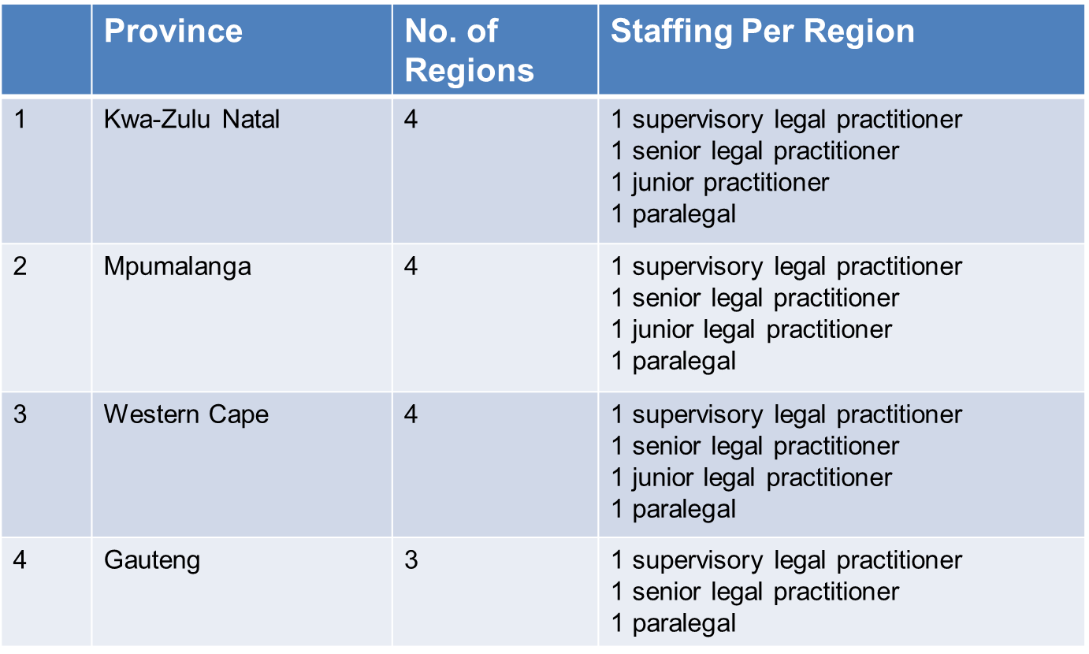
LRMU Proposed Provincial Org Structure
1
Presentation to PC on Justice & Correctional Services: May 2022

Slide 33
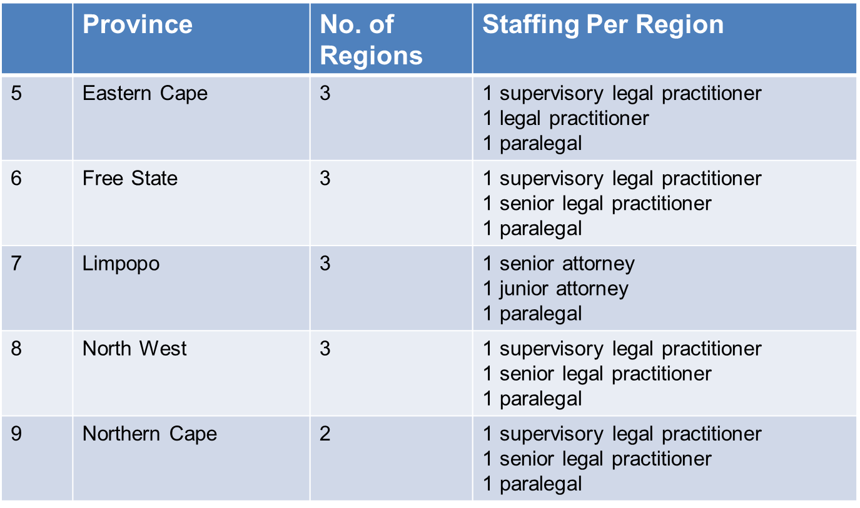
LRMU Proposed Provincial Org Structure
1
Presentation to PC on Justice & Correctional Services: May 2022

Slide 34
LRMU Funding Requirements
The table below summarizes the LRMU financial requirements
Available funding – R24m – National Treasury Retained Surplus and R33m from the DoJ & CD.
Province | Provincial Office | Number of Positions | Salary Expenses | Operating Expenses | Legal Expenses | Total Once Off Capital Exp. | Total Expenditure
Gauteng | National Office | 10 | R6,676,871 | R530,865 | R2,000,000 | R310,000 | R9,517,736
 | Gauteng | 7 | R4,693,188 | R299,822 | R3,300,000 | R1,772,800 | R10,065,810
KwaZulu-Natal | KwaZulu-Natal | 16 | R9,228,812 | R564,047 | R4,400,000 | R2,477,400 | R16,670,259
Mpumalanga | Limpopo & Mpumalanga | 16 | R9,228,812 | R564,047 | R4,400,000 | R2,477,400 | R16,670,259
Western Cape | Northern Cape & Western Cape | 16 | R9,280,958 | R534,047 | R4,400,000 | R2,477,400 | R16,692,405
Eastern Cape | Eastern Cape | 9 | R3,734,892 | R263,199 | R3,300,000 | R1,741,800 | R9,039,891
Free State | Free State & North West | 9 | R3,734,892 | R263,199 | R3,300,000 | R1,741,800 | R9,039,891
Limpopo | Limpopo & Mpumalanga | 9 | R6,202,887 | R373,068 | R3,300,000 | R1,834,800 | R11,710,755
North West | Free State & North West | 9 | R3,734,892 | R236,699 | R3,300,000 | R1,223,200 | R8,494,791
Northern Cape | Northern Cape & Western Cape | 6 | R2,489,928 | R175,466 | R2,200,000 | R1,161,200 | R6,026,594
Total |  | 91 | R59,006,133 | R3,804,459 | R33,900,000 | R17,217,800 | R113,928,392
1
Presentation to PC on Justice & Correctional Services: May 2022

Slide 35
LRMU PRIORITIES
Improve the internal delivery model with due regard to the demand for legal representation in land related matters.
Support the DoJ &CD in finalizing the MTEF funding with National Treasury to ensure a fully funded mandate.
Collaborate with DARD&LR and CLCC to optimize the LRMU operations.
Train the internal Legal Practitioners and Judicare Practitioners.
Roll out the Provincial footprint.
Monitor the Judicare Partners legal service delivery offering.
Collaborate with all Stakeholders in the land justice cluster.
1
Presentation to PC on Justice & Correctional Services: May 2022

Slide 36

NGIYABONGA
THANK YOU
KE A LEBOGA DANKIE

Slide 37

Follow us on social media
www.legal-aid.co.za

