Slide 1
Local Government Sector
Education & Training Authority (LGSETA)
Local Government Sector
Education & Training Authority (LGSETA)
Presentation to Board Strategy Session– 25 to 27 June 2017
Presentation to Portfolio Committee on Higher Education, Science and Innovation
Mr. Ineeleng Molete
CEO: LGSETA
04 May 2022
LGSETA TARGETS – THE WAY FORWARD

Slide 2
CONTENTS
1. Corporate Profile
Legislative Mandate
Scope of Coverage
LGSETA Governance Body
LGSETA National Foot Print
2. LGSETA Strategic Plan 2020 - 2025
LGSETA Strategic Intent: Vision/Mission/Values
LGSETA Strategic Focus for the Next Five Years
3. Annual Performance Plan 2022/23
Programme 1: Administration
Programme 2: Skills Planning
Programme 3: Learning Programmes
Programme 4: Quality Assurance
4. Budget 2022/23 and MTEF Estimates

Slide 3
CORPORATE PROFILE

Slide 4
LEGISLATIVE MANDATE
Constitutional Mandate
Section 29(1)(a) and (b) of the South African Constitution provides for the state to take reasonable measures to make adult and further education accessible to citizens, as a human right. In terms of local government, Sections 152 and 153 of the Constitution outline the role of local government in promoting social and economic development, while maintaining and improving service delivery to all community members.
Skills Development Act, No. 97 of 1998
The LGSETA derives its existence and mandate from the Skills Development Act. The Sector Education and Training Authorities’ (SETAs) Grant Regulations regarding skills development levies received by a SETA and related matters published in the Government Gazette, No. 27807 of 18 July 2005 and in the Government Gazette, No. 29584 of 2 February 2007, were repealed. The new grant regulations came into effect on 1 April 2013 as published in the Government Gazette, No. 35940 of 3 December 2012.
Skills Development Levies Act, No. 9 of 1999
The Skills Development Levies Act of 1999 makes provision for levy employers to pay 1% of their payroll to the South African Revenue Service (SARS) to be transferred to SETA’s for training and development purposes.

Slide 5
LGSETA MANDATE
KEY FUNCTIONS
Implement the Sector Skills Plan through Learning Programmes (Specific Interventions)
Allocate Grants in a prescribed manner
Monitor Education and Skills Programmes in the Sector and conduct research
Develop a Sector Skills Plan
Quality assurance of qualification & ensure certification
LGSETA Strategic Plan & Annual Performance Plan

Slide 6
SCOPE OF COVERAGE
LGSETA SCOPE OF COVERAGE
Municipalities (Metropolitan, District and Local)
Traditional Leadership Entities
Municipal Agencies/Entities
Local Government Agencies/Entities

Slide 7
LGSETA GOVERNANCE BODY
The LGSETA Board was appointed by the Minister on the 01 April 2020. The composition of the LGSETA Board is established as a stakeholder board inline with the LGSETA Constitution.
The following are the board subcommittees and they are all fully functional:
Executive Committee (EXCO)
Remuneration Committee (REMCO)
Finance Committee (FINCO)
Audit and Risk Committee (ARC)
There are currently vacancies in the Board and the process of filling these vacancies is under way.
Effective risk management exists to ensure that all potential threats to financial interests of the state as well as the LGSETA achievement of objectives are identified and addressed in a timely manner.
An adequate system of internal control is in place to mitigate significant risks faced by the LGSETA to an acceptable level

Slide 8
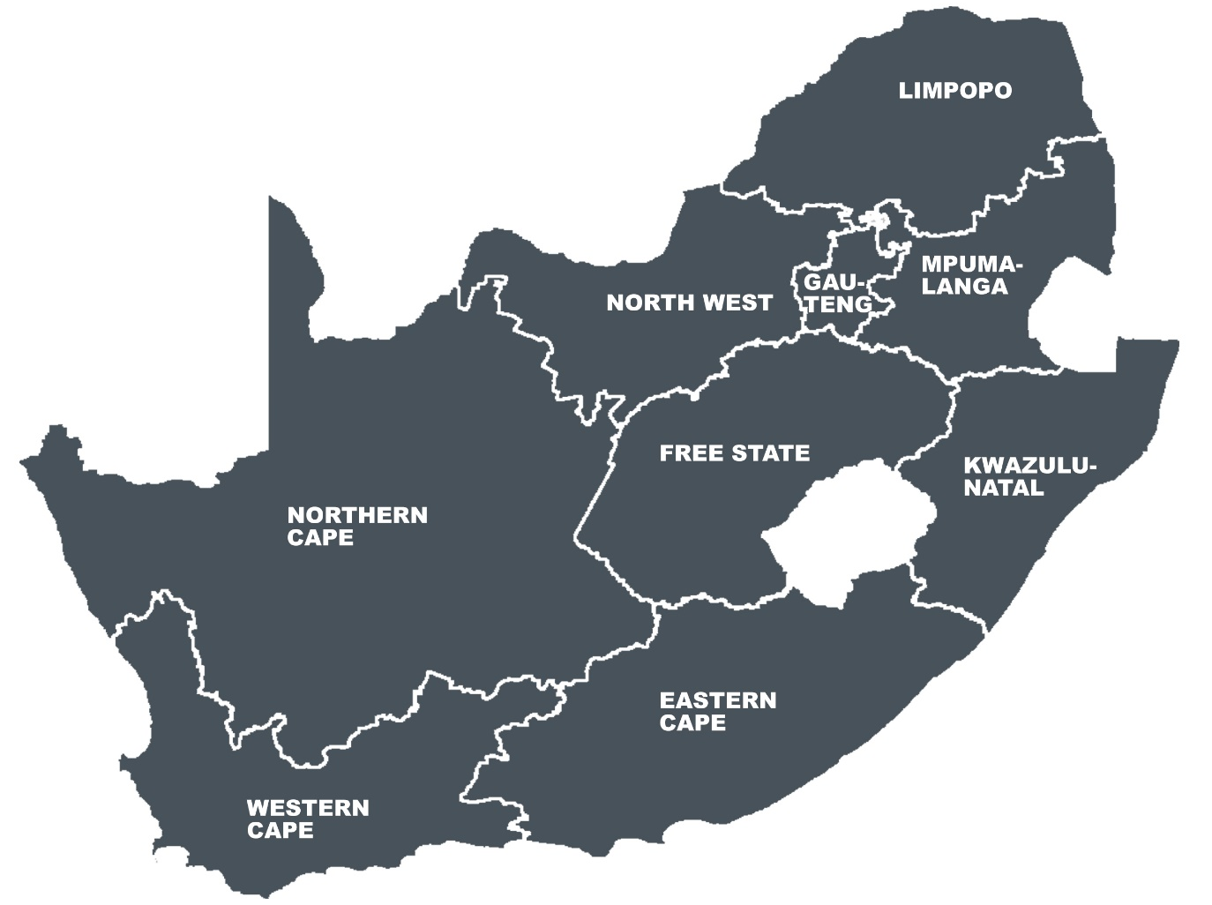
LGSETA NATIONAL FOOTPRINT
LGSETA OFFICES NATIONAL FOOT PRINT
9 provincial offices
3 satellite offices based at TVET Colleges

Slide 9
STRATEGIC PLAN 2020 - 2025

Slide 10
STRATEGIC INTENT
Vision
Highly-Skilled and Capable Local Government
Mission
Values
Customer Centric, Responsive, Passionate, Integrity, Collaborative and Innovative
To build local governments’ ability to meet its developmental needs through innovative approaches, effective capacity building and strategic partnerships

Slide 11
LGSETA STRATEGIC FOCUS AREAS
Enhancing Good Governance, Leadership and Management Capabilities
Promoting Sound Financial Management and Financial Viability
Enhancing Infrastructure and Service Delivery
Enhancing Municipal Planning
Promoting Spatial Transformation and Inclusion

Slide 12
STRATEGIC PARTNERSHIP MODEL
Non-Monetary Partnership
Impactful and yielding desired Strategic Outcomes
Monetary Partnership
Impactful and yielding desired Strategic Outcomes
Co-funding by Both Partners
Impactful and yielding desired Strategic Outcomes

Slide 13
LOCAL GOVERNMENT COUNCILLOR DEVELOPMENT
STRATEGY
Pillar 3: Soft Skills Development
(Coaching and Mentoring)
Pillar 2: Function Based Training and Development
(Core Programmes)
Pillar 1: Councillor Induction and Skills Audit
(Foundation Programmes)
Councillor Marco Learning Pathway

Slide 14
PILLARS OF THE COUNCILLOR DEVELOPMENT STRATEGY
PILLAR 1: Councillor Induction and Skills Audit
Objectives of this pillar:
Providing an induction programme for newly elected Municipal Councillors through addressing key areas of expertise and values that they will be expected to display while conducting their mandate and responsibilities;
Capacitated on local government policies, legislation, systems and processes relevant to their day to day work as councillors.
Assessing and identifying skills gaps and requirements from Councillors through skills audit battery that will enable to outline short, medium and long term skills development interventions for the Councillor
Major Focus Areas for this pillar:
Councillor Orientation Programme
Councillor Induction Programme
Skills Audit and Skills Assessment for Councillors

Slide 15
PILLARS OF THE COUNCILLOR DEVELOPMENT STRATEGY
PILLAR 2: Function Based Training and Development
The function based training and development pillar aimed at building capacity and skills to Councillors based on their assigned functions and portfolios in the Municipality
Objective of the Pillar
The objective of the function based training and development pillar is to ensure that Councillors are adequately capacitated to perform oversight functions based on their respective portfolios assigned by the Municipal Councils

Slide 16
PILLARS OF THE COUNCILLOR DEVELOPMENT STRATEGY
Key Areas for Functional Training and Development pillar
Municipal Key Performance Area | Functional Committees
Finance/ SCM and Audit | MPAC’s Committee on Municipal Finance and Procurement (Budget &SCM/IDP) Audit and Risk Committee
Infrastructure and Service Delivery | Committee on Infrastructure and Service Delivery/Project Management Unit
Municipal Planning | Committee on Municipal Planning & LED
Institutional Development and Municipal Administration | Committee on Human Resource/LLF
Executive Committee (EXCO) | Mayoral Committees Section 79 Committees Section 80 Committees
Ward Committee | Ward Committee
16

Slide 17
PILLARS OF THE COUNCILLOR DEVELOPMENT STRATEGY
PILLAR 3: Soft Skills Development
Objectives of this pillar:
This pillar deals with values, norms and standard that councillors must possess to ensure ethical leadership in the Municipality and communities;
Although soft skills development do not necessary influence demand of skills in the local government, the top up skills remain critical for Councillors in executing their roles and responsibilities
Six Core Skills for Councillors
Leadership and Ethics
Partnership Working
Communication Skills
Political and Administrative Interference
Scrutiny and Challenge
Regulating, Monitoring and Evaluation

Slide 18
IMPLEMENTATION PLAN OF THE COUNCILLOR
STRATEGY
The implementation plan of the Local Government Councillor Development Strategy calls for forging strategic partnership with different role players in the local government sector playing various roles and responsibilities within their mandates.
Institution | Role and Responsibility
Local Government SETA | Funding Identify skills gaps and skills demand Develop and Design Programmes/Qualifications for Councillor Development
National Treasury | Funding Implementing MFMA/MPAC training
SALGA | Implementing Partner
National COGTA | Implementing Partner

Slide 19
IMPLEMENTATION PLAN OF THE COUNCILLOR
STRATEGY
The Councillor Development Strategy will be implemented in phases as detailed below:
Phase | Strategy Pillar | Training Initiative | Implementing Partners | Time line
Phase 1: Implementation | Pillar 1 : Councillor Induction and Skills Audit | Councillor Orientation Programme | SALGA/LGSETA | First Year of Implementation
 |  | Councillor Induction Programme | SALGA/LGSETA | First Year of Implementation
 | Pillar 1: Councillor Induction and Skills Audit | Skills Audit and skills assessment for Municipal Councillors | COGTA/LGSETA | First Year of Implementation
Phase 2: Implementation | Pillar 2: Functional Based Training and Development | Skills Programmes identified in pillar 2 | COGTA/SALGA/LGSETA | Second Year of Implementation
Phase 3: Implementation | Pillar 3: Soft Skills Development | Skills Programmes identified in pillar 3 | COGTA/SALGA/LGSETA | Second Year to Last Year of implementation

Slide 20
LGSETA APPROACH TO DDM
LGSETA Approach to DDM
The implementation of the DDM will focus on forging strategic partnership with District Municipalities to implement training initiatives to respond to the Nine Municipal Service Areas.
Step 1:
Identify Skills Gaps and Shortages at District level
Analysis of OFO Codes according to municipal service delivery areas
Step 2:
Confirm appropriate interventions /Shortages
Step 3:
Implementation/Monitoring and Evaluation
Develop Project Plans for each District and Metros in each province
-Quarterly reports on implementation of projects per district and metros
-Monitoring and reporting of District/Metro Partnership project deliverables and milestones
WSP Data analysed according to municipal service delivery areas and triangulated against provincial and district analysis
identify any challenges or gaps linked to planning
identify any gaps linked to outcomes of relevant research
Identify any district/metro projects for strategic partnerships
Analysis of interventions identified for skills gaps per each of 44 districts and 8 metros
Confirm appropriate intervention to address skills gap/shortages
- Identify extent of skills supply in the province in relation to the identified interventions
-Identify any gaps or challenges linked to the implementation of interventions
-Assess and evaluate impact made on district projects linked to strategic partnerships

Slide 21
LGSETA STRATEGIC PRIORITY AREAS RESPONSE TO
DDM
LOCAL GOVERNMENT STRATEGIC FOCUS AREA | RESPONSE THROUGH DDM
Enhancing Good Governance, Leadership and Management Capabilities | Strengthen governance, engaged management and ethical leadership through appropriate and targeted interventions using District Development Model (DDM) including link to: Service-Oriented Delivery Technology and 4IR Building capacity of new Councillors Integrated HRD Framework
Promoting Sound Financial Management & Financial Viability | Sound financial management to ensure efficient and effective use of public resources through appropriate and targeted interventions using DDM including:: - Service-Oriented Delivery - Utilising outcomes of AG report

Slide 22
LGSETA STRATEGIC PRIORITY AREAS RESPONSE
TO DDM
LOCAL GOVERNMENT STRATEGIC FOCUS AREA | RESPONSE THROUGH DDM
Enhancing Infrastructure and Service Delivery | Improved Service Delivery and Infrastructure Asset Management through appropriate and targeted interventions using DDM and strategic partnerships model including linking to: Service-Oriented Delivery Technology and 4IR Youth Unemployment initiatives Nine Municipal-Service Areas: Energy Water and Sanitation Waste and Refuse Management Town and Regional Planning Public Safety and Security Settlements and Housing Community Services Economic Development Transport, Roads and Storm Water

Slide 23
LGSETA STRATEGIC PRIORITY AREAS RESPONSE
TO DDM
LOCAL GOVERNMENT STRATEGIC FOCUS AREA | RESPONSE THROUGH DDM
Promoting Spatial Transformation and Inclusion | Strengthen coordination towards local economic development and transformation through appropriate and targeted interventions using the DDM and strategic partnerships and link to: National Government Strategies and Priorities (promoting Intergovernmental Relation) Technology and 4IR LED – DDM – partnerships to close gaps and promote local economy Green and Ocean Economy; Township and Informal Economy Youth unemployment initiatives
Enhancing Municipal Planning | Improved collaboration with stakeholders for efficient and effective skills Planning and Delivery through appropriate targeted interventions using the DDM and strategic partnerships and link to: - Integrated HRD framework, mentoring, coaching, professionalization programmes

Slide 24
ECONOMIC RECOVERY PLAN AND SKILLS STRATEGY
Skills development, science and innovation are key enablers for successful implementation of the Economic Recovery Plan.
The skills strategy identifies the skills implications of ERRP and outlines the ways in which the PSET system will ensure skills required to implement this plan are available through the ERRSS
The strategy focuses on maximising opportunities for new entrants to access labour markets to boost job creation and to support re-training of employees to prevent further job losses.
infrastructure development
delivery for network industries
industrialisation through localisation
energy security
green economy
agriculture and food security
digital economy and global business services
public employment
Presidential Youth Employment Intervention

Slide 25
ANNUAL PERFORMANCE PLAN 2022/23

Slide 26
PROGRAMME 1 – FINANCE, INTERNAL AUDIT & RISK MANAGEMENT
Annual Performance Plan Priorities 2022/23:
Unqualified Audit Opinion
Reduction of LGSETA reserves and 95% commitment of our reserves
Payment of suppliers within 30 days upon receiving compliant documentation (Discretionary and Corporate Suppliers)
Reduction of audit findings
Risk Mitigation measures implemented

Slide 27
PROGRAMME 1 – CORPORATE SERVICES
Annual Performance Plan Priorities 2022/23:
Career development events/exhibitions participated in urban and rural areas on occupations in high demand
Capacity building workshops on Career Development Services conducted
Cyber Security Assessment conducted
Cement relationship between LGSETA and its stakeholder through vigorous engagements mechanism

Slide 28
PROGRAMME 2 – SKILLS PLANNING
Annual Performance Plan Priorities 2022/23:
Revenue Enhancement through participation of levy paying into the LGSETA
Sector research agreements signed for TVET growth and occupationally-directed programmes
Through research, will identify skills needs for established and emergent co-operatives, small and emerging enterprises
Monitoring and Tracking of learners tool developed
Evaluation Studies and Tracey Studies conducted on skills development programmes/projects

Slide 29
PROGRAMME 3 – LEARNING PROGRAMMES
Annual Performance Plan Priorities 2022/23:
Opening of workplace based learning opportunities will be increased
Increase municipal workers participating in various learning programmes:
Address critical skills required by various sectors of the economy,
Transform workplaces,
Improve productivity to improve economic growth prospects in various sectors of the economy.
Support the growth of TVET and CET Colleges through various learning interventions
To increase skills development support for entrepreneurial activities and the establishment of new enterprises and cooperatives
Support local government trade union through training programmes
Support NGO’s/NPO’s/CBO’s and SMMEE’s through skills programmes

Slide 30
PROGRAMME 3 – LEARNING PROGRAMMES
Annual Performance Plan Priorities 2022/23:
Artisan Development to produce occupations in high demand
Support Centres of Specialisation through forging partnership with employers
High School Development Programme implemented through attracting learners into choose local government careers
Implement DDM Priority Areas to improve service delivery and infrastructure in municipalities
Enhance capacity to Municipal Councillors through implementation of Councillor Development Strategy

Slide 31
PROGRAMME 4 – QUALITY ASSURANCE
Annual Performance Plan Priorities 2022/23:
Local Government Qualifications developed, Learning Material and RPL Toolkits developed
Accreditation and Re-accreditation of Skills Development Providers
Certification of learners against Unit Standards and or Qualifications
Establishment of assessment centres for quality assurance of occupational qualifications

Slide 32
BUDGET 2022/23 AND MTEF ESTIMATES

Slide 33
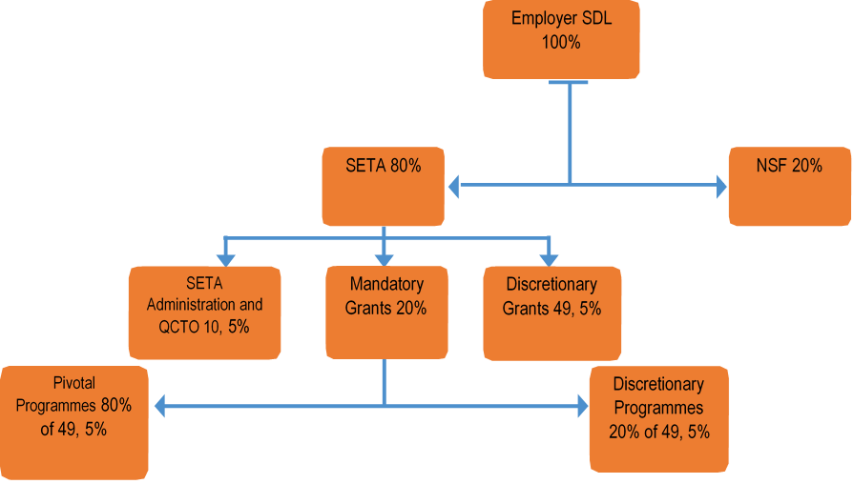
FUNDING MODEL

Slide 34
FUNDING MODEL
Mandatory Grant
Paid to levy paying organisations upon submission of a Workplace Skills Plan (WSP), Annual Training Report (ATR) and PIVOTAL report by 30 April.
The SETA pays 20% of the total levies back to the employer upon approval and verification of the WSP, ATR and PIVOTAL report.
Mandatory Grants payments are done and Mandatory Grants not claimed by 30 April will be transferred to the discretionary grant by 15 August each year.

Slide 35
FUNDING MODEL
Discretionary Grant
80% of available discretionary funding should be committed to PIVOTAL training programmes 20% of the available discretionary funds should be committed to programmes/projects of sectoral importance which are not PIVOTAL in nature. A maximum of 7,5% of any grant or SETA funded project may be used for project management.
PIVOTAL means Professional, Vocational, Technical and Academic Learning Programmes that result in qualification or part qualification on the National Qualification Framework (NQF)
PIVOTAL programmes includes:
Learnerships, Skills programmes, Apprenticeship, Workplace Experience, Recognition of Prior Learning, Bursaries Work Integrated Learning (WIL), Internships and any other learning programmes registered on the NQF.

Slide 36
SUMMARY OF BUDGET ESTIMATES
LGSETA derives its revenue from the skills development levy contributed by entities and municipality in the local government sphere. The MTEF budget, which forms an integral part of the Annual Performance Plan, is made up of the discretionary, mandatory and administrative components. The budget for the 2022/23 financial period will be focusing on the implementation of the NSDP 2030
There were no significant changes in the revenue structure for LGSETA relating to 2022/23 financial period. The total revenue is made up of the following components
Discretionary funds: 49.5%. A total of 80% of the discretionary funds is earmarked for PIVOTAL programmes, while the remaining 20% will be applied to non-PIVOTAL interventions.
Mandatory funds: 20% -Mandatory grants funds will be disbursed to municipalities and entities that have submitted their Work Skills Plan (WSP) and Annual Training Plan (ATR), in line with the grant regulations. Unclaimed mandatory grants will be transferred to the discretionary funds, in line with the grant regulations.

Slide 37
SUMMARY OF BUDGET ESTIMATES
Administration: 10.5% - As regulated, 0.5% of the administration funds will be transferred to the QCTO. The remaining 10% will be used to finance the overall administration of the LGSETA.
Levy Penalties and Interest – Penalties and interest is charged by SARS to all levy payers who do not adhere to the legislated timeframes for paying Skills Development Levy. These funds will finance the discretionary grants projects within LGSETA.
Investment income – The investment income is the interest derived from funds invested with the Corporation for Public Funds (CPD) as per the instructions issued by the National Treasury. The investment income will be utilised in financing the administration budget.
Other income - The Other Income relates to the mandatory grants income received from ETDPSETA

Slide 38
SUMMARY OF BUDGET ESTIMATES
2022-23 BUDGET ESTIMATES | 2019/20 | 2020/21 | 2021/22 | 2021/22 | 2022/23 | 2023/24 | 2024/25
 | Audited | Audited | Approved Budget | Revised budget
 | Outcome | Outcome |  |  | Budget Estimates | Budget Estimates | Budget Estimates
 | R'000 | R'000 | R'000 | R'000 | R'000 | R'000 | R'000
REVENUE
Levy income - 80% | 738 530 | 519 706 | 664 677 | 780 992 | 849 654 | 900 633 | 945 665
Administration Levy Income - 10,5% | 96 955 | 68 240 | 87 260 | 104 711 | 111 517 | 118 208 | 124 119
Discretionary grants levy income - 49,5% | 456 907 | 321 584 | 411 216 | 493 460 | 525 724 | 557 267 | 585 131
Mandatory Levy Income - 20% | 184 668 | 129 882 | 166 201 | 182 821 | 212 413 | 225 158 | 236 416
Levy interest and penalties | 17 520 | 14 572 | 7 078 | 17 744 | 7 503 | 7 953 | 8 351
Interest Income | 75 860 | 57 728 | 68 274 | 38 618 | 48 274 | 51 170 | 53 729
Other Income | 113 | 93 | 161 | 161 | 172 | 182 | 192
TOTAL REVENUE | 832 023 | 592 099 | 740 190 | 837 515 | 905 603 | 959 939 | 1 007 937

Slide 39
SUMMARY OF BUDGET ESTIMATES
EXPENDITURE | 2019/20 | 2020/21 | 2021/22 | 2021/22 | 2022/23 | 2023/24 | 2024/25
Administration Expenditure | 72 670 | 67 363 | 155 695 | 143 491 | 159 963 | 169 561 | 178 040
Employee Costs | 30 399 | 30 334 | 75 490 | 68 522 | 76 603 | 81 199 | 85 260
Goods and services | 42 271 | 37 030 | 80 205 | 74 969 | 83 360 | 88 362 | 92 780
Operating lease buildings | 7 409 | 8 586 | 14 000 | 14 000 | 15 000 | 15 900 | 16 695
Maintenance and repairs | 914 | 381 | 1 500 | 1 500 | 1 200 | 1 272 | 1 336
Communication and marketing | 2 799 | 667 | 4 200 | 4 200 | 5 000 | 5 300 | 5 565
Conferences, workshops and catering | 3 770 | 276 | 3 000 | 3 000 | 3 150 | 3 339 | 3 506
Consultancy and service provider | 1 181 | 1 383 | 2 140 | 2 140 | 3 290 | 3 487 | 3 662
Legal fees | 694 | 802 | 2 646 | 5 000 | 5 300 | 5 618 | 5 899
Travel and subsistence | 2 327 | 2 761 | 9 907 | 9 907 | 8 448 | 8 955 | 9 403
Staff training and development | 512 | 623 | 2 731 | 2 731 | 2 868 | 3 040 | 3 192
Governance costs | 1 648 | 1 987 | 3 062 | 3 062 | 3 246 | 3 441 | 3 613
QCTO expense | 4 355 | 4 600 | 4 980 | 3 502 | 4 158 | 4 407 | 4 628
Printing | 1 444 | 1 210 | 4 612 | 3 500 | 2 700 | 2 862 | 3 005
Telephone and internet | 3 605 | 3 901 | 4 000 | 4 000 | 4 200 | 4 452 | 4 675
External audit fees | 5 072 | 3 236 | 5 292 | 5 292 | 4 900 | 5 194 | 5 454
Internal audit fees | 533 | 866 | 1 819 | 2 897 | 3 200 | 3 392 | 3 562
Other expenses including asset purchases | 3 155 | 4 346 | 12 500 | 6 422 | 13 845 | 14 676 | 15 409
General expenses | 2 853 | 1 405 | 3 816 | 3 816 | 2 855 | 3 026 | 3 178

Slide 40
SUMMARY OF BUDGET ESTIMATES
2022-23 BUDGET ESTIMATES | 2019/20 | 2020/21 | 2021/22 | 2021/22 | 2022/23 | 2023/24 | 2024/25
Mandatory grants expenditure | 196 606 | 129 881 | 166 201 | 182 821 | 212 413 | 225 158 | 236 416
Discretionary grants expenditure | 265 301 | 223 928 | 418 294 | 511 203 | 533 227 | 565 221 | 593 482
- Discretionary grants projects expenditure | 200 312 | 164 808 | 386 992 | 472 933 | 493 249 | 522 844 | 548 986
-Project employee costs | 54 095 | 59 120 | 31 302 | 38 270 | 39 978 | 42 377 | 44 496
-Project admin costs | 10 894 | - | - |  | - | - | -
TOTAL EXPENDITURE | 534 577 | 421 172 | 740 190 | 837 515 | 905 603 | 959 939 | 1 007 937
Surplus/ Deficit | 297 446 | 170 926 | - | 0 | 0 | 0 | 0

Slide 41
Questions Comments Inputs Suggestions Nothing

