Slide 1
Presentation
Portfolio Committee justice and correctional services
Judicial Inspectorate for Correctional Services
Operational Plan
2022/2023
Date: 4 May 2022
By Justice E Cameron;
Mr. V. Misser

Slide 2
VISION
To uphold the human rights of inmates through independent, proactive and responsive oversight.
MISSION
To independently inspect, investigate and report on the treatment of inmates and conditions in correctional centres and remand detention facilities and on any corrupt or dishonest practices.
VALUES
JICS subscribes to the following values:
Human dignity
Independence
Fairness
Efficiency
Integrity
Professionalism
Accountability
Legality

Slide 3
PURPOSE
To present the Operational Plan, APP indicator and Budget 2022/23 for the Judicial Inspectorate for Correctional Services to the Portfolio Committee on Justice and Correctional Services.

Slide 4
RECENT DEVELOPMENTS
Progress on JICS’s independence as ordered by the Constitutional Court in Sonke Gender Justice NPV v President of the Republic of South Africa
JICS as a National Government Component;
Amendments to the Correctional Services Act 111 of 1998; and
JICS Draft Bill (version 20).
Other engagements and collaborations:
NCCS and JICS Sub-Committee;
NPM and other stakeholders; and
PC and JICS planned workshop on mandatory minimum sentences.

Slide 5
JICS programmes/directorates
To effectively and efficiently deliver JICS’s mandate through the following programmes:
Programme 1: Strategic Management and Leadership
Programme 2: Administration
Programme 3: Legal Services
Programme 4: Management Regions

Slide 6
programme
1
Strategic Management and Leadership

Slide 7
Strategic Management and Leadership
Purpose
To ensure that JICS compiles strategic documents and that the organisation has monitoring and evaluation systems in place.
To ensure that all Directorates are in full compliance with the internal procedures and control mechanisms of JICS’s policies and procedures and all government regulations applicable.

Slide 8
Strategic Management and Leadership (continued)
Functions
Ensure work performances within JICS conforms to set standards and norms;
Measure the efficiency and effectiveness of all Directorates;
Determine when programmes are on track and when changes may be required;
To ensure all Directorates adhere to good corporate governance principles and practices; and
Measure the efficiency and effectiveness of all Directorates.
Document, evaluate, test systems and controls to determine their adequacy and effectiveness to ensure:
  Compliance with rules and regulations;
  The accomplishment of management’s objectives;
  Reliability and integrity of information;
  Economical use of resources; and
  Safeguarding of assets.

Slide 9
Strategic Management and Leadership (continued)
Activities
Compilation of:
  Operational plan;
  Annual Performance Plan;
  Governance Calendar;
  Monthly reporting Mechanism (M&E monthly reporting tools);
  Quarterly reports; and
  Annual report.
Ensure drafting, reviewing and compiling of JICS’s policies.
Ensure compliance and quality management through continuous work performance assessments.
Monitor and report on the implementation status of recommendations from internal/external audits.

Slide 10
programme
2
ADMINISTRATION

Slide 11
Directorate: Support Services
Purpose
To ensure organisational support and administration.
Functions
To ensure that the allocated budget ito the MTEF meets the main cost items: compensation of employees, goods and services and others.
The Human Resources function provides, amongst others, an integrated and comprehensive HR service covering Employment Equity, Workplace Skills Plan, Training Plan, Employee Wellness Programme, HR Planning, Organisational Development, Recruitment and Selection Processes and HR Administration.
To create business value through the provisioning of reliable, integrated and secured ICT infrastructure and business application systems to ensure effective strategic alignment and enhancement of business processes.

Slide 12
Directorate: Support Services (continued)
Functions:
Facilitate an efficient and effective communications system (internal and external) through:
  Consistency in communications internally while building and promoting JICS externally as an organ of state.
  Senior managers must support the communication programme by allowing and encouraging staff to participate in various departmental initiatives. A media committee comprising of representatives must allow all branches to participate in internal departmental communication issues.
  Media Liaison occurs in a highly pressured environment with stringent deadlines. To avoid misrepresentation of JICS or media releases, JICS has to respond to media enquiries immediately. All Managers must facilitate a response, when required to do so, within 24 hours of receiving the request.
  To manage strategic communications within JICS, empower and inform staff on various issues pertaining to JICS and include crucial information that may impact staff.
To manage the information & communication technology of JICS, which includes:
  Software, hardware, remote access;
  LAN, WAN, MAN;
  Website; and
  Back end and front end technical support.

Slide 13
Human Resource Management
Activities
Continuous review, updates and reports on the organisational establishment structure;
Management of vacancies, recruitment and selection;
Develop/review job descriptions;
Manage Performance Assessments and Appraisals;
Maintain an employment equity plan (EEP);
Manage labour relations and disciplinary procedures; and
Leave management.

Slide 14
Human Resource Management (continued)
Activities
Updated personnel files:
  Oath of secrecy;
  Job description;
  Code of Conduct; and
  Performance agreement.
Identify and provide needed training and development of staff.
Manage appointment of Independent Correctional Centre Visitors (ICCVs).

Slide 15
Finance and Supply Chain Management
Activities
Consolidate JICS’s annual budget.
Monitor and evaluate JICS’s monthly expenditure according to monthly/annual projections.
Limit under-expenditure to a quarter percent of voted funds.
Request budget inputs from all Directorates.
Compile, approve and implementat procurement and acquisition plans.
Conduct quarterly and annual asset verifications, recording and updating of a moveable asset register.

Slide 16
Finance and Supply Chain Management (continued)
Activities
Report monthly on accruals.
Invoices received for all goods and services and payments effected within 30 days.
Ensure clearance of suspense accounts before month-end.
Coordinate and consolidate monthly reports on irregular, fruitless and wasteful expenditure.
Process, verify and quality check S&T claims.
Monitor, evaluate, check and sign petty cash register weekly.
Ensure No Audit Qualifications (NAQ).

Slide 17
2021/2022 JICS Budget Allocation
JICS allocated budget for 2022/23 financial year:
R 78 743 000-00
SCOA ITEMS | ALLOCATION FOR 2022/2023
Compensation of Employees | R 66 641 000-00
Goods and Services | R 10 553 000-00
Transfers and Subsidies | R 17 000-00
Payments of Capital Assets | R 1 532 000-00
Total Allocation | R 78 743 000-00

Slide 18
Budget allocatioNS
84,63 % allocated to compensation of employees.
13,40 % allocated to goods and services.
0,02 % allocated to transfers and subsidies.
1,95 % allocated to payment of capital assets.

Slide 19
INFORMATION AND COMMUNICATIONS TECHNOLOGY (ICT)
Activities
Create a functioning JICS website and ensure public access.
Manage, update and maintain JICS’s website.
Access LOGIS, BAS, PERSAL, MIS – E-Corrections.
Manage and maintain the LAN, MAN,WAN and exchange server which supports disaster and recovery.
Remote Access i.e. VPN, 3G connection support.
Provision and renewal of electronic tools of trade (desktops, laptops etc.)
Manage disposal of ICT tools and equipment.

Slide 20
Media and Communication
Activities:
Brand Communication
Brand management for JICS to –
Inform;
Recommend;
Remind; and
Enrich the knowledge of its stakeholders, including the public and media, about the JICS’s brand, its strengths, values and statutory mandate.
Brand Awareness
Creating JICS’s branding material for JICS’s profile, public advocacy and awareness.

Slide 21
Media and Communication (continued)
Corporate identity
Fostering relations with the media through media conferences and publishing media on relevant themes (including mandatory reporting and overcrowding in correctional centres and remand detention facilities).
Internal Communications
JICS’S management releases internal communiques to keep staff informed and to ensure and maintain an environment of accountability, openness, fairness and transparency.
Future Online Brand Development
Content for website;
Twitter account;
Social media strategy; and
External and internal online communication analytics.

Slide 22
programme
3
LEGAL SERVICES

Slide 23
Directorate: Legal Services
Purpose
To manage and administer complaints, mandatory reports and to ensure that inspections and investigations are conducted rigorously and timeously.
Functions
To inspect all correctional facilities in accordance with an approved annual inspection plan and submit the inspection reports.
To conduct investigations into allegations of human rights abuses in correctional facilities.
To manage the mandatory reporting by heads of correctional facilities to JICS (deaths, mechanical restraints, segregations and the use of force).
To analyse and finalise within 72 hours inmates’ appeals on mechanical restraints and segregations.
To follow up and monitor all criminal cases and inquests.
To receive, manage, report, finalise and respond to all complaints received from inmates and external sources.
To refer all matters that require investigations to the Investigations Unit.

Slide 24
Inspections
2021/2022 performance indicator as per DCS APP
Strategic objective | Strategic indicator | Actual achievement 2019/20 | Actual achievement 2020/2021 | Actual achievement 2021/2022 | Planned target 2022/2023
Provide effective and independent oversight relating to the treatment of inmates and conditions in the correctional facilities and PPPs. | Percentage of correctional facilities and PPP facilities inspected on the conditions and treatment of inmates. | 53% (129/243) | 56% (136/243) | 70% (170/243) *including unannounced inspections | 56% (136/243)

Slide 25
Inspections
2022/2023 performance indicator as per DCS APP (Quarterly Targets)
Sub Programme: Judicial Inspectorate for Correctional Services (JICS)
 |  | Annual 2022/2023 | Quarter 1 | Quarter 2 | Quarter 3 | Quarter 4
7.1.3.13 | Percentage of correctional facilities and PPP facilities inspected on conditions and treatment of inmates. | 56% | 15% (37/243) | 30% (73/243) | 41% (100/243) | 56% (136/243)

Slide 26
Investigations
Conducts investigations at correctional facilities into allegations of human rights abuses on an ad hoc basis within 30 days after receiving instructions.
Investigate all cases of:
Suicides by inmates;
Violent acts in correctional facilities;
Unnatural deaths with allegations of homicide, negligence, etc.; and
Allegations of assault by officials on inmates.
If necessary, JICS requests that all the records relating to incidents from DCS (copies of medical records, registers and other relevant documents) be made available electronically.

Slide 27
Mandatory reports
Deaths
All reports on unnatural and natural deaths received from correctional facilities are analysed and feedback is provided to stakeholders within 60 days.
Use of mechanical restraints and segregations
Ensure all mechanical restraints and segregation appeals received from inmates are analysed and feedback provided to inmates within 72 hours.
Use of force
Ensure all reports on the use of force received from inmates are analysed/investigated and recommendations are given as per the incident recorded.

Slide 28
programme
4
MANAGEMENT REGIONS

Slide 29
Directorate: Management Regions
Purpose
Manage and coordinate the functions and activities of the regions.
Functions
Manage operational, human resources and financial matters of the regions;
Monitor, evaluate and report on regional complaints management;
Promote and facilitate the management of community participation in JICS’s outreach programmes;
Ensure effective and efficient Visitors’ Committee and stakeholder engagement meetings to promote the resolution of complaints; and
Submit comments/inputs/amendments to policies, SOPs and other working documents.

Slide 30
Management Regions
Activities
Development of regional operational documents:
  Regional Operational Plan;
  Regional Governance Calendar;
  Compilation of Monthly M&E Reports;
  Submission of management of regions inputs to Quarterly Reports; and
  Submission of management of regions inputs to the Annual Report.
Submission of comments/inputs/amendments to policies, SOPs and other working documents.
Effective and efficient management of ICCVs.
Ensure the management of the Visitors’ Committee meetings.
Reporting on treatment of inmates, conditions in correctional facilities and any corrupt or dishonest practices.
Stakeholder engagements and community outreach programmes.

Slide 31
Management OF ICCVS
Effective and efficient management of ICCVs in the following functions:
Regular visits by ICCVs to correctional facilities;
Interview inmates;
Record complaints in the official diary and monitor the manner in which they have been dealt with;
Discuss complaints with the Head of the Correctional Facility or subordinate to resolve issues internally; and
Obtain and correlate information concerning mandatory reporting.

Slide 32
Visitors’ Committee (VC)
JICS established 36 VC seats in all regions, where meetings are held quarterly for each VC seat.
This enables stakeholder engagements for the management of inmates’ complaints that could not be resolved internally within correctional facilities.
The engagement with all stakeholders interested in the correctional services environment.
Enhance working relationships within the JPCS cluster and others, including civil society, NGOs, CBOs and FBOs.

Slide 33
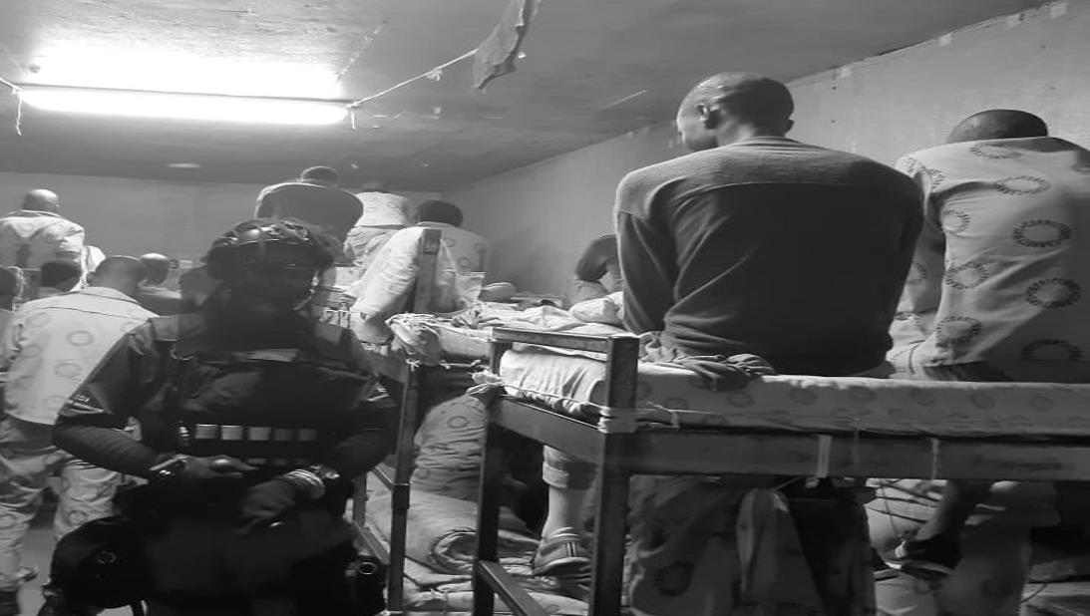
THANK YOU
QUESTIONS

