Slide 1
Provincial Treasury
Briefing to The Public Accounts Committee
Briefing by the Department of the Premier, as well as Provincial Treasury, on the status of the implementation of the Integrated Financial Management System (IFMS) piloting in the Western Cape
04 May 2022

Slide 2
Summary
Presentation focuses on the following requests from SCOPA:
3.1 To brief Western Cape Provincial Parliament Standing Committee on Public Accounts on the Integrated Financial Management System (IFMS) piloting in the Western Cape

Slide 3
Background
The IFMS program is a joint initiative between National Treasury (“NT”), Department of Public Service and Administration (“DPSA”) and the State Information Technology Agency (“SITA”) to modernize the management and execution of “back-office” processes in the Public Service (excluding Public Entities, Local Government and Intelligence Agencies)
National Cabinet first approved the development of the IFMS on 14 September 2005. Given the challenges experienced in implementing this project, National Cabinet endorsed an amendment to the project scope, implementation time line and budget of the project on 18 November 2013.
The National Treasury has concluded the contract to purchase software licenses for the Integrated Financial Management System (IFMS) programme with Oracle Corporation (South Africa) (Pty) Ltd (“Oracle”)
National Treasury has since issued a number of Treasury Practice notes (i.e. No. 7 of 2006 and No. 5 of 2017/18) which effectively communicate a moratorium placed on government departments in acquiring any ERP solution (i.e. system, software and software as a service) that might result in a duplication of functionality to the IFMS modules covering the domains mentioned above
NT approached the WCG with the intention of offering an opportunity for the province to participate in the programme as lead-site. Cabinet approved this in principle in and requested clarity on the roles and responsibilities and the funding of IFMS. Since then IFMS implementation programme changed continuously

Slide 4
Objectives of IFMS

Slide 5
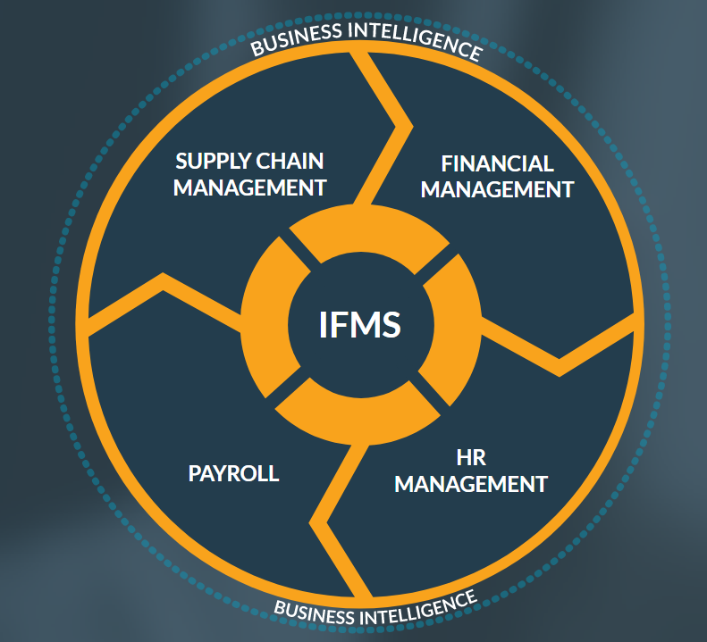
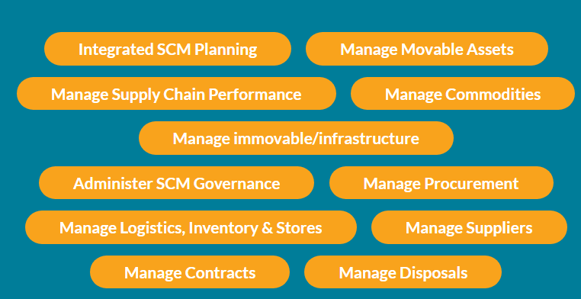
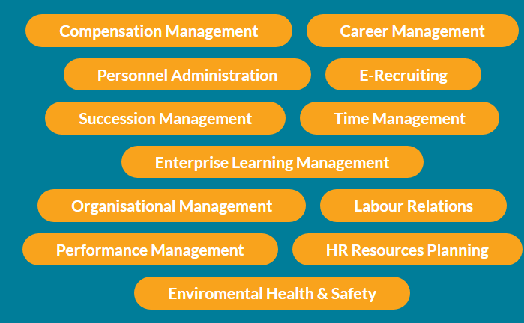
What is contained in the IFMS??

Slide 6
Pilot plans for WCG
At this point there are no pilot initiatives on the IFMS with WCG.
The only pilot was the IFMS 1 for SAP implementation on the HR systems which failed.
The National Treasury has approached WCG to assist with technical resources to support their e-Recruitment pilot at National Treasury and DPSA.
WCG are currently in a process of reviewing the memorandum of understanding in respect of the technical resources to support the National Treasury with their pilot.

Slide 7
Project Plan for IFMS
The project plans by National Treasury have been fluctuating and a number of delays have continued to plague the roll out of the IFMS:

Slide 8
Improvement of Legacy systems in absence of IFMS
Projects on the go
Opportunities
In light of the COVID pandemic, the aging Legacy Computer Systems (BAS, LOGIS, PERSAL) urgently require a revamp or modernisation to enable access to credible information, quickly.
“New Norm” demands more collaboration and secure digital platforms to transact on financial systems.
COVID-19 has shown clearly that data driven/led decision making is critical and opportunities presented by 4TH industrial revolution digital revolution & technological innovation will feature highly in the “New Norm”.
We have a focus geared towards Evergreen Legacy System (i.e. Continue to Innovate and improve current legacy systems) in order to respond to the New Norm caused by the disruption of COVID-19.
The Evergreen Legacy System project has strong linkages to the Vision Inspired Priorities number five (VIP 5), Innovation and Culture, as well as the Digital Transformation strategy driven by the Centre for e-Innovation.
Dashboarding of systems information as part of Data enablement on all key sources systems (BAS, LOGIS, PERSAL)
E-leave systems to support digital transformation in HCM.
General e-Administration on financial systems ( AFS, e-recruitment, etc.)
Integration of financial systems and standardisation.
Data cleansing activities on the financial systems with a particular focus on Master data management to enable seamless transition to IFMS.

Slide 9
A Mazomba

