Slide 1
PORTFOLIO COMMITTEE ON AGRICULTURE, LAND REFORM AND RURAL DEVELOPMENT AGRICULTURAL PRODUCE AGENTS AMENDMENT BILL [B 6 – 2020]
PRESENTATION BY ADOLF KIEVIET

Slide 2
TABLE OF CONTENTS
ITEM PAGE
Freshworld background
Marketing and Selling p3
Market Distribution p4
Support Functions p5-6
Role of an Exporter p7-8
Market Access that will be curtailed due to Proposed Bill p9
Additional Costs that will be incurred due to Proposed Bill p10
Additional Administrative Burden that the Proposed Bill will bring p11
Recommendations p12

Slide 3
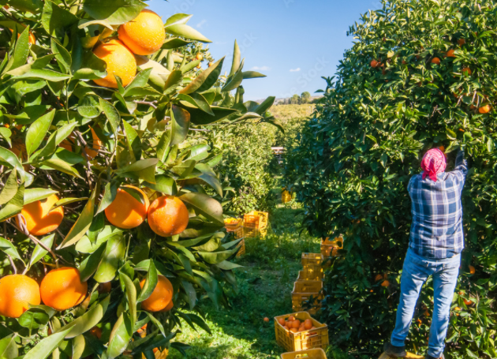
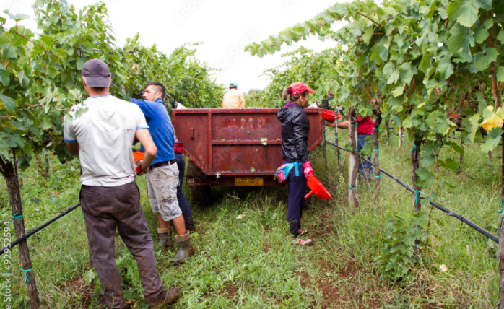
MARKETING AND SELLING (1a)
Freshworld have exported and sold fruit internationally for over 21 years.
Our fruit sales team have a combined experience of 234 years in selling and marketing fruit for export.
We sell 29 types of Fresh Produce into 49 different countries across the globe.
An endless drive to maximize grower returns by our ‘Farmer First’ philosophy. We really have the success of the producer at heart.

Slide 4
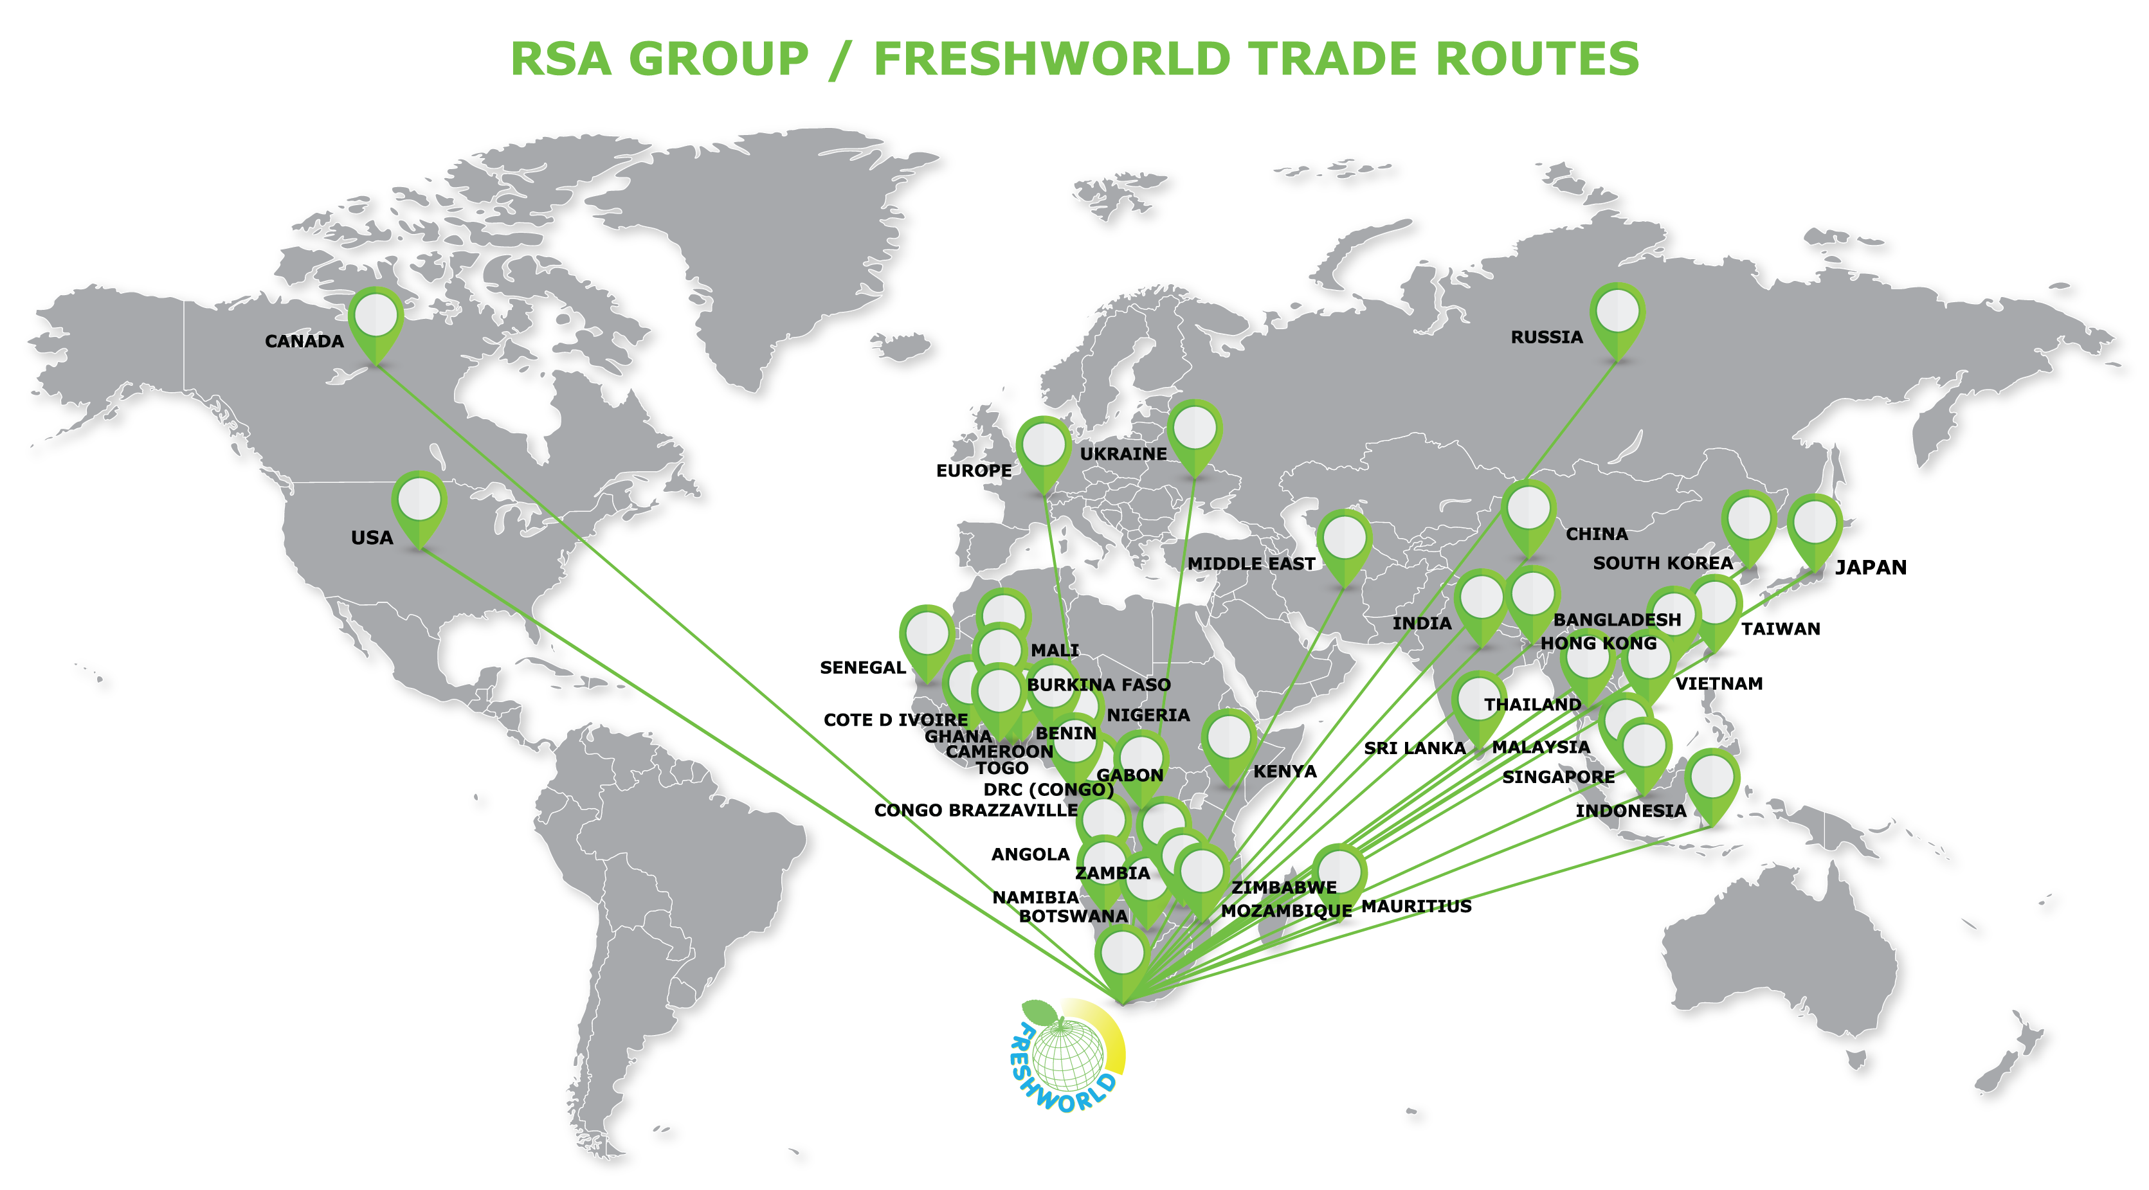

Slide 5
FRESHWORLD SERVICES
TECHNICAL
Provide up to date packing guide with marking requirements and allowable chemical residues for different markets.
Feedback on quality through the season.
Dedicated area representatives
Advice on cultivar selection
TECHNICAL

Slide 6
FRESHWORLD SERVICES (cntd)
TECHNOLOGY AND SYSTEMS
Logistics system for smooth information flow between packhouse and cold stores as well as weekly exported information back to the grower. Full traceability.
Weekly reporting and reconciliation of all payments.
TREASURY System that accommodate all payments. We are Financial services board accredited (FSB).

Slide 7
ROLE OF AN EXPORTER
Increasing
conflicts
Technological development
Global
information
exchange
Consumer
Production
Buyer
Climate
and
environmental
change
Export is complex and dynamic
Logistics
Sales
Social
and
political
development
Compliance
Social responsibility
Marketing
Incoterm
Differentiation
of
customer needs
Disruption of the
value chain
INTERCONNECTEDNESS

Slide 8
LINKING PRODUCER AND CONSUMER
LINKING PRODUCER AND CONSUMER
Marketing info
C
O
N
S
U
M
E
R
P
R
O
D
U
C
T
Farmgate Price
Consignment
Fixed Price
MGP
Other
P
R
O
D
U
C
E
R
Payment Terms
Transaction Type
(EXW, FOB, CIF)
Type of Customer
(Retail, Wholesale, import agent)
Transit time
Compliance
C
U
S
T
O
M
E
R
EXPORTER
Price discovery

Slide 9
Administrative Burden of Proposed Bill
Additional Audit Requirements – Not required by the Companies Act
Additional Trust Accounts – Per grower, per foreign currency
Additional Requirements on registering of Directors (background checks, police clearance etc.). This may prohibit Non-Executive directors to participate in the Fresh Produce Export industry.
Additional costly examinations per company

Slide 10
Loss of Market Access due to the Proposed Bill
Requirements of Credit Insurance will exclude our company of supplying fruit into any African country, Russia, the Ukraine, India and Bangladesh (close to 30% of our business). Credit Insurance is not available OR expensive for shipments to these countries. This will affect ALL producers.
Requirements of Marine Insurance will add additional transaction cost of at least 1%. This will make us as a country less competitive in the Global Market. Here we already compete with countries that have Free Trade Agreements in place.

Slide 11
Additional Disadvantages to Exporters due to the Proposed Bill
The Bill doesn’t differentiate between Exporters, and Producers that export themselves. This implies that the Exporter will incur additional costs to comply and that Producer Exporters will be exempt from the legislation. This will not level the playing field.
The proposed Fidelity fund contribution will place another burden on exporters. Currently, South African exports are not subsidised by government. In fact, most of the trade shows and export related marketing activities are self-funded by voluntary organisations like the FPEF.

Slide 12
Recommendations
Revise the Bill / Draft a new Bill to specifically make provision for Fresh Produce Exports that operate in a very complex environment. The original bill is based on legislation from 1992. This pre-empts the deregulation of the Fresh Produce Export sector in 1996.
Review the current definition of Agent as the current definition is NOT representative of the Fresh Produce Export environment.
Rely on current structures already in place (FPEF, FruitSA etc.) to self-regulate and provide guidance to government on matters relating to Export of Fresh Produce.

