Slide 1
2020-2025
Strategic Plan and
2022/23 APP

Slide 2
Content
Introduction
Overview of Programmes
CPSI Structure
Five-year Strategy (2020-2025)
Progress in relation to the 5-year outcome indicators
COVID-19 Impact on the Mandate
2022/23 Annual Performance Plan
Budget (Including Compensation of Employees)

Slide 3
Introduction
The Mandate of the CPSI derives from the Public Service Act locating the responsibility for public service innovation in the Minister. This mandate is further expanded on in Government Notice 700 of 2 September 2011.
VISION: A solution-focused Public Sector through innovation
MISSION: To entrench an innovative culture and practice in the Public Sector

Slide 4
Overview of Programmes (New Budget Structure)
  PROGRAMME 1: ADMINISTRATION
Programme Purpose: Provide strategic leadership, overall management of and support to the organisation.
Within Administration, there are three sub-programmes:
  Executive Support oversees the overall management of the CPSI and manages and facilitates the provision of internal audit and organisational risk and integrity management services and legal services.
  Corporate Services manages and monitors the provision of corporate resource management services, ICT management services, security management services, office support, and auxiliary services.
  Office of the Chief Financial Officer ensures compliance with all relevant financial management statutes and regulations, notably the Public Finance Management Act (PFMA), and oversee the effective financial and supply chain management of the organisation and co-ordinate implementation, monitoring and reporting on the organisation’s overall performance.

Slide 5
Overview of Programmes (New Budget Structure)
  PROGRAMME 2: PUBLIC SECTOR INNOVATION
Programme Purpose: Drives service delivery innovation in the public sector in line with government priorities.
Within Public Sector Innovation Programme, there are three sub-programmes:
Research and Development establishes the knowledge base in support of the programme to inform the selection and development of potential innovative models and solutions.
Institutional Support and Replication Facilitates the testing, piloting, institutional support, demonstration, replication and mainstreaming of innovative solutions for the public sector to improve service delivery.
Enabling Environmental and Stakeholder Management nurtures and sustains an enabling innovative environment, entrenches a culture and practices of Innovation in the public sector through innovative platforms and products, and develops and maintains partnerships and stakeholder relations to enhance collaboration.

Slide 6
CPSI Structure
The organisational structure has 30 posts on its fixed establishment, with two interns.
2 Vacancies: Executive Director currently filled by an Acting incumbent (post advertised)
HR Officer in final stages of appointment (interviews conducted).
MPSA
Executive Director (Accounting Officer)
Programme 1: Administration
Programme 2: Public Sector Innovation
Office of the CFO
(1-D)
Executive Support (2)
Finance (3)
SCM (2)
Corporate Services (8)
Research and Development (4)
Institutional Support and Replication (3)
Enabling Environment and Stakeholder Management (4)
Internal Audit / Legal Services (DPSA) (2 x interns)
Deputy
Minister
CIO (1)
DD, 2 x Clerk
DD, Clerk
DD, PA, Reception-ist
DD, Officer, Clerk, 2 x Cleaning, 3 x Security
DD
CD, 2 x DD, Admin
CD, D, Admin
CD, 2x DD, Admin

Slide 7
FIVE-YEAR STRATEGY (2020-2025)
INSTITUTIONAL IMPACT, OUTCOMES AND OUTPUTS ON THE STRATEGIC PLAN
Impact Statement: Improved effectiveness and efficiency of the public service and its service delivery to the public through innovation.
OUTCOMES
Effective Corporate Governance: The achievement of this outcome will ensure, amongst others, accountability for the efficient, effective, and economic use of allocated resources towards fulfilling the mandate of the organisation.
Innovative Culture and Practice in the Public Sector entrenched: This outcome contributes directly to the achievement of the mandate of the CPSI and the implementation of the NDP. It is also a cross-cutting outcome that positively impacts on the seven priorities of government as identified by the Sixth Administration.

Slide 8
FIVE-YEAR STRATEGY (2020-2025)
The following schematic depicts the CPSI value chain and how this is institutionalised in the organisations two programmes, Administration and Public Sector Innovation.
VISION
A solution focused Public Sector through innovation
IMPACT
(MISSION)
MISSION
To entrench an innovative culture and practice in the Public Sector
Innovative culture and practice in the Public Sector entrenched
Effective corporate governance
OUTCOMES
Innovation research and development initiatives undertaken
Knowledge platforms sustained to nurture an enabling environment for innovation in the Public Sector
Innovative solutions replicated in the Public Sector
Unqualified audit opinion on financial and non-financial information
OUTPUTS
Conduct innovation research
Facilitate solution development
Sustain knowledge sharing platforms
Ensure unearthing and recognition for innovation
Facilitate replication and mainstreaming of innovative solutions
Provide Institutional support
Provide integrated corporate governance
ACTIVITIES
INPUTS
HUMAN RESOURCES, FUNDS, TECHNOLOGY, INFORMATION, ASSETS
VALUES
Innovative Committed Need driven
Ethical Collaborative

Slide 9
FIVE-YEAR STRATEGY (2020-2025)
Outcome | Outcome Indicator | MTSF Priority 1 | Baseline | Five-year target
Effective Corporate Governance | Number of unqualified audit opinions | A Capable, Ethical and Developmental State | 1 p/a | 5
Innovative culture and practice in the Public Sector entrenched | Number of innovation initiatives enabled |  | 15 p/a | 75

Slide 10
3. PROGRESS IN RELATION TO THE 5 YEAR OUTCOME INDICATORS
Administration
The CPSI has achieved its 5th Clean Audit Outcome for the 2020/2021 Financial Year from the Auditor General for the 4th year in a row.
17 Innovation initiatives have been enabled: These include
6 Innovation research and development initiatives undertaken
  Public Sector Innovation Rapid Assessment
  In-depth Case Study Report (four case studies)
  Support towards the establishment of the Anton Lembede MST Academy (School of Innovation)
  Digital skills development and support of youth developers through Hackathons
  Department of Home Affairs Real-time Service Delivery Monitoring

Slide 11
3. PROGRESS IN RELATION TO THE 5 YEAR OUTCOME INDICATORS
20 Knowledge Platforms sustained (2020/21 and 2021/22)
Annual Public Sector Innovation Conference and Webinars
  Annual Public Sector Innovation Awards Programme
  Publication of Ideas that Work: A South African Innovation Journal
  Innovation and Design Thinking Workshops
  International Public Sector Innovation Programmes
3 Innovative solution replicated in the public sector
  E-Learning Solution replicated in Gauteng (2020/21)
  Inhouse digital solutions (2020/21)
  Vulamanzi low cost Water Filtration System replicated in Tshwane Municipality (2021/22)
  E-learning solution replicated North West, Eastern Cape and Free State provinces (2021/23)

Slide 12
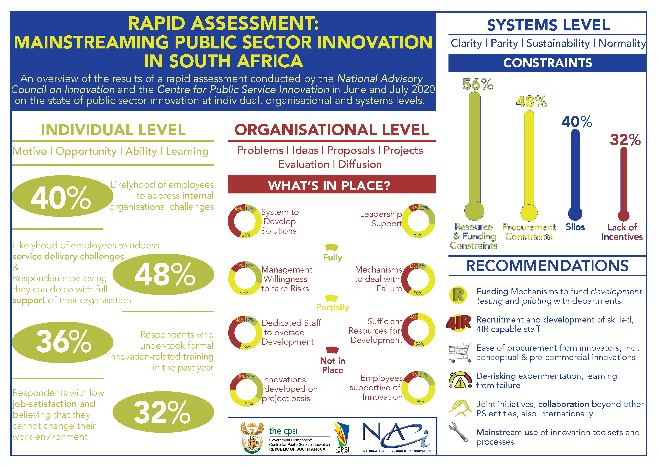
4.HIGHLIGHTS
Innovation Research and
Development Initiatives Undertaken
Public Sector Innovation Rapid Assessment in collaboration with NACI (2020/21)
  Considered determinants of Innovation:
  Individual (motive, opportunity, ability),
  Organisational (projects, programmes, learning)
  Systems (enabling mechanisms, constraints)
Comprehensive review and benchmarking of CPSI (2021/22)

Slide 13

4.HIGHLIGHTS
Innovation Research and Development Initiatives Undertaken (cont.)
In-depth Case Study Report (2020/21)
The CPSI produced a report featuring four in-depth case studies of innovation projects that were developed and piloted with the CPSI, including the MEMEZA community alarm initiative, its replication in the education sector to safeguard ICT equipment, the establishment of the Bertha Gxowa Hospital-based Innovation Hub, and the Inland Waterways Safety Project.
SA-EU Dialogue Series on Open Digital Governance (2021-22)
Collaborative initiative between CPS, DPSA, Wits and the Danish Agency for Digitisation
Three academic papers on the status of digital transformation and governance in South Africa, Denmark and other International good practices

Slide 14
4.HIGHLIGHTS
Other initiatives
The CPSI further compiled a compendium of COVID-19-related innovations, thus showcasing local and global COVID-inspired innovations. (2020/21)
Support the Eastern Cape on improving planning processes through Foresight to build better agility and resilience. This work is contributing towards their review of the Annual Performance Plans and Strategic Plans of departments. (2020/21)

Slide 15
4.HIGHLIGHTS
Development Initiatives
In-house electronic solutions developed (2020/21)
In-house solutions were developed in response to the COVID-19 Pandemic. These include the online COVID-19 screening form, bid evaluation and adjudication process flows for online committee meetings.
Northern Cape Online Thusong Centre (2021-23)
The CPSI initiated a new multi-year development project with the Northern Cape Office of the Premier to develop a virtual Thusong Centre and a service monitoring system. The project is now entering the proto-typing stage. A design thinking workshop was held in March 2022 to refine the design of the solution.
Gauteng EMS Patient Transport eHailing (2021-23)
A second multi-year project was also initiated in support of Gauteng Emergency Medical Services to improve the efficiency of their planned patient transfer through the use of mobile technology. This analytical and user specification phase of this project has also been concluded and co-design commenced.

Slide 16

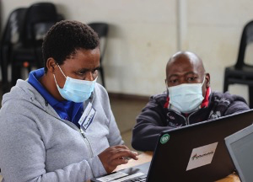
4.HIGHLIGHTS
Engagements with youth developers
The CPSI continues to partner with youth organisations to promote the participation of youth in the development of service delivery innovations. The CPSI plays a mentoring role during hackathons and other engagements with youth that are developing solutions for the public sector.
This year the CPSI also hosted #PSIHack22 as part of a programme of dedicated support to developers of public sector solutions and co-hosted the Youth ICT and Business VacWork Programme in Siyabuswa, Johannesburg and Mthatha
Over the past two years, the CPSI provided mentorship during the following initiatives:
  The Department of Communications and Digital Technologies, AlgoAtWork Robotics and National ICT Youth Council's two-day Makerthon at the RBIDZ Techno Hub in Richards Bay.
  Aquatech Hackathon of the Eastern Cape Office of the
  Premier.
  MTN App of the Year AppAcademy
  Geekulcha Student Society Challenge
  TadHack South Africa

Slide 17
4.HIGHLIGHTS
Innovative Solutions replicated in the Public Sector
E-Learning Solution-2020-2021
The CPSI facilitated the replication of this solution in two Gauteng province schools namely Katlehong and Reiger Park High Schools. The former Deputy Minister for the Public Service and Administration handed over the replication of the e-Learning Solution to the two schools and Gauteng Dept of Education in March 2021.
  The SchoolLMS solution introduces cost-saving to ICT in Education through Innovative integration of tools, content, and users by making learning and teaching materials available for learners electronically and online. The solution is an integration platform for the distribution of eBooks and interactive content as well as functionality that facilitates the submission of digital handwritten lessons and assessments – homework, classwork, assignments, tests, and exams.

Slide 18
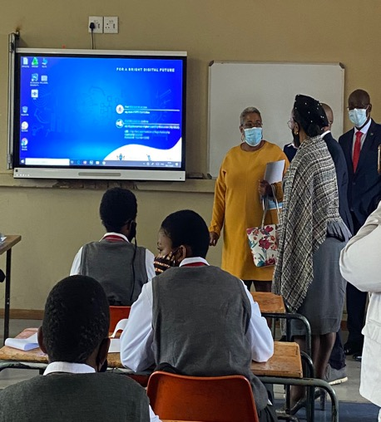
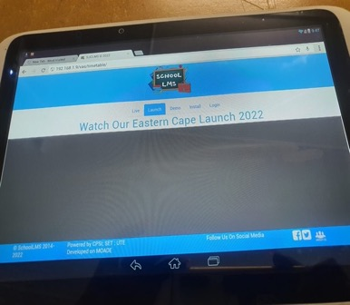
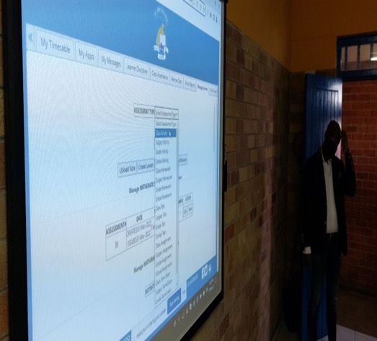
4.HIGHLIGHTS
E-Learning Solution 2021-2022
Replicated in St John's College and Umthatha High School in E C ( O R Tambo DDM Pilot Site) and North West and Free State schools will follow

Slide 19
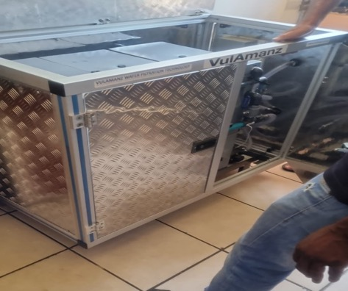
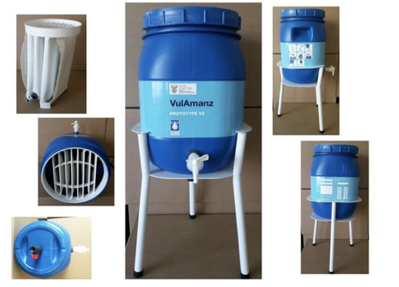
4.HIGHLIGHTS
Vulamanzi Water Filtering System 2021/22
Vulamanzi Water Filtering solutions was replicated in Odirile Centre Hammanskraal a residential care centre catering for persons with profound intellectual disabilities age 2 to 55 yrs. The area has water challenges, most of the time the water is brown and not good for consumption. This has an impact on the facility as they have to depend on the municipal trucks for water whenever they come. The Vulamazi Water Purification System is a point-of-use membrane technology that provides safe drinking water and .is produced in South Africa It removes suspended material, colloids, and water-borne pathogens to give safe drinking water from raw water that is contaminated with biological pathogens.

Slide 20
COVID19 Impact on the Mandate
CPSI's mandate is to drive and entrench innovation in the public sector, thus COVID19 impact is as follows:
  The achievement of targets that require on-site work at service delivery points may be affected, for instance the replication programme and development of solutions that require visits to service delivery points to monitor implementation.
  Verification of innovation projects as part of the Public Sector Innovation Awards Programme may also be affected and may negatively affect the quality of innovation projects.
  Change of mode of presentation and engagement in our innovation knowledge platforms

Slide 21
2022/23 ANNUAL PERFORMANCE PLAN

Slide 22
Outcomes, outputs, performance indicators, and targets
Outcome | Outcome Indicators | Outputs | Output Indicators | Annual Targets
 |  |  |  | MTEF Period
 |  |  |  | 2022/23 | 2023/24 | 2024/25
Effective corporate governance | Number of unqualified audit opinions | Unqualified audit opinion on financial and non-financial information | Type of audit opinion on financial and non-financial information | Unqualified audit opinion on financial and non-financial information for the 2021/22 financial year | Unqualified audit opinion on financial and non-financial information for the 2022/23 financial year | Unqualified audit opinion on financial and non-financial information for the 2023/24 financial year
Innovative culture and practice in the public sector entrenched | Number of Innovation initiatives enabled | Innovation research and development initiatives undertaken | Number of innovation research and development initiatives undertaken | 4 | 4 | 4

Slide 23
Outcomes, outputs, performance indicators, and targets
Outcome | Outcome Indicators | Outputs | Output Indicators | Annual Targets
 |  |  |  | MTEF Period
 |  |  |  | 2022/23 | 2023/24 | 2024/25
Innovative culture and practice in the public sector entrenched | Number of Innovation initiatives enabled | Knowledge platforms sustained to nurture an enabling environment for innovation in the public sector | Number of knowledge platforms sustained to nurture an enabling environment for innovation in the public sector | 9 | 9 | 9
 | Number of Innovation initiatives enabled | Innovative solutions replicated in the public sector | Number of innovative solutions replicated in the public sector | 2 | 2 | 2

Slide 24
2022/23 Quarterly Targets
Output Indicators | Annual Target | Q1 | Q2 | Q3 | Q4
Type of audit opinion on financial and non-financial information | Unqualified audit opinion on financial and non-financial information for 2019/20 financial year | - | Unqualified audit opinion on financial and non-financial information for 2019/20 financial year | - | -
Number innovation research and development initiatives undertaken​ | 4​ | -​ | -​ | -​ | 4​
Number of Knowledge platforms sustained to nurture an enabling environment for innovation in the public sector | 9 | 1 | 3 | 2 | 3
Number of innovative solutions replicated in the public sector | 2 | - | - | - | 2

Slide 25
MTEF Budget
The CPSI’s budget is located within the budget appropriation of the DPSA. The new budget structure is according to the organisational structure.
Programmes | 2022/23 | 2023/24 | 2024/25
 | R'000 | R'000 | R'000
Executive Support | 4 890 | 5 105 | 5 339
Corporate Services | 13 949 | 11 897 | 12 179
OCFO | 6 830 | 7 127 | 7 421
Administration | 25 669 | 24 129 | 24 939
RD | 6 548 | 6 783 | 6 945
Institutional Support and Replication | 4 806 | 5 356 | 5 444
Enabling Environment and Stakeholder Management | 7 499 | 9 095 | 10 072
Public Sector Innovation | 18 853 | 21 234 | 22 461
Total | 44 522 | 45 363 | 47 400
Economic Classification
Compensation of Employees | 24 554 | 24 869 | 25 985
Goods and Services | 19 872 | 20 393 | 21 309
Payment for Financial Assets | - | -
Transfers and Subsidies | 1 | 1 | 1
Payment for Capital Assets | 95 | 100 | 105
Total | 44 522 | 45 363 | 47 400

Slide 26
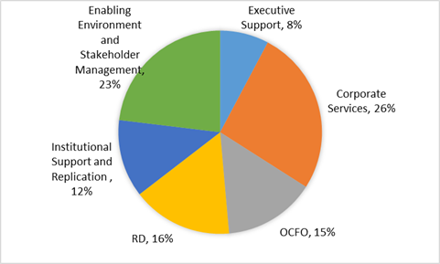
MTEF Budget (% allocation per Programme)

Slide 27
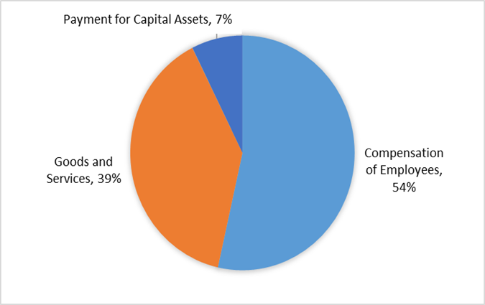
MTEF Budget (% allocation per Economic Classification)

Slide 28
THANK YOU!

