Slide 1
PowerPoint Title 1
Annual Performance Plan for the 2022/23 Financial Year

Slide 2
PRESENTERS
Ms. Palesa Legoze – ZADNA Board Chairperson
Mr. Nicholas Msibi – ZADNA ARC Chairperson
Mr. Molehe Wesi – ZADNA CEO
Ms. Kedibone Mpholeng – ZADNA Finance Manager
Mr. Peter Madavhu- ZADNA Operations Manager

Slide 3
Presentation Overview
01
05
Overview of ZADNA
ZADNA Strategic Outcomes
02
Legislated Mandate
06
Strategic Outcome 1 to 5
03
07
Strategic Overview
2022-23 Budget
04
08
ZADNA Strategic Outcomes
Conclusion and Way Forward

Slide 4
01
Overview of ZADNA
The .za Domain Name Authority (ZADNA) is statutory regulator and manager of .ZA Namespace
^{PRT}1
^{PRT}2
The Authority must enhance public awareness on the economic and commercial benefits of domain name registration.
Comply with international best practice in the administration of the .ZA domain name space; license and regulate registries and registrars and publish guidelines on .ZA domain namespace.
^{PRT}3
ZADNA is the custodian of the Internet Governance in South Africa.
^{PRT}4

Slide 5
02
Legislated Mandate
ZADNA is a statutory, not-for-profit entity established in terms of Chapter X of the ECT Act 25 of 2002 to administer, manage and regulate the .ZA namespace. The mandate can be summed up as follows:
Management and administration of the .ZA namespace;
.ZA policy, licensing and regulation;
Monitoring and compliance;
Domain name awareness and education;
Research and development; and
Making relevant policy recommendations to the Minister.
Alternate Dispute Resolution Regulations
Additional non-ECT Act Responsibilities
dotCities
Internet Governance

Slide 6
03
Strategic Overview
VISION – A world-class domain name regulator
OUR VALUES
OUR MISISON
Transparency - ZADNA maintains active consultations with interested and affected parties in carrying out its mandate, in developing policies for .ZA.
Accountability - ZADNA takes responsibility for its decisions and is able to objectively and fairly justifying its actions.
Inclusivity - ZADNA ensures that its stakeholders can participate actively in its policy and regulatory processes and that none should feel constrained from making a meaningful contribution in such processes.
Integrity - We act with integrity in all we do (doing what’s right).
To implement an effective domain name regulatory and management framework that positions .ZA to be accessible, stable, secure, growing and competitive in serving South Africans and then the global Internet community.

Slide 7
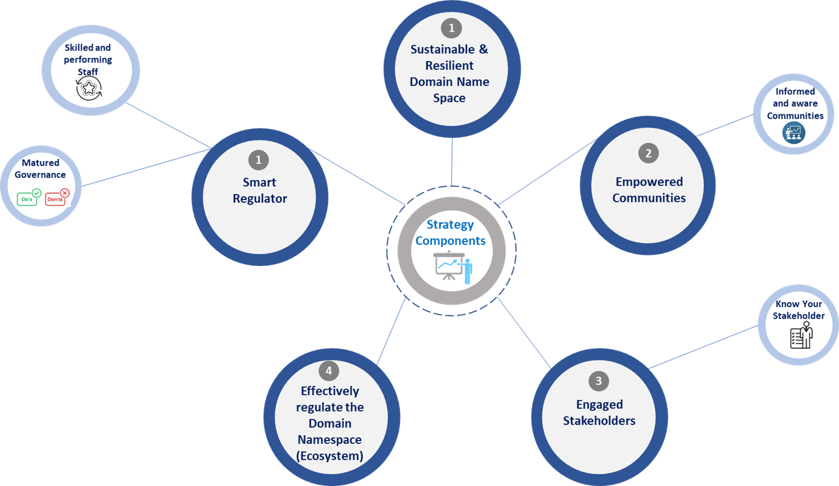
03
Strategic Overview

Slide 8
2021-2022 Performance Summary

Slide 9
04
ZADNA Strategic Outcomes
Impact statement
To contribute to an economically prosperous and empowered communities by enabling a regulated, secure and vibrant ZA domain name space.
Outcomes | Outcome indicator | Baseline | Five-year target
Sustainable and resilient domain namespace | Number of domain names registered | 1.24 million domain names registered | 125 000 domain name registered
 | Increased net growth rate | New Indicator | Addition 1% increase (62 500 domain names)
Empowered Communities | Number of awareness events conducted | 12 awareness campaigns conducted in 2019/20 financial year | 60 awareness campaigns conducted
 | Number of Registrar reseller training conducted | 12 registrar reseller training conducted in 2019/20 financial year | 60 registrar reseller training conducted
 | Number of media coverage achieved | 16 media coverage in 2019/20 financial year | 72 media coverage
 | Number of strategic partnerships agreements signed | 4 strategic partnership agreement | 15 strategic partnership agreement signed
 | Number of research or Benchmark studies conducted | 3 Research studies | 20 Research and Benchmark Studies conducted
 | Number of public schools with a domain name | New Indicator | 2300 of Quintile 1 and 2 Public Schools nation-wide

Slide 10
04
ZADNA Strategic Outcomes
Impact statement
To contribute to an economically prosperous and empowered communities by enabling a regulated, secure and vibrant ZA domain name space.
Outcomes | Outcome indicator | Baseline | Five-year target
Engaged Stakeholders | Number of stakeholder engagement conducted | 9 stakeholder engagement | 60 stakeholder engagement conducted
 | Unique Value Proposition (UVP) by Client Type and by Industry defined | New Indicator | Up to date Stakeholder segmentation and defined needs
Effectively regulate the Domain Namespace (Ecosystem) | Approved and promulgated Registrar and Registry Licensing Regulations | None | Implemented and operational Registry & Registrar Licensing Regulations
 | Percentage of compliant Registries, Operators, Administrators, Registrars and Registrants | None | 80 % Compliance of Registries, Operators, Administrators and Registrars with ZADNA approved policies and regulations.
 | Skilled technical stakeholders | None | Conduct four annual Domain Name Technical Training for Registrars

Slide 11
04
ZADNA Strategic Outcomes
Impact statement
To contribute to an economically prosperous and empowered communities by enabling a regulated, secure and vibrant ZA domain name space.
Outcomes | Outcome indicator | Baseline | Five-year target
Become a Smart Regulator | Percentage of audit findings resolved within prescribed timelines | 80% of audit findings resolved within prescribed timelines | 80% of Audit findings resolved
 |  | 35 Audit findings | Reduce findings by 20%
 |  | 5 repeat findings | <20% of reported findings to be repeat findings
 | Increased Staff satisfaction index percentile | None | Staff satisfaction (incorporating manager effectiveness) index >80%
 | Defined and codified the internal business process | None | Documented and accessible Standard Operating Procedures.

Slide 12
05
2021/22 Performance
Outcomes | Outcome indicator | 2020/21 Achievement
Sustainable and resilient domain namespace | Number of domain names registered | Not achieved
 | Increased net growth rate | Not achieved
Empowered Communities | Number of awareness events conducted | Achieved
 | Number of Registrar reseller training conducted | Achieved
 | Number of media coverage achieved | Achieved
 | Number of strategic partnerships agreements signed | Achieved
 | Number of research or Benchmark studies conducted | Achieved
 | Number of public schools with a domain name | Achieved
Engaged Stakeholders | Number of stakeholder engagement conducted | Achieved
 | Unique Value Proposition (UVP) by Client Type and by Industry defined | Achieved
Effectively regulate the Domain Namespace (Ecosystem) | Approved and promulgated Registrar and Registry Licensing Regulations | Not achieved
Become a Smart Regulator | Percentage of audit findings resolved within prescribed timelines | Achieved
 | Increased Staff satisfaction index percentile | Achieved
 | Defined and codified the internal business process | Achieved

Slide 13
Annual Performance Targets for 2022-2023

Slide 14
06
Strategic Outcome 1
Outcomes | Output indicators | 2022/23 Annual Target
Sustainable and resilient domain namespace | Number of domain names registered | 20 000 domain names registered
 | Increased net growth rate | 1% increase in net growth

Slide 15
06
Strategic Outcome 2
Outcome | Output indicators | 2022/23 Annual Target
Empowered Communities | Number of awareness events conducted | 15 awareness events conducted
 | Number of registrar reseller training conducted | 15 registrar reseller training conducted
 | Number of media Coverages achieved | 17 media coverage achieved
 | Number of strategic partnership agreements signed | 3 strategic partnership agreement signed
 | Number of research and Benchmark studies conducted | 3 Research and 1 Benchmark studies conducted
 | Number of public schools with a domain name | 734 Public Schools domain names registered

Slide 16
06
Strategic Outcome 3
Outcome | Output indicators | 2022/23 Annual Target
Engaged Stakeholders | Number of stakeholder engagement conducted | 16 Internet Governance engagements conducted
 | Unique Value Proposition (UVP) by Client Type and by Industry defined | Reviewed and approved stakeholder analysis and market segmentation

Slide 17
06
Strategic Outcome 4
Outcome | Output indicators | 2022/23 Annual Target
Effectively regulate the Domain Namespace (Ecosystem) | A baseline compliance rate determined | A baseline compliance rate for Registries, Operators, Administrators and Registrars determined
 | Skilled technical stakeholders | One (1) advance technical training for the South African DNS industry conducted.

Slide 18
06
Strategic Outcome 5
Outcome | Output indicators | 2022/23 Annual Target
Become a Smart Regulator | % of audit findings resolved within prescribed timelines | 80% audit findings resolved
 | Defined and codified the internal business process | Documented internal processes (HR, Fin and Ops) with 50% of the documented processes digitised
 | Reduction of repeat findings | Reported repeat audit findings maintained at 20%
 | Increased Staff Satisfaction index | Maintain Staff turnover rate below 20%

Slide 19
2022/23 Financials

Slide 20
07
2022-23 Budget
2022/2023
Budget item | Description | Description |  | 2022/2023 @R15 Proposed Budget (Rands)
INCOME |  |  |  | 21 816 200
 | Revenue: ZACR | Revenue: ZACR |  | 20 475 000
Other Income
 | Interest Income | Interest Income |  | 1 341 200
EXPENDITURE |  |  |  | 21 746 947
Basic office costs |  |  |  | 1 819 102
Stakeholders Engagement |  |  |  | 1 310 000
Vehicle |  |  |  | 40 000
ICT |  |  |  | 991 732
Legal Expenses |  |  |  | 500 000
Meetings & events |  |  |  | 2 013 536
Namespace Development |  |  |  | 2 000 000
Professional Fees |  |  |  | 1 611 400
Employee cost |  |  |  | 10 414 177
Training & Development |  |  |  | 612 000
Systems & controls |  |  |  | 185 000
Travel, accommodation & subsistence other |  |  |  | 250 000
"Surplus for the year" |  |  |  | 69 253
CAPEX
Allocation | Allocation from reserves. |  |  | 1 900 000
 |  |  |  | -

Slide 21
02
Conclusion
In 2022 ZADNA will finalised the Registry-Registrar Licencing framework, conducting public participation.
Member driven engagements.
Thought leadership through Research Chairs.
Industry qualification for the DNS space
Enable and become a pivotal participant in the digitisation of the informal economy

Slide 22
Thank you – Questions and Discussion

