Slide 1
Education
Meeting with Basic Education Portfolio Committee
Petition: Closure of Seekoegat Primary School - 2021
Tuesday, 3 May 2022

Slide 2
Vision
Vision
Quality Education
for every child
in every classroom
in every school in the province.
Caring
Competence
Accountability
Integrity
Innovation
Responsiveness

Slide 3
Content
  Conditions for an administrative decision
  Legislation guiding school closure and/or mergers
  Conditions for school closure
  Minister’s intention to close school
  Reasons for closing the school
  National Position on small unviable schools
  Public Consultation Process
  Minister’s decision to close the school
  Management of assets and resources
  Meeting between Honourable MP Marie Sukers and the Head of Department
  Letter from Honourable MP M Sukers
  Response from HOD Walters to Honourable MP Sukers
  Process of registering an independent school

Slide 4
What are the Conditions for an administrative action

Slide 5
What are the Conditions for an administrative action?
  The Western Cape Education Department (WCED) considers the closure and/or merger of schools under its auspices to be an administrative action, based on the definition of “administrative action” as enshrined in the Promotion of Administrative Justice Act, 2000 (PAJA)
  Based on the point 1, the WCED is acutely aware that such decisions must be made under an empowering provision, i.e., the decision must be lawful
  It also means that the WCED, as a juristic person, is aware that any administrative action taken, that affects a person, must be procedurally fair

Slide 6
What are the Conditions for an administrative action?
By operation of the law, as stated in PAJA, under section 3(2)(b)(1), the WCED understands what procedurally fair means:
Adequate notice of the nature and purpose of the proposed administrative action must be given
A reasonable opportunity must be given to make representations
A clear statement of the administrative action must be given
Adequate notice of any right of review or internal appeal, where applicable
Adequate notice of the right to request reasons

Slide 7
  Legislation guiding school closure and/or mergers

Slide 8
  Legislation guiding school closure and/or mergers
Any decision or administrative action must have an enabling and/or empowering provision, i.e. it must be lawful:
Section 12A (1) of the South African Schools Act 84 of 1996 (SASA) states that the Member of the Executive Council may, by notice in the Provincial Gazette, merge two or more public schools into a single school
Section 33 (1) of SASA states that the Member of the Executive Council may, by notice in the Provincial Gazette, close a public school

Slide 9
Conditions/Process for school closure

Slide 10
Conditions/Process for school closure
  SASA section 33 (2) states that: “The Member of the Executive Council may not close a school unless he/she has –
  Informed the SGB of his/her intention so to act and the reasons for such
  Granted the SGB a reasonable opportunity to make representations to him/her in relation to such action
  Conducted a public hearing on reasonable notice, to enable the community to make representations to her in relation to such, and
  given due consideration to any such representations received”

Slide 11
Date of MEC’s intention to close the school

Slide 12
Date of MEC’s intention to close the school
The MEC signed a letter on 19 August 2020, directed at the Chairperson of the Governing Body of Primary School (E 1326), indicating her intention to close said school by 31 December 2020.
(d) The Chairperson signed acknowledgement of receipt of the letter on 3 September 2020.

Slide 13
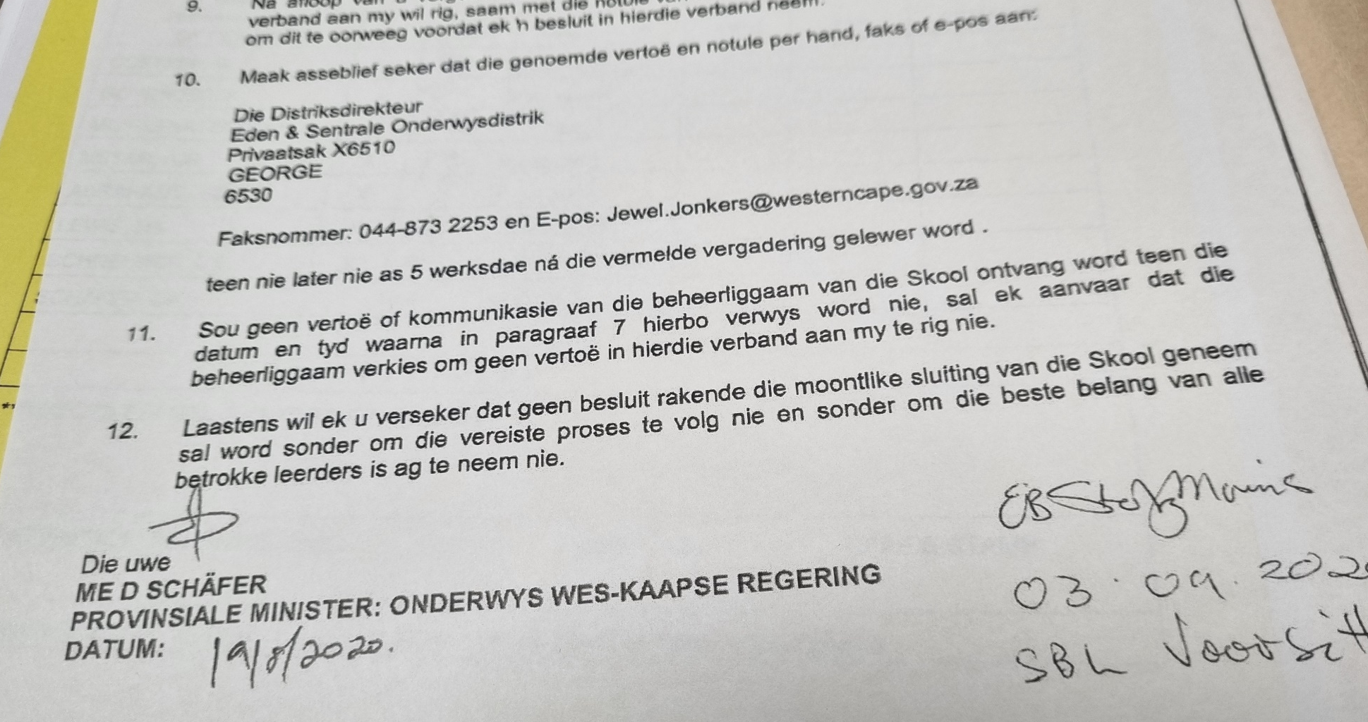
Date of MEC’s intention to close the school

Slide 14
Reasons for closing the school

Slide 15
Reasons for closing the school
Reasons stipulated in said letter:
The school had a learner enrolment of 19 learners (it must be noted that the school has had dwindling enrolment numbers from 2016 when the school had 34 learners).
The school offered the curriculum from grade 1 to 6 (grades 1 – 3 in the foundation phase and grades 4 – 6 in the intermediary phase).
It is thus clear that multi-grade classes were offered in one class group at this school.
There were no prospects that the school would experience learner growth in the immediate future.

Slide 16
Reasons for closing the school
Most of the parents of the learners work on the local farms, but they constantly migrated to nearby towns for better work opportunities.
The school had 2 classrooms that could accommodate about 80 learners. With a capacity of 80, but an occupancy rate of about 17,5%; it was not feasible.
In terms of the Regulations Relating to Minimum Uniform Norms and Standards for Public School Infrastructure (2013), the school is considered a micro-primary school with a capacity of less than 135 learners.
The school could not fulfil its financial obligations to its creditors, like the food suppliers and could also not afford to pay its hostel staff (school was in arrears with the payment of their salaries).

Slide 17
Reasons for closing the school
The school had one substantive post on the Educator Staff Establishment for the 19 learners. This educator, who also served as the principal of the school, was appointed on a contract basis with end date of 31 December 2020.
It was not educationally sound for one educator to teach 19 learners over two bands/phases (foundation and intermediary) as well as over six (6) classes or grades (and on top of that being the principal).
It was also not economically viable and justifiable for a school to have a ratio of one educator to only 19 learners, where the great majority of primary schools have an E:L ratio that tends(→) to ≈1:40. This is not in line with the department’s affordable basket of posts.

Slide 18
Reasons for closing the school
Learners enrolled at the school could be placed appropriately at Teske Gedenk PS, Prince Albert PS or Klaarstroom PS.
The schools mentioned in point 12 had ample accommodation available to accommodate the learners of Seekoegat PS.
Teske Gedenk Primary School had a fully equipped hostel in which learners could be accommodated if required.

Slide 19
Reasons for closing the school
15.The three receiving schools offered monograde classes, had suitably qualified educators, and learners would benefit from a wider range of extra-curricular and co-curricular activities.
The learners would have been included in the learner transport schemes and routes applicable in the area and/or they could reside in the hostel.

Slide 20
National position

Slide 21
National Position
In terms of s5A(1)(a) of SASA, the Minister of Basic Education published Regulations Relating to Minimum Uniform Norms and Standards for Public School Infrastructure on 29 November 2013 in which a primary school of less than 135 learners is declared a micro primary school.
In the document “Standard Parameters for Closure and Merger of Micro Public Schools”, Version 1, Draft 2, dated 25 March 2017 of the Department of Basic Education it is stated in point 3(1) that only schools classified as micro schools should be considered for closure. It goes further in subpoint (2) where it states if the LEF (learner enrolment figure) is more than 20% of the 135 a formal request for approval must be submitted to MEC for closure

Slide 22
National Position
By implication where the LEF is equal to or less than 20%, it is not really necessary to do the formal process. However, the WCED honours the process prescribed in SASA.
The 19 learners at the school were less than 20% of 135 (which is 27).
Further, the DBE published a document “Terms of reference for the Rationalization, Closure and Merger of small and Non-viable Schools”. The document states that the aim of the project of rationalization is to:
Improve quality of education;
Expedite the resourcing of schools;
Promote access to schools; and
Retention of learners and educators in rural and farm schools.

Slide 23
National Position
DBE published the “Guidelines for the rationalization of small or non-viable schools” in July 2009.
In the guidelines it states that larger and better resourced schools will contribute to development and poverty alleviation in the rural areas.
It also states the following criteria to consider in closing schools, viz. (i) Number of learners, (ii) Curriculum considerations, (iii) Accessibility of schools, (iv) School infrastructure, (v) The retention of learners, (vi) Attracting and retaining educators, (vii) Public schools on private property
(c) It must be noted that WCED’s process is similar with the process outlined in the DBE guidelines.

Slide 24
National Position
7. There is a national drive to assess micro schools and to close it in an attempt to give these learners access to better education at “better” resourced schools.

Slide 25
Public Consultation process

Slide 26
Public Consultation process
1. Consultations took place on 18 September 2020 with the SGB and the SGB of the school indicated that they were not in favour of the closure of the school.
2. Public Consultation process took place on 22 October 2020 and the parents of the community indicated that they were not in favour of the closure of the school.

Slide 27
Public Consultation process
3. A summary of the representations made from the parents:
The uncertainty created by the rumours spread by some of the school closure in 2019, forced parents to relocate learners from Seekoegat URC Primary School and enroll them in neighbouring schools.
The school has adequate accommodation for the learners, with 3 classrooms and a fully equipped computer room.
Learners who are relocated to neighbouring schools at such an early age are likely not to attend school regularly.

Slide 28
Public Consultation process
iv. The school no longer has a financial crisis and all current debts have been settled.
v. Parents are concerned about the Covid-19 virus and the safety of their children in neighbouring schools due to the pandemic.
vi. Learners stay 30-50 kilometers from the nearest Learner Transport Scheme pick up points.
vii. The relocation of learners will have a financial impact on parents, for new school uniforms will have to be purchased.

Slide 29
Minister’s decision to close the school

Slide 30
Date of Minister’s decision to close the school
Even though the consultation process was concluded in 2020, and though the MEC indicated her intention to close the school on 31 December 2020, the school could not close by 31 December 2020, as the submission requesting the final closure, reached the MEC only in 2021
The MEC then signed the submission on 25 February 2021 and she indicated that the closure be done subject to the fact that the school now only closes on 31 December 2021 and that parents be informed immediately by the district and be assisted to reassure them of the safety and beneficial impact for their children if the children moved to a bigger school.

Slide 31
Date of Minister’s decision to close the school
Another submission was elevated to the MEC on 17 March 2021 and this submission was signed off on 17 May 2021, in which the MEC added a rider that her approval is subject to the receipt of a report on consultation.
Report was submitted to the Head Office (as requested by the MEC) in September 2021.
MEC’s decision prevailed.

Slide 32
Management of assets and resources

Slide 33
Management of assets and resources
An educator was appointed on contract and completed her contract on 31 December 2021.
All movable assets are still on the premises. The relocation of assets was halted on request of Honorable MP Marie Sukers and her delegation.
Banking account of school is not closed yet.
The lease agreement with the church has been terminated.

Slide 34
Meeting between Honourable MP Marie Sukers and HOD Brent Walters

Slide 35
Meeting between Hon MP Sukers and HOD Walters
On request of Hon Sukers, the HOD Mr Walters, agreed to meet her on 7 February 2022.
At this meeting on 7 February 2022, Hon Sukers was accompanied by a delegation. An appeal was made to the HOD to reopen the school.
Mr Walters explained that neither he nor the Minister has appeal authority on the closure of a school. The only recourse is a competent court of law.
The school was closed on 31 December 2021 and provision was made by the WCED to place the learners appropriately at other schools.
The delegation requested HOD Walters not to remove the mobile units, because they will now attempt to open an independent school on the site. The HOD agreed to the request.

Slide 36
Letter from the Hon MP Marie Sukers

Slide 37
Letter from Hon. Sukers
Honourable MP Marie Sukers wrote to the HOD on 1 April 2022, raising concern about the community of Seekoegat PS.
In the communication she requested, amongst other things, the following:
The appointment of a teacher;
The appointment of 2 teaching assistants;
The provision of food by NSNP; and
Assistance to register an independent school.

Slide 38
Letter from the HOD Walters to the Honourable MP Marie Sukers

Slide 39
HOD response to Hon. Sukers
1. The HOD responded to Honourable MP Marie Sukers on 8 April 2022 and pointed out the following:
  The WCED cannot allocate a teacher to the school, because it has been closed and provision has been made for learners at three potential schools.
  Similarly, 2 teaching assistants cannot be allocated to the school.
  There are clear criteria contained in the DoRA prescripts on the NSNP and feeding of learners. The prescripts do not make provision to provide food to a school that has been closed. Further more, learners have returned 100% to school and it is difficult, if not impossible, for other schools to share their stock with Seekoegat PS.
2. Lastly, the details of Mr William Jantjies was provided as contact person in the WCED to assist with the process of establishing an independent school.

Slide 40
Process of registering an independent school

Slide 41
Process of registering an independent school
Subject to SASA and any applicable provincial legislation, any person may, at his/her own cost establish an independent school.
There are certain compliance/registration documents which the WCED can provide on request.
After a year, the school may apply for a subsidy and the school must have a minimum number of 20 learners if the school wants to qualify for a subsidy.
The WCED does not provide any staff, neither does it provide any other resources to independent schools.
The standards (curriculum delivery) at such a school may not be inferior to public schools, (Please refer to Section 6A and Section 46 of SASA).

Slide 42
Vaccination

Slide 43
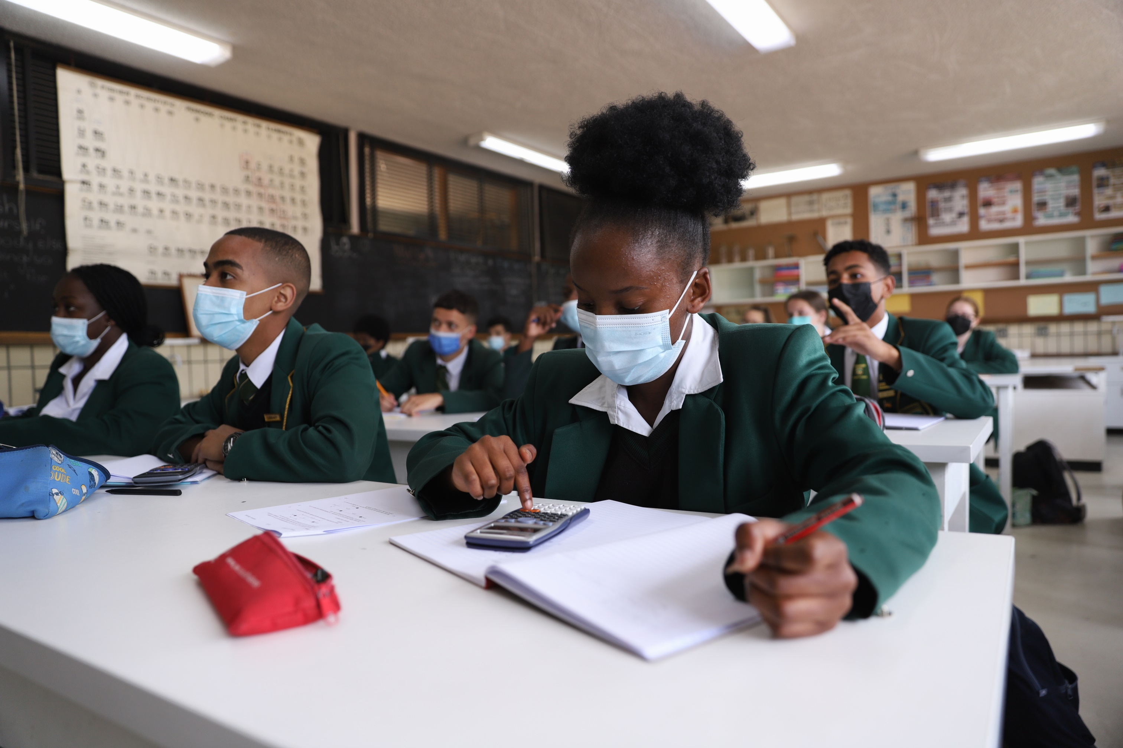
Quality Education
for every child
in every classroom
in every school
in the province.

Slide 44
The End!!
William Jantjies
021 467 2613
William.Jantjies@westerncape.gov.za
071 351 6912
North Wharf Square 1, Floor 6,
Room 6.32

