Slide 1
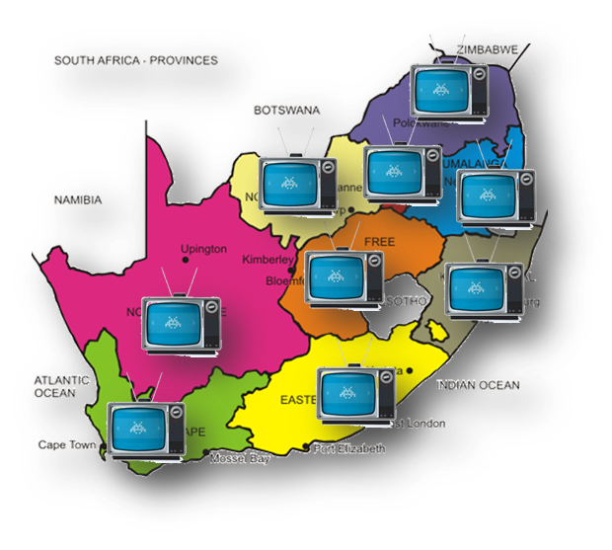
Presentation to the Portfolio Committee
On Communications
Revised USAF 2021-2022

Slide 2
Revised USAF Annual Performance Plan2021-2022
IMPACT STATEMENT:
Enhanced access to ICT and digital broadcasting services in identified underserviced areas.
OUTCOME 1:
Broadened access to broadcast digital services by qualifying households
3 New APP targets
A report on registration and awareness conducted in support of the Analogue Switch Off by 31 March 2021 developed
Conceptual framework on the funding model to support the revised Analogue Switch Off Plan approved
Procurement strategy to National Treasury on the appointment of multiple service providers to support the revised Analogue Switch Off Plan approved
Revised USAF APP:
3 New Targets to align to the revised BDM Analogue Switch Activities
2 New Targets to align to the revised SA Connect Model Phase 2 required activities
OUTCOME 2:
Increased access to broadband in underserviced areas
2 New APP Targets
Procurement strategy to National Treasury on the appointment of multiple service providers to support the revised Analogue Switch Off Plan approved
Conceptual framework on the funding model to support the revised Analogue Switch Off Plan approved
2

Slide 3
New Targets USAF Programme 1 - Business Operations: Indicators, Annual and Quarterly Targets
Broadcasting Digital Migration
A report on registration and awareness conducted in support of the Analogue Switch Off by 31 March 2021 developed
Conceptual framework on the funding model to support the revised Analogue Switch Off Plan approved
Procurement strategy to National Treasury on the appointment of multiple service providers to support the revised Analogue Switch Off Plan approved
To monitor and report progress on the approval by the National Treasury on the proposed procurement strategy initiated on the appointment of multiple service providers to support the revised Analogue Switch Off Plan
To monitor and track the activities implemented on registration and awareness to ensure the targeted households are registered to enable the Analogue Switch off to take place in prioritise provinces
To monitor the funding activities on identified service providers in the revised Analogue Switch Off Plan
3

Slide 4
New Targets USAF Programme 1 - Business Operations: Indicators, Annual and Quarterly Targets
Broadband Connectivity
Implemented conceptual framework on funding model to support the approved revised SA Connect Phase 2 model
To monitor the funding activities on the identified service provider to support the approved revised SA Connect Phase 2 model implementation
To monitor and report progress on the approval by the National Treasury on the proposed procurement strategy initiated on the appointment of a service provider to support the revised SA Connect Phase 2 model
Implemented procurement strategy from National Treasury on the appointment of a service provider to support the revised SA Connect Phase 2 model
4

Slide 5
Revised USAF Programme 1 - Business Operations: Indicators, Annual and Quarterly Targets
OUTPUT INDICATORS | 2021/22 ANNUAL TARGET | QUARTERLY TARGETS
 |  | Q1 Apr-Jun 2021 | Q2 Jul - Sep 2021 | Q3 Oct-Dec 2021 | Q4 Jan - Mar 2022
Number of the subsidised set-top-box kits installed at qualifying households | 810 000 subsidized set-top-box installations coordinated and monitored in four (4) provinces (Free State, Northern Cape, North West and Limpopo | Distribution and installation of 330 000 set-top-boxes coordinated and monitored in Free State, Northern Cape, North West and Limpopo | Distribution and installation of 480 000 set-top-boxes coordinated and monitored in Free State, Northern Cape, North West and Limpopo | - | -
Number of DTT qualifying households migrated to digital terrestrial television through a voucher system | 2 266 474 DTT subsidised digital television installations coordinated and monitored | Appointment of the panel of service providers of devices finalized | Contracting the panel of service providers and placement of orders 466 474 DTT vouchers issued to qualifying households for subsidized digital television installation | - | -
Number of DTH qualifying households migrated to digital terrestrial television through a voucher system | 289 058 DTH subsidised digital television installations coordinated and monitored | Appointment of the panel of service providers of devices finalized | Contracting the panel of service providers and placement of orders 70 058 DTH vouchers issued to qualifying households for subsidized digital television installation | - | -
Implemented registration and awareness conducted in support of the Analogue Switch Off by 31 March 2022 | A report on registration and awareness conducted in support of the Analogue Switch Off by 31 March 2021 developed | - | - | Report on registration and awareness conducted in support of the Analogue Switch Off by 31 March 2021 developed | Consolidated report on registration and awareness conducted in support of the Analogue Switch Off by 31 March 2021 developed
Implemented conceptual framework on funding model to support the revised Analogue Switch Off Plan | Conceptual framework on the funding model to support the revised Analogue Switch Off Plan approved by Board | - | - | Conceptual framework on funding model to support the revised Analogue Switch Off Plan approved by Board | Monitoring report on the implementation of the approved conceptualise framework on funding model to support the revised Analogue Switch Off Plan developed
Implemented procurement strategy from National Treasury on the appointment of multiple service providers to support the revised Analogue Switch Off Plan | Procurement strategy on the appointment of multiple service providers to support the revised Analogue Switch Off Plan approved by the National Treasury | - | - | Initiate a procurement strategy to National Treasury for approval in support of the revised Analogue Switch Off Plan | Monitoring report on the implementation of the approved procurement strategy in support of the revised Analogue Switch Off Plan developed
Yellow colour denotes revisions on USAF APP
5

Slide 6
Revised USAF Programme 1 - Business Operations: Indicators, Annual and Quarterly Targets
OUTPUT INDICATORS | 2021/22 ANNUAL TARGET | QUARTERLY TARGETS
 |  | Q1 Apr-Jun 2021 | Q2 Jul - Sep 2021 | Q3 Oct-Dec 2021 | Q4 Jan - Mar 2022
Number of sites with broadband internet connectivity to new sites in identified municipal areas | Provision of broadband internet connectivity sites to 280 sites to identified 2 (two) local municipalities | Initiate bid processes for the appointment of the service provider | Conclude bid processes and contracting of a service provider Provision of internet connectivity to 80 sites identified in local municipalities ensured | - | -
 |  | Stakeholder consultations and sites identification conducted | - | - | -
Implemented conceptual framework on funding model to support the approved revised SA Connect Phase 2 model | Conceptual framework on the funding model to support the revised Analogue Switch Off Plan approved by Board | - | - | Initiate administrative processes for approval of the conceptual framework on funding model by the Board in support of the revised SA Connect Phase 2 model | Submission of the conceptual framework on funding model to support the revised SA Connect Phase 2 model approved by Board
Implemented procurement strategy from National Treasury on the appointment of a service provider to support the revised SA Connect Phase 2 model | Procurement strategy on the appointment of a service provider to support the revised SA Connect Phase 2 model approved by the National Treasury | - | - | Initiate a procurement strategy administrative processes for the appointment of a service provider in support of the revised SA Connect Phase 2 model approved by the National Treasury | Submission of the procurement strategy to National Treasury for approval in support of the approved revised SA Connect Phase 2 model
Percentage (%) of valid invoices paid within 30 days from date of receipts | 100% of valid invoices paid within 30 days from date of receipt | 100% of valid invoices paid within 30 days from the date of receipts | 100% of valid invoices paid within 30 days from the date of receipts | 100% of valid invoices paid within 30 days from the date of receipts | 100% of valid invoices paid within 30 days from the date of receipts
Percentage (%) of the elimination of wasteful and fruitless expenditure | Reduction of wasteful and fruitless expenditure to 20 % of R 4 009 000 USAF AFS 2019-2020 incrementally from baseline of 2019 by 2024 | 5% reduction of wasteful and fruitless expenditure | 8% reduction of wasteful and fruitless expenditure | 12% reduction of wasteful and fruitless expenditure | 20% reduction of wasteful and fruitless expenditure
Percentage % reduction of irregular expenditure | Reduction of irregular expenditure to 15% of R63 520 000 USAF AFS 2019-2020 incrementally from baseline of 2019 by 2024 | 3% reduction of irregular expenditure | 5% reduction of irregular expenditure | 9% reduction of irregular expenditure | 15% reduction of irregular expenditure
Yellow colour denotes revisions on USAF APP
6

Slide 7


THANK YOU

