Slide 1
Annual Performance Plan & Budget
Presentation
Portfolio
Committee on
Communications
8 April 2022
DCDT Alignment Workshop
17 March 2022

Slide 2
Corporate Strategy & Plan

Slide 3
Strategy

Slide 4
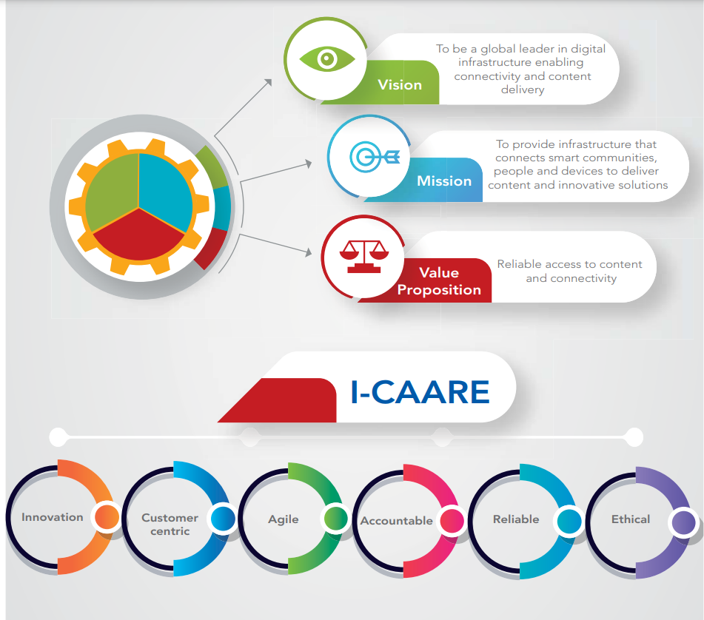
Organizational Identity

Slide 5
Our values

Slide 6
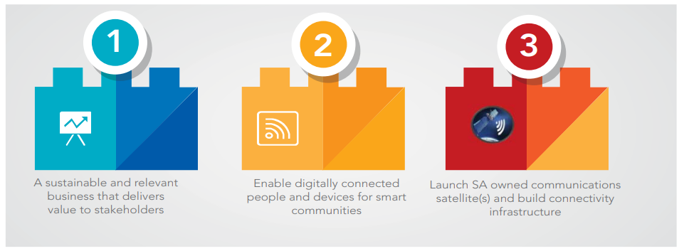
Strategic Goals

Slide 7
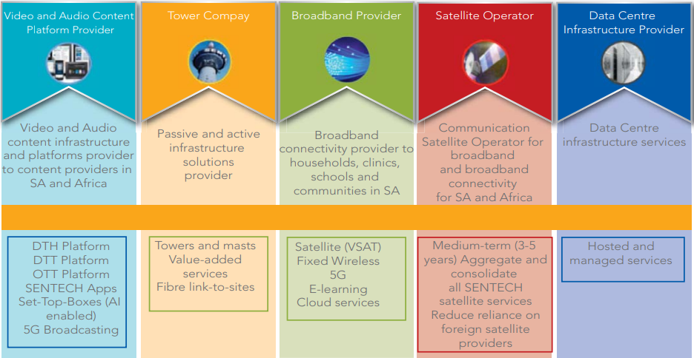
Strategic choices

Slide 8
Annual Performance Plan 2022/23

Slide 9
Annual Performance Plan
Shareholder Outcomes | Strategic Pillars | Outcomes Indicators | # | FY22/23 Annual Targets
Increased access to Digital Infrastructure Digitally Transformed Economy and Society |  | Number of customers onboarded on digital platforms | 1 | Two new customers onboarded on OTT platform
 |  |  | 2 | Boarder management solution developed and implemented
 |  | SA Satellite launch readiness plan | 3 | SA Satellite Bankable Business Plan finalized, funding commitments secured, and submitted to Shareholder for approval
 |  | Number of broadband sites connected | 4 | 680 Broadband sites connected
 |  | % Balance of Set-Top-Boxes installation of registered households | 5 | 100% Balance of registered Set-Top-Boxes installation of registered households
 |  | Innovation initiatives implemented for revenue growth and operational efficiency | 6 | Two innovation initiatives implemented for revenue growth and operational efficiency
 |  | Customer satisfaction score (%) | 7 | 75% Customer satisfaction score
 |  | Weighted average network availability (%) | 8 | 99.80% Weighted average network availability

Slide 10
Annual Performance Plan
Shareholder Outcomes | Strategic Pillars | Outcomes Indicators | # | FY22/23 Annual Targets
High performing portfolio to enable achievement of respective mandates and policy objectives |  | Percentage of planned sites installed with green energy supply | 9 | 30% of planned sites installed with green energy supply
 |  | New revenue Growth (%) | 10 | New revenue growth of 35.3%
 |  | Cost to Income (%) | 11 | Cost to income 86.7%
 |  | Percentage of digital training planned intervention implemented | 12 | 100% of digital training planned intervention implemented
 |  | Clean Audit Achieved | 13 | Clean Audit Achieved
 |  | SOC Rationalisation Plan | 14 | SOC Rationalisation Plan implementation

Slide 11
Financial Plan

Slide 12
Financial Summary
DETAILS | FY2021 | FY2022 | FY2023 | FY2024 | FY2025
 | Actual | Forecast | Budget | Budget | Budget
 | R 'mil | R 'mil | R 'mil | R 'mil | R 'mil
Revenue | 1,275 | 1,259 | 1,501 | 1,494 | 1,597
Operating Expenses (total) | (1,190) | (1,136) | (1,301) | (1,340) | (1,381)
Adjustment for dual illumination | 167 | 141 | - | - | -
EBIT | 253 | 263 | 200 | 154 | 215
Net Profit | 313 | 10 | 98 | 55 | 90
Cash generated from operations | 566 | 321 | 480 | 423 | 473
Cash balances | 2,000 | 2,156 | 1,894 | 1,557 | 1,618
Capital expenditure | (71) | (130) | (536) | (556) | (180)

Slide 13
Projected Revenue
Product | FY2022 | FY2023 | FY2024 | FY2025 |  | FY2022 vs FY2023
 | R 'mil | R 'mil | R 'mil | R 'mil |  | R 'mil | %
TV | 664 | 303 | 322 | 341 |  | (361) | (54%)
FM | 341 | 345 | 365 | 387 |  | 4 | 1%
MW | 10 | 9 | 9 | 10 |  | (2) | (16%)
DTH | 153 | 129 | 136 | 144 |  | (25) | (16%)
MIS | 78 | 76 | 81 | 85 |  | (2) | (3%)
BB | 12 | 20 | 21 | 22 |  | 8 | 73%
Baseline | 1,259 | 881 | 934 | 990 |  | (377) | (30%)
Community TV | - | 1 | - | - |  | 1 | 100%
DTT Migration | - | 53 | - | - |  | 53 | 100%
DTH | - | 33 | - | - |  | 33 | 100%
MIS | - | 2 | - | - |  | 2 | 100%
BB | - | 138 | 143 | 149 |  | 138 | 100%
Strategic initiatives | - | 393 | 417 | 458 |  | 393 | 100%
New Business | - | 620 | 560 | 607 |  | 620 | 100%
Total | 1,259 | 1,501 | 1,494 | 1,597 |  | 243 | 19%

Slide 14
Capital Expenditure
Funding Source | FY2023 | FY2024 | FY2025 | MTEF
 | R’ mil | R’ mil | R’ mil | R’ mil
Internal funds | 136 | 66 | 80 | 282
External funds | 150 | - | - | 150
Strategic Initiatives | 250 | 250 | 100 | 600
SA Satellite | - | 240 | - | 240
Total | 536 | 556 | 180 | 1,272

