Slide 1
SANEDI/ Strategic session

Slide 2
Contents
Governance Processes
Strategic focus
APP Targets
Budget Summary
Concluding remarks

Slide 3
Governance Matters
Board appointed January 2022
Undertook a process of review of the APP with management through a series of engagements to ascertain :
Necessary engagements with stakeholders were undertaken, both internally and externally
Engagements with the shareholder, which is on-going (Alignment is critical)
APP supported by the necessary swot and Pestel and follows process of theory of change.
Appropriate reviews by relevant assurance providers has taken place
This was an initial engagement with the strategy, continue to monitor developments, update accordingly during the med year review period
September
Internal strategy sessions
October-November
External consultations
December engagement with DMRE
November Submit First draft
February Sessions with Board
January Internal Audit process
February Submit DMRE

Slide 4
Strategic Focus: Overall Objective
Support Energy Sector Transformation
The Act provides for SANEDI to direct, monitor and conduct energy research and development, promote energy research and technology innovation as well as undertake measures to promote energy efficiency throughout the economy.
Priority 1: Capable, Ethical and Developmental State
Priority 2: Economic Transformation and Job Creation
Priority 5: Spatial Integration, Human Settlements and Local Government
Priority 7: A Better Africa and World
NDP 2030
ERRP
Energy laws and regulations and policies
Energy Security and universal access
Resilient and Resource efficiency

Slide 5
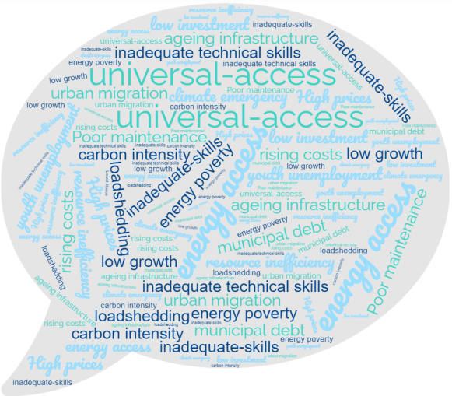
Strategic focus : Key challenges
Themes
Responsive Strategy
Striking a Balance
Climate Emergency
The need to decarbonize the economy
Urbanisation
The impact on access and energy poverty
Priotitisation
Municipal service delivery
Convergence
ICT impacting on services delivery

Slide 6
Annual performance Plan Targets
Programme 1: Administration
Programme 2: designed to address SANEDI’s responsibilities per Chapter 4 of the Energy Act, section 7(2)(b)
Energy Research and Development
Programme 3: designed to address SANEDI’s responsibilities per Chapter 4 of the Energy Act, section 7(2)(a)
Energy Efficiency(EE)
Programme | No. of targets
Programme 1 : Administration | 7
Programme 2 : Applied Energy Research and Innovation | 19
Programme 3: Energy Efficiency | 6
Overall | 32

Slide 7
Programme 1: Administration
7 targets
Responsible for, amongst other things, ensuring:
Providing facilities and a conducive, safe and healthy working environment
Ensure adequate capacity and skills to support implementation of the strategy
Sound internal control environment and good governance
Compliance with laws and regulations and Effective management of Risks
Effective stakeholder engagement

Slide 8
Core programmes prog 2&3
Overall 2 programmes and 7 sub-programme with different by complementary focus areas.
Strategic outputs:
Smart Grids systems piloted for smart cities
Demonstration of GhG emission mitigation potential in support of national commitments
Evidence based planning, resource allocations and decision making
Energy transition expertise

Slide 9
Programme 2&3: Planned Initiatives
Technologies
Planned Initiatives | % of Plan
Skills Interventions | 4%
Knowledge sharing /Awareness | 11%
Demonstrations and Pilots | 9%
Research Reports | 17%
Datasets developed | 9%
Energy Efficiency interventions | 28%
Research Funding support | 11%
Technology Roadmaps | 6%
Energy Status reports | 4%
Energy Performance Standards | 2%
25 targets

Slide 10
Impact Area : Just Energy Transition
Renewable Energy
Waste to Energy Roadmap
NECSA /SANEDI Plaswen Pilot
Support to International Collaboration Efforts:
As directed by the department
Dialogues/Bilateral around various topics on JET/RE/EE
JET Net Jobs and Economic growth Study:
Opportunity cost of disinvesting from Fossil fuels
WASA Phase IV : Mpumalanga
Establishment of Research facilities that advance clean energy projects – Solar thermal Lab
Clean Coal Research Partnerships:
Tracking Research around Clean Coal Technologies
Support research into Clean Coal
Capacity building and skills development Initiatives
KPIs
2022/23
Demonstration Pilots:
Prove technology
Adaptability to SA context
De-risk technology
kick start local economies
Contribution to green Hydrogen economy
Large scale pilot projects

Slide 11
Impact Area : Just Energy Transition
Renewable Energy
WASA Phase IV : Mpumalanga
Establishment of Research facilities that advance clean energy projects – Solar thermal Lab
Clean Coal Research Partnerships:
Tracking Research around Clean Coal Technologies
Support research into Clean Coal
Waste to Energy Roadmap
NECSA /SANEDI Plaswen Pilot
Capacity building and skills development Initiatives
Tracking Tool/Database:
GIS based
JET plans, projects and activities
JET outputs tracking:
Employment
Training
Local industrialisation etc
Projections and reporting
Measure contribution to NDC,CO2 emission reductions etc
KPIs
2022/23
Demonstration Pilots:
Prove technology
Adaptability to SA context
De-risk technology
kick start local economies
Contribution to green Hydrogen economy
Large scale pilot projects

Slide 12
Impact Area : Energy Planning and decision making
Data &Knowledge management
Smart Grids
Cleaner Mobility
Enterprise service business requirements for Smart Grid applications
The Development of an Asset Management Policy, Strategy and Governance Framework for Municipalities.
Complementary Energy Modelling/datasets linked to :
DMRE priorities
Sector priorities
Enable decision making
Support Energy planning
Improve Data and information availability
Capacity Building
Report on Developments and trends in Hydrogen Storage technologies for transportation.
Economic study on EV charging infrastructure for municipal and public buildings.
Assessment of Policy and support instruments for EV market development.
KPIs
2022/23

Slide 13
Impact Areas
Hydrogen Economy
Energy Efficiency
Series of Seminars and workshops on Hydrogen following local and International developments
Build on internal/External hydrogen capacity
Hydrogen Mapping of Hydrogen projects and Reporting:
GIS based map
Continuous Modelling Impact of projects
Awareness creation programmes
ESCO market development:
ESCO register
WB Research project
Research business Models
Research Financing Models
Digitilisation in EE
EPC database
Wastewater Treatment EE
Standards and Labelling
KPIs
2022/23
Implementation of regulations :
12L SARS TAX incentives
EPCs
Possible improvements to Instruments
Initiatives as per the DMRE

Slide 14
Budget Summary
REVENUE BUDGET
SANEDI has a budget of R125 million for the upcoming year, coming from the MTEF(65%) and other sources(35%).
There is EU funding of R13 million and a further of R18 million from the DSI’s Energy Secretariat in terms in the form of admin fees.
Based on the funding secured, SANEDI is satisfied that the APP, as approved, is fully funded.
Notes:
through the GBS for projects which are implemented by the department in collaboration with SANEDI towards improving the energy performance of government buildings and achieving a net-zero energy wastewater treatments plants and the NAMA EE in Public Buildings and Infrastructure Programme.

Slide 15
Budget Summary
EXPENDITURE BUDGET
Programme 1:Administration | 50 012
Programme 2: Energy efficiency programme | 26 563
Programme 3: Applied Energy research | 48 606
60% of the Budget is earmarked for programme 2 and 3,Core programme ; 40% is Administration.
36% is to fund the Human capital needs of the organisation
64% Pertains to goods and services
Capex Budget amounts to 13% of the total goods and services. Pertains to IT upgrades and investment in data Centre.
Notes:
through the GBS for projects which are implemented by the department in collaboration with SANEDI towards improving the energy performance of government buildings and achieving a net-zero energy wastewater treatments plants and the NAMA EE in Public Buildings and Infrastructure Programme.

Slide 16
Concluding Remarks
SANEDI will be celebrating 10 years of existence on 19 July 2022 and has made a significant contribution to the country in a relatively short space of time (with many challenges), but maintaining an impeccable reputation amongst local and international stakeholders.
SANEDI has in the past maintained a high standard of performance. The 2022/23 year should be no different.
We firmly believe that Increased investment in Research and innovation remain critical to SA’s competitiveness globally and in resolving some of the challenges that the sector faces.
With the current ‘new’ challenges facing the South African energy industry, we aim to do even more and are working on a number of pledges to formalise these commitments, going forward!
The committee is requested to note the APP.

