Slide 1
THE PORTFOLIO COMMITTEE ON TRANSPORT
RAF 2022/2023 ANNUAL PERFROMANCE PLAN
03 MAY 2022

Slide 2
PRESENTATION OUTLINE
THE PRESENTATION COVERS THE FOLLOWING:
STRATEGIC CONTEXT
  Mandate
  Socio Economic Impact
  Vision, Mission & Values
THE RATIONALE FOR CHANGE
  Strategic Challenges Pre 2020-25 Strategy
KEY STRATEGIC INITIATIVES AND ACHIEVEMENTS IN FIRST 2 YEARS
2022/2023 RAF ANNUAL PEFOMANCE PLAN
BUDGET
CONCLUSION

Slide 3
  STRATEGIC CONTEXT

Slide 4
MANDATE OF THE FUND
The public value of the RAF is better described by the report of the Road Accident Fund Commission(2002), which noted that, “ the lives of more than 120 000 road accident victims are disrupted each year by death or injuries. Their families, friends and employers also share in and bear the burden of deaths and injuries on the roads. Initially there is a horror of the road accident itself which is accompanied by the need for transport to medical care and the search for appropriate health care whether it be in the hospitals or clinics, from nurses, doctors or therapists. It further notes that although the State provides some healthcare and rehabilitation services many road accident victims are simply unable to find the money to pay for medication”
Therefore the object of the RAF as indicated in section 3 of the RAF Act is the payment of compensation for loss or damage wrongfully caused by the driving of motor vehicles.

Slide 5
THE RAF SOCIO ECONOMIC IMPACT
The Fund has paid out R34.2 billion towards personal claims over the past 12 months. R20.87 billion of this was paid towards loss of earnings for claimants who lost their ability to earn an income as a result of motor vehicle accidents.
Just over R2.2 billion was spent on loss of support to fend for the dependants of victims of motor vehicle accidents. In many instances these include dependants of breadwinners.
R10.5 billion was spent on General Damages.
R446 million was spent on medical expenses,
In a country with such high poverty levels and unemployment rate, a RAF pay out for loss of support to surviving dependants of a breadwinner can be the difference between economic survival and abject poverty.
However, as alluded in the presentation, the RAF will only optimize its socio economic impact when the current system of lump sum payments is done away with and the priority is the innocent motor vehicle accident victim instead of indemnifying the wrongdoer driver.

Slide 6
VISION, MISSION AND VALUES
INTEGRITY
COMPASSION.
RESPECT
EXCELLENCE
ACCOUNTABILITY
VISION
An equitable and sustainable compensation system for motor vehicle accident victims
OUR CORE VALUES
MISSION
To provide appropriate benefits to all qualifying road users within the borders of South Africa and support safe use of roads

Slide 7
  THE RATIONALE FOR CHANGE
  KEY CHALLENGES PRE 2020-25 STRATEGY

Slide 8
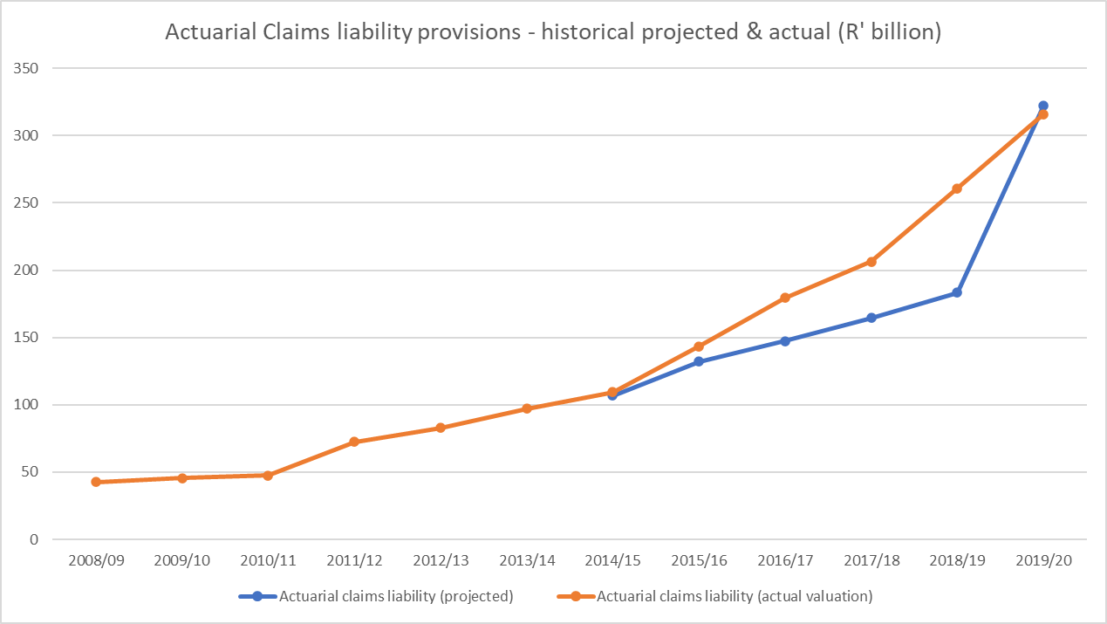
Actuarial Liability Projections vs Actual 2008 to 2020
* The actual always exceeded the projected liability

Slide 9
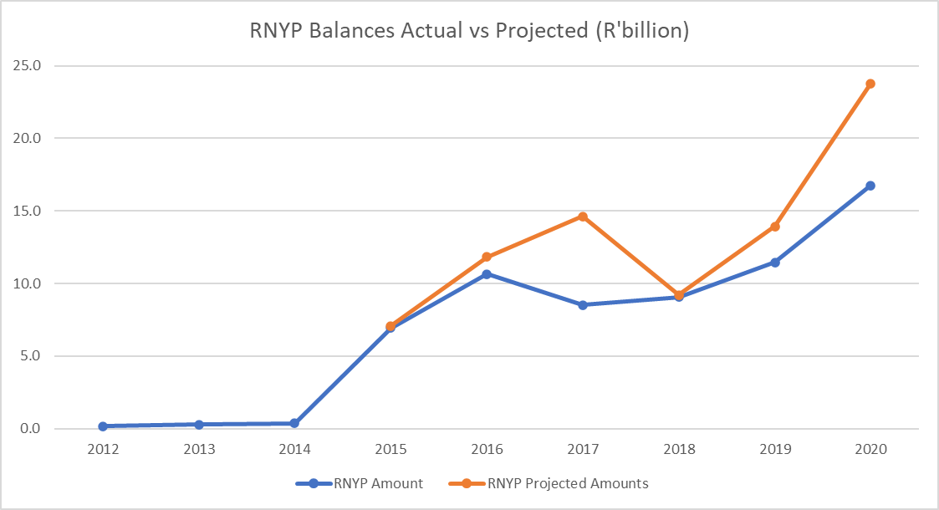
RNYP Historical Balances 2012 to 2020
* Generally upward Trajectory

Slide 11
The Administrative Cost Effect
Other administrative costs during this period included;
Outsourcing Actuarial services to a Panel at an annual cost of R181 million and R10 000 per calculation.
One of the key core funtion of the RAF is investigation of claims. This was also going to be outsourced to a panel of assessors at an annual cost of R200 million and R 1billion over 5 years.
The RAF was paying much more on medical costs compared to Medical Aid Schemes. For the reporting period ending 31 March 2020, R17 149 billion of medical costs accounted for the Fund’s total liability.

Slide 12
The Increase in Average Claim Settlement Amounts
Average amount and number of claims- LOE 2007 - 2019
Financial Year | Average Amount | Number of Claims | Settlements Amount
2007 | R 222 655 | 6 194 | R 1 379 125 070
2008 | R 264 337 | 5 957 | R 1 574 655 509
2009 | R 335 503 | 6 782 | R 2 275 381 346
2010 | R 314 270 | 7 695 | R 2 418 307 650
2011 | R 393 672 | 8 251 | R 3 248 187 672
2012 | R 433 739 | 7 191 | R 3 119 017 149
2013 | R 535 050 | 8 636 | R 4 620 691 800
2014 | R 649 912 | 11 865 | R 7 711 205 880
2015 | R 732 371 | 14 072 | R 10 305 924 712
2016 | R 739 214 | 17 926 | R 13 251 150 164
2017 | R 645 832 | 16 663 | R 10 761 498 616
2018 | R 691 459 | 17 787 | R 12 298 981 233
2019 | R 767 506 | 20 702 | R 15 888 909 212
Annual settlements for loss of earnings increased from an aggregate amount of below R2bn per year under the Old Act, to an average amount of more than R12,5bn in the recent five years under the new Amendment Act.
This was driven by increases over settlements as a result of inefficiencies and fraud in some instances. The direct claims strategy also increased the number of claims registered.
This was exacerbated by paying out in lump sum payments

Slide 13
The Increase In Average Claim Settlement Amounts( the 2008 RAF Amendment effect)
Annual paid per passenger claim: 2007 - 2019
Financial Year | % Passenger Settlements | Total paid on passenger claims | Average paid per passenger claim
2007 | 36% | R2 081 565 426 | R32 344
2008 | 36% | R2 898 369 626 | R35 984
2009 | 34% | R3 448 755 201 | R39 479
2010 | 35% | R3 503 874 087 | R48 618
2011 | 33% | R3 851 456 079 | R67 079
2012 | 33% | R3 553 953 130 | R76 683
2013 | 35% | R4 665 671 719 | R112 010
2014 | 45% | R8 752 411 657 | R185 319
2015 | 47% | R11 464 349 264 | R222 096
2016 | 47% | R14 189 621 859 | R268 733
2017 | 46% | R13 268 074 246 | R214 979
2018 | 48% | R15 580 897 713 | R240 725
2019 | 47% | R18 714 080 280 | R276 153
The proportion of annual payments spent on passenger claims increased from 36% in 2007 to 48% in 2020, and the average amount per claim increased from R32 344 to R292 300 for the same period
This is the source of RAF’s formal complaint to FSCA on the conduct of the insurance sector.

Slide 14
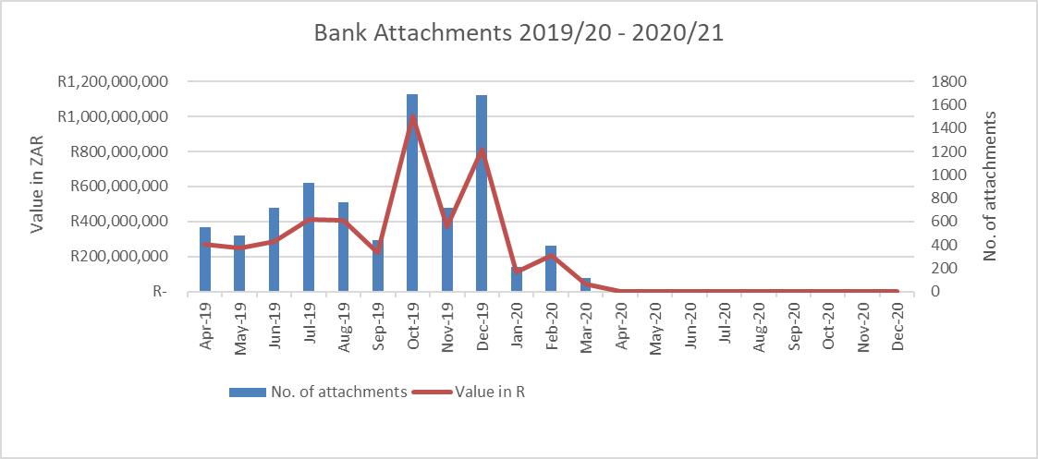
“DAY ZERO” SCENARIO_The Writs Effect
  Bank Account Attachments since Inception and Implementation of Strategy
Effects of Covid
  Around July 2020, the value of transactions relating to bank attachments which could have resulted in bank attachments had increased to R1.7 billion. This was only averted following a reconciliation process.
Effects of Strategy

Slide 15
The Duplicate Payments
The bank attachments as a result of these Writs against the RAF gave rise to the risk of duplicate payments.
This was exacerbated by lack of an integrated financial payment system and not conducting reconciliations during this period.
This control gap was fully exploited by lawyers, whilst the Sheriffs Offices also benefited from increased revenue fees.
As indicated in the subsequent slides, the RAF has since brought this under control by employing a legal strategy to halt the bank attachments and building capacity in the Treasury unit to ensure that regular reconciliations are done.
This has resulted in the recovery of over half a billion in duplicate payments and the reporting of 102 legal firms to the LPC for further investigation.

Slide 16
An Inequitable Payment System
The top 20 payees make up 29.1% of the total RNYP balance of R9.55 billion as at 31 Mar 2022
The Payment Strategy was based on a fixed allocation system, skewed towards the big legal firms.
Consideration was not given to the age of the debt. This resulted in the majority of claimants preferring to use these big legal firms to expedite receiving payments.
The legacy of this approach is clearly evident in this table.

Slide 17
Insufficient Information To Settle Claims Within 120 days
As clearly illustrated in the table below in the audit conducted on the RAF claims backlog, the majority do not have sufficient information to enable the Fund to make an offer.
This was made worse by the fact that Section 22(1)(a) of the RAF Act, which provides that, “when, as a result of the driving of a motor vehicle, any person other than the driver of the motor vehicle has been killed or injured, the owner and the driver, if the driver is not the owner, of the vehicle shall, if reasonably possibly within 14 days after the occurrence, furnish the Fund on the prescribed form with the particulars of the occurrence, together with the prescribed statements…..” was never enforced by the RAF.

Slide 18
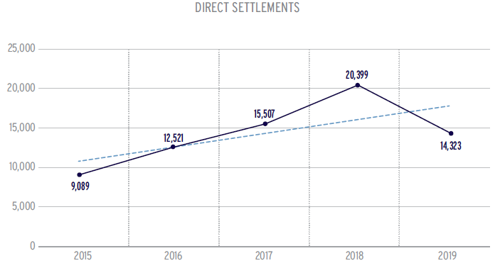
The Direct Claims Strategy
The Direct Claims strategy presented both operational and legal challenges. As illustrated in the graph below, the strategy peaked in 2018 highest number of claims registered.
Section 19(c)(i)(ii) of the RAF Act is prescriptive on who can lodge a claim on behalf of a third party( i.e. an attorney or a person in service or a representative of the state or government…)
This has presented the RAF with challenges in instances of prescription of Direct claims.

Slide 19
SARS TAX Refund
Clause 16(1)(a) of the RAF Act states:
“The Fund, its assets, property, income and its operation and transactions shall be exempt from all taxation, or the Fund shall be refunded all taxation paid by it, as the case may be…”
Historically, the Fund paid value added tax of around R12,6 billion to the South African Revenue Services;
A Legal opinion indicated the following:
  “That it is clear from section 16 of the RAF Act that what the Fund is exempted from is all taxation and that it is in law entitled to be refunded all taxation paid by it without any limitation”
  The opinion concludes that the Fund is entitled to be refunded all the taxes paid by it to the South African Revenue Services;
Engagements with SARS are still ongoing.

Slide 20
Other Challenges
Some of the challenges included;
Governance and leadership Instability. The RAF operated with an interim Board and an acting Chief Executive Officer for a prolonged period.
An unsustainable Funding model, where the benefits offered are much more costly than the funding that is available for the scheme through fuel levies and a lack of nexus between the revenue and the benefits offered;
A manually based operating model which was highly susceptible to fraud and corruption.

Slide 21
  THE RAF 2020-25 STRATEGY
  KEY STRATEGIC INITIATIVES AND ACHIEVEMENTS IN THE FIRST 2 YEARS.

Slide 22
TURNAROUN PLAN: RAF- 2020-25 STRATEGY
RAF 2020 – 25 STRATEGY
The 2020-25 Strategic Plan was developed as our framework to turn RAF around and is underpinned by the following initiatives aligned to the key priorities
  Reduction of legal costs
  Reviewing of operating model
  Introduction of Integrated claims management system
  Issue regulations enhancing the claims lodgment process
  Review the current legislation

Slide 23
KEY STRATEGIC INITIATIVES AND ACHIEVEMENTS IN THE 2 YEARS OF IMPLEMENTING THE 2020-25 RAF STRATEGY
The litigation strategy of using an internal RAF panel of attorneys was abandoned. The new strategic focus is on claims investigation and settlement. In matters where litigation is required, RAF entered into a collaboration agreement with the State Attorneys office to manage RAF litigation. The model is being implemented and already resulted in reduced legal costs in the first 2 years of implementation.
RAF also moved away from a model outsourcing actuarial function to an actuarial panel that was costing the Fund R10 000 per calculation and around R181 million per year. In terms of the new strategy, actuarial function is considered core business. Capacity has now been created internally thereby saving the Fund millions in actuarial costs. The insourcing budget is R51 million per annum, thus saving the Fund R130 million.
A Claims Investigation Unit has been established. This is to ensure quality accident investigations previously outsourced to a panel of assessors for many years without any value for money. This panel would have amounted to R1 billion over a five year period.
Medical Tariffs and Treatment Protocols were developed to assist in reducing medical costs. The final publication is expected before end of the first quarter of the 2022/23 FY.
The Minimum Information Requirements for claims lodgment have been finalized for publishing.
The average age of the RAF Claims Requested but Not Yet Paid(RNYP) has reduced from 180 days to 120 days as at 01 April 2022.

Slide 24
KEY STRATEGIC INITIATIVES AND ACHIEVEMENTS IN THE 2 YEARS OF IMPLEMENTING THE 2020-25 RAF STRATEGY
One of the key strategic outcomes to address financial sustainability was obtaining a bridging facility of R15 billion. The Board has since taken a decision not to pursue this strategy owing to the improved liquidity position of the RAF.
Following prolonged period of leadership instability, the DoT Minister appointed a permanent board in December 2019. the board then appointed a permanent CEO in August 2020.
As part of the transformation the RAF, one of the key strategic outcomes was to review the organisational structure and comprehensive skills audit to ensure that it is fit for purpose and have the appropriate skills to implement the new Operating Model.
Both the executive macro and micro organizational structures have been finalized and recruitment of permanent executives is underway. The comprehensive skills audit was also completed and informed the job design for the new organisational structure.
The onboarding of an implementing partner for the Integrated Claims Management System(ICMS) will finally see the RAF start its digitization journey.
Notwithstanding the current dispute between AGSA and RAF on the Accounting Policy change for the 2020/21 audit, the RAF obtained a clean audit outcome for the 2019/20 audit.
Achieved 78% of the 2020/21 APP targets and are on track to achieve similar performance for the 2021/22 APP.

Slide 25
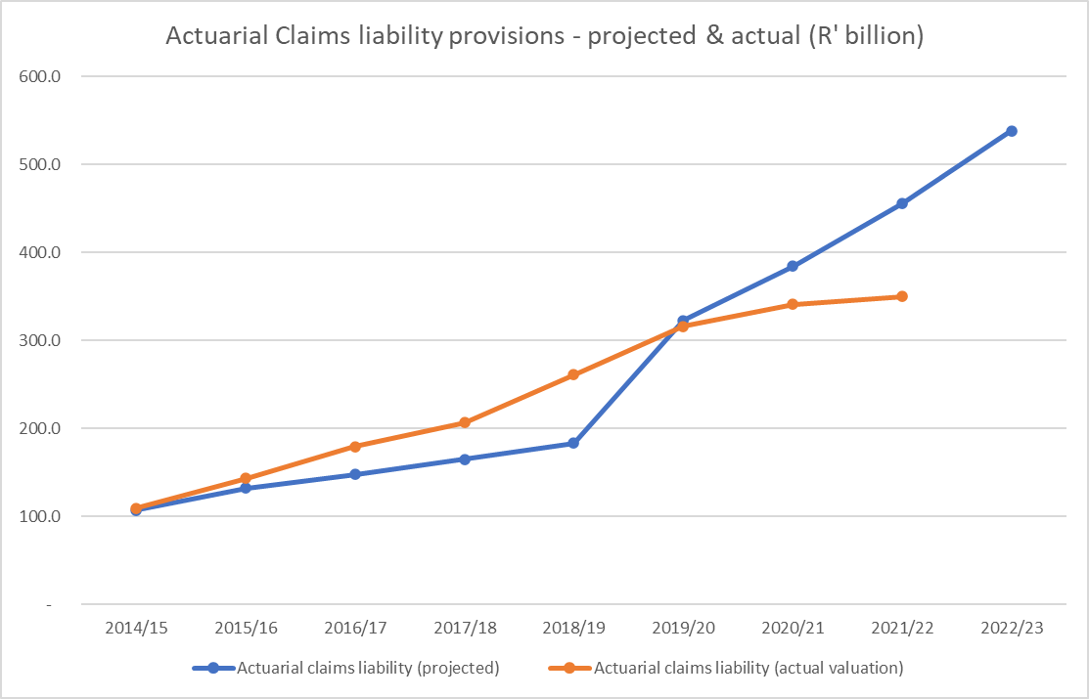
Actuarial Liability Projections vs Actual 2015 to 2022

Slide 26
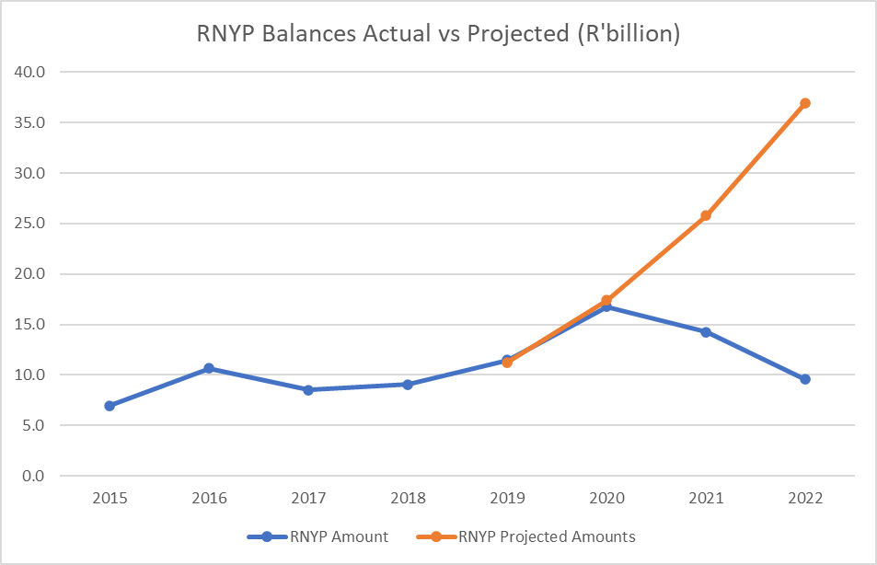
RNYP Balance Projections 2015 to 2022

Slide 28
REDUCED LEGAL COSTS- Revenue vs Expenses 2019-2022
1
Year | 2019 | 2020 | 2021 | 2022
Revenue | R 43 239 | R 41 240 | R 42 249 | R 48 032
Claims Expenditure | R 96 405 | R 44 870 | R 37 877 | R 43 905
Legal Expenses | R 9 799 | R 10 104 | R 5 488 | R 7 963
Administration Expenses | R 1 970 | R 2 214 | R 2 508 | R 2 814
* The legal costs for 2022 includes backlog legal costs for panel attorneys

Slide 29
ROAD TO FINANCIAL SUSTAINABILITY

Slide 30
  2022/2023 ANNUAL PERFOMANCE PLAN

Slide 31
IMPACT AND OUTCOME STATEMENTS
IMPACT STATEMENT
A SUSTAINABLE AND EQUITABLE MVA BENEFIT SCHEME
A TRANSFORMED AND SUSTAINABLE RAF
Approved RAF business operating model | RAF Amendment Act proposal submitted to DoT | Claims processed within 120 days | Claims validated and verified within 60 days | Reduced average age of old claims | Reduction of legal costs | RAF Medical Tariffs implemented | Developed medical treatment protocols | Reduction of medical costs | RAF funding model finalized | Asset and Liability Strategy implemented
SYSTEM MODERNIZATION
Integrated Claims Management System implemented
IMPROVED GOVERNANCE AND STRENGTHENED CONTROL ENVIRONMENT
MoT governance targets
IMPROVED SERVICE DELIVERY
Stakeholder management strategy implemented
Clean Audit
Reduction in the number of audit findings
Customer satisfaction survey rating)
Organisational structure reviewed and approved
Skills audit report
2020-2025 Strategic Plan Impact Assessment
STRATEGIC OUTCOMES

Slide 32
OUTCOME INDICATORS: A TRANSFORMED AND SUSTAINABLE RAF
 | Outcome Indicator | Five Year Target | 2020/21 | 2021/22 | 2022/23
1. | RAF business operating model | Implemented RAF business operating model | Approved RAF business operating model | RAF business operating model implemented | Year 2 business operating model initiatives implemented
2. | New claims settled within 120 days | 75% | 5% | 5% | 5%
3. | Claims validated and verified within 60 days | 95% | 20% | 50% | 55%
4. | % increase in settlement of claims older than 3 years | 50% | - | 10% | 20%

Slide 33
OUTCOME INDICATORS: A TRANSFORMED AND SUSTAINABLE RAF CONTINUED
 | Outcome Indicator | Five Year Target | 2020/21 | 2021/22 | 2022/23
5. | Reduction of legal costs | 75% | 15% | 25% | 30%
6. | Reduced Medical costs | RAF medical Tariffs implemented | RAF Medical Tariffs developed | RAF Medical Tariffs implemented | RAF Year 2 medical tariff implemented
7. | Reduced Medical costs | RAF medical treatment protocols implemented | Medical treatment protocols developed | Medical treatment protocols implemented | 10% reduction

Slide 34
OUTCOME INDICATORS: A TRANSFORMED AND SUSTAINABLE RAF CONTINUED
 | Outcome Indicator | Five Year Target | 2020/21 | 2021/22 | 2022/23
8. | Improved Financial sustainability | Asset and Liability Strategy implemented | - | Asset and Liability Strategy developed and approved | Asset and Liability Strategy implemented( to be removed)

Slide 35
OUTCOME INDICATOR: SYSTEM MODERNIZATION
 | Outcome Indicator | Five Year Target | 2020/21 | 2021/22 | 2022/23
9. | Implement interim solution to enhance the current system and an Integrated Claims Management system (ICMS) | An Integrated Claims Management system (ICMS) implemented. | Implement Integrated Claims Management system (ICMS) | On-boarding of Service Provider and Approved Project Plan for ICMS. | Phase 2 initiatives of the ICMS Project Plan implemented

Slide 36
OUTCOME INDICATORS: IMPROVED GOVERNANCE AND STRENGTHENED CONTROL ENVIRONMENT
 | Outcome Indicator | Five Year Target | 2020/21 | 2021/22 | 2022/23
10. | Reduction of qualified audits | Regulatory Audit Outcome by the Auditor-General of South Africa (AGSA) | - | Unqualified Audit Report with no significant findings | Unqualified Audit Report with no significant findings
11. | Adequacy of responses to Parliament questions | Percentage responses to Parliament questions within stipulated timelines | - | 100% responses to Parliament questions | 100% responses to Parliament questions
12. | Resolution of reported incidents of fraud and corruption | Percentage resolution of reported incidents of fraud and corruption | - | 75% resolution of reported incidents of fraud and corruption | 85% resolution of reported incidents of fraud and corruption

Slide 37
OUTCOME INDICATORS: IMPROVED GOVERNANCE AND STRENGTHENED CONTROL ENVIRONMENT
 | Outcome Indicator | Five Year Target | 2020/21 | 2021/22 | 2022/23
13. | Functionality of ethics structures and adequate capacity | Ethics committees established and operationalised | - | Departmental Ethics Committees operationalised | Report on status and operations of Ethics Committee
14. | Implementation of action plan to address audit findings | Percentage implementation of action plans to address audit findings | 67.74% | 65% implementation of action plans to address audit findings | 75% implementation of action plans to address audit findings
15. | Elimination of wasteful and fruitless expenditure | Percentage reduction of cases of wasteful and fruitless expenditure | - | 80% reduction of cases of wasteful and fruitless | Report on cases of Fruitless and Wasteful expenditure

Slide 38
OUTCOME INDICATORS: IMPROVED GOVERNANCE AND STRENGTHENED CONTROL ENVIRONMENT
 | Outcome Indicator | Five Year Target | 2020/21 | 2021/22 | 2022/23
16. | Reduction of irregular expenditure | Percentage reduction of cases of irregular expenditure | - | 55% reduction of cases of Irregular expenditure | Report on cases of Irregular expenditure
17. | Report on steps taken to ensure Compliance to 30-day payment requirement | Report on steps taken to ensure Compliance to 30-day payment requirement | - | 100% compliance to 30 days payment requirement | Report on steps taken to ensure 100% compliance to 30-day payment requirement

Slide 39
OUTCOME INDICATOR: IMPROVED SERVICE DELIVERY
 | Outcome Indicator | Five Year Target | 2020/21 | 2021/22 | 2022/23
18. | Stakeholder management strategy | Stakeholder management strategy implemented | Stakeholder management strategy developed and approved | 50% of the Stakeholder Management Strategy Implemented. | 75% of 2022/23 Stakeholder management strategy initiatives implemented
19. | Customer satisfaction survey conducted | % customer satisfaction survey rating | - | - | 50%
20. | Organisational structure reviewed and approved | Reviewed organisational structure implemented | Approved organisational Structure Report | Work Study and Organisational Structure Developed. | 30% implementation of the approved organisational structure
21. | Skills audit of all employees | Skills audit of all employees | Skills Audit Initiated | Skills Audit Report Finalised. | Year 1 implementation of Skills Audit Report Outcomes

Slide 40
OUTCOME INDICATOR: IMPROVED SERVICE DELIVERY
 | Outcome Indicator | Five Year Target | 2020/21 | 2021/22 | 2022/23
22. | % of Enterprise Service Development (ESD) spent on women owned enterprises | % of Enterprise Service Development (ESD) spent on women owned enterprises |  | Develop ESD plan for women empowerment | 30%
23. | 2020-2025 Strategic Plan Impact Assessment | Approved Strategy Impact Assessment Report | - | - | Approved Impact Assessment Report

Slide 41
  BUDGET

Slide 42
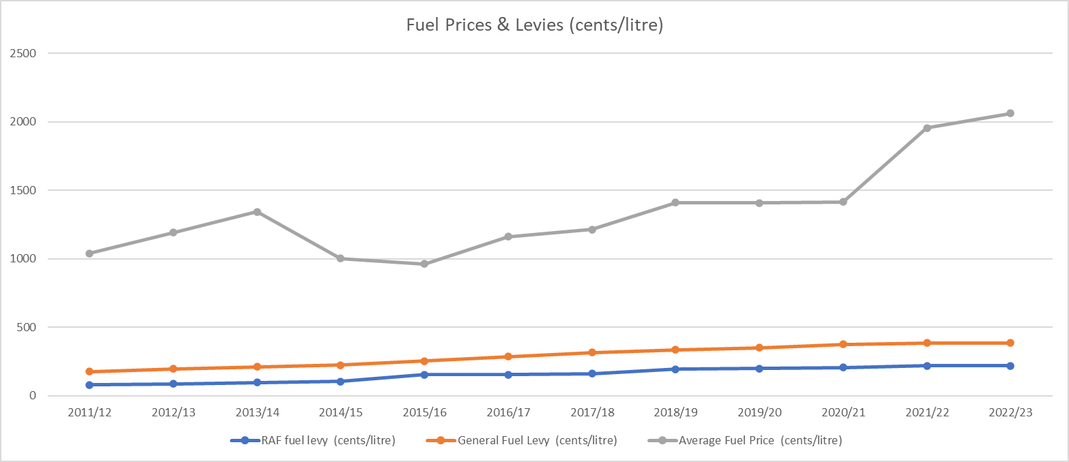
COMPARATIVE ANALYSIS: Average Fuel Prices vs RAF Levies and General Fuel levy

Slide 43
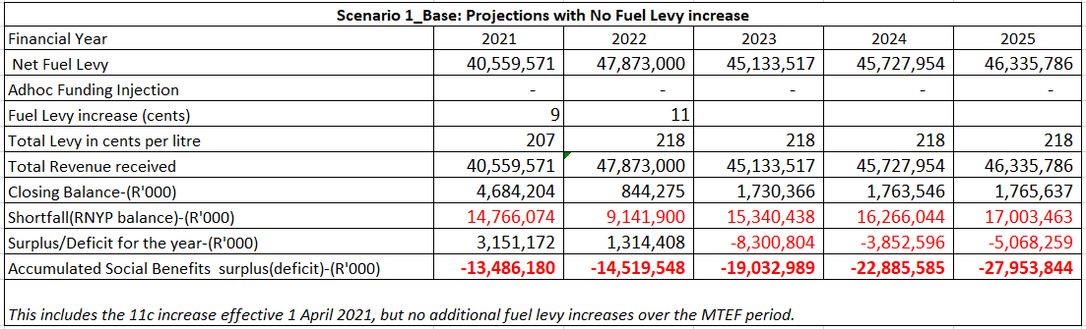
BUDGET - FUNDING SCENARIOS

Slide 44
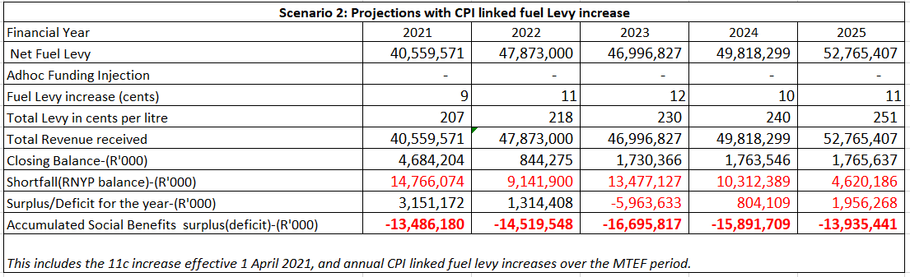
BUDGET - FUNDING SCENARIOS

Slide 45
BUDGET - INCOME STATEMENT
YEAR ENDED 31 MARCH | 2021 Actual R’m | 2022 Actual R’m | 2023 Budget R’m | 2024 Budget R’m | 2025 Budget R’m
INCOME | 42 249 | 48 033 | 46 187 | 47 525 | 49 613
1.1 Net Fuel Levies | 42 089 | 47 873 | 45 462 | 45 879 | 46 490
1.2 Investment Income | 157 | 160 | 725 | 1 646 | 3 123
1.3 Other Income | 3 | - | - | - | -
2. EXPENDITURE | (40 465) | (46 718) | (50 424) | (53 687) | (53 482)
2.1 Claims Expenditure | (37 877) | (43 905) | (46 718) | (49 712) | (49 269)
2.2 Employee Costs | (1 941) | (2 112) | (2 707) | (2 910) | (3 128)
2.3 General Expenses | (530) | (534) | (806) | (842) | (880)
2.4 Reinsurance Premiums | (4) | (5) | (4) | (5) | (5)
2.5 Depreciation & Amortisation | (50) | (44) | (88) | (111) | (86)
2.6 Finance Costs | (63) | (118) | (101) | (117) | (114)
3. SURPLUS/(DEFICIT) FOR THE YEAR | 1 784 | 1 315 | (4 237) | (6 162) | (3 869)

Slide 46
BUDGET - BALANCE SHEET
YEAR ENDED 31 MARCH | 2021 Actual R’m | 2022 Actual R’m | 2023 Budget R’m | 2024 Budget R’m | 2025 Budget R’m
ASSETS
1.1 Current Assets | 15 448 | 11 702 | 26 053 | 49 798 | 73 063
1.2 Non-Current Assets | 215 | 216 | 310 | 333 | 388
Total Assets | 15 663 | 11 918 | 26 363 | 50 131 | 73 451
2. LIABILITIES AND RESERVES
2.1 Current Liabilities | 31 437 | 26 376 | 52 420 | 82 346 | 109 530
2.2 Non-Current Liabilities | 60 | 62 | 67 | 71 | 76
2.3 Reserves | (15 834) | (14 520) | (26 124) | (32 286) | (36 155)
Total Liabilities and Reserves | 15 663 | 11 918 | 26 363 | 50 131 | 73 451

Slide 47
THE INSTALMENT PAYMENTS EFFECT
The financial sustainability of the RAF will further be enhanced by implementation of payment of certain benefits in instalment payments. The projected effect of introducing instalment payments is as follows;
The RAF settles an average of R28.6 billion a year for loss of income and general damages and the average age of each claimant is approximately 39 years.
Assuming that loss of income is paid till retirement at age 65 years, the remaining number of years is 26 years.
If the RAF settlements were paid as annuities over 26 years, the RAF would need to pay about R1.1 billion per year for one year`s worth of settlements instead of the current R28.6 billion per year which becomes payable as lump sum amounts under the current arrangements, thus implementing installment payments for loss of income and general damages will significantly improve the RAF`s liquidity position.
Of the R14.9 billion RNYP balance as at 31 March 2021, about R11.8 billion of that balance is for loss of income and general damages compensation,
If the settlements were payable on instalment terms, the RAF would only need 562 million for payments due in the 2020/21 financial year, instead of the R11.8 billion which is currently considered overdue.

Slide 48
THE INSTALMENT PAYMENTS EFFECT
Annual figures based on the 2019FY
Total amount for paid/settled claims (R' million)
Financial Year | Annual Settlements
General Damages (R' million) | 9 200
Loss of Earnings (R' million) | 15 900 |  | Installments
Loss of support (R' million) | 3 500 | 28 600
Funeral (R' million) | 160
Medical Compensation excl suppliers | 1 400 |  | Lumpsum
Supplier Claims (R' million) | 2 200 | 3 760
Legal expenses (Defence and Plaintiff costs) (R' million) | 10 300 | 10 300 | Lumpsum
Total Settlements | 42 660
Total Settlements |  | R 42 660 000 000
Total For Annuity Payments |  | R 28 600 000 000
Payment Years |  | 26
Annual Annuity Payments |  | R 1 100 000 000
Annual Fixed Payments |  | R 14 060 000 000
Annual Administration Costs |  | R 2 615 000 000
Total Annual Payments |  | R 17 775 000 000
Annual Fuel Levy |  | R 43 200 000 000
Available for investment |  | R 25 425 000 000

Slide 49
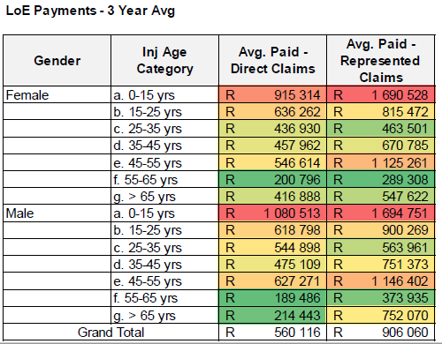
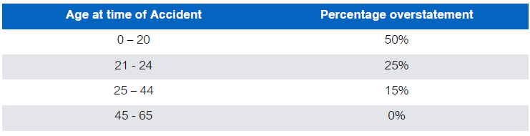
THE INSTALMENT PAYMENTS EFFECT- The Impact of Minor Claims
2014 Research Findings

Slide 50
CONCLUSION
Going into year 3 of the 2020-25 strategic journey, the finalisation of the RAF Amendment Act will be a critical dependency.( i.e. the implementation of instalment payments is at the core of the RAF financial sustainability).
The final publishing of the RAF medical tariffs and Minimum Information Requirements will be critical in further bringing down the administrative costs and expediting settlement of claims.
On governance, the RAF Board has been stable over the past 2 financial years. The Board is now into the final year of its first term and stability at Board and Executive leadership level will be critical if the RAF is to continue with the reforms as envisaged in the 2020-25 Strategic Plan.
With the RAF having achieved a clean audit in the 2019/20 Financial Year, the speedy resolution of the litigation with AGSA on the accounting policy change of the RAF is crucial to ensure that implementation of the strategy and the 2020/21 audit are not adversely affected.

Slide 51
THANK YOU

