Slide 1
ANNUAL PERFORMANCE PLAN
2022/23
Presentation to the Parliamentary Portfolio Committee on Higher Education, Science and Innovation
22 April 2022

Slide 2
Introduction
TIA Act
To support the state in stimulating and intensifying technological innovation in order to improve economic growth and quality of life for all South Africans
To promote the development and utilisation – in the public interest – of discoveries, inventions, innovations and improvements
Mission
Vision
Be a leading technology innovation agency that stimulates and supports technological innovation to improve the quality of life for all South Africans.
Facilitate the translation of South Africa’s knowledge resources into sustainable socioeconomic opportunities
2

Slide 3
Policy Environment
National Development Plan: STI the driver of equitable economic growth and development, job creation and socio-economic reform; key to improving health systems, education and infrastructure
2019-2024 MTSF: Priority 2 (Economic transformation and job creation); Priority 3 (Education, skills and health)
Economic Reconstruction and Recovery Plan: SA’s response to the covid-19 crisis
Science, Technology & Innovation White Paper: Support inclusive economic growth through technological innovation; improve competitiveness of businesses (esp. SMMEs); empower youth, women and people with disabilities
STI Decadal Plan: Principles of transformation and economic inclusivity
Bio-economy Strategy: Use SA’s bio-based resources to significantly contribute to the economy by 2030 through biotechnology-based industries
District Development Model: Synchronise government planning within 44 district and 8 metropolitan municipalities
UN Agenda 2030: Support 17 interlinked SDGs for greater economic, social and environmental benefits for present and future generations
AU Agenda 2063: Collaboration with R&I institutions across Africa using STI to achieve the continent’s developmental goals
3

Slide 4
Strategic Context – Macro Level
Economic Growth
Sector contribution to GDP
Triple challenges
GDP
4,8% against a forecast of 5,1%
Mining
18,1% growth contributing 1,2% to GDP
Manufacturing
Contributing 14% to GDP
Agriculture
Contributing 2,4% to GDP (2020)
Unemployment
34,9%
Poverty
16.3 mil people in SA
Inequality
Gini Coefficient = 63%
Other important factors
COVID-19
Access to healthcare
Climate change
Low levels of job creation
Vaccine manufacturing
Increased burden of disease
Digital Participation
Entrepreneur ecosystem

Slide 5
Reflecting on TIA’s Position in the NSI (MTSF Year 3)
Reviews
Key Issues / Highlights
HESTILL Review
NACI STI Indicators Report
Technology Transfer Office Survey 2014–2018
National Treasury Spending Review
TIA’s lack of leadership stature in the NSI (funding and weak commercialisation record)
Poor coordination and integration of RDI funding instruments
Benefits of innovation not evenly distributed (spatially; demographics)
Low rate of utilisation of scientific outputs for socio-economic benefit
Decline in experimental development research
Research outputs concentrated within a handful of universities
Positive impact of Seed funding and funding gap for commercialisation
Refocus TIA as a Funder, reduce dependency on fiscus and intensify private sector partnerships
TIA Ministerial
Review Process
Policy Considerations
White Paper on STI
Decadal Plan
DST and DHET reporting to one Ministry
Economic Reconstruction and Recovery Plan

Slide 6
Strategic Context - Institutional
Financial
Stakeholder / Customer
Budget on average – R410m
68 projects funded – R650m
All funds disbursed
Improved efficiency ratio – 25%
Leveraged Funding – R1.3b
2020/21 performance = 99% (2021/22 YTD 45%)
Commercialisation record
  2020/21 – 32 against a target of 15
  2021/22 YTD = 35 against a target of 26
Commercialisation – undermined by lack of effective post investment support
TIA visibility – Strategic Marketing and Comms
Internal Business
Learning & Growth
Unqualified audit with no matters of emphasis (5yrs in a row)
ISO9001 (2015) recertification (4yrs in a row)
Turnaround time challenge
Lack of integration of internal portfolios
International benchmarks of TIA-like institutions
Institutionalised evaluation and learning (impact assessment and programme specific M&E)

Slide 7

SA IKS goes mainstream
African Traditional Medicines Platform established
R35m investment by TIA
R10m co-funding by DST
TIA approved China-SA Flagship programme (R500k per annum over 3 years)
  Flagship Programme between Beijing University of Chinese Medicines & UFS
SAHPRA approved the PHELA COVID-19 Clinical trial.
  A country and sub-regional first for a traditional medicines controlled clinical trials and clinical trial for COVID-19

Slide 8
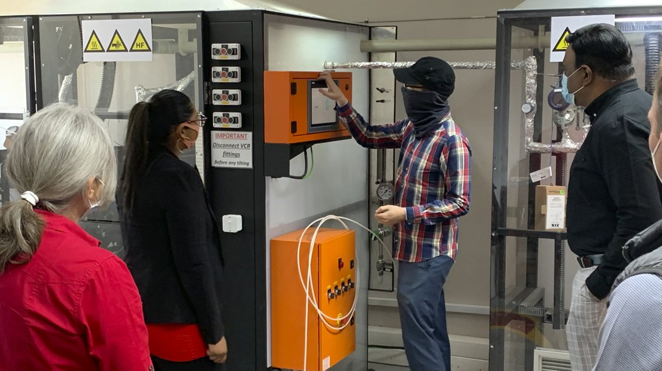
Commercialisation Success
Rare Earth Refineries
TIA funded market facing entity
The IP- fluorination of rare earth metals
Operating under license from Necsa
Patents filed globally by Necsa
Current status: 70 ton/pa Neodymium Fluoride demonstrated with TIA funds in Gemini Natural rare earth price~$40\kg After beneficiaries with Necsa IP ~$150\kg
26% black women owned

Slide 9


UNIDO GCIP-SA
Global Cleantech Innovation Programme-South Africa
A competition and accelerator supports entrepreneurs (SMEs) in energy efficiency, renewable energy, green building practices and biotechnology
Provides early-stage financing and support to SMEs from concept to commercialisation
TIA secured $3.4m over 5yrs for Phase II to assist transitioning towards a circular economy and create green jobs
Target is to support 200 start-ups

Slide 10
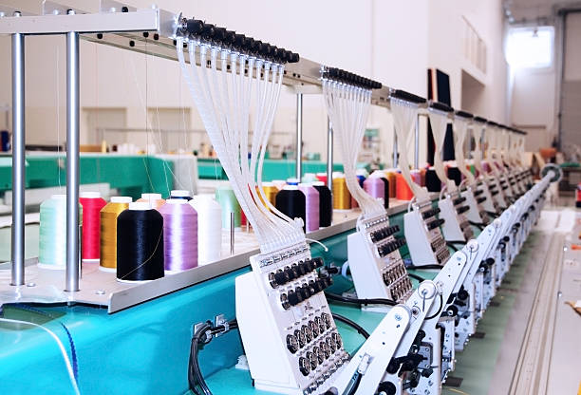

Stakeholder Engagement
Establishment of Clothing and Textile Hub at Tshwane South College – Odi Campus, Mabopane, GP
GPED approved funding of R4.65m (capacity building and training; capex for high-end infrastructure)

Slide 11
Planning Priorities
Promote commercialisation for increased socio-economic impact
Increase pipeline of de-risked publicly funded IP
Increased investments in innovation infrastructure
Increased private sector investments in STI
Promote transformation and inclusive growth
Promote partnerships for increased funding
Implement a revised operating model as per TIA Review

Slide 12
Opportunities and Challenges
Opportunities
Challenges
Increased dynastism of the innovation ecosystem
Increasing participation of the private sector in the development and utilisation of locally developed technologies
Start-up Act initiative by the investor community
Strong DSI drive to promote public procurement of locally developed technologies
Innovation Fund will increase commercialisation of locally developed technologies through the provision of Series A and Series B funding
Draft Decadal Plan clarifies key STI policy priorities, auguring well for policy certainty
The DSI is pursuing key industry development initiatives, e.g. vaccine manufacturing, hydrogen economy
Partnerships with DHET entities (TVET Colleges and SETAs)
Uneven participation of PDI institutions in the production of publicly funded research output
Persistently low innovation activity in underserved provinces
Fragmentation, silo mentality and avoidable competition amongst funders within the NSI

Slide 13
Outcome 1: Commercialised innovations
Challenge
Objective
Poor translation of public-funded technologies & IP for socio-economic growth development
Direct more of TIA’s resources to support the translation of locally developed technologies & IP from HEIs & science councils into commercialised innovations
Decadal Plan
Rejuvenate manufacturing and mining through competitiveness and efficiency improvements and application of new technologies
Improve energy supply security and decarbonise the economy through greener energy technologies
Sustainably utilise its natural resources (waste and water) and transitioning to a circular economy
Digital transformation of key industries and sectors, including cybersecurity
Bridge digital divide for access and inclusion of PDIs and marginalised groups
Support access to IP from public-funded R&D to black, women and youth-owned high-tech start-ups

Slide 14
Planned Performance: Outcome 1
Output | Indicator | Annual Targets
 |  | MTEF Period
 |  | 2022/23 | 2023/24 | 2024/25
Technologies licensed or assigned | No. of licensed/assigned technologies | 15 | 20 | 25
Academia/industry collaborations | No. of projects | 36 | 40 | 44
Technologies diffused | No. of diffused technologies | 15 | 20 | 24
Products launched | No. of products launched | 28 | 29 | 36
Leveraged funds | Rand value leveraged | R250m | R275m | R305m
14

Slide 15
Outcome 2: Delivering on the Bio-economy Strategy
Challenges
Objective
Unrealised potential for new bio-based products and processes and the creation of new enterprises and new markets
Support the translation of bio-based knowledge resources into sustainable bio-based solutions through implementing the Bio-economy Strategy (agriculture, health, industrial biotechnology and IKS)
Decadal Plan
Revitalising and modernising the agriculture sector through improving economic competitiveness and productivity
Leveraging off the circular economy
Innovation in support of health (optimisation of health systems, improving quality of healthcare, digitisation of healthcare systems)
Ecosystem-based climate change adaptation and mitigation through technology development and dissemination in key sectors
Cross-cutting nature of bio-economy – opportunity to address interconnected societal challenges (healthcare, burden of disease, food security, managing renewable biological resources, dependence on fossil fuels, climate change)

Slide 16
Planned Performance: Outcome 2
Output | Indicator | Annual targets
 |  | MTEF period
 |  | 2022/23 | 2023/24 | 2024/25
Bio-based technologies developed | No. of bio-based technologies demonstrated | 23 | 26 | 30
Technology Platforms managed & supported | No. of Technology Platforms | 8 | 8 | 8
Technology Innovation Clusters managed & supported | No. of Technology Innovation Clusters | 7 | 7 | 7
16

Slide 17
Outcome 3: SMMEs supported through strategically informed and regionally distributed Technology Stations
Objective
Challenges
Promote the growth of SMMEs and cooperatives, contribute towards innovation-led industrialisation processes, creation of decent jobs, technology start-up enterprises and the support of SMMEs
Structurally high unemployment, esp. women and youth; poor SMME startup and survival rates; fragmented and poorly coordinated NSI
Decadal Plan
Foster inclusive development through SET and enterprise development support to grassroots innovators, cooperatives, entrepreneurs and businesses
Foster transformation through increased spatial footprint to underserved provinces and priority districts

Slide 18
Planned Performance: Outcome 3
Outputs | Output indicators | Annual targets
 |  | MTEF period
 |  | 2022/23 | 2023/24 | 2024/25
New centres | No. of new technology & innovation support centres | 7 | 5 | 6
SMMEs & cooperatives supported | No. of SMMEs & cooperatives supported | 2,800 | 2,940 | 3,115
Human capital development | No. of high-level students & post-doc fellows supported | 121 | 130 | 150
Innovation products produced | No. of IP & knowledge based innovation products | 149 | 165 | 180
18

Slide 19
Planned Performance: Administration
Output | Indicator | Annual Targets
 |  | MTEF Period
 |  | 2022/23 | 2023/24 | 2024/25
Good financial governance | Audit opinion | Unqualified external audit opinion; no financial matters in audit report | Clean external audit opinion | Clean external audit opinion
Improved funding application turnaround time | Turnaround time (<R1m) | 4 weeks | 4 weeks | 4 weeks
 | Turnaround time (R1m-R15m) | 15 weeks | 15 weeks | 15 weeks
 | Turnaround time (>R15m) | 26 weeks | 26 weeks | 26 weeks
Support underserved provinces | Funding to underserved provinces | Min. 30% available funds allocated | Min. 30% available funds allocated | Min. 30% available funds allocated
Transform TIA’s investment portfolio | Funding to transformed recipients | Min. 30% available funds allocated | Min. 40% available funds allocated | Min. 50% available funds allocated
19

Slide 20
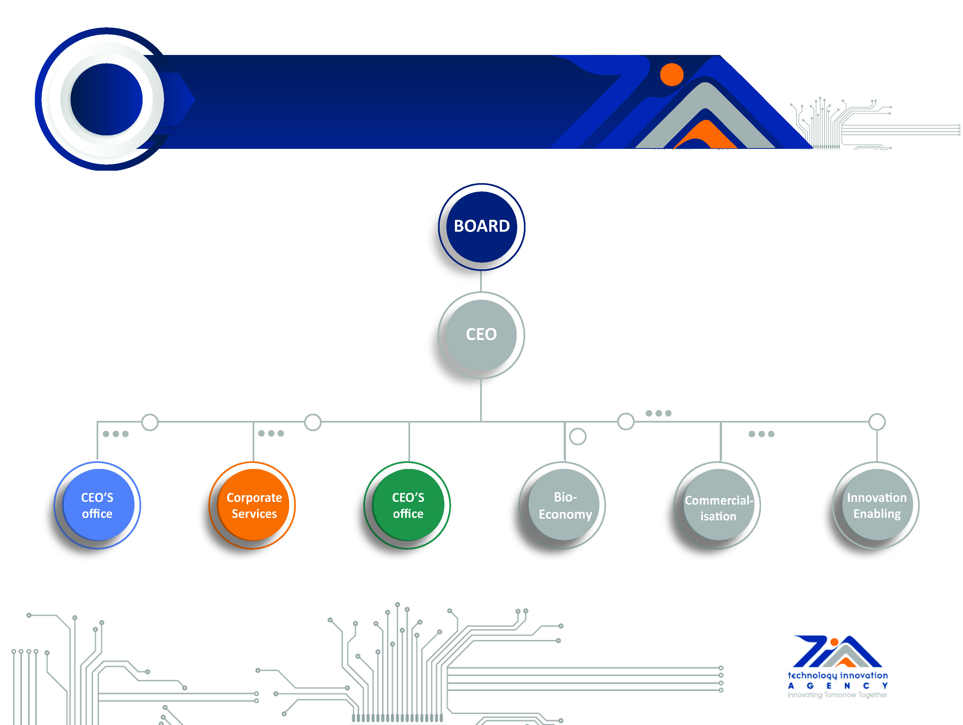
Organogramme
Organogram
20

Slide 21
Selected Strategic Initiatives
INITIATIVES | KEY ACTIONS
Textile Tech Hub | Establish a clothing and textile hub in partnership with GDED
Special Purpose Vehicle | Develop a business plan to establish a SVP to leverage funding partnerships
Biorefinery | Establish an ALGAL Biorefinery initiative
Fund Manager Programme | Implement the TIA/SA SMME/SAVCA Fund Manager Development Programme
TIA Accelerator | Establish a TIA Accelerator Programme
SBRI | Implement the Small Business and Research Innovation Programme

Slide 22
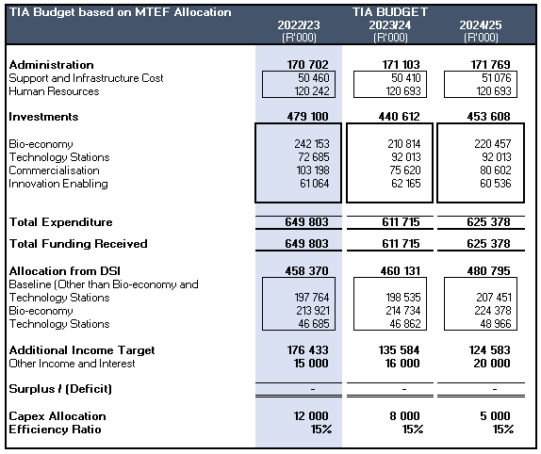
3-year Budget
22

Slide 23
THANK YOU

