Slide 1
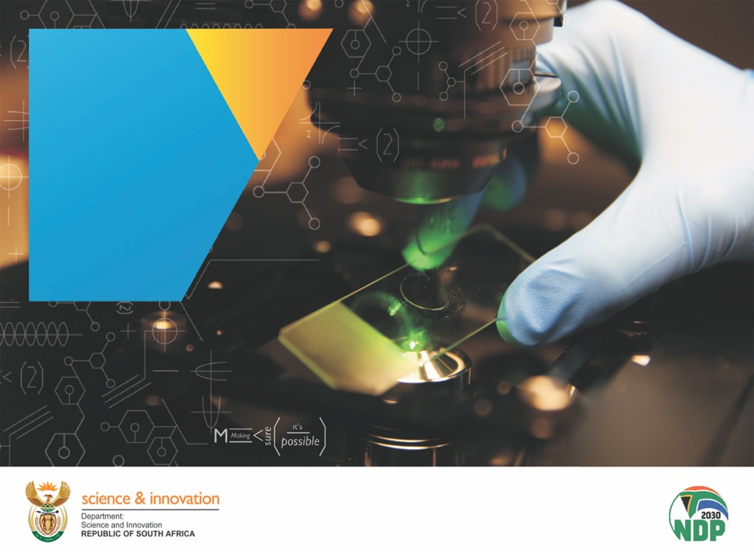
Contents
The DSI Revised 2020-2025 and 2022/23 APP
Chapter 01
Chapter 01
Chapter 01
Chapter 01
Chapter 01
Chapter 01
Chapter 01
22 April 2022

Slide 2
Presentation Outline
Context
DSI Revised 2020-2025 Strategic Plan
  The 2022 Decadal Plan: the philosophy and key interventions planned
  Support to the national response to COVID-19 and contributions to ERRP and
  DSI Performance Information
DSI 2022/23 Annual Performance Plan
    Implementation of DSI Outcomes
    Performance information
    MTEF Allocations per budget programmes
    DSI Entities
    DSI Infrastructure Projects
Revised 2019-2024 Medium-Term Strategic Framework
  Increasing focus on vulnerable groups in particular women, the youth and people with disabilities

Slide 3
The DSI Revised 2020-2025 Strategic Plan

Slide 4
Context (1)
  Vision of the White Paper: Science, technology and innovation enabling sustainable and inclusive development in a changing world.
  Approach in the White Paper: STI that builds on previous successes; embraces technological change for socio-economic and environmental impact.
  Philosophy underlying the Decadal Plan
  “deepening the knowledge economy for enhanced socio-economic impact”
  Decadal Plan has two mutually reinforcing aims:
  Pivoting the NSI towards making an increased positive impact on SA’s socio-economic & environmental priorities.
4

Slide 5
Context (2)
The Economic Reconstruction and Recovery Plan, to which the Department and the NSI broadly, contributes towards:
      The revitalisation of sectors that were depressed by Covid-19
      The development of new sources of growth
      The building of a capable and developmental state
      Support to sectors such as energy and health
4

Slide 6
New policy priorities
Maintaining equilibrium between a focus on impact (e.g. inclusive innovation) and continued investment to develop the system (e.g. in systemic enablers such as knowledge creation and institutions).
  Decadal Plan priorities approved by Cabinet in March 2021 for consultation with social partners:
Exploiting new sources of growth: Circular economy, the Digital economy.
Modernising agriculture, mining and manufacturing.
Societal Grand Challenges (SGCs): Climate Change and Environmental Sustainability; Future-proof education, and The future of society.
Large Research Programmes: Health innovation; and Energy innovation.
Building a capable state.

Slide 7
Exploiting new sources of growth: The Circular Economy
An estimated 50% of greenhouse gas emissions, 90% of water stress and 90% of global biodiversity loss is attributed to resource extraction and processing (UNEP & IRP, 2020).
Circular Economy approaches also create jobs and economic efficiencies.
Sector | e.g. Climate impact | e.g. Circular economy interventions*
Mining | Resource extraction, energy consumption (fossil-based) | Regenerative, renewable energy
Energy | Fossil-based energy generation (electricity, fuels) | Regenerative, renewable energy
Agriculture | Globally, food losses and waste a major GHG emitter SA food losses and waste 2.1% of GDP (34% of local production) Sector vulnerable to changing climates (temperature, rainfall) | Reducing wastage Minimising resource inputs Regenerative farming Unavoidable waste beneficiated
Manufacturing | Major contributor to GHG emissions through reliance on fossil-based fuels, high resource demands, inefficient use of resources | Regenerative, renewable energy Disruptive 4IR technologies Remanufacturing (embedded energy)
Human settlements | Cities contribute up to 75% of global carbon emissions | Change in resource use and wastage Urban agriculture
Mobility | 98% of SA’s transport sector’s energy from petroleum products 77% of land freight is still transported via road in South Africa | Change in mobility systems
Water | SA uses 98% of available supply, by 2030 demand will exceed supply by 17% | Regenerative, reuse, efficiency
* The above list of circular economy interventions is not exhaustive but provides examples of where interventions can address GHG emissions or risks of changing climates

Slide 8
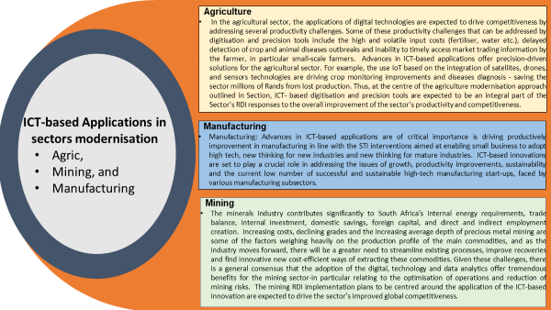
Mordenising Existing Industries

Slide 9
Catalytic Projects
  To kick-start the development of a hydrogen society in South Africa, a number of catalytic projects have been identified:
  Hydrogen Valley or Platinum Valley Initiative
  CoalCO2-X project
  Boegoebaai Special Economic Zone
  Sustainable Aviation Fuels

Slide 10
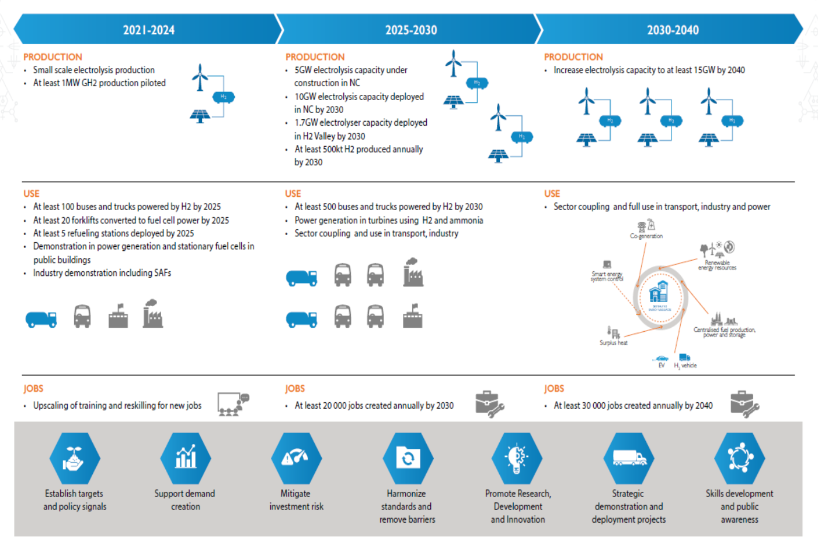
Key Actions and Milestones

Slide 11
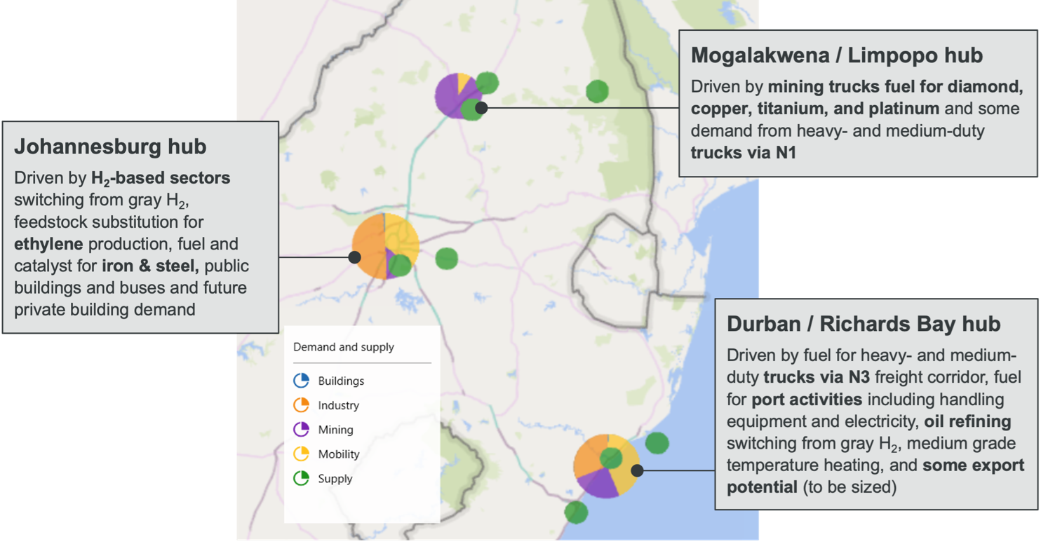
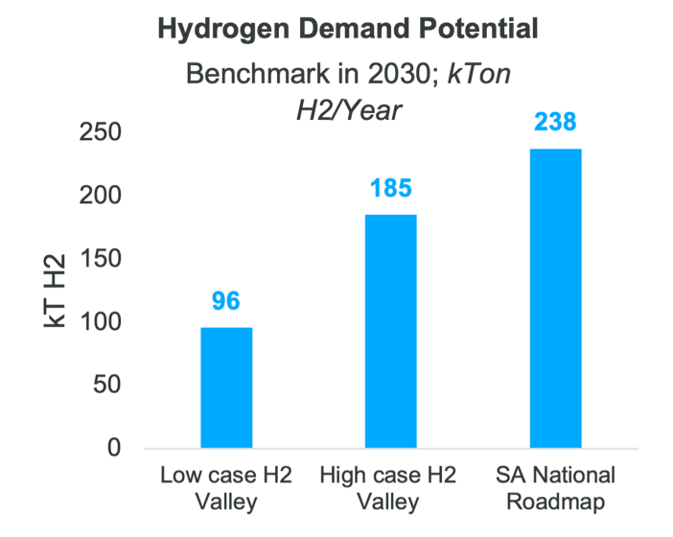
Platinum Valley - structured around three hydrogen hubs
H2 VALLEY HUBS
H2 DEMAND
Green Transport Strategy
Green Hydrogen Commercialisation Strategy
Hydrogen Society Roadmap
Just Energy Transition
Framework
South African
Renewable
Energy
Masterplan
Hydrogen Research
Development &
Innovation
Strategy
The Hydrogen Society Roadmap seeks the effective integration of hydrogen related technologies in various sectors
of the economy/society to foster inclusive growth and help reduce poverty and inequality,
H2 demand in the Valley could reach up to 185 kt H2 by 2030, or 40%-80% of demand in the national hydrogen roadmap.
By 2030, green H2 LCOH across hubs is expected to be ~$4 per kg H2 , still more expensive than gray hydrogen, with a green premium of $2-$2.5 per kg.
Completed
Dec 2020
To be Completed
Dec 2021
Completed
July 2021
To be Completed
Aug 2021
To be Completed
Aug 2021
Completed
Dec 2020

Slide 12








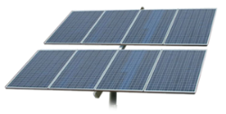
CoalCO2-X Programme
Challenges
Proposed Solution
Resulting in:
Global COP21 (Paris Agreement) Commitments
  CO₂ → PPD trajectory; Carbon Tax: Eskom R11bn/y, Sasol R1bn/y
Local Pollutant Legislation
  PM, Hg, NOx, SOx → Industry Non-Compliance 1 April 2020
Environmental Crises
  Poor Air Quality → Sickness, Death, Decreased Economic Productivity, Changing Weather Patterns i.e. Drought & Floods
Constitutional Right vs Litigation
  Criminal Proceedings → Mittal, Min. of Env. Affairs & President
✓
CoalCO2-X™ Programme
Carbon Capture & Utilisation
Ringfence Carbon Tax / Other Funding
Greener Electricity
Flue Gas
Residential
Compliance & Beyond
Clean Air
Health
Industrial
✓
Mining
✓
EV
✓
Coal
Coal-Fired and/or Industrial Plant
Green Onsite Commodities & Jobs
Green H₂
CoalCO2-X™ Demonstration Facility
Hydrogen
Green NH₃
Ammonia
Renewable Energy
PM
SO₂
NOx
CO₂
The objective of the CoalCO2-X™ Programme is to convert coal-fired and industrial flue gas into multiple onsite industrial commodity streams using green ammonia and green hydrogen employing local and international IP.
Fertiliser
Sulphuric Acid
Pictures from: pngwing,
Towards a Carbon Capture and Utilisation Economy

Slide 13
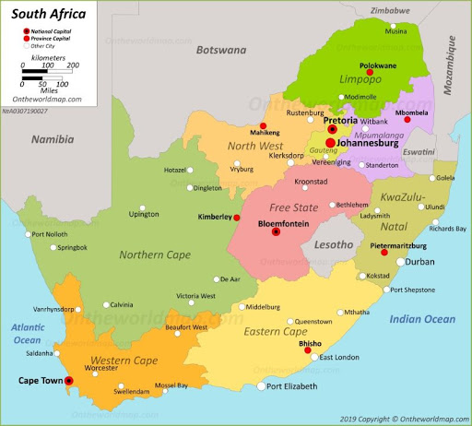
Developmental Impact for South Africa – Linked to the Global Hydrogen Economy
1
2
Utilise RSA Renewable Energy for Green Hydrogen & Ammonia Production
Address Air Quality in the Highveld Priority Area: Flue Gas Conversion
Fertiliser
Production
Sulphuric Acid
Production
Green Hydrogen & Ammonia Export @ Richards Bay
Green Hydrogen & Ammonia Export @ Boegoebaai
Green Hydrogen
Production
RE
Green Ammonia
Production
`
Sea Water
Desalination
* Use 25% of Green Hydrogen Production for the Production of Green Ammonia for Priority Area Multipollutant Carbon Capture and Conversion (CCU)
http://ontheworldmap.com/south-africa/
Towards a Carbon Capture and Utilisation Economy

Slide 14

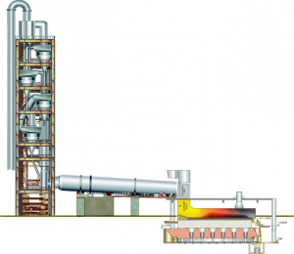
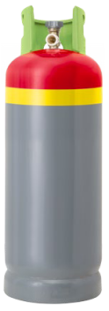

Pilot Technology Demonstration & Training
Hard-to-Abate Cement Industry Pilot Plant Demonstration in 2022
CoalCO2-X™ Programme Awareness Training
Completed in 2021
Capture: PM + Heavy Metals
Convert: CO₂ and NOx into Fertiliser
Grey Ammonia
Treated Flue Gas
(PM, SOx, NOx, CO₂)
NH₃
Flue Gas CO₂ Conversion
PM
Fertiliser Production
Coal
ABC
Fertiliser Salt
Commercial Fertiliser
South African Cement Clinker Plant
Awareness Training done for 178 Students
Future upscaling and demonstration at coal-fired power generation plants
Future training of engineers and technicians in hydrogen and CCU technologies
Towards a Carbon Capture and Utilisation Economy

Slide 15





DSI Response to COVID-19
Support and strengthen the country's local research, development and innovation capabilities to manufacture active pharmaceutical ingredients, vaccines, biopharmaceuticals, diagnostics and medical devices to address the disease burden while ensuring security of supply of essential therapeutics and prophylactics.
Vaccine development & manufacturing to provide for adequate level of sovereignty
API manufacturing cluster
Drug discovery & development / therapeutics
National Bio-economy Strategy
Surveillance capabilities
NGS-SA (identify/monitor variants circulating in SA and gather data on whether there is clinical & epidemiological evidence suggesting health impact
Diagnostics
Medical devices
Establish world class infrastructure to fast track research & development
Human capital development

Slide 16
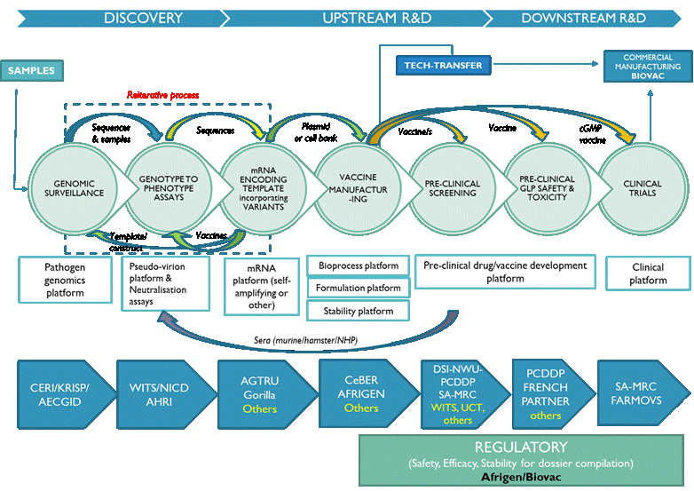




Health: Build innovation capacity and pipeline of homegrown products
17

Slide 17
PROPOSED TECHNOLOGY PLATFORMS
As informed by existing capabilities, propose three additional platforms to supplement mRNA Technology Transfer Hub, and the subsequent development of a business case for the three platforms
VLP
mRNA
INACTIVATED PATHOGEN
Conjugated vaccines
mRNA partners – WHO, CEPI, Africa CDC, Biovac, Afrigen Biologics, SAMRC, MPP, French Government and a network of local universities to develop, manufacture and distribute locally developed vaccines for Africa-specific COVID-19 variants as well as future pathogens threatening the health of people on the continent. Partnership for Biovac to manufacture and distribute the Pfizer/BioNTech COVID-19 vaccine for distribution within the African continent.

Slide 18
Cont.…
  Benefits:
  Short-term (improving trade balance and current account balance & create employment);
  Medium and long-term (building strategic national competency in life sciences & technology, providing strategic security of supply of vaccines nationally and regionally.
  The local production of vaccines to not only support the local demand, but also that of Africa and this could have significant revenue potential for South Africa and have a positive influence on our trade balance.
  Vaccine import dependence in Sub-Saharan Africa is rising, creating significant export opportunities for African manufactured vaccines.

Slide 19







AFRICAN MEDICINES AND COVID-19 RESEARCH
African Medicines and COVID-19 Research
  The DSI established the Indigenous Knowledge-Based COVID-19 Research Team, a sub-team of the African Medicines Platform of the department
  The team is constituted by African medicine practitioner organisations, science councils, universities and government department
  Two multi-herbal and seven mono-herbal formulation were selected out of twenty medicines historically used in the treatment of respiratory conditions
  A total of R15 million was re-aligned from existing project on other health conditions under African medicines, nutraceuticals, health infusions, technology transfer and commercialisation platforms
  Two multi-herbal and two mono-herbal formulations have progresses to clinical trial phase; and one has received a SAHPRA approval
  Forty IK-Holders were trained through a 6-month CoachLab Programme on Bio-Entrepreneurship and Enterprise Development

Slide 20



AFRICAN MEDICINES AND COVID-19 RESEARCH
Cont.…
  South Africa is the current chair of the WHO-AFRO’s Regional Expert Committee of African Medicines and COVID-19.
  R18 million has been leveraged for Phase II clinical trials from the Technology Innovation Agency.
  R1 million was leveraged to support agro-processing and manufacturing activities for supporting IK-Based SMMEs producing health products (immune modulators and boosters).
  R1.7 million was leveraged to support the establishment of a committee to develop a legal framework for inclusion of African medicines in Essential Medicines List at SAHPRA.
  The Impact of COVID-19 on African Medicines Practitioners and their participation in Epidemic Preparedness and Response was concluded.
  Medicinal Cannabis aspects of the Presidential Master-Plan on Industrialisation of Cannabis are being investigate for COVID-19 and other priority health conditions.

Slide 21
Global Change

Slide 22
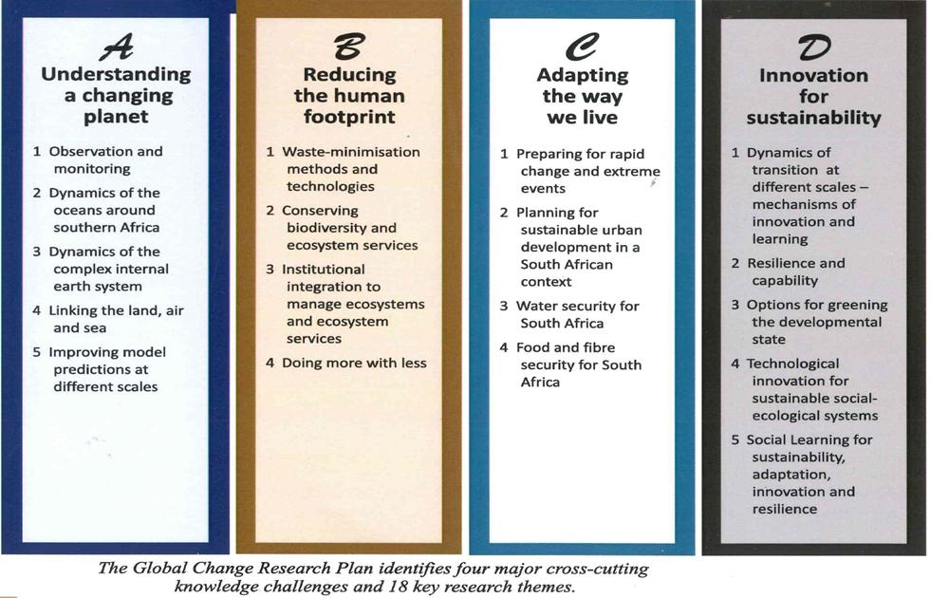






Global change – Knowledge Generation
Global Change Research Plan for SA, 2010
Key principles underlying GCRP include:
  Adopts a systems approach;
  Inter-, multi- and trans-disciplinary approach to research;
Recognises SA’s advantageous geographical location - surrounded by three oceans that influence the climate system of the southern African region
4 knowledge areas and 18 research themes
GC research programmes & initiatives:
ESSFP
FBIP
GCSSRP

Slide 23
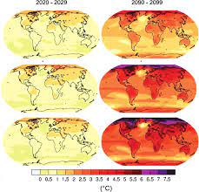
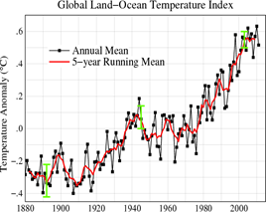
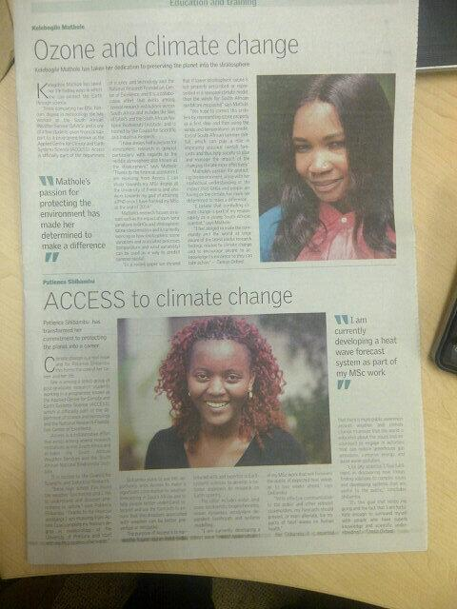


ACCESS
ACCESS is a CSIR- hosted virtual network of collaborating partners (research entities and universities) and programme focusing earth systems science
Flagship programmes include Habitable Planet Workshops (HPW), Conversations on Climate Change series etc.
Contributes to:
Investment - Over R200m (13yrs); ave. R16m/yr

Slide 24

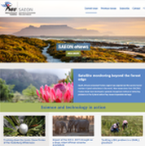



SAEON
SAEON is a comprehensive, sustained, coordinated and responsive South African environmental observation network that delivers long-term reliable data for scientific research and informs decision-making; for a knowledge society and improved quality of life.
Contributes to:
Investment - Over R320m (13yrs); ave. R25m/yr

Slide 25

SARVA & SCIENCE CENTRES
  SARVA – A “one-stop-shop” spatial database system aimed at equipping decision-makers with information on the impacts and risks associated with global change at local level
RVSC - A complimentary programme aimed at building capabilities of rural-based universities in the area of environmental risks and vulnerability assessment. Current participants - Walter Sisulu (WSU), Fort Hare (UFH), Limpopo (UL), Free State –QwaQwa (UFS) and Sol Plaatje (SPU) Venda (future)
Investments - R4m/yr for SARVA; R4m/RVSC/yr

Slide 26
Global Change Performance and Investment Council
Intn’l Resource Mobilising
Team
Science Committee
South African Environmental Observation Network (SAEON)
Space Agency (Global Change Monitoring Network)
SA Polar Research Entity
Knowledge Brokering Support Unit
Centre of Excellence
Applied Centre for Climate and Earth Systems Studies (ACCESS)
Africa Earth Observation Network (AEON) programmes
Inkaba ye Africa/ !Khure Africa
Large scale research programme
Global Change, Society, and Sustainability
R&V science
centres
South African Risk and Vulnerability Atlas (R&V Atlas)
Bureau for Global Change Science

Slide 27
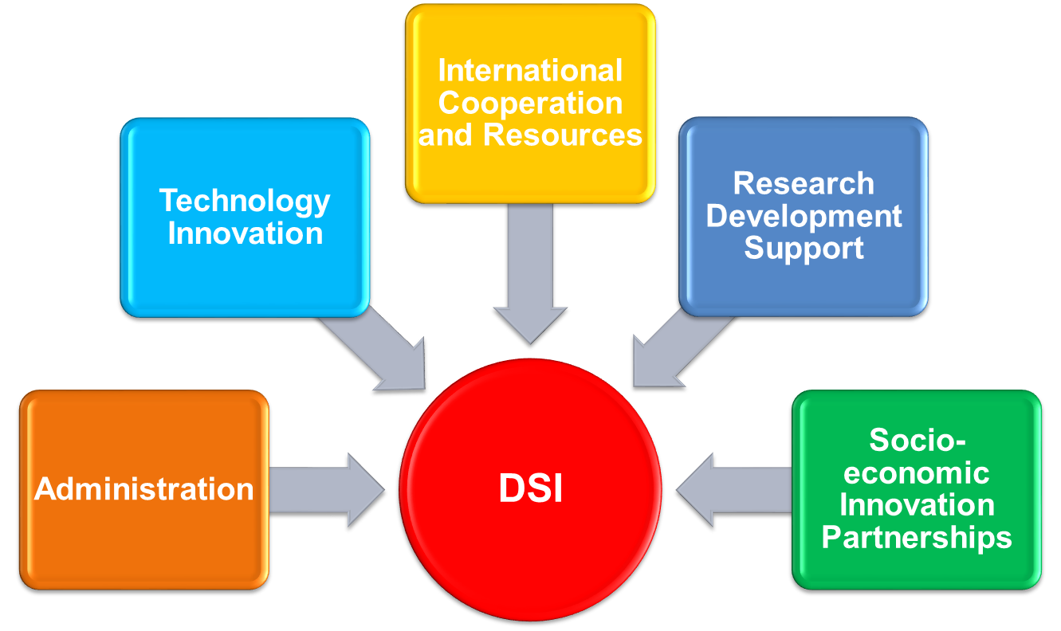
Institutional Arrangement
Internally the DSI is organised into five budget programmes to deliver on its mandate and contribution to 2019-2024 MTSF apex priorities and the South African Economic Reconstruction and Recovery Plan.
26

Slide 28
Cont.…
The recently approved revised 2020-2025 Strategic Plan is underpinned by elements of:
  The NDP three Pillars,
  Revised 2019-2024 Medium-Term Strategic Framework apex priorities;
  The DSI Response to COVID-19;
  DSI contributions to the Economic Reconstruction and Recovery Plan (ERRP);and
  2019 White Paper on Science, Technology and Innovation policy thrust and intents including the STI Decadal Plan short/medium-term Intervention.
The revised 2020-2025 Strategic Plan is contained of a revised impact statement, Six Institutional Outcomes; and revised nineteen (19) associate outcome indicators in support of national government developmental agenda.
27

Slide 29
DSI Performance Information
Impact statement: South Africa’s sustainable and inclusive development enabled and enhanced through Science, Technology and Innovation.
  A transformed, inclusive, responsive and coherent NSI
  Human capabilities and skills for the economy and for development
  Knowledge utilisation for economic development:
    (a) in revitalising existing industries
    (b) in stimulating R & D led industrial development
  Increased knowledge generation and innovation output
  Innovation in support of a capable and develop- mental State
  Knowledge utilisation for inclusive development
Partnerships
Internationalisation
Transformation

Slide 30
Outcome One: A transformed, inclusive, responsive and coherent NSI.
Supported by the following Outcome Indicators:
  Number of formalised partnerships between different category actors of the NSI that advance Decadal Plan priorities.
  Number of missions introduced and adopted by Cabinet to crowd in resources and capabilities across the NSI.
  Percentage of STI investment support by government, domestic business, non-governmental sector and foreign / international sources that advances GERD towards 1.1% of GDP.
  Number of approved strategies that give effect to the agreed dimensions of transformation to be effected in the NSI.

Slide 31
Outcome Two: Human capabilities and skills for the economy and for development.
Supported by the following Outcome Indicators:
  Number of DSI funded PhDs graduating annually as a contribution to the NDP target of 100 PhDs per million population by 2030.
  Number of artisans and technicians absorbed into the economy in sectors where DSI has active programmes.
  Percentage of women and black researchers in South African research workforce.
  4. Percentage of PhD qualified staff in higher education research and academic workforce.
  5. Improved knowledge about science among the general public.

Slide 32
Outcome Three: Increased knowledge generation and innovation output.
Supported by the following Outcome Indicators:
Percentage of South Africa's share of global publication output.
Percentage of prototypes, technology demonstrators and pilot plants that advance industrialisation through innovation.

Slide 33
Outcome Four: Knowledge utilisation for economic development –
(a) in revitalising existing industries (b) in stimulating R&D-led industrial development.
in revitalising existing industries; and
in stimulating R&D-led industrial development.
Supported by the following Outcome Indicators:
  Rand value of RDI investment attracted to support RDI needs identified through the sector masterplans process.
  Percentage investment in SMMEs/Co-ops/Starter-Up to secured new opportunities through support provided by the DSI and its entities.
  Number of new commercialised disclosures from publicly financed research and development R&D.
  Number of new R&D-led industrial development opportunities initiated by the DSI.

Slide 34
Outcome Five: Knowledge utilisation for inclusive development
Supported by the following Outcome Indicators:
  Number of grassroots innovations whose commercialisation has been facilitated by the support/access of the multi-tiered support package provided by the DSI and its entities.
  Number of publicly financed intellectual property made available in support of grassroots innovators.

Slide 35
Outcome Six: Innovation in support of a capable and developmental State.
Supported by the following Outcome Indicators:
  Number of demonstrators that have successfully introduced a new way of delivering a service.
  Number of district/metropolitan municipalities supported with technology-based applications as part of the District Development Model for service delivery improvement.

Slide 36
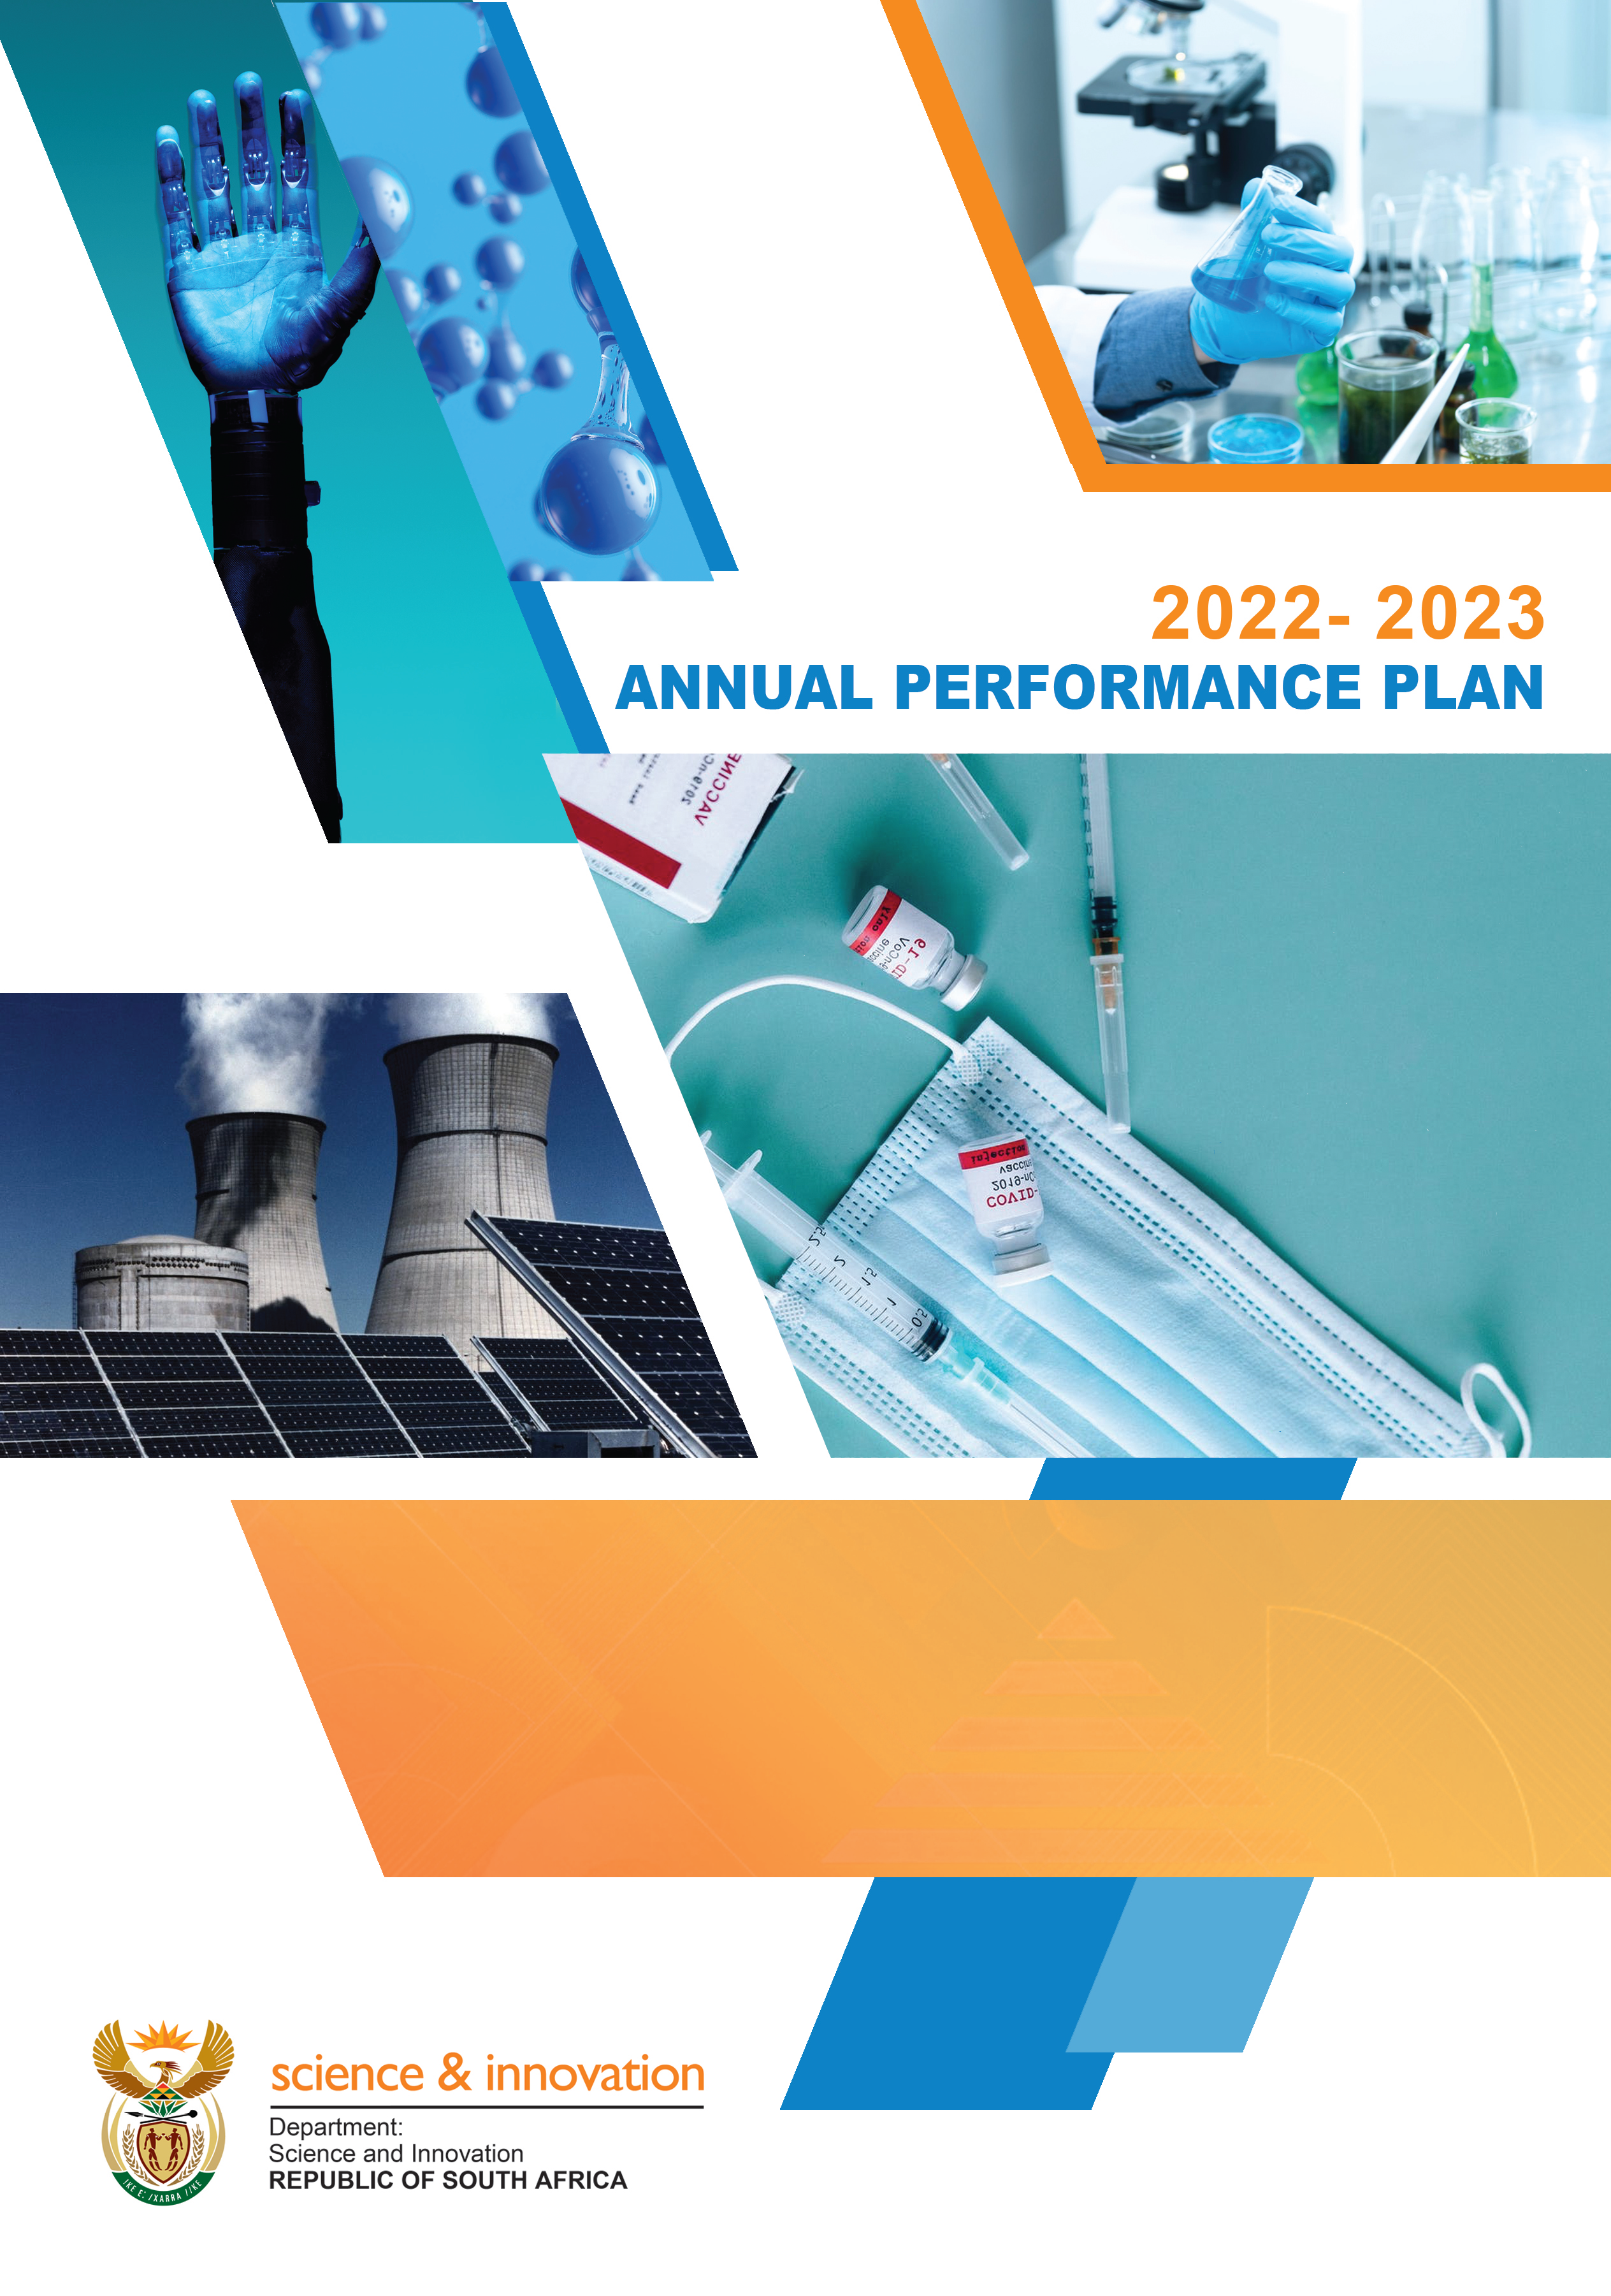
The DSI 2022/23 Annual Performance Plan

Slide 37
Cont.…
The DSI Revised 2020-2025 Strategic Plan maintained the March 2020 adopted six strategic institutional outcomes. However revisions and amended were effected on the associate twenty-two (22) outcome indicators to nineteen (19) against which the Department’s medium-term performance and results will be measured and evaluated.
In implementing the DSI Revised 2020-2025 Strategic Plan, the 2022/23 Annual Performance Plan (APP) identified fifty-three (53) output performance indicators, and medium-term targets that the Department seeks to achieve over the medium-term (2022/23; 2023/24; and 2024/25).
36

Slide 38
Implementing Outcome 1
Outcome 1: A transformed, inclusive, responsive and coherent NSI
Planned policy initiatives/ targeted interventions:
  Finalise Transformation Framework to expand transformation agenda in all strategic STI focus areas through ten key transformation dimensions e.g. Demographic transformation; Transdisciplinary transformation; Institutional transformation; Transformation through translation of science and innovation for the social benefit of society and fundamental economic transformation etc.. [transformed]

Slide 39
Cont…
  Support grassroots innovators and support new entrants into the economy, via targeted RDI instruments; [inclusive]
  Modernisation of sectors of the economy such as manufacturing, agriculture and mining to ensure that these sectors are competitive and can contribute to higher GDP growth; [responsive]
  Finalise the Decadal Plan which will be 2019 WP for STI implementation plan and define critical missions that will be attend to between 2021-2031; [coherent]

Slide 40
Implementing Outcome 2
Outcome 2: Human capabilities and skills for the economy and for development
Planned policy initiatives/ targeted interventions
Implement new Postgraduate Funding Policy that provides for Full Cost of Support for certain groups of students, namely, the financially needs, students with disabilities and the exceptional academic achievers;
Support more than 8 782 Honours, Masters and PhD students across programmes by 31 March 2022;
Mainstream themes in research grants covering all knowledge fields;

Slide 41
Cont…
Support the development of critical high-end skills in selected technology areas such as the bioeconomy, space science and technology, energy, intellectual property management nanotechnology, robotics, photonics and areas of technology convergence that are important in building a knowledge society; and
Production of more master's and doctoral degrees in engineering in line with the innovation and economic development priorities of the country, as identified in different sector master plans and the STI Decadal Plan currently under development.

Slide 42
Implementing Outcome 3
Outcome 3: Increase knowledge generation and innovation outputs
Planned policy initiatives/ targeted interventions
Increase South Africa’s research outputs/productivity, and its world share of publications towards the 1% of global output.
  fast-tracking interventions aimed at PhD qualification among non- PhD-qualified staff; and
  Interventions to improve the publishing rate of academics at HDIs to increase research outputs per capita.

Slide 43
Cont…
Measure and track the number of outputs commercialised as a result of support provided in designated areas; e.g. licenses, assignments, options of varying nature (such as directed research, joint ventures and the like), start-ups, spin outs, new companies; etc..
Expand the roll-out of the South African National Research Network (SANReN) to TVETs and increase the total available broadband capacity to 5 800Gbps; and
Establish IK-Based Bio-Innovation Institute to interface and mainstream African wisdoms for applied integral research, inclusive innovation, local technology transfer, holistic enterprise development and conscious commercialisation.

Slide 44
Implementing Outcome 4
Outcome 4: knowledge utilisation for economic development in -
revitalising existing industries and
stimulating R&D led industrial development.
Planned policy initiatives/ targeted interventions
Introduction of the Sovereign Innovation Fund (SoIF), which will serve as a new financing instrument in partnership between the public and private sectors with the sole purpose of harvesting and commercialising the South African technology innovations for deployment in national and international markets;
Participate in the development of sectoral master plans i.e. agriculture, the oceans economy, energy, mining and health;

Slide 45
Cont…
Participate in the development of sectoral master plans i.e. agriculture, the oceans economy, energy, mining and health;
Implement common flagship programmes in support of priority sectors as reflected in the national reimagined/revitalised industrial strategy;
Partnering with the DMRE in deploying fuel cells at government buildings and critical infrastructure such as airports, as well as rural formal and urban informal settlements to reduce the impact of rolling blackouts; and
Using industrial ports as the nerve centres for scaling up the use of clean hydrogen towards building a Hydrogen Economy in SA.

Slide 46
Cont…
Leads the RDI aspect of the national master plan programme on medicinal cannabis and hemp in developing medicines, nutraceuticals and cosmeceuticals from cannabis in collaboration with other government departments, civil society, academia and business grounded on the principles of socio-economic transformation, i.e. inclusion of women and youth.
Continue managing a portfolio of projects with a potential of creating new industries or rejuvenating existing industries.

Slide 47
Implementing Outcome 5
Outcome 5: knowledge utilisation for inclusive development
Planned policy initiatives/ targeted interventions
In line with the national development profile and social dynamics and ensuring knowledge for inclusive development enable innovation deployment, the department will expand the multi-tiered package to support commercialisation of grassroots innovations, through technology development, compliance with industry standards where applicable, and protection of IP and mentorship;

Slide 48
Cont…
More deliberate focus on IP related solutions that will enable and improve access to basic services, strengthening the capacity of the state in service delivery and promote the inclusion of women, youth and people living with disabilities; and
Facilitate commercialisation of grassroots innovation and its access to publicly available IP in line with the commitment for the deployment of locally developed technology solutions, using instruments such as technology demonstrations, agroprocessing facilities and support for entrepreneurs.

Slide 49
Implementing Outcome 6
Outcome 6: Innovation in support of a capable and developmental state
Planned policy initiatives/ targeted interventions
The Department will be more deliberate in promoting the expansion of piloted solutions that enable and improve access to basic services such as waste and water management, housing, sanitation and energy provision and that strengthen the capacity of the state in service delivery.
Locally developed technology deployment in support of the use of innovation in implementing State policies in Basic Education, e-Health, infrastructure project scoping etc..

Slide 50
2022/23 Output Performance Indicator Analysis Programme

Slide 51
MTEF Allocations per Programme
Programme | Adjusted Appropriation 2020/21 | MTEF ALLOCATION
 |  | 2022/23 R’000 | 2023/24 R’000 | 2024/25 R’000
Administration | 334 724 | 335 077 | 333293 | 348 264
Technology Innovation | 1 7052 89 | 1 784 052 | 1 793 320 | 1 873 858
International Cooperation and Resources | 144 416 | 149 881 | 149 466 | 156 177
Research Development and Support | 4 995 632 | 5 105 044 | 5 203 385 | 5 436 856
Socio-economic Innovation Partnerships | 1 825 577 | 1 759 246 | 1 765 117 | 1 632 945

Slide 52
2022/23 Budget Analysis per Programme

Slide 53
DSI Entities alignment to the DSI Six Outcomes
ENTITY | OUTCOME SUPPORTED
National Research Foundation | A transformed, inclusive, responsive and coherent NSI Increased knowledge generation and innovation output Human capabilities and skills for the economy and for development
Council for Scientific and Industrial Research | Knowledge utilisation for economic development (a) in revitalising existing industries and (b) in stimulating R&D led industrial development Increased knowledge generation and innovation output Innovation in support of a capable and developmental state

Slide 54
Cont.…
ENTITY | OUTCOME SUPPORTED
Technology Innovation Agency | Knowledge utilisation for economic development (a) in revitalising existing industries and (b) in stimulating R&D led industrial development Increased knowledge generation and innovation output Innovation in support of a capable and developmental state
Human Sciences Research Council | Innovation in support of a capable and developmental state Increased knowledge generation and innovation output Knowledge utilisation for inclusive development

Slide 55
Cont.…
ENTITY | OUTCOME SUPPORTED
South African National Space Agency | Increased knowledge generation and innovation output. Innovation in support of a capable and developmental state. Knowledge utilisation for economic development (a) in revitalising existing industries and (b) in stimulating R&D led industrial development.
National Advisory Council | A transformed, inclusive, responsive and coherent NSI. Innovation in support of a capable and developmental state.
South African Council for Natural and Scientific Professions | A transformed, inclusive, responsive and coherent NSI. Human capabilities and skills for the economy and for development.

Slide 56


Slide 57
DSI 2021/22 Infrastructure Projects
Infrastructure Projects | Programme | Outputs | 2021/22 Allocation
Square Kilometer Array (SKA) | Research Development and Support | 1. Production of 20 L-band receivers; 2. Installation of 13 additional MeerKAT receivers; 3. Installation of 4 new SKA 1MID receivers. | R830 216 000
South African Research Infrastructure Roadmap (SARIR) |  | The 4 RIs to be initiated: South African Marine and Antarctic Research Facility; 2. Nano Manufacturing facility; 3. Solar Research Facility; and 4. Materials Characterisation Facility. | R861 609 000

Slide 58
Cont.…
Infrastructure Projects | Programme | Outputs | 2021/22 Allocation
National Integrated Cyberinfrastructure System (NICIS) | Research Development and Support | 1. Increase the total available broadband capacity provided by SANReN annually. 2. Increase the data storage capability through DIRISA Projects. 3. Conduct a feasibility study to increase the compute capability to 10 PFlops. 4. Graduate master’s students in e-science through the National e-Science Postgraduate Teaching and Training Platform. | R281 777 000

Slide 59
Other MTSF aspects of relevance to the DSI and its Entities
Women, Youth and People with disability as designated groups
  Gender-responsive planning, budgeting and reporting framework
  Data disaggregation at Planning and M & E
Priority 1- A Capable, Ethical and Developmental State
  Innovation in support of a capable and developmental state
  District Development Model (DDM) to Improve the Coherence and Impact of Government Service Delivery and Development
  Provide timely, accurate and independent data and information for mega projects monitoring and evaluation.
58

Slide 60
Cont.…
Priority 2: Increase the contribution of digital economy to GDP through 4IR
  Achieving 100% universal broadband by aligning and contributing to the DoC Satellite Communication Strategy.
Priority 3: Education, Skills and Health
  TB treatment research success rate
    Better diagnostics
    TB therapies
    Local manufacturing of TB drugs
  Development of treatment and prevention technologies for HIV, NCD and maternal health care.
Priority 4: Consolidating the social wage through reliable and quality basic services
  Innovative technology approaches for the delivery of basic services (energy, water, sanitation, roads).
59

Slide 61
Cont.…
Priority 6: Spatial integration, human settlements and local government
  Provision of applications and products for precision agriculture, human settlement and water bodies information layers.
  Demonstrations in partnership with the Department of Mineral Resources and Energy to assess the appropriateness of new technologies such as hydrogen fuel cells to improve service delivery.
  Provision of information for air quality information system, land cover and land use mapping, frequent information on weather patterns, and human activity on critical resources such as water, land and air.
  Provision of decision support tools, human settlements layer, water bodies information layer.
60

Slide 62
Thank you
Siyathokoza
Siyabonga
Dankie
Ha khensa
Ro livhuwa
Re a leboga
Enkosi

Slide 63
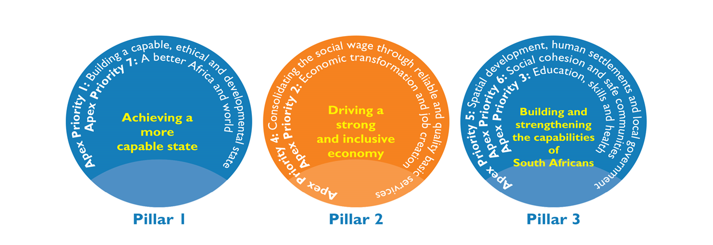
The Revised 2019-2024 MTSF
The revised 2019-2024 MTSF is premised on three NDP Pillars with seven associate apex priorities over the medium-term in addressing the triple challenges of Poverty, Unemployment, and Inequality as well as playing a catalytic role in achieving the NDP targets:

Slide 64
DSI Commitments on the Revised 2019-2024 MTSF
Priority 2:
Economic Transformation and Job Creation
More decent jobs created and sustained
Investing for accelerated inclusive growth
Skills Priority Plan developed by 2020- led by DHET and supported by DSI
Industrialisation, localisation and exports
Masterplans developed for all national priority sectors by end 2021- DSI supporting
No direct commitment

Slide 65
Cont.…
Priority 2:
Economic Transformation and Job Creation
Improve competitiveness through ICT adoption
GERD of 1.1% as a percentage of GDP by 2024
Commercialisation of intellectual property
Competitive and accessible markets
Improved quality and quantum of investment
No direct commitment
No direct commitment
64

Slide 66
Cont.…
Priority 3:
Education, Skills and Health
Expanded access to PSET opportunities
# of PhD students awarded bursaries
# of pipeline postgraduate students awarded bursaries by NRF and DSI
Improved success and efficiency of the PSET system
Improved quality of PSET provisioning
Proportion of university lecturers who hold doctoral degrees (gender, race, disability and age)
# of emerging researcher grants to improve % of PhD qualified staff
AI, data analytics for the profiling of students
65

Slide 67
Cont.…
Priority 3:
Education, Skills and Health
A responsive PSET system
# of users from the education and research sector supported through SANReN
# of graduates and students placed in DSI funded work opportunities
# of IP awareness sessions in TVET colleges
# of people reached through outreach, awareness and training programmes in priority sciences
66

Slide 68
Energy: Platinum Valley Hydrogen Valley
Our objective is to kickstart a South African hydrogen economy through the creation of a Hydrogen Valley.
The South African government’s Department of Science and Innovation (DSI), in partnership with Anglo-American, Bambili Energy and ENGIE are looking into opportunities to transform the Bushveld complex and larger region around Johannesburg, Mogalakwena and Durban into a Hydrogen Valley.
The goal of this study was to identify concrete, catalytic project opportunities in promising H2 hubs to kickstart H2 activities in the region. Promising ongoing initiatives like the H2 corridor project were leveraged in the selection of the hubs.
The selection of the corridor from Durban to Mogalakwena was based on existing hydrogen potential to switch many of the industrial, mobility and buildings activities to hydrogen fuel or feedstock.
Techno-economic analysis was carried out to assess the business case of identified projects, map their potential for positive social impact and define necessary policy actions to create the conditions for implementation.
Within the Valley, project sponsors are interested in identifying hydrogen hubs which are local areas with high concentration of hydrogen customers/off-takers and nearby hydrogen producers. Hubs may also extend to neighboring areas such as Johannesburg extending towards Rustenburg, mimicking a hub and spoke configuration.
A
16
Notes:
The Platinum Valley Initiative is an Experimental Policy Engagement used to establish a niche innovation, accelerate and embed them, through the process of upscaling, replication, circulation and institutionalization. The status quo is heavy-duty diesel trucks and the disruptive technology is heavy-duty fuel cell trucks.

Slide 69

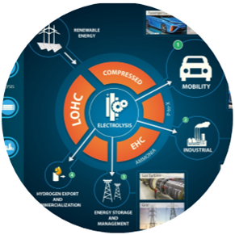

Policies to support the Hydrogen Economy
SOUTH AFRICAN ECONOMIC RECONSTRUCTION AND RECOVERY PLAN
NATIONAL DEVELOPMENT PLAN
Green Transport Strategy
Green
Hydrogen Commercialisation Strategy
Hydrogen
Society
Roadmap
Just Energy Transition
Framework
South African
Renewable
Energy
Masterplan
Hydrogen
Research
Development & Innovation
Strategy
The Hydrogen Society Roadmap seeks the effective integration of hydrogen related technologies in various sectors
of the economy/society to foster inclusive growth and help reduce poverty and inequality,
Notes:
The Green Transport Strategy was developed by the Department of Transport
The Green Hydrogen Commercialisation Strategy is being developed by the Department of Trade, Industry and Competition
The Hydrogen Society Roadmap is being developed by the Department of Science and Innovation
The Just Energy Transition Framework is being developed by the Department of Mineral Resources and Energy
The South African Renewable Energy Masterplan in being developed under the leadership of the DMRE
National Hydrogen and Fuel Cell Research Development and Innovation Strategy was approved by Cabinet in 2007 and is being implemented by the DSI

Slide 70
Priority Actions based on the High-Level Outcomes of the Hydrogen Society Roadmap
Notes:
The Hydrogen Society Roadmap identified key priority actions for various stakeholders to implement.

Slide 71
Boegoebai: A global hub for future fuel
A number of initiatives have been earmarked for the port of Boegoebaai, which is located in the Namakwa SEZ. These include:
Electrolyser park: A range of anchor investors with appropriate electrolyser technologies will bid for inclusion, and the successful bidder will construct facilities at the port.
Desalination plant: The production of green hydrogen requires significant amounts of water. Given the water-scarce nature of the Northern Cape, this will most likely require the desalination of sea water.
Green- ammonia production plant: expected to house the infrastructure and facilities required to produce green ammonia as a renewable fuel, linked to the green hydrogen production process.

Slide 72
Boegoebai: A global hub for future fuel
Storage facility: A liquid-storage facility for both green hydrogen and green ammonia, will offer tailored loading capacity for export vessels carrying the liquid volumes, and fueling capability for vessels transitioning to green ammonia as a fuel.
Solar, wind and battery park: This will upscale the generation of renewables (specifically wind and solar), ensuring 100 percent renewable energy for green hydrogen and green ammonia production. Potential also exists to produce manganese based precursor materials for the production of lithium ion batteries, leveraging on the manganese mines located in the Northern Cape.

Slide 73
Boegoebai: A global hub for future fuel
Gigafactory: This will be a dedicated, advanced manufacturing site to ramp up production of electrolysers, leveraging on locally produced intellectual property and expertise.
Sasol has partnered with both national and local government to finalise the location and development of the Boegoebaai facility, signing a memorandum of agreement with the Gauteng Provincial Government and the Northern Cape Economic Development, Trade and Promotion Agency.

Slide 74
SGC on Climate change and environmental sustainability: SAEON
SAEON is a comprehensive, sustained, coordinated and responsive South African environmental observation network that delivers long-term reliable data for scientific research and informs decision-making; for a knowledge society and improved quality of life.
Contributes to:
Investment - Over R320m (13years); average R25m/a

Slide 75




SGC on Climate change and environmental sustainability: GEOBON
GEO BON, the Biodiversity Observation Network of GEO, is building up for the pathway to link biodiversity data and metadata to GEOSS, the Global Earth Observation System of Systems. GEOSS will provide decision-support tools to a wide variety of users.
Contributes to:

Slide 76
Innovation example: Revitalising Agriculture (RDI Plan)
OBJECTIVES
GOAL: Innovation
driving economic growth &
socio-economic development
Need for productivity – plants and animals Climate change Security of supply – Sustainability Control – mitigation products, green economy solutions | Agility – technology dissemination to farmers Food security Biosecurity – detection, diagnosis, early warning systems Nutrition (hidden hunger)
INTERVENTIONS
OUTPUTS
OUTCOME/IMPACT
Crop/plant improvement, molecular breeding and genome engineering
Crop Improvement:
(Wheat, Maize, Potato, Cotton breeding)
Climate Resilience research
Smart and Precision Agriculture
Biosecurity Research Hub – diagnostics, monitoring
Animal Improvement, molecular breeding and genome engineering
Animal Improvement
Animal vaccines
Livestock Identification and Traceability Systems (LITS)
Beef Genomics Programme
Aquaculture Bio-innovation Cluster
Dairy Breeding programme
New products, processes, Technology services: High-value crop and animal value chains are efficient, agile and robust.
Increased GDP
Decision support
tools to promote
productivity and
incomes
Biosecurity -Pest
and diseases
Boost rural
economies
Traceability
Sustainability
SMMEs
Job creation as a
result of skills
transfer
Support new and emerging
farmers to become commercial
Bio-innovation in support of food
and nutrition
High-end skills, MSc, PhD,
technicians
Bio-innovation in support of Food and Nutrition and
farmer innovation support
Agroprocessing value chain development
(Marula, honeybush, maize, Cape Aloe, vegetables, soya, bambara, beans), legumes
Value chain analysis:
Sorghum,
Canola,
Dryland rice, and Cassava
Agro-processing (niche products)
in rural communities
Agro-innovation Hubs
Digital technology:
Decision support systems for farmers
Biosecurity: Early warning systems
Precision agriculture: Phenotyping Remote sensing, Smart tools, etc.
Small scale farmer technology diffusion
(Grapes, Low-chill apples, Urban Agric.
Mobile food safety labs
Digital Agriculture
Coordination, facilitation and multi-disciplinary, multi-institutional agricultural
bio-innovation programmes to drive productive value chains
18

