Slide 1


Revised Strategic Plan 2020/21 – 2024/25 and Annual Performance Plan (APP) 2022/23:
Presentation to the Portfolio Committee on Higher Education Science and Innovation (PC: HESI)
Ms. Sibongile Antoni
Acting Council Chairperson
20 April 2022
14h00 – 18h00

Slide 2
Contents
Vision, Mission and Values
Governance
Senior Management Structure
Legislative Mandate
Accounting Authority Statement
Situational Analysis
Strategic Imperatives
Measuring our performance: APP 2022/23
  Programme 1: Administration
  Programme 2: Occupational Qualifications Management, Assessment and Certification
  Programme 3: Occupational Qualifications Quality Assurance
  Programme 4: Research Analysis
  QCTO’s response to the Economic Reconstruction and Recovery Skills Strategy (ERRSS) Implementation Plan
  QCTO Post-COVID-19 Response

Slide 3



VALUES:
Innovation and Excellence
  We rise to opportunities and challenges, we continuously learn, we are innovative and we consistently produce work of distinction and fine quality, on time, and in line with our clients’ needs
Empowerment and Recognition
  We enable people to make things happen, we encourage and support one another when and where needed, and we celebrate successful accomplishment of work
Respect and Dignity
  We value and show consideration for all the people we work with, treat one another with kindness and thoughtfulness, and embrace inclusivity
Ethics and Integrity
  We embrace and practice a moral code of trustworthiness, honesty and truthfulness in everything we say and do, and we honour our promises and commitments
Ownership and Accountability
  We take ownership of our responsibilities and we answer for our decisions and actions
Authenticity
  We protect the public by issuing authentic, quality qualifications
VISION:
Qualify a skilled and capable workforce
MISSION:
QCTO’s mission is to effectively and efficiently manage the occupational qualifications sub-framework in order to set standards, develop and quality assure national occupational qualifications for all who want a trade or occupation and, where appropriate, professions

Slide 4
Governance
ARC
Audit and Risk Committee
OQACC
Occupational Qualifications, Assessment and Certification Committee
QAOQC
Council
Quality Assurance of Occupational Qualifications Committee
ITStratCom
Information Technology Strategic Committee

Slide 5

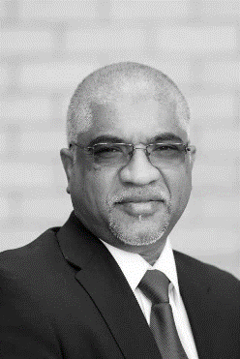




Senior Management Structure
Mr. E Mbuwe Chief Director: Occupational Quality Assurance
Ms. N Madilonga-Khondowe Chief Director Corporate Services
Ms. Sibongile Antoni
Acting Council Chairperson
Mr. V Naidoo Chief Executive Officer
Mr. T Lata Chief Director: Occupational Qualifications Management
Mr. I Gumbochuma Chief Financial Officer

Slide 6


Accounting Authority Statement:
Revised Strategic Plan 2020/21 – 2024/25
Since the establishment of the Quality Council for Trades and Occupations in 2010, much progress has been made in terms of the implementation of the Occupational Qualifications Sub-Framework (OQSF) its policies, criteria and guidelines.
As we move into our third Strategic Plan (Revised) we do so with renewed focus and support from our strategic partners. Current changes in the Post-School Education and Training policy environment, like the promulgation of the National Skills Development Plan (NSDP) and the development of the Department of Higher Education and Training (DHET) Skills Strategy, have brought about a number of opportunities that may lead to the expansion of the QCTO and its national footprint.

Slide 7

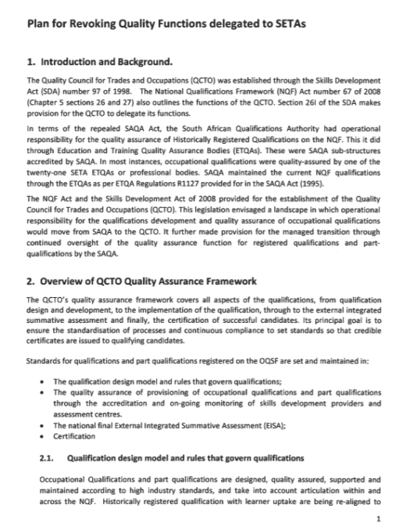
Accounting Authority Statement (Cont.)
QCTO has managed to weather many storms over the past decade and the organisation has made significant strides in the implementation of its new organisational structure and its Vision 2020: The plan for revoking quality assurance functions delegated to Sector Education and Training Authorities (SETAs).
This will set the strategic trajectory of the organisation in line with the ideals as espoused in the White Paper for Post-School Education and Training (WPPSET).
The implementation and funding of the QCTO's full legislative mandate will further strengthen the resolve of the Council and Management of the QCTO as it works diligently towards the principles as adopted in the NSDP

Slide 8

The Council, CEO and staff are fully committed to ensuring the successful implementation of this Revised Strategic Plan and the targets set in the National Development Plan (NDP).
In respect of achieving its full legislative mandate, the QCTO has resolved that, over the next five years, it will be directed by the following strategic imperatives adopted by Council:

Slide 9
Strategic Imperatives 2020/21-2024/25
Revised Strategic Imperatives 2022/23 – 2024/25
Creating a dynamic Occupational Qualifications Sub-Framework (OQSF)
Ensuring the development and quality assurance of occupational qualifications, part qualifications and skills programmes that are responsive to labour market and developmental state initiatives. (replacing the Imperative :Adopting a special focus on Technical and Vocational Education and Training (TVET) Colleges and Community Education and Training (CET) Colleges)
Creating a QCTO that is a learning organization

Slide 10
Situational Context
“Building the road as we walk”

Slide 11
Legislative Mandate & Other National Imperatives
National Qualifications Framework Act No. 67 of 2008
(as amended)
Skills Development Act No. 97 of 1998 (as amended)
Priority 3: Education, Skills and Health
National Development Plan
National Skills Development Plan
White Paper on PSET
Ministerial Determinations and Guidelines
Draft Economic Reconstruction and Recovery Plan Skills Strategy, Implementation Plan (March 2022)
Occupational Qualifications Sub-Framework (OQSF), 2021
Ministerial Determination, 2020

Slide 12
QCTO contributes to Priority 3: Education, Skills and Health
Expand access in the PSET system
Quality provisioning and a renewed focus of TVETs and CETs as institutions of choice
PSET system that is responsive to the needs of individual citizens, employers in both public and private sectors, as well as broader societal and developmental objectives
Quality Assurance Function (QAF) needs to be streamlined
The quality assurance conducted by SETAs and NAMB will be integrated into the QCTO.
Funding allocation from the fiscus and skills levy will be reviewed to ensure that QCTO is adequately resourced to comply with its legislative mandate
Expanded access to PSET opportunities.
Improved success and efficiency of the PSET system
Improved quality of PSET provisioning.
A responsive PSET system
The ERRP further emphasises that skills development, science and innovation as not only critical in driving South Africa’s economic reconstruction and recovery, but also key in sustaining it.
As a result, the Department developed a draft Skills Strategy to support government’s efforts to mitigate the impact of COVID-19 and the initiatives towards economic and social recovery.
Supports the National Development Plan (NDP) target of 30 000 artisans per annum by 2030
QCTO EVOLVING MANDATE

Slide 13
Strategic Imperatives
1
1
Imperative 01
Creating a dynamic Occupational Qualifications Sub-Framework (OQSF)
2
3

Slide 14
Policy Framework and PSET Possibilities
GAME CHANGER in the PSET Sector
Ministerial Determination on the three sub-frameworks that comprise the National Qualifications Framework, Government Gazette Notice No. 1391 of 2020 published in Government Gazette No 44031 of 24 December 2020.
OQSF Policy, published in Government Gazette Notice No. 45401 of 29 October 2021
Lifelong Learning for adults in South Africa: The role of Community Education and Training (OECD Draft version released, 16 October 2018)
“Part-qualifications, like the skills programmes offered by SETAs, could be the best option for CET.” Page 39
Skill Programmes included

Slide 15
Implications of the Revised OQSF
  GAME CHANGER IN THE PSET
  OQSF Gazetted by the Minister; MHESI on the 29 October 2021
  Parity of Esteem between OQSF, HEQSF and GENFETQF
  Promotes single national coordinated NQF.
  TVET Colleges “Institutions of Choice”
  Promotes Systematic Articulation between TVET Colleges and HEI’s
  HEI”s offering OQSF Qualifications.
  CET Colleges to offer Skills Programmes
  Contribute to ERR SS

Slide 16
NQF Sub-Framework/ Quality Council | NQF Level | NQF Sub-Framework and Qualification Type |  | NQF Sub-Framework/ Quality Council
Higher Education Qualifications Sub- Framework (HEQSF) Council on Higher Education (CHE) | 10 | Doctoral Degree Doctoral Degree (Professional)
 | 9 | Master’s Degree Master’s Degree (Professional)
 | 8 | Bachelor Honours Degree Post Graduate Diploma Bachelor’s Degree | Specialised Occupational Diploma | Occupational Qualifications Sub-Framework (OQSF) Quality Council for Trades and Occupations (QCTO)
 | 7 | Bachelor’s Degree Advanced Diploma | Advanced Occupational Diploma
 | 6 | Diploma Advanced Certificate | Occupational Diploma Advanced Occupational Certificate
 | 5 | Higher Certificate | Higher Occupational Certificate
General and Further Education and Training Qualifications Sub-Framework (GFETQSF) Umalusi | 4 | National Certificate | National Occupational Certificate
 | 3 | Intermediate Certificate | Intermediate Occupational Certificate
 | 2 | Elementary Certificate | Elementary Occupational Certificate
 | 1 | General Certificate | General Occupational Certificate

Slide 17
Strategic Imperatives
2
1
Imperative 02
Ensuring the development and quality assurance of occupational qualifications, part qualifications and skills programmes that are responsive to labour market and developmental state initiatives.
2
3

Slide 18

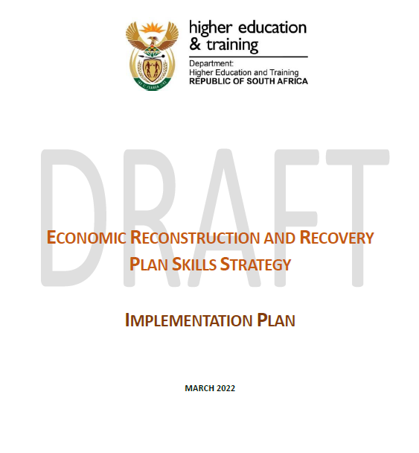

DRAFT: Economic Reconstruction and Recovery Plan Skills Strategy, Implementation Plan, March 2022
The key principle of the strategy is to ensure that skills interventions are demand led, and will lead to beneficiaries being empowered to find earning opportunities as a result. The Strategy focuses on the needs of young people, vulnerable workers, and support for sector focused interventions to stimulate economic growth.
The Implementation Plan outlines the DHET’s partnerships with other economic actors in support of the Strategy, the structures established to facilitate demand led skilling, the specific initiatives to be delivered for each Intervention, and the monitoring and oversight modalities going forward.

Slide 19
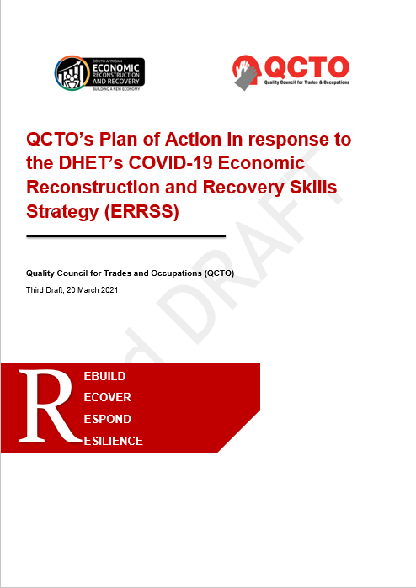
Introduction to QCTO’s Plan of Action (PoA)
This draft plan provides a response and proposed plan of actions of how the Quality Council for Trades and Occupations (QCTO) will respond to the South African Economic Reconstruction and Recovery Plan (ERRP), launched by President Ramaphosa on 15 October 2020, more broadly, and more specifically to the Department of Higher Education and Training’s (DHETs) COVID-19 Economic Reconstruction and Recovery Skills Strategy (ERRSS) (Updated draft, 6 February 2021) as well as the Department of Science and Innovation’s (DSIs) Role of science, technology and innovation in South Africa’s Economic Recovery Plan (June 2020)
The QCTO as a member of the Technical Implementation Forum (TIF), has the responsibility to report Quarterly to DHET on the progress of the interventions and actions.
  Endorsed by Council on 17 March 2021
  Third Draft 20 March 2021

Slide 20
Strategic Imperatives
3
1
Imperative 03
Creating a QCTO that is a learning organisation
2
3

Slide 21
Organisational Restructuring
In June 2016, the QCTO undertook a restructuring process which culminated to a revised Organisational Structure for QCTO.
The revised structure was intended to facilitate the appointment of subject matter experts in addition to the process managers. This was seen as a key to building capacity within the QCTO so that many of the functions delegated to third parties would be performed in-house.
The revised QCTO approved structure provides for 246 permanent posts to be filled in phases based on the availability of funds. Furthermore, the revised structure gave into effect the cluster model with a total of six (6) clusters. Of the six (6) Clusters in the approved structure, only two (2) clusters have been implemented i.e. Cluster 1 – Engineering and Trades, and Cluster 2 -Business and General. The number of clusters will increase incrementally over the years as the QCTO continues to build its capacity

Slide 22
Organisational Restructuring

Slide 23
Organisational Restructuring
FUNDED POSTS
Only 114 posts from the approved structure are funded from the QCTO’s compensation budget of R73, 868, million
These posts are funded mainly from the SETA grant; however, as these funds are allocated annually, based on a yearly submission to the DHET, and the amount received (if any) can vary considerably.
The uncertainty constrains the QCTO in fully implementing its mandate.
Given the limited funding available accompanied with extreme budget cuts throughout the MTEF period that the QCTO experienced, not all approved 246 posts could be filled.
Management to evaluate the effectiveness of the cluster model and consider taking a revised model to Council for consideration

Slide 24
QCTO Mandate vs Budget
QCTO Budget needs urgent review to enable the QCTO to fulfil its role in the PSET Sector as it aims to provide an enabling skills development across all intuitional types i.e. to enable the implementation of the OQSF
The NSF cash injections of R2.2 billion in TVET and CET to implement Occupational Qualifications will place a greater strain on the QCTO resources to provide for adequate quality assurance.
The QCTO has played a pivotal role in the development of the ERR SS. to ensure that all the identified qualifications and skills programmes are developed.

Slide 25
Update on the finalisation of the business case of the entity and migration of ETQA functions from the SETAs.
The Business Case was presented to the DHET on the 15th Feb 2017 and workshopped with DHET during July 2017. The DHET legal view was that while it is true that the QCTO is not adequately funded, the fact was that such funding resides in the SETA Budgets. The argument being made was that funding must follow function.
At a workshop convened by the DHET on 21 July 2019 it was agreed that the QCTO will enter into SLAs with SETAs where SETAs will execute the functions while QCTO remains in terms of its mandate overall responsible for QA. This means that the SETAs will report to the QCTO and QCTO will monitor and report on the SETAs.
This currently presents the most sustainable way of revoking of the Quality Assurance functions previously “delegated “ to the SETAs
This approach once perfected would be most suitable as the SETAs are in close proximity with Industry.
The QCTO Revised Strat Plan and APP are designed to give effect to this position.
The QCTO continues to receive 0.5% of the Skills Levy despite the provisions of the NSDP.

Slide 26
This process must also be viewed in terms of the Ministerial Determination published on the 24 December 2020 which clearly indicates that the end date of all pre -2009 qualifications will expire in June 2023. This means that after June 2023 )and the teach out period) the NLRD will not reflect any qualifications with a SETA as the ETQA.
This implies that Qualifications will be listed with the QCTO as the responsible QA body. This will further strengthen and embed the SLA between the QCTO and the SETAs.

Slide 27
Part C: Measuring Performance
Impact Statement:
To ensure a skilled and capable workforce that is employable or self-employed”, through ensuring the development of relevant qualifications, part qualifications and skilled programmes , ensuring the quality of provisioning and assessment and issuing certificates to qualifying candidates.
Outcome 3
QCTO is a responsive learning organisation
Outcome 2
Outcome 1
QCTO to ensure that development and quality assurance of occupational qualifications, part qualifications and skills programmes are responsive to labour market and developmental state initiatives
A single national quality assured Occupational Qualifications Sub-framework that promotes synergy, simplification and effectiveness.

Slide 28
Strategic Outcomes and indicators 2020 - 2025
Outcome 1: A single national quality assured Occupational Qualifications Sub-framework that promotes synergy, simplification and effectiveness.
Contribution of Outcome | Enablers | Risks
Increased participation of various stakeholders in the OQSF will facilitate active interaction between the various stakeholders which is essential in order to have a functional integrated national OQSF system. Better articulation within the NQF will promote access to qualifications, part qualifications and skills programmes within the NQF and encourage Lifelong Learning. The uptake of occupational qualifications, part qualifications and skills programmes will indicate the need of occupational qualification from the demand perspective (e.g. national list of occupations in high demand). The level of employer satisfaction with the OQSF will assist in evaluating and assessing the impact of the OQSF. All of the above have a bearing on the achievement of the intended impact | The NQF Act will not change radically, Ministerial guidelines are implemented and that there will be consistency in vision. There is a trusted and reliable QA system that is supported by effective Inter Governmental Relations (IGR) structures e.g. forums etc. Skills requirements will be known (accurate and updated national list of occupations in high demand) and a reliable labour information system is established. There is industry participation where industry participates in identifying and developing qualifications in high demand, QAP’s, offer adequate workplace experience/learning, simulation design. There is cohesion and research and Lesson Learned are applied. There is employee and employer buy-in (Approval and internal acceptance of the QCTO business case). | Radically changed legislative environment Unreliable QA system Effective implementation of the QCTO QA system. Un-identified skills needs Conduct Lack of Industry participation Repetition of past systemic errors No buy-in by Employees and Employers Insufficient funding allocation Impact of the COVID-19 and the implementation of the Disaster Management Act

Slide 29
Strategic Outcomes and indicators 2020 - 2025
Outcome 1: A single, national, quality-assured Occupational Qualifications Sub-framework that promotes synergy, simplification and effectiveness
Outcome Indicator | Baseline | Five-Year Target
1.1 Quality assurance functions performed by the QCTO for qualifications, part qualifications and skills programmes on the OQSF evaluated and reported on | QCTO currently performs all QA functions (accreditation, quality assurance of provisioning, quality assurance of assessment and certification) for newly registered occupational qualifications, part qualifications and skills programmes and provides an Annual Report of such activities | An evaluation report on the quality assurance functions performed by the QCTO for qualifications and part qualifications on the OQSF over 5 years
1.2 Level of Articulation between the OQSF, GENFETQA and HEQSF | No baseline established as yet | An evaluation report on the extent of articulation of qualifications on the OQSF with qualifications on the other two Sub-frameworks (GENFETQA and HEQSF)

Slide 30
Strategic Outcomes and indicators 2020 - 2025
Outcome 1: A single, national, quality-assured Occupational Qualifications Sub-framework that promotes synergy, simplification and effectiveness
Outcome Indicator | Baseline | Five-Year Target
1.3 Uptake of occupational qualifications, part qualifications and skills programmes | 11% (32 out of 300) | 60%
1.4 Level of Industry satisfaction with the OQSF | No baseline established as yet | Evaluation report on the extent of Industry satisfaction with the OQSF
1.5 Number of comparable Qualifications Frameworks against which the OQSF is benchmarked | No baseline established as yet | 5

Slide 31
Strategic Outcomes and indicators 2020 - 2025
Outcome 2: QCTO to ensure that development and quality assurance of occupational qualifications, part qualifications and skills programmes are responsive to labour market and developmental state initiatives
Contribution | Enablers | Risks
If TVETs, CETs and Universities offer occupational qualifications, part qualifications and skills programmes that respond to the skills needs of the industries of the country as identified in the ERRPs, the increase in skills development will significantly contribute to a skilled and capable workforce which will be employable or self-employed. | The Minister of Higher Education, Science and Innovation (MHESI) approves the implementation of Economic Reconstruction and Recovery Skills Strategy Occupational qualifications, part qualifications and skills programme are relevant to the needs of the labour market Occupational qualifications, part qualifications and skills programme are developed timeously Occupational qualifications, part qualifications and skills programme are registered TVETs, CETs and Universities capacitated by DHET to deliver occupational qualifications, part qualifications and Skills Programmes (funding and lecturers) | ERRSS not approved by Minister of DHET TVET, CET Colleges Universities, and Private Skills Development Providers do not implement the occupational qualifications, part qualifications and skills programmes in high demand TVET CET Colleges Universities and Private Skills Development Providers do not have the capacity to offer occupational qualifications and skills programmes

Slide 32
Strategic Outcomes and indicators 2020 - 2025
Outcome 2: QCTO to ensure that development and quality assurance of occupational qualifications, part qualifications and skills programmes are responsive to labour market and developmental state initiatives
Outcome Indicator | Baseline | Five-Year Target
2.1 Percentage of occupational qualifications, part qualifications and skills programmes developed as identified in the DHET Economic Reconstruction and Recovery Skills Strategy | No Baseline established as yet | 80 % Percent of qualifications developed as identified in the DHET Economic Reconstruction and Recovery Skills Strategy
2.2 Number of occupational qualifications, part qualifications and skills programmes in high demand offered by TVET Colleges | 14 occupational trade qualifications | As per targets in the approved DHET Revised Strategic Plan and ERR SS
2.3 Number of occupational qualifications, part qualifications and skills programmes in high demand offered by Universities | No baseline established as yet. | As per agreed targets in the approved DHET Revised Strategic Plan and ERR SS

Slide 33
Strategic Outcomes and indicators 2020 - 2025
Outcome 2: QCTO to ensure that development and quality assurance of occupational qualifications, part qualifications and skills programmes are responsive to labour market and developmental state initiatives
Outcome Indicator | Baseline | Five-Year Target
2.4 Number of occupational qualifications, part qualifications and skills programmes in high demand offered by CET Colleges | No baseline established as yet | As per agreed targets in the approved DHET Revised Strategic Plan and ERR SS
2.5 Number of occupational qualifications, part qualifications and skills programmes in high demand offered by Private Skills Development Providers | No baseline established as yet | As per ERRSS
2.6 Number of TVET Colleges offering occupational qualifications part qualifications and skills programmes in high demand | No baseline established as yet | As per agreed targets in the approved DHET Revised Strategic Plan and ERR SS

Slide 34
Strategic Outcomes and indicators 2020 - 2025
Outcome 2: QCTO to ensure that development and quality assurance of occupational qualifications, part qualifications and skills programmes are responsive to labour market and developmental state initiatives
Outcome Indicator | Baseline | Five-Year Target
2.7 Number of CET Colleges offering occupational qualifications part qualifications and skills programmes in high demand | No baseline established as yet | As per agreed targets in the approved DHET Revised Strategic Plan and ERR SS
2.8 Number of Universities offering occupational qualifications part qualifications and skills programmes in high demand | No baseline established as yet | As per agreed targets in the approved DHET Revised Strategic Plan and ERR SS
2.9 Number of Private Skills Development Providers offering occupational qualifications part qualifications and skills programmes in high demand | No baseline established as yet | As per agreed targets in the approved DHET Revised Strategic Plan and ERR SS

Slide 35
Strategic Outcomes and indicators 2020 - 2025
Outcome 3: QCTO is a responsive learning organisation
Contribution | Enablers | Risks
By being responsive to the environment and having the capacity to meet the identified needs, the achievement of this outcome will contribute to the achievement of the intended impact as stated in terms of policy priorities. | The availability of financial and human resources. The availability of reliable, (demand) data. Enabling legislation. Partnerships, buy in/support from all stakeholders for the achievement of the outcome. Political will. Implementation of relevant research recommendations. | Lack of funding Lack of buy-in/ support from key stakeholders Not becoming a learning organisation

Slide 36
Strategic Outcomes and indicators 2020 - 2025
Outcome 3: QCTO is a responsive learning organisation
Outcome Indicator | Baseline | Five-Year Target
3.1 The relevance and responsiveness of the QCTO and the OQSF evaluated | No baseline established | An evaluation report that measures sectoral perceptions of the relevance and responsiveness of the QCTO and the OQSF

Slide 37
Annual Performance Plan 2022/23
1. ADMINISTRATION
2. OCCUPATIONAL QUALIFICATIONS MANAGEMENT, ASSESSMENT AND CERTIFICATION
3. OCCUPATIONAL QUALIFICATIONS QUALITY ASSURANCE
4. RESEARCH ANALYSIS

Slide 38
Towards a National Quality Assurance System
National Quality Assurance System for OQSF
Reduce Quality Assurance of Historically Registered Qualifications
Increase Quality Assurance of Occupational Qualifications
Monitoring and reporting of QAPs performance on delegated functions through MoUs
Resolution of accreditation and certification issues including backlogs.
Qualification Development Model
Accreditation of Providers and Assessment Centres
Approval of Assessment Partners
QA of assessments
Certification

Slide 39
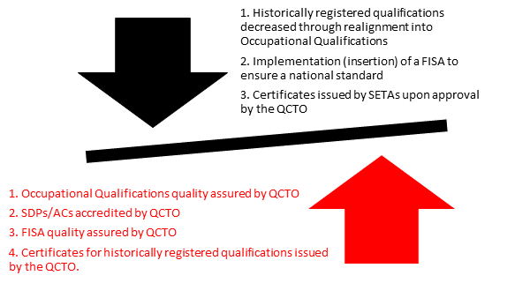
Implementation Plan.
1.Stronger and more cooperative relationships between SETAs, Professional bodies and QCTO
3. Review and rationalise occupational qualifications.
4. Improve QA processes and standardize these across the system.
5. Continue to standardise curricula development.
6. Improved Research capabilities
2. Strengthen and expand the PSET System.

Slide 40
Measuring our performance: APP 2022/23
No | Programme | Purpose of the programme
1 | Administration | To enable QCTO performance through strategic leadership and reliable delivery of management support services that will ensure a responsive and learning organisation.
2 | Occupational Qualifications Management, Assessment and Certification | To ensure that occupational qualifications, part-qualifications and skills programs on the OQSF are available; issue certificates to qualifying learners; verify the authenticity of issued certificates; and maintain stakeholder relationships.
3 | Occupational Qualifications Quality Assurance | To establish and maintain quality standards for Accreditation and Assessment within the OQSF.
4 | Research Analysis | To establish and maintain QCTO Standards for quality assurance through research, monitoring, evaluation and analysis

Slide 41
Programme Performance Indicators
Programme | No. of indicators per programme | Annual Targets | Bi-Annual targets | Quarterly Targets
One | 4 | 4 | - | -
Two | 10 | 1 | 3 | 6
Three | 12 | 3 | - | 9
Four | 2 | 2 | - | -
Total Distribution | 28 | 10 | 3 | 15
Percentage Distribution |  | 36% | 11% | 54%

Slide 42
Programme 1
Outputs | Output Indicators* | Annual Targets
1.1 A capacity building strategy is developed and implemented | 1.1.1 % implementation of the Capacity building strategy | 40% of the capacity building strategy implemented (Year 2)
1.2 MSP is developed and implemented | 1.2.1 % implementation of the MSP | MSP Annual Plan deliverables 100% Implemented
1.3 A Marketing and communications strategy is developed and implemented | 1.3.1 % implementation of the Marketing and communication Strategy | 40% of the Marketing and Communications strategy implemented (Year 2)
1.4 A change management strategy is developed and implemented | 1.4.1 % implementation of the Change management strategy | 40% of the Change management strategy implemented (Year 1)

Slide 43
Programme 2
Outputs | Output Indicators | Annual Targets
2.1.Occupational Qualifications and part qualifications recommended for registration on the OQSF | 2.1.1 Number of prioritised occupational qualifications (full/ part) recommended to SAQA for registration on the OQSF | 50
 | 2.1.2 Number of Historically Registered Qualifications recommended to SAQA for deactivation on the OQSF | 200
 | 2.1.3 Number of skills programmes approved by QCTO Council | 100
2.2 A national External assessment is implemented for all qualifications registered on the OQSF | 2.2.1 % of assessments for occupational qualifications and part qualifications quality assured against QCTO standards within 21 working days turnaround time | 90%
 | 2.2.2 % of assessments for historically registered qualifications quality assured against QCTO standards (excluding historical skills programmes and NATED) within 21 working days turnaround Time | 90%
 | 2.2.3 Annual report on the implementation of the quality assurance plan for NATED Report 190/191 Programmes | Report on the Implementation of Approved Council Plan
 | 2.2.4 % of assessments for QCTO developed skills programmes quality assured against QCTO standards within 21 working days | 90%
 | 2.2.5 % of Assessment Quality Partners (or Assessment Bodies) quality assured against QCTO compliance standards | 90%

Slide 44
Programme 2
Outputs | Output Indicators | Annual Targets
2.3 A certification system is maintained | 2.3.1 % of certificates issued within turnaround time (21 working days) | 95%
 | 2.3.2 % of verification of authenticity of certificates requests received and verified within turnaround time (5 working days) | 95%

Slide 45
Programme 3
Outputs | Output Indicators | Annual Targets
3.1 A national Accreditation system is implemented for all qualifications registered on the OQSF. | 3.1.1 % of Skills Development Providers accreditation applications for Occupational qualifications and, part qualifications processed within the turnaround time (90 working days) | 90%
 | 3.1.2 % of Skills Development Providers accreditation applications for Council approved Skills Programmes processed within the turnaround time (90 working days) | 80%
 | 3.1.3 % of Skills Development Providers accreditation applications for historically registered Qualifications (Trades, Non-Trades, NATED Report 190/191, Skills Programmes) processed within the turnaround time (90 working days) | 80%
 | 3.1.4 % of assessment centre accreditation applications processed (accreditation granted or declined) within the turnaround time (30 working days) | 90%
3.2 A national quality assurance system is implemented for all qualifications registered on the OQSF | 3.2.1 % of accredited SDPs with implemented occupational qualifications and part qualifications quality assured according to QCTO standards | 80%
 | 3.2.2 % of accredited SDPs with implemented historically registered qualifications (Excluding NATED Report 190/191 Programmes) quality assured against QCTO compliance standards | 75%

Slide 46
Programme 3
Outputs | Output Indicators | Annual Targets
3.2 A national quality assurance system is implemented for all qualifications registered on the OQSF | 3.2.3 (a) % of accredited SDPs with implemented NATED Report 190/191 (e.g. N4-N6) programmes quality assured against QCTO compliance Standards | 75%
 | *3.2.3 (b) Number of NATED Report 190/191 (e.g. N4 – N6) Instructional offering Exams sessions conducted at accredited SDPs, quality assured against QCTO standards | 120
 | *3.2.3 (c) Number of NATED Report 190/191 instructional offering marking sessions quality assured against QCTO standards | 40
 | 3.2.4 % of accredited SDPs with skills programmes implemented, quality assured against QCTO standards. | 75%
 | 3.2.5 % of accredited Assessment Centres conducting EISAs (External Integrated Summative Assessments) quality assured against QCTO standards | 60%
*Portfolio Committee to note the omission of 3.2.3 (b) and (c) from table Output Indicators: Annual and Quarterly Targets (APP 2022/23)

Slide 47
Programme 3
Outputs | Output Indicators | Annual Targets
3.3 Uptake of occupational qualifications and skills programmes by TVET Colleges, CET Colleges, Universities and Private Skills Development Providers | 3.3.1 Report on occupational qualifications, part qualifications and skills programmes in high demand offered by TVET Colleges, CET Colleges, Universities and Private Skills Development Provider | As per approved ERRSS

Slide 48
Programme 4
Outputs | Output Indicators | Annual Targets | Q1 | Q2 | Q3 | Q4
4.1 Research on issues of importance to the development and implementation of the OQSF conducted or commissioned and published | 4.1.1 Number of Research Reports approved by the CEO | 3 | N/A | N/A | N/A | 3
 | 4.1.2 Research Bulletin published online | 1 | N/A | N/A | N/A | 1

Slide 49
OFFICE OF THE CFO

Slide 50
PROCUREMENT OF THE QCTO PREMISES:
All the documents required were obtained and the new council approved the offer of R84.5m
An application (together with all required documentation) was submitted Minister of higher Education, Science and Innovation.
QCTO is currently waiting for the response from the Minister and once received will thereafter apply to the Minister of Finance.
This process is expected to be completed by June 2022.

Slide 51
Overview of 2022 budget and MTEF estimates
Annual Performance Plan Page 13
 | 2020/21 | 2021/22 | 2022/23 | 2023/24 | 2024/25
 | R’000 | R’000 | R’000 | R’000 | R’000
DHET Grant | 25 507 | 27 630 | 28 506 | 28 250 | 29 518
SETA Grant | 97 200 | 67 743 | 96 147 | 100 954 | 106 002
Certification Services | - | - | 1 400 | 1 470 | 1 580
Accreditation Services | - | - | 2 000 | 2 100 | 2 255
Interest Received | - | - | 1 200 | 1 236 | 1 332
Approved Surplus | - | 23 657 | - | - | -
Total | 122 707 | 119 030 | 129 253 | 134 010 | 140 687
Projected Revenue for 2022/23 and projections for the MTEF outer years are depicted in figures above

Slide 52
Expenditure Estimates Per Programme
Annual Performance Plan Page 14
 | Adjusted Appropriation |  |  | Projections
Programmes | 2021/22 |  |  | 2022/23 | 2023/24 | 2024/25
 | R’000 | R’000 | R’000 | R’000 | R’000 | R’000
 | Original Budget | Adjustment | Adjusted Budget
Administration | 37 746 | 22 657 | 60 403 | 66 051 | 68 280 | 71 670
2. Occupational Qualifications Management, Assessment and Certification | 25 932 | - | 25 932 | 22 805 | 23 717 | 24 903
3. Occupational Qualifications Quality Assurance | 29 732 | - | 29 732 | 36 530 | 37 991 | 39 891
4. Research Analysis | 1 963 | 1000 | 2 963 | 3 867 | 4 022 | 4 223
Total | 95 373 | 23 657 | 119 030 | 129 253 | 134 010 | 140 687

Slide 53
Expenditure Estimates Per Classification
Annual Performance Plan Page 14
 | Adjusted Appropriation |  |  | Projections
Classification | 2021/22 |  |  | 2022/23 | 2023/24 | 2024/25
 | R’000 | R’000 | R’000 | R’000 | R’000 | R’000
 | Original Budget | Adjustment | Adjusted Budget
Compensation | 70 300 | - | 70 300 | 73 868 | 76 823 | 80 664
Goods and services | 24 313 | 13 657 | 37 970 | 51 385 | 53 027 | 55 655
Capital expenditure | 760 | 10 000 | 10 760 | 4 000 | 4 160 | 4 368
Total | 95 373 | 23 657 | 119 030 | 129 253 | 134 010 | 140 687
*Corrected

Slide 54
Abbreviations
Acronym | Definition
APP | Annual Performance Plan
CEO | Chief Executive Officer
CET | Community Education and Training
COVID-19 | Coronavirus Disease 2019
ERRP | Economic Reconstruction and Recovery Plan
ERRSS | Economic Reconstruction and Recovery Skills Strategy
DHET | Department of Higher Education and Training
GFETQSF | General and Further Education and Training Qualifications Sub-Framework
HEQSF | Higher Education Qualifications Sub-Framework
MSP | Master Systems Plan
MTEF | Medium Term Expenditure Framework
Acronym | Definition
NATED | National Accredited Technical Education Diploma
NQF | National Qualifications Framework
OQSF | Occupational Qualifications Sub-Framework
POA | Plan of Action
PSET | Post-School Education and Training
QA | Quality Assurance
QCTO | Quality Council for Trades and Occupations
SETA | Sector Education and Training Authority
TVET | Technical and Vocational Education and Training Colleges

Slide 55

+27 (0)12 003 1800
SWITCH BOARD
info@qcto.org.za / qcto@tip-offs.com
EMAIL
www.qcto.org.za
WEBSITE
QCTO Page
SOCIAL MEDIA
QCTO TV
SOCIAL MEDIA

