Slide 1

GCIS
ANNUAL PERFORMANCE PLAN
MEDIUM TERM PERIOD 2022/23 – 2024/25
Presentation to the
Portfolio Committee

Slide 2

Presentation outline
1. Our Mandate
2. Strategic Focus
3. Context
4. GCIS Structure
5. 2022/23 Targets per Programme
6. 2022/23 Budget summary and MTEF Estimates
7. 2022/23 Expenditure Estimates
8. Revision to the 2021/22 - 2022/23 APP

Slide 3


Slide 4
1. OUR MANDATE
Constitutional Mandate
Section 195(g) of the Constitution of the Republic of South Africa of 1996 - the public should be provided with information that is timely, accurate and importantly, accessible.
In 1998, the South African Communication Service was dissolved and the GCIS established by Cabinet, largely on the basis of recommendations contained in the report of the Task Group on Government Communications (Comtask: 1996: 58).
Provide strategic leadership and coordinating a government communications system that ensures that the public is informed, and have access to information on government programmes and policies that benefit them.
Legislative & Policy Mandate
Public Finance Management Act (PFMA), 1999 (Act 1 of 1999), as amended.
Media Development and Diversity Agency (MDDA) Act 2002, (Act 14 of 2002).
Brand South Africa (SA) Trust Deed
Electronic Communications Act, 2005 (Act 36 of 2005).
Use of Official Languages Act, 2012 (Act 12 of 2012).
2019- 2024 National Communication Strategy Framework (NCSF).
The Government Communication Policy, approved by Cabinet on 22 August 2018.
The Revised 2019-2024 MTSF.

Slide 5


Slide 6





VISION
2. STRATEGIC FOCUS
MISSION
  To deliver effective strategic government communication; set and influence adherence to standards and coherence of message and proactively communicate with the public about government policies, plans, programmes and achievements.
The pulse
of communication excellence
in government.
OUR VALUES
Professionalism
Diversity
Openness and transparency
Innovation
Honesty and integrity.

Slide 7
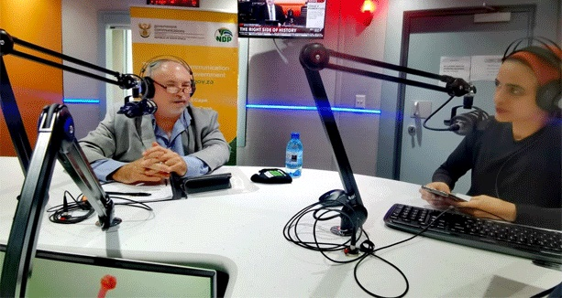
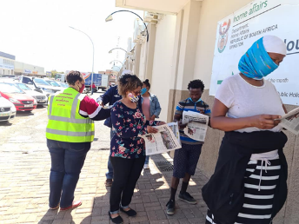
3. CONTEXT
The democratic dispensation inherited an unequal society where the majority of the people did not have access to information that could empower them to live a better life.
The strategic location of the GCIS in The Presidency empowers the department to coordinate and lead on communication-related projects that straddle across almost all government departments.
The GCIS provides developmental-related information such as available government programmes and services that empower citizens to actively participate in improving their lives.
The GCIS ensures consistent communication of the remarkable progress being achieved by government in providing sustained service delivery to communities.

Slide 8
4. GCIS STRUCTURE
Approved structure = 475
Vacancies= 32

Slide 9


Slide 10
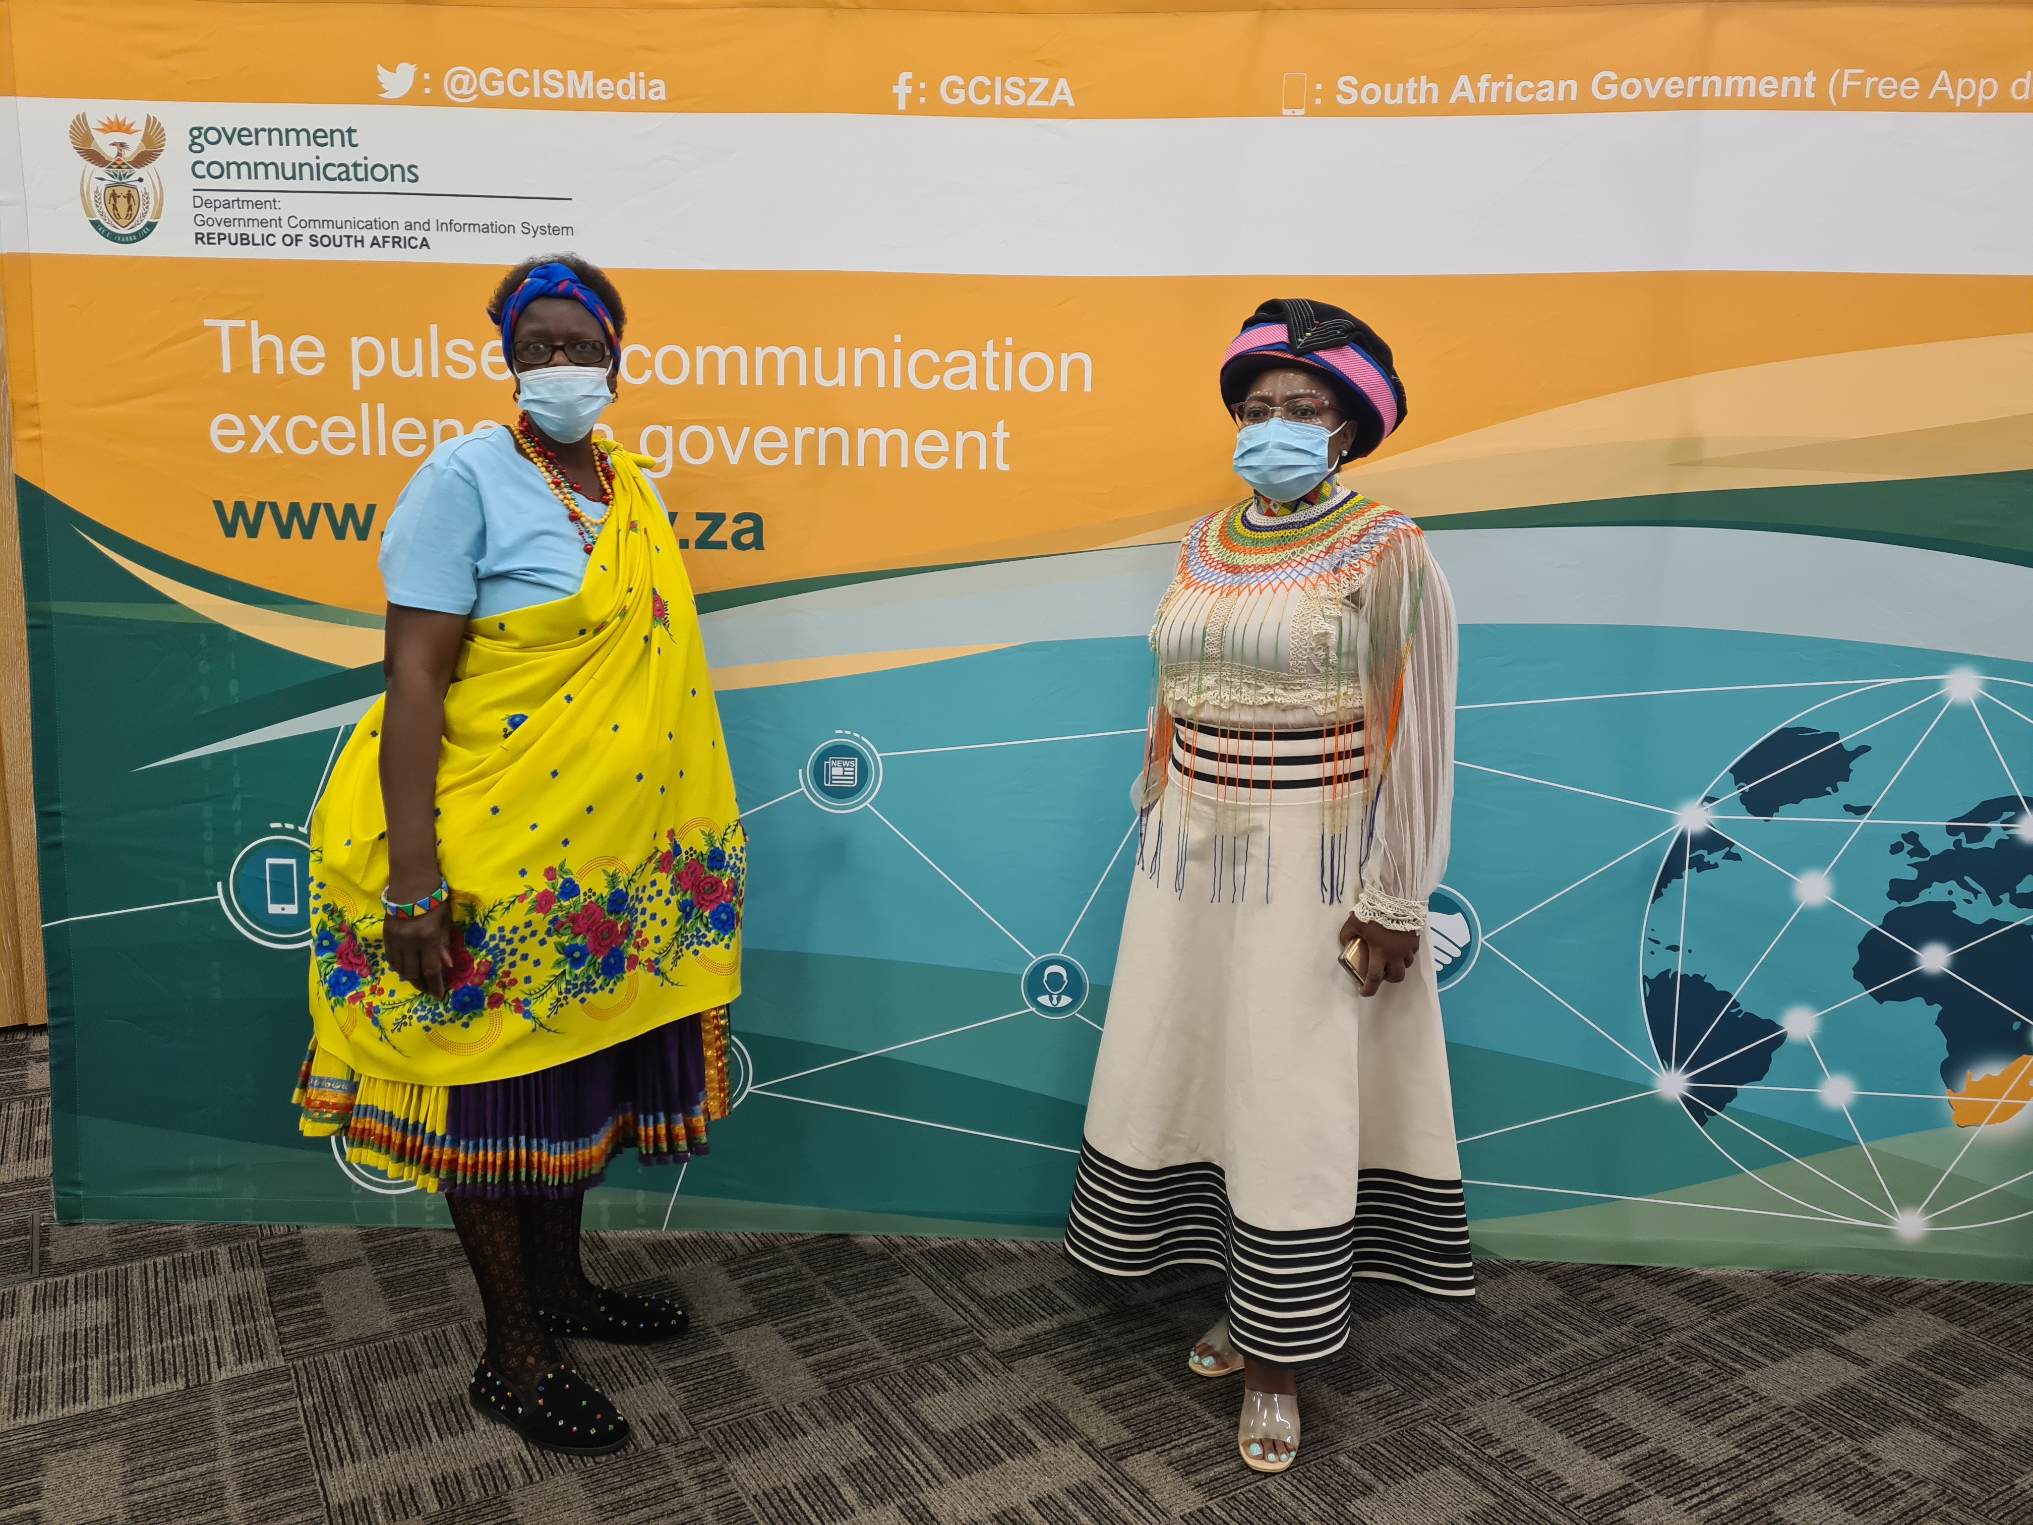
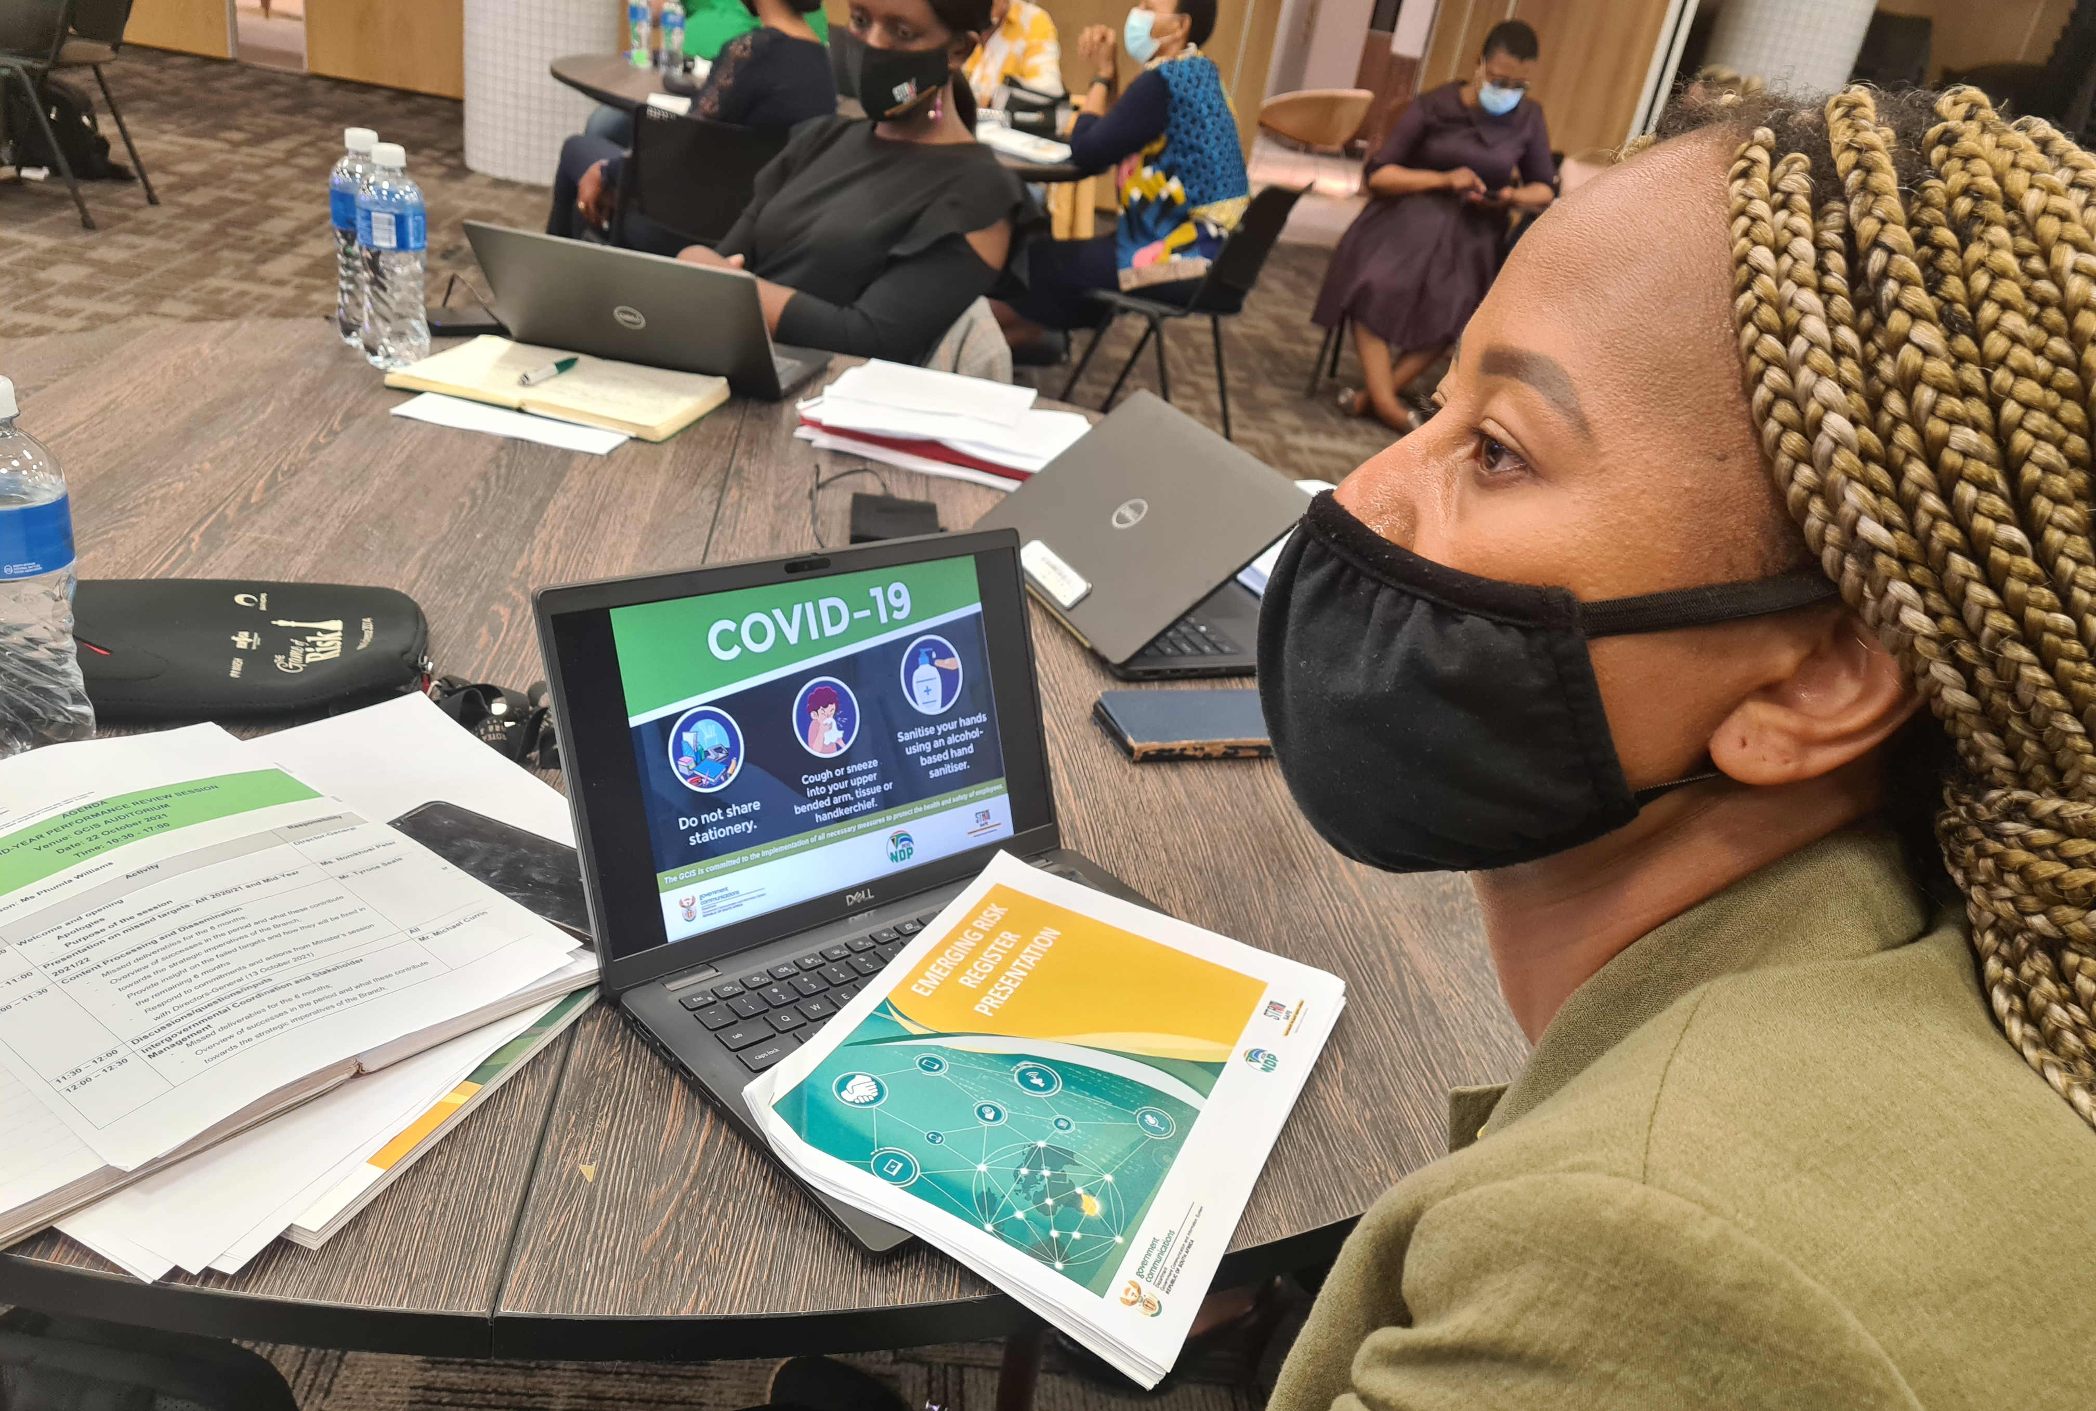
5. 2022/23 TARGETS PER PROGRAMME
PROGRAMME 1: Administration
Purpose: Provide strategic leadership, management and support services to the department.
Outcome: Sound corporate governance
Output Indicator | Annual target 2022/23
Vacancy rate of no more than 10% against the approved organisational structure maintained | Vacancy rate of no more than 10% against the approved organisational structured maintained
Number of governance reports on the availability of IT infrastructure and systems presented to the Audit Committee | Four governance reports on the availability of IT infrastructure and systems presented to the Audit Committee

Slide 11
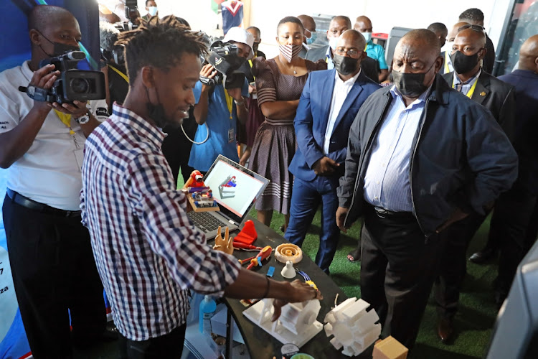
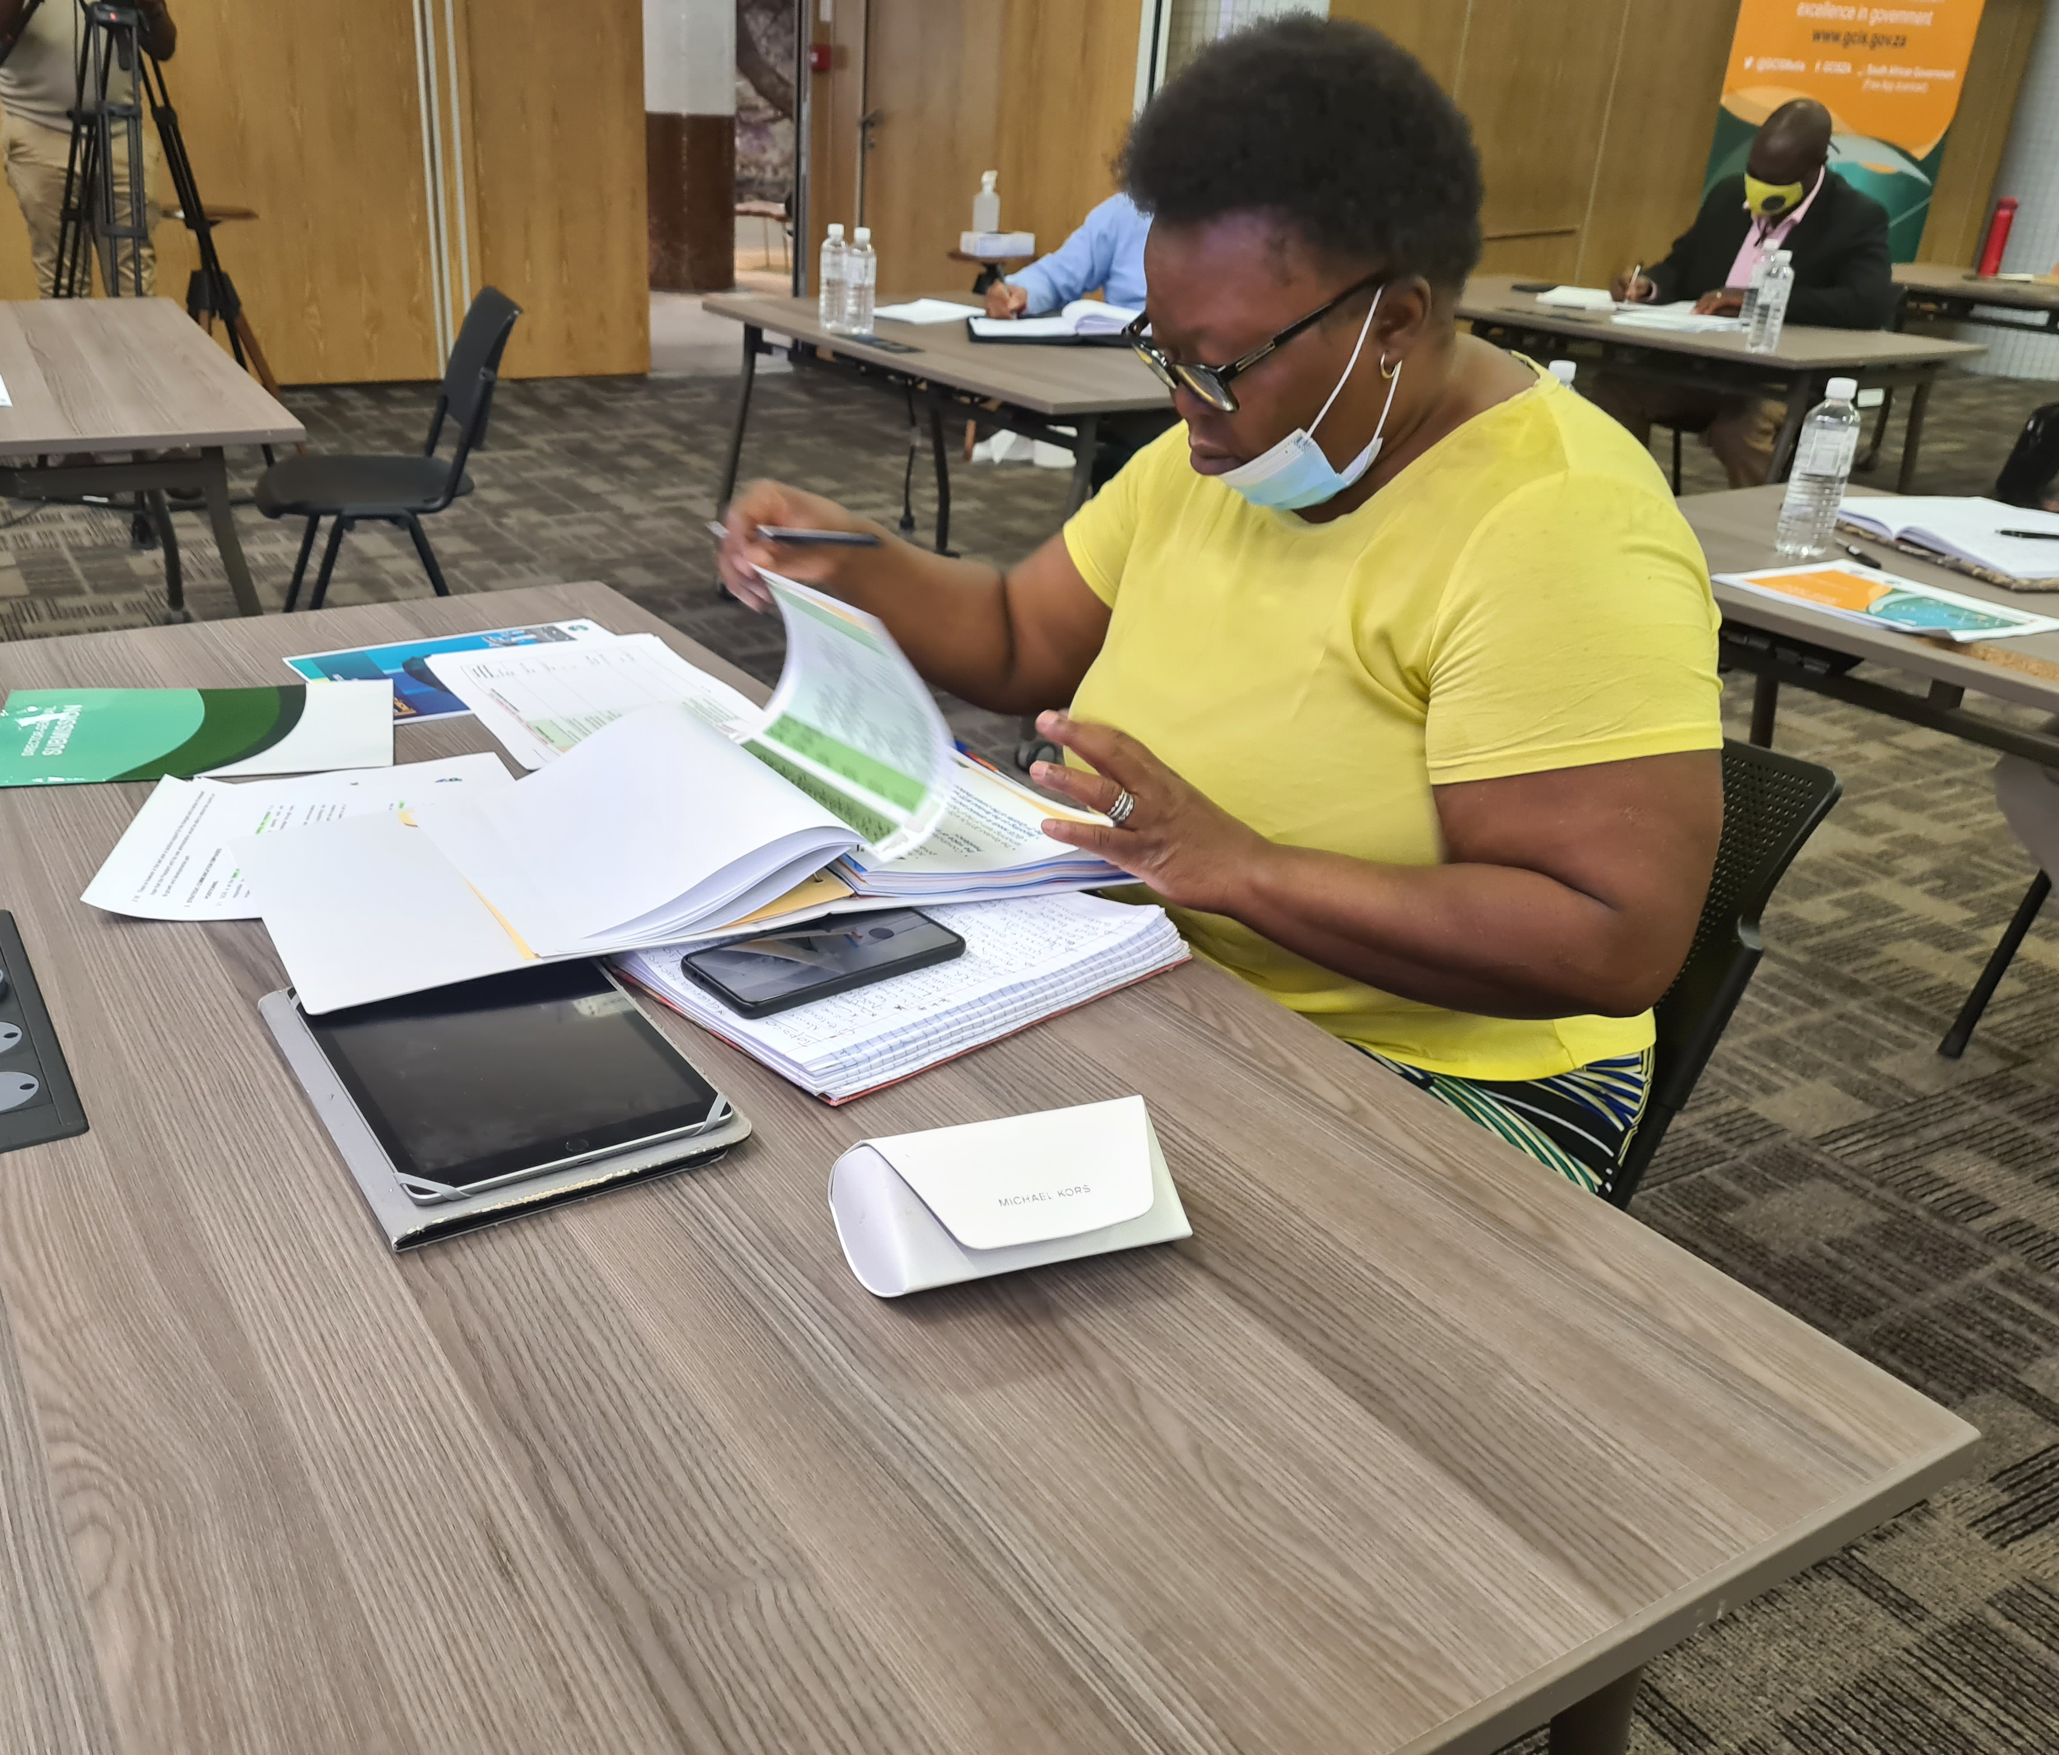
5. 2022/23 TARGETS PER PROGRAMME
PROGRAMME 2: Content Processing and Dissemination
Purpose: Provide strategic leadership in government communication to ensure coherence, coordination, consistency, quality, impact and responsiveness of government communication.
Outcomes: Informed and empowered citizens
Transformed mainstream print and digital media, advertising and community media

Slide 12
5. 2022/23 TARGETS PER PROGRAMME
Output Indicators | Annual targets 2022/23
Number of copies of Vuk’uzenzele newspaper produced | 10.2 million copies of Vuk’uzenzele newspaper produced
Number of online editions of Vuk’uzenzele newspaper published annually | 22 online editions of Vuk’uzenzele newspaper published annually
Number of online editions of PSM magazine published annually | 11 online editions of PSM magazine published
An online edition of the SAYB published annually | One online edition of the 2021/22 SAYB published annually
An online of the Official Guide to South Africa published annually | One online edition of 2021/22 Official Guide to South Africa published annually
Percentage of language services requests completed | 100% language services requests completed

Slide 13
5. 2022/23 TARGETS PER PROGRAMME
Output Indicators | Annual targets 2022/23
Number of stories on key government programmes and activities published on SANews | 2 800 stories on key government programmes and activities published on SANews
Number of screens reached on GCIS-managed social media platforms quarterly | 80 million screens reached on GCIS-managed social media platforms
Number of page views on www.gov.za website | 48 million page views on www.gov.za website

Slide 14
5. 2022/23 TARGETS PER PROGRAMME
Output Indicators | Annual targets 2022/23
Number of cluster reports on perceptions of government priorities produced | 10 cluster reports on perceptions of government priorities produced
Percentage of requested key messages produced (excluding weekends, public holidays and holiday periods) | Produce 100% of key messages requested (excluding weekends, public holidays and holiday periods)
Percentage of requested opinion pieces produced (excluding weekends, public holidays and holiday periods) | Produce 100% of opinion pieces requested (excluding weekends, public holidays and holiday periods)
Number of monitoring and evaluation G-CET reports on communication in government produced | Four monitoring and evaluation G-CET reports on communication in government produced

Slide 15
5. 2022/23 TARGETS PER PROGRAMME
Output Indicators | Annual targets 2022/23
Percentage of approved media-buying campaigns implemented | 50% of approved media buying campaigns implemented
Number of national events, government programmes and The Presidency’s engagements profiled through photographic services per year | 400 national events, government programmes and The Presidency’s engagements profiled through photographic Services
Number of national events, government programmes and The Presidency’s engagements profiled through video services per year | 300 national events, government programmes and The Presidency’s engagements profiled through video Services

Slide 16
5. 2022/23 TARGETS PER PROGRAMME
Output Indicators | Annual targets 2022/23
Number of radio products and services provided per year | 500 radio products and services provided
Number of graphic designs completed per year | 600 graphic designs completed
Percentage of approved marketing services requests implemented | 100% of approved marketing services requests implemented
Number of GCIS print products distributed | 13 print products produced by the GCIS distributed (12 editions of Vuk’uzenzele newspaper and the GCIS Annual Report)

Slide 17

5. 2022/23 TARGETS PER PROGRAMME
Output Indicators | Annual targets 2022/23
Number of performance review and compliance monitoring reports submitted to the Minister | Eight performance review and compliance monitoring reports submitted to the Minister
MAC Sector Code reviewed and published in the Government Gazette | MAC Sector Code reviewed, updated and approved by the Minister in The Presidency

Slide 18
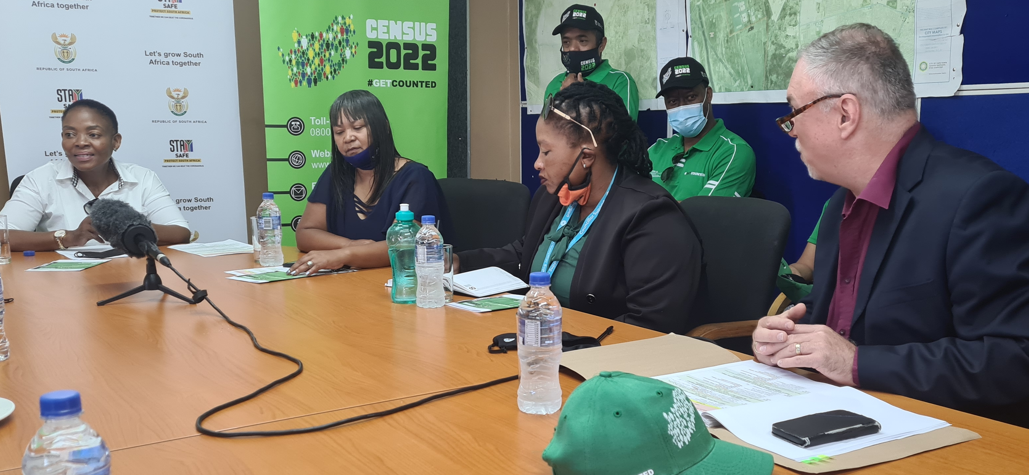
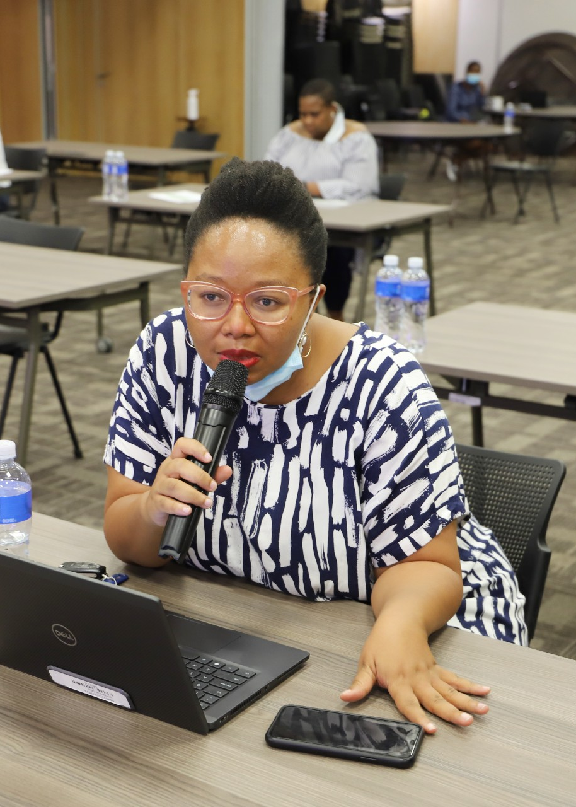
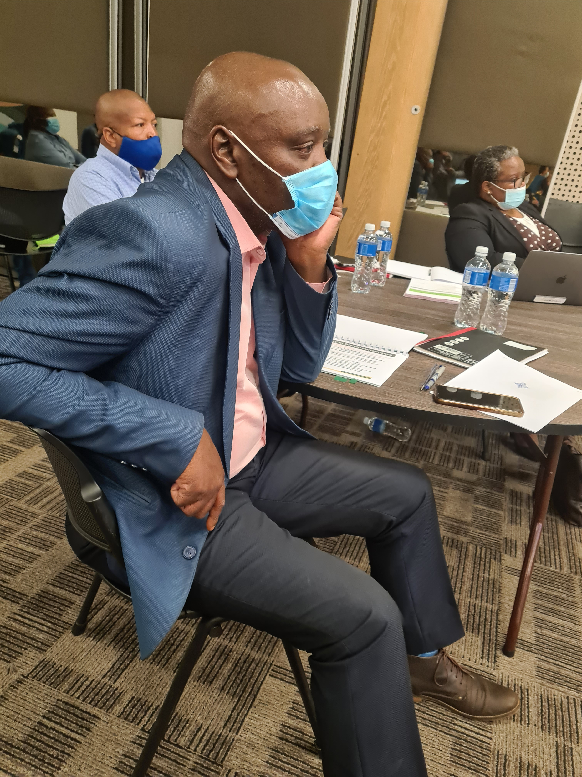
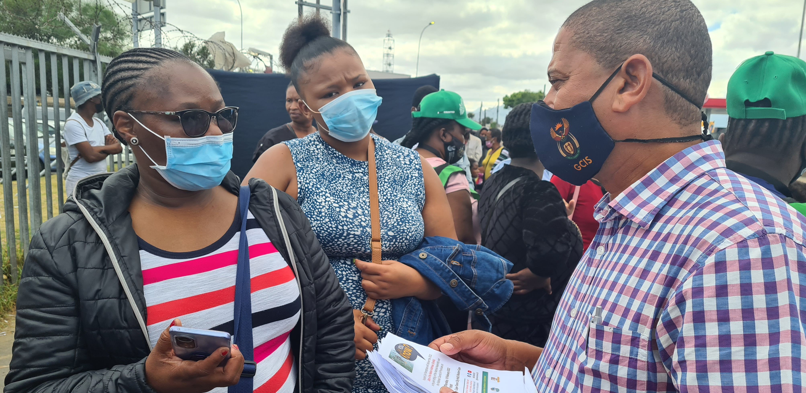
PROGRAMME 3: Intergovernmental Coordination and Stakeholder Management
5. 2022/23 TARGETS PER PROGRAMME
Purpose: Implementation of development communication, through mediated and unmediated communication and sound stakeholder relations and partnerships.
Outcomes: Improved relations with the media
Well-functioning government communication system
Informed and empowered citizens

Slide 19
5. 2022/23 TARGETS PER PROGRAMME
Output Indicators | Annual targets 2022/23
Number of engagements between government officials and senior journalists on government’s key programmes in the NASP held | 24 engagements between government officials and senior journalists on government’s key programmes in the NASP held
Number of post-Cabinet media briefings and/or statements issued after ordinary Cabinet meetings per year | 17 post-Cabinet media briefings and/or statements issued after ordinary Cabinet meetings per year
Percentage of media briefings supported from requests received from government departments per year | 100% of media briefings supported from requests received from government departments

Slide 20
5. 2022/23 TARGETS PER PROGRAMME
Output Indicators | Annual targets 2022/23
Number of engagements with HoCs held | Two engagements with HoCs held
Number of ICFs held | 10 ICFs held
Number of communication campaigns implemented aligned to the MTSF/SoNA priorities | Four communication campaigns implemented aligned to the MTSF/SoNA priorities
Number of communication training opportunities availed across the communication system | 20 communication training opportunities availed across the communication system
Campaign= communication focus areas as defined in the NCSF

Slide 21
5. 2022/23 TARGETS PER PROGRAMME
Output Indicators | Annual targets 2022/23
Number of development communication projects aligned to the NCSF | Not less than 1 140 development communication projects aligned to the NCSF
Number of community and stakeholder liaison sessions/visits undertaken per year | Not less than 1140 community and stakeholder liaison sessions/visits undertaken
Number of electronic My District Today newsletter published per year | 47 electronic My District Today newsletters published
Number of reports on support to the functioning of government communication system produced (provincial and local level), including the DDM | Four reports on support to the functioning of government communication system produced (provincial and local level), including the DDM

Slide 22
6. 2022/23 BUDGET SUMMARY AND MTEF ESTIMATES
 |  | 2022/23 |  |  |  | 2023/24 | 2024/25
R thousand |  | Total | Current payments | Transfers and subsidies | Payments for capital assets | Total | Total
MTEF allocation |  | R'000 | R'000 | R'000 | R'000 | R'000 | R'000
Administration |  | 177 251 | 176 639 | 50 | 562 | 176 052 | 184 062
Content Processing and Dissemination |  | 411 706 | 155 501 | 254 944 | 1 261 | 410 871 | 428 953
Intergovernmental Coordination and Stakeholder Management |  | 130 954 | 129 655 | 10 | 1 289 | 127 939 | 133 815
Total expenditure estimates |  | 719 911 | 461 795 | 255 004 | 3 112 | 714 862 | 746 830

Slide 23

7. 2022/23 EXPENDITURE ESTIMATES
Programmes | Audited outcomes |  |  | Adjusted Appropriation | Medium term expenditure estimate
R thousand | 2018/19 R’000 | 2019/20 R’000 | 2020/21 R’000 | 2021/22 R’000 | 2022/23 R’000 | 2023/24 R’000 | 2024/25 R’000
 | R’000 | R’000 | R’000 | R’000 | R’000 | R’000 | R’000
Administration | 155 341 | 167 654 | 177 791 | 178 752 | 177 251 | 176 052 | 184 062
Content Processing and Dissemination | 375 666 | 389 860 | 416 339 | 451 775 | 411 706 | 410 871 | 428 953
Intergovernmental Coordination and Stakeholder Management | 112 651 | 118 109 | 117 980 | 126 903 | 130 954 | 127 939 | 133 815
Total | 643 658 | 675 623 | 712 110 | 757 430 | 719 911 | 714 862 | 746 830

Slide 24
7. 2022/23 EXPENDITURE ESTIMATES
Programme 1: Administration
 | Audited outcomes |  |  | Adjusted Appropriation | Medium term expenditure estimate
R thousand | 2018/19 R’000 | 2019/20 R’000 | 2020/21 R’000 | 2021/22 R’000 | 2022/23 R’000 | 2023/24 R’000 | 2024/25 R’000
Departmental Management | 6 914 | 7 506 | 8 513 | 7 941 | 9 700 | 9 550 | 10 015
Corporate Services | 48 926 | 56 560 | 54 100 | 56 946 | 54 358 | 53 417 | 56 080
Financial Administration | 33 935 | 37 682 | 38 398 | 39 583 | 38 067 | 37 637 | 39 373
Internal Audit | 9 017 | 9 087 | 9 774 | 10 618 | 9 955 | 10 054 | 10 264
Office Accommodation | 56 549 | 56 819 | 67 006 | 63 664 | 65 171 | 65 394 | 68 330
Total | 155 341 | 167 654 | 177 791 | 178 752 | 177 251 | 176 052 | 184 062

Slide 25
7. 2022/23 EXPENDITURE ESTIMATES
Programme 2: Content Processing and Dissemination
 | Audited outcomes |  |  | Adjusted Appropriation | Medium term expenditure estimate
R thousand | 2018/19 R’000 | 2019/20 R’000 | 2020/21 R’000 | 2021/22 R’000 | 2022/23 R’000 | 2023/24 R’000 | 2024/25 R’000
Programme Management for Content Processing and Dissemination | 2 193 | 2 399 | 2 342 | 3 221 | 4 135 | 4 041 | 4 222
Policy and Research | 32 686 | 35 367 | 34 152 | 38 234 | 39 310 | 38 537 | 40 033
Products and Platforms | 51 323 | 48 565 | 52 858 | 51 106 | 52 005 | 50 793 | 53 074
Communication Service Agency | 57 085 | 53 473 | 109 857 | 106 465 | 56 845 | 56 548 | 59 089
Entity Oversight | 232 129 | 246 509 | 215 828 | 250 708 | 257 314 | 258 891 | 270 382
Media Policy | 250 | 3 547 | 1 302 | 2 041 | 2 097 | 2 061 | 2 153
Total | 375 666 | 389 860 | 416 339 | 451 775 | 411 706 | 410 871 | 428 953

Slide 26
7. 2022/23 EXPENDITURE ESTIMATES
Programme 3: Intergovernmental Coordination and Stakeholder Management
 | Audited outcomes |  |  |  | Adjusted Appropriation | Medium term expenditure estimate
R thousand | 2018/19 R’000 | 2019/20 R’000 |  | 2020/21 R’000 | 2021/22 R’000 | 2022/23 R’000 | 2023/24 R’000 | 2024/25 R’000
Programme Management for Intergovernmental Coordination and Stakeholder Management | 1 514 | 1 460 |  | 1 484 | 3 189 | 3 240 | 3 168 | 3 311
Provincial and Local Liaison | 80 135 | 81 782 |  | 82 173 | 89 823 | 92 101 | 90 398 | 94 378
Media Engagement | 14 033 | 16 818 |  | 16 019 | 15 917 | 17 165 | 16 871 | 17 584
Cluster Supervision (Human Development, Social Protection and Governance and Administration) | 8 698 | 9 727 |  | 10 316 | 9 668 | 10 014 | 9 255 | 9 926
Cluster Supervision (Economic and Infrastructure, Justice and International) | 8 271 | 8 322 |  | 7 988 | 8 306 | 8 434 | 8 247 | 8 616
Total | 112 651 | 118 109 |  | 117 980 | 126 903 | 130 954 | 127 939 | 133 815

Slide 27
8. CONCLUSION
The GCIS has repeatedly demonstrated sound corporate governance and a clean audit for 7 consecutive years.
This APP also demonstrates improved maturity in the planning approach and in seeking to demonstrate the outcomes of communication efforts
The repeated cuts on the GCIS baseline allocation have necessitated a review of indicators and targets
  Reduction in indicators from 38 to 35
  Several targets reduced downwards
Despite the cuts in budget, GCIS remains focused and dedicated towards communication that enables South Africans to change their lives

Slide 28

Thank You

