Slide 1
RETURN TO PLAY

Slide 2
PILLARS
Return to sporting Activities
Return to Play
“Its in your hands” Vaxx Social Mobilisation Campaign
Return of Spectators

Slide 3
Return to sporting Activities

Slide 4
RETURN TO PLAYING ACTIVITIES
Presentations of proposals to the Covid 19 Work streams Sectors
Inputs into Regulations from Level 3 to include Sport , Arts and Culture
Engaged with sector and SASCOC /Artists
Developed guidelines for the Sport and Arts Sectors
Submitted and motivated for amendments of regulations to take sport and the arts out of the lockdown
Return of Sporting Activities included into Regulations
Minister’s Directions developed and gazetted

Slide 5
IMPLEMENTATION OF DIRECTIONS
Call to sector to submit Plans
Portal set up for submission of Plans
Analysis team set up
Analysis Team workshopped by Health Authorities
Analysis completed as plans were submitted
Analysed Plans sent to Health Authorities for assessment
Letters of Approval sent to NFS
Monitoring team set up to sample

Slide 6
EVENTS /ACTIVITIES
Events hosted in a Biosafe Environment
PSL matches
International Cricket Events-England , Sri Lanka, India
Netball Telkom National League
British and Irish Lions
Domestic Sporting Events
Mass participation sporting events that complied with health & safety protocols such as the Cape Town Cycle Tour (held in October 2021 and March 2022), the Cape Town Marathon (held in October 2021) and Ride Joburg (held in November 2021) were hosted with between 10,000 and 18,000 participants without any known community cluster outbreaks directly attributed to any of these mass participation sporting events.

Slide 7
“Its in your hands” Vaccination Social Mobilisation Campaign

Slide 8
LAUNCH
Deputy President David Mabuza, led the DSAC vaccination social mobilisation campaign for sports and creative personalities by the Department of Sport, Arts and Culture (DSAC). The launch of the national campaign,
“Return to Play – it’s in your hands”,
Tuesday, 7 September 2021 at FNB Stadium
The Ministry of Sport, Arts and Culture launched the vaccination campaign using its unique position of galvanizing support and voice to the country’s sporting and creative industries. This followed the opening of vaccinations for citizens aged 18 – 34 earlier than expected
Campaign also linked to the Vooma Vaccine Weekend Campaigns

Slide 10
FORMAT AND ROLLOUT
#Ichoose 2BActive Community Walk
Formal Programme
Messages of Support – Sport and Creative Sectors
Entertainment
Vaccine Station Activation- well known Personalities in attendance to take vaccines
Launch : 7 September 2021 –Gauteng
Provincial Campaigns
Mpumalanga North West Western Cape
KZN Northern Cape Eastern Cape

Slide 11
USING SPORTING EVENTS TO ROLLOUT VACCINES
Department of Health using major Sporting events to rollout Vaccines.
Already completed at Sundowns CAF champions League match on 2 April 2022.
Identified PSL matches will be used to roll out vaccines.
PSL has also indicated that Diski matches (target group ) will be utilised as vaccine sites
Engaging other codes as well.
Looking at next phase of strategy to also encourage those vaccinated to take the booster

Slide 12
Return of Spectators

Slide 13
On 15 October 2021, the amended Directions for Sport, Arts and Culture under the Disaster Management Act No. 57 of 2002 was gazetted.
The published Directions allows sport, arts and cultural events to resume subject to compliance with measures to prevent and combat the spread of COVID–19
69 (10) Sporting events including both professional and non‐professional matches, by recognised sporting bodies are allowed, subject to strict adherence of the times of operation as provided for in regulation 66 and the following:
b) Spectators and the venue of a sports event are permitted but limited to 750 persons or less for indoor venues and 2000 persons or less for outdoor venues and if the venue is too small to hold the prescribed number of persons observing a distance of at least one and a half meters from each other, then not more than 50% of the capacity of the venue may be used, subject to strict adherence to all health protocols and social distancing measures.
(11) An owner or operator of a sporting facility or an organiser must, ensure compliance with the limitation on the number of persons attending such a gathering contemplated in sub regulation (10)
Ministers directions gazetted to indicate that spectators had to be vaccinated
Guidelines developed to assist the sector
Portal established for submission of applications
Reopen the events sector through a controlled set of government approved ‘pilot’ events.
Monitoring team in place to attend events to monitor compliance

Slide 14
1
2
3
4
5
6
7
8
9
Applicants
Applications (guidelines template)
DSAC Secretariat
Vetting of applications
Interaction with applicants
Adjudication Panel
Adjudication
Outcomes (Recommendations)
10
Monitoring
DG/ Minister

Slide 15
1- Applicants
Applications (guidelines template)
2- DSAC Secretariat
3- RTPAC
4- DSAC Secretariat
5- DG/Minister
Vetting of applications
Interaction with applicants
Adjudications
Outcomes (Recommendation)
Response to Applicant – via DG letter
Process Outcomes to Director-General /Minister

Slide 16
EVENTS /ACTIVITIES
Bafana Bafana vs Zimbabwe
Bafana Bafana vs Ethiopia
MTN 8 Final
Sundowns CAF Champions League match against Al Ahli and Al Merrick
Rugby Carling Cup
Super Rugby Events
No major incidents of outbreak

Slide 17
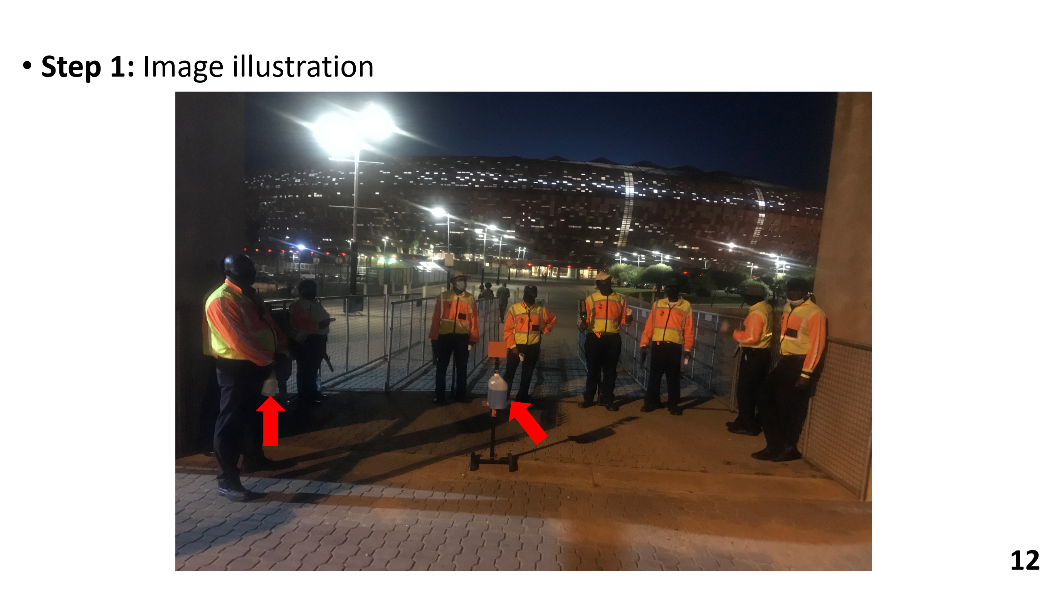

Slide 19
PROPOSAL FOR RELAXATION OF RESTRICTIONS TO SPECTATORS
Final Submissions tabled in Mid March 2022
Consideration of scientific evidence used to motivate rationale to increase the number of spectators allowed
International best practice provided to motivate for more spectators
Existing Regulations in support of proposals
For attendees
Safety at Sports & Recreational Events Act of 2010
Event Safety & Security Planning Committee to be established for all events over 2,000 people
City Bylaws and Regulations
National, Provincial and Local government oversight
SASREA

Slide 20
PROPOSAL FOR RELAXATION OF RESTRICTIONS TO SPECTATORS
Reopening the events sector proposal
Increasing to 75% capacity within 1-2 months, and 100% capacity within 3-4 months
All persons entering these venues must show proof of vaccination
Vaccine certificate to be verified through EVDS portal
Children under 12 be exempted until the age cohort becomes eligible for vaccination
Negative PCR test for persons with medical exemptions (such as allergies to ingredients in the vaccine)
No physical distancing required (as of status) – Purely as people are vaccinated (as is done in other parts of the world that allow only the vaccinated to take part in events)
Mask mandates for indoor venues and vulnerable people
Enhanced health & safety measures to be implemented based on risk assessment
Alcohol sales to be permitted in line with liquor laws
Events <1,000 persons indoors or <2,000 persons outdoors permitted without proof of vaccination subject to 1.5m physical distancing and wearing of masks

Slide 21
CALL FOR COMMMENTS
The Department of Health published proposed health regulations to deal with COVID-19 and other notifiable medical conditions outside the National State of Disaster.
Call for public comments “to allow the public to have meaningful input into the decision-making process” after it extended the National State of Disaster with another month.(17 March 2022)
The Department consulted with its stakeholders to share the information and urge stakeholders to make inputs into the regulations by 15 April 2022.

Slide 22
CALL FOR COMMMENTS
The Department of Health published proposed health regulations to deal with COVID-19 and other notifiable medical conditions outside the National State of Disaster.
Call for public comments “to allow the public to have meaningful input into the decision-making process” after it extended the National State of Disaster with another month.(17 March 2022)
The Department consulted with its stakeholders to share the information and urge stakeholders to make inputs into the regulations by 15 April 2022.

Slide 23
AMENDMENTS TO REGULATIONS
Government Notice no 1915 of 22 March 2022 Section 69
Gatherings
venue capacity of 50%
Allowed for those fully vaccinated and in possession of a vaccination certificate and those unvaccinated but with a valid certificate of a Covid 19 PCR test obtained at least 72 hours before a gathering
venue capacity of 1000 indoors and 2000 outdoors
those not fully vaccinated and not in possession of a vaccination certificate and those unvaccinated but without a valid certificate of a Covid 19 PCR test obtained at least 72 hours before a gathering -

Slide 24
TRANSITIONAL MEASURES
End of state of Disaster came into effect on 5 April 2022.
Government Notice no 146195 of 4 April 2022 gazetted with some of the measures from 22 March 2022 gazette still in force
Section 69 Gatherings
venue capacity of 50%
Allowed for those fully vaccinated and in possession of a vaccination certificate and those unvaccinated but with a valid certificate of a Covid 19 PCR test obtained at least 72 hours before a gathering
venue capacity of 1000 indoors and 2000 outdoors
those not fully vaccinated and not in possession of a vaccination certificate and those unvaccinated but without a valid certificate of a Covid 19 PCR test obtained at least 72 hours before a gathering -
if the venue is too small to hold the prescribed number of persons observing a distance of at least one metre from each other, then not more than 50 percent of the capacity of the venue may be used, subject to strict adherence to all health protocols and social distancing measures.

Slide 25
RECOMMENDATIONS
Committee to note :
The report
That the Department will
- continue to review existing legislation and strength it to consider inclusion of measures for any such situations that may occur in the future
Engage in the processes associated the finalisation of new measures as arising from the Department of Health Initiatives

Slide 26
THANK YOU

