Slide 1
Presentation to the
Select Committee on Finance
Presenter:
Unathi Kamlana – Commissioner, 19 April 2022

Slide 2
Background & context
2008 Global Financial Crisis
Historical bank vs non-bank regulatory architecture required reform
Twinpeaks introduced in 2018 – Financial Sector Conduct Authority (FSCA) & Prudential Authority in the SARB
Covid 19 – observations and response
April 2021 - Permanent Commissioner / 3x Deputy Commissioners appointed
2

Slide 3
The legal mandate
The FSCA’s mandate is to:
enhance the efficiency and integrity of financial markets; promote fair customer treatment by financial institutions; promote financial literacy by providing financial education; and assist in maintaining financial stability – s57 Financial Sector Regulation Act
3

Slide 4
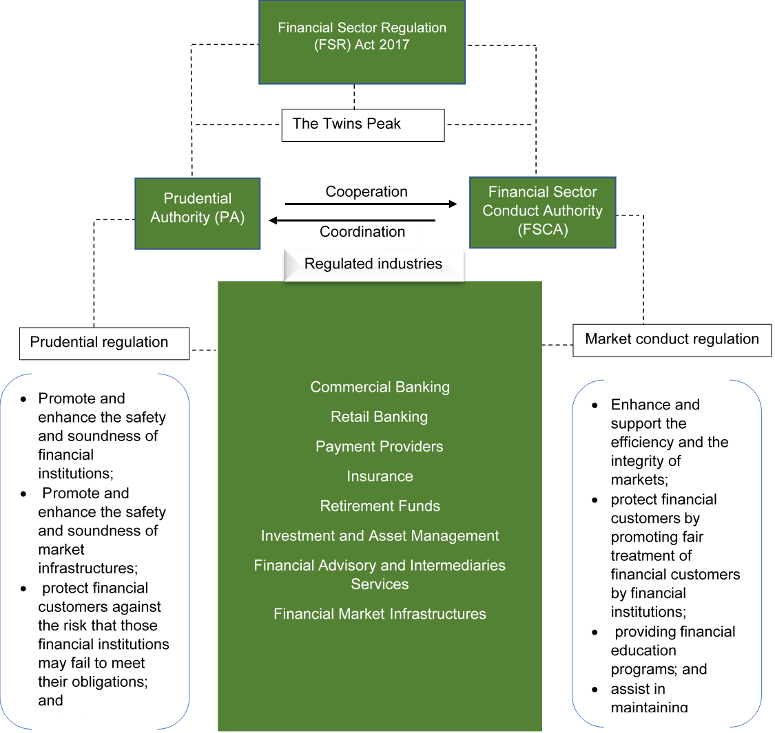
Regulatory scope
4

Slide 5
Q3,2021/22 Performance Report

Slide 6
FSCA Objectives 2018 - 21
01
Building a New Organisation
02
An inclusive and transformed financial sector
03
A robust regulatory framework that promotes fair customer treatment
04
Informed financial customers
.
05
Strengthening the efficiency and integrity of our financial markets; .
06
Understanding new ways of doing business
and disruptive technologies.
6

Slide 7
Q3 Performance
Achieved | Not Achieved | Exclusion | Reason for the Exclusion
23 | 7 | 1 | Dependency on warrants being issued.
7

Slide 8
Achieved Targets
Programme | Outcome | # | Target | Achievement
Administration | A modern organisation that is financially sustainable and efficient. | 1 | 2 broadcast media interviews . | 2 broadcast media interviews.
 |  | 2 | 2 community radio interviews. | 2 community radio interviews.
 |  | 3 | 1 media monitoring report. | 1 media monitoring report.
 |  | 4 | 1 FSCA newsletter. | 1 FSCA newsletter
 |  | 5 | 1 “Our Voice. | 1 FSCA “Our Voice”.
Licensing and Business Centre | Effective and efficient licensing processes that ensures fair treatment of customers by financial institutions. | 6 | Licence 80% of all received applications within 90 days. | 80.13%.
8

Slide 9
Achieved Targets – cont…
Programme | Outcome | # | Target | Achievement
Regulatory Policy | Improved brand awareness, financial literacy, customer awareness and understanding of their rights and responsibilities when making financial decisions. | 7 | 14 workshops conducted. | 60 workshops conducted
 |  | 8 | 2 exhibitions | 8 exhibitions.
 |  | 9 | 1 Speech Competition activities. | 83 Speech Competition activities.
 |  | 10 | 1 Resources developed | 2 Resources developed
 |  | 11 | 1 research and M&E reports/case studies. | 1 research and M&E reports/case studies.
 |  | 12 | 1 report on online activities. | 1 report on online activities.
 |  | 13 | Respond to 90% of queries received by the FSCA within 28 days of receipt | Responded to 98% of queries received by the FSCA within 28 days of receipt.
Market Integrity Supervision | Improved regulation and supervision processes to strengthen the efficiency and integrity of our financial markets. | 14 | Conduct 1 inspection for Market Infrastructures and SROs (virtual or physical). | 1 inspections conducted for Market Infrastructures.
Retirement Funds Supervision | Enhanced supervision to promote sound management of retirement funds thereby protecting and safeguarding retirement benefits. | 15 | 80% of inspections conducted as per the risk-based supervisory plan (on-site, desktop or virtual). | 82.35% of virtual or desktops on-site inspections conducted.
 |  | 16 | 80% of returns received from registered funds analysed (off-site reviews) within agreed timeframes. | 100% of returns received from registered funds analysed (off-site reviews).
9

Slide 10
Achieved Targets – cont…
Programme | Outcome | # | Target | Achievement
Conduct of Business Supervision | Improved brand awareness, financial literacy, customer awareness and understanding of their rights and responsibilities when making financial decisions. | 17 | Hold 1 awareness programme to educate Communities utilising banking services. | 1 – awareness program held.
 |  | 18 | Perform 80% off-site analysis on statutory returns received from registered Financial service providers (FSP). | Perform 93.35% off-site analysis on statutory returns received from registered Financial service providers (FSP).
 |  | 19 | Perform offsite analysis on 80% of the conduct of business returns submitted by insurers earmarked for review. | Performed offsite analysis on 104% of the conduct of business returns submitted by insurers earmarked for review in the 2021/22 financial year.
 |  | 20 | Conduct desktop reviews on statutory returns of 80% of investment providers. | Conducted desktop reviews on statutory returns of 86% of investment providers.
Enforcement | Effective, impartial investigation and enforcement processes to maintain transparency and integrity of our financial sector. | 21 | 90% of administrative sanctions executed. | 100% of administrative sanctions executed.
 | Effective, impartial investigation and enforcement processes to maintain transparency and integrity of our financial sector. | 22 | Provide assistance to 100% of requests received from law enforcement agencies within the requested date. | Provided assistance to 100% of requests received from law enforcement agencies.
 |  | 23 | Provide assistance to 100% of requests received from international regulators within the requested date. | Provided assistance to 100% of requests received from international regulators within the requested date.
 |  | 24 | 100% of warrants obtained from a judge or magistrate executed within 10 days of receipt. | N/A – (Fulfilment of target depends on department obtaining warrants – no warrants were obtained in Q3).
10

Slide 11
Unachieved Targets
Programme | Outcome | # | Target | Achievement | Corrective action | Year to date actual achievement
Administration | A modern organisation that is financially sustainable and efficient. | 1 | Pay 100% of valid supplier’s invoices within 30 days. | 93% of valid supplier invoices paid within 30 days. | Following up with service providers and relevant Cost Center Managers to resolve queries timeously | Not Achieved - 94% of valid supplier invoices paid within 30 days.
 | 2 | 2 | 50% female 50% male 2% employees with disabilities 90% employees from black group (79% African, 7% coloured, 4% Indian) 10% from white group. | 55% female 45% male 0.7% employees with disabilities 88% employees from black group (79% African, 6% coloured, 3% Indian) 12% from white group. | Focus is being directed at recruiting people with disabilities, Coloured and Indians. The overrepresentation of the white population group can only be achieved through natural attrition. EXCO has approved a bursary policy to recruit people with disabilities which will assist in meeting the disability target in the long-term. | Not Achieved - 55% female 45% male 0.7% employees with disabilities 88% employees from black group (79% African, 6% coloured, 3% Indian) 12% from white group.
Regulatory Policy | Improved brand awareness, financial literacy, customer awareness and understanding of their rights and responsibilities when making financial decisions. | 3 | 3 media activities. | 2 media activities. | Ensure confirmation of interviews with media house in advance. | Achieved - 755 media activities
 |  | 4 | Resolution of 90% of RSB test cases within six months after defining parameters. | Resolution of 66% of RSB test cases within six months after defining parameters. | Going forward, targets are being adjusted to take account of certain test cases being more complex and requiring a longer test period. This is the consequence of learning experience, as this is a new activity for the FSCA, and the RPD specifically. | Not Achieved - Resolution of 49.67% of RSB test cases within six months after defining parameters.
11

Slide 12
Unachieved Targets - cont…
Programme | Outcome | # | Target | Achievement | Corrective action | Year to date actual achievement
Conduct of Business Supervision | Improved brand awareness, financial literacy, customer awareness and understanding of their rights and responsibilities when making financial decisions. | 5 | Conduct 5 workshops to provide up-skill training for small financial services providers (FAI 3) and Micro 2) | Conducted 3 workshops to provide up-skill training for Small Financial Services Providers (FAI 3) and Micro (0) | The workshops will resume in Q4 if possible, with the Covid-19 restrictions | Not Achieved Conducted 3 workshops to provide up-skill training for small financial services providers (FAI 3 and Micro 0) (The workshops were supposed to be conducted in a face-to-face manner, as this works best for the target audience )
 |  | 6 | Conduct 5 empowerment workshops with SMMEs. | Conducted 4 empowerment workshops with SMMEs. | The workshops will resume in Q4 via Teams Events. The Teams registration methods included information that was not required in terms of the POPI Act. The department has to redesign their registration process to make sure it is POPI compliant and give ICT development time to amend the online registration form. | Achieved - Conducted 41 empowerment workshops
 |  | 7 | 42 onsite inspections BPP 5 IRF 0 Micro institution 10 FAI 15 Investment providers 12 | 39 onsite inspections Banks and Payment Providers (BPP) 2 Insurance and Retirement Funds (IRF) 2 Micro institution 9 Financial Advisors and Intermediaries (FAI) 15 Investment providers (IP) 11 | BPP: No action, currently exceeding the year-to-date target. Micro: The 2 outstanding inspections for Q3 will be conducted in Q4. IP: The remaining inspection (1), to be conducted in Q4. | Achieved 95 onsite inspections Banks and Payment Providers (BPP) 31 Insurance and Retirement Funds (IRF) 5 Micro institution 13 Financial Advisors and Intermediaries (FAI) 25 Investment providers (IP) 21
12

Slide 13
Risks/Challenges or Gaps Identified | Mitigation Strategies Adopted
The proactive dissemination of information in a changing environment that includes the COVID-19 pandemic. | The FSCA continuously engages with all stakeholders, including the public, to ensure that all changes are communicated timeously and accurately. The FSCAs virtual media interviews, media engagements, thought leadership activities, industry workshops, social media engagements and press releases are some of the vehicles through which the FSCA manages this risk.
Potential failure of strategic ICT project (IRS). The Integrated Regulatory Systems (IRS) TOR: There was a recommendation to analyse the impact of the Prudential Authority (PA)/FSCA Shared Services Business Case project to the IRS Project. (Project on hold as per National Treasury's instruction to stop all tenders until the issue of the PPPFA is resolved). | Entrenchment of project governance throughout the project – effective once procurement process is concluded. Business Case Review – Completed. Vendor Management Risk Assessment – Planned.
Delays in finalisation of the Financial Sector Code at the Financial Sector Transformation Council. The FSCA participates in various sub-committees and has contributed significantly to the work done in those committees. However, there has been lengthy delays in terms of the finalisation of a new Financial Sector (FS) Code. | The issue has been communicated to the National Treasury and has been noted by the FSCA at the Financial Sector Transformation Council (FSTC) subcommittees.
Legislative framework not adapting quickly enough to financial sector trends, emerging risks, and international developments. | Carrying out proactive research into and monitoring of financial sector trends, emerging risks, and international developments. Ensuring regulatory instruments are timeously developed to address emerging risks. Participate in the work of international financial sector principle/standard setting bodies .
Under capacity and new skills required (e.g. behavioural economics approaches) including from industry. | Training existing staff on new skills (behavioural economics). Leveraging on partnerships with external stakeholders. Evaluation of FSCA structures to ensure efficacy of its intended functions.
Challenges
13

Slide 14
Risks/Challenges or Gaps Identified | Mitigation Strategies Adopted
Uncertainties regarding the intention and timing of the Financial Sector Regulation Act (FSRA) insofar it relates to the various mandates of the different financial sector regulators and legislative architecture. | A Task Team consisting of National Treasury, FSCA, PA and Council of Medical Schemes (CMS) were established to consider overlapping objectives and information sharing measures and to make recommendations on future conduct and prudential delineation. The FSCA will contribute to these discussions as part of its participation on the Task Team. PA/FSCA established working groups to facilitate the smooth transition of the prudential regulation of Collective Investment Schemes, Pension Funds and Friendly Societies from the FSCA to the PA. Regular quarterly meetings have been set up between the National Payment System (NPS) department of the SARB and the FSCA to discuss areas of overlap, coordination, and development. In addition, special workstreams are set up to discuss mandate and development matters as they arise with regards to, development of the COFI Bill and the NPS Act review. Internal FSCA working groups have been set up to further refine the perimeter and scope of the FSCA mandate with regards to credit, debt collection, various markets activities and payment services. This work will be used to inform COFI Bill developments as well as to inform discussions with the National Credit Regulator (NCR), Council of Debt Collectors (CDC), SARB and PA. Considerations with regards to services related to forex are taking place through the development of the COFI Bill
Delays in the promulgation of the COFI Bill framework - Under the future legislative framework all sectoral laws will be collapsed into the COFI Bill. There is therefore a significant body of existing subordinate legislation that must be facilitated through Standards under the COFI Bill. If COFI is passed and the body of subordinate legislation is not ready, it could lead to a significant delay in the implementation of the COFI framework and/or gaps in legislation | Development of financial sector law Harmonisation and Transition Plans with the purpose of ensuring a smooth transition into the COFI Framework
Challenges
cont.
14

Slide 15
Risks/Challenges or Gaps Identified | Mitigation Strategies Adopted
The supervisory framework needs to continue to transition towards a more robust, intensive, intrusive, and risk-based conduct of business regulatory regime. This also entails the development of a more mature risk rating methodology that needs to be applied | Continuously reviewing and updating the supervisory framework by drawing on input from the International Association of Insurance Supervisors (IAIS) and other overseas financial regulators Increased focus on level of engagement with regulated entities, particularly insurers, to enhance the robustness of the supervisory framework Thematic reviews will be focused on gaps identified through the data we receive to assist us in being more proactive in our supervision Engagements with World bank to assist with the development of uniform Risk Mitigation Methodology
Insurers do not consistently have access to or maintain reliable, complete, and accurate data of appropriate quality to provide sufficient insight into the level of customer outcomes across the industry | Development of conduct of business returns (CBR’s). Information received from the CBR’s will enable the proactive identification of key conduct risks Development of reports to assist in the analysis of the data received to enable the division to use the data in its supervisory approach and risk rating of entities Suptech programmes to assist with the analysis of big data and eventually do predictive analysis Legislative interventions (through further Policy holder Protection Rules and Regulations in Tranche 3 Amendments) Secured data analysis services which scans media to identify potential areas of conduct risk
Regulatory information not provided timeously, which inhibits pro-active and pre-emptive supervision | Quarterly asset allocation and conduct of business returns for at least the top 200 funds are being developed to support the Proactive Pre-emptive Intrusive and Intensive (PPII) supervisory framework
Poor governance and management of Funds by Trustees | Consideration is being given on the feasibility of developing a high level/principles governance standard for pension funds or piggy-bagging on some of the governance provisions in the CoFI legislation" The Retirement Funds Supervision Division (“RFSD”) is planning to host various online workshops to assist with the training of trustees on legislative developments and regulatory requirements.
Challenges
cont.
15

Slide 16
Risks/Challenges or Gaps Identified | Mitigation Strategies Adopted
Strengthening of the liquidations process | During recessions and economic hardships , there has been an decrease in the number of employers participating in funds due to Covid-19, it has become increasingly important to ensure that the liquidations process is cost-effective and expeditious. A draft liquidations standard has been developed that will dovetail with the proposed changes to section 28 of the Pension Funds Act setting clear timelines, revised prescribed fees, etc.
The inability to conduct in depth onsite reviews. - New operating and market risks emerging as participants develop new ways of addressing performance declines | A revised onsite review methodology that enables a review of activities remotely promotes proactive escalation of regulatory issues being experienced by the market infrastructures and Over the Counter (OTC) derivative providers.
New ways of doing business and disruptive technologies resulting in the legislative framework becoming outdated and inappropriate | Fintech Unit to actively and continuously monitor Fintech trends, unpack their implications for the financial sector, and develop proposals to address the associated emerging risks.
Lack of understanding of the importance of Environmental, Social and Governance protocols (ESG) | International Finance Corporation (IFC) and World Bank – The Authority was approached by the IFC and World Bank wherein the Authority was offered other opportunities for assistance with capacity building and supervisory framework guidance based on international standards and best practice. A meeting was held to discuss the needs of the RFSD (and to an extent the Authority) focusing on Climate Risk. The proposals for the opportunities, scope and duration of the partnership were provided during the month of August 2021 for approval. The IFC Team has indicated that further funding is available to continue the work with the Authority specifically within the RFSD for the next few years. A new co-operation agreement will have to be entered into and approved by the Authority. A meeting was held with the IFC representatives on 24 November 2021 to discuss how best to continue the work. A formal plan will be provided by the IFC in due course.
Challenges
cont.
16

Slide 17
FSCA New Objectives 2022 - 25
01
Improve industry practices to achieve fair outcomes for financial customers.
02
Act against misconduct to support confidence and integrity in the financial sector.
Promote the development of an innovative, inclusive, and sustainable financial system.
03
Empower households and small businesses to be financially resilient.
.
04
Accelerate the transformation of the FSCA into a socially responsible, efficient, and responsive organisation.
.
05
17

Slide 18
Mitigating conduct risks
Agile response to emerging and systemic conduct risks
Responses include :
Thematic supervisory initiatives & targeted research
Risks already identified and being addressed:
Crypto-assets; cyber and systems risks; arrear contributions & governance in retirement funds
18

Slide 19
Maintaining trust in financial sector
FSCA to act decisively and visibly against misconduct
Enhancing our ability to proactively detect misconduct through targeted surveillance, enhanced enforcement activity and pro-active reviews of financial information
Strengthening regulatory frameworks and the ability of the FSCA to exercise oversight
Includes bringing new areas of regulation into the ambit of the FSCA (e.g. payment service providers, financial benchmarks)
Financial market regulation - implementation of a roadmap on central clearing of derivative instruments – G20 commitment
19

Slide 20
Encouraging an innovative, inclusive, and sustainable financial system
FSCA will implement ways in which it can collect data on inclusion and transformation and monitor changes over time
Build on and establish close relationships with key stakeholders (FSTC, BBBEE Commission, Financial Inclusion Forum)
Encourage innovation that supports financial inclusion of low-income households and small businesses
Ensure that regulatory frameworks enable new entry, and support the development of new entrants into sectors with established market infrastructure
Enabling sustainable finance, primarily through disclosure but also through enabling regulation
20

Slide 21
Financially resilient households and small businesses
Core mandate of the FSCA is to promote financial literacy
Build on this to more broadly support financial resilience of households and small businesses, primarily by enabling them to make better financial decisions
Making resources and information available and targeted campaigns
Aim to develop a framework to monitor resilience and vulnerability
21

Slide 22
Leading a socially responsible, efficient and responsive organisation
We are focused on our performance and responsiveness as an institution, including through improvements in service delivery commitments
Improve availability and quality of data to improve regulatory and supervisory outputs
Emphasis on stakeholder management and external communication with a range of stakeholders:
Including building stronger relationships with financial customers, regulated entities, policy makers and other regulators, etc.
Thought leadership and broad engagement through policymaking fora, both locally and internationally
22

Slide 23
FSCA draft strategy for promoting financial sector transformation
Phase 1 will focus on the role that the FSCA will play within the current legislative framework
Phase 2 will focus on the role that the FSCA will play within the COFI Act legislative framework once the Act is implemented, amongst others:
Considering transformation plans during the licensing process and supervising the progress of financial institutions against their plans.
Setting minimum B-BBEE levels (e.g. Level 4) that must be targeted by each firm and documented in the transformation plan and requiring progression through the levels of transformation over defined periods of time.
Take action when there is a lack of commitment
Phase 2
Engaging with financial institutions on existing transformation plans and the extent to which targets identified in the plan are achieved
Improving availability and quality of transformation data, especially in relation to ownership
Build strong co-operative relationships with the FSTC and the B-BBEE Commission
Coordinate supervisory transformation initiatives with the PA
Support initiatives of Nedlac and the FSTC related to financial sector transformation
Support small businesses in the financial sector
Developing regulatory frameworks that promote transformation of the financial sector
Internal readiness for Phase 2
Subject to the final approved framework for transformation in financial sector laws, undertake regulatory and supervisory actions to promote transformation
Regular engagement with the FSTC and B-BBEE Commission
Continual evaluation of the effectiveness of legislative frameworks and their application
Phase 1
Strategy available on www.fsca.co.za; for public comment until 29 April 2022

Slide 24
THANK YOU

