Slide 2
Contents
Constitutional & Legislative Mandates
Vision, Mission & Values
Regulatory Philosophy
Strategic Goals and Outcomes
Industry and Organisational Analysis
Annual Performance Plan 2022/23
Key Focus Areas For 2022/23
Measuring Our Performance
2022/23 Outputs
Budget
Inadequate funding and new funding model
Immediate Challenges
Highlights

Slide 3
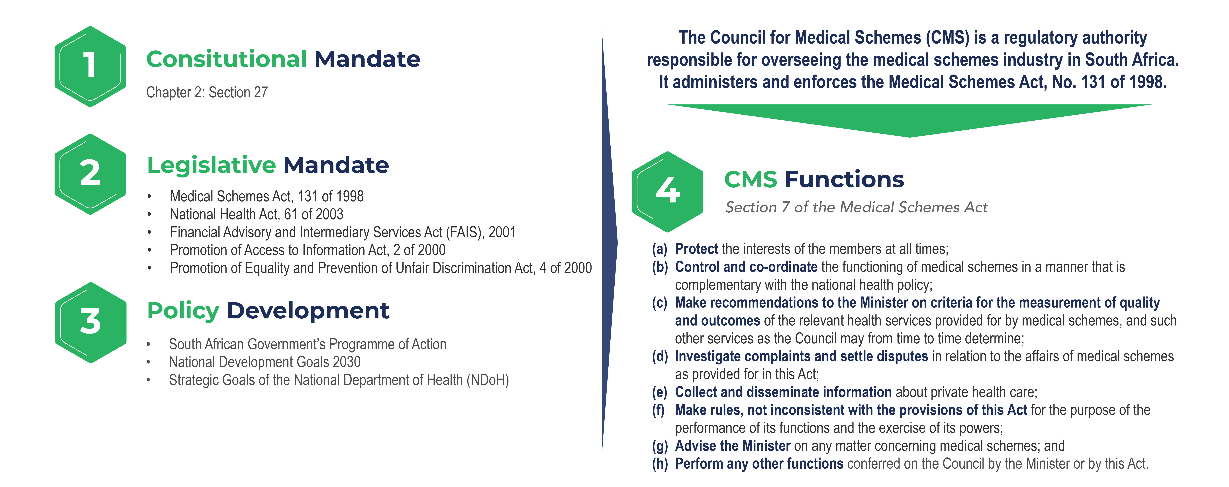
Constitutional & Legislative Mandate

Slide 4
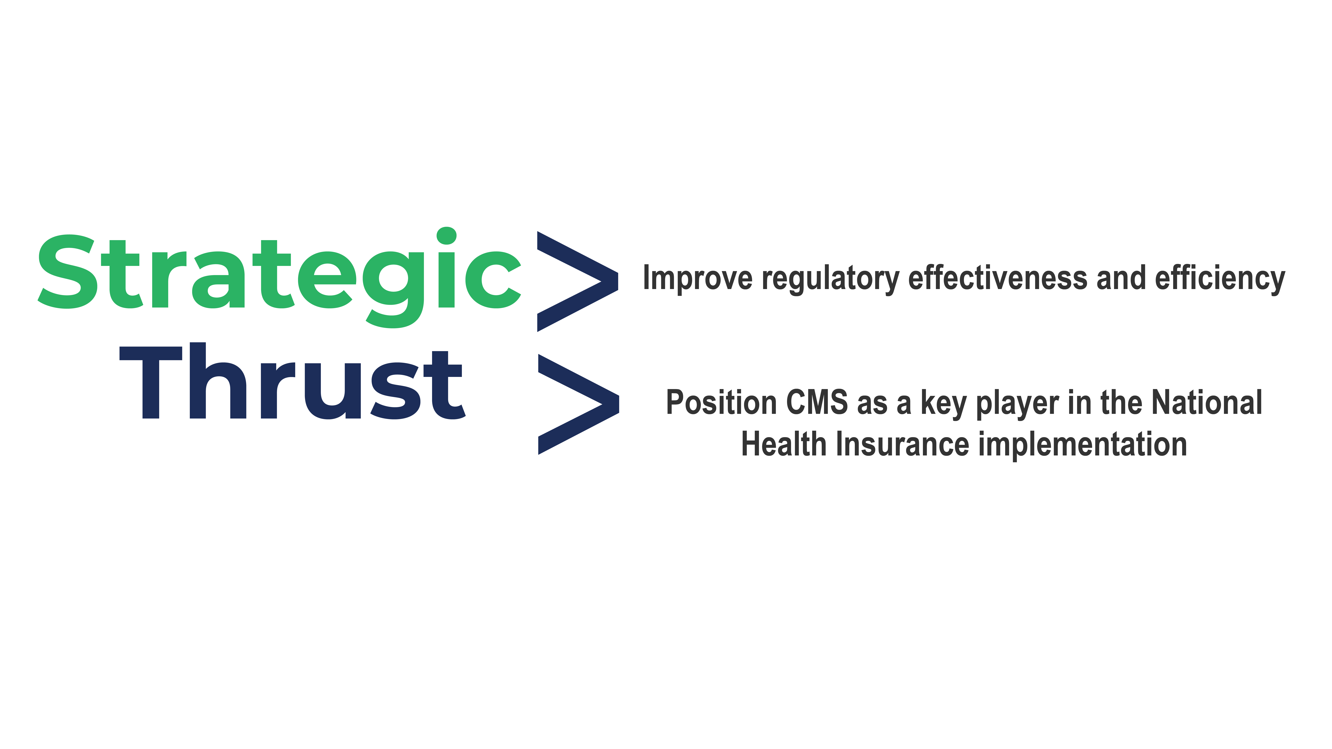

Slide 5


Slide 6
Mission
The CMS regulates the medical schemes industry in a fair and transparent manner and achieves this by:
Protecting the public and informing them about their rights, obligations and other matters, in respect of medical schemes;
Ensuring that complaints raised by members of the public are handled appropriately and speedily;
Ensuring that all entities conducting the business of medical schemes, and other regulated entities, comply with the Medical Schemes Act;
Ensuring the improved management and governance of medical schemes;
Advising the Minister of Health of appropriate regulatory and policy interventions that will assist in attaining national health Policy objectives; and
Ensuring collaboration with other stakeholders in executing its regulatory mandate

Slide 7

Regulatory Philosophy
Transparent
Fair
Equitable
Consultative
Cost Effective
Firm
Pro-active
INDEPENDENT

Slide 8
Shared Values
Accountability
Ubuntu
Professionalism
Integrity and Independence
Honesty
Respect

Slide 9
Strategic Goals/Outcomes
To promote the improvement of quality and the reduction of costs of in the private health care sector
To encourage effective risk pooling
To ensure that all regulated entities comply with, National Policy, MSA and regulations
To be a more effective and efficient organisation
To conduct policy-driven research, monitoring and evaluation of the medical schemes industry to facilitate decision-making and policy recommendations to the Health Ministry
To collaborate with local, regional and international entities

Slide 10
Outcomes
Impact statement | To be an agile and transformative Regulator in order to promote affordable and accessible healthcare cover towards universal health coverage.
Outcome 1 | To promote the improvement of quality and the reduction of costs in the private health care sector
Statement | The high costs of health care services in the private sector has been identified as one of the key factors that affects the sustainability of medical schemes in the short to medium term. The CMS is mandated to collect quality data from the private sector and advise the Health Ministry regarding the appropriate policy interventions. The CMS has to collect all the data on both quality and costs in order to determine if scheme members are getting value-for-money in the many health programmes that they belong to. The CMS supports the increased utilisation of Alternative Reimbursement Models Compared to Fee-for-Service Arrangements coupled with contracting for better outcomes between Schemes and Managed Care Organisations, as well as between Medical Schemes and Healthcare Providers
Outcome 2 | To encourage effective risk pooling
Statement | Through the standardisation of scheme options, the consolidation of medical schemes with less than 6000 members; the consolidation of government funded schemes, risk based capital solvency framework and the development of a comprehensive Primary Health Care benefit package, the CMS will ensure effective risk pooling and will be measuring the impact of co-payments exposure to beneficiaries. This work will be done through a consultative approach and by being mindful of the risks to scheme members, employers, trade unions and other key stakeholders.
Outcome 3 | To ensure that all regulated entities comply with, national policy, the MSA and Regulations
Statement | Through ensuring that all entities that are doing the business of a medical scheme are registered or accredited as per the requirements of the Medical Schemes Act, its Regulations and National Policy Interventions. The approval of scheme rules and options; efficient and expedient management of complaints; conducting the necessary inspections, examining all schemes to ensure that they are compliant with the financial requirements including solvency and the effective defence and litigation against errant regulated entities, the CMS will provide members of schemes with the protection they need.

Slide 11
Outcomes (cont)
Impact statement | To be an agile and transformative Regulator in order to promote affordable and accessible healthcare cover towards universal health coverage.
Outcome 4 | To be a more effective and efficient organisation
Statement | Through the review, updating, development and implementation of policies, strategies and standard operating procedures for the Office of the CEO, Office of the CFO, Information Communication and Technology (ICT), Human Resources (HR), Finance, and Legal support sub-programmes, the effectiveness and efficiency of the organisation will be improved. CMS will promote ethical and effective leadership through training, policies and incentivisation.
Outcome 5 | To conduct policy driven research, monitoring and evaluation of the medical schemes industry to facilitate decision-making and policy recommendations to the Health Ministry
Statement | The refocussing of our research efforts and aligning them with the policy developments in the public and private health sectors will ensure that this Outcome is achieved. There will be a need to reprioritise the outputs of the Research and Monitoring, as well as the Strategy office programmes to gain synergies on the one hand and avoid duplications, on the other hand. These research efforts should through partnership with other research institutions support both internal and external stakeholders in understanding the strategic trajectory of the CMS.
Outcome 6 | To collaborate with local, regional and international entities
Statement | The establishment of formalised agreements, attendance of regular meetings and scheduled visits to local, regional and international regulatory authorities will ensure that the CMS is recognised by key regulators as an effective and efficient sector regulator.

Slide 12
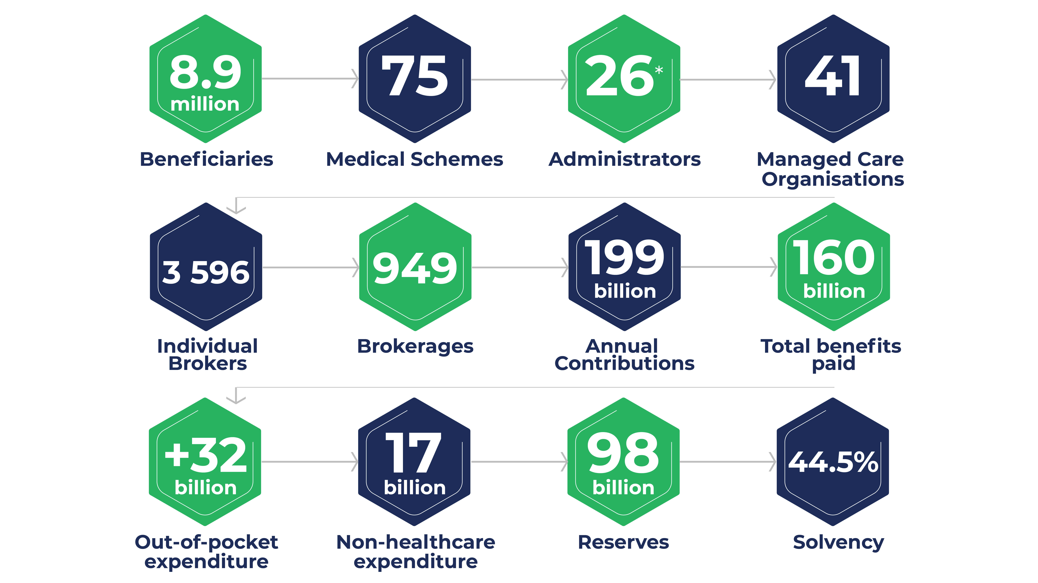
CMS’ Regulatory Scope

Slide 13
Industry Overview
Industry Trends
The following are some of the interventions that CMS is working towards to ensure affordable private healthcare for all:
On the positive side
  Medical schemes registered a record-high net healthcare result for all medical schemes combined, reflecting a surplus of R19.93 billion in 2020 (2019: R1.03 billion surplus). This was mainly due to the lower utilisation of health services and because some of the elective procedures were deferred due to the pandemic.
  The industry solvency levels improved significantly from a solvency ratio of 35.61% in 2019 to 44.55% in 2020, still higher than the statutory requirement of 25% throughout the period under consideration
  The number of schemes that failed to meet the 25% statutory solvency remained at seven between 2014 and 2020
  The number of Efficiency Discounted Options (EDOs) increased from 40 in 2014 to 69 in March 2021
  The proportion of the beneficiaries covered by the EDOs increased from 25.3 to 28.8% in 2020
  There was a reduction in the number of schemes from 83 in 2014 to 74 in 2020. This is in line with CMS policy stance to increase risk pooling for sustainability.
These positive industry trends mean that medical schemes have been mainly successful in compliance with the 25% solvency requirements during this period. The scheme beneficiaries are expected to have benefited from an increase in the number of EDO options through lower annual contribution increases during this period. It is, however, of great concern that the proportion of beneficiaries covered by the EDO’s has not changed over the years and remains at 23.50%.
Page 10 of Part A of APP

Slide 14
Industry Overview (cont)
On the negative side
COVID-19 has adversely affected the global sphere and claimed more than 500 lives in the medical schemes sector by August 2021.
COVID-19 has also had a negative impact on life expectancy. Statistics South Africa reports that Life expectancy at birth for males declined from 62,4 in 2020 to 59,3 years in 2021 (3,1-year drop) and from 68,4 in 2020 to 64,6 years for females (3,8-year drop)
The number of scheme beneficiaries declined by 1,1% between 2019 and 2020.
The decline was more notable in the open schemes; restricted schemes depicted a slight increase over the same review period.
The industry experienced an increasing age profile of 0,4 factor, with beneficiaries ageing from 33.0 years in 2019 to 33.4 in 2020.
The growing levels of Out-of-Pocket (OOP) payments in the industry continue to affect members negatively. The CMS conducted study showed that OOPs incurred by members increased at an annual rate of 7.9%, from an estimated R22.3 billion in 2013 (R2 562.83 per beneficiary per annum (pbpa)) to over R35.2 billion in 2019 (R3 913.94 pbpa), in real terms. OOPs made up just over 18% of the total amount claimed from medical schemes in 2019; this increased from 15.5% in 2013. OOPs incurred for medicines dispensed increased annually by 7.8% between 2013 and 2019, from R7.4 billion to R11.6 billion, respectively.
Poor governance and financial management of schemes resulted in a number of schemes being placed under curatorship in this period
The main conclusion that can be drawn from the above-observed trends is that the medical aid industry is faced with serious sustainability challenges. A negative beneficiary growth was experienced due to COVID-19 and other socio-economic factors, resulting in more principal members exiting at a slightly higher rate than dependents.

Slide 15
Organisational Overview
Analysis of the performance: Unqualified Audits since inception
2015/16 an overall achievement score of 85%
2016/17 an overall achievement score of 94.44%
2017/18 an overall achievement of 97%
2018/19 an overall achievement of 98%
2019/20 an overall achievement of 92%
2020/21 an overall achievement of 90%
Notes:
Page 8

Slide 16
Key Focus Areas for 2022/23
Standardisations of medical schemes benefit options
Development of a guidance framework for the Low-Cost Benefit Options (LCBO)
Review of the Prescribed Minimum Benefits
Consolidation of medical schemes with less than 6 000 members
Consolidation of government funded schemes
Development of a Central Beneficiary Registry
Prevention of fraud waste and abuse
Collaboration with local, regional and international regulators.

Slide 17
Annual Performance Plan
2022/23

Slide 18
Content: CMS Annual Performance Plan 2022/23
PART B – OUR STRATEGIC FOCUS
PART C - MEASURING OUR PERFORMANCE Cont…
2. Explanation of planned Performance
over the Medium-term Period
3. Programme Resource Considerations for
2022/23 Budget
4. . Updated Key Risks
1. Situation Analysis
1.1 External Environment Analysis
1.2 Internal Environment Analysis
Pages 10 to 15
Pages 16 to 23
Page 24 to 72
Page 57 to 68
Page 73 to 133
PART D – TECHNICAL INDICATOR DESCRIPTION
PART A – OUR MANDATE
PART C – MEASURING OUR PERFORMANCE
INSTITUTIONAL PROGRAMME
PERFORMANCE INFORMATION
1. PROGRAMME 1 (Administration)
1.1 Sub-programme 1.1 (CEO & Registrar)
1.2 Sub-Programme 1.2 (Office of the CFO)
1.3 Sub-Programme 1.3 (ICT & IM)
1.4 Sub-Programme 1.4 (Corporate services)
1.5 Sub-Programme 1.5 (Council secretariat)
1.6 PROGRAMME 2 (Strategy, Performance and Risk)
1.7 PROGRAMME 3 (Regulation)
1.8 PROGRAMME 4 (Policy, Research and Monitoring)
1.9 PROGRAMME 5 (Member Protection)
9.1 SUB-PROGRAMME 1.1 (Office of CEO)
9.2 SUB-PROGRAMME 1.2 (Office of CFO)
9.3 SUB-PROGRAMME 1.3 (ICT & IM)
9.4 SUB-PROGRAMME 1.4 (Corporate Services)
9.5 SUB-PROGRAMME 1.5 (Council Secretariat)
9.6 PROGRAMME 2 (Strategy, Performance and Risk)
9.7 PROGRAMME 3 (Regulation)
9.8 PROGRAMME 4 (Policy, Research & Monitoring)
9.9 PROGRAMME 5 (Member Protection)
1. Updates to the Relevant Legislative and Policy Mandates:
1.1 The National Health Act, 61 of 2003 (NHA)
1.2 The Medical Scheme Act, 131 of 1998 (MSA)
1.3 Related Legislation impacting on and influencing the functioning of CMS
1.4 Policy Mandates
2. Updated to Institutional Policies and Strategies
3. Updated to relevant Court Rulings

Slide 19
Measuring Performance

Slide 20
CMS Programmes
The report is presented per the following programmes brought about by the new microstructure:
The administrative programmes of the CMS are effectively focused on the efficient functioning of the office and provide support to the core programmes to efficiently carry out their mandates. The programme is made up of the following 5 sub-programmes:
Programme 1: Administration
Sub-Programme 1.1 - Office of the CEO
Sub-Programme 1.2 - Office of the CFO
Sub-Programme 1.3 – Information Communication Technology and Information Management
Sub-Programme 1.4 - Corporate Services (This programme now includes Legal Services, HR, Part of Stakeholder Relations, and Office Management)
Sub-Programme 1.5 – Council Secretariat
    The core programmes are mainly concerned with the regulation and stability of the industry, and the programmes are as follows:
Programme 2 - Strategy, Performance and Risk
Programme 3 - Regulation (This programme now includes Accreditation, Benefits Management, Compliance and Investigations, Financial Supervision)
Programme 4 - Policy, Research and Monitoring
Programme 5 – Member Protection (This programme now includes the other part of Stakeholder Relations, Clinical Unit, Complaints Adjudication)
Notes:
Page 26
Part B

Slide 21
Sub-Programme 1.1:Office of the Registrar and CEO
The CEO is the accounting officer exercising overall control over the office of the Council for Medical Schemes, and as Registrar, he exercises legislated powers to regulate medical schemes, administrators, brokers and managed care organisations.
The CEO and Registrar is responsible for leading the development and execution of the Council for medical schemes strategy. The CEO and Registrar is ultimately responsible for all day-to-day management decisions and for implementing the CMS’s strategic and annual plans.
Performance Indicators |  | Audited/actual performance |  |  | Estimated performance | Medium-term targets
 |  | 2018/19 | 2019/20 | 2020/21 | 2021/22 | 2022/23 | 2023/24 | 2024/25
Outcome 4: To become a more effective and efficient organisation
Output 1: Ensure that reported performance information is in accordance with the Framework for Strategic and Annual Performance plans.
Output Indicator 1.1 | Ensure that the Review and Development of a Strategic Plan and Annual Performance Plan is done for Council’s consideration | New indicator | New indicator | New indicator | New indicator | 1 | 1 | 1
Output Indicator 1.2 | Ensure that the overall performance of the entity is 80% of the targets set for the year | New indicator | New indicator | 90.83% | 80% | 80% | 80% | 80%
Output Indicator 1.3 | Ensure that an Annual Performance Information report produced is reliable, accurate and complete by 31 July each year in line with the statutory requirements | 1 | 1 | 1 | 1 | 1 | 1 | 1
Outcome 6: To collaborate with local, regional, and international entities
Output 2: Develop strategic relationships with other regulators and stakeholders
Output Indicator 2.1 | Number of signed Memoranda of Understanding with local, regional and international regulators and stakeholders | New indicator | New indicator | 4 | 4 | 4 | 4 | 4
Notes:
Page 27

Slide 22
Sub-programme 1.2: Office of the CFO
The purpose of the Sub-programme is to support all business units in the CMS, the executive management team and the Council by maintaining an efficient, effective and transparent system of financial performance and supply chain management that complies with the applicable legislation.
The Office of the CFO, in support of the Registrar, also serves the Council, Audit and Risk Committee, internal auditors, the NDoH, National Treasury and the Auditor-General South Africa by making available to them information and reports that allow them to carry out their statutory responsibilities. By doing this, the Sub-programme assists the CMS to be a reputable regulator.
Performance Indicators |  | Audited/actual performance |  |  | Estimated performance | Medium-term targets
 |  | 2018/19 | 2019/20 | 2020/21 | 2021/22 | 2022/23 | 2023/24 | 2024/25
Outcome 4: To be a more effective and efficient organisation
Output 3: Ensure that reported financial information is useful and reliable, and in accordance with the Expenditure Management and Reporting Framework.
Output Indicator 3.1 | An unqualified opinion issued by the Auditor- General South Africa on the Annual Financial Statements by 31 July each year | 1 | 1 | 1 | 1 | 1 | 1 | 1
Output 4: Ensure effective financial management and alignment of budget allocation with strategic priorities
Output Indicator 4.1 | Review, develop and implement a funding model that considers the long- term strategic outcomes of the CMS | New indicator | New indicator | New indicator | New indicator | 1 | 1 | 1
Output Indicator 4.2 | Produce a budget that is approved by Council by 31 January each year | New indicator | New indicator | 1 | 1 | 1 | 1 | 1
Notes:
Page 28

Slide 23
Sub-Programme 1.3 : Information and Communication Technology (ICT) and Information Management (IM)
The purpose of the sub-programme is to provide secure, reliable, innovative and process driven information and communication technology and knowledge management solutions, thereby improving productivity and business value.
Performance Indicators |  | Audited/actual performance |  |  | Estimated performance | Medium-term targets
 |  | 2018/19 | 2019/20 | 2020/21 | 2021/22 | 2022/23 | 2023/24 | 2024/25
Outcome 4: To be a more effective and efficient organisation
Output 5: An established ICT Infrastructure that ensures information is available, accessible and protected.
Output Indicator 5.1 | Percentage of network uptime | 99.41% | 99% | 99% | 99% | 99% | 99% | 99%
Output Indicator 5.2 | Percentage of IT security incidents (breaches) | 0% | 5% | 0.75% | 5% | 5% | 5% | 5%
Output Indicator 5.3 | Number of successful IT Disaster Recovery (DR) failover tests | New indicator | New indicator | 2 | 2 | 2 | 2 | 2
Output 6: Provide software applications that serve both internal as well as external stakeholders and which improves business operations and performance.
Output Indicator 6.1 | Percentage of uptime business- critical application systems (server uptime) | 100% | 99% | 99% | 99% | 95% | 95% | 95%
Output 7: Effectively provide information management services and organise and manage organisational knowledge with a view to enhancing knowledge sharing.
Output Indicator 7.1 | Percentage of PAIA requests for information received and finalised within 30 days | 98.5% | 95% | 95% | 95% | 95% | 95% | 95%
Notes:
Page 30

Slide 24
Sub-Programme1.4: Corporate Services
The purpose of the Sub-programme is to:
• provide legal advice and representation to the CMS and business units to ensure the integrity of regulatory decisions;
• provide high-quality service to internal and external customers by assessing their needs and proactively addressing those needs through developing, delivering, and continuously improving human resource programmes that promote and support the Council’s vision;
• create and promote awareness and understanding of the Medical Schemes Act (1998) and the Industry among all regulated and non-regulated entities through communication, marketing, and stakeholder engagement.
Performance Indicators |  | Audited/actual performance |  |  |  | Estimated performance | Medium-term targets
 |  | 2018/19 |  | 2019/20 | 2020/21 | 2021/22 | 2022/2023 | 2023/24 | 2024/25
Outcome 4: To become a more effective and efficient organisation
Output 8: Legal advisory and support services for effective regulation of the industry and operations of the office.
Output Indicator 8.1 | Percentage of written and verbal legal opinions provided to internal and external stakeholders attended to within 14 days | 7.1% | 279 | 80% | 85% | 85% | 90% | 95% | 95%
Output 9: Defending decisions of the Council and the Registrar
Output Indicator 9.1 | Percentage of court and tribunal appearances in legal matters received and action initiated by the Unit within 14 days | There were 5 out of 14 positions that tool longer than the 90 days to fill | 100% 17 | 100% | 100%. | 100% | 100% | 100% | 100%
Notes:
Page 33

Slide 25
Sub-Programme1.4: Corporate Services (Continued…)
The purpose of the Sub-programme is to:
• provide legal advice and representation to the CMS and business units to ensure the integrity of regulatory decisions;
• provide high-quality service to internal and external customers by assessing their needs and proactively addressing those needs through developing, delivering, and continuously improving human resource programmes that promote and support the Council’s vision;
• create and promote awareness and understanding of the Medical Schemes Act (1998) and the Industry among all regulated and non-regulated entities through communication, marketing, and stakeholder engagement.
Performance Indicators |  | Audited/actual performance |  |  |  | Estimated performance | Medium-term targets
 |  | 2018/19 |  | 2019/20 | 2020/21 | 2021/22 | 2022/2023 | 2023/24 | 2024/25
Outcome 4: To become a more effective and efficient organisation
Output 10: Build competencies and retain skilled employees.
Output Indicator 10.1 | Minimise staff turnover rate to less than 15% per annum | 79.82% | 4.48% | 8.33% | 18.3% | <15% | <15% | <15% | <15%
Output Indicator 10.2 | Turnaround time to fill a vacancy (turnaround time of 120 working days for each vacancy that exists during the year), excluding the position of CEO | New Indicator | There were 14 vacancies during the period, 12 were filled within 120 days, one took longer than the 120 days to fill and the recruitment process was underway for 3 | 18 vacancies during the period were filled within 120 days, | 70.8 days | 120 days | 120 days | 120 days | 120 days
Notes:
Page 33

Slide 26
Sub-Programme1.4: Corporate Services (Continued…)
The purpose of the Sub-programme is to:
• provide legal advice and representation to the CMS and business units to ensure the integrity of regulatory decisions;
• provide high-quality service to internal and external customers by assessing their needs and proactively addressing those needs through developing, delivering, and continuously improving human resource programmes that promote and support the Council’s vision;
• create and promote awareness and understanding of the Medical Schemes Act (1998) and the Industry among all regulated and non-regulated entities through communication, marketing, and stakeholder engagement.
Performance Indicators |  | Audited/actual performance |  |  |  | Estimated performance | Medium-term targets
 |  | 2018/19 |  | 2019/20 | 2020/21 | 2021/22 | 2022/2023 | 2023/24 | 2024/25
Outcome 4: To become a more effective and efficient organisation
Output 10: Build competencies and retain skilled employees.
Output Indicator 10.3 | Improve the CMS B-BBEE targets [according to the Broad-Based Black Economic Empowerment Act (BBBEEA targets)], annually | 79.82% | New indicator | New indicator | New indicator | New indicator | 40-54 | 55-69 | 70-79
Output Indicator 10.4 | Develop and maintain a talent management Policy Framework by implementing a career path and succession plan | New Indicator | New indicator | New indicator | New indicator | 1 | 1 | 1 | 1
Output 11: Maximise performance to improve organisational efficiency and maintain high-performance culture.
Output Indicator 11.1 | Percentage of employee’ performance agreements are signed by 31st May each year (excluding employees out of office on extended absence) |  | 100% | 100% | 100% | 95% | 95% | 95% | 95%
Notes:
Page 33

Slide 27
Sub-Programme 1.4: Corporate Services (Continued…)
The purpose of the Sub-programme is to:
• provide legal advice and representation to the CMS and business units to ensure the integrity of regulatory decisions;
• provide high-quality service to internal and external customers by assessing their needs and proactively addressing those needs through developing, delivering, and continuously improving human resource programmes that promote and support the Council’s vision;
• create and promote awareness and understanding of the Medical Schemes Act (1998) and the Industry among all regulated and non-regulated entities through communication, marketing, and stakeholder engagement
Performance Indicators |  | Audited/actual performance |  |  | Estimated performance | Medium-term targets
 |  | 2018/19 | 2019/20 | 2020/21 | 2021/22 | 2022/23 | 2023/24 | 2024/25
Outcome 4: To become a more effective and efficient organisation
Output 11: Maximise performance to improve organisational efficiency and maintain high-performance culture.
Output Indicator 11.2 | Percentage of employees’ performance assessment concluded, bi-annually (excluding employees out of office on extended absence) | 93.97% | 100% | 99.10% | 95% | 95% | 95% | 95%
Output Indicator 11.3 | Number of Training and Development Sessions to Improve Employee Relations | New indicator | New indicator | New indicator | 4 | 4 | 4 | 4
Output Indicator 11.4 | Percentage of signed annual declarations of Financial interest by CMS employees (excluding employees out of office on extended absence) | New Indicator | New Indicator | New Indicator | New Indicator | 100% | 100% | 100%
Notes:
Page 33

Slide 28
Sub-Programme 1.4: Corporate Services (Continued…)
The purpose of the Sub-programme is to:
• provide legal advice and representation to the CMS and business units to ensure the integrity of regulatory decisions;
• provide high-quality service to internal and external customers by assessing their needs and proactively addressing those needs through developing, delivering, and continuously improving human resource programmes that promote and support the Council’s vision;
• create and promote awareness and understanding of the Medical Schemes Act (1998) and the Industry among all regulated and non-regulated entities through communication, marketing, and stakeholder engagement
Performance Indicators |  | Audited/actual performance |  |  | Estimated performance | Medium-term targets
 |  | 2018/19 | 2019/20 | 2020/21 | 2021/22 | 2022/23 | 2023/24 | 2024/25
Outcome 4: To become a more effective and efficient organisation
Output 12: Ensure maximisation in the coordination of various planning efforts that are undertaken in relation to the CMS facilities
Output Indicator 12.1 | Develop an Office Capacity and Utilisation Report by 30 June each year | New Indicator | New Indicator | New Indicator | New Indicator | 1 | 1 | 1
Outcome 3: To ensure that all regulated entities comply with National Policy, the MSA and Regulations
Output 13: To create awareness and collaboration with stakeholders while enhancing the visibility and protecting the reputation of the CMS.
Output Indicator 13.1 | Number of stakeholder awareness activities conducted | 85 | 21 | 55 | 25 | 30 | 35 | 40
Output Indicator 13.2 | Percentage of stakeholder awareness of the CMS resulting from a survey | 64 | 50% | 50% | 55% | 60% | 65% | 70%
Output 14: CMS must ensure that an Annual Report is submitted to the Executive Authority five months after the end of a financial year.
Output Indicator 14.1 | Submission of the CMS Annual Report by 31 August to the Executive Authority | 1 | 1 | 1 | 1 | 1 | 1 | 1
Notes:
Page 33

Slide 29
Sub-Programme 1.6: Council Secretariate
The purpose of this programme is to provide corporate governance services to the Council as Accounting Authority and its committees. The Council Secretariat also provides support to the independent Appeal’s Board and ensures that all the rulings are communicated to key stakeholders. The program seeks to achieve the above objective through seamless board administration, secretariat service and support.
Performance Indicators |  | Audited/actual performance |  |  | Estimated performance | Medium-term targets
 |  | 2018/19 | 2019/20 | 2020/21 | 2021/22 | 2022/23 | 2023/24 | 2024/25
Outcome 4: To become a more effective and efficient organisation
Output 15: Corporate governance, Secretariat & Board administration Support and Legal Services for effective governance by the Accounting Authority
Output Indicator 15.1 | Develop an Annual Council Work Plan for Council and its Committees by 31 March | New Indicator | New Indicator | New Indicator | 1 | 1 | 1 | 1
Output Indicator 15.2 | Develop and Review Council and Committees Governance Charters | New Indicator | New Indicator | New Indicator | 1 | 6 | 6 | 6
Output Indicator 15.3 | Communicate Council resolutions within 3 days of the meeting to the affected internal stakeholders | New Indicator | New Indicator | New Indicator | 100% | 100% | 100% | 100%
Output Indicator 15.4 | Arrange Council meetings quarterly | New Indicator | New Indicator | New Indicator | New Indicator | 4 | 4 | 4
Output Indicator 15.5 | Arrange Council Committees meetings | New Indicator | New Indicator | New Indicator | New Indicator | 4 | 4 | 4
Output Indicator 15.6 | Facilitate training and development of Council | New Indicator | New Indicator | New Indicator | New Indicator | 1 | 1 | 1

Slide 30
Sub-Programme 1.6: Council Secretariate (Continued…)
The purpose of this programme is to provide corporate governance services to the Council as Accounting Authority and its committees. The Council Secretariat also provides support to the independent Appeal’s Board and ensures that all the rulings are communicated to key stakeholders. The program seeks to achieve the above objective through seamless board administration, secretariat service and support.
Performance Indicators |  | Audited/actual performance |  |  | Estimated performance | Medium-term targets
 |  | 2018/19 | 2019/20 | 2020/21 | 2021/22 | 2022/23 | 2023/24 | 2024/25
Outcome 4: To become a more effective and efficient organisation
Output 15: Corporate governance, Secretariat & Board administration Support and Legal Services for effective governance by the Accounting Authority
Output Indicator 15.7 | Percentage of signed annual declaration of financial interest by Council Members (excluding Council Members out of office on extended absence) | New Indicator | New Indicator | New Indicator | New Indicator | 100% | 100% | 100%
Output 16: Support Dispute Resolution Forums in furtherance of Council and MSA objectives
Output Indicator 16.1 | Arrange the Appeals Committee hearings | New Indicator | New Indicator | New Indicator | New Indicator | 12 | 12 | 12
Output Indicator 16.2 | Arrange the Appeal Board hearings | New Indicator | New Indicator | New Indicator | New Indicator | 4 | 4 | 4
Output Indicator 16.3 | Support the publication of rulings of the Appeals Committee and the Appeal Board within 14 days of receipt from the Presiding Officers. | New Indicator | New Indicator | 100% | 100% | 100% | 100% | 100%

Slide 31
Programme 2 : Strategy, Performance and Risk
• To engage in projects to provide information to the Council through the office of the Registrar, on strategic organisational and health reform matters to achieve the government’s objective of an equitable and sustainable healthcare financing system in support of universal access.
• To co-ordinate the review, formulation, implementation, performance monitoring and evaluation of the Strategic, Annual Performance and Operational Plans
• To analyse developments and trends in the medical industry and advice the Registrar and Council on the appropriate responses through the use of appropriate tools
• To facilitate engagements between the CMS and National Department of Health Treasury and other key stakeholders. To assume the responsibility for the preparation of key policy and technical documents for the engagements between the CMS and Key Stakeholders
• To represent the CMS in key Stakeholder events as delegated by the Registrar. To co-ordinate all efforts aimed at ensuring that the CMS is compliant with all the relevant legislation
• To develop and maintain the CMS Enterprise Risk Management and Compliance Frameworks. Identify and evaluate the risks to the organization's people, property, finances, and image and implement measures to control and mitigate risks in consultation with the Council through the office of the Registrar. To review and implement the Council’s Ethics Policy in developing an ethical leadership culture within the CMS
Performance Indicators |  | Audited/actual performance |  |  | Estimated performance | Medium-term targets
 |  | 2018/19 | 2019/20 | 2020/21 | 2021/22 | 2022/23 | 2023/24 | 2024/25
Outcome 4: To become a more effective and efficient organisation
Output 17: Ensure that strategic projects are scoped, and project plans are in place.
Output Indicator 17.1 | Development and Maintain a Strategic Projects Register | New Indicator | New Indicator | New Indicator | New Indicator | 1 | 1 | 1
Output Indicator 17.2 | Scope and develop plans for strategic projects | New indicator | New Indicator | New Indicator | New Indicator | 80% | 80% | 80%
Output 18: Compile performance information in accordance with the Framework for Strategic and Annual Performance Plans
Output Indicator 18.1 | Review and Develop a Strategic Plan and Annual Performance Plan for the consideration of the CEO & Registrar as well as Council | New Indicator | New Indicator | New Indicator | New Indicator | 1 | 1 | 1
Output Indicator 18.2 | Produce an Annual Performance Information report that is reliable, accurate and complete by 31 July each year in line with the statutory requirements | 1 | 1 | 1 | 1 | 1 | 1 | 1
Output Indicator 18.3 | Produce Quarterly Performance Information report that is reliable, accurate and complete | New Indicator | New Indicator | New Indicator | New Indicator | 4 | 4 | 4
Notes:
Page 41

Slide 32
Programme 2 : Strategy, Performance and Risk (Continued…)
• To engage in projects to provide information to the Council through the office of the Registrar, on strategic organisational and health reform matters to achieve the government’s objective of an equitable and sustainable healthcare financing system in support of universal access.
• To co-ordinate the review, formulation, implementation, performance monitoring and evaluation of the Strategic, Annual Performance and Operational Plans
• To analyse developments and trends in the medical industry and advice the Registrar and Council on the appropriate responses through the use of appropriate tools
• To facilitate engagements between the CMS and National Department of Health Treasury and other key stakeholders. To assume the responsibility for the preparation of key policy and technical documents for the engagements between the CMS and Key Stakeholders
• To represent the CMS in key Stakeholder events as delegated by the Registrar. To co-ordinate all efforts aimed at ensuring that the CMS is compliant with all the relevant legislation
• To develop and maintain the CMS Enterprise Risk Management and Compliance Frameworks. Identify and evaluate the risks to the organization's people, property, finances, and image and implement measures to control and mitigate risks in consultation with the Council through the office of the Registrar. To review and implement the Council’s Ethics Policy in developing an ethical leadership culture within the CMS
Performance Indicators |  | Audited/actual performance |  |  | Estimated performance | Medium-term targets
 |  | 2018/19 | 2019/20 | 2020/21 | 2021/22 | 2022/23 | 2023/24 | 2024/25
Outcome 4: To become a more effective and efficient organisation
Output 19: An effective, efficient and transparent system of risk management is maintained in order to mitigate the risks exposure of the CMS.
Output Indicator 19.1 | Number of strategic risk register reports submitted to the Council for monitoring | 4 | 4 | 4 | 4 | 4 | 4 | 4
Output 20: An effective, efficient and transparent system of coordinating the CMS Audit function is maintained
Output Indicator 20.1 | Ensure the development of an Internal Audit three year rolling plan and reports, for the Audit and Risk Committee’s adoption and monitoring | New Indicator | New Indicator | New Indicator | New Indicator | 4 | 4 | 4
Output Indicator 20.2 | Coordinate the External Audit Function and submit an Audit Strategy and Reports to Council for adoption | New Indicator | New Indicator | New Indicator | New Indicator | 1 | 1 | 1
Notes:
Page 41

Slide 33
Programme 3: Regulation
• Ensure brokers and broker organisations, administrators and managed care organisations are accredited in line with the accreditation requirements as set out in the Medical Schemes Act (1998), including whether applicants are fit and proper,
have the necessary resources, skills, capacity and infrastructure and are financially sound.
• To serve beneficiaries of medical schemes and the public in general by reviewing and approving changes to contributions paid by members and benefits offered by schemes. The Programme analyses and approves all scheme rules to ensure consistency with the MSA. This ensures that the beneficiaries have access to affordable and appropriate quality health care. By doing this, we help the CMS ensure that the rules of medical schemes are fair to beneficiaries and are consistent with the
MSA;
• Serve members of medical schemes and the public in general by taking appropriate action to enforce compliance with the Medical Schemes Act;
• Serve beneficiaries of medical schemes, the Registrar’s Office and Trustees by analysing and reporting on the financial performance of medical schemes and ensuring adherence to the financial requirements of the MSA. By doing this, the unit helps the CMS to monitor and promote the financial performance of schemes in order to achieve an industry that is financially sound.
Performance Indicators |  | Audited/actual performance |  |  | Estimated performance | Medium-term targets
 |  | 2018/19 | 2019/20 | 2020/21 | 2021/22 | 2022/23 | 2023/24 | 2024/25
Outcome 3: To ensure that all regulated entities comply with National Policy, the MSA and Regulations
Output 21: Accredit regulated entities based on their compliance with the requirements for accreditation in order to provide accredited services and monitor legal compliance throughout the period of accreditation.
Output Indicator 21.1 | Percentage of broker and broker organisation applications accredited within 30 working days per quarter on receipt of complete information | 5030 | 80% | 84.8% | 80% | 80% | 80% | 80%
Output Indicator 21.2 | Percentage of managed care organisation applications analysis completed, and outcomes communicated to applicants, within three months of receipt of complete information | 22 | 100% | 100% | 100% | 100% | 100% | 100%
Output Indicator 21.3 | Percentage of administrators and self-administered schemes' applications analysis completed, and outcomes communicated to applicants, within three months of receipt of complete information | 14 | 100% | 100% | 100% | 100% | 100% | 100%
Notes:
Page 41

Slide 34
Programme 3: Regulation (Continued…)
• Ensure brokers and broker organisations, administrators and managed care organisations are accredited in line with the accreditation requirements as set out in the Medical Schemes Act (1998), including whether applicants are fit and proper,
have the necessary resources, skills, capacity and infrastructure and are financially sound.
• To serve beneficiaries of medical schemes and the public in general by reviewing and approving changes to contributions paid by members and benefits offered by schemes. The Programme analyses and approves all scheme rules to ensure consistency with the MSA. This ensures that the beneficiaries have access to affordable and appropriate quality health care. By doing this, we help the CMS ensure that the rules of medical schemes are fair to beneficiaries and are consistent with the
MSA;
• Serve members of medical schemes and the public in general by taking appropriate action to enforce compliance with the Medical Schemes Act;
• Serve beneficiaries of medical schemes, the Registrar’s Office and Trustees by analysing and reporting on the financial performance of medical schemes and ensuring adherence to the financial requirements of the MSA. By doing this, the unit helps the CMS to monitor and promote the financial performance of schemes in order to achieve an industry that is financially sound.
Performance Indicators |  | Audited/actual performance |  |  | Estimated performance | Medium-term targets
 |  | 2018/19 | 2019/20 | 2020/21 | 2021/22 | 2022/23 | 2023/24 | 2024/25
Outcome 3: To ensure that all regulated entities comply with National Policy, the MSA and Regulations
Output 22:Output 22: To ensure that rules of the schemes are simplified, standardised, fair and compliant with the Medical Schemes Act (1998).
Output Indicator 22.1 | Percentage of interim rule amendments processed within 14 working days of receipt of all information | 96.2% | 80% | 96.8% | 80% | 80% | 80% | 80%
Output Indicator 22.2 | Percentage of annual rule amendments processed before 31 December of each year | 100% | 90% | 100% | 90% | 90% | 90% | 90%
Output 23: Inspect regulated entities for routine monitoring of compliance with the Medical Schemes Act, 1998 and all other related laws
Output Indicator 23.1 | Number of draft inspection reports issued annually | New Indicator | New Indicator | New Indicator | New Indicator | 10 | 10 | 10
Output 24: Inspect regulated entities for alleged irregularity or non-compliance with the Medical Schemes Act, 1998 and all other related laws
Output Indicator 24.1 | Percentage of commissioned inspection finalised within 12 months from the date the appointment letter was signed | New Indicator | New Indicator | New Indicator | New Indicator | 60% | 60% | 60%
Output 25: Ensure enforcement action is undertaken against regulated entities.
Output Indicator 25.1 | Percentage of enforcement actions undertaken during the period | 92% | 100% | 100% | 100% | 70% | 70% | 70%
Notes:
Page 41

Slide 35
Programme 3: Regulation (Continued…)
• Ensure brokers and broker organisations, administrators and managed care organisations are accredited in line with the accreditation requirements as set out in the Medical Schemes Act (1998), including whether applicants are fit and proper,
have the necessary resources, skills, capacity and infrastructure and are financially sound.
• To serve beneficiaries of medical schemes and the public in general by reviewing and approving changes to contributions paid by members and benefits offered by schemes. The Programme analyses and approves all scheme rules to ensure consistency with the MSA. This ensures that the beneficiaries have access to affordable and appropriate quality health care. By doing this, we help the CMS ensure that the rules of medical schemes are fair to beneficiaries and are consistent with the
MSA;
• Serve members of medical schemes and the public in general by taking appropriate action to enforce compliance with the Medical Schemes Act;
• Serve beneficiaries of medical schemes, the Registrar’s Office and Trustees by analysing and reporting on the financial performance of medical schemes and ensuring adherence to the financial requirements of the MSA. By doing this, the unit helps the CMS to monitor and promote the financial performance of schemes in order to achieve an industry that is financially sound.
Performance Indicators |  | Audited/actual performance |  |  | Estimated performance | Medium-term targets
 |  | 2018/19 | 2019/20 | 2020/21 | 2021/22 | 2022/23 | 2023/24 | 2024/25
Outcome 3: To ensure that all regulated entities comply with National Policy, the MSA and Regulations
Output 27: Monitor and promote the financial soundness of medical schemes.
Output Indicator 27.1 | Percentage of business plans processed in respect of Regulation 29 (which requires all schemes below statutory solvency to submit nature and causes of failure to the Registrar) | 88% | 100% | 0% | 100% | 100% | 100% | 100%
Output Indicator 27.2 | Percentage of business plans processed in respect of schemes with rapidly reducing solvency (but above statutory minimum) | 100% | n/a | 0% | 100% | 100% | 100% | 100%
Output Indicator 27.3 | Percentage of auditor applications analysed | 100% | 100% | 100% | 100% | 100% | 100% | 100%
Output Indicator 27.4 | Number of quarterly financial return reports published (excluding quarter four) | 3 | 3 | 3 | 3 | 3 | 3 | 3
Output Indicator 27.5 | Number of financial sections prepared for the Annual Report | 1 | 1 | 1 | 1 | 1 | 1 | 1
Notes:
Page 41

Slide 36
Programme 4:
Policy, Research and Monitoring
The purpose of the Programme is to serve beneficiaries of medical schemes and members of the public by collecting and analysing data to monitor, evaluate and report on trends in medical schemes, measure risk in medical schemes and develop recommendations to improve regulatory policy and practice. By doing this, the programme helps the CMS to contribute to the development of policy that enhances the protection of the interests of beneficiaries and members of the public. The Unit also undertakes strategic research that would enable the CMS to advise the NDoH on policy initiatives. It also provides a mechanism for the CMS to provide support to the NDoH on key policy reforms such as the NHI and HMI.
Performance Indicators |  | Audited/actual performance |  |  | Estimated performance | Medium-term targets
 |  | 2018/19 | 2019/20 | 2020/21 | 2021/22 | 2022/223 | 2023/24 | 2024/25
Outcome 5:To conduct policy driven research, monitoring and evaluation of the medical schemes industry to facilitate decision-making and policy recommendations to the Health Ministry.
Output 28: Conduct research to inform appropriate national health policy interventions
Output Indicator 28.1 | Number of research projects and support projects published in support of the National Health Policy | 14 | 12 | 12 | 12 | 17 | 17 | 17
Output 29: Monitoring trends to improve regulatory policy and practice.
Output Indicator 29.1 | Non-financial report submitted for inclusion in the annual report | 1 | 1 | 1 | 1 | 1 | 1 | 1
Notes:
Page 43

Slide 37
Programme 5: Member Protection
The purpose of the Programme is to:
• Provide customer service and training in support of the CMS Stakeholder engagement initiatives.
• Serve the beneficiaries of medical schemes and the public by investigating and resolving complaints in an efficient and effective manner. By doing this, we ensure that beneficiaries are treated fairly by their medical schemes.
• Provide support to the office on clinical matters so that good quality medical scheme cover is maximised and that regulated entities are properly governed through prospective and retrospective regulation.
Performance Indicators |  | Audited/actual performance |  |  | Estimated performance | Medium-term targets
 |  | 2018/19 | 2019/20 | 2020/21 | 2021/22 | 2022/23 | 2023/24 | 2024/25
Outcome 3: To ensure that all regulated entities comply with National Policy, the MSA and Regulations
Output 30: To enhance knowledge and skills among stakeholders in order to create an in-depth understanding of governance and compliance with the Medical Schemes Act through education and training interventions.
Output Indicator 30.1 | Number of stakeholder education and training sessions | New indicator | 35 | 56 | 40 | 50 | 55 | 60
Output 31: To provide Customer care interventions by rendering effective and efficient services.
Output Indicator 31.1 | Percentage of customer care interventions resulting from calls and e-mailed queries handled by the customer care Centre | New indicator | New indicator | New indicator | 90% | 90% | 90% | 90%
Outcome 3: To ensure that all regulated entities comply with National Policy, the MSA and Regulations
Output 32: Resolve complaints with the aim of protecting beneficiaries of medical schemes.
Output Indicator 32.1 | Percentage of complaints older than 120 calendar days adjudicated during the reporting period in accordance with complaints standard operating procedures | New indicator | New indicator | New indicator | New indicator | 75% | 75% | 75%
Output Indicator 32.2 | Percentage of category 4 complaints adjudicated within 120 calendar days and in accordance with complaints standard operating procedures | 55% | 65% | 76% | 70% | 75% | 80% | 80%
Output Indicator 32.3 | Percentage of category 1 complaints adjudicated within 30 working days and in accordance with complaints standard operating procedures | New indicator | New indicator | 76% | 70% | 75% | 80% | 80%
Notes:
Page 47

Slide 38
Programme 5: Member Protection (Continued…)
The purpose of the Programme is to:
• Provide customer service and training in support of the CMS Stakeholder engagement initiatives.
• Serve the beneficiaries of medical schemes and the public by investigating and resolving complaints in an efficient and effective manner. By doing this, we ensure that beneficiaries are treated fairly by their medical schemes.
• Provide support to the office on clinical matters so that good quality medical scheme cover is maximised and that regulated entities are properly governed through prospective and retrospective regulation.
Performance Indicators |  | Audited/actual performance |  |  | Estimated performance | Medium-term targets
 |  | 2018/19 | 2019/20 | 2020/21 | 2021/22 | 2022/23 | 2023/24 | 2024/25
Outcome 3: To ensure that all regulated entities comply with National Policy, the MSA and Regulations
Output 32: Resolve complaints with the aim of protecting beneficiaries of medical schemes.
Output Indicator 32.4 | Percentage of category 2 complaints adjudicated within 60 working days and in accordance with complaints standard operating procedures | New indicator | New indicator | 76% | 70% | 75% | 80% | 80%
Output Indicator 32.5 | Percentage of category 3 complaints adjudicated within 90 working days and in accordance with complaints standard operating procedures | New indicator | New indicator | 76% | 70% | 75% | 80% | 80%
Output Indicator 32.6 | Percentage of Rulings submitted to Corporate Services for publication on the CMS website within 30 calendar days following the lapse of 3 months within which an appeal must be filed. | New indicator | New indicator | 100% | 100% | 80% | 80% | 80%
Output 33: Appeal Committee hearings attended based on requests from Council
Output Indicator 33.1 | Percentage of Appeal Committee hearings attended based on requests from the Council | 100% | 100% | 100% | 100% | 100% | 100% | 100%
Notes:
Page 47

Slide 39
Programme 5: Member Protection (Continued…)
The purpose of the Programme is to:
• Provide customer service and training in support of the CMS Stakeholder engagement initiatives.
• Serve the beneficiaries of medical schemes and the public by investigating and resolving complaints in an efficient and effective manner. By doing this, we ensure that beneficiaries are treated fairly by their medical schemes.
• Provide support to the office on clinical matters so that good quality medical scheme cover is maximised and that regulated entities are properly governed through prospective and retrospective regulation.
Performance Indicators |  | Audited/actual performance |  |  | Estimated performance | Medium-term targets
 |  | 2018/19 | 2019/20 | 2020/21 | 2021/22 | 2022/23 | 2023/24 | 2024/25
Outcome 1: To promote the improvement of quality and the reduction of costs in the private health care sector
Output 34: Formulate Prescribed Minimum Benefits (PMBs) definitions to ensure uniform interpretation of the benefits and entitlements
Output Indicator 34.1 | The number of benefit definitions published. | 10 | 10 | 10 | 10 | 10 | 10 | 10
Output Indicator 34.2 | A service-based preventative and primary healthcare package and costing methodology report was submitted to the Executive Authority | Develop primary healthcare package for incorporation into the PMBs |  | Revised and updated PMB befits package costed | Review and update revised PMB benefit package | Review and update revised PMB benefit package | Review and update revised PMB benefit package | Review and update revised PMB benefit package
Output 35: Provide clinical opinions to resolve complaints and enquiries.
Output Indicator 35.1 | Percentage of category 1 clinical opinions provided within 30 working days of receipt of a request from Complaints Adjudication Unit | 54% | 90% | 92.75% | 90% | 90% | 90% | 90%
Output Indicator 35.2 | Percentage of category 2 clinical opinions provided within 60 working days of receipt of a request from Complaints Adjudication Unit | 99% | 95% | 100% | 95% | 95% | 95% | 95%
Notes:
Page 47

Slide 40
Programme 5: Member Protection (Continued…)
The purpose of the Programme is to:
• Provide customer service and training in support of the CMS Stakeholder engagement initiatives.
• Serve the beneficiaries of medical schemes and the public by investigating and resolving complaints in an efficient and effective manner. By doing this, we ensure that beneficiaries are treated fairly by their medical schemes.
• Provide support to the office on clinical matters so that good quality medical scheme cover is maximised and that regulated entities are properly governed through prospective and retrospective regulation.
Performance Indicators |  | Audited/actual performance |  |  | Estimated performance | Medium-term targets
 |  | 2018/19 | 2019/20 | 2020/21 | 2021/22 | 2022/23 | 2023/24 | 2024/25
Outcome 1: To promote the improvement of quality and the reduction of costs in the private health care sector
Output 35: Provide clinical opinions to resolve complaints and enquiries.
Output Indicator 35.3 | Percentage of category 3 clinical opinions provided within 90 working days of receipt of a request from Complaints Adjudication Unit | 98% | 98% | 100% | 98% | 98% | 98% | 98%
Output Indicator 35.4 | Percentage of clinical enquiries received via e-mail or telephone and responded to within 7 days | 98% | 98% | 100% | 98% | 98% | 98% | 98%
Notes:
Page 47

Slide 41


Slide 42
Assumptions used for 2022/23 budget
Proposed Levy Increase for 2022/2023 4.23%
Inflationary increase for 2022/2023 4.23% *
* As per Medium term expenditure framework (MTEF) guidelines
General Cost-of living adjustment plus 1.5% progression for 2022/2023
- limited to budget figure of 4.23%
- performance bonus 0%

Slide 43
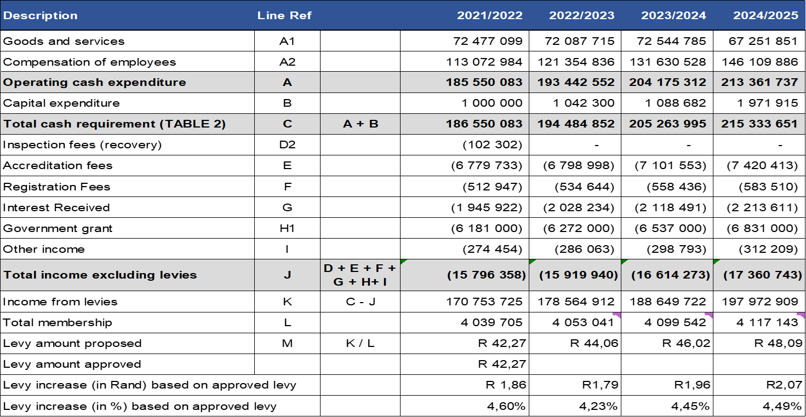
Proposed Budget 2022/23

Slide 44
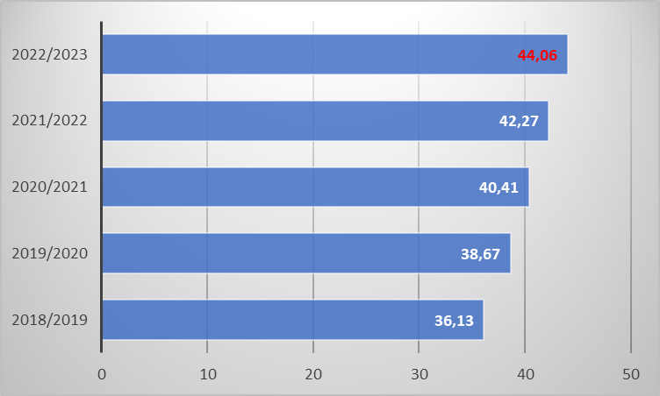
Levy Trends

Slide 45
Expenditure per Economic Classification

Slide 46
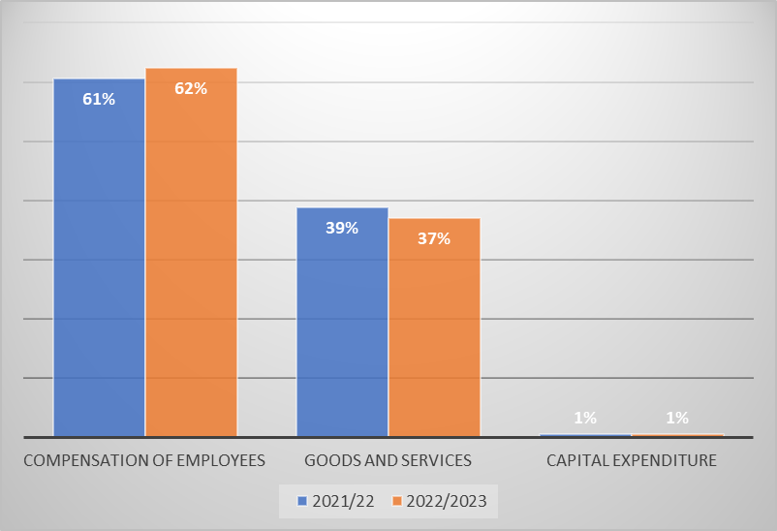
Cash requirement per economic classification

Slide 47
Goods and services 21/22 & 22/23
Note: Goods and Services classified as per the updated ENE classification per the MTEF 2022/2023

Slide 48
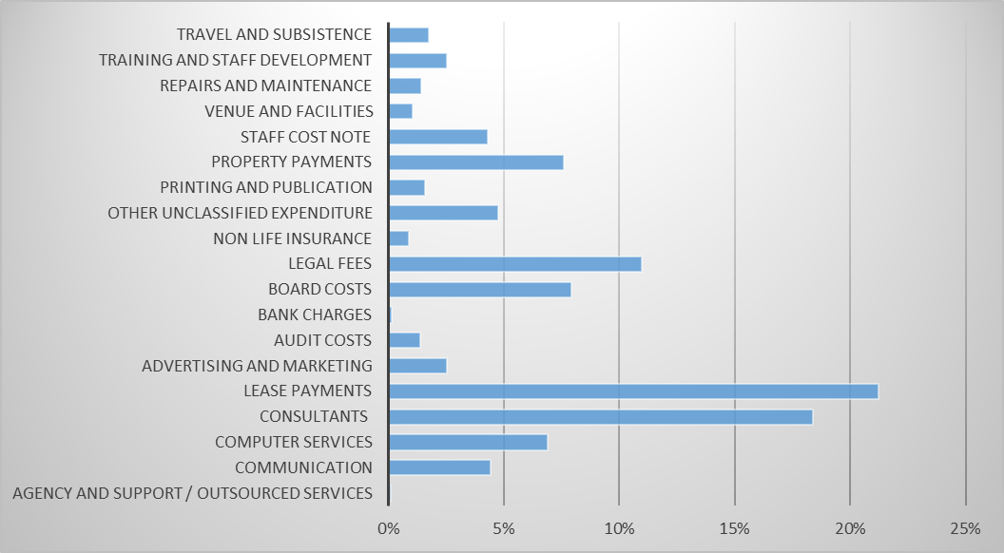
Goods and services 2022/23
Note: Goods and Services classified as per the updated ENE classification per the MTEF 2022/2023

Slide 49
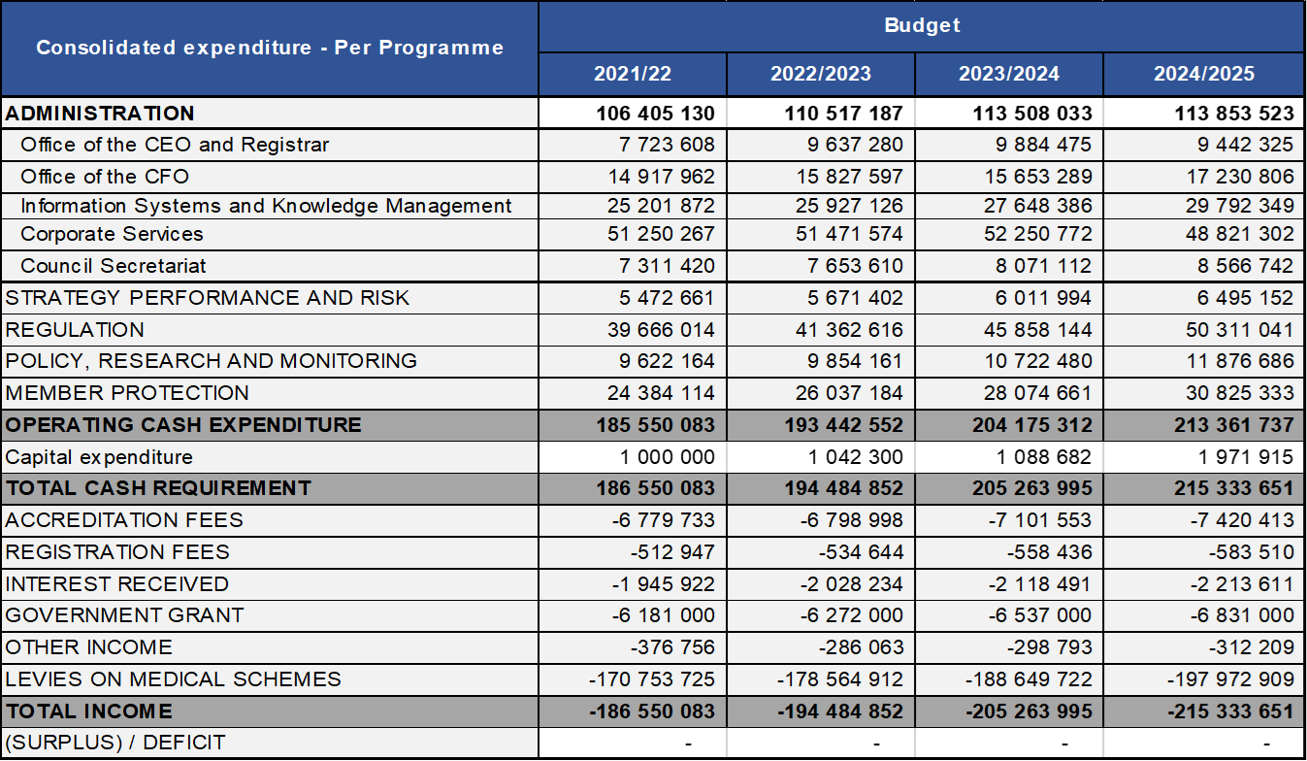
Expenditure per programme

Slide 50
Occupational Levels at CMS
Occupational Levels | Male |  |  |  | Female |  |  |  | Foreign Nationals |  | TOTAL
 | A | C | I | W | A | C | I | W | Male | Female
Top Management | 4 | 0 | 0 | 0 | 1 | 0 | 0 | 0 | 0 | 0 | 5
Senior Management | 0 | 0 | 0 | 0 | 1 | 0 | 0 | 2 | 1 | 0 | 4
Professionally qualified and specialised | 13 | 1 | 1 | 2 | 10 | 2 | 1 | 1 | 0 | 0 | 31
Skilled technical and academically qualified | 22 | 1 | 0 | 0 | 25 | 1 | 0 | 4 | 0 | 0 | 53
Semi-skilled and discretionary decisions | 3 | 0 | 0 | 0 | 10 | 0 | 1 | 0 | 0 | 0 | 14
Unskilled and defined decisions | 1 | 0 | 0 | 0 | 8 | 0 | 0 | 0 | 0 | 0 | 9
TOTAL PERMANENT | 43 | 2 | 1 | 2 | 55 | 3 | 2 | 7 | 1 | 0 | 116
Internships & Fixed Term employees | 4 | 0 | 0 | 0 | 8 | 0 | 0 | 0 | 0 | 0 | 12
GRAND TOTAL | 47 | 2 | 1 | 2 | 63 | 3 | 2 | 7 | 1 | 0 | 128
Five employees with disabilities have been counted for at Top management, senior management, professionally qualified and skilled technical levels

Slide 51
Internships and Fixed-term Contracts
CMS appointed a total number of 12 employees on internship and fixed term contractors.
Interns are appropriately placed in units with agreed workplans to achieve experiential learning at the end of the internship programme. Temporary employees are appointed on fixed-term period when a need arises in terms of Section 198B(1).
Business unit | Fixed-Term Contracts | Internships
Accreditation | 1 | 1
Stakeholder Relations | 0 | 2
ICT & Knowledge Management | 0 | 1
CEO’s Office | 1 | 1
CFO’s Office | 0 | 1
Research & Monitoring | 0 | 2
Benefits Management | 2 | 0
Total | 4 | 8

Slide 52
Immediate Challenges
Significant Budgetary constraints
  2022/23 proposed levy increase in process.
  Business cases submitted for key strategic projects not approved.
  There is improvement in liquidity position but not out of the red yet.
  Regulatory and compliance litigation costs.
  Labour related litigations.
  Inadequate financial and human resources

Slide 53
Immediate Challenges
Financial Services Regulatory Act and the COFI Bill
Budgetary constraints (R194.48m vs R219bn)
Personnel of 128 vs 8.9m scheme beneficiaries
Widening mandate (FWA, Coding, Competition, NHI, Policy)
Restructuring organisation (fit for purpose, effective and efficient)

Slide 54
Inadequate Funding
FUNDING MODEL
The CMS had a budget of over R194.48 million to execute its mandate in the 2022/23 financial year vs R219 billion of contributions to medical schemes in 2020/21 terms.
Budget sources:
Principal scheme member once-off levies
Revenues generated through regulatory activities
Conditional Grant from National Department of Health
New funding model focus on:
Review of tariffs.
Introduction of new tariffs.
Standard increase in levies.
How additional key priorities are funded.
Growing on contingency reserves.

Slide 55
Inadequate Funding
Lack of additional for the Section 59 and SIU investigations, respectively
Lack of additional funding means that our ability to support urgent NHI projects, will be severely compromised
CMS is currently exploring alternative funding models together with strategies to contain costs for long term sustainability of the entity

Slide 56
Section 59 Investigation
Allegations of racial profiling by medical schemes and administrators using Section 59 and Regulations 5 & 6 of the MSA
Established an independent investigation panel led by Adv Ngcukaitobi to investigate complaints and make recommendations
Submissions from 20 June – 19 July 2019
Hearings July 2019 – January 2020
Report writing delayed by additional information presented and COVID-19
Interim Report issued in January 2021
Awaiting Final Report with recommendations

Slide 57
FSRA and Cofi Bills
FSRA passed in August 2017
COFI Bill published in December 2018
Proposes regulation of Schemes by the FSCA and PA
Agreement: Poor Communication and Consultation, Regulatory Arbitrage
Established Joint Task Teams to address legislative misalignment
Close co-operation and have agreed on way forward
COFI Bill published again for comments
Acknowledges the ongoing engagements between CMS, Treasury, FSCA and PA

Slide 58
Thank you.

