Slide 1
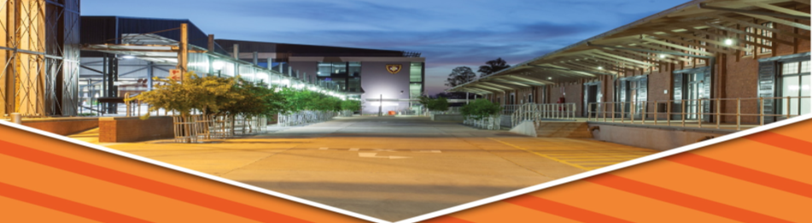

Briefing on investigation into the damage to the fire-affected Parliamentary buildings
PRESENTATION TO THE JOINT STANDING COMMITTEE ON THE
FINANCIAL MANAGEMENT OF PARLIAMENT
1 APRIL 2022

Slide 2
PURPOSE
The DPWI was requested to provide a briefing on the latest developments in respect of the investigation into the damage to the fire-affected Parliamentary buildings, and related matters.
The purpose of this presentation is to provide progress on:
1) Making Safe (Phase 1) and Damage Assessments (Phase 2) of the fire-affected Old and National Assembly Buildings;

Slide 3
MAKING SAFE & DAMAGE ASSESSMENTS OF THE FIRE-AFFECTED OLD AND NATIONAL ASSEMBLY BUILDINGS

Slide 4
Table of Contents
Terms of Reference
Initial Assessment Findings
Progress to Date
National Assembly Basement Water Extraction
HAWKS & Fire Forensic Investigations after Structural Pronouncement
Other Health and Safety Risks Identified
Updated Action Register
Program for Phase 1 & 2
Conclusion

Slide 5
1. TERMS OF REFERENCE
The context and details on the appointment of the external engineering team are as follows:
An internal DPWI professional engineering team conducted a preliminary visual assessment of the damages including the safety aspect of the site immediately following the January 2022.
  Their findings recommended that the National Assembly building should be cordoned off and closed to restrict access.
  This information was immediately communicated to Parliament who agreed to cordon off the National Assembly.
Recommendations of the preliminary visual assessment were used as the Terms of Reference for an independent specialist engineering team to conduct further detailed damage assessments and testing of material strength.

Slide 6
1. TERMS OF REFERENCE
Appointment expedited through a National Treasury deviation.
Implementing agents were approached to quote and the DPWI’s Bid Evaluation Committee recommended the cheapest bidder, COEGA, be appointed.
COEGA appointed on Friday 11 February 2022.

Slide 7
1. TERMS OF REFERENCE
Scope of Services includes:
1) An Initial Assessment Report :
  Damage report indicating the extent of the structural damage and any other structural issues
  Pronouncement on the safety aspects of the structure
  Advise on short term measures to address any safety concerns
  Provide proposed programme for completing detailed assessment report.
2) Thereafter, a Detailed Assessment Report to address:
  Detailed assessment report indicating the extent of the damage and any other structural issues.
  Pronouncement on the residual strength of the structure (including all relevant tests and analysis).
  Proposed restorative measures with associated cost comparisons for restoration.
  Proposed estimate of the rehabilitation project.
  Proposed preliminary cost estimate of the rehabilitation project.
  Pronouncement on possible long term restorative measures.

Slide 8
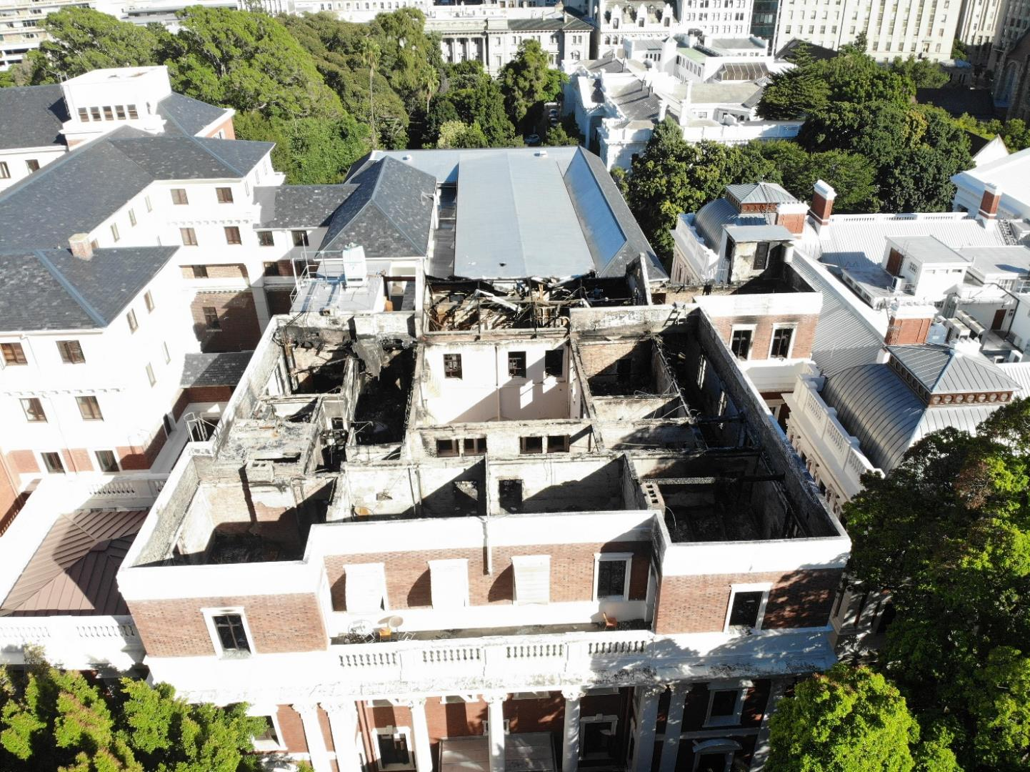
2. INITIAL ASSESSMENT FINDINGS
OLD ASSEMBLY PHOTOGRAPHS

Slide 9
2. INITIAL ASSESSMENT FINDINGS
OLD ASSEMBLY PHOTOGRAPHS

Slide 10
2. INITIAL ASSESSMENT FINDINGS
OLD ASSEMBLY PHOTOGRAPHS

Slide 11
2. INITIAL ASSESSMENT FINDINGS
OLD ASSEMBLY PHOTOGRAPHS

Slide 12
2. INITIAL ASSESSMENT FINDINGS
OLD ASSEMBLY PHOTOGRAPHS

Slide 13
2. INITIAL ASSESSMENT FINDINGS
OLD ASSEMBLY PHOTOGRAPHS

Slide 14
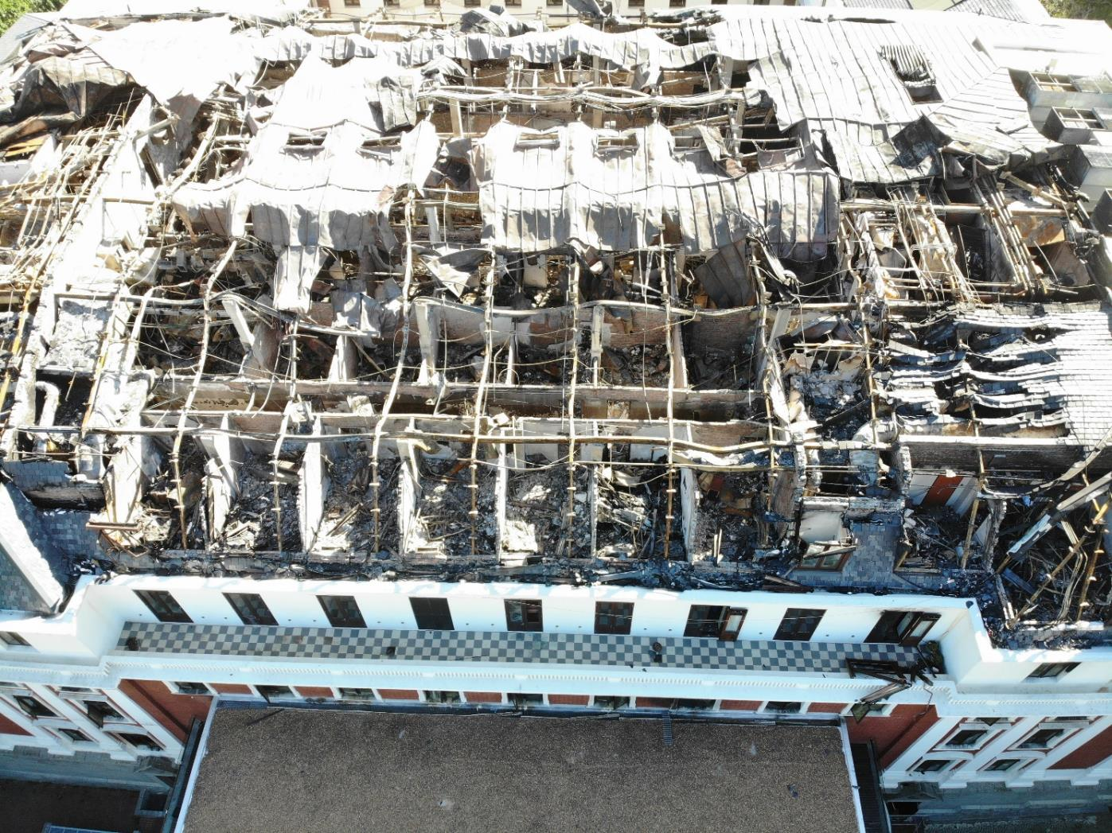
2. INITIAL ASSESSMENT FINDINGS
NATIONAL ASSEMBLY PHOTOGRAPHS

Slide 15
2. INITIAL ASSESSMENT FINDINGS
NATIONAL ASSEMBLY PHOTOGRAPHS

Slide 16
2. INITIAL ASSESSMENT FINDINGS
NATIONAL ASSEMBLY PHOTOGRAPHS

Slide 17
2. INITIAL ASSESSMENT FINDINGS
NATIONAL ASSEMBLY PHOTOGRAPHS

Slide 18
2. INITIAL ASSESSMENT FINDINGS
NATIONAL ASSEMBLY PHOTOGRAPHS

Slide 19
2. INITIAL ASSESSMENT FINDINGS
NATIONAL ASSEMBLY PHOTOGRAPHS

Slide 20
2. INITIAL ASSESSMENT FINDINGS
NATIONAL ASSEMBLY PHOTOGRAPHS

Slide 21
2. INITIAL ASSESSMENT FINDINGS
NATIONAL ASSEMBLY PHOTOGRAPHS
NATIONAL ASSEMBLY STRUCTURAL DESIGN

Slide 22
2. INITIAL ASSESSMENT FINDINGS
NATIONAL ASSEMBLY PHOTOGRAPHS

Slide 23
2. INITIAL ASSESSMENT FINDINGS
NATIONAL ASSEMBLY PHOTOGRAPHS

Slide 24
2. INITIAL ASSESSMENT FINDINGS
NATIONAL ASSEMBLY PHOTOGRAPHS
NATIONAL ASSEMBLY STRUCTURAL DESIGN

Slide 25
2. INITIAL ASSESSMENT FINDINGS
NATIONAL ASSEMBLY PHOTOGRAPHS
NATIONAL ASSEMBLY STRUCTURAL DESIGN

Slide 26
2. INITIAL ASSESSMENT FINDINGS
Current structural damage does not pose a risk of the collapse of the buildings.
However, severe structural damage to the central concrete structure of National Assembly from the 2nd floor to the 6th floor.
Safety measures for National Assembly involve three working zones: Green (safe); Amber (under close guidance by structural engineers) and Red (“no-go” zones until temporary access structures are provided).
Making-safe work urgently required on Old Assembly as to exterior walls and to provide a temporary roof to prevent rain causing damage to lower floors.
Making-safe works urgently required on the National Assembly regarding roof debris after the HAWKS investigations.

Slide 27
2. INITIAL ASSESSMENT FINDINGS
NATIONAL ASSEMBLY SAFETY ZONES
Groundfloor
1st floor

Slide 28
2. INITIAL ASSESSMENT FINDINGS
NATIONAL ASSEMBLY SAFETY ZONES
2th floor
3rd floor

Slide 29
2. INITIAL ASSESSMENT FINDINGS
NATIONAL ASSEMBLY SAFETY ZONES
5th floor
4th floor

Slide 30
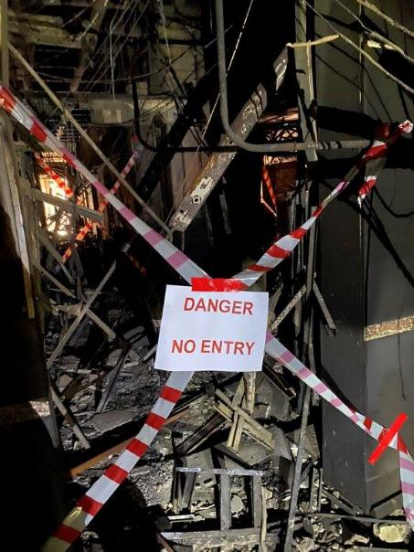
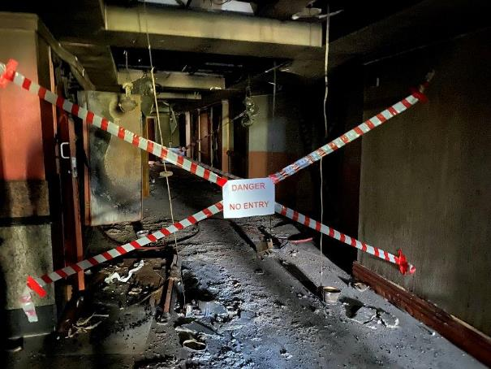
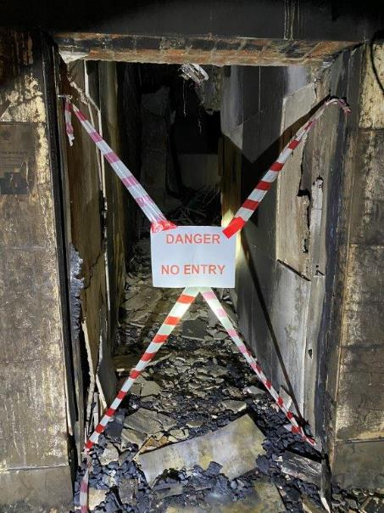
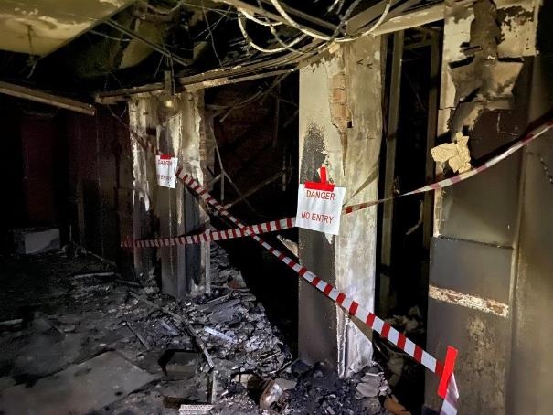
2. INITIAL ASSESSMENT FINDINGS
NATIONAL ASSEMBLY SAFETY ZONES – RED ZONE NO-GO AREAS

Slide 31
3. PROGRESS TO DATE
Phase 1 – Initial Assessment:
Draft Final Report submitted on 22 February 2022 (CDC allowed access into buildings from 14 February 2022).
Presentation made to aDG on Wednesday 23 February 2022 on the draft report findings and recommendations.
Presentation made to Minister of DPWI on Friday 25 February 2022 on to the draft report findings and recommendations.
Action Register was compiled and issued to DPWI on Friday 25 February 2022 (On-going updating).
CDC submitted a cost proposal to DPWI on 2 March 2022 for additional services for implementing the report recommendations for making safe buildings and other additional services.
DPWI issued the approved cost proposal to CDC on 4 March 2022 for certain services that must be provided by the CDC post this initial assessment.

Slide 32
4. NA BASEMENT WATER EXTRACTION
On site meeting held with Fire Department, City of Cape Town officials from various departments, DPWI, and FM service provider to resolve basement water extraction into municipal sewers on 25 February 2022 due to volume of water and previous method not being cost effective.
City of Cape Town issued the permit for water pumping into their sewer system on 19 March 2022 to DPWI with specific conditions that must be complied with.
DPWI in various meetings to ensure compliance with the conditions stipulated on the permit before the works could start.
On 26 March 2022, the DPWI Term Contractor conducted an assessment on site which included the measuring of volume for the pumping and pumping works started in the evening of 29 March 2022.
Once extraction is completed, the CDC team will inspect the basement areas and incorporate findings into the Phase 1 Initial Assessment Report and issue the Final Report.

Slide 33
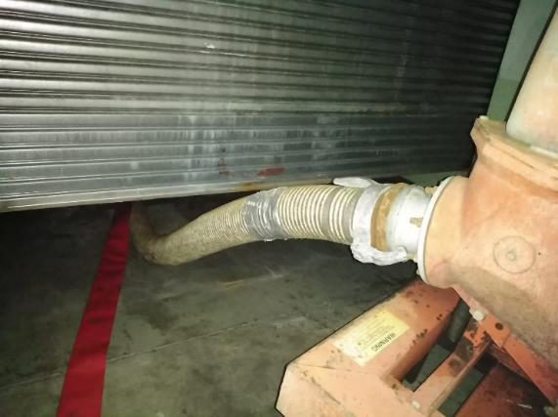
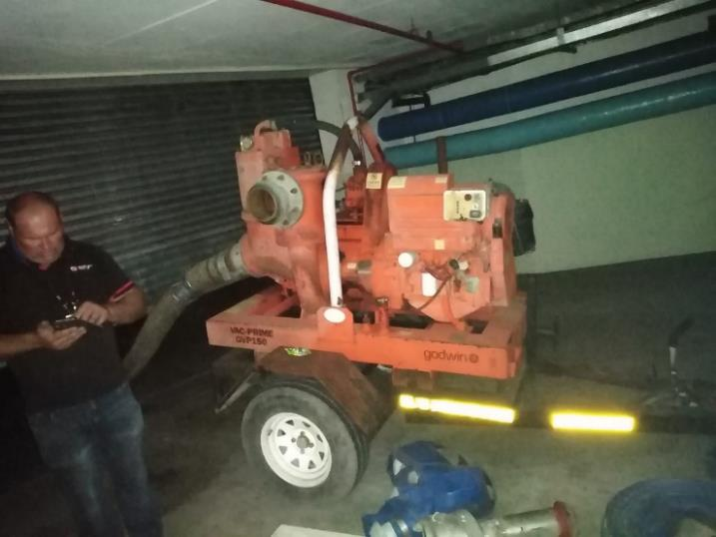
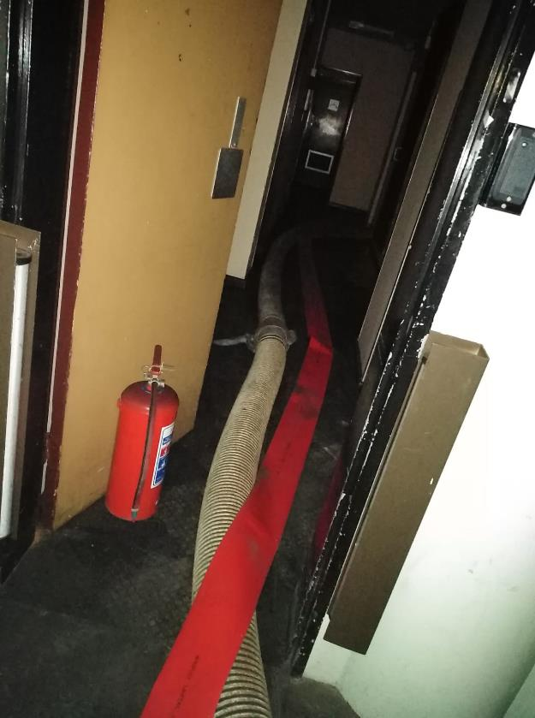
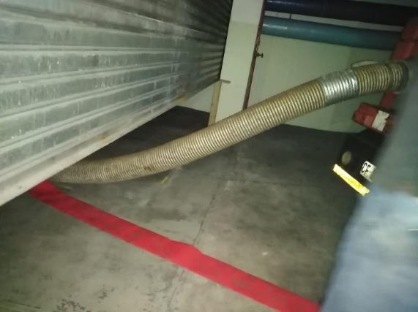
4. NA BASEMENT WATER EXTRACTION

Slide 34
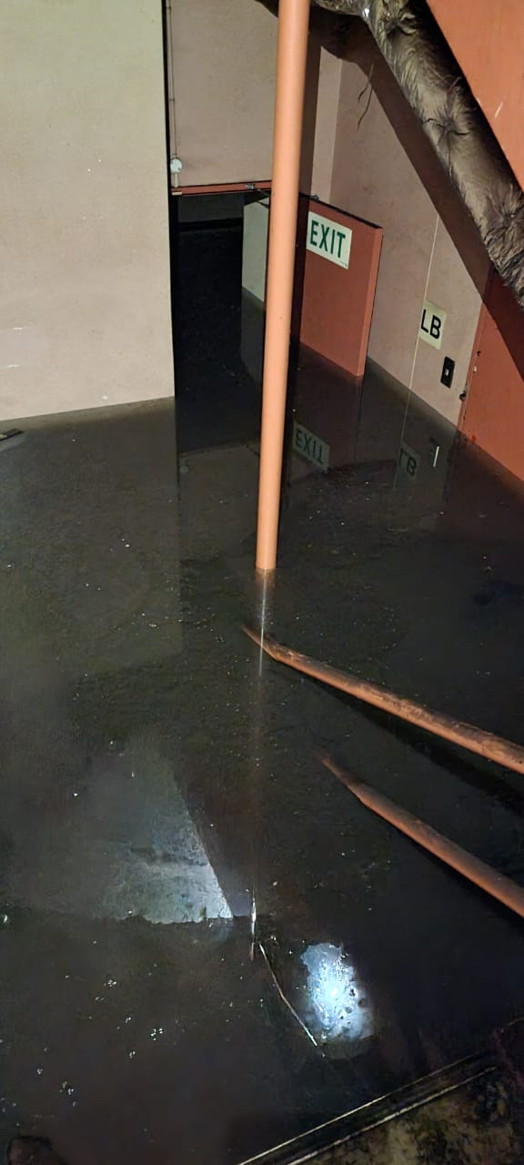
4. NA BASEMENT WATER EXTRACTION
Level of the water taken on 26 March 2022
Standard Door
Height = 2032 mm
Volume to be Extracted:
estimated 4188 kiloliters
Pumping underway (6PM to 6AM)
following permission for discharge issued by the City of Cape Town
Approx. Water Depth = 1732 mm
Floor Level

Slide 35
5. HAWKS & FIRE FORENSIC INVESTIGATIONS AFTER STRUCTURAL PRONOUNCEMENT
HAWKS & Fire Forensic Investigations after Structural Pronouncement:
CDC initially inducted the HAWKS and fire forensic team on health & safety and other hazardous aspects to enter the National Assembly on 24 February 2022.
CDC proceeded to demarcate RED ZONE “no-go” areas in the National Assembly and completed this work on 4 March 2022.
CDC issued official correspondence dated 5 March 2022 to DPWI confirming HAWKS and other investigators may access the National Assembly as from Monday 7 March 2022.
HAWKS investigations indicated 1 April 2022 as the planned completion of National Assembly site investigations.

Slide 36
5. HAWKS & FIRE FORENSIC INVESTIGATIONS AFTER STRUCTURAL PRONOUNCEMENT
HAWKS & Fire Forensic Investigations after Structural Pronouncement (Continue)
CDC’s structural team guided and accompanied the investigators into the AMBER AREAS.
Investigators indicated that access was required into two areas in the RED ZONES but no special access support structures had to be provided and the structural engineer guided them safely in these areas as limited persons required access.
The HAWKS informed DPWI on 29 March 2022 that they had concluded their site investigations, for hand back of the building to DPWI.

Slide 37
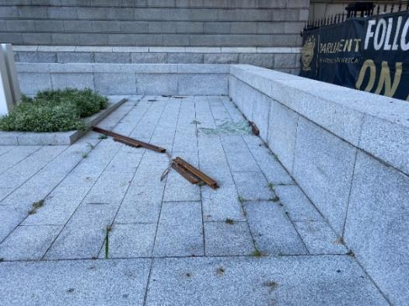
6. OTHER HEALTH & SAFETY RISKS IDENTIFIED
Fridge in basement with rotten fish and meat which when opened may cause serious health risks.
Huge breeding of mosquitoes in water in the basement.
Gas smell (rotten egg) again detected right up to the 4th floor, possible H₂S (hydrogen sulphide) – [highly flammable]
Basement has pump to deal with ground water ingress so once contaminated water is extracted then this existing pump needs to be reinstated to prevent flooding again.
Loose debris material (roof sheeting, ceiling boards, etc) on roof level and 5th floor to immediately be removed as this material may blow off during windy days and thereby posing risk to persons on the Precinct or in Government Avenue at the back.

Slide 38
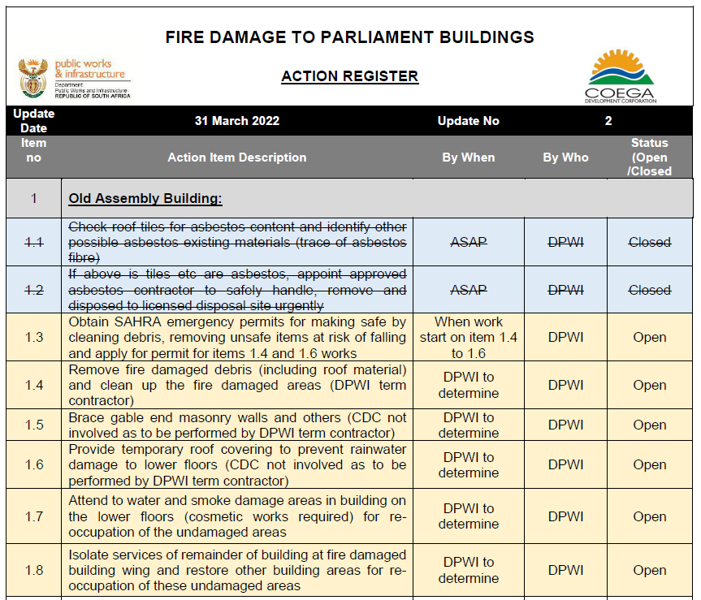
7. UPDATED ACTION REGISTER
.

Slide 39
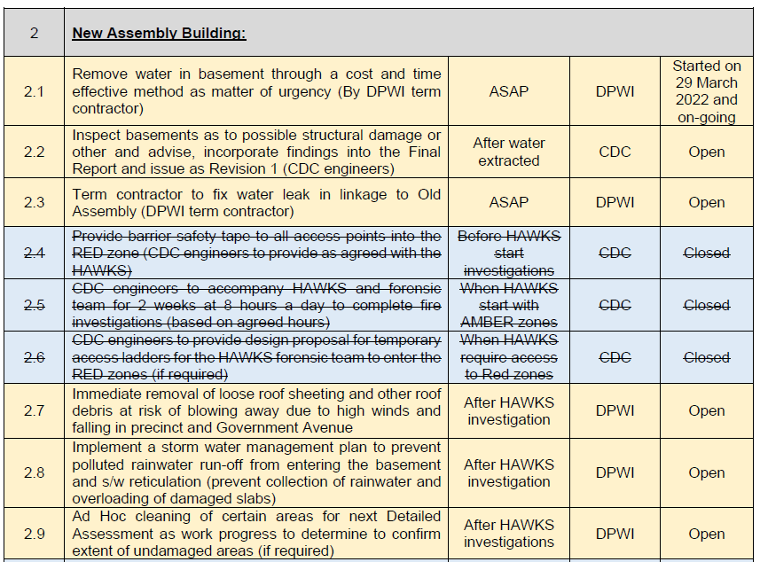
7. UPDATED ACTION REGISTER
.

Slide 40
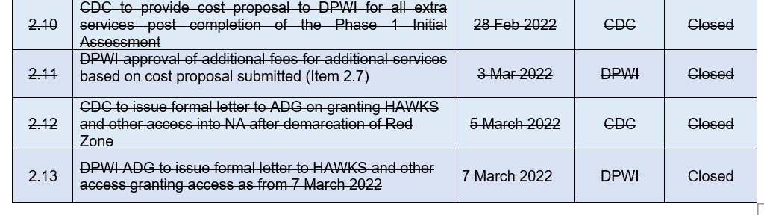
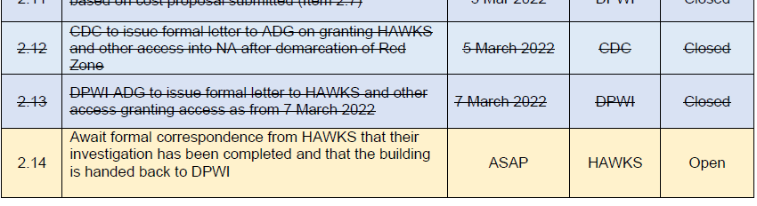
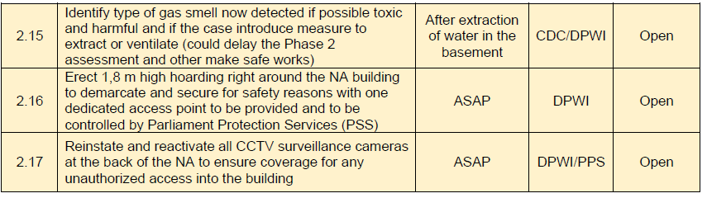
7. UPDATED ACTION REGISTER
.

Slide 41
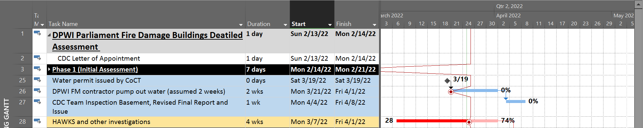
8. PROGRAM FOR PHASES 1 &2
The implementation program for the next Phase 2 was dependent on the HAWKS and fire forensic investigation start and completion dates.
It was assumed after the delayed start by the HAWKS investigations, that completion of this work would be achieved by 1 April 2022 (Based on liaison with HAWKS).
.

Slide 42
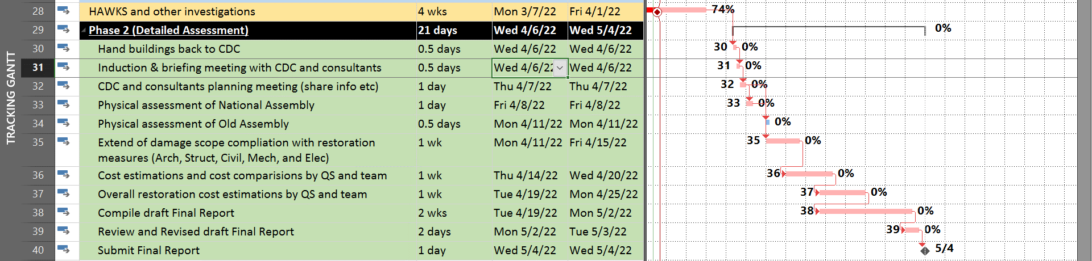
8. PROPOSED PROGRAMME FOR PHASES 1 &2
.

Slide 43
9. SUMMARY OF PHASE 1 & 2 ASSESSMENTS
Making-safe of Old Assembly fire damaged areas (Roof debris and other) followed by constructing a temporary roof covering and stabilizing the masonry gable end wall and other exterior walls.
Old Assembly unaffected lower floors may be re-occupied after addressing smoke and water damage and restoring the building services.
Water in basement in the National Assembly delayed the Final Initial Assessment Phase 1 Report.
Identify gas smell in National Assembly and determine if safe for entry by the CDC team.
HAWKS and fire forensic investigators had to first complete their investigation before Phase 2 could commence.
Making-safe of National Assembly fire damaged areas, including roof debris, to now immediately start after completion of the HAWKS and other investigations.
Phase 2 Report submission envisaged by early May 2022.
The restoration project for both buildings will commence as soon as all the internal DPWI project registration processes have been completed.

Slide 44

THANK YOU
END
Department of Public Works and Infrastructure
Head Office
CGO Building
Cnr Bosman and Madiba
Pretoria Central
Private Bag X65
Pretoria
0001
Website: http://www.publicworks.gov.za

