Slide 1
BRIEFING TO MULTI-PARTY WOMEN’S CAUCUS MEETING: Implementation of the National Strategic Plan on Gender-Based Violence and Femicide: Prevention and Rebuilding of Social Cohesion
2 December 2021

Slide 2
Background
2

Slide 3
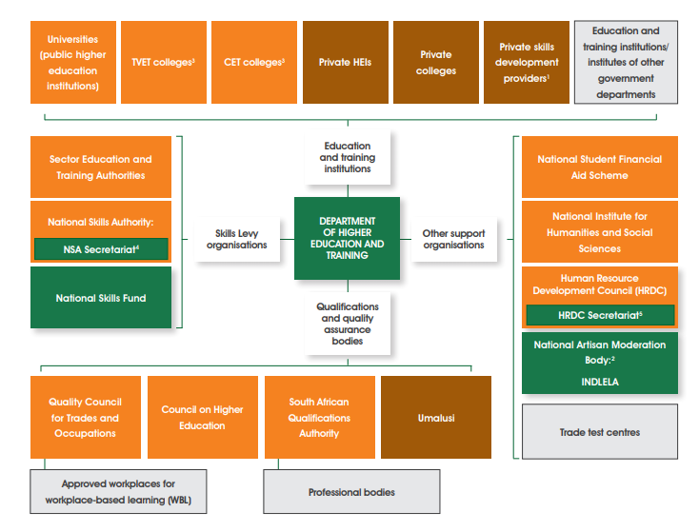
3

Slide 4
Social Inclusion functions within the Department of Higher Education and Training
GBV forms part of integrated Gender Equality functions, under the umbrella of Social Inclusion across the Department (in all branches)
There are no separated budget allocations for GBV in the DHET/institutions - it is included within the budgets of Branches/institutions
Implementation Branches (UE, TVET, CET and Skills):
Create the enabling environment, coordinate, support institutions in the implementation of social inclusion in the PSET system
Manage institutional policy environment
Manage and support implementation programmes within institutions
Monitor the implementation of Social Inclusion in institutions
Branch: A:
Create the enabling environment, coordinate, and support the DHET in the implementation of social inclusion
Manage DHET policy environment
Manage and support implementation programmes within the DHET
Monitor the implementation of Social Inclusion in the DHET
Manage all HR related issues within the DHET, TVET and CET colleges
Report to the DPSA on implementation and Govt. employees
4

Slide 5
Social Inclusion functions within the Department of Higher Education and Training
Branch: Planning, Policy and Strategy (through the Directorate: Social Inclusion and Equity):
Develop and manage the enabling policy environment (including sector policies, guidelines, standards, protocols and tools) for social inclusion in the PSET system
Support (where needed) implementation branches in the implementation of Social Inclusion
Collate information from Branches and monitor the implementation of social inclusion policies and programmes in the PSET system
Report on the implementation of social inclusion in the PSET system
Liaise with Chapter 9 institutions, other Departments
Report on national and international obligations
5

Slide 6
Implementation, Monitoring and Reporting of Social Inclusion in the PSET System
DHET employees
DPSA
Govt Employees
TVET Col employees
Administration
CET Col employees
Annual Social Inclusion Report
Events
Universities
University Education
NSFAS
Chapter 9 institutions
CHE
NIHSS
Portfolio Committee
Directorate Social Inclusion and Equity
TVET
Higher Health Implementation on campuses
TVET Colleges
Institutional/Organisational Implementation
Manage implementation in Sectors
Institutions, Entities
Other Departments
excl. DPSA
CET
CET Colleges
Ad Hoc requests
Policy Environment
Monitor Implementation
Report to different departments and formations
SETAs
Skills Development
NSF
International Reporting Obligations
QCTO
NSA
Reports to the Minister e.g. on equity
Planning, Policy and Strategy
SAQA
6

Slide 7
HIGHER HEALTH is the implementation arm of the DHET to implement a comprehensive and integrated programme promoting health and wellbeing of students across South Africa’s public universities and TVET colleges and provide on-campus support to PSET institutions in 7 PRIORITY AREAS:
HIV/TB/STI
Sexual Reproductive Health, Maternal Health & Contraception
Gender-based Violence
Mental Health
LGBTQI+
Alcohol & Drug Abuse Prevention
Disability
7

Slide 8
Progress regarding the implementation of the National Strategic Plan on GBV and Femicide
8

Slide 9
Background to the development of the National Strategic Plan on Gender-Based Violence and Femicide (NSP on GBVF) and the involvement of the DHET
NSP was triggered by the #TotalShutdown march against GBVF on 1 August 2018
24 Demands contained in a memorandum given to the President led to the development of teams tasked with responding systematically to the demands
The DHET co-chaired the Prevention Team with the DBE
The Base Document on Prevention was developed and discussed during the Presidential Summit held on 1-2 November 2018
The DHET was part of the team that finalised the Presidential Summit Against Gender-Based Violence & Femicide Declarations
The DHET was part of the Presidential Interim Committee on GBVF that developed the NSP on GBVF
An Emergency Response Action Plan (ERAP) was adopted at the Joint Parliamentary Session of 18 Sept 2019 (reporting began from Oct 2019 – March 2020)
ERAP report and NSP GBVF handed over and adopted by the President in April 2020
NSP M&E Plan has been developed and is being implemented
DHET, through the D:SI&E reports monthly to the DWYPD
9

Slide 10
National Strategic Plan on GBVF
The Department is involved in Pillars 2 and 4
The DHET will include all the pillars progressively in their work on GBV
10

Slide 11
DHET Key Interventions For Pillar 2 – Prevention and Restoration of Social Fabric
Key Intervention | Activities | Indicator | Target | Progress
Strengthen the delivery capacity of SA to roll out effective prevention programmes | Develop a comprehensive national prevention strategy | National prevention strategy with key overarching messages in place | Annually April 2020 to March 2024 | The DHET has developed an prevention strategy as one of the Strategic Objectives of the Policy Framework to address GBV in the PSET sector (Notice 410 of 2020 – 31 July 2020) Each institution is expected to implement the Policy Framework
 | Develop & collate transformative materials, curriculum, tools & approaches that can be adapted for prevention interventions for different institutional & social context & meet diverse needs | Manuals and training support materials developed and accessible for all disability groups | Range of standardised and flexible materials in place reviewed and adapted annually | National training materials developed by Higher Health is available and implemented in all of PSET DHET developed Training Material as self-directed open learning materials and they are available on the National Open learning System (NOLS) [https://tinyurl.com/wpkrfs3v] Higher Health is flighting advocacy, prevention and support materials on 21 Community and Campus Radio Stations Universities’ Curriculum: GBV part of the Higher Health ‘Peer to Peer Education’ (Second Curriculum) programme TVET and CET Colleges’ Curriculum: First Curriculum of NC(V), Life Orientation Lectures, Integration with other disciplines Higher Health has developed GBV Risk Assessment Questionnaires for early risk ID All these materials are available as Open Educational Resources and are adapted by institutions where it is appropriate/in need Other initiatives such as Ntombi Vimbela! sexual violence intervention in selected TVET and University campuses
11

Slide 12
DHET Key Interventions For Pillar 2 – Prevention and Restoration of Social Fabric
Key Intervention | Activities | Indicator | Target | Progress
2. Change behaviour & social norms that drive GBV with key groups using variety of approaches | Implement programmes to prevent GBV and eliminate the scourge of GBV in the PSET System | Policy Framework to Address GBV in the PSET system is approved | Annually April 2020 to March 2024 | The Policy Framework to address GBV in the PSET sector was approved by Cabinet on 3 June 2020 and published in the Government Gazette (Notice 410 of 2020 – 31 July 2020)
 | Institutions implement evidence based programmes to prevent GBV and eliminate the scourge of GBV in the PSET system | National and institutional accountability and enabling environment is in place to curb and address GBV in PSET Institutions | Annually April 2020 to March 2024 100% institutions with GBV policies | DHET: integrated policies (100%) Entities: integrated policies (44%) Universities: integrated policies (100%) TVET Colleges: DHET is working with colleges to standardise policies CET Colleges: DHET is working with colleges to standardise policies
 |  | National support for institutions in the implementation of GBV policies and provides support and assistance to victims of GBV | Implemented continuously and reported biannually | DHET provides support: Universities: through the Chief Directorate: Higher Education Policy Development and Research and the Transformation Managers’ Forum TVET Colleges: through the Directorate: Student Support Services (SSS) and the SSS Forum Policy support and M&E: through the Directorate: Social Inclusion and Equity Higher Health is providing extensive effective support to all PSET institutions and provides proper support and assistance to victims of GBV with an effective and comprehensive referral system (see presentation)
12

Slide 13
DHET Key Interventions For Pillar 2 – Prevention and Restoration of Social Fabric
Key Intervention | Activities | Indicator | Target | Progress
3. Challenge & transform toxic masculinities driving GBVF perpetration | Design and adapt interventions that provide skills that shape new forms of positive masculinities | Strategic interventions targeting young men (PSET, unemployed, working) identified and rolled out, including in their role as fathers and building gender equitable approaches to communication and relationships is rolled out | Annually August 2020 to March 2024 | Several universities and TVET colleges have reported interventions to build the capacity in male students and staff to understand their roles and responsibilities in society and towards women Under Higher Health’s programmes, there is specific attention given to the role of men in society and addresses patriarchy in society Specific workshop are held with male students and staff As part of the ‘First Things First’ and the ‘Peer to Peer Education’ (Second Curriculum) programme students and staff are capacitated in building gender equitable approaches
4. Harness approaches to prevention that facilitates integration & deepen impact | Integrate GBV prevention into SOGI (sexual orientation & gender identity) now (gender identity and expression, and sex characteristics (SOGIESC) programming | SOGI violence prevention integrated into GBV prevention Programming GBV prevention integrated into SOGI programmes | Annually April 2020 to March 2024 | Higher Health has a comprehensive programme of integrating GBV into their programmes that include HIV?TB?STI, Sexual Reproductive Health, Maternal Health & Contraception; Mental health; LGBTQI+; Alcohol & Drug Abuse Prevention and Disability Institutions and Higher Health held specific workshop with students and staff on gender identity and expression, and sex characteristics As part of the ‘First Things First’ and the ‘Peer to Peer Education’ (Second Curriculum) programme students and staff are capacitated in SOGIESC
13

Slide 14
DHET Key Interventions For Pillar 4 – Response, Care, Support & Healing
Key Intervention | Activities | Indicator | Target | Progress
1. Strengthened existing response, care and support services by the state and civil society in ways that are victim-centred and survivor-focused to facilitate recovery and healing | Psychosocial Support Programme for all frontline workers in place and rolled out, including those working in CSOs. | Institutional mechanisms such as compulsory leave, task shifting and team building to provide a supportive institutional environment for service providers. | Implemented continuously and reported annually | Employee Wellness programmes in the DHET and institutions are expanded to include psychosocial services for victims of GBV and violence Currently all 26 universities and their campuses have campus clinics where nurses provide primary healthcare services At TVET Colleges HIGHER HEALTH has facilitated the establishment of 80 clinics where the frequency of services ranges from daily to monthly. At large campuses, full-time facilities are ideal, while part-time clinics, run at least once a fortnight from mobile units or suitable rooms, work at smaller campuses. HIGHER HEALTH drives public sector partnerships for the supply of diagnostics, medicines, contraceptives and other consumables. It also offers training for nursing personnel to expand their competencies – for example, in terms of initiating ART, providing contraception and primary mental health services. HIGHER HEALTH also facilitates partnerships with provincial health departments, district health offices, security services and with SAPS
 |  | Mandatory debriefing and psychosocial support services captured in Victim Empowerment Support and Services Bill
14

Slide 15
Implementation of the
Policy Framework to address GBV in the PSET system
15

Slide 16
GBV REALITIES
GBV is a complex issue located in different realities e.g. social justice, human rights, criminal justice, socio-economic environment, culture, as well as the education and training system
GBV mostly occurs outside institutions (in clubs, private accommodation, etc). It also occurs inside institutions and residences
Social inclusion related issues are not always prioritised throughout the year
Competing priorities of institutions (also ito funding)
Institutional capacity to address GBV varies
Relationships with SAPS and other role players varies
Mitigation
Integrated approach - norms, standards, guidelines for institutions (just released Procedural Guidelines on Sexual and Gender Related Misconduct in PSET Institutions; Implementation Protocol on Rape and Sexual Assault Cases; and Implementation Protocol on the PSET Code of Ethics
A monitoring tool and reporting framework to monitor institutions (Social Inclusion Review and Improvement Model (SI-RIM) is being developed)
Higher Health (HEAIDS) is the implementation arm of the DHET on campuses
Partnerships with other Departments’ structures/SAPS/local structures
16

Slide 17
2016
2014
2020
17

Slide 18
PURPOSE OF THE POLICY FRAMEWORK
To address GBV in the PSET System:
create an enabling environment for the eradication of GBV and instil respect, protection, promotion and fulfilment of human rights as enshrined in the Bill of Rights of the Constitution of SA.
assist PSET institutions to address the occurrence of GBV
provide a monitoring instrument to the Department to assess the implementation of the Policy Framework
18

Slide 19
AIMS OF THE POLICY FRAMEWORK
Conceptualise GBV/define its manifestation ito existing laws and policies
international and national regulatory framework compelling institutional and departmental responses to GBV
Guidance on structures, mechanisms and processes to address GBV
Compel institutions to create an enabling environment to inform, prevent, support and monitor GBV in PSET institutions
The safety of all students and staff is promoted
Supportive, efficient and reparative assistance procedures for complainants/victims are in place
National and institutional enabling environment is in place to curb GBV
National support for PSET institutions in implementation of GBV policies
Students and staff are supported in GBV-related matters
Awareness and Prevention of GBV is prioritised
National and institutional systems of accountability are operational
OUTCOMES OF THE POLICY FRAMEWORK
19

Slide 20
STRATEGIC OBJECTIVES
Enabling Environment
Support & Assistance
Comprehensive, specialised support and other assistance of victims and where possible perpetrators
Procedures for reporting, investigation and resolution of complaints
Legislation and Policies
Norms, standards, guidelines, procedures
Structures, mechanisms
Accountability
Monitoring and Evaluation
Budget
Prevention & Awareness
Prevention programmes
Awareness programmes
Measures aimed at preventing incidents
The Policy Framework is the DHET’s response to the multi-sectoral, policy and programming framework provided by
the NSP for GBVF (2020)
20
Notes:
SO1: Enabling Environment:
Include regulations, norms, standards, guidelines and standardised procedures
Structured engagements with other government departments, agencies, entities and non-governmental organisations
Institutional policies are implemented
Accountability, monitoring and evaluation
SO2. Prevention and Awareness:
Promote the safety of all students and staff by putting in place comprehensive prevention programmes intended to raise awareness of policies and services addressing GBV, as well as other measures aimed at preventing incidents of GBV in PSET institutions
SO3: Support and Assistance
PSET institutions refer victims of GBV appropriately to and provide for comprehensive, specialised support and other assistance
Support and assistance are in line with the National Instructions, National Directives, List of Designated Health Establishments and Additional Services (2019), issued by the Dept of Justice in terms of the Sexual Offences and Related Matters Amendment Act (Act No 32 of 2007).
PSET institutions to ensure that complainants receive multi-disciplinary support
MONITORING AND EVALUATION
At institutional and national levels
Comprehensive Monitoring and Evaluation System adopted
Common indicators developed

Slide 21
SYSTEM OF ACCOUNTABILITY
Governance and Management of PSET Institutions
Institutional Forums/Committees
National Coordination and Consultation
Transformation Managers’ Forum (Universities)
SSS Forum (TVET Colleges)
National Social Inclusion Forum
PSET GBV Technical Task Team (expert advice)
Directors-General Inter-Sectoral Committee for the Management of Sexual Offences
National Forums established by other Departments:
DWYPD
DoJ&CD
DSD
DIRCO
etc
21

Slide 22
PSET GBV Technical Task Team
Higher Health was responsible to set up a PSET Technical Task Team (TTT), chaired by Prof LenkaBula, which is a consultative team of experts to advise on the work required to implement the Policy Framework
Department of Justice
& Constitutional Development
Higher Health GBV Team
SATVETSA (SA Technical and Vocational Education & Training Student Association)
The TTT provides inputs on draft Implementation Guidelines, protocols and other work on GBV undertaken by HIGHER HEALTH for the sector
The TTT will continue to oversee and provide support to HIGHER HEALTH in its work to implement the DHET GBV Policy Framework
DHET (Planning, TVET, Universities and CET branches)
United Nations Agencies – UNFPA, UNWOMEN
Made up of experts from:
Department of Women, Youth & People with Disabilities
South African Police Services
SA Medical Research Council
Commission for Gender Equality
SAUS (South African Union of Students)
USAf (Universities South Africa)
Civil Society
SAPCO (South African Public
Colleges Organisation)
22

Slide 23
What has been done so far to create and enabling environment?
Baseline principles have been drafted that form the backbone of the model documents, in the same way that the Bill of Rights forms the backbone of the South African Constitution.
GBV Implementation Guidelines including responsibility and compliance, behaviour constituting GBV, investigation and disciplinary process, consequences etc.
Institutional implementation guidelines and supporting protocols prepared
Model templates have been created that can be used by different PSET Institutions to implement the DHET Framework. These will establish minimum standards that PSET Institutions would be required to implement.
Implementing Protocols on Rape and Sexual Assault and Code of Ethics indicating PSET Institution’s commitment to eradicating GBV and Minimum Standards Protocols that support the guidelines. These deal, with campus safety, protection on outreach/field visits, whistleblowing, staff student relationships, alcohol etc.
Minimum standards checklist/s on GBVF that take into account different institutional configurations are to be prepared.
23

Slide 24
ORGANISATIONAL AND FINANCIAL IMPLICATIONS
Universities transformation offices and safety and security units; financial allocations include infrastructure funding for universal access to the built environment and to address the safety and security of staff and students
Existing academic modules on human rights and diversity
TVET and CET colleges are building funding frameworks incl. safety and security as well as anti-GBV programmes in Student Support Services frameworks
Content of capacity building programmes for both academic and administrative staff to be reviewed to include GBV
Allocation in the Department to manage social inclusion, that includes GBV, has been increased to R16,3 million over the MTEF
R1 million, above the normal allocation, earmarked for advocacy and awareness of the Policy Framework and the work of MTT on GBV
Higher Health (HEAIDS) assists all institutions in a holistic approach to healthy living, including addressing GBV
Allocation to Higher Health has been increased to R62,1 million over the MTEF (to be approved by Cabinet). Further allocation from the National Skills Fund and have access to donor funds and contributions by the Department of Health (in kind) to around R50 million
24

Slide 25
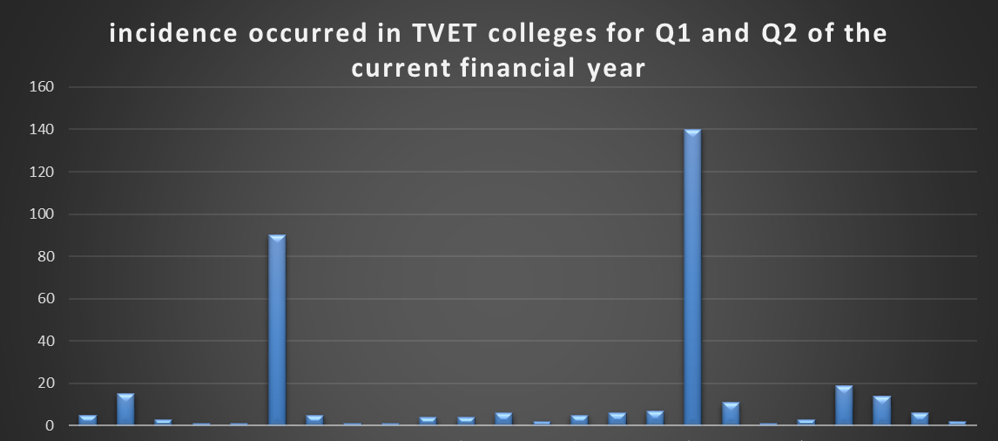
TVET Colleges Implementation
25

Slide 26
Implementation of GBV Policy Framework
TVET Colleges are guided by the Policy Framework which aims to assist the institutions to address GBV
All colleges are in the process of finalising GBV Institutional Policies where they do not exist
Colleges are guided by the Procedural Guidelines on Sexual and Gender Related Misconduct in PSET Institutions; Implementation Protocol on Rape and Sexual Assault Cases; and Implementation Protocol on the PSET Code of Ethics
Monitoring of the GBV Policy Framework by the TVET Branch
The Survey Hub is a new online reporting system which the TVET Branch utilises to collect data from colleges. This allows for data of incidents that occur to be collected and reported with verifiable information
The Branch collects data from colleges on a quarterly basis, whereby Colleges are required to provide data on GBV incidents
26

Slide 27
Programmes providing awareness, information, advice and guidance to prevent GBV
The Branch encourages colleges to develop programmes to address GBV challenges and the following have been done, but are not limited to:
Programmes in partnership with Higher Health on gender equity and equality
During 2021 TVET Month, the DDG gave a directive to the South Africa Technical and Vocational Education Student Association (SATVETSA) to engage in awareness campaigns among students on campuses
TVET and Women’s Month events were held in colleges to sensitise young women and men about GBV
Colleges’ websites, webinars and social networks platforms are used to share information through posters and articles
27

Slide 28
Programmes dealing with safety of students
Safety of students is a challenge for the TVET colleges and therefore partner with South African Police for assistance
Colleges appoint private security companies for campuses and student residences
Colleges have safety officer to conduct training for the college community
Colleges are tasked to ensure incident reporting and information desks
Colleges have student support offices to report cases
Higher Health Coordinators and Student Support Offices work in partnership with SAPS and other stakeholders for reporting and following up on cases of GBV
The Higher Health hotline is accessible 24/7 by students
Programmes in handling incidences of GBV, including reporting facilities in campus
28

Slide 29
Programmes providing adequate assistance and psycho-social support to survivors of GBV
Higher Health is the key stakeholder in the PSET sector focusing on student’ wellbeing
Some colleges have Higher Health Coordinators appointed to assist colleges in addressing student wellbeing issues
Various programmes are put in place by Higher Health and colleges respectively or in partnership
Higher Health has a 24/7 hotline accessible to students in need of support
Programmes dealing with perpetrators
Higher Health assists colleges in dealing with all students who need support in various areas
In issues beyond the capacity of colleges, Higher Health assists or referrals are made to experts
29

Slide 30
CET Implementation
30

Slide 31
CET Implementation relevant to Gender Equality and GBV
The intention of the Policy Framework to create an enabling environment where everyone has the right to live, study and work freely and safely in the PSET environment without any fear of sexual/gender-based intimidation, harassment, abuse, rape or other forms of sexual/gender-based violence is supported by the CET Branch
CET colleges are not yet ready to respond on the progress of the implementation of the Policy Framework as systems for implementing the Policy Framework are not yet in place in CET colleges. This is in consideration of the history of CET colleges with no adequate infrastructure, physical and human resources as well as adequate funding
As part of developing CET systems and to create enabling student support environments, the CET Branch has recently published the National Policy on Students and Community Support Services for CET colleges (2021). This is one of the steering mechanisms that have been developed to support CET students. This policy makes reference and supports the intentions of the Policy Framework on GBV through its Students and Community Support Services (SCSS) intervention programmes
One of the developments of this policy, has been the process of nominating and building capacity of interim SCSS structures in CET colleges as there has been no dedicated student support personnel in the past
The CET Branch has therefore identified such structures as well as CET college management to work and deliberate on GBV issues in CET colleges
31

Slide 32
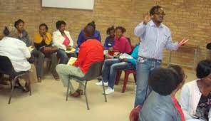
CET Implementation relevant to Gender Equality and GBV
The Directorate: Social Inclusion and Equity will work in collaboration with the CET Branch on giving inputs and implementing the proposed CET Social Inclusion and Equity Implementation Plan
In preparing our CET systems and building their capacity will consequently enable the implementation of the Policy Framework on GBV in CET colleges
32

Slide 33
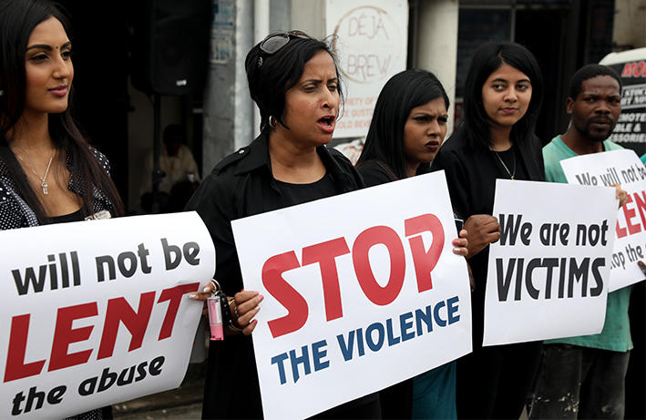
University Implementation
33

Slide 34
Public Higher Education Institutions: Policies
In 2019, following the establishment of the Ministerial Task Team (MTT), the Minister wrote to all institutions and requested them to submit to the Department their policies relating to sexual harassment, and gender-based violence and harm in their institutions
The universities were also requested to indicate which offices in their institutions have responsibility for dealing with GBV matters, what is the nature of support offered for policy implementation, support to victims of gender-based harm, and formal processes related to managing these issues
All universities responded to the request by submitting their Council approved policies to the Department of Higher Education and Training (DHET). The University of Fort Hare’s policy was submitted after being finalised in September 2019
The analysis of the policies, which forms part of the work of the MTT, has highlighted variations in terms of how the policies are conceptualised. Some universities have consolidated policies on GBV and others have separate policies that address different focus areas, such as sexual harassment or discrimination
All universities take forms of GBV such as rape, sexual assault and sexual harassment into account in their policies. However, the extent to which these forms are mentioned varies, with some institutions being more exhaustive than others in their lists of what forms of GBV or forms of sexual harassment depending on what the focus of the policy is
34

Slide 35
Overview of policies
Areas that are generally addressed well in policies include definition of sexual harassment and harassment, policy objectives and scope, reporting structures, formal procedures for reporting, the rights of victims/survivors to pursue separate criminal/civil processes while institutional procedures are underway and support for victims/survivors (psychosocial and sometimes medical). Policies also include Disciplinary Procedure for Gender Related Misconduct; Sexual Harassment and Assault in the Workplace; Sexual and Romantic Relationships between Staff and Students and Anti-Discrimination Policies and Procedures
Some universities has also policies, charters, guidelines focusing on men, e.g. in CPUT the HeforShe Men’s Pledge has been operational since 2018
Most universities have a Charter/Pledge on GBV that are being signed by both students and staff
In many policies, it is not clear what the consequences are for various forms of GBV. These are often located in separate disciplinary documentation
None of the policies are explicitly costed and the level of institutional capacity to implement policies is an area requiring attention
As part of its work the MTT will identify good practices that could be replicated and policy weaknesses that may be contributing towards failures by universities to address the challenges
Engagements with various institutions exposed the need to consider their approaches to reporting procedures, and whether these should be centralised
35

Slide 36
Awareness, information, advice, and guidance to prevent GBV
All universities have student/staff programmes for awareness, education and support in relation to GBV and are working on/have already a GBV Strategy and Plan
Work on informing universities communities about GBV is primarily through workshops or presentations during orientation weeks and during various parts of the year for students, and targeted workshops for staff organised
Roadshows to inform various members of the university community
Some universities produce brochures and other literature for the university community, and information is also available on some institutional websites. Higher Health’s materials are extensively been used
All universities have a dedicated portfolio/facility in the institution that heads gender awareness, advice, and guidance programmes. Most have medical support facilities
Various institutions have measures in place that include the assistance of change champions, peer helpers, and SRC support for awareness-raising purposes at an institutional and departmental level
Training about GBV is often ad hoc. The MTT is exploring the possibility of national standards and principles about what should be included as a minimum in training sessions
There is a need for content training, particularly for security officers (often the first responders) and other staff dealing with GBV issues. However, guidelines on the type of content should be specific and audience-based
36

Slide 37
Offices that deal with GBV matters
Some institutions have centralised offices, while others have multiple entities that deal with GBV, and others have bodies (committees) rather than physical offices. The roles and responsibilities of the various offices/entities/committees that deal with GBV are well articulated in the policies. All universities have some form of facility to deal with GBV matters/ occurances
From the engagements the MTT on GBV held with universities it appeared that the variation in this regard could be as a result of some universities having inadequate capacity in terms of human resources working on GBV. This is necessary for quick turnaround times in dealing with cases to resolve the experiences of survivors and give them closure quickly as far as the institutional processes are concerned
All institutions have clear formal procedures for dealing with GBV related misconduct on campus. All universities take an inquisitorial approach, and procedures for investigating reported cases are outlined in the policies
All universities make it clear in their policies that approaching the South African Police Service (SAPS) and laying charges is not mutually exclusive to undertaking the processes at the universities
37

Slide 38
Monitoring and Evaluation
Reporting structures and procedures are quite clear in all policies. However, it does not appear that all institutions have a secure online system for recording, monitoring and analysing data. The MTT report will provide recommendations in this area, including on the question of whether a register of offenders is possible within the higher education sector
On the issue of protection for complainants, some policies do not indicate whether they investigate anonymous complaints. This is a matter that is being investigated by the MTT
While many universities may have scopes that extend outside of campus or campus-related activity, it is not clear what the procedure is for individuals who find themselves victims of GBV outside of campus
All institutions provide trauma counselling and provision of information in the recourse that students can take, sometimes also in partnership with organisations that have expertise in these areas
38

Slide 39
Higher Health Implementation
39

Slide 40
HIGHER HEALTH MODEL
Peer to Peer Education (Second Curriculum)
First Curriculum
LO Lectures
Integration with other disciplines
Future Beats
Campus & Community Radio Programmes & Social Media
DEMAND
CREATION
EARLY RISK SCREENINGS & ASSESSMENTS AT CAMPUSES
HIV/TB/STI
Sexual and Reproductive Health and Rights (SRHR)
GBV
Mental Health
RECRUITMENT OF YOUNG PEOPLE - STUDENTS
ARVs ON SITE; MMCs, CONTRACEPTION, PrEP, GBV & Mental Health Support
Adherence Clubs on Positive living for HIV; young women on Contraceptives; PrEP; LGBTQI; Drugs & Alcohol; Gender Based Violence Survivor Clubs; Mental Health
On Site – Bi-Monthly- By Appointment
Student routine on-campus appointments for
'nurse-initiation and management of ART (NIMART) and SRHR Services through Nurses
Social Workers and Psychologists
First Things First Student Health & Wellness Activations – 3-5 Days – Monthly Free Health & Wellness and Psycho-social support Services at campuses Peer to Peer Testing/Screening/Counselling & Treatment/Care & Support including linkage to care
40

Slide 41
Reporting of GBV on Campuses
An incident of GBV can be reported by any person (not only staff and students) to any member of the campus community
No threshold. No matter how minor
The person to whom it is reported must immediately, or on next working day if it is a weekend refer it to Responsible Office (RO)
Complainant can go to SAPS as well. Can follow both routes or choose one
It is mandatory to report to RO if it is suspected that there has been GBV perpetrated
Complainant may choose not to pursue action in which case RO can (when the RO thinks there is chance of risk)
41

Slide 42
Complainant Centred Approach
Confidentiality: Info only available to limited number of people
Anonymity: Complainant centred means right to remain anonymous
Complainant may withdraw matter, choose informal or formal process, report to SAPS
Supportive and protective measures to be provided
42

Slide 43
Supportive and Protective Measures
To secure safety of complainant and guard against harm
Psychosocial support
Medical support
Suspension or special leave for staff, or leave of absence for students
Sick leave
Change of academic classes or academic concessions
No contact/restriction of activities orders
Change of student res where applicable or barring alleged perpetrator from res
43

Slide 44
PREVENTION CARE AND SUPPORT FOR STUDENTS ON GBV
44

Slide 45
Awareness and Prevention
Continued routine provision of youth-friendly GBV prevention via second curriculum in-class and out of classroom
Early risk detection of students that are at risk of being victims or perpetrators of GBV
Strengthening the peer- led GBV support groups on campuses
Use the curriculum to change behaviour and educate on GBV
On – campus access to bio-medical interventions such as PEP, including access to rape kits and youth friendly safe rooms
45

Slide 46
Integrated GBV Prevention, Care and Support Model Students Supported with GBV Education and Services via HIGHER HEALTH 2020/1 (one year)
LEARN
Primary Level
GBV Second Curriculum/Extra mural health & wellness resource manual
Peer to Peer Education
Peer to Peer Initiatives, Activities and Events
STUDENTS ENROLLED INTO GBV CURRICULUM = 131 995
Knowledge Transfer
GBV second curriculum resource manual
Secondary Level
GBV Risk Assessments tool kits
STUDENTS GBV RISK SCREENING SUPPORT SERVICES PROVIDED = 80 350
DO
Practical Learning
Self administered GBV
risk screening
Tertiary Level
Access dedicated student 24/7/365 toll free crisis help-line
Psychosocial support provided by mental health professionals
Referral to professionals outside the PSET facility
Referral to Specialised Clinical Services Through Mobile Clinics
STUDENTS SUPPORTED = 58 201 (reported their personal abuses/violence/psycho-social distress related to GBV and seeking psycho-social assistance)
Linkage to Youth Friendly Services
ACT
46

Slide 47
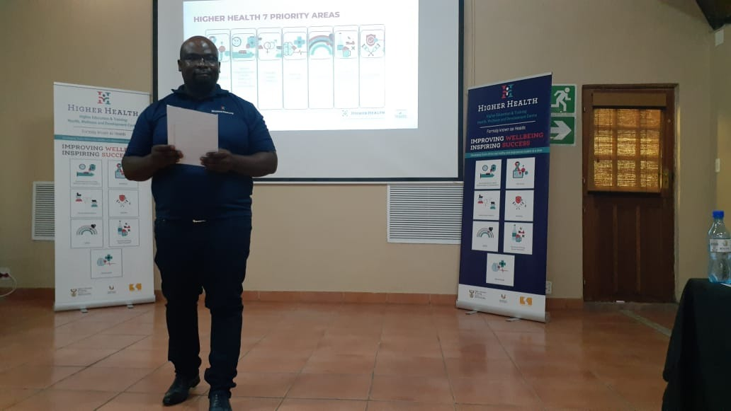
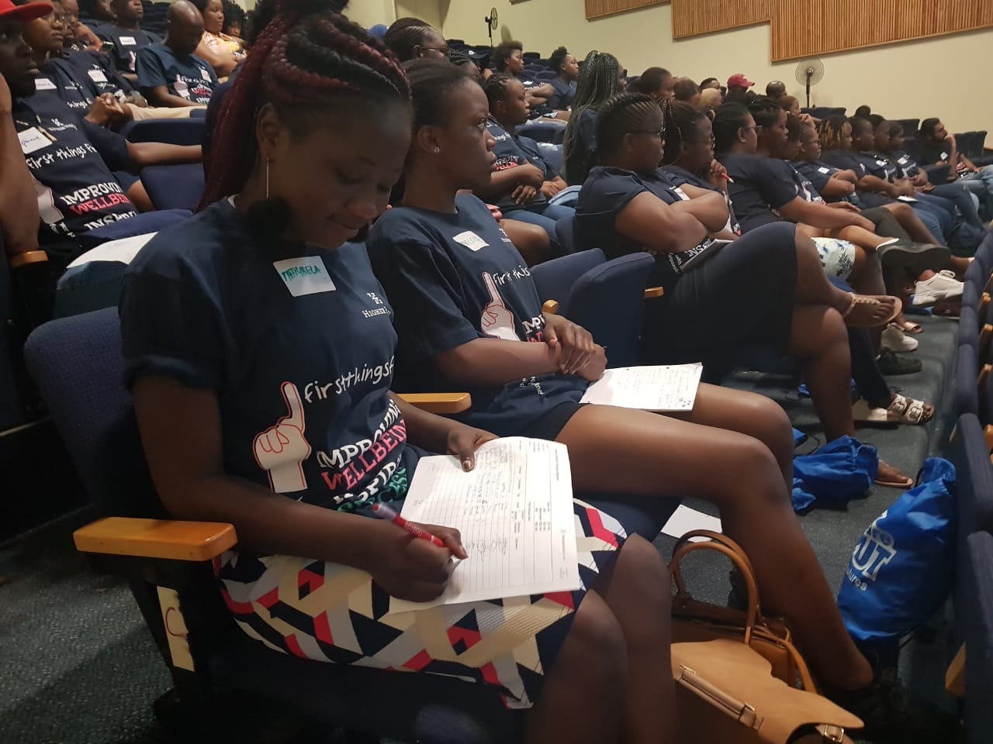
Promoting Awareness & Prevention – 2nd Curriculum peer to peer programme
DHET developed the Training Materials as self-directed open learning materials and they are available on the National Open learning System (NOLS) [https://tinyurl.com/wpkrfs3v]
47

Slide 48
HIGHER HEALTH Campus and Community Radio Programme for Demand Creation & Awareness for GBV Support & Care
Over 1 million regular youth listenership
Current 21 youth radio stations
Over 200 radio journalists trained
Over 80 radio shows running per week including Prime time
48
Notes:
Love

Slide 49
What are the next steps that Higher Health will embark on?
Further that is being undertaken in relation to GBV Implementation Guidelines
Preparation of protocols, minimum standards and checklists on:
Femicide
Staff student relationships
Campus safety and security
Preparation of templates to accompany implementation guidelines;
Preparation of monitoring and evaluation checklists to ensure that PSET institutions are complying
49

Slide 50
GBV Implementation Capacity Development and Skills Training in the PSET
To be given to following partnership forums in September 2021:
Transformation Managers Forum
Deans of student Affairs Forum
Campus Protection Society of Southern Africa (CAMPROSA)
Campus health HODs
SAUS and SATVESTSA
HR Directors Forum
DHET Regional Managers
SAPCO
In October and November 2021
Capacity Building in TVET Colleges in all 6 DHET regions, 26 universities and student leadership in TVET and universities, including the following:
Transformation Managers
SSS Managers
Gender Offices
Deans of Student Affairs
Management
SRCs
Security
Capacity building
The capacity development and training that will be given by Higher Health will cover:
The GBV Principles
GBV Implementation Guidelines
Rape Protocol
Code of Ethics
50

Slide 51
SETA and other entities Implementation
51

Slide 52
SETA Implementation
No entity has a separate GBV policy
Most SETAs and entities integrate GBV in existing policies and frameworks
All, except 1, have integrated programmes of awareness, education and support for staff in relation to GBV
GBV is integrated in mostly HR budgets and no separate budgets are allocated for GBV
S
100% SETAs reported
52

Slide 53
SETA Implementation
Name of SETA | Do you have a policy, charter, guidelines and procedures to deal with GBV? | Do you have any programmes for awareness, education and support for staff in relation to GBV? | Do you have a budget for GBV?
CHIETA | No | No | No
LGSETA | No internal policy or charter, but have Sexual Harassment Policy. Guidelines and procedures contained in HR policies | No awareness and education programmes, staff supported by EHW service provider | R90 000 per annum
HWSETA | Have a Workplace policy, Ethics guidelines and a Disciplinary policy that addresses harassment and discrimination in the workplace | The EHW programme supports staff affected by GBV Collaborated with Higher Health and Workforce Health Care (WFHC), an external EHW service provider that maintains anonymity and confidentiality of employees when dealing with issues such as GBV Do awareness programmes | No, makes use of EAP Budget for GBV
SASSETA | Have an internal GBV policy but no charter. No guidelines and procedures for dealing with GBV in the workplace | Education, awareness and support of staff handled through the EHW programme Partnered with NICDAM for general awareness training and support for NGOs to deal with trauma and crime victims | No
PSETA | No internal policy for GBV, no charter and no guidelines and procedures | GBV related information is communicated through newsflash and website Staff support is done through an external service provider All employees appointed in the organisation undergo criminal and security vetting | No, makes use of HR budget
FOODBEV SETA | No own internal GBV policy or charter signed by all staff and management | Support to staff through EHW Safety audits are done quarterly Promotion of safety done through awareness campaigns, policy reviews and workshops They have processes for reporting including a 24 Hour Hotline | No
MERSETA | No | No programmes, plans, or doing anything regarding GBV They have an EHW service provider for all staff members that require emotional and social support All staff members are vetted by external service providers before appointment, including background checks and police cases | No
MICT SETA | No internal GBV Policy | EHW partner is equipped to provide counselling services as and when required | No
No cases of GBV reported in any entity
53

Slide 54
SETA Implementation
Name of SETA | Do you have a policy, charter, guidelines and procedures to deal with GBV? | Do you have any programmes for awareness, education and support for staff in relation to GBV? | Do you have a budget for GBV?
EWSETA | Anti-Sexual Harassment Policy approved March 2020. The current EWSETA Code of Conduct and Anti-Sexual Harassment Policy deal with violence in the workplace | Has an employee wellness programme through which awareness programmes are implemented and GBV is one of them. An Employee climate survey was conducted and the results indicated the need for proactively transforming gender norms. Recently launched Employee Engagement Strategy “Yenza Kahle” which also seeks to address key culture change initiatives around inclusivity, diversity and transformation. OHS Audits do consider safety issues that may affect staff. Action is taken to close gaps identified from the audits. Strict physical site security measures include CCTV’s strategically positioned around the office, controlled access into the office, registration at reception and security presence which is offered by the landlord. | The EHW budget for 2021/22 is R175 000. Remaining as at 1 August 2021 is R136 220
ETDP SETA | Yes they have an internal policy on GBV approved in 2019, and have procedures for dealing with GBV | Marketing Unit issues regular Communication to Staff during National Days, including 16 Days of Activism for no Violence against women and children. The EAP Provider is available to staff. The SETA does background checks before appointing staff. | No
FASSET | No specific GBV Policy, no Charter, and no procedures and guidelines to deal with GBV. They have a Sexual Harassment Policy | In ‘Circle of Influence’ event which takes in August annually, women issues are addressed. The event is also attended by males. Security controls are in place, such as limited access; staff including interns access the building through finger prints. Surveillance cameras are in place and there is also 24-hours security guard. The institution has appointed an EHW service provider to provide psychological support to staff. Background checks are done on new staff for criminal records, which include GBV related crimes. | No
CETA | There are 32 organisational HR policies that are applicable to CETA staff. Relevant to GBV are: Sexual Harassment policy; Code of Conduct; Grievance Procedure and Disciplinary Policy. There are no GBV charter or GBV guidelines. | Policy workshops are held to bring awareness of new policies in the organisation. As per the organisations policy frameworks, incidents can be reported to the HR department and will be handled with sensitivity and confidentiality Employees have access to counselling services through both Discovery Health and Liberty as subsidised. The employee wellness provider will also provide counselling services for employees and immediate family members. | No
No cases of GBV reported in any entity
54

Slide 55
SETA Implementation
Name of SETA | Do you have a policy, charter, guidelines and procedures to deal with GBV? | Do you have any programmes for awareness, education and support for staff in relation to GBV? | Do you have a budget for GBV?
MICT SETA | Not specifically a GBV policy, however, GBV related matters are addressed in MICT SETA Harassment and Discrimination Policy, Code of Conduct and Disciplinary Code and Procedure. | MICT SETA’s wellness partner is equipped to provide counselling services as and when required. MICT SETA policies categorically prohibits any form of discrimination based on gender and promotes equality on all matters of employment relations, i.e. recruitment, training, performance, remuneration, incentives and discipline. | No
TETA | Sexual Harassment Policy, it outlines the procedures to deal with GBV. | Run awareness campaigns on policies including the SH Policy for staff and students. The policy also deals with procedures on how to deal with perpetrators. An EHW service provider offers psychosocial support for employees in distress. The Executive Corporate Services Manager is the first person to be approached in cases of GBV. Training on diversity and transformation is run on an annual basis and includes the LGBTIQA+ group and persons with disabilities. The Labour Relations Unit covers the use of drugs and alcohol through relevant policies. Reference and criminal checks are done on staff and students. | R1.5m set aside for training which includes training on GBV related matters.
CATHSETA | No | An employment equity policy in place to promote gender and racial equity. Implemented Employee Health and Wellness programmes that focus on providing support to the employees who need support. EHW supports employees in distress Pamphlets and electronic messages relating to GBV are circulated amongst staff Every staff member is encouraged to report wrong doing using the Anti-Fraud Hotline. Probity checks conducted prior to the appointment of the Members of Board and staff | No
W&R SETA | No, has a code of conduct that ensures that staff subscribe to code of good practice. | On annual basis seek wellness services and there is 24hrs a day service for all staff. Appointed OHS Compliance Officers and trained them. An external service provider offers support for employees in distress. All staff are inducted using organisational policies including reporting incidents. There is a need to plan and dedicate training on GBV. | No
No cases of GBV reported in any entity
55

Slide 56
SETA Implementation
Name of SETA | Do you have a policy, charter, guidelines and procedures to deal with GBV? | Do you have any programmes for awareness, education and support for staff in relation to GBV? | Do you have a budget for GBV?
BANKSETA | All GBV related challenges are addressed through Human Resources policies, i.e. Sexual harassment Policy and Employment Equity Policy. Currently, BANKSETA is using the DHET Gender-Based Violence (GBV) in the Post-School Education and Training System to implement Gender-Based Violence Programme. | The BANKSETA is currently leading a collaboration of SETAs in conducting an online GBV Campaign via the following platforms: Website, Social Media, New Flashes and Print Media. The Board has approved the implementation of a three-year GBV Program at three universities in the Eastern Cape namely, the University of Fort Hare, Rhodes and Walter Sisulu Universities. The BANKSETA is currently working on a process of procuring a service provider that will implement the GBV programme. The programme was supposed to start in August 2021 but due to the procurement delays, we hope to start it early in 2022. Employee wellness day was organised and staff members participated in the campaign to address GBV. Safety audits were done, precautionary measures identified i.e. cameras installed and limited access to the building. | The budget for the 3-Year GBV Programme that will be implemented at the above-mentioned three universities for both students and staff is R4, 1m including administration
AgriSETA | Draft Sexual Harassment Policy is still to be approve | Have EHW Programme through an external service provider for the psychosocial support of employees. AgriSETA has put in place cross-functional teams, which have no gender boundaries, are not discriminatory and live the organisational values. They promote the spirit of diversity and ensure that their Code of Conduct also sets the tone for preventative measures. HR Business Partners will assist employees with formal and informal complaints should they arise. | No
INSETA | No specific GBV policy Harassment Policy Disciplinary policy Occupational Health and Safety policy (OHS policy) Grievance Policy Employment Equity Policy Code of conduct | The policies are workshopped to all the staff and they all have copies of the policies. An external company was appointed to do safety audits. The Health and Safety committee attended to the issues raised in line with OHS policy. The EHW programme assists all staff with external systems of support and counselling. New staff is inducted on policies, and there are posters. HR staff is trained to attend to the complaints/reporting of GBV. Criminal checks for new employees and Board members are done. | GR350 000.00 through EHW
No cases of GBV reported in any entity
56

Slide 57
SETA Implementation
Name of SETA | Do you have a policy, charter, guidelines and procedures to deal with GBV? | Do you have any programmes for awareness, education and support for staff in relation to GBV? | Do you have a budget for GBV?
MQA | No specific GBV Policy in the MQA Disciplinary, Grievance, Code of Conduct, Employment Equity | HR Unit provides support to Staff on all matters related to GBV and other. EAP service provider offers support, and counselling to all staff members. 24/7 Security ensures the safety of staff. The reporting of any GBV matter is done through the HR unit. There is a formal Grievance policy and process in place to report any instances. Policies available on the intranet; and communicated in induction and policy workshops. Criminal checks are conducted for all staff and Board members prior to appointment. | GBV is budgeted under employee assistance programme at R302 927,25
Services SETA | The Services SETA does not have a stand-alone approved GBV policy. Matters of harassment and discrimination are addressed in a number for HR&D Policies, namely: Code of Conduct, Disciplinary Policy, Grievance Policy, and Sexual Harassment Policy. Employers and training providers are required to develop their own policies regarding the wellbeing and behaviour of students | The HR&D department runs awareness programmes affecting employee wellness. Awareness and support to staff is provided through topic specific webinars, and global communication through emails, with attachments and messaging. The SETA also has an EHW programme that is performed by an external service provider, for privacy and decency purposes. This service includes counselling, psychological support and health services. The organisation strives to establish an inclusive culture, including the development of policies that are against discrimination, and capacitating staff members on these policies and the principles of the organisation. All SETA offices are protected by 24-hour security, including CCTV coverage and access control security features. All staff members are encouraged to communicate any incidents either to their immediate manager or HR&D for immediate assistance. All staff members are inducted on all policies of the SETA, and are also capacitated through wellness awareness sessions on any new developments. Background checks are performed on any new appointment at the SETA including criminal and reference checks. | The SETA does not have a separate budget line for GBV, it is included in the EHW budget (R500 000)
No cases of GBV reported in any entity

Slide 58
SETA Implementation
Name of SETA | Do you have a policy, charter, guidelines and procedures to deal with GBV? | Do you have any programmes for awareness, education and support for staff in relation to GBV? | Do you have a budget for GBV?
FP&M SETA | FP&M Seta has the following policies to address GBV varyingly: Employment Equity Sexual Harassment HIV/AIDS Code of Conduct Code of Ethics Disciplinary & Grievance | Sharing of available information is done on all platforms for staff. Safety of staff is dealt with through the Occupational Health & Safety policy. All grievances are dealt with through the Grievance Procedure. Referrals for support in line with government initiatives are shared with staff. Perpetrators will be disciplined and handed over to the Law enforcement agencies. There is a Social & Ethics Committee which has been set out at Accounting Authority level. Staff is aware of all policies and processes to follow when aggrieved. Sharing of available public information will be heightened to ensure that staff is aware of available programmes. Induction programme, training interventions, staff meetings & email communications are used to inform and empower staff; and there are policies and procedures in place for staff and operations that guide staff. A detailed induction, orientation and on boarding session which includes policies and processes applicable to safety is conducted. Staff issues are treated with absolute confidentiality without prejudice or bias. Information is posted on the intranet and shared drive that can be accessed by all staff members. Professional counselling referrals are always the best option and will be prioritised. However, internal HR Manager provides immediate face-to-face support. Background checks, in particular criminal are done for Senior Personnel prior to appointing them. | No
No cases of GBV reported in any entity

Slide 59
Other Entities’ Implementation
Name of Entity | Do you have a policy, charter, guidelines and procedures on GBV? | Do you have any programmes for awareness, education and support for staff in relation to GBV? | Do you have a budget for GBV?
CHE | The CHE does not have a specific GBV policy. It has the following policies in place: 1. Grievance Policy 2. Disciplinary Code and Procedure Policy 3. Sexual Harassment Policy | The CHE has a partnership with Careways that deals with and supports all employees with wellness aspects including mental health, discrimination, victims of GBV, sexual harassment, etc. Safety audits have been addressed through the Occupational Health and Safety Committee in place and security measures in place The CHE conducts criminal background checks on all prospective employees | Included in the EHW budget
NIHSS | Harassment, Racial harassment, and Sexual Harassment Policy covers procedures and processes of dealing with GBV, the last policy reviews were approved on 26 March 2021 | They have set up a consultative forum where all employee relations matters are discussed There is Health and Safety committee in place that is known to staff, the committee addresses all safety issues on a daily basis, staff are encouraged to report any safety issues and concerns to the OHS members at any given time They are in the process of facilitating diversity training (including LGBTQI+ awareness training) to educate staff about the community | No budget for GBV
SAQA | SAQA has a Policy on Sexual Harassment. | An induction programme is implemented which includes aspects on health and safety for staff and interns. SAQA has a Wellness program with 24 hrs Employee Assistance programme support by an external service provider. Communication on GBV matters is integrated into women`s month campaigns | No budget for GBV
QCTO | QCTO does not have a GBV policy or charter, but has the following policies: - Harassment policy for staff Grievance process and procedure for staff Disciplinary policy for staff Code of conduct for staff | If cases are reported to HRM Unit by victims, such cases will be referred for professional assistance via the medical aids QCTO is in the process of implementing a panel of Wellness, health and counselling service providers Employment Equity Policy and Change Management strategy in development phase Staff training initiatives on embracing change in workplace Safety audit conducted. QCTO in a process of addressing matters of concern Counselling, referral to professional practitioners through the medical aid as well as the Wellness support; Awareness programmes on GBV are done by the Marketing Unit; They conduct employment reference and criminal checks on all recommended candidates. | No budget for GBV
No information received from NSA, NSF
No cases of GBV reported in any entity
59

Slide 60
DHET Implementation
60

Slide 61
DHET Policies/Procedures relevant to Gender Equality and GBV
Principle: All EHWP policies address discrimination against race, sexual orientation and disability
Recruitment and Selection Policy
Disciplinary and Grievance Procedure
Code of Good Practice
Uniform and Protective Clothing
Training and Development Policy
Policy Pertaining to Employee Wellness
HIV/AIDS Policy
Succession Policy/Career Pathing (draft, not approved)
Staff Retention Policy (draft, not approved)
Policy Pertaining to Retirement Planning
Sexual Harassment Policy (draft, not approved) [procedure of lodging a grievance and stakeholder’s roles and responsibilities]
Policy Pertaining to Promotions and Remuneration
Minutes from the Employment Equity Forum
The DHET plans to develop a GBV Charter and ensure that all DHET officials sign it. It will be made available to all DHET sites, Regional Offices and Colleges
Use DPSA Policies
DHET Specific Policies
61

Slide 62
DHET curbs the occurrence of GBV and supports GBV victims
The Department is using the Wellness Centre in the DHET as the GBV Facility for staff that runs awareness programmes, psycho-social interventions and provides reporting services for staff
EHWP deals with organisational wellness and work life balance, including GBV
The Department inculcates individual and organisational change in order to transform gendered norms through capacity building of staff
Reporting Officers, including fraud, corruption and risk offices, the EHW office and Labour relations offices are trained and continuously supported to present options to complainants of GBV. Frontline staff are trained to handle such cases and it is covered in their job descriptions
The Department also do background checks on GBV offences before appointing any staff member or support personnel in the organisation. The Fraud, Corruption and Risk Unit will register offenders as contemplated in the Sexual Offences Act and related legislations (e. g 2019 Strategic Sexual Offences Framework developed by the DoJ&CD which requires that every department must develop background checks on applicants during recruitment and selection processes and even in the course of employment)
62

Slide 63
DHET curbs the occurrence of GBV and supports GBV victims
The following support is given to staff in GBV:
Capacity building workshops conducted in the DHET, Regional offices, and Colleges. The Department is empowering DHET officials, Regional Offices and Colleges through EHW capacity building workshop which addresses Sexual Harassment, Sexual Offences and Discrimination
Psycho-social support and referral systems in place to support victims of GBV
Sexual harassment policy and procedures are to be followed when dealing with GBV cases by Labour Relations
EHWP deals with psycho-social support to victims of GBV in line with EHW policies
EHWP also deals with GBV related issues such as to combat use/abuse of drugs and alcohol
Labour relations deals with perpetrators as per the Labour Relations policies
the Department, in collaboration with the Department of Social Development, refers GBV cases to only registered facilities
One case of GBV took place from January to July 2021 in the DHET
There are no pending cases of GBV
63

Slide 64
Safety Audits of the Department to identify issues of concern to staff
EHWP together with Facilities Management address issues of health and safety through SHERQ
The DHET utilises an SMT tool, SHERQ Inspection tool and Quarterly Integrated Reporting Tool
The DHET developed an Annual Improvement Plan to address the identified gaps
Staff empowerment and diversity management are addressed by the EHWP and the Department ensures that diversity management issues, disability, substance abuse and empowerment issues are being addressed
EHWP ensures the implementation of JobAcces, Reasonable accommodation, Sexual Harassment, Disability Management, Pilar Policy and Substance Abuse Policy
DHET actions diversity of staff in the Department including LGBTQI+, persons with disabilities, and the use of drugs and alcohol
64

Slide 65
65

