Slide 1
RESTORATIVE JUSTICE and the Prevention and Combatting of Hate Crimes and Hate Speech Bill

Slide 2
OVERVIEW
Clarification about restorative justice
Reference to written submission

Slide 3
SOME DISTINCTIONS
Not a soft option in responding to crime
Mainly a different way of thinking about crime and justice issues
Offers constructive ways of holding offenders accountable

Slide 4
SOME DISTINCTIONS
A way of thinking about crime and justice issues
Restorative justice processes e.g. victim offender mediation
Interventions that contain restorative elements e.g. life skills, vocational skills

Slide 5
REVIEWING RESTORATIVE JUSTICE CONCEPTS
Crime is a violation of people and relationships
Violations create obligations
The central obligation is to put right the wrongs

Slide 6
REVIEWING RESTORATIVE JUSTICE CONCEPTS
Fundamentally, crime is about disrespect
Justice is about respect
Justice demands 3 things:
That we respect the life of others
That we respect the property of others
That we respect the feelings of others

Slide 7
Three (3) pillars of restorative justice
1) Harms and needs
(Of victims, first of all, but also of communities)
2) Obligations to put right
(offenders’, but also society’s)
3) Engagement of stakeholders
(victims, offenders, community members)

Slide 8
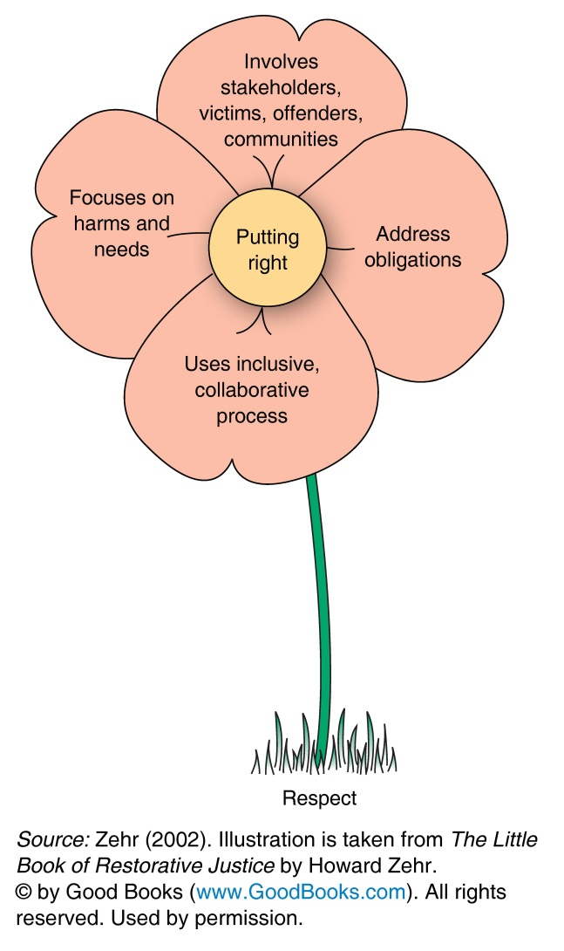
Restorative justice
Putting right requires that we:
Address harms
Address causes at all levels – personal, interpersonal, environmental and societal

Slide 9
Reviewing the purposes of punishment and related theories: retributive theory
Research indicates:
apart from the general deterrent effect of having a criminal justice system, there is no evidence to show that sentences have a deterrent effect on either individuals or on other potential offenders.
punishment does not change behaviour.

Slide 10
HIGHLIGHTING THE WRITTEN SUBMISSION
Why do we support hate crime legislation?
the significance of the State’s denunciation of actions as wrong
the implicit promise of active protection of victims

Slide 11
HIGHLIGHTING THE WRITTEN SUBMISSION
Points of reference for integrating restorative justice:
Diversion practice – Child Justice Act, superior court precedents p6
PEPUDA P8

Slide 12
HIGHLIGHTING THE WRITTEN SUBMISSION
Insights from international research p9
Insights from SA research on hate crimes p10
Current perspectives from advocates and service providers working with hate crimes and hate speech p11

Slide 13
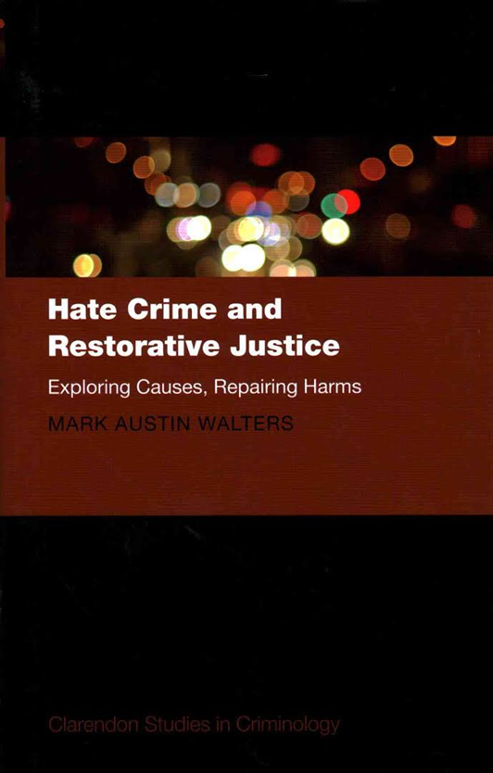
HATE CRIME + RJ - RESEARCH
Notes:
Published in 2014

Slide 14
HATE CRIME + RJ - RESEARCH
Research outline:
two main restorative practices: Community Mediation, administered by the Hate Crimes Project at Southwark Mediation Centre, South London and the Restorative Disposal, implemented by Devon and Cornwall Police since 2008
over 60 interviews were conducted with victims, restorative practitioners and police officers, who had participated in restorative practices
Observation of 18 separate restorative justice meetings many of which involved face-to-face dialogue between victim, offender and their supporters.

Slide 15
HATE CRIME + RJ - RESEARCH
Findings: Community Mediation
The majority of complainant victims interviewed (17/23)
the mediation process directly improved their emotional well-being, levels of anger, anxiety and fear were reduced directly after the mediation process
The four most common reasons:
Participants felt they could play an active part in their own conflict resolution
Participants were able to explain to the perpetrator and others the harms they had experienced
Participants felt supported by mediators who listened to their version of events
The perpetrator signed an agreement promising to desist from further hate incidents.

Slide 16
HATE CRIME + RJ - RESEARCH
Findings: Community Mediation (continued)
Prevention of re-offending
11 out of 19 separate cases of ongoing hate crime incidents researched in Southwark ceased directly after the mediation process had taken place.
A further 6 cases stopped after the community mediator included other agencies within the mediation process. These included schools, social services, community police officers and housing officers.

Slide 17
HIGHLIGHTING THE WRITTEN SUBMISSION
Discussion about concerns, framing our response to hate crimes and speech as part of crime prevention and building social cohesion p 12
Conclusion and recommendations p13

