Slide 1


Colloquium on
Institutional Autonomy of Public Universities in South Africa
CPUT, (SARETEC), Bellville, 29 March 2022
Dr RS Legoabe
Board Chairperson 29/03/2022

Slide 2
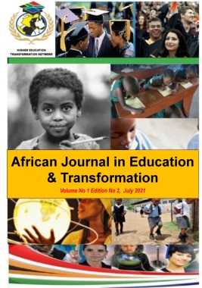
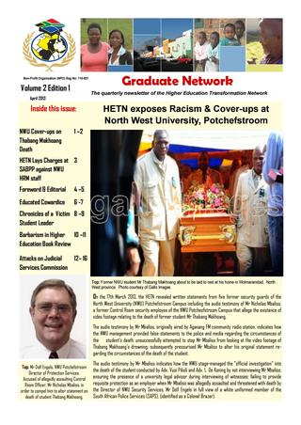
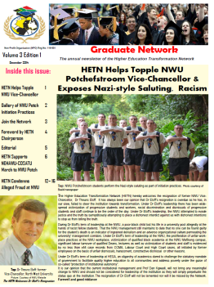
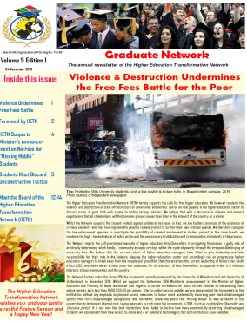
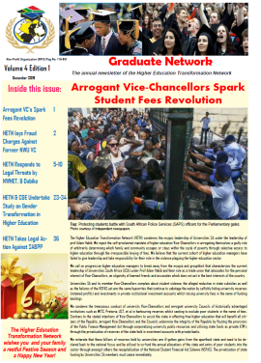
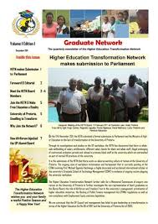

About the HETN
Independent Network of Alumni from Universities & TVET Colleges across South Africa
Established 11 February 2011
Registered NPO , since 22 March 2013

Slide 3
Our Mission
To increase equitable access to higher education, knowledge, skills to ensure:-
An education system that is accessible especially to marginalised & poor communities.
An education system that narrows the divide between intellectual and manual labour.
Socio-Economic Development in a prosperous South African society.
The elimination of socio-economic disparities through education.

Slide 4
Our Objectives
Public Policy Advocacy
Increased Research Output by Disadvantaged Scholars
African Journal in Education & Transformation (AJET) ISSN 2788-6379
Strategic Public Interest Litigation

Slide 5
National Development Plan Vision 2030
Objective: Expand the Production of Highly skilled Professionals & Enhance Innovative Capacity of the Nation
- Women & Africans to form 50% of academic & research staff
- Increase Percentage of PhD qualified staff to over 75% by 2030
- Produce more than 100 doctoral graduates per million per year by 2030
“Universities should be welcoming for black and female teachers, students & Researchers to ensure progress in reversing gender & racial imbalances in the higher education sector to ensure that Africans & women make up 50% of the teaching & research staff”

Slide 6
Rationale for State Intervention
Trends Affecting Transformation in HE Sector
Non-Compliance with Employment Equity targets (compliance purposes)
Lack of Compliance Enforcement
Undermining by Vice-Chancellors due to Non-statutory Advisory Status of Transformation Oversight Committee
Disproportionate employment of blacks / Africans as Contractors Discriminatory workplace practices
Exclusive Rehiring Practices (Consultants & Prof Emeritus status)
Inequities Discriminatory Practices (Journals)
– Workplace Victimizations & Poor Career Growth
– Adverse Organizational Workplace Culture
– Disproportionate / Secretive Remuneration scales
– High Turnover of Black Graduates and Staff
- Transformation Charters and Policies in Place but Poor Implementation
Poor Link between EE Compliance & Programme Accreditation status
Low Number of Black African Professors
Prioritization of Non-South Africans in Executive & Senior Roles outside NDP Objectives

Slide 7
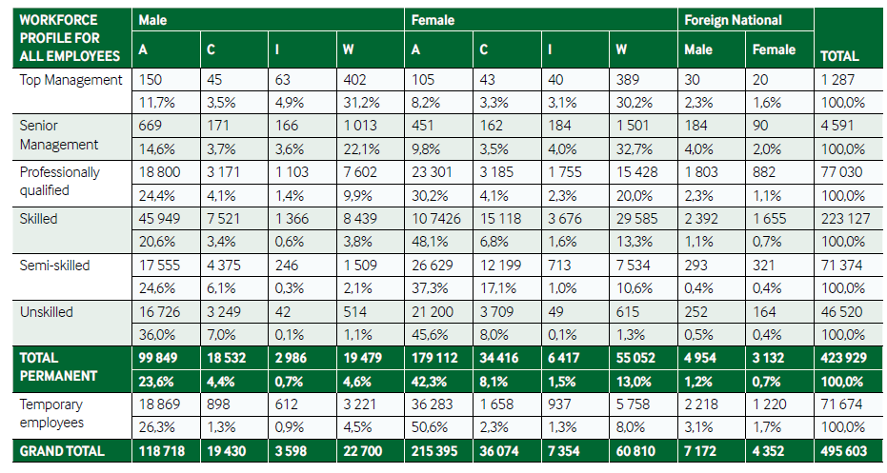
Employment Equity Profile of HE Sector
Section 15 (2) (d) (i) of Employment Equity (EEA) Act 55 of 1998 - All Designated Employers To implement AA to ensure Equitable Representation of suitably qualified people from Designated Groups In Workplace
Source: Employment Equity Commission Report 2021
Source: Employment Equity Commission Report 2021

Slide 8
Rationale for State Intervention
Governance Challenges
Poor Utilization, Fruitless & Wasteful Expenditure
Adverse Audit Findings
Non-Compliance with Delegations of Authority
Non Compliance with SCM Policies;
Dysfunctional Bid Committees
Poor Oversight on Infrastructure Projects
Abandoned Uninhabitable Public Infrastructure Projects
Lack of Consequence Management by Councils & VC’s
No Recoveries on Errant Service Providers
Poor Utilization of Infrastructure Efficiency Grant Funding
Unlawful Private Public Partnerships Without Ministerial Approval Using Public Funding
Utilization of Historic Reserves by Historically Advantaged Institutions
Utilization of Public Funds in Frivolous Litigation & High Settlement payoffs

Slide 9
Rationale for State Intervention
Governance Challenges
DHET Regulations for Reporting by Public Higher Education Institutions gazetted ito Section 41 and Section 69 of Higher Education Act No 101 of 1997 (Notice R464, Gazette No 37726 of 9th June 2014) states that:-
Role of VC refers to CEO / Accounting Officer of a public HEI & includes a Principal / Rector, as contemplated in the Higher Education Act No. 101 of 1997.
Section 38(1)(c)(ii) and Section 51(1)(b)(ii) of PFMA Act 1 of 1999 require Accounting Officers (including Vice-Chancellors as Accounting Officers) and Accounting Authorities to, amongst others, take effective and appropriate steps to prevent fruitless and wasteful expenditure.

Slide 10
Rationale for State Intervention
Governance Challenges
Section 217(1) of the Constitution of RSA - Entity of state must contract for goods & services in compliance with tendering procurement system that is fair, equitable transparent, competitive and cost-effective.
Section 51(1)(a)(iii) of the PFMA Act 1 of 1999 - Accounting Officer (Vice-Chancellor) and Accounting Authority (Council) of a publicly funded entity to ensure that the entity has and maintains an appropriate procurement and provisioning system which is fair equitable, transparent and cost effective.
Section 50(1)(a) of the Public Finance Management Act (PFMA) Act 1 of 1999 – VC & Council to exercise the duty of utmost care to ensure reasonable protection of the assets of the entity.
Section 50(1)(b) of the PFMA Act 1 of 1999 obliges the Accounting Officer (Vice-Chancellor) and Accounting Authority (Council) to act with fidelity, honesty and integrity and in the best interests of the entity in managing its financial affairs.

Slide 11
Way Forward
Greater Role of the A-G in auditing HEI’s
Greater Transparency in Utilization of Public Funds especially Infrastructure Efficiency Grant (IEG)
Greater Transparency on PPP partnerships by HEI’s using public funds
Stronger Compliance Enforcement

