Slide 1
Justice and Correctional Services Committee Presentation
March 2022

Slide 2
Prevention & Combating of Hate Crimes & Hate Speech Bill
[B9 – 2018]

Slide 3
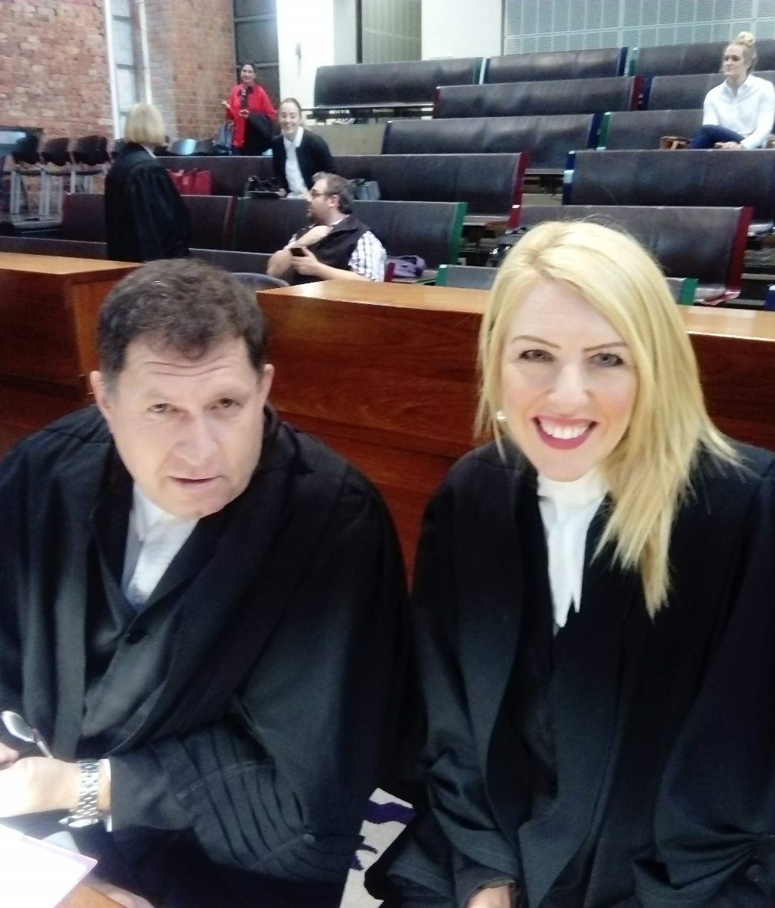
Introducing FOR SA
FOR SA is a faith and doctrinally neutral legal advocacy organisation, working to protect and promote the right to religious freedom.
Established in January 2014, religious leaders, organisations and individuals representing millions of people have joined FOR SA to contest multiple areas where rights are in danger of erosion.

Slide 4
Ambit of Religious Freedom

Slide 5

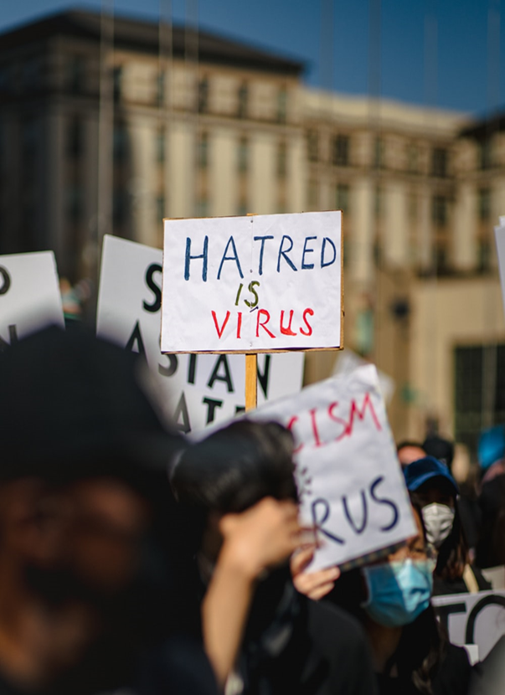
What is Religious Freedom?
  To believe and to publicly live out that belief by words and actions.
Photo: Unsplashed
Tell others about it
Without fear of punishment / persecution
Photo: Unsplashed

Slide 6
Synopsis of Concerns

Slide 7
Synopsis of Concerns – Overbroad
Definition OF HATE SPEECH
  Bill’s current definition of hate speech (is contrary to the Qwelane judgment) and is therefore unconstitutional:
Bill’s definition of “hate speech” - Clause 4(1) | Constitutional Court’s definition hate speech
“Any person who intentionally publishes, propagates or advocates anything or communicates to one or more persons in a manner that could reasonably be construed to demonstrate a clear intention to (i) be harmful or to incite harm; or (ii) promote or propagate hatred, based on one or more of the following grounds…” | “extreme detestation and vilification which risks provoking discriminatory activities against that group”
Photo: Unsplashed

Slide 8
Synopsis of Concerns – Overbroad
prohibition OF HATE SPEECH
  Bill’s current prohibition of hate speech (is contrary to the Qwelane judgment) and is therefore unconstitutional:
Bill’s prohibition of “hate speech” - Clause 4(1) | Constitutional Court’s reworked PEPUDA hate speech prohibition
“Any person who intentionally publishes, propagates or advocates anything or communicates to one or more persons in a manner that could reasonably be construed to demonstrate a clear intention to (i) be harmful or to incite harm; or (ii) promote or propagate hatred, based on one or more of the following grounds…” | “….no person may publish, propagate, advocate or communicate words that are based on one or more of the prohibited grounds, against any person, that could reasonably be construed to demonstrate a clear intention to be harmful or to incite harm and to promote or propagate hatred”
Photo: Unsplashed

Slide 9
Synopsis of Concerns - Overbroad
DEFINITION OF HARM
  Bill’s current definition of harm (is contrary to the Qwelane judgment) in a substantial way.
Bill’s Definition of “harm” - Clause 1 | Constitutional Court’s definition of “harmful”
“ ‘harm’ means any emotional, psychological, physical, social or economic harm” | “‘harmful’ can be understood as deep emotional and psychological harm that severely undermines the dignity of the targeted group.”
Photo: Unsplashed

Slide 10

Synopsis of Concerns – Exemption
Religious Exemption found in clause 3(2)(d) of the Bill
  Excludes following from the definition of “hate speech”:
“the bona fide interpretation and proselytising or espousing of any religious tenet, belief, teaching, doctrine or writings, to the extent that such interpretation and proselytisation does not advocate hatred that constitutes incitement to cause harm, based on one or more of the grounds referred to in subsection (1)(a)”
Photo: Unsplashed

Slide 11
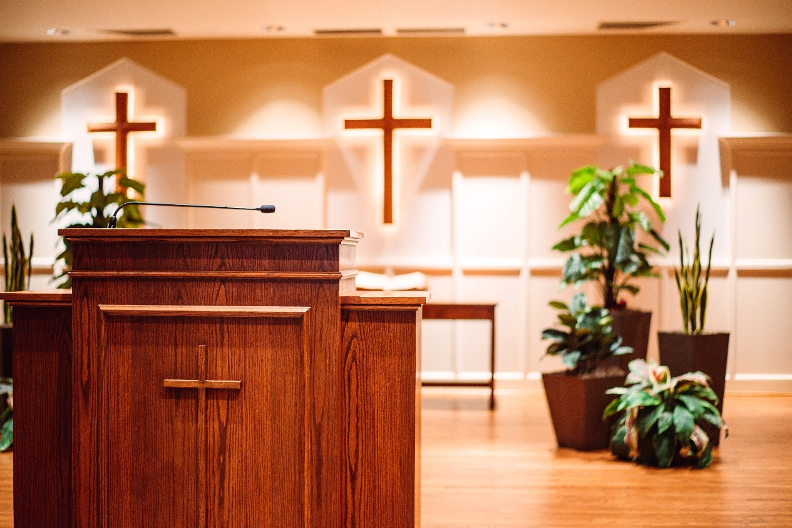
Synopsis of Concerns – Exemption
Deputy Minister indicated at Parliamentary briefing on 30 May 2018 that this exemption would only apply to statements that are part of a sermon, but not when someone was expressing their own view.
Photo: Unsplashed

Slide 12
Synopsis of Concerns – Exemption
Problem:
Current exemption clause can be interpreted in a way that:
  does not protect religious freedom in the public realm; and
  Would serve to “stifle ideology, belief or views” (as per the Constitutional Court’s Qwelane judgment).
Constitutional Court said in its Qwelane judgment that “that the expression of unpopular or even offensive beliefs does not constitute hate speech”.

Slide 13

Synopsis of Concerns – Exemption
The Bill does not protect South Africans’ right to publicly express unpopular opinions, thoughts, and even offensive beliefs, due to its simultaneous wide definitions and narrow grounds for exemption.
Photo: Unsplashed

Slide 14
Synopsis of Concerns – Criminalisation
The Bill criminalises speech, despite:
  UN supporting more speech, not less, as the key means to address hate speech.
  SA is obliged to protect the rights to freedom of religion and expression in the public realm.
  International law does not require SA to criminalise hate speech.
  Bill fails to pass the six-part Rabat threshold test contrary to the UN Rabat Plant of Action – requires high threshold test for restricting freedom of expression to ensure article 20 of the ICCPR is not violated.

Slide 15
Synopsis of Concerns – General
The Bill criminalises speech, despite:
  The Bill goes much wider than South Africa’s obligations under these instruments, because it:
    extends the prohibited grounds from race to a variety of others, and
    adopts the idea of “less speech is better”,
    criminalises speech,
    ignores SA’s other obligations under other international instruments to protect religious freedom and freedom of expression.

Slide 16
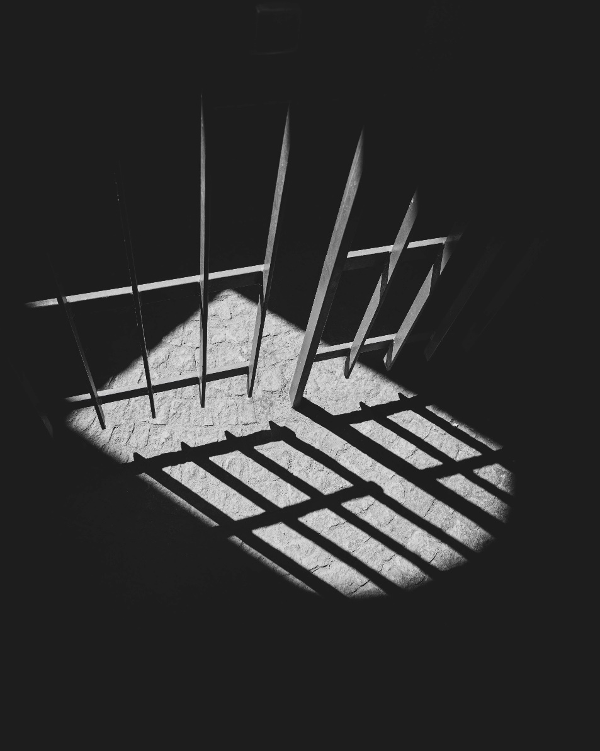
Synopsis of Concerns – General
The Bill is unnecessary:
  Bill is unnecessary as the:
South African crime of crimen iniuria (i.e. the wilful injury to someone’s dignity), and
civil sanctions for hate speech under the Promotion of Equality and Prevention of Unfair Discrimination Act,
have already been effectively used to combat instances of hate speech.
Photo: Unsplashed

Slide 17
Recommendations
Omit the “hate speech” provisions ALTOGETHER
Alternatively:
Revise definitions Harm and Hate Speech
Revise prohibition of Hate Speech
strengthen the RELIGIOUS EXEMPTION clause
Ensure that Bill meets RABAT THRESHOLD TEST – and that this test’s criteria is expressly set out. Failing to do so, will lead to a violation of the ICCPR.
Preamble of Bill should include specific reference to sections 15 and 31 of the Constitution.

Slide 18
Recommendations
Replace the current religious exemption clause in 4(2)(d) of the Bill with the following text:
“the bona fide interpretation and proselytizing or espousing of any religious conviction, tenet, belief, teaching, doctrine or writings, by a religious organisation or an individual, in public or in private, to the extent that such interpretation and proselytization does not advocate hatred that constitutes incitement to cause harm, based on one or more of the grounds referred to in subsection (1)(a).”

Slide 19
QUESTIONS & ANSWERS

Slide 20
Contact us
Protecting and promoting
freedom of religion in South Africa!
+27 (21) 556 5502
info@forsa.org.za
FreedomOfReligionSA
www.forsa.org.za
Freedom of Religion SA NPC | 2014/099286/08

